Slide 1
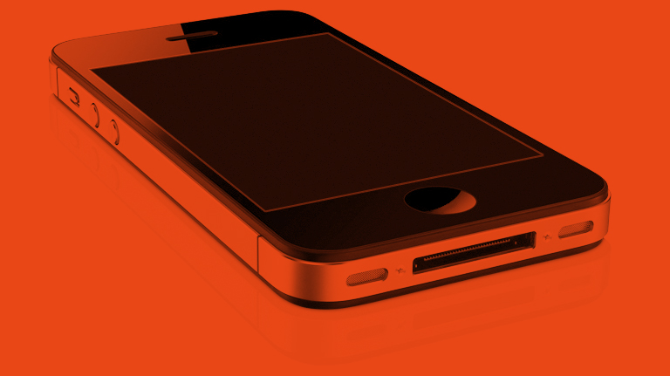

DozyAP: Power-Efficient Wi-Fi Tethering
Hao Han, Yunxin Liu, Guobin Shen, Yongguang Zhang, Qun Li
Microsoft Research Asia, Beijing, China
College of William and Mary, Williamsburg, VA, USA
MobiSys’12
2012.09.20
Presented by Hyemin kim

Slide 2
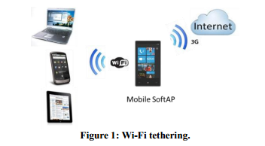
Introduction
Wi-Fi tethering : “mobile hotspot”, sharing the Internet connection (e.g., a 3G connection) of an Internet-capable mobile phone with other devices over WiFi.
Why Wi-Fi tethering is desirable
  cellular data networks provide ubiquitous Internet access but the coverage of Wi-Fi networks is spotty.
  it is common for people to own multiple mobile devices but likely they do not have a dedicated cellular data plan for every device.
SoftAP mode, the high power state and never sleeps.
“ This increases the power consumption”
Wireless data communications lab. Korea univ.
Notes:
Power를 절약하기 위해선 Windows phone의 wifi를 일정시간 사용하지 않으면 끄면 됨
하지만 두가지의 결점 1) wifi는 idle한 상태가 스레스 홀드보다 높은 파워를 먹음 (새 글로 넘어가기 전에 읽는 글의 시간이 길다)
2) 불편함 (유저가 일정 스레스홀드까지 트레픽을 발생시키지 않다가 다시 네트워크를 연결하려고 하면 테더링 작업을 다시 거쳐야 한다.

Slide 3
Introduction
- Contribution
We analyze the traffic patterns of various applications and identify many opportunities to optimize the power consumption of Wi-Fi tethering.
  current Wi-Fi tethering is power hungry and wastes energy unnecessarily.
DozyAP to improve power efficiency of Wi-Fi tethering.
  sleep protocol to schedule a mobile SoftAP for sleep without requiring tight time synchronization between the SoftAP and its clients.
Evaluation results show that DozyAP is able to significantly reduce power consumption of Wi-Fi tethering and retain comparable user experience at the same time.
Wireless data communications lab. Korea univ.
Notes:
애들이 만든 테더링 프로토콜은 sleep mode를 둠으로써 파워를 절약시키자는 것
wifi의 idle state가 전체 application time에 비해 큰 부분을 차지하니까 이 부분을 이용하여 파워를 줄이자.
SoftAp에서 두가지를 도입함
1. client는 ap가 항상 사용가능하다고 생각하고 언제든지 패킷을 받는다.
하지만 ap가 sleep mode라면 패킷을 읽을 것이고 network stack의 low layer에서 다시 retran을 해야할 것이다. => dozy ap : sleep request-response protocol
2. ap가 자버리면 network letency가 증가할 것이다. => adaptive sleep scheme and limit the maximum sleep duration

Slide 4
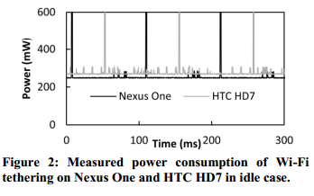
WI-FI Tethering
Power Consumption
Wi-Fi Tethering Smartphone | Disable average power consumption | Enable
 |  | Average power consumption | Drop of the battery lifetime
Nexus One (Android 2.3.6) | 20mW | 270mW | From 70 hours To 5.2 hours
HTC HD7 (Windows Phone 7.5) | 30mW | 302mW | From 43 hours To 4.3 hours
iPhone4 (iOS 4.3.5) | 22mW | 333mW
They consume an order of magnitude more power than necessary when there is no ongoing traffic.
Wireless data communications lab. Korea univ.
Notes:
Using Monsoon power monitor

Slide 5
WI-FI Tethering
Traffic Patterns
Enabled Wi-Fi tethering on a Nexus One with a China Unicom 3G connection, and connected a Wi-Fi client to the mobile SoftAP
  two Client
    a Nexus One smartphone, a Wi-Fi version iPad 2
  Linux 2.6.32 as a Wi-Fi sniffer
    to capture all the frames
  Working : (1)News reading (2)Online book reading (3)Video streaming (4) Search (5)Map (6) Email (7) RSS Reader
Wireless data communications lab. Korea univ.
Notes:
Inter-packet interval : source에서 보낸 패킷의 시간 간격
Cdf in total app time : 총 보낸 시간
-> 매 패킷마다 interval이 쌓이고 작은 순서대로 sorting. App를 쓸 때 패킷 간격이 얼마나 되냐를 보니 200ms보다 작은건 하고 크면 idle상태 일 때 전체 앱 사용시간의 30%만 무언가를 한다.

Slide 6
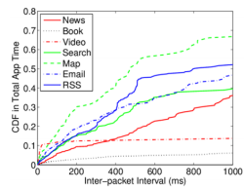
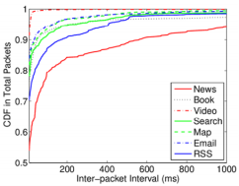
WI-FI Tethering
Traffic Patterns
The same application may behave differently on different devices.
the intervals under 200ms only take less than 30% of the total application time for all the applications on the Nexus One
the inter-packet intervals under 150ms cover more than 80% of all the packets for all the applications.
Wireless data communications lab. Korea univ.
Notes:
Inter-packet interval : source에서 보낸 패킷의 시간 간격
Cdf in total app time : 총 보낸 시간
-> 매 패킷마다 interval이 쌓이고 작은 순서대로 sorting. App를 쓸 때 패킷 간격이 얼마나 되냐를 보니 200ms보다 작은건 하고 크면 idle상태 일 때 전체 앱 사용시간의 30%만 무언가를 한다.

Slide 7
WI-FI Tethering
Traffic Patterns
Applications only spent a small portion of time for the Internet access and their network traffic is very sparse and bursty.
  content fetching phase & content consuming phase
  the bandwidth of 3G is much lower than that of Wi-Fi
The Wi-Fi interface of mobile SoftAP should sleep to save power
  long network idle intervals resulting from the user content consuming.
  the relatively shorter network idle intervals that occur during the content downloading.
Wireless data communications lab. Korea univ.
Notes:
모든 어플리케이션은 두가지 상태가 있다. content fetching, content consuming
1. 유저가 웹서버를 통해 다운로드하면 그 다운받은 내용을 볼 시간을 필요하다. 그 content consuming time은 십초에서 수십분이 걸릴수도 있음.
이 상태에는 network는 idle한 상태가 됨.
2. 3g 밴드위스(300kbps-1mbps downlink throughput)가 wifi(much higer data : 54Mbps for 802.11a/g, 300Mbps for 11n)보다 낮다.
3g는 higher RTT, ranging from 200ms to 500ms than wifi
그렇기 때문에 테더링을 하는 경우엔 3g에서 보내는 것을 받는데 시간을 기다려야함. => idle 상태

Slide 8
WI-FI Tethering
Power Saving
Traffic Indication Map (TIM) :
AP buffers the packet and sets
AP
Client
periodic beacons broadcasted every 100ms
PS-Poll frame
The IEEE 802.11 standard defines PSM to save power of Wi-Fi client devices
Nexus One static PSM scheme
  PM_MAX : allowing the client to sleep immediately if the AP does not have any packet. But, long network latency and hence low network efficiency
  PM_FAST : a client stays in active unless its Wi-Fi interface is idle for a threshold of 200ms
Wireless data communications lab. Korea univ.
Notes:
Nexous one PSM
PM_MAX와 PM_FAST로 나뉨
PM_MAX = AP가 보낼 packet이 없으면 client는 잔다. 이렇게 하면 long network latency와 비효율적임
So, ps_poll message가 매 packet마다 필요함.
PM_FAST는 threshold가 200ms까지 idle하지 않는한 cliet는 actvie한 상태
But, threshold가 되면 null_data frame을 보냄. Ap에서 ack가 오면 sleep. 데이터는 ap buffer에 쌓아둠 .
Nexous one은 스크린이 꺼지면 PMS_MAX로 전환 평상시엔 PM_FAST 상태

Slide 9
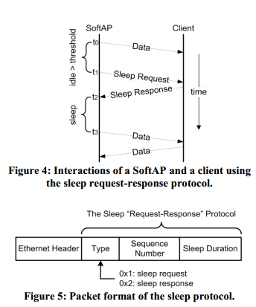
DOZYAP DESIGN
- Scheduling for Sleep
The sleep protocol is implemented directly on top of the underlying link layer without TCP/IP headers in the middle to reduce the overhead.
Type : the packet type
Sequence Number : unique ID to identify a sleep request-response pair ( start 0 -> new request++)
Time Duration : how long (in milliseconds) the SoftAP requests to sleep
All the sequence numbers and time durations are decided by the SoftAP
Wireless data communications lab. Korea univ.

Slide 10
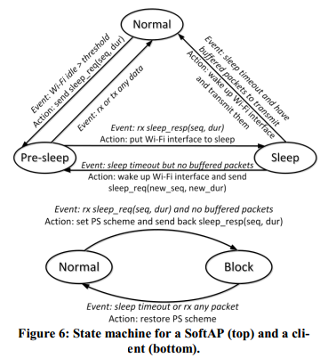
DOZYAP DESIGN
- State machine
SoftAP Sates
  When the sleep timeout expires, if the SoftAP has any buffered data, it wakes up its Wi-Fi interface, switches to Normal state and transmits the buffered data to the client
Client Sates
  Using PM_MAX, PM_FAST
  Normal : the client communicates with the SoftAP
  Block : SoftAP&Client = Sleep
Wireless data communications lab. Korea univ.
Notes:
Normal ; PM_MAX 1. AP sleep requet 2. client 보낼 패킷이 없으면 3. null-data보내고 4. block state : 빠르게 자므로 power save가 더 잘됨
PM_FAST 3.null-data를 보내고 ack를 기다림 4. block state : 응답안오면 못 잠

Slide 11
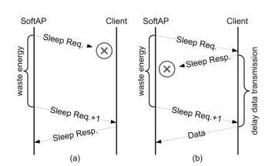
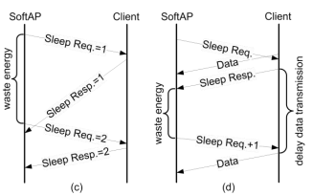
DOZYAP DESIGN
- Synchronization
the client will never conclude that the SoftAP is awake while it is sleeping
  Packet loss
  Packet out-of-order
the SoftAP stays in active, wasting energy, buy, the client assumes the SoftAP is in sleep and delays its packets transmission.
Wireless data communications lab. Korea univ.

Slide 12
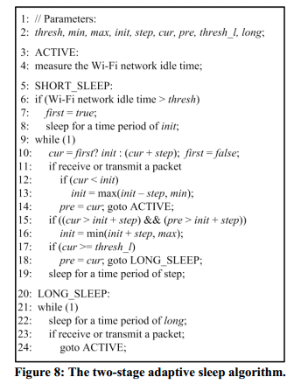
DOZYAP DESIGN
- Adaptive Sleeping
Short sleep stage & Long sleep stage
Sleep period : init + N * step (N : the number of continuous sleep slots after the first sleep slot of init)
cur, pre : to track the gross length of all successful sleep slots in the current sleep cycle and that in the previous sleep cycle
Wireless data communications lab. Korea univ.
Notes:
기본 아이디어는 softap 최적의 Sleep interval을 찾아서 패킷이 도착하기 전에 일어날 수 있도록 하자.
Idle 시간의 thresh가 오면 softap는 short sleep상태로 들어감
Sleep interval을 최소값으로 초기화 하고 일어나서 패킷을 보낼 것 오는 것을 기다리는 동안 active 상태가 됨. 혹, 계속 자려면 interval을 수정함.
패킷의 도착하는 패턴에 따라 sleep cycle이 길어질 수도 있음.(다음 wake up은 더 늦어질수도..)
불필요하게 일어나는 것을 줄이기 위해 (power save) – sleep period

Slide 13
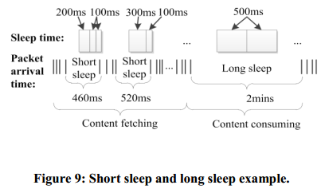
DOZYAP DESIGN
- Adaptive Sleeping
current value of init : 200ms
step :100ms
thresh : 150ms
inter-packet interval : 460ms
the SoftAP starts to sleep after 150ms.
first sleep for 200ms, followed by two 100ms sleep slots.
increase the value of init : 300ms
inter-packet interval : 520ms
the SoftAP will first sleep for 300ms followed by one more 100ms sleep slot.
after sleeping for a time period of thresh_l, the SoftAP enters the long sleep stage and periodically sleeps for a time period of long(500ms).
Wireless data communications lab. Korea univ.
Notes:
Cur : init + (N-1)*Step : 패킷이 도착해서 버퍼에 들어가기 전에 일어나야 하기 때문
Pre: 그 전의 기록
앞 서 설명한 3g의 rtt로 인한 시간동안 sleep 하자 .
Thresh : softap가 short sleeping로 진입하면서 burst data가 전송되는 것을 막기 위함.
시간차가 있는 건 아무래도 short sleep 이후 새로운 client가 있는지 검사하는 과정인 듯.

Slide 14
DOZYAP DESIGN
- Supporting Multiple Clients
DozyAP can support repeatedly applying the sleep request-response protocol to each client.
  A Client goes to sleep once it agrees to the AP’s sleep request.
  A SoftAP can sleep only if it receives the sleep responses from all the clients.
  but other clients did not so that the SoftAP has to stay awake
the possibility of broadcasting the sleep requests as it can obviously reduce the overhead of the sleep protocol.
  broadcast packets are less reliable
  broadcast packets are transmitted at lowest data rate and thus take more air time than normal packets.
  the sleep responses are still sent in unicast packets.
Wireless data communications lab. Korea univ.
Notes:
Ap가 sleep인 동안은 비콘을 쏘지 않음. 그래서 새로운 client는 wifi join이 불가능하다.
Active인동안은 다시 쏘므로 가능함. Long stage동안에도 주기적으로 일어나서 비콘을 쏨. 그래서 문제 없음. 약간의 longer latency만 발생.

Slide 15
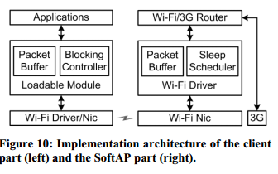
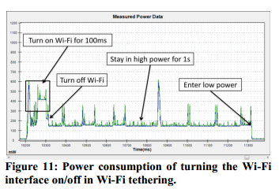
IMPLEMENTATION
DozyAP prototype on Nexus One Android 2.3.6 with a Wi-Fi chipset of Broadcom
BCM4329 802.11 a/b/g/n
SoftAP : in sleep state, all the packets received from 3G interface are buffered.
client : a loadable module where a packet buffer
  together with a blocking controller to decide if and when application packets must be buffered.
Wireless data communications lab. Korea univ.

Slide 16
Experiment Setup
Hardware devices.
Nexus One smartphone as a SoftAP with a China Unicom 3G connection (WCDMA)
another Nexus One smartphone as a client to run applications.
Both smartphones run Android 2.3.6., a Monsoon Power Monitor to measure the power consumption.
Applications and methodology
five of the applications : news reading, book reading, video streaming, search, and map.
the captured trace of the applications to find out all the HTTP requests contained in the traces Traces
Traces
MoodSense, the authors conducted a two-month field study with 25 iPhone users and collected their network traffic everyday using tcpdump
Wireless data communications lab. Korea univ.

Slide 17
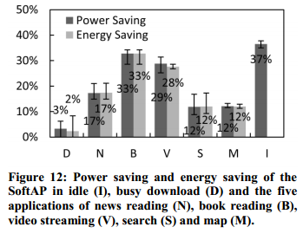
Power Consumption
Average power
the power consumption
  mobile SoftAP with DozyAP & without DozyAP.
  two extreme cases: idle case and busy download case.
power saving percentage : the total power consumption of the whole system
(including the power consumed by CPU and 3G)
Total energy
As DozyAP buffers packets and delays their transmission,
it may lead to longer application time comparing with
the case without DozyAP.
Wireless data communications lab. Korea univ.

Slide 18
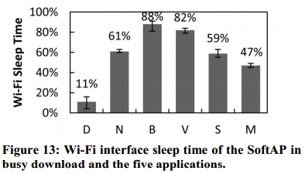
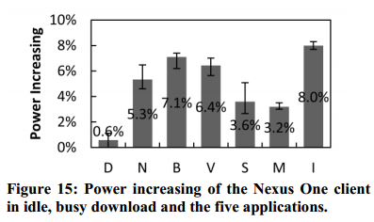
Power Consumption
Wi-Fi interface sleep time
DozyAP should be able to save significantly more power.
Given proper control over the Wi-Fi hardware, more energy is expected to be saved from sleeping.
Power consumption of a client
Client needs to wake up to receive the sleep requests from the SoftAP and send back the sleep responses when the network is idle
Idle case introduces the highest overhead but it is still only 8%
Wireless data communications lab. Korea univ.

Slide 19
CONCLUSIONS
The power efficiency of Wi-Fi tethering
Reliable sleep request-response protocol for a mobile SoftAP to coordinate its sleep schedule
Automatically adapt to the on-going traffic load for the best power saving.
Wireless data communications lab. Korea univ.

