Slide 1
Smart Charge Communication (SCC) for electric vehicles
ISO/IEC 15118-2

Slide 2
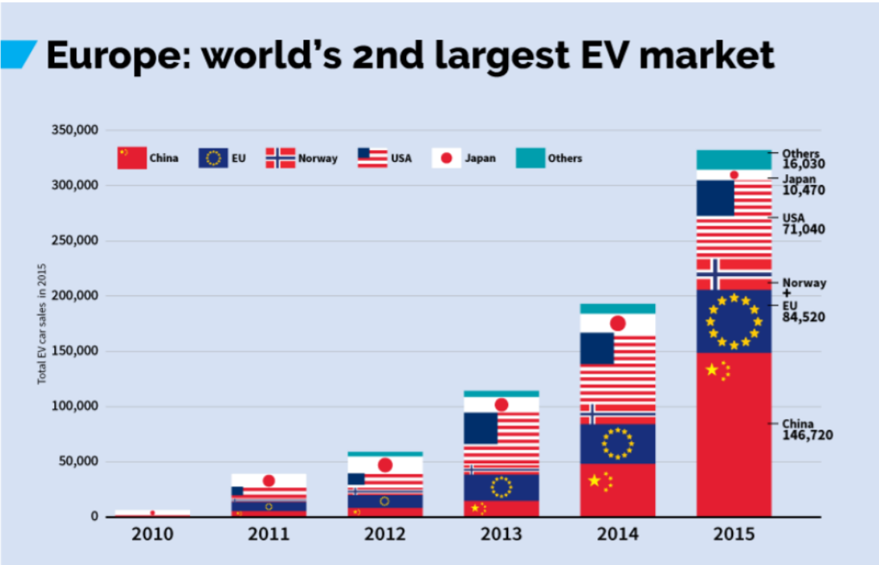
Electric vehicles market growth

Slide 3
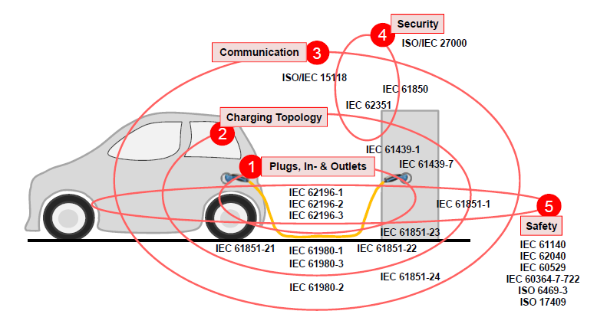
Standardization Landscape of V2G Interface

Slide 4
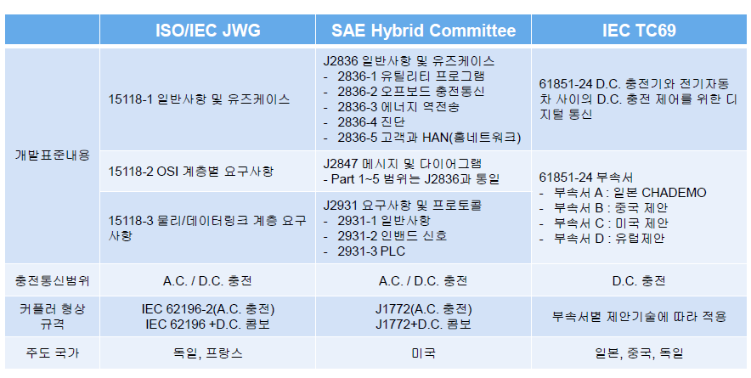
Comparison of International Standards

Slide 5
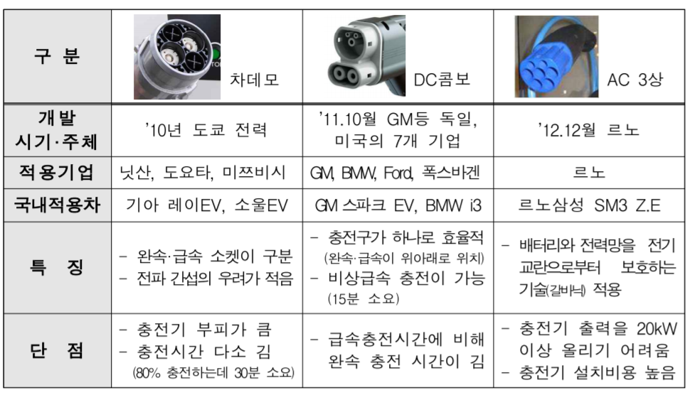
Comparison of International Standards
Slow charging uses AC
Types of fast charging interfaces
  ChAdeMO, DC Combo use DC
    “Combo”: 완속 + 급속
    ChAdeMO: 충전구 분리

Slide 6
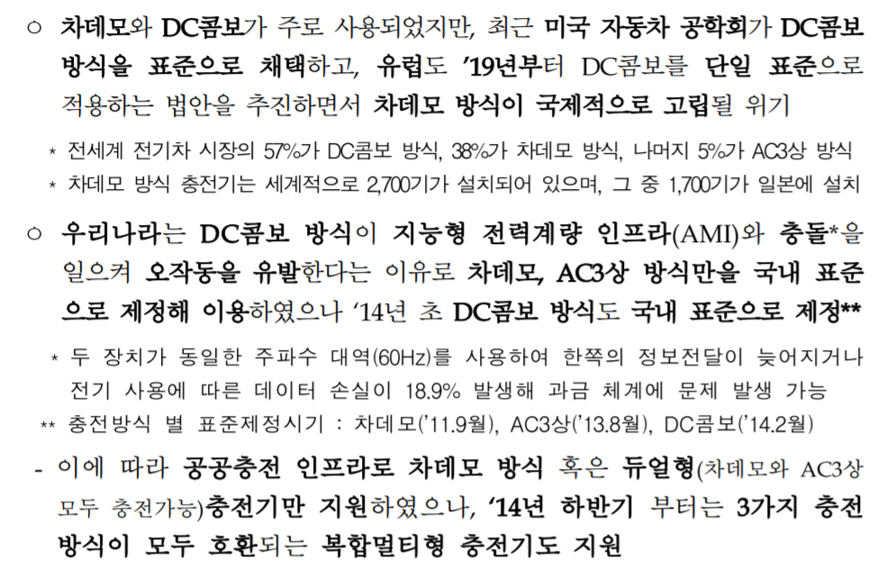
Comparison of International Standards

Slide 7
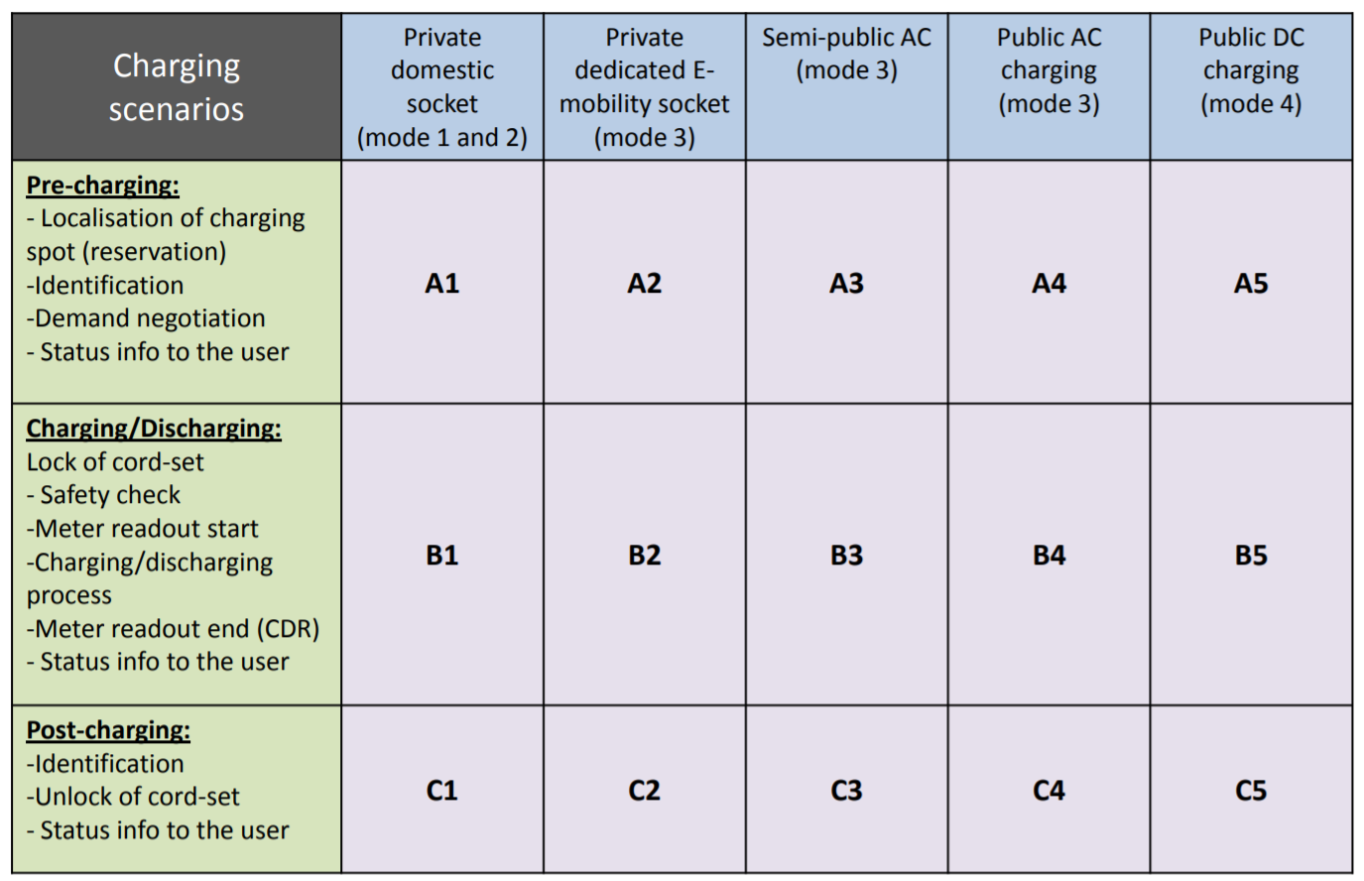
Charging Scenarios

Slide 8
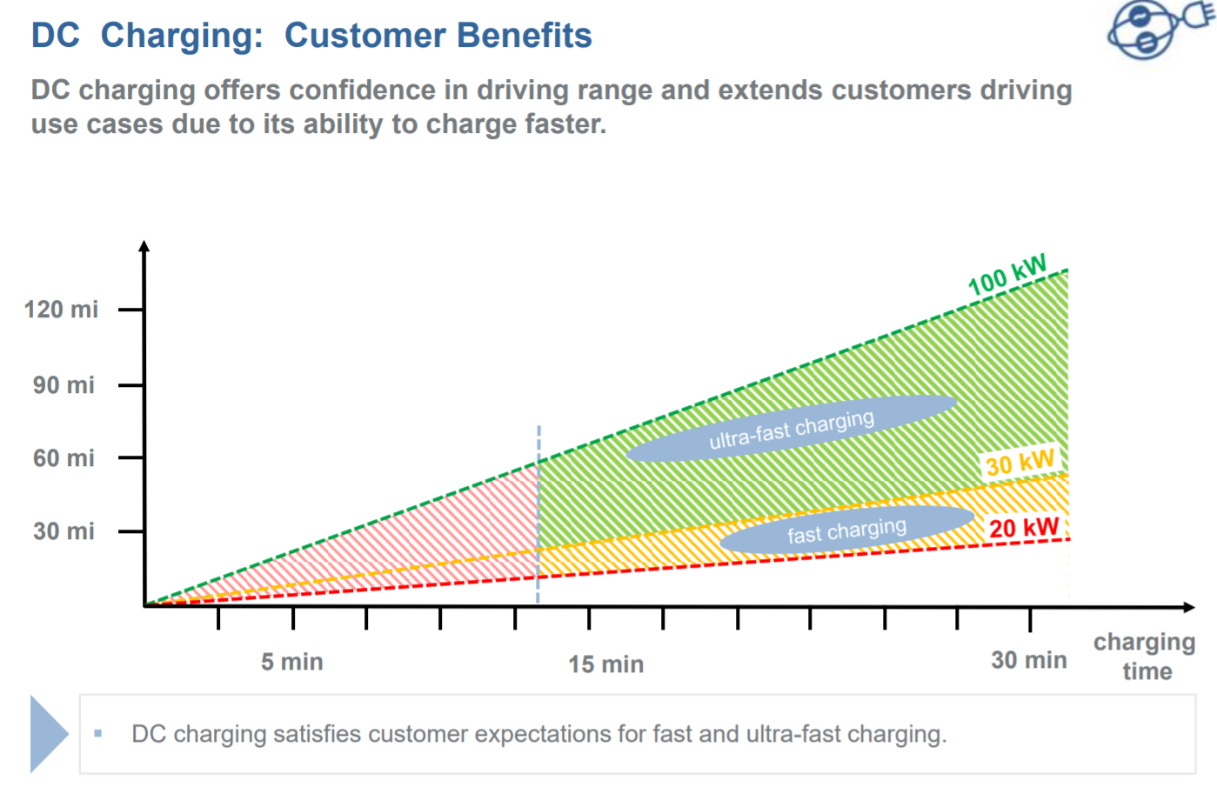
DC is for fast charging

Slide 9
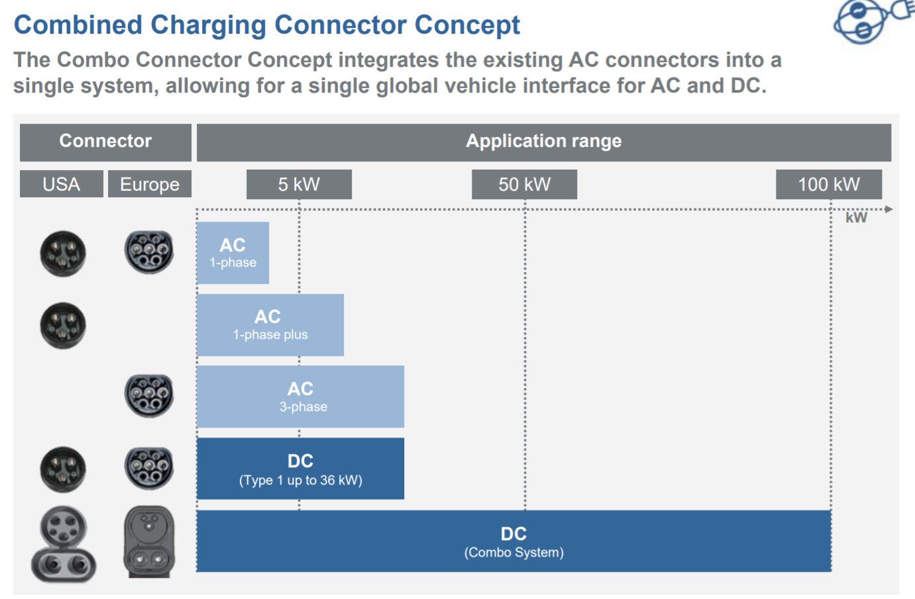
DC is for fast charging

Slide 10
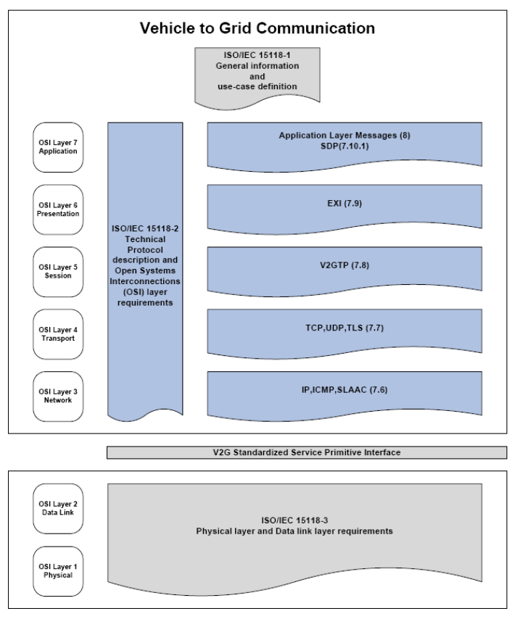
ISO/IEC 15118
ISO/IEC 15118 consists of the following parts
  Part 1: General information and use-case definition
  Part 2: Technical protocol description and open systems interconnections (OSI) requirements
  Part 3: Physical and data link layer requirements

Slide 11
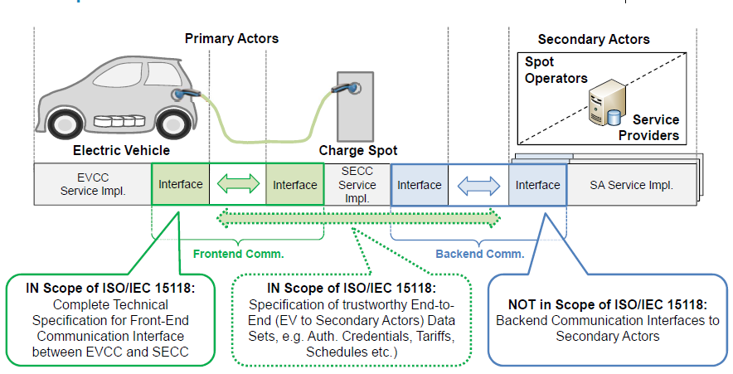
Scope of ISO/IEC 15118 V2G Communication Interface

Slide 12
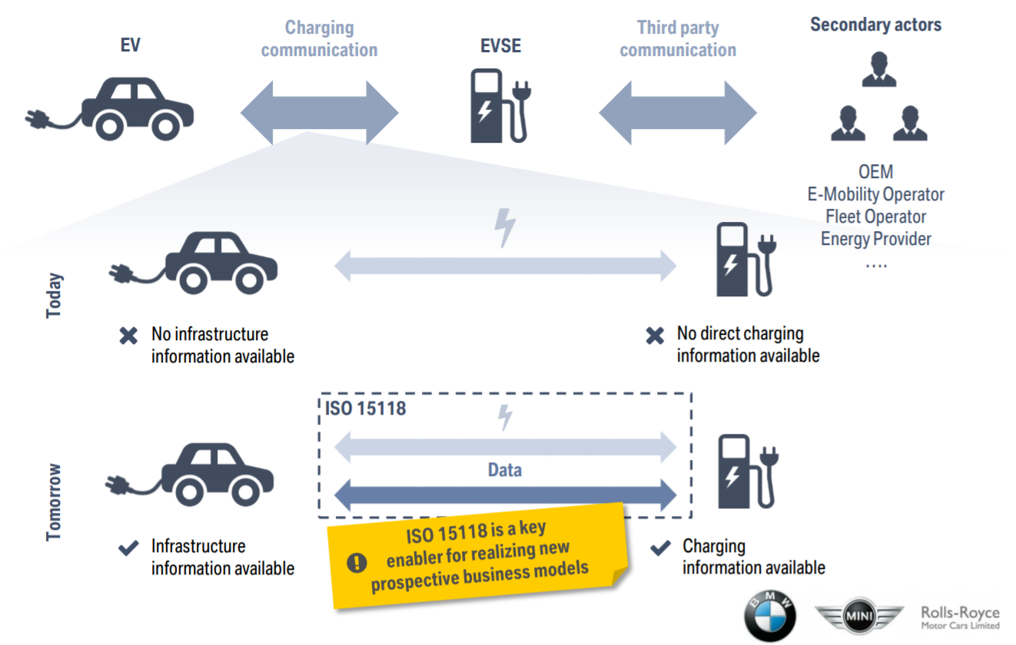
Scope of ISO/IEC 15118 V2G Communication Interface

Slide 13
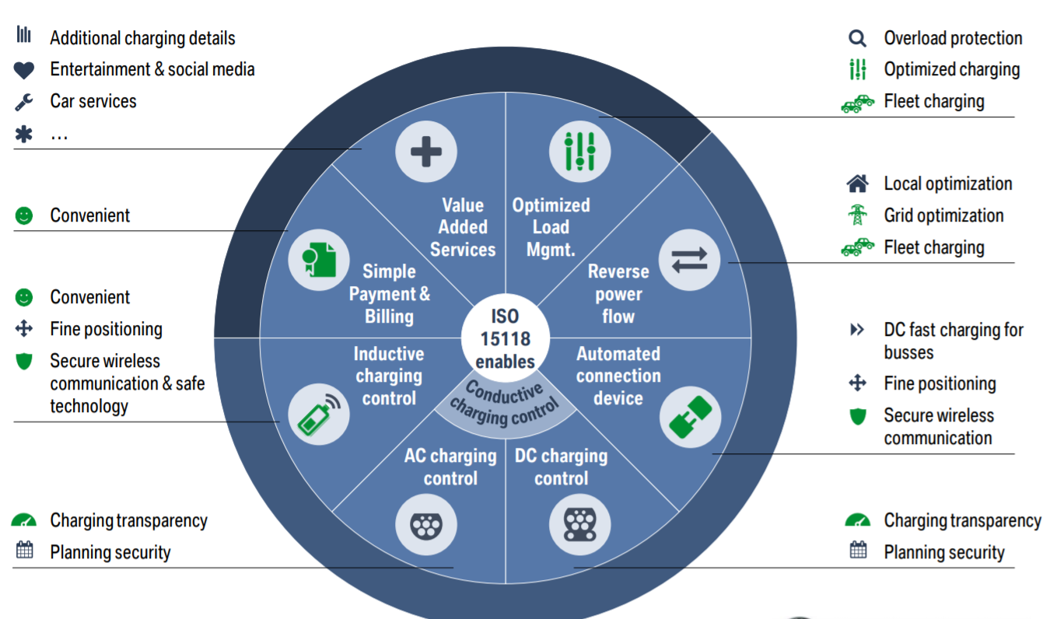
ISO/IEC 15118 – Use Cases

Slide 14
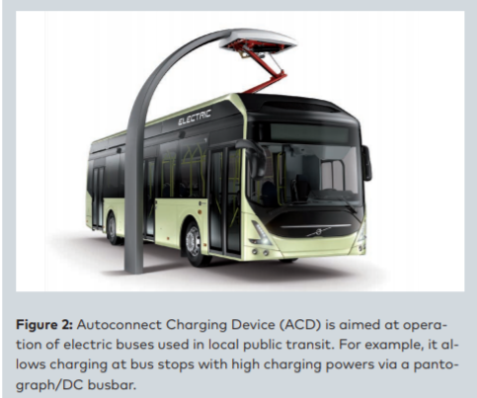
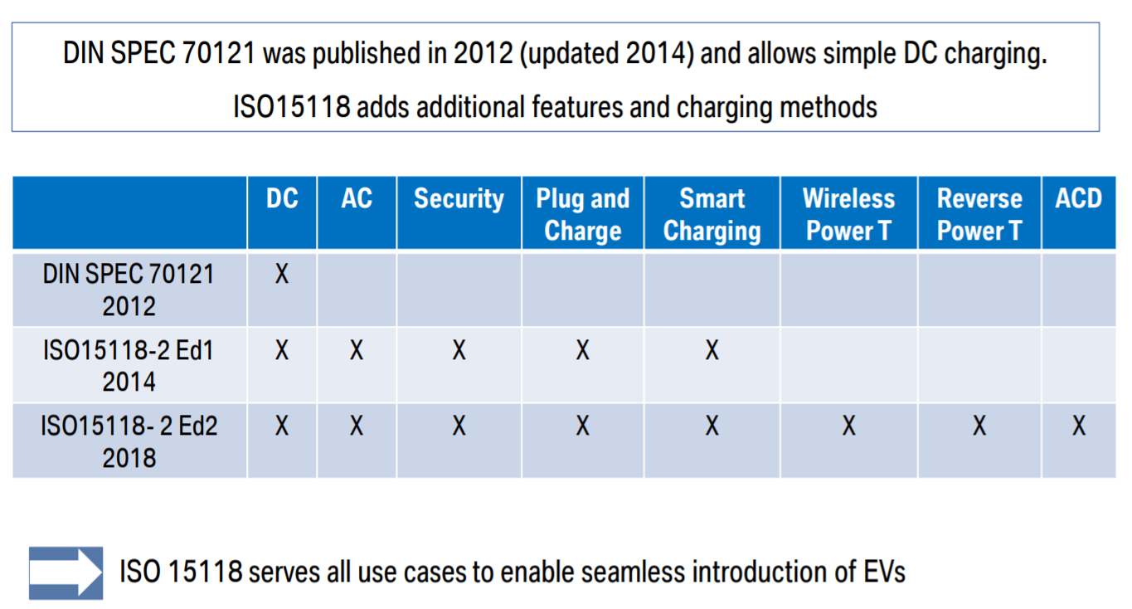
ISO/IEC 15118 – Evolution

Slide 15
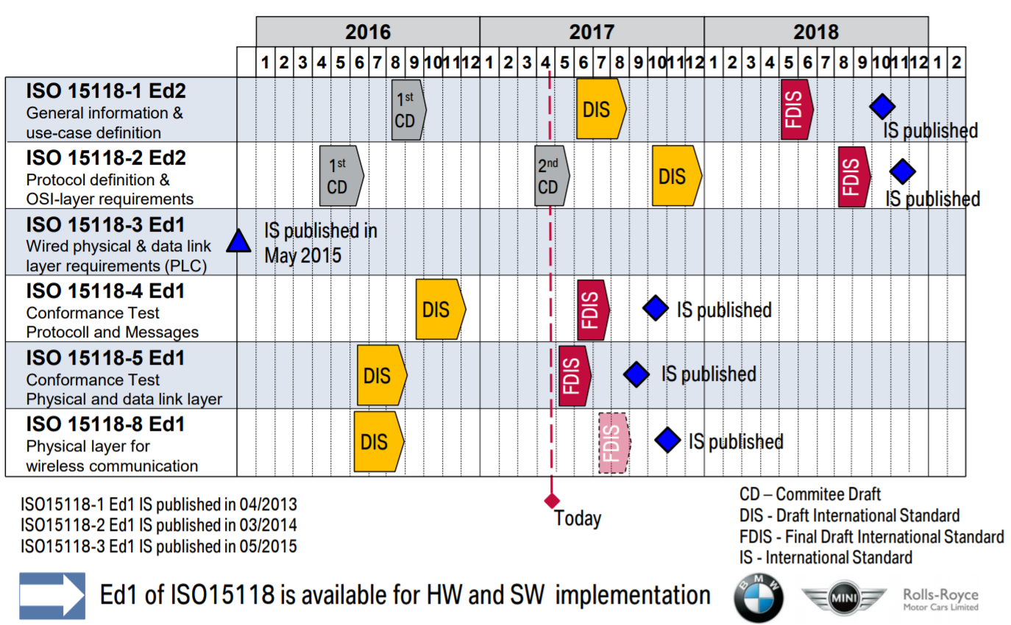
ISO/IEC 15118 – Evolution

Slide 16
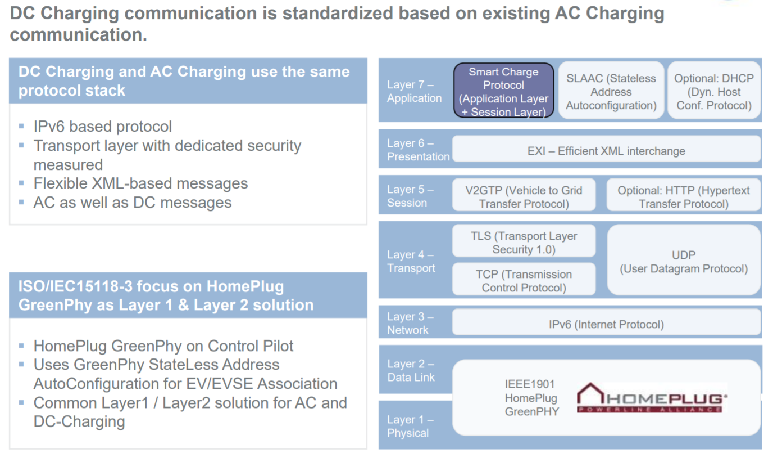
ISO/IEC 15118 – Evolution

Slide 17
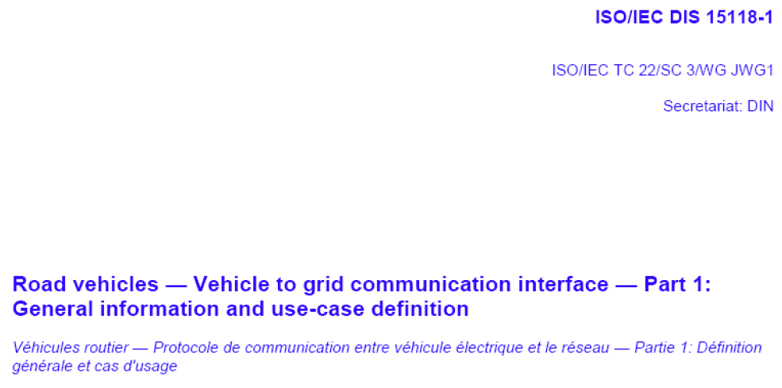
ISO/IEC 15118-1

Slide 18
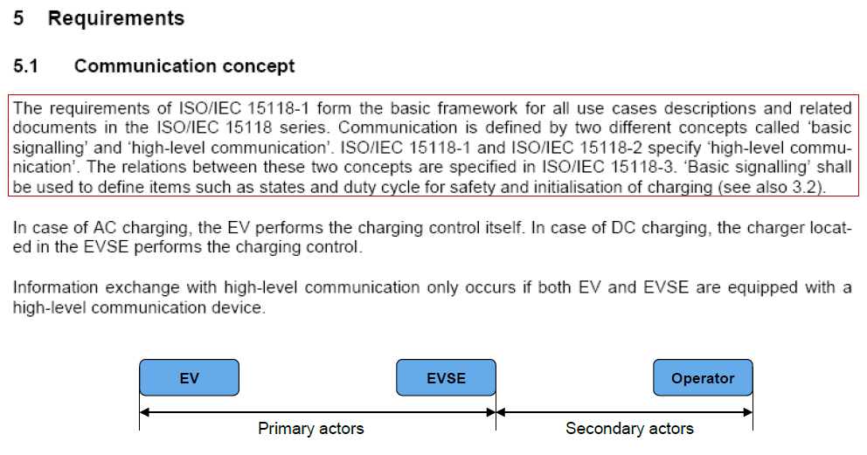
ISO/IEC 15118-1

Slide 19
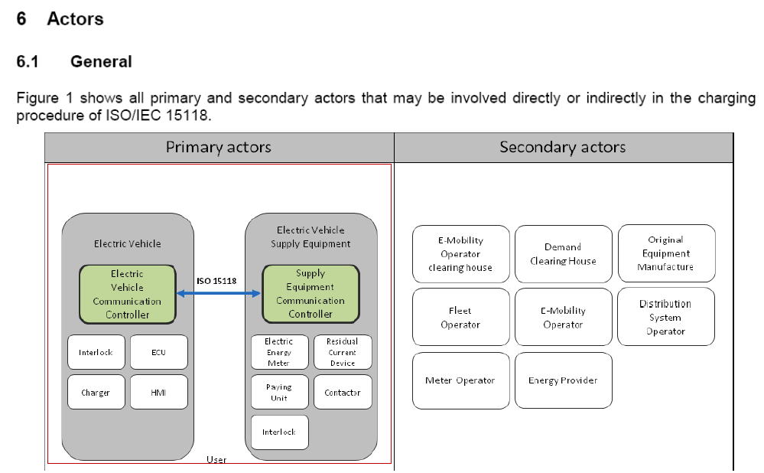
ISO/IEC 15118-1

Slide 20
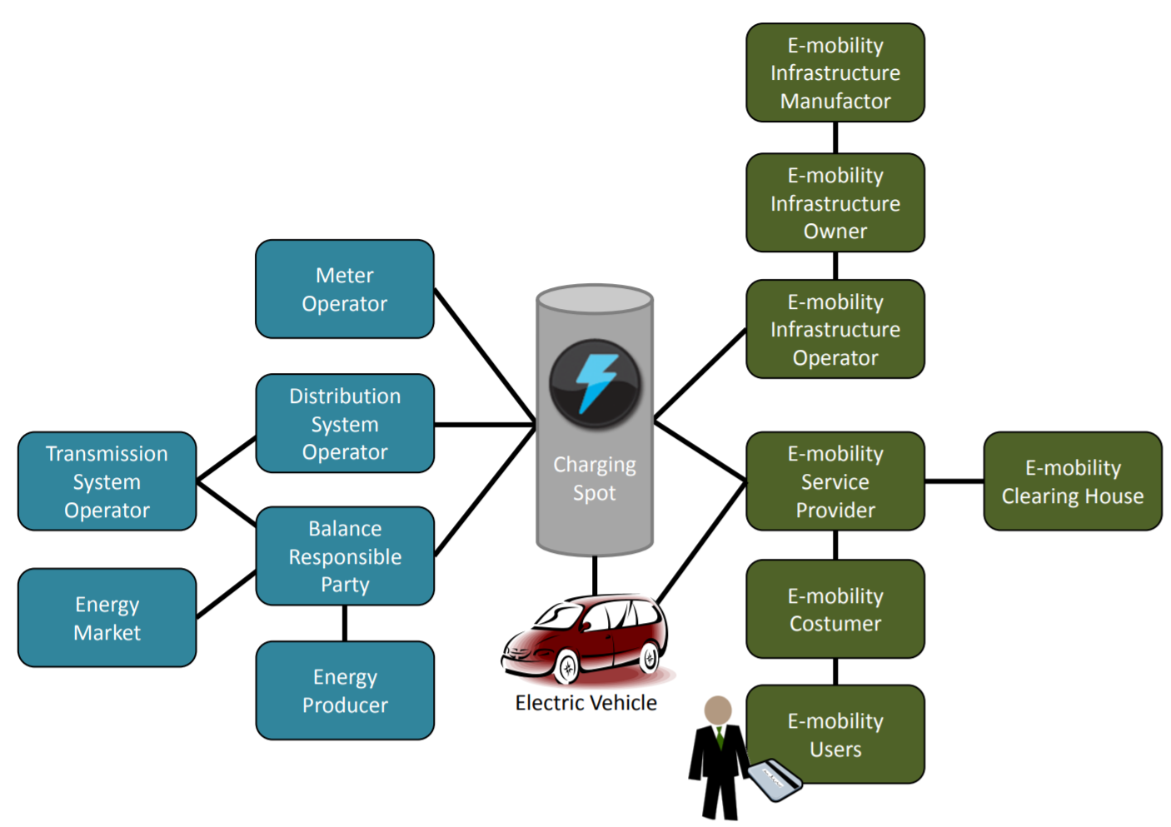
ISO/IEC 15118-1 – E-mobility

Slide 21
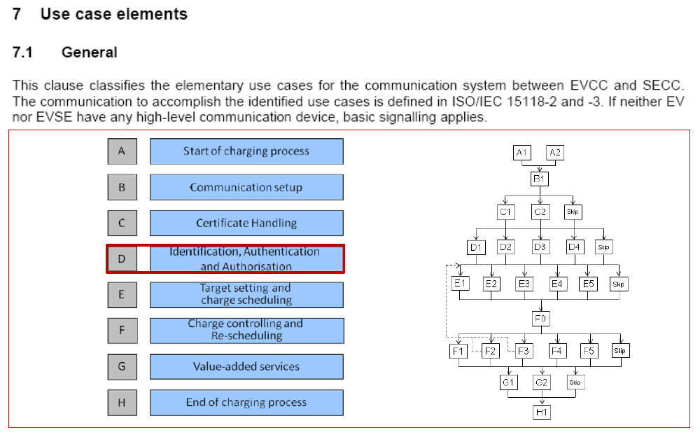
ISO/IEC 15118-1

Slide 22
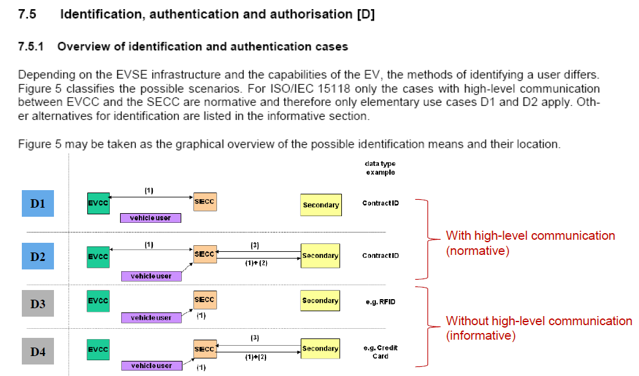

ISO/IEC 15118-1

Slide 23
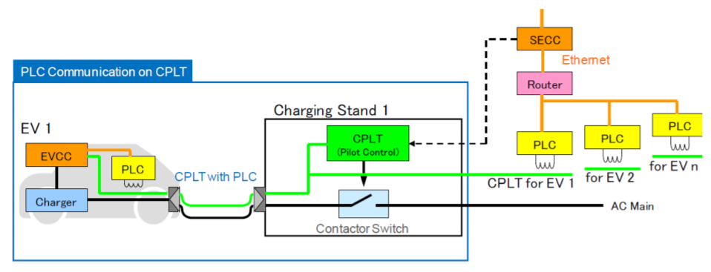
ISO/IEC 15118-1
Multiple EVCCs and one SECC communicate with each other
EVSE and EV communicate using the power line standard HomePlug Green PHY as per ISO 15118
  The requirements for this are described in ISO 15118-3

Slide 24
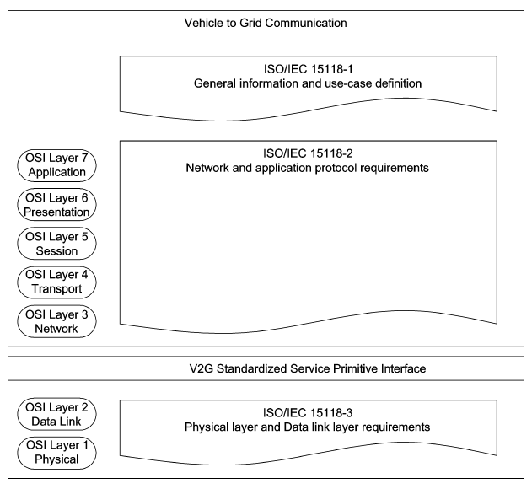
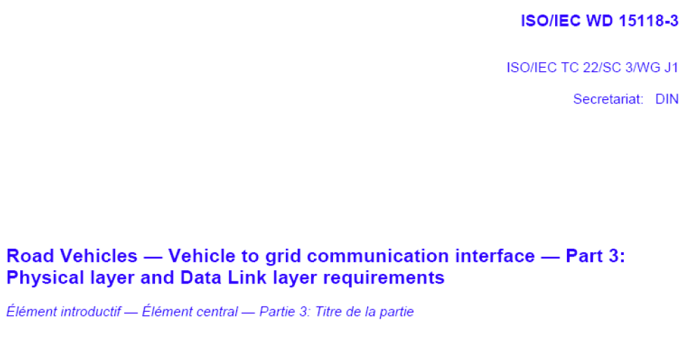
ISO/IEC 15118-3

Slide 25
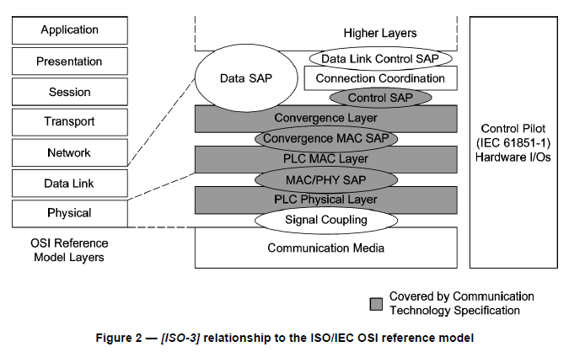
ISO/IEC 15118-3

Slide 26
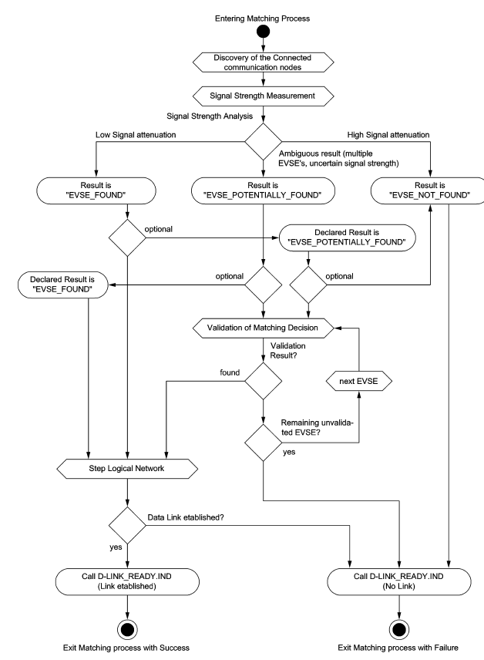
ISO/IEC 15118-3

Slide 27
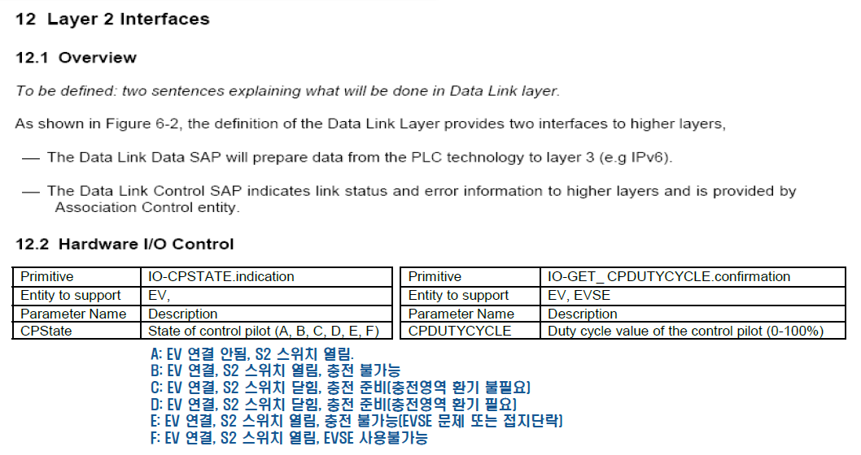
ISO/IEC 15118-3

Slide 28
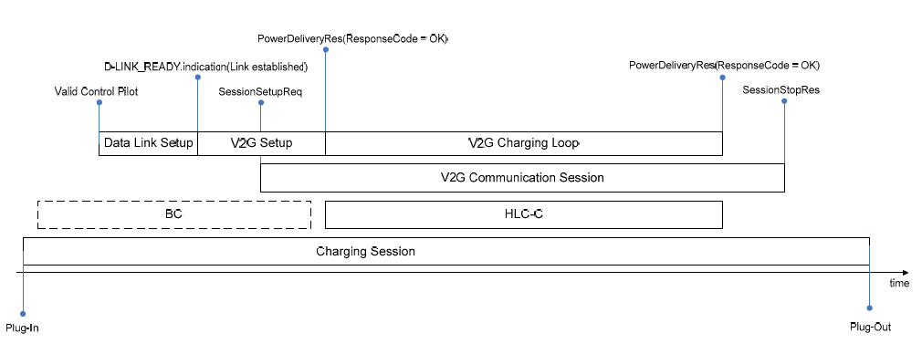
ISO/IEC 15118-2
Relation of charging and communication

Slide 29
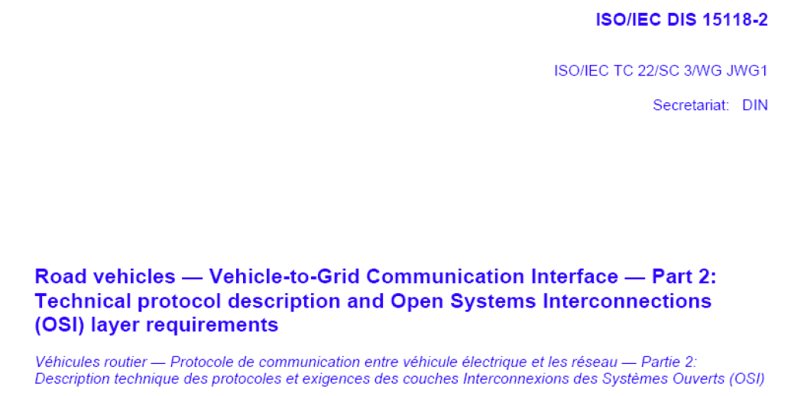
ISO/IEC 15118-2

Slide 30
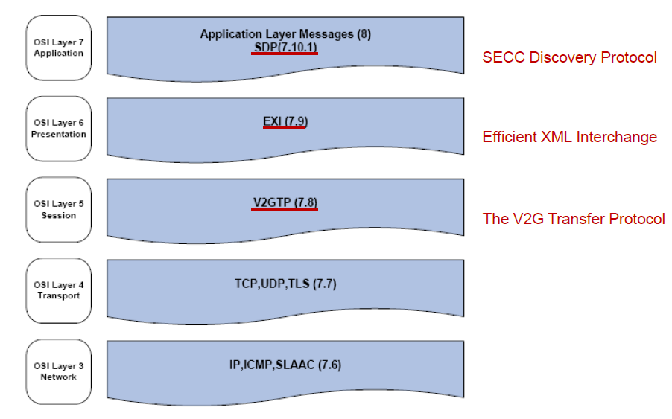
ISO/IEC 15118-2

Slide 31
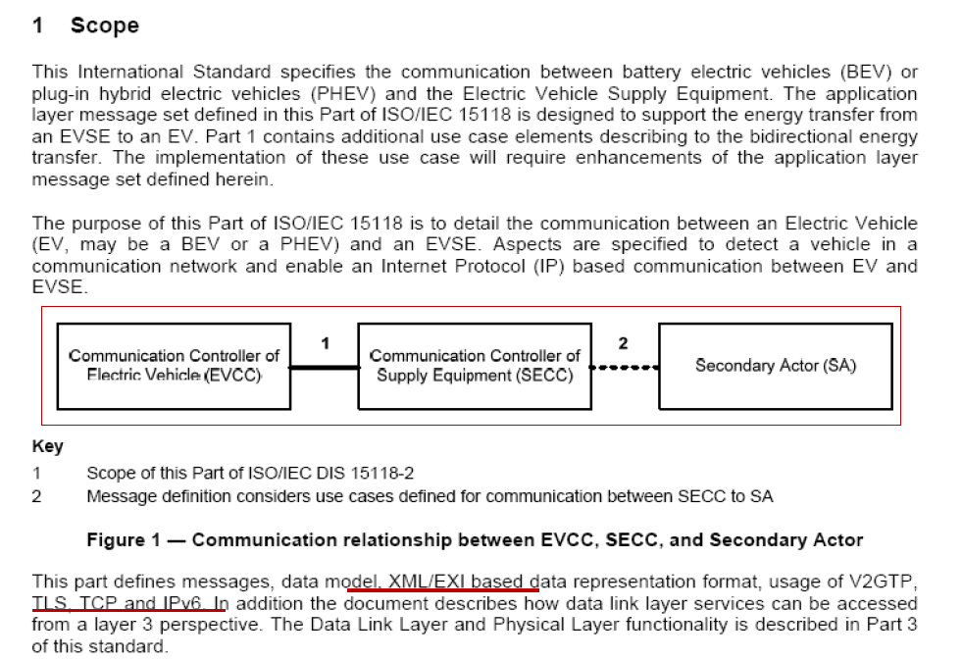
ISO/IEC 15118-2

Slide 32
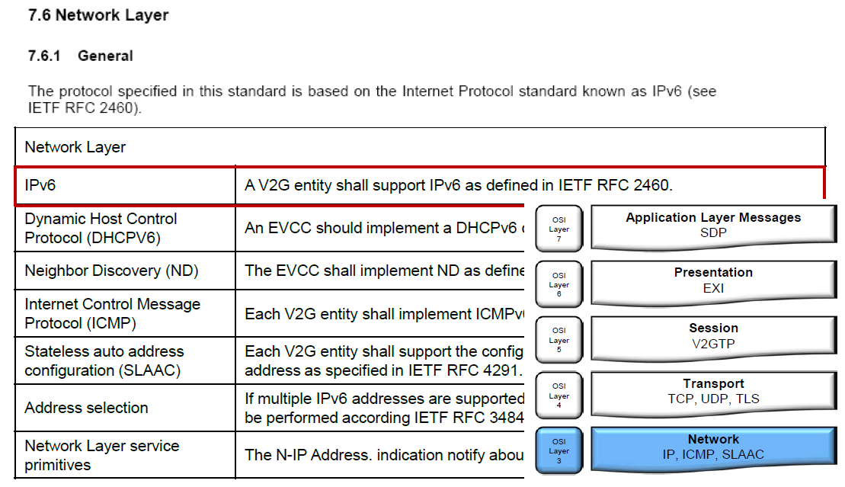
ISO/IEC 15118-2

Slide 33
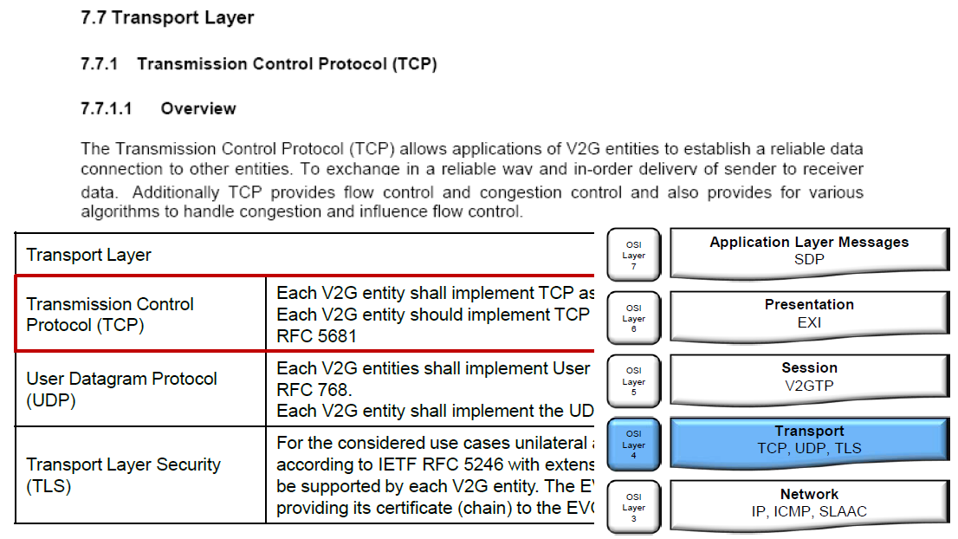
ISO/IEC 15118-2

Slide 34
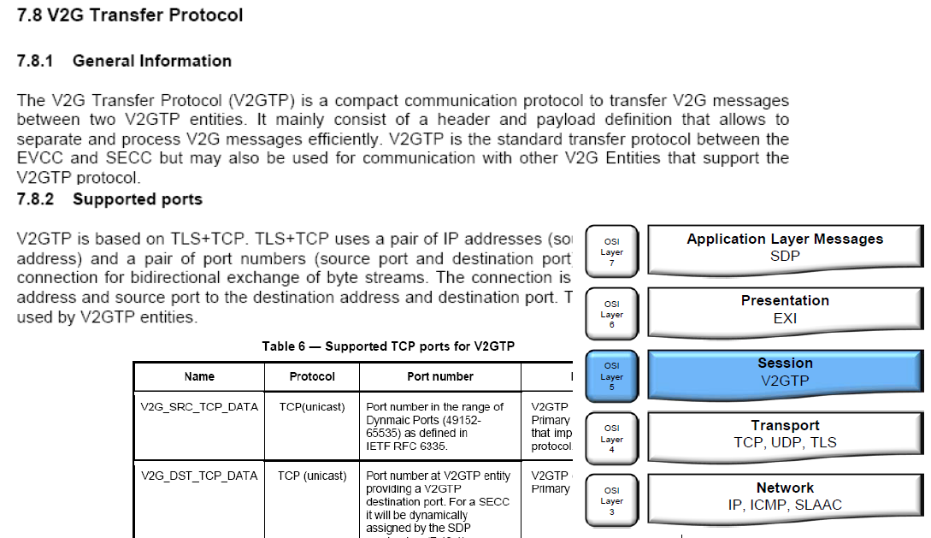
ISO/IEC 15118-2

Slide 35
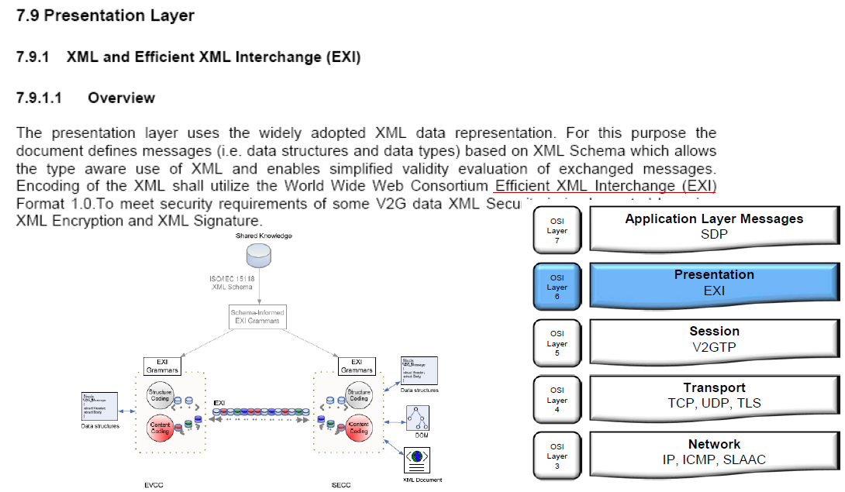
ISO/IEC 15118-2

Slide 36
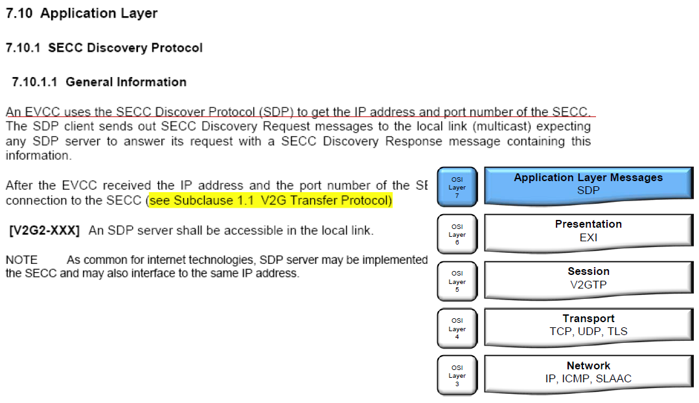
ISO/IEC 15118-2

Slide 37
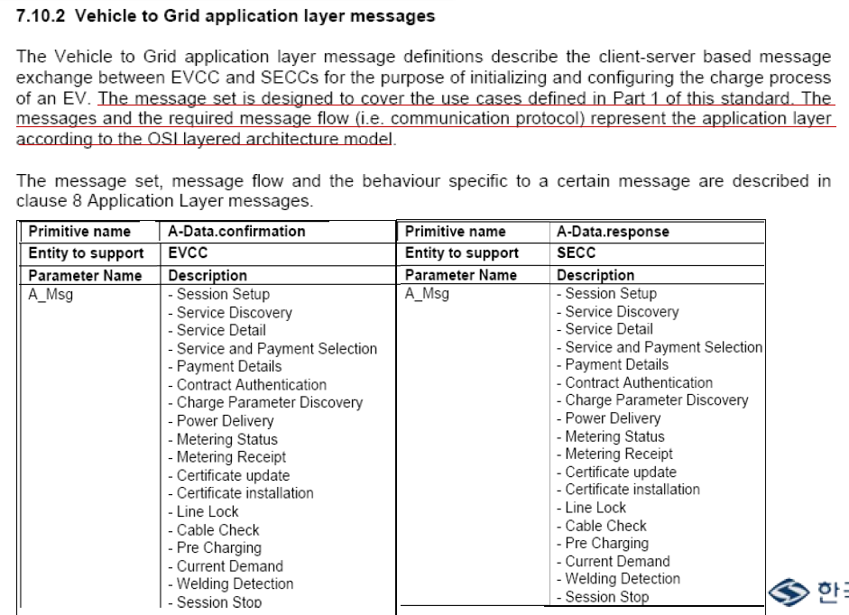
ISO/IEC 15118-2

Slide 38
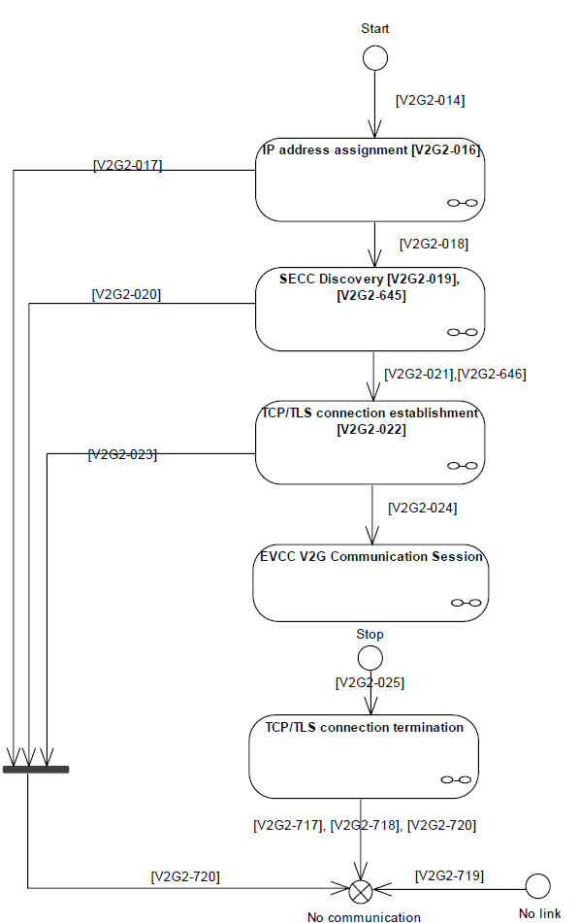
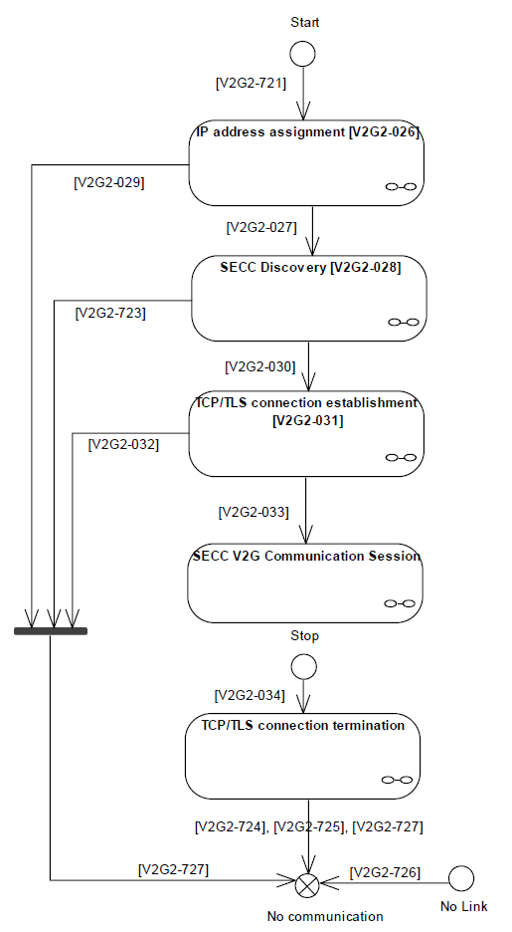
ISO/IEC 15118-2 – Overview of EVCC/SECC States

Slide 39
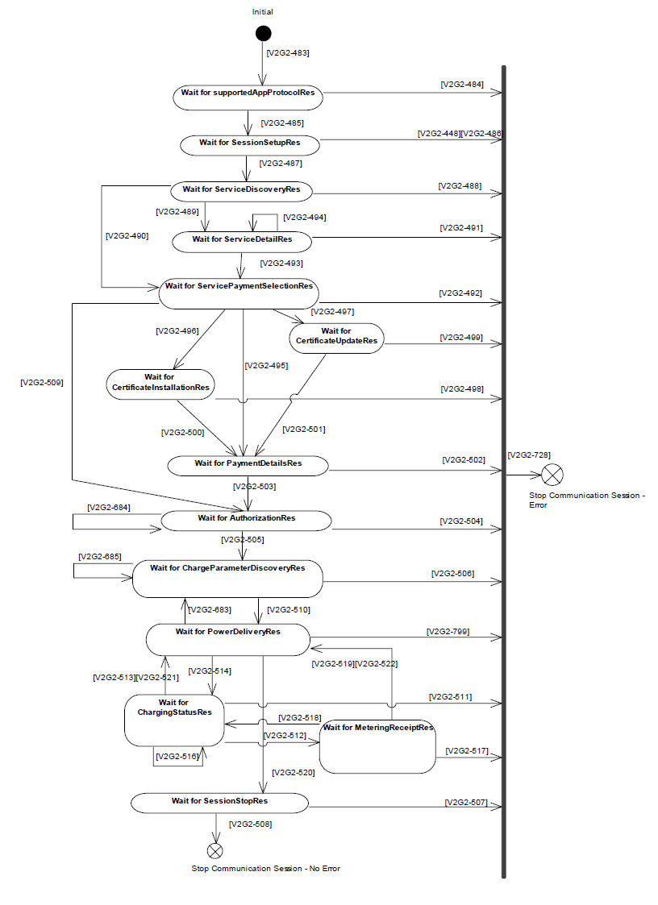
ISO/IEC 15118-2
EVCC communication states for AC V2G messaging

Slide 40
ISO/IEC 15118-2
EVCC communication states for AC V2G messaging

Slide 41
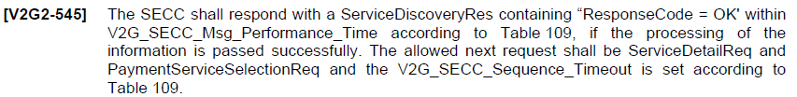
ISO/IEC 15118-2

Slide 42

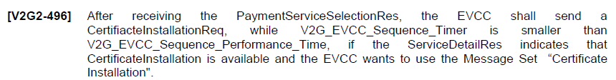
ISO/IEC 15118-2

Slide 43
ISO/IEC 15118-2
EVCC communication states for AC V2G messaging

Slide 44
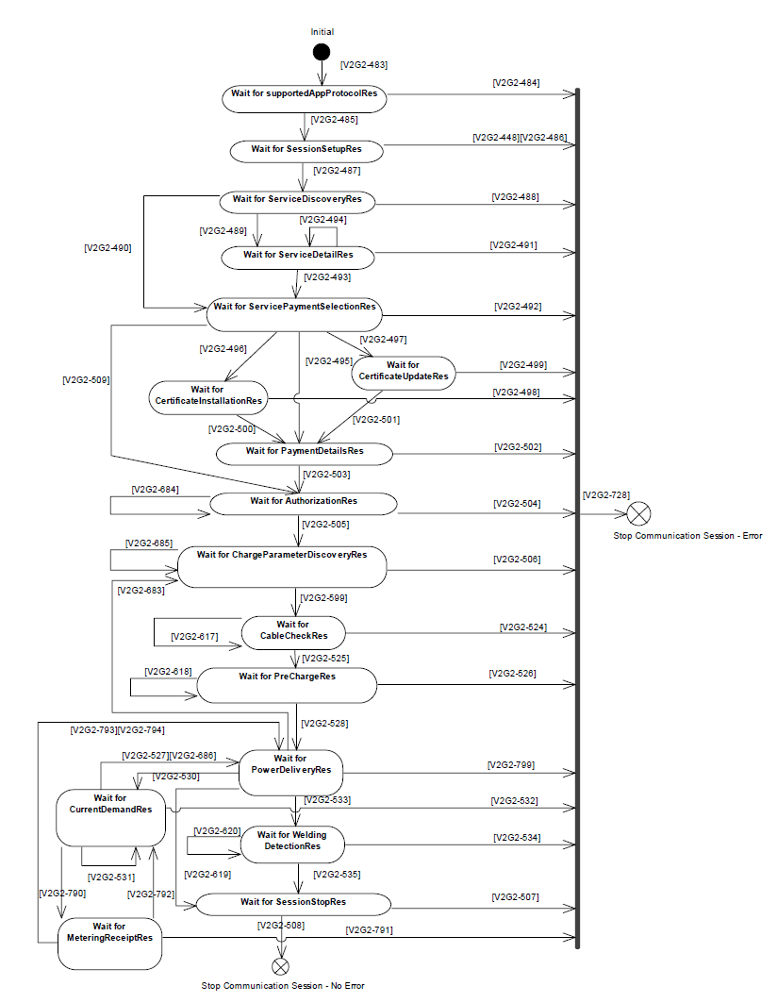
ISO/IEC 15118-2
EVCC communication states for DC V2G messaging

Slide 45
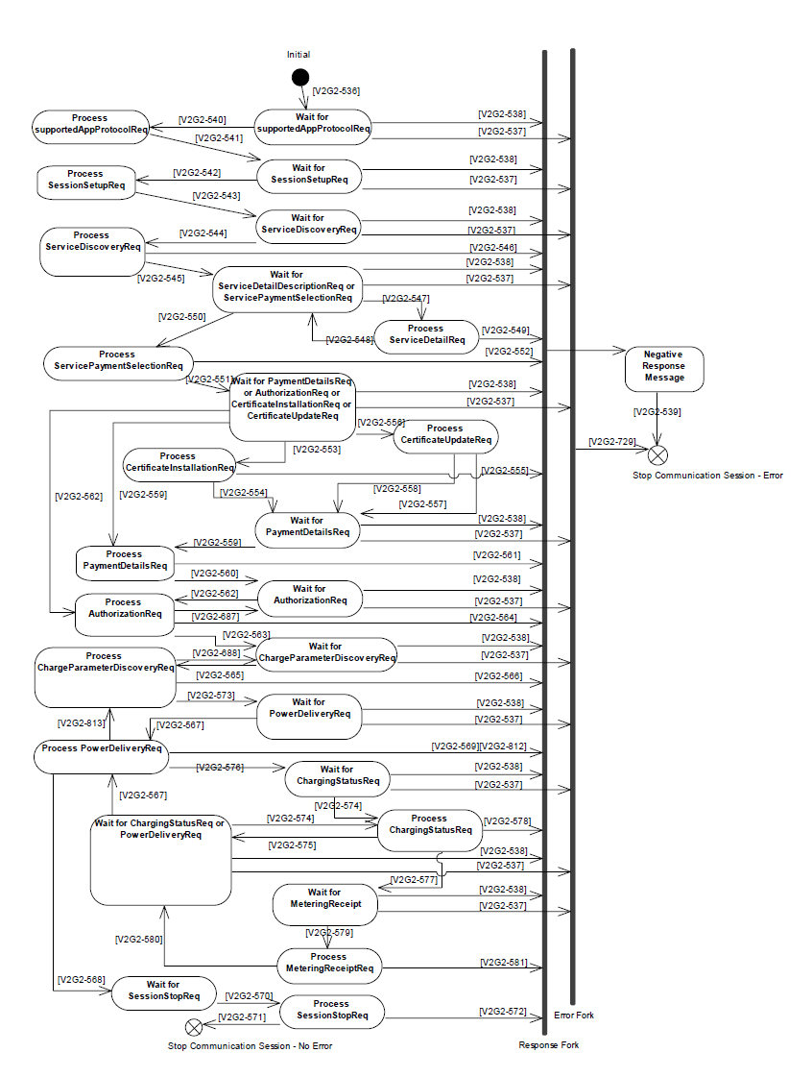
ISO/IEC 15118-2
SECC communication states for DC V2G messaging

Slide 46
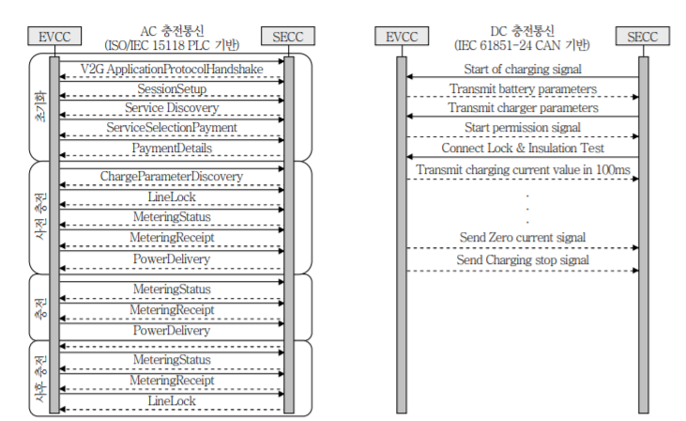
ISO 15118-2 – AC vs. DC Communication

Slide 47
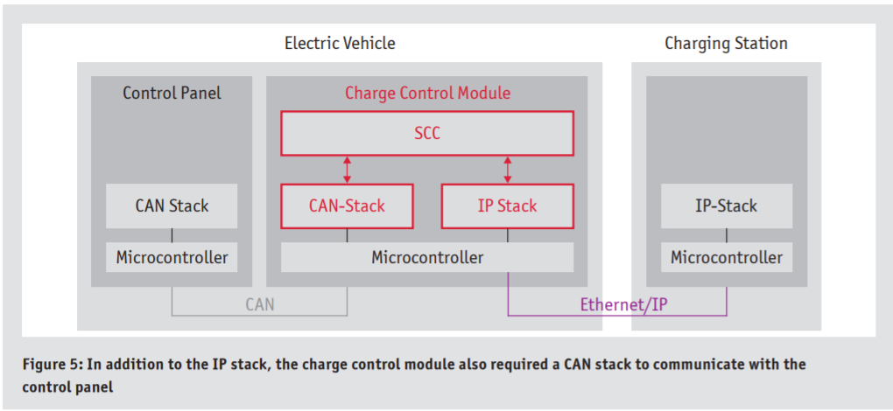
Smart Charge Communication

Slide 48
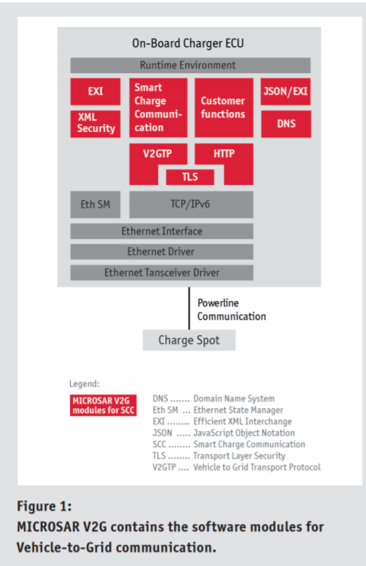
Smart Charge Communication

Slide 49
ISO/IEC 15118 – Terminology
Actor
  specifies a role played by an user or any other system that interacts with the subject
Basic Signaling
  physical signaling according to the pilot function provided by IEC 61851-1 Annex A.
Battery Management System (BMS)
  electronic device that controls or manages the electric and thermal functions of the battery system and that provides communication between the battery system and other vehicle controllers
Certificate
  certificate which contains the contract id
Charging control
  confirms the maximum charge current that is allowed to be withdrawn from EVSE based on charge schedule
  NOTE Actual charge current to the battery should be controlled by BMS. It is not in scope of this standard.

Slide 50
ISO/IEC 15118 – Terminology
Charging schedule
  maximum charging current vs. time information, which the EV will not exceed while charging the battery. It shall be calculated based on target setting, sales tariff table and grid schedule information, respecting the corresponding current limitations, i.e. using the lowest current value
Charging session
  time between the beginning (connection of the cable) and the end (disconnection of the cable) of a charging process
  NOTE During a charging session the EV may have none, one, or many periods of charging the battery, doing pre-conditioning or post-conditioning.
Contactor
  electrically controlled switch used for switching a power circuit
  NOTE 1 Unlike a circuit breaker, a contactor is not intended to interrupt a short circuit current.
  NOTE 2 As far as communication is concerned the contactor occurs as a trigger for the power supply.
Contract ID
  identification of the contract that is used by the SECC to enable charging and related services (incl. billing)
  NOTE The contract ID is associated with the electricity consumer and may be vehicle-specific or customer-specific. The customer can e.g. be the driver, the owner of the vehicle or an E-mobility operator.

Slide 51
ISO/IEC 15118 – Terminology
Demand Clearing House (DCH)
  entity for grid negotiation that provides information on the load of the grid
  NOTE 1 The demand clearing house mediates between two clearing partners – a SECC and the part of the power grid connected to this SECC.
    Collect all necessary information from all parts of the power grid, e.g. current or forecasted load of local trans-formers, distribution grid, power substation, transmission grid, transmission substation, power plants (incl. re-newable energies), and predicted charging profiles submitted by EVCCs.
    Consolidate the collected grid information to a “grid profile” and offer it to SECCs / EVCCs.
    Provide charging profile proposal for the connected EV to the requesting SECC based on the collected grid pro-file.
    Inform the SECC as to the necessity for an updated charging profile if the grid profile has changed.
    On the contrary, the SECC will inform the demand clearing house if the EV's charging profile has changed.
  NOTE 2 Demand clearing house and meter operator may exchange information with each other as well as with other actors.
Distribution System Operator (DSO)
  item responsible for the voltage stability in the distribution grid (medium and low-voltage power grid)
  NOTE 1 Electricity distribution is the final stage in the physical delivery of electricity to the delivery point (e.g. end user, EVSE or parking operator).
  NOTE 2 A distribution system network carries electricity from the transmission grid and delivers it to consumers. Typi-cally, the network would include medium-voltage power lines, electrical substations and low-voltage distribution wiring networks with associated equipment. Depending on national distribution regulations, the DSO may also be responsible for metering the energy (MO).

Slide 52
ISO/IEC 15118 – Terminology
E-Mobility Operator
  entity with which the customer has a contract for all services related to the EV operation
  NOTE 1 Typically the E-mobility operator will include some of the other actors, like spot operator or energy provider, and has a close relationship with the distribution system operator and meter operator. An OEM or utility could also fulfil such a role.
  NOTE 2 The E-mobility operator authenticates contract IDs from his customers received either from the E-Mobility op-erator clearing house, other E-mobility operators or spot operators he is in relation with.
E-Mobility Operator ID
  unique identification related to the contract between the vehicle user or the vehicle itself and the E-mobility operator, which identifies the issuer of the contract ID
  NOTE E-Mobility Operator ID may be used for roaming services
E-Mobility Operator Clearing House (EMOCH)
  entity mediating between two clearing partners to provide validation services for roaming regarding contracts of different E-Mobility Operators for the purpose of:
    collecting all necessary contract information like Contract ID, E-Mobility Operator, communication path to E-Mobility Operator, roaming fees, begin and end date of contract, etc.
    provide SECC with confirmation that an E-Mobility Operator will pay for a given Contract ID (authen-tication of valid contract) transfer a Service Detail Record (SDR) after each charging session to the electricity provider of the identified contract
  NOTE E-Mobility operator clearing house, E-Mobility Operator and meter operator may exchange information with each other as well as other actors.
Electric Energy Meter (EEM)
  equipment for measuring electrical energy by integrating power with respect to time, which complies with IEC 62052-11 and IEC 62053-21, IEC 62053-52 NOTE Some use cases need the amount of electric ener-gy measured by the electric energy meter and communicated through the SECC to the EVCC, while other scenarios do not need a separate electric energy meter. The EV may get this information and use it according to the OEM‟s intentions

Slide 53
ISO/IEC 15118 – Terminology
Electricity Provider (EP)
  body of secondary actor to provide electricity
Electric Vehicle (EV)
  any vehicle propelled by an electric motor drawing current from a rechargeable storage battery or from other portable energy storage devices (rechargeable, using energy from a source off the vehicle such as a residen-tial or public electric service), which is manufactured primarily for use on public streets, roads or highways
Electric Vehicle Charger
  power converter that performs the necessary functions for charging a battery
Electric Vehicle Communication Controller (EVCC)
  embedded system, within the vehicle, that implements the communication between the vehicle and the SECC in order to support specific functions
  NOTE Such specific functions could be e.g. controlling input and output channels, encryption, or data transfer be-tween vehicle and SECC.
Electric Vehicle Supply Equipment (EVSE)
  conductors, including the phase(s), neutral and protective earth conductors, the EV couplers, attached plugs, and all other accessories, devices, power outlets or apparatuses installed specifically for the purpose of deliv-ering energy from the premises wiring to the EV and allowing communication between them as necessary
Electronic Control Unit (ECU)
  unit providing information regarding the vehicle

Slide 54
ISO/IEC 15118 – Terminology
EVSE ID
  unique identification of the charging spot
EVSE operator
  actor for managing and maintaining the charging spot
EVSE operator ID
  unique identification of the EVSE operator which provides the EV with energy
  NOTE SECC provides the EVSE operator ID together with the EVSE ID uniquely identify the spot. The EVSE opera-tor will fix the power outlet ID.
External Identification Means (EIM)
  any external means that enable the user to identify his contract or the car
  EXAMPLE NFC, RFID, SMS
Fleet operator (FO)
  a person or legal entity operating several EVs and may have the contracts with the E-Mobility Operator

Slide 55
ISO/IEC 15118 – Terminology
Grid Schedule
  maximum charging current vs. time information, which is possible at the current outlet based on the local grid situation
  NOTE Parameters to calculate grid schedule are e.g. local grid demand and supply situation, actual and forecast.
High Level Communication
  bidirectional digital communication using protocol and messages specified in ISO/IEC 15118-2 and physical and data link layer specified in ISO/IEC 15118-3.
  NOTE High-level communication in ISO/IEC 15118 is compliant with the term digital communication in SAE J1772/2836/2847/2931.
Human Machine Interface (HMI)
  interface allowing the vehicle user to receive information relative to the charging process and provide input to the charging system
  NOTE 1 All information from a user (input) or displayed to a user (output) will be performed through an HMI.
  NOTE 2 The HMI could be implemented as a function of the EV, EVSE, mobile phone etc.
Interlock
  safety function using a mechanical lock, either electrically or manually controlled. This prevents the contacts of a socket outlet or inlet from becoming live before it is properly engaged with a plug, and which either prevents the plug from being withdrawn, while its contacts are live, or makes the contacts dead before separation
Level selector
  function to select the lowest value among the Sales tariff table, Grid schedule and Local physical limit, and feeds to scheduling function
  NOTE This function may be implemented in EV or EVSE.

Slide 56
ISO/IEC 15118 – Terminology
Meter Operator (MO)
  body having the legal responsibility for the installation and maintenance of the electric energy meter
Original Equipment Manufacturer (OEM)
  an original equipment manufacturer, or OEM, manufactures products or components that are purchased by a company and retailed under that purchasing company‟s brand name. OEM refers to the company that original-ly manufactured the product. When referring to automotive parts, OEM designates a replacement part made by the manufacturer of the original part
Paying Unit (PU)
  device on EVSE side that offers payment methods
  EXAMPLE payment methods: EIM, cash, credit cards, etc.
  NOTE If the EVCC normally chooses a payment method then the paying unit indicates to the SECC whether the cus-tomer is authorised or not.
Payment Data Container
  container, which can carry payment definitions and is thus not directly bound to a message structure encapsu-lating the payment information
Pilot function
  any means, electronic or mechanical, that insures the conditions related to the safety, or the transmission, of data required for the mode of operation, compliant with IEC 61851-1

Slide 57
ISO/IEC 15118 – Terminology
Plug and Charge
  scenario where the customer just has to plug his vehicle into the EVSE and all aspects of charging are auto-matically taken care of with no further intervention from the driver, this may include, load control, authentica-tion, authorisation and billing
Power Outlet
  part of a plug and socket outlet intended to be installed with the fixed wiring. All power outlets shall have the pilot function
Power Outlet ID
  unique identification of the power outlet to the vehicle
Primary actor
  role involved directly in the charging process
Pulse Width Modulation (PWM)
  pulse control in which the pulse width or frequency, or both, are modulated within each fundamental period to produce a certain output waveform (IEC 60050; IEV 551-16-30).
Residual Current Device (RCD)
  mechanical switch device designed to make, carry and break currents under normal service conditions and to cause the opening of the contacts when the residual current attains a given value under specified conditions
  NOTE 1 A residual current device can be a combination of various separate elements designed to detect and evaluate the residual current and to make and break current.
  NOTE 2 In the following countries, an RCD may be either electrical, electronic, mechanical or a combination thereof: US, JP, UK.

Slide 58
ISO/IEC 15118 – Terminology
Sales tariff table
  time table of energy price or percentage of green energy and optional current vs. time information
  NOTE - Sales tariff table provides input for calculating a charging schedule.
    - Sales tariff table shall be issued by a secondary actor, e.g. energy provider or mobility operator.
    - Sales tariff table should reflect “supply and demand balance of the energy provider” and “usage of green energy” (e.g. wind mill, photovoltaic).
    - Information of the chosen tariff should be included in service detail record.
    - Sales tariff table can be updated periodically. It may differ by country or energy provider.
    There may be multiple Sales tariff tables existing for one customer.
    - Sales tariff table information should be constructed in such a way that normal fluctuations on the grid side will not lead to an insufficiently charged EV or cost increase.
    - The contract-based current limitation might vary over time, e.g. lower value during daytime and higher value during the night.
Secondary actor
  role involved indirectly in the charging process
  NOTE 1 Secondary actors may exchange information between each other.
  NOTE 2 Secondary actors could also be a single entity.
Semi online
  status, where the SECC or any other device in general has the ability to go online, but being online is not re-quired synchronously to the referring use case(s)
  NOTE The SECC may decide to go online, if required.

Slide 59
ISO/IEC 15118 – Terminology
Service Detail Record (SDR)
  data package of a charge or service related session with all necessary information that an E-Mobility Operator needs for billing or for informing the customer about the session
  NOTE Some data may be sent from EVSE. Some data originally owned by E-Mobility Operator Clearing House. Some data may be created at E-Mobility Operator Clearing House. Some records to be sent to E-Mobility Operator for billing or informing their customers.
Service provider
  body of secondary actor to offer value-added services to customers throughout the EVSE operator
  NOTE Contract ID may be used for activation.
Supply Equipment Communication Controller (SECC)
  entity which implements the communication to one or multiple EVCCs according to ISO/IEC 15118-2 and which may be able to interact with secondary actors
  NOTE 1 Further details regarding possible architectures are given in Annex A.
  NOTE 2 Functions of a supply equipment communication controller may control input and output channels, data en-cryption, or data transfer between vehicle and SECC.
Trigger
  event that will start or be a condition in the use case

Slide 60
ISO/IEC 15118 – Terminology
Use case
  description of a system‟s behaviour as it responds to a request that originates from outside that system
  NOTE In systems engineering, a use case describes "who" can do "what" with the system in question. The use case technique is used to capture a system's behavioural requirements by detailing scenario-driven threads through functional requirements.
Value-Added Services (VAS)
  elements not directly needed for the pure charging of the EV
Vehicle coupler
  means of enabling the manual connection of a flexible cable to an EV for the purpose of charging the traction batteries consisting of two parts: A vehicle connector and a vehicle inlet
Vehicle to grid (V2G)
  plug-in electric vehicle interaction with the electric grid, including charging as well as discharging (excerpted from „scope of V2G Domain Expert Working Group‟, SGIP, NIST) and bi-directional communication interface
Vehicle user
  person or legal entity using the vehicle and providing information about driving needs and consequently influences charging patterns

