Slide 1
Ad hoc and Sensor Networks
Chapter 11: Routing protocols
Holger Karl

Slide 2
Goals of this chapter
In any network of diameter > 1, the routing & forwarding problem appears
We will discuss mechanisms for constructing routing tables in ad hoc/sensor networks
  Specifically, when nodes are mobile
  Specifically, for broadcast/multicast requirements
  Specifically, with energy efficiency as an optimization metric
  Specifically, when node position is available
Note: Presentation here partially follows Beraldi & Baldoni, Unicast Routing Techniques for Mobile Ad Hoc Networks, in M. Ilyas (ed.), The Handbook of Ad Hoc Wireless Networks

Slide 3
Overview
Unicast routing in MANETs
Energy efficiency & unicast routing
Multi-/broadcast routing
Geographical routing

Slide 4
Unicast, id-centric routing
Given: a network/a graph
  Each node has a unique identifier (ID)
Goal: Derive a mechanism that allows a packet sent from an arbitrary node to arrive at some arbitrary destination node
  The routing & forwarding problem
  Routing: Construct data structures (e.g., tables) that contain information how a given destination can be reached
  Forwarding: Consult these data structures to forward a given packet to its next hop
Challenges
  Nodes may move around, neighborhood relations change
  Optimization metrics may be more complicated than “smallest hop count” – e.g., energy efficiency

Slide 5
Ad-hoc routing protocols
Because of challenges, standard routing approaches not really applicable
  Too big an overhead, too slow in reacting to changes
  Examples: Dijkstra’s link state algorithm; Bellman-Ford distance vector algorithm
Simple solution: Flooding
  Does not need any information (routing tables) – simple
  Packets are usually delivered to destination
  But: overhead is prohibitive
  ! Usually not acceptable, either
! Need specific, ad hoc routing protocols

Slide 6
Ad hoc routing protocols – classification
Main question to ask: When does the routing protocol operate?
Option 1: Routing protocol always tries to keep its routing data up-to-date
  Protocol is proactive (active before tables are actually needed) or table-driven
Option 2: Route is only determined when actually needed
  Protocol operates on demand
Option 3: Combine these behaviors
  Hybrid protocols

Slide 7
Ad hoc routing protocols – classification
Is the network regarded as flat or hierarchical?
  Compare topology control, traditional routing
Which data is used to identify nodes?
  An arbitrary identifier?
  The position of a node?
    Can be used to assist in geographic routing protocols because choice of next hop neighbor can be computed based on destination address
  Identifiers that are not arbitrary, but carry some structure?
    As in traditional routing
    Structure akin to position, on a logical level?

Slide 8
Proactive protocols
Idea: Start from a +/- standard routing protocol, adapt it
Adapted distance vector: Destination Sequence Distance Vector (DSDV)
  Based on distributed Bellman Ford procedure
  Add aging information to route information propagated by distance vector exchanges; helps to avoid routing loops
  Periodically send full route updates
  On topology change, send incremental route updates
  Unstable route updates are delayed
  … + some smaller changes

Slide 9
Proactive protocols – OLSR
Combine link-state protocol & topology control
Optimized Link State Routing (OLSR)
Topology control component: Each node selects a minimal dominating set for its two-hop neighborhood
  Called the multipoint relays
  Only these nodes are used for packet forwarding
  Allows for efficient flooding
Link-state component: Essentially a standard link-state algorithms on this reduced topology
  Observation: Key idea is to reduce flooding overhead (here by modifying topology)

Slide 10
Proactive protocols – Combine LS & DS: Fish eye
Fisheye State Routing (FSR) makes basic observation: When destination is far away, details about path are not relevant – only in vicinity are details required
  Look at the graph as if through a fisheye lens
  Regions of different accuracy of routing information
Practically:
  Each node maintains topology table of network (as in LS)
  Unlike LS: only distribute link state updates locally
  More frequent routing updates for nodes with smaller scope

Slide 11
Reactive protocols – DSR
In a reactive protocol, how to forward a packet to destination?
  Initially, no information about next hop is available at all
  One (only?) possible recourse: Send packet to all neighbors – flood the network
  Hope: At some point, packet will reach destination and an answer is sent pack – use this answer for backward learning the route from destination to source
Practically: Dynamic Source Routing (DSR)
  Use separate route request/route reply packets to discover route
    Data packets only sent once route has been established
    Discovery packets smaller than data packets
  Store routing information in the discovery packets

Slide 12
DSR route discovery procedure
Search for route from 1 to 5
[1]
[1,7]
1
2
1
2
[1]
7
7
5
[1,7]
5
4
3
4
3
6
6
[1,7]
[1,4]
2
1
2
1
[1,7,2]
7
[1,7,2]
7
[1,4,6]
5
5
4
4
3
6
3
6
[1,7,3]
[5,3,7,1]
Node 5 uses route information recorded in RREQ to send back, via source routing, a route reply

Slide 13
DSR modifications, extensions
Intermediate nodes may send route replies in case they already know a route
  Problem: stale route caches
Promiscuous operation of radio devices – nodes can learn about topology by listening to control messages
Random delays for generating route replies
  Many nodes might know an answer – reply storms
  NOT necessary for medium access – MAC should take care of it
Salvaging/local repair
  When an error is detected, usually sender times out and constructs entire route anew
  Instead: try to locally change the source-designated route
Cache management mechanisms
  To remove stale cache entries quickly
  Fixed or adaptive lifetime, cache removal messages, …

Slide 14
Reactive protocols – AODV
Ad hoc On Demand Distance Vector routing (AODV)
  Very popular routing protocol
  Essentially same basic idea as DSR for discovery procedure
  Nodes maintain routing tables instead of source routing
  Sequence numbers added to handle stale caches
  Nodes remember from where a packet came and populate routing tables with that information

Slide 15
Reactive protocols – TORA
Observation: In hilly terrain, routing to a river’s mouth is easy – just go downhill
Idea: Turn network into hilly terrain
  Different “landscape” for each destination
  Assign “heights” to nodes such that when going downhill, destination is reached – in effect: orient edges between neighbors
  Necessary: resulting directed graph has to be cycle free
Reaction to topology changes
  When link is removed that was the last “outlet” of a node, reverse direction of all its other links (increase height!)
  Reapply continuously, until each node except destination has at least a single outlet – will succeed in a connected graph!

Slide 16
Alternative approach: Gossiping/rumor routing
Turn routing problem around: Think of an “agent”
wandering through the network, looking for data (events, …)
Agent initially perform random walk
Leave “traces” in the network
Later agents can use these traces to find data
Essentially: works due to high probability of line intersections
?

Slide 17
Overview
Unicast routing in MANETs
Energy efficiency & unicast routing
Multi-/broadcast routing
Geographical routing

Slide 18
Energy-efficient unicast: Goals
Particularly interesting performance metric: Energy efficiency
Goals
  Minimize energy/bit
    Example: A-B-E-H
  Maximize network lifetime
    Time until first node failure, loss of coverage, partitioning
Seems trivial – use proper link/path metrics (not hop count) and standard routing
4
A
2
3
1
1
2
C
3
B
2
D
1
2
4
3
E
2
F
2
1
G
2
4
2
H
Example: Send data from node A to node H

Slide 19
Basic options for path metrics
Maximum total available battery capacity
  Path metric: Sum of battery levels
  Example: A-C-F-H
Minimum battery cost routing
  Path metric: Sum of reciprocal battery levels
  Example: A-D-H
Conditional max-min battery capacity routing
  Only take battery level into account when below a given level
Minimize variance in power levels
Minimum total transmission power
4
A
2
3
1
1
2
C
3
B
2
D
1
2
4
3
E
2
F
2
1
G
2
4
2
H

Slide 20

A non-trivial path metric
Previous path metrics do not perform particularly well
One non-trivial link weight:
  w_{ij} weight for link node i to node j
  e_{ij} required energy, λ some constant, α_{i} fraction of battery of node i already used up
Path metric: Sum of link weights
  Use path with smallest metric
Properties: Many messages can be send, high network lifetime
  With admission control, even a competitive ratio logarithmic in network size can be shown

Slide 21
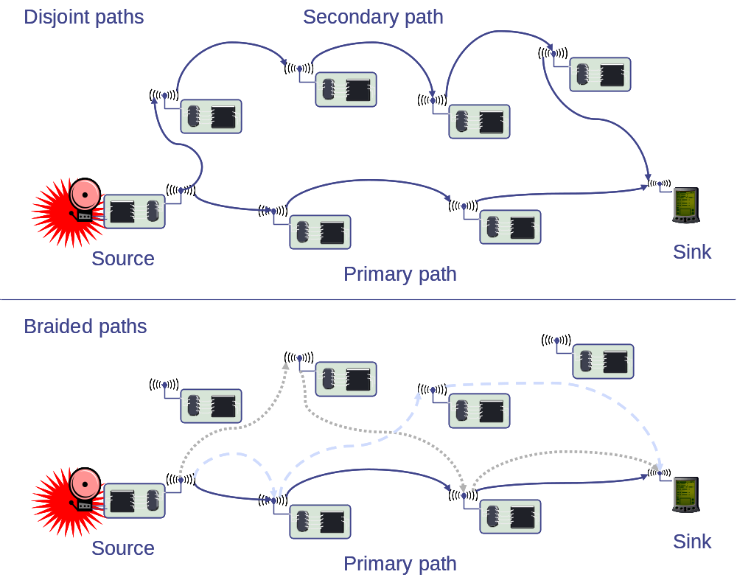
Multipath unicast routing
Instead of only a single path, it can be useful to compute multiple paths between a given source/destination pair
  Multiple paths can be disjoint or braided
  Used simultaneously, alternatively, randomly, …

Slide 22
Overview
Unicast routing in MANETs
Energy efficiency & unicast routing
Multi-/broadcast routing
Geographical routing

Slide 23
Broadcast & multicast (energy-efficient)
Distribute a packet to all reachable nodes (broadcast) or to a somehow (explicitly) denoted subgroup (multicast)
Basic options
  Source-based tree: Construct a tree (one for each source) to reach all addressees
    Minimize total cost (= sum of link weights) of the tree
    Minimize maximum cost to each destination
  Shared, core-based trees
    Use only a single tree for all sources
    Every source sends packets to the tree where they are distributed
  Mesh
    Trees are only 1-connected ! use meshes to provide higher redundancy and thus robustness in mobile environments

Slide 24
Optimization goals for source-based trees
For each source, minimize total cost
  This is the Steiner tree problem again
For each source, minimize maximum cost to each destination
  This is obtained by overlapping the individual shortest paths as computed by a normal routing protocol
Steiner tree
Source
Destination 2
2
2
1
Destination 1
Shortest path tree
Source
Destination 2
2
2
1
Destination 1

Slide 25
Summary of options (broadcast/multicast)
Broadcast
Multicast
One tree
per source
Shared tree
(core-based tree)
Mesh
Minimize
total cost
(Steiner tree)
Minimize
cost to each node
(e.g., Dijkstra)
Single
core
Multiple
core

Slide 26
Wireless multicast advantage
Broad-/Multicasting in wireless is unlike broad-/multicasting in a wired medium
  Wires: locally distributing a packet to n neighbors: n times the cost of a unicast packet
  Wireless: sending to n neighbors can incur costs
    As high as sending to a single neighbor – if receive costs are neglected completely
    As high as sending once, receiving n times – if receives are tuned to the right moment
    As high as sending n unicast packets – if the MAC protocol does not support local multicast
! If local multicast is cheaper than repeated unicasts, then wireless multicast advantage is present
  Can be assumed realistically

Slide 27
Steiner tree approximations
Computing Steiner tree is NP complete
A simple approximation
  Pick some arbitrary order of all destination nodes + source node
  Successively add these nodes to the tree: For every next node, construct a shortest path to some other node already on the tree
  Performs reasonably well in practice
Takahashi Matsuyama heuristic
  Similar, but let algorithm decide which is the next node to be added
  Start with source node, add that destination node to the tree which has shortest path
  Iterate, picking that destination node which has the shortest path to some node already on the tree
Problem: Wireless multicast advantage not exploited!
  And does not really fit to the Steiner tree formulation

Slide 28
Broadcast incremental power (BIP)
How to broadcast, using the wireless multicast advantage?
  Goal: use as little transmission power as possible
Idea: Use a minimum-spanning-tree-type construction (Prim’s algorithm)
But: Once a node transmits at a given power level & reaches some neighbors, it becomes cheaper to reach additional neighbors
From BIP to multicast incremental power (MIP):
  Start with broadcast tree construction, then prune unnecessary edges out of the tree

Slide 29
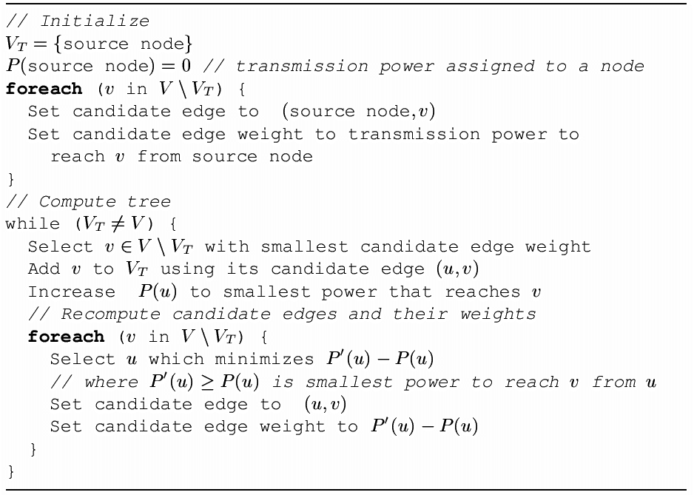
BIP – Algorithm

Slide 30
BIP – Example
Round 1:
A
Round 2:
A
Round 3:
A
5
3
4
3
2
3
S
1
B
S (1)
B
S (3)
B
10
9
7
3
7
2
7
7
D
1
D
1
D
1
C
Round 4:
A
C
Round 5:
A
C
2
3
3
S (3)
B
S (5)
B
7
10
6
7
D
D
C (1)
C (1)

Slide 31
Example for mesh-based multicast
Two-tier data dissemination
  Overlay a mesh, route along mesh intersections
  Broadcast within the quadrant where the destination is (assumed to be) located
Sink
Event

Slide 32
Overview
Unicast routing in MANETs
Energy efficiency & unicast routing
Multi-/broadcast routing
Geographical routing
  Position-based routing
  Geocasting

Slide 33
Geographic routing
Routing tables contain information to which next hop a packet should be forwarded
  Explicitly constructed
Alternative: Implicitly infer this information from physical placement of nodes
  Position of current node, current neighbors, destination known – send to a neighbor in the right direction as next hop
  Geographic routing
Options
  Send to any node in a given area – geocasting
  Use position information to aid in routing – position-based routing
    Might need a location service to map node ID to node position

Slide 34
Basics of position-based routing
“Most forward within range r” strategy
  Send to that neighbor that realizes the most forward progress towards destination
  NOT: farthest away
  from sender!
Nearest node with (any) forward progress
  Idea: Minimize transmission power
Directional routing
  Choose next hop that is angularly closest to destination
  Choose next hop that is closest to the connecting line to destination
  Problem: Might result in loops!

Slide 35
Problem: Dead ends
Simple strategies might send a packet into a dead end

Slide 36
Right hand rule to leave dead ends – GPSR
Basic idea to get out of a dead end: Put right hand to the wall, follow the wall
  Does not work if on some inner wall – will walk in circles
  Need some additional rules to detect such circles
Geometric Perimeter State Routing (GPSR)
  Earlier versions: Compass Routing II, face-2 routing
  Use greedy, “most forward” routing as long as possible
  If no progress possible: Switch to “face” routing
    Face: largest possible region of the plane that is not cut by any edge of the graph; can be exterior or interior
    Send packet around the face using right-hand rule
    Use position where face was entered and destination position to determine when face can be left again, switch back to greedy routing
  Requires: planar graph! (topology control can ensure that)

Slide 37
GPSR – Example
Route packet from node A to node Z
Leave face routing
E
I
B
K
F
H
Z
A
D
Enter face routing
J
L
G
C

Slide 38
Geographic routing without positions – GEM
Apparent contradiction: geographic, but no position?
Construct virtual coordinates that preserve enough neighborhood information to be useful in geographic routing but do not require actual position determination
Use polar coordinates from a center point
Assign “virtual angle range” to neighbors of a node, bigger radius
Angles are recursively redistributed to children nodes

Slide 39
GeRaF
How to combine position knowledge with nodes turning on/off?
  Goal: Transmit message over multiple hops to destination node; deal with topology constantly changing because of on/off node
Idea: Receiver-initiated forwarding
  Forwarding node S simply broadcasts a packet, without specifying next hop node
  Some node T will pick it up (ideally, closest to the source) and forward it
Problem: How to deal with multiple forwarders?
  Position-informed randomization: The closer to the destination a forwarding node is, the shorter does it hesitate to forward packet
  Use several annuli to make problem easier, group nodes according to distance (collisions can still occur)

Slide 40
GeRaF – Example
A₄
A₃
A₂
A₁
1
D-1
D

Slide 41
Overview
Unicast routing in MANETs
Energy efficiency & unicast routing
Multi-/broadcast routing
Geographical routing
  Position-based routing
  Geocasting

Slide 42
Location-based Multicast (LBM)
Geocasting by geographically restricted flooding
Define a “forwarding” zone – nodes in this zone will forward the packet to make it reach the destination zone
  Forwarding zone specified in packet or recomputed along the way
  Static zone – smallest rectangle containing original source and destination zone
  Adaptive zone – smallest rectangle containing forwarding node and destination zone
    Possible dead ends again
  Adaptive distances – packet is forwarded by node u if node u is closer to destination zone’s center than predecessor node v (packet has made progress)
Packet is always forwarded by nodes within the destination zone itself

Slide 43
Determining next hops based on Voronoi diagrams
Goal: Use that neighbor to forward packet that is closest to destination among all the neighbors
Use Voronoi diagram computed for the set of neighbors of the node currently holding the packet
B
C
S
D
A

Slide 44
Geocasting using ad hoc routing – GeoTORA
Recall TORA protocol: Nodes compute a DAG with destination as the only sink
Observation: Forwarding along the DAG still works if multiple nodes are destination (graph has multiple sinks)
GeoTORA: All nodes in the destination region act as sinks
  Forwarding along DAG; all sinks also locally broadcast the packet in the destination region
Remark: This also works for anycasting where destination nodes need not necessarily be neighbors
  Packet is then delivered to some (not even necessarily closest) member of the group

Slide 45
Trajectory-based forwarding (TBF)
Think in terms of an “agent”: Should travel around the network, e.g., collecting measurements
  Random forwarding may take a long time
Idea: Provide the agent with a certain trajectory along which to travel
  Described,
  e.g., by a
  simple curve
  Forward
  to node closest
  to this trajectory

Slide 46
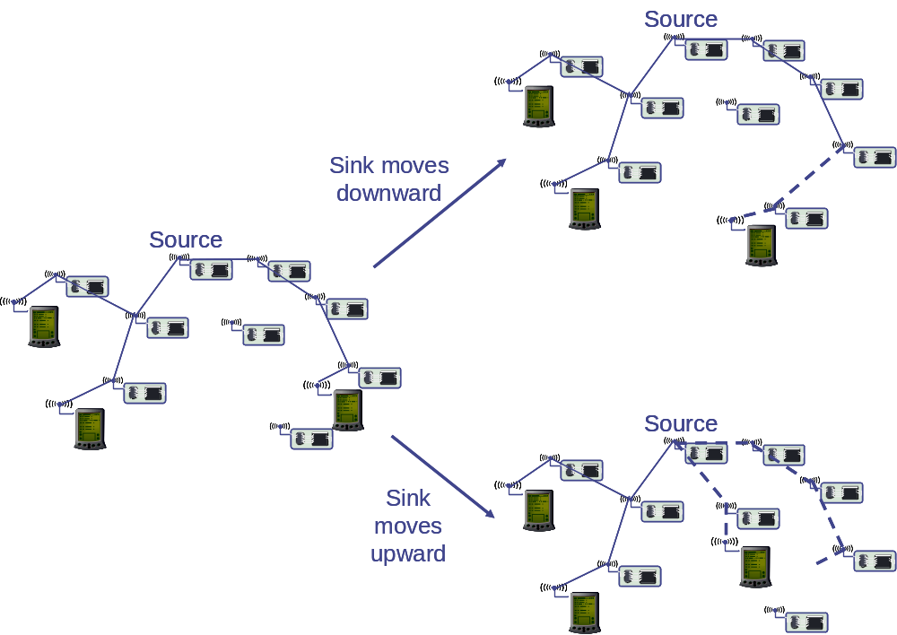
Mobile nodes, mobile sinks
Mobile nodes cause some additional problems
  E.g., multicast tree to distribute readings has to be adapted

Slide 47
Conclusion
Routing exploit various sources of information to find destination of a packet
  Explicitly constructed routing tables
  Implicit topology/neighborhood information via positions
Routing can make some difference for network lifetime
  However, in some scenarios (streaming data to a single sink), there is only so much that can be done
  Energy efficiency does not equal lifetime, holds for routing as well
Non-standard routing tasks (multicasting, geocasting) require adapted protocols

