Slide 1
Monitoring a Person’s Heart Rate and
Respiratory Rate on a Shared Bed Using Geophones
Zhenhua Jia, Amelie Bonde, Sugang Li, Chenren Xu, Jingxian Wang, Yanyong Zhang
SenSys ‘17 (15th ACM Conference on Embedded Network Sensor Systems)
Seunghoon Woo
Korea University
Oct 23, 2018

Slide 2
Background
Geophone
  Seismic energy (vibrations) inputs into electrical voltage
Ballistic movement
  Muscle contractions that exhibit maximum velocities and accelerations over a very short period of time

Slide 3
Motivation
Monitoring a person’s vital signs during sleep has received a great deal of attention
  Heart rate and respiratory rate
Most existing systems monitor by measuring aspects during a heartbeat pulse
Recent work has shown that a geophone sensor
  Measures the vibration velocity caused by ballistic force
  Alternative in detecting heart rate during sleep without having the existing problems
    Requiring special mattress/sheets, requiring the user to keep the same sleeping position/posture

Slide 4
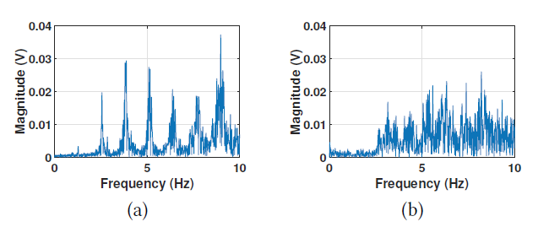
Problem
Despite the advantages of using geophone, a great deal of effort is still required
  Detect respiration using geophones is very difficult
    The vibrations caused by respiration are weak
    Also the frequency components are below the extremely low frequency (ELF) band (<1 Hz)
  Difficult to extract the targets heart rate from the mixed vibration signal (multiple people share a bed)
Single subject on the bed Two subjects on the bed

Slide 5
Challenges
second-order high-pass filter
- 저주파를 감쇠시키고 고주파만 통과시킴
Challenges of Respiration Monitoring
  A geophone is naturally a velocity sensor and a second-order high-pass filter
  Insensitive to low-speed low-frequency vibrations
Challenges of Heart Rate Monitoring
  Monitoring a person’s heart rate when he/she shares the bed with others remains an challenge

Slide 6
Solution
Authors develop VitalMon
  An in-bed heart rate and respiratory rate monitoring system using geophones
  For respiratory rate estimation, model the signal as AM
    Use the modulated signal itself to achieve demodulation, which allows us to apply demodulation without knowing the frequency of the carrier signal (i.e., heartbeat)
  For heart rate estimation, focus on the spatial differences (공간적 차이) between two heartbeats
  They measured a total of 5084 data sets and collected vital sign signals over 56 hours
  AM(진폭 변조)
    전파의 진폭이 신호의 세기로 변화하는 변조 방식

Slide 7
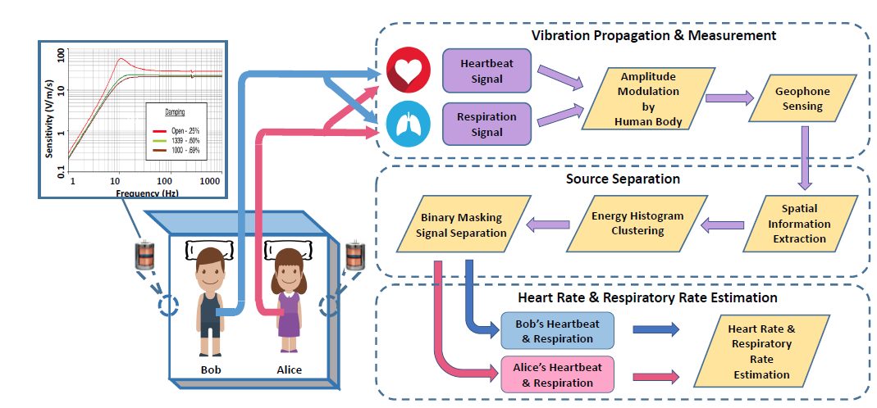
Solution
VitalMon overview

Slide 8
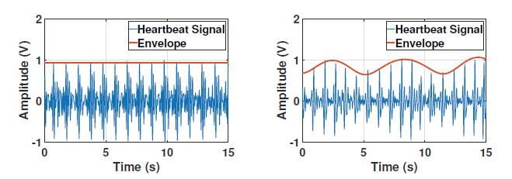
VitalMon
Monitoring respiratory rate using geophone
  Difficult to extract data directly from Geophone
      Because of second-order high-pass filter
        Its frequency threshold is 8.4 Hz, respiration frequency should be below 1 Hz
      Velocity of breathing is quite slow
  The amplitude of the signal fluctuates in a periodic fashion, and the frequency is very close to the subject’s breathing frequency
  formulate the respiration signal extraction problem as an amplitude modulation problem
※ 아마도 숨을 쉬면 가슴이 단단해 지는 효과가 있기 때문에 심장박동이 전달되면서 에너지를 잃을것이다.
Holding breath 10BPM breath

Slide 9


VitalMon
Monitoring respiratory rate using geophone
    S(t) -> source signal for single person case
    Sr(t) -> respiration signal
    Shj(t) -> j-th harmonics of the heartbeat signal (Sh1: fundamental frequency of heartbeat signal)
  Should devise a suitable amplitude demodulation algorithm to extract the respiratory rate information
    But, heartbeat signal (carrier signal) remains unknown
    Existing RF (라디오 주파수) demodulation techniques are not suitable
    Therefore, they choose the square-law demodulation approach
      Geophone signal as the carrier signal
        It can be demodulate itself to extract the information signal (i.e., respiration signal)

Slide 10
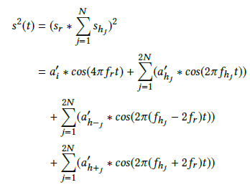
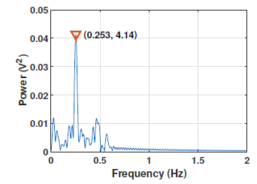
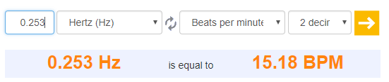
VitalMon
Monitoring respiratory rate using geophone
  First, measure environmental noise
    Empty bed in the lab -> majority of the noise is above 11Hz
    Single subject is lying on the bed -> FFT results of target signal are below 15 Hz
    Therefore, they set cutoff frequency at 10 Hz
  Perform amplitude demodulation by multiplying the geophone signal with itself (squaring)
    - Simply set both signals’ phases to be 0

Slide 11
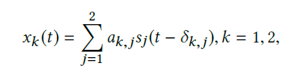
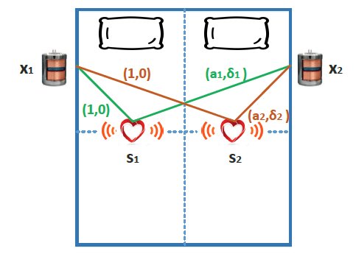
VitalMon
Monitoring target heart rate when multiple subjects are present
  First formulate the heartbeat separation problem by formally defining the mixed signal
  Suppose that they are 2 signal sources s1 and s2, with signals s1(t) and s2(t)
  Also there are 2 geophone receivers x1 and x2, which receive mixed signals x1(t) and x2(t)
  There is no prior knowledge of the true signal attenuation and delay
    Rely on relative signal attenuation and delay
    x1(t) as reference signal (with a1,1 = a1,2 = 1 and δ1,1 = δ1,2 = 0)
where ak, j and δk, j are the attenuation coefficients and time delay
parameters associated with the path from sj to xk

Slide 12
VitalMon
Monitoring target heart rate when multiple subjects are present
  Blind Source Separation and the DUET Algorithm
    Their problem is similar to the cocktail party problem
      DUET has proven to be a good solution to the cocktail party problem
        It computes the symmetric attenuation and relative delay of the signals
        Then calculates the energy histogram within different ranges of attenuation-delay values
        Finally identifies each energy peak as a signal source
  They choose to adopt DUET due to the similarity between audio signals and heartbeat signals
    Both have a fundamental frequency component and high frequency components (harmonics)
    They have no control of, nor a prior knowledge of them
    The paths between different sources and receivers have diversity, making it possible to establish spatial features for each source

Slide 13
VitalMon
Monitoring target heart rate when multiple subjects are present
  However, heartbeat signals have their own characteristics
    They have much narrower frequency ranges
    They have less frequency difference
  How!?

Slide 14
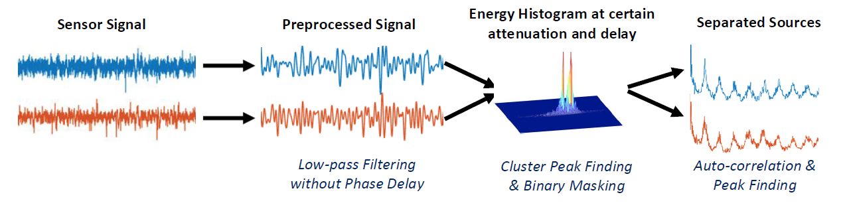
VitalMon
Monitoring target heart rate when multiple subjects are present
  Assume that there are two synchronized geophone receivers that continuously collect mixed signals
    They partition the signals into processing windows of equal length (40 seconds)
    Signal processing
      Filtering -> STFT -> Spatial Signatures -> Energy Clustering -> Binary Masking -> Heart Rate Estimation

Slide 15
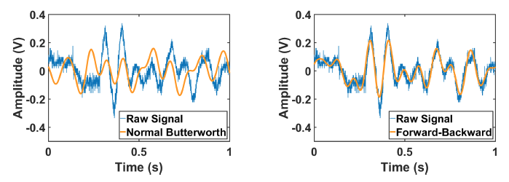
VitalMon
Low-pass filter: 정해진 cut-off 이하는 통과,
그 위는 감쇠시킴
Monitoring target heart rate when multiple subjects are present
  FFT and Low-pass Filtering for Noise Reduction
    Geohphone signals are highly noisy
      In their experiment, most of the noise is above 11 Hz while the target signals are mainly below 15 Hz
      A high-order Butterworth low-pass filter with cut-off frequency at 10 Hz
    DUET separates signal using their spatial sigantures
      They should make sure the filtering step does not cause any signal distortions
      Therefore, choose a forward-backward digital filtering
        Apply this filtering, the phase distortions caused by the two filters cancel out each other

Slide 16
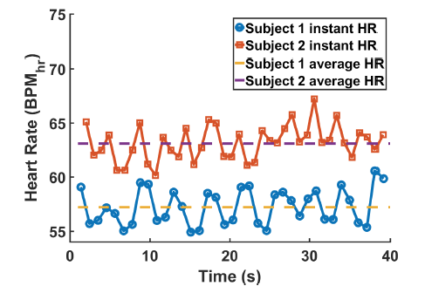

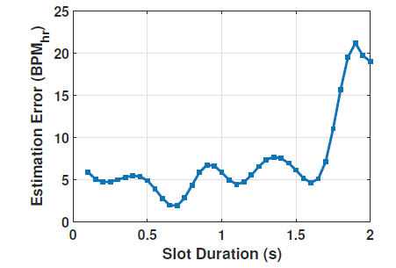
VitalMon
Monitoring target heart rate when multiple subjects are present
  Time-Frequency Representation for Locating Spatial Information
    Compared to audio, heartbeat signals do not have a stable frequency
      They have to partition the signals within a processing window of 40 seconds into smaller segments
    For any pair of signals that have the same length,
      s1(t) and s2(t) are W-disjoint orthogonal when they satisfy
    Heartbeat separation does not work at the same frequency
    >> First, they focus on the heartbeat signal’s high frequency components for
    more sparsity
    >> Also, they partition each processing window into much smaller slots

Slide 17
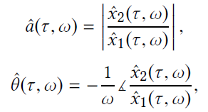

VitalMon
Monitoring target heart rate when multiple subjects are present
  Calculating Symmetric Attenuation and Relative Delay
    From the STFT results, the relative attenuation and relative delay are computed
    x^1(τ ,ω), x^2(τ ,ω) are the time-frequency representation from the STFT, ω is the frequency vector
    Symmetric attenuation yields higher resolutions when signals from the same source get different attenuation at different receivers -> further compute the estimated symmetric attenuation

Slide 18
VitalMon
Monitoring target heart rate when multiple subjects are present
  Calculating Symmetric Attenuation and Relative Delay
    Using symmetric attenuation and relative delay, compute the energy histogram
      By summing up the estimated energy in those frequency ranges
    Eventually cluster the frequencies that are from the same source!

Slide 19
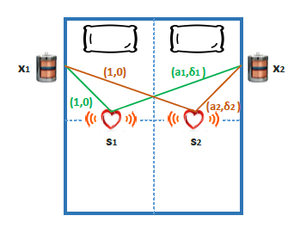


VitalMon
Monitoring target heart rate when multiple subjects are present
  Finding Cluster Peaks and Applying Binary Masking in 3D space
    However, symmetric attenuation and delay values from different sources overlap with each other
      Not use normal peak finding or machine learning algorithms (K-Means or CLIQUE)
BoB
Alice
Alice: Positive
BoB : Negative

Slide 20
VitalMon
Monitoring target heart rate when multiple subjects are present
  Estimating Target Heart Rate
    Inverse STFT
    Compute the signal power
    Calculate the sample auto-correlation function (ACF)
    Find peaks in the sample ACF results
    Convert the peak locations to corresponding heartbeat pulses

Slide 21
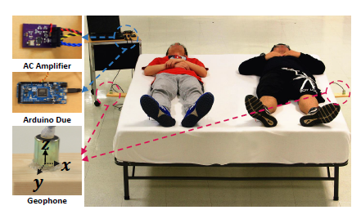
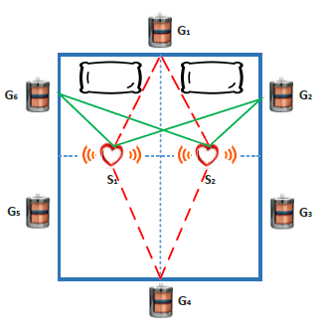

Testbed
The raw analog signal from each geophone is amplified (200)
Those signals are fed into a 12-bit analog-to-digital converter (ADC) on an Arduino Due
Choose vertical geophones (z – plane)

Slide 22
Evaluation
Estimating the respiratory rate for a single subject
Estimating the target subject’s heart rate when two subjects are present
Estimating the target subject’s respiratory rate when two subjects are present
Real world deployment

Slide 23
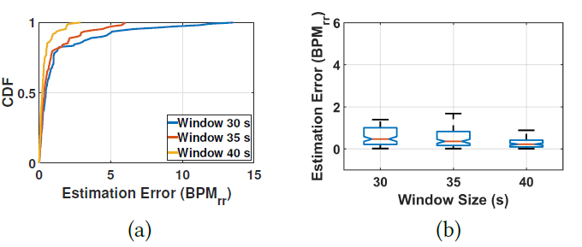
Evaluation
Estimating the respiratory rate for a single subject
  Conducted 525 experiments
  Recorded more than 350 minutes data
  From a total of 23 subjects
    14 males and 9 females
    Mean age is 25.14 with a standard deviation of 3.42 (21 ~ 34 years old)
  Report error between estimated and the ground truth
Mean error of 0.38 BPMrr, and
median error of 0.22 BPMrr in
window size 40 seconds
(others: 0.47 and above 2 BPMrr)

Slide 24


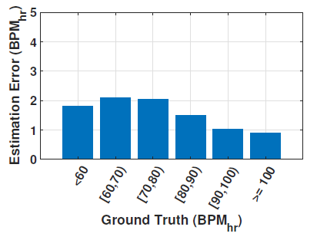
Evaluation
Estimating the target subject’s heart rate when two subjects are present
  Conducted over 3000 experiments
  Recorded more than 33 hours of geophone data
  From a total of 35 subjects
    19 males and 16 females
    Mean age is 25.26 with a standard deviation of 3.25 (21 ~ 35 years old)
  Report error between estimated and the ground truth
  One of the two subjects exercised before experiments
The median and the mean of overall estimation error over more than 4000 samples is 0.72 and 1.90 BPMhr , and it is as accurate as finding the heartbeats for single persons in others
(e.g. mean error of 1.17 BPMhr and 2 BPMhr)

Slide 25
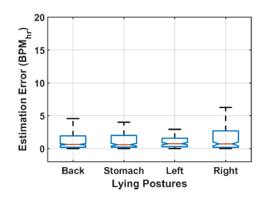
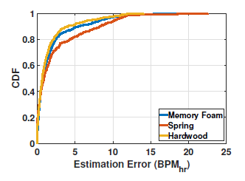
Evaluation
Estimating the target subject’s heart rate when two subjects are present
  The impact of lying position (1203 experiments)
    The mean estimation error is 1.75, 1.62, 2.17, and 2.47 BPMhr
    The median error is 0.61, 0.57, 0.73, and 0.70 BPMhr
  The impact of different mattress type (901 experiments)
    Memory foam, spring, and hardwood
    The mean estimation error is 1.85, 2.44, and 1.53 BPMhr
    The median error is 0.73, 0.88, and 0.66 BPMhr

Slide 26
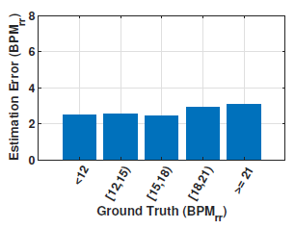
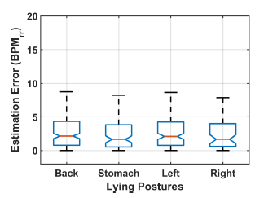
Evaluation
Overall mean estimation error across more than 3000 samples is 2.62 BPMrr, while the median error is 1.95 BPMrr
Estimating the target subject’s respiratory rate when two subjects are present
  Conducted 1503 experiments
  Recorded more than 16 hours of data
  Did not give any instructions on how the subjects should breathe
  A total of 28 healthy volunteer
  Some subjects were asked to exercise before experiments
The average estimation error for these different postures (lying on back/stomach/left/right) is 2.77, 2.36, 2.68, and 2.40 BPMrr, while the median error is 2.15, 1.66, 2.09, and 1.67 BPMrr

Slide 27
Evaluation
Real world deployment
  Their system can monitor heart rate and respiratory rate for one or two people on a bed
    Also detect a user’s gross body motions or smaller activities such as snores during sleep
  They could build a more sophisticated sleep monitoring system
    That can accurately detect a person’s sleep stage and evaluate the sleep quality

Slide 28
Conclusion
In this paper, they proposed VitalMon
  Centers around a geophone sensor that can sense the vibration velocity cause by ballistic force
  It can monitor the subject’s breathing rate, even though geophones cannot directly detect breathing
  It can track the subject’s heart rate and breathing rate when he/she shares the bed with another person
In the evaluation, involving 86 participants and collecting 56 hours of geophone data
  Show that their system is accurate and can work in different scenarios (e.g., lying postures, mattress types)

Slide 29
CRITIQUE
Pros
  가장 놀랐던 부분은 참신한 모델링
    호흡 측정 문제를 진폭 변조 문제로, 심장박동 신호 분리 문제를 칵테일 파티 문제로 모델링
  기존 연구의 단점을 많이 극복한 높은 정확도
  Robust 한 측정 설계
Cons
  가장 큰 문제는 사람 수 당 geophone 이 필요한 문제 및 현재까지는 최대 2명
    실제로 그런 경우는 드물..

Slide 30
Thank you
<seunghoonwoo@korea.ac.kr>

