Slide 1
Chapter 10
Error Detection and Correction
Redundancy: how many extra bits, arranged how, buys what
Forouzan, Data Communications and Networking, 5th ed., Chapter 10
10.1 Introduction, 10.2 block coding, 10.3 cyclic codes
10.4 Checksum, 10.5 forward error correction
Nine empty slides of the original deck filled from the textbook
Figures 10.11 to 10.14, 10.18, 10.19 recovered from the textbook

Slide 2
10.1-10.2
Errors and block codes
10.3
Cyclic codes
Single-bit vs. burst errors
Redundancy, detection vs. correction
Datawords, codewords, Hamming distance
Linear block codes, parity check
CRC: encoder, decoder, division
Polynomials and modulo-2 arithmetic
What a generator catches, and why
Hardware: shift registers and XOR
10.4-10.5
Checksum and FEC
Chapter 10
Where we are
Internet checksum, Fletcher, Adler
FEC: Hamming distance, XOR, interleaving, compounding
Chapter 9: the data-link layer delivers frames hop by hop
Chapter 10: how a receiver knows a frame arrived damaged
Chapter 11: what the link does about it, retransmit

Slide 3
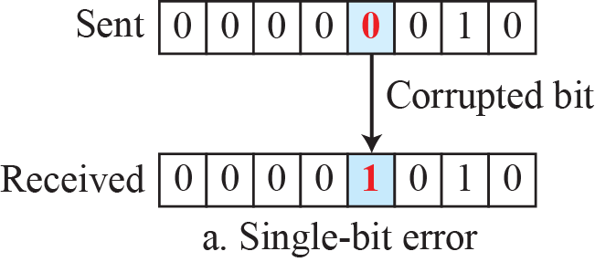
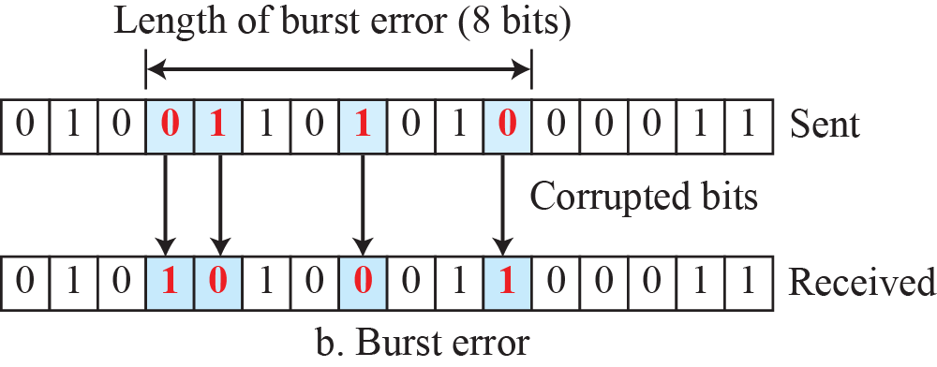
10.1.1
Types of errors
Figure 10.1
Single-bit and burst error
Interference changes the signal, so bits flip
Single-bit error: 1 bit of the unit changed, 0 to 1 or 1 to 0
original deck prints "0 to 10": typo
Burst error: 2 or more bits changed
length: first corrupted bit to last
Bursts are the common case: noise lasts longer than a bit
1 ms of noise at 10 kbps: 10 bits, at 10 Mbps: 10,000 bits
10.1.2
Redundancy
10.1.3
Detection vs. correction
10.1.4
Coding
Extra bits added by the sender, removed by the receiver
They let the receiver detect or correct errors
Detection: did any error occur? yes or no
Correction: how many bits, and where
Correction needs far more redundancy
Sender creates a relationship between data and redundant bits
Receiver checks that relationship
Judged by redundancy ratio and robustness

Slide 4
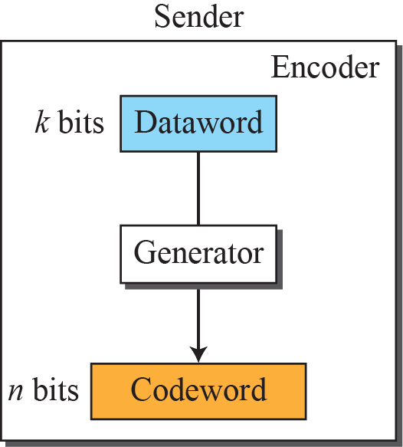
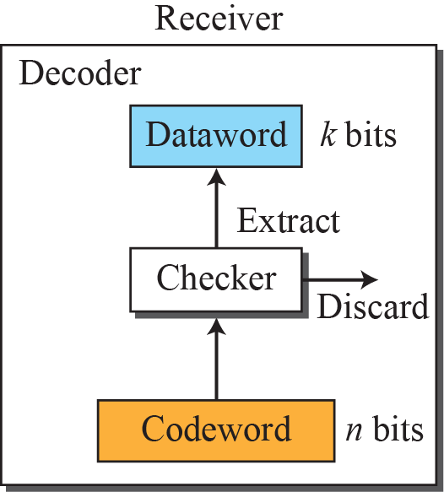

10-2
Block coding
10.2.1
Error detection
Message split into k-bit datawords
r redundant bits added: n = k + r codeword
2^{k} datawords, 2^{n} possible words
2^{n} - 2^{k} words are invalid: unused
Detected when two conditions hold
receiver has, or can compute, the list of valid codewords
the codeword changed into an invalid one
Valid-to-valid change: undetected
Figure 10.2
Process of error detection in block coding

Slide 5
Table 10.1
A code for error detection, k = 2, n = 3
Example 10.1
01 sent as 011
Dataword
Codeword
011 received: valid, dataword 01 extracted
111 received (leftmost bit flipped): invalid, discarded
000 received (right two bits flipped): valid
dataword 00 extracted, two errors undetected
00
000
01
011
10
101
11
110
Example 10.2
Two distances
10.2.1
Hamming distance
d(000, 011) = 2: 000 ⊕ 011 = 011
d(10101, 11110) = 3: 10101 ⊕ 11110 = 01011
d(x, y): number of positions where x and y differ
= number of 1s in x ⊕ y
Distance between sent and received = bits corrupted
d_{min}: smallest distance between any two codewords
10.2.1
d_{min} for detection
Detect up to s errors: d_{min} = s + 1
s errors cannot turn one codeword into another
More than s may be detected sometimes, s guaranteed

Slide 6
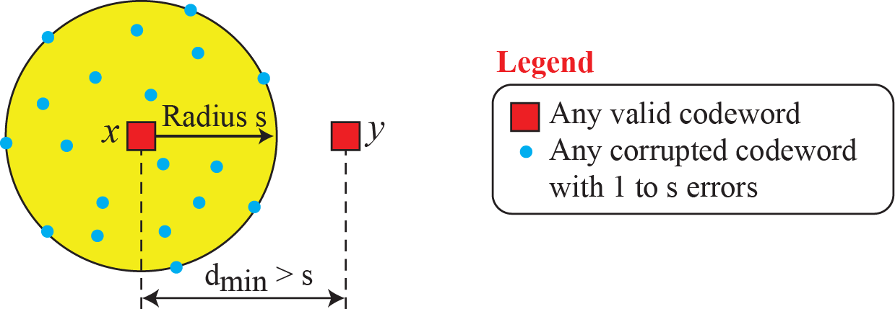
Figure 10.3
Geometric concept explaining d_{min} in error detection
Example 10.3
The k = 2 code
d_{min} = 2, so single errors detected
101 sent, one error: no match, detected
Two errors: may match another codeword
Example 10.4
d_{min} = 4
Detects up to 3 errors: s = d_{min} - 1
10.2.1
Linear block codes
Example 10.5
The k = 2 code is linear
XOR of two valid codewords is a valid codeword
Almost all block codes in use are linear
d_{min} = smallest number of 1s in a nonzero codeword
011 ⊕ 101 = 110, the fourth codeword
Example 10.6
Its d_{min}
Nonzero codewords have 2, 2, 2 ones: d_{min} = 2

Slide 7
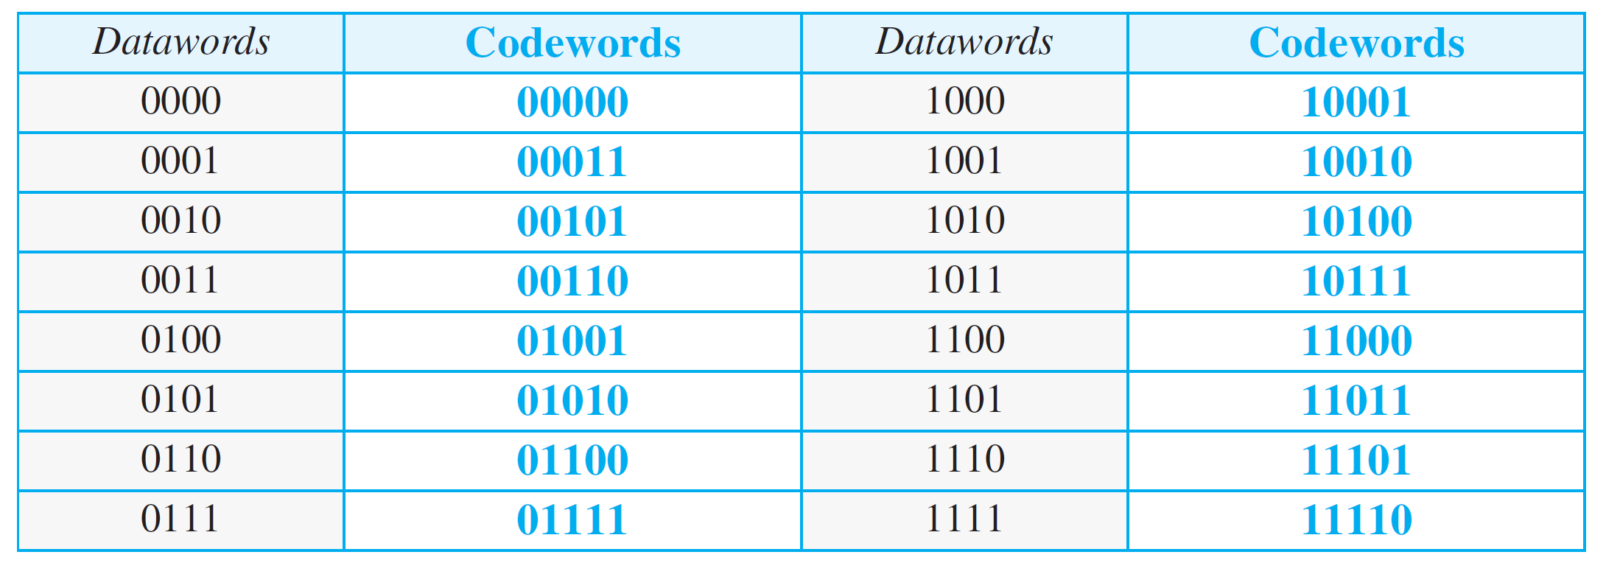
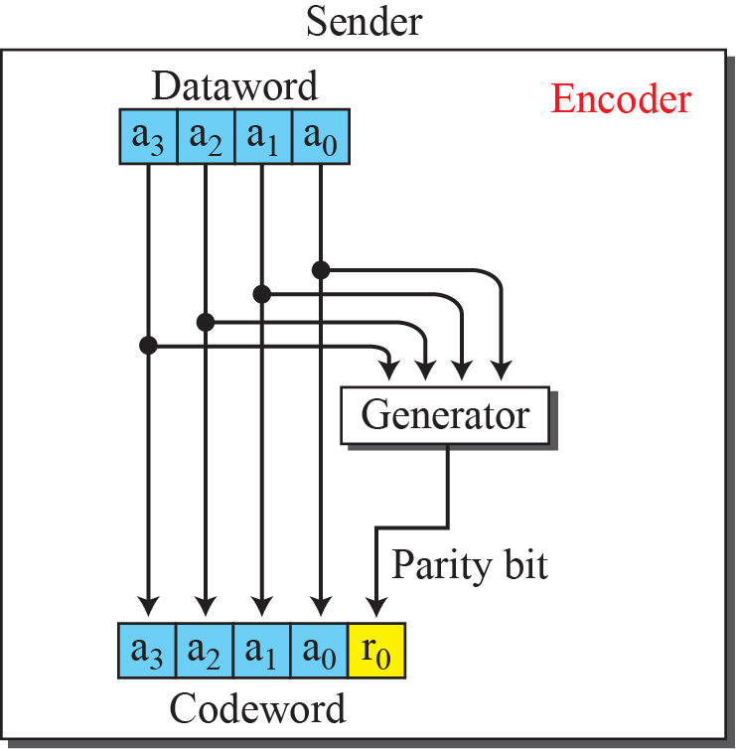
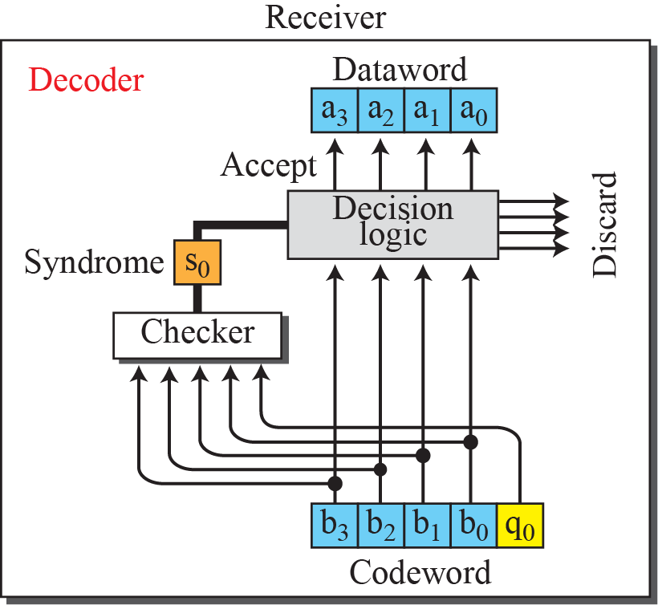
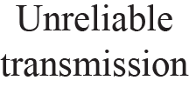
10.2.1
Simple parity-check code
Table 10.2
Simple parity-check code C(5, 4)
k-bit dataword, n = k + 1
Parity bit makes the number of 1s even
d_{min} = 2: detects any odd number of errors
Syndrome = XOR of all received bits, 0: accept, 1: discard
Example 10.7
Dataword 1011 sent as codeword 10111
No error: 10111, syndrome 0, dataword 1011
a₁ flipped: 10011, syndrome 1, discarded
r₀ flipped: 10110, syndrome 1, discarded
data bits intact, but the code cannot locate the error
r₀ and a₃ flipped: 00110, syndrome 0, wrong dataword 0011
even number of errors cancel
a₃, a₂, a₁ flipped: 01011, syndrome 1, discarded
any odd number of errors is detected
Original deck prints dataword 10110: it is 1011
Figure 10.4
Encoder and decoder for simple parity-check code

Slide 8
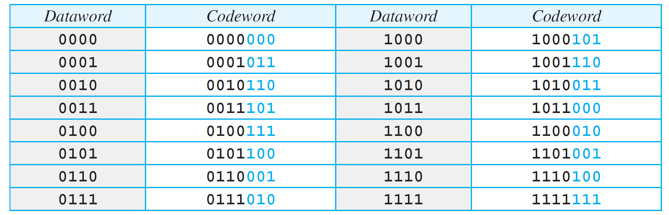
10-3
Cyclic codes
10.3.1
Cyclic redundancy check
Linear block codes with one more property
Cyclic shift of a codeword is a codeword
1011000 → left shift → 0110001
Subset of cyclic codes, used in LANs and WANs
Generator (divisor) agreed by both ends
Original deck: "a subset of. cyclic codes": typo
Table 10.3
A CRC code with C(7, 4)
10.3.1
Encoder and decoder
Encoder: append n - k zeros, divide by generator
remainder = check bits, replaces the zeros
Decoder: divide the received codeword
remainder = syndrome
all 0s: accept, otherwise discard
Division uses XOR, no borrows

Slide 9
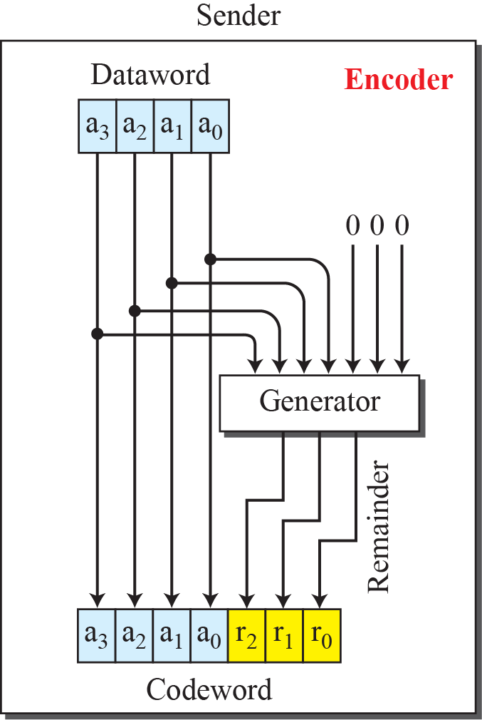
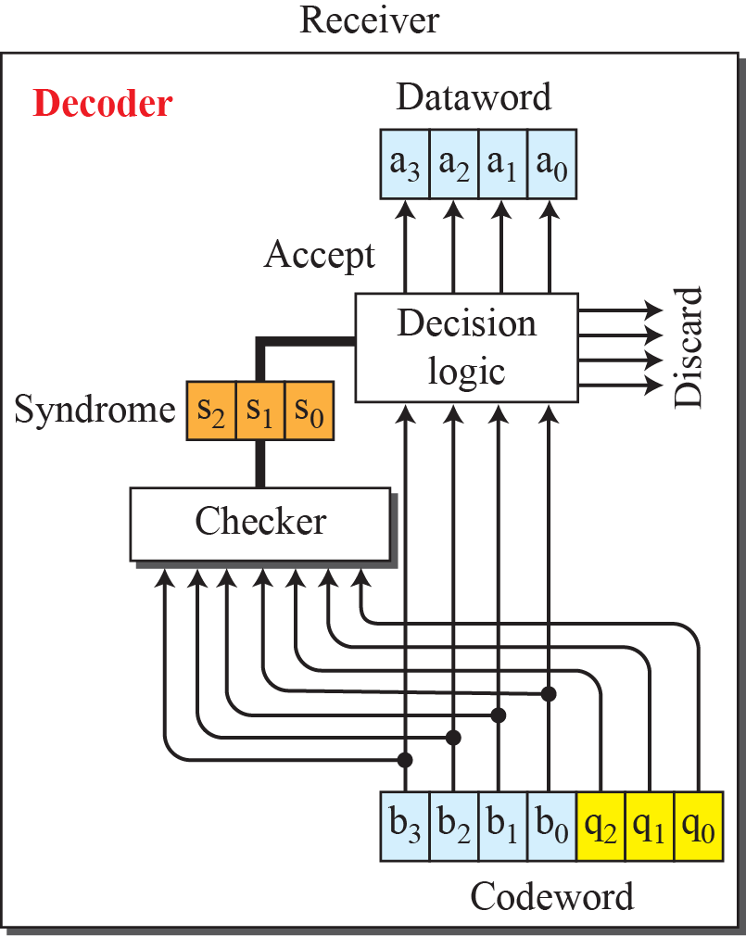
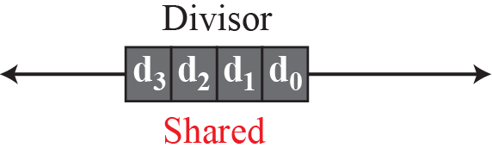
Figure 10.5
CRC encoder and decoder
10.3.1
Reading the figure
Dataword 4 bits, codeword 7 bits
Divisor 1011, 4 bits = n - k + 1
Generator and checker are the same divider

Slide 10
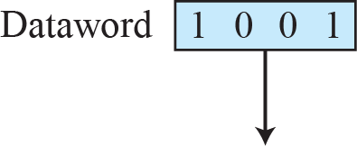
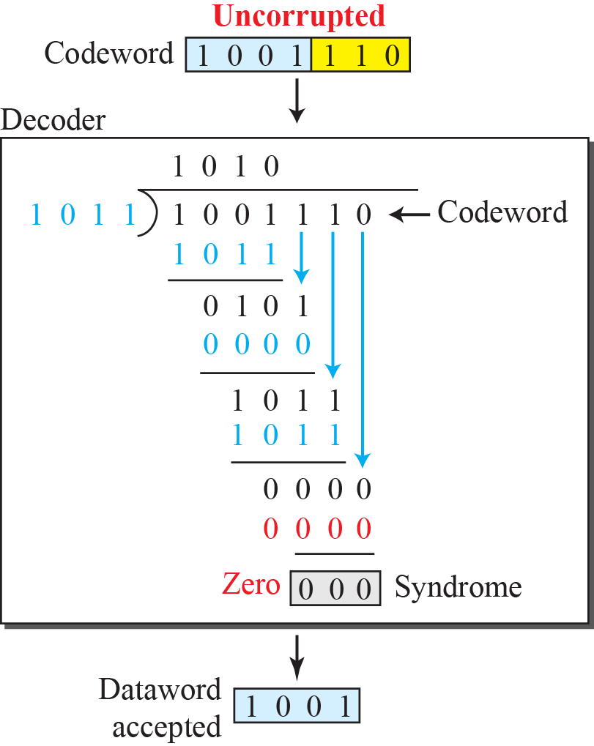
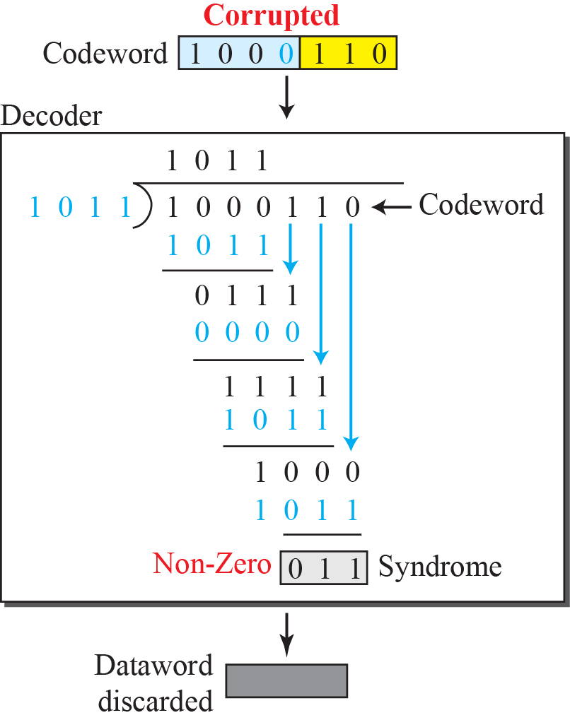
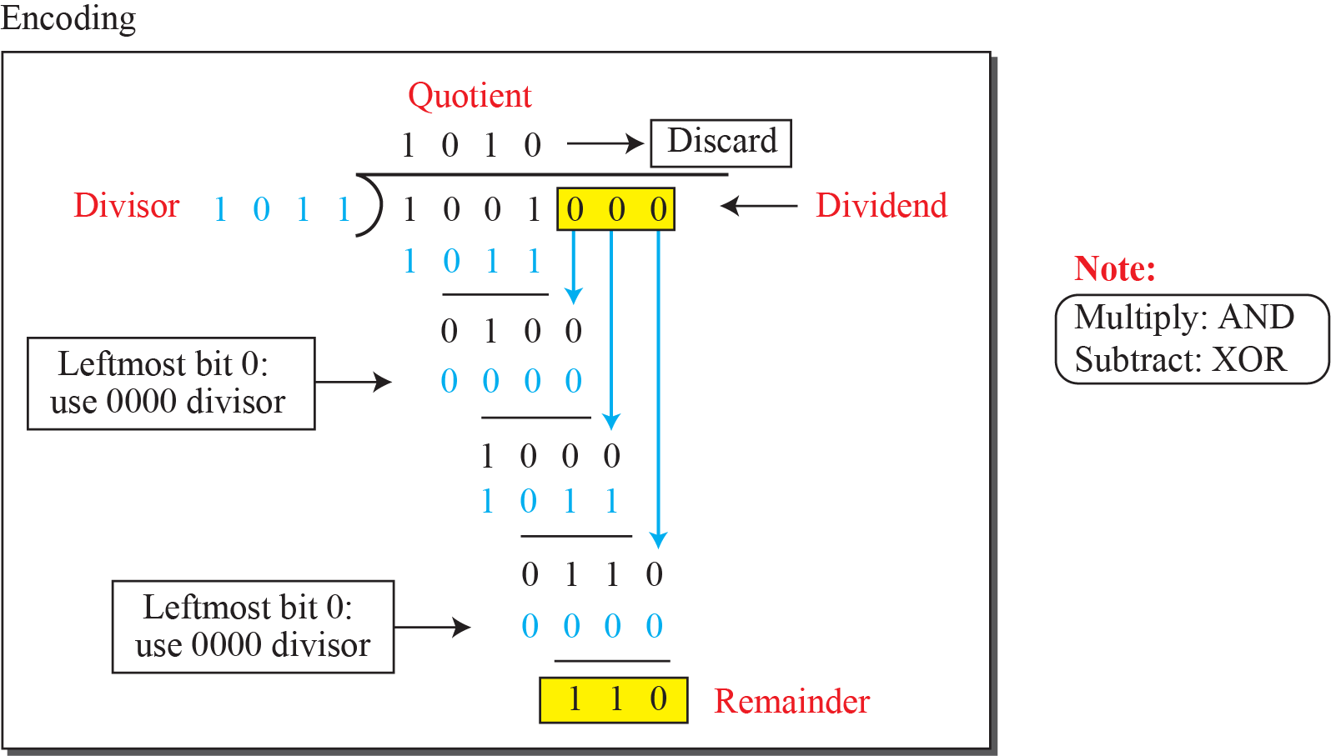
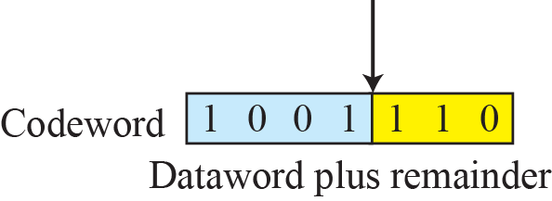
Figure 10.6
Division in CRC encoder
Figure 10.7
Division in the CRC decoder for two cases

Slide 11
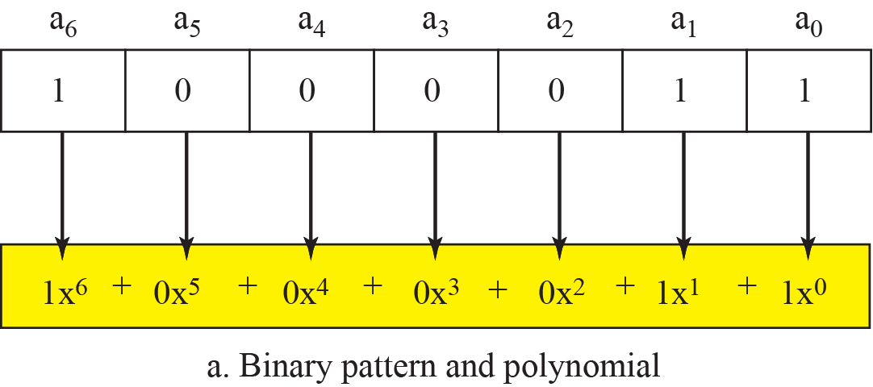
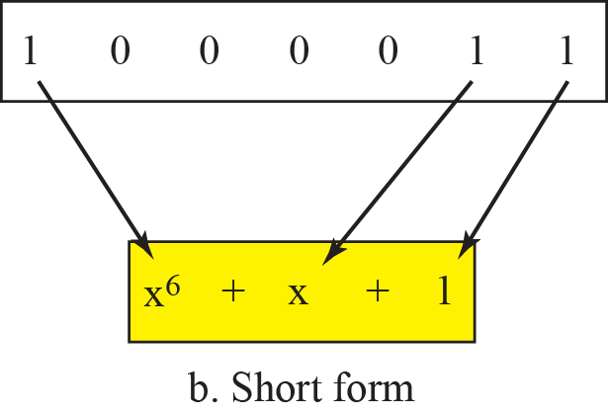
10.3.2
Polynomials
Figure 10.8
A polynomial to represent a binary word
Bit pattern ↔ polynomial, coefficients 0 or 1
Power = position, coefficient = bit
1000011 → x⁶ + x + 1
Degree = highest power = bits - 1
Original deck prints "coefficients of 0 and 10": 0 and 1

Slide 12
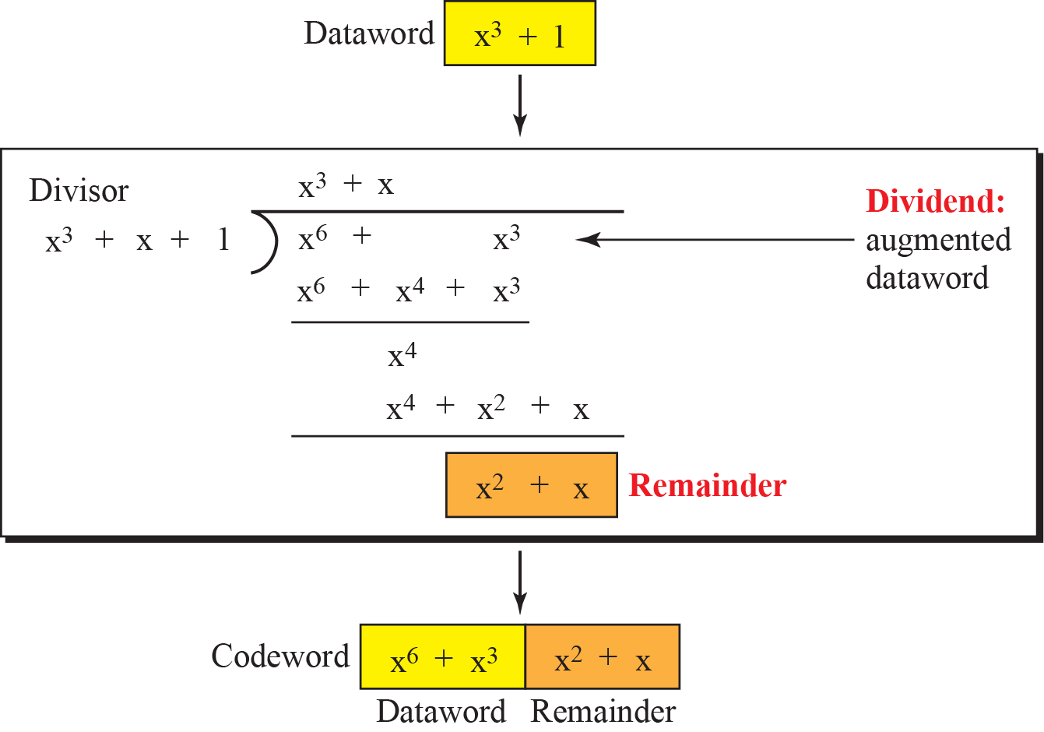
10.3.2
Modulo-2 arithmetic on polynomials
10.3.3
The 1001 / 1011 example in polynomial form
Add = subtract = XOR of coefficients, no carries
x^{i} + x^{i} = 0, identical terms cancel in pairs
(x⁵ + x⁴ + x²) + (x⁶ + x⁴ + x²) = x⁶ + x⁵
Multiply terms: add powers, x³ × x⁴ = x⁷
Shift left by m bits: multiply by x^{m}
Divide: long division, subtracting by XOR
Dataword 1001: d(x) = x³ + 1
Generator 1011: g(x) = x³ + x + 1, r = 3
Augment: x³ · d(x) = x⁶ + x³
Remainder of (x⁶ + x³) / g(x) = x² + x → 110
Codeword x⁶ + x³ + x² + x → 1001110
Figure 10.9
CRC division using polynomials
10.3.3
Shorter than binary
Same division as the binary 1001 / 1011 example
Only nonzero terms written
Original deck repeated three slides of 10.3.1 here: removed

Slide 13
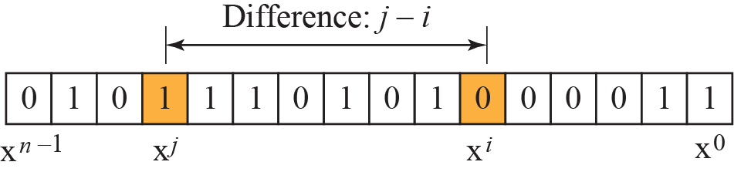
10.3.4
Cyclic code analysis
10.3.4
Single-bit error
d(x) dataword, c(x) codeword, g(x) generator
e(x) error, s(x) syndrome
Received: c(x) + e(x)
Syndrome = remainder of [c(x) + e(x)] / g(x)
c(x) divides exactly, so s(x) = remainder of e(x) / g(x)
s(x) ≠ 0: one or more bits corrupted
s(x) = 0: no error, or e(x) divisible by g(x)
Errors divisible by g(x) are not caught
e(x) = x^{i}
g(x) with at least two terms and x⁰ term 1 cannot divide x^{i}
Such a generator catches every single-bit error
Example 10.8
Single-bit errors
x + 1: no x^{i} divisible, all caught
x³: x^{i} divisible for i ≥ 3, only errors in the 3 rightmost positions caught
1: divides everything, nothing caught, and no check bits at all
Figure 10.10
Two isolated single-bit errors
10.3.4
Two isolated single-bit errors
e(x) = x^{j} + x^{i} = x^{i} (x^{j-i} + 1)
x^{i} is never divisible, so g(x) must not divide x^{t} + 1
t from 2 to n - 1

Slide 14
Example 10.9
Four generators
10.3.4
Odd number of errors
x + 1: poor, two adjacent errors not caught
x⁴ + 1: errors 4 positions apart not caught
x⁷ + x⁶ + 1: good
x¹⁵ + x¹⁴ + 1: catches isolated pairs up to 32,768 bits apart
Original deck lists only the first two in the question
A factor x + 1 in g(x) catches every odd number of errors
Proof
odd number of terms: e(1) = 1
(x + 1) | g(x) and g(x) | e(x) would give e(1) = 0
contradiction, so the error is detected
Factor, not the whole generator: x + 1 alone misses adjacent pairs
10.3.4
Burst errors
Example 10.10
Three generators and bursts
e(x) = x^{i} (x^{j-i} + ... + 1), length L = j - i + 1
r check bits
L ≤ r: always detected
L = r + 1: undetected with probability (1/2)^{r-1}
L > r + 1: undetected with probability (1/2)^{r}
g(x) = x¹⁴ + x³ + 1
L = 15: 1 in 8192, book says almost 1 in 10,000
L > 15: 1 in 16,384
x⁶ + 1: all L ≤ 6, 3 in 100 at L = 7, 16 in 1000 at L ≥ 8
x¹⁸ + x⁷ + x + 1: all L ≤ 18, 8 per million at 19, 4 per million at 20+
x³² + x²³ + x⁷ + 1: all L ≤ 32, 5 in 10 billion at 33
2 in 10 billion at 34+, book rounds to 3
Missing from the original deck

Slide 15
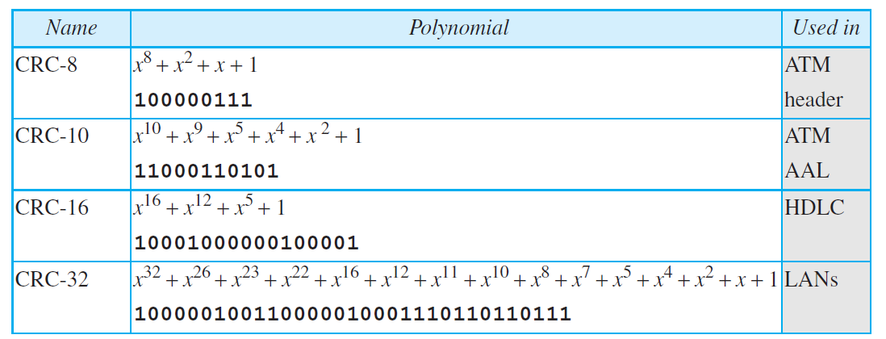
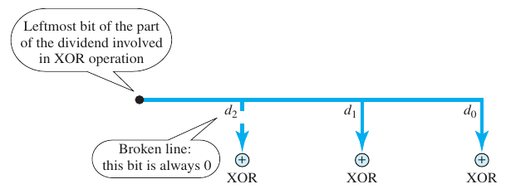
10.3.4
A good generator
Table 10.4
Standard polynomials
At least two terms
x⁰ coefficient 1
Does not divide x^{t} + 1 for t = 2 to n - 1
Has the factor x + 1
10.3.7
Hardware implementation, missing from the deck
Figure 10.11
Hardwired design of the divisor in CRC
Divisor bits fixed: either the generator or all 0s
Leftmost bit of each step decides which
Only n - k bits of the divisor are used: hardwire them
Remainder held in n - k registers

Slide 16
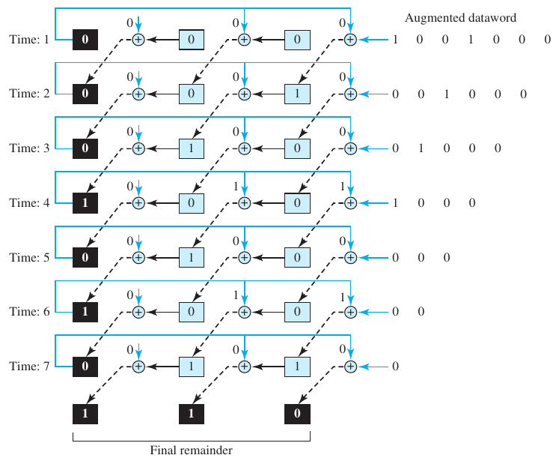

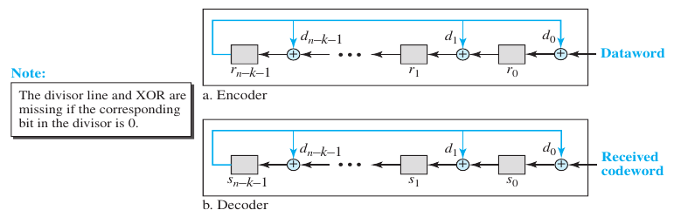
Figure 10.12
Simulation of division in CRC encoder
10.3.7
From simulation to circuit
Each clock: shift one bit of the augmented dataword in
After 7 clocks the registers hold the remainder, 110
Only the final values matter: drop the intermediate copies
Figure 10.13
CRC encoder design using shift registers
Figure 10.14
General design of encoder and decoder of a CRC code
10.3.7
General design
n - k one-bit shift registers
XOR only where the generator has a 1
Same circuit checks at the receiver
Cost: n - k extra clocks before check bits are ready

Slide 17
Today
Where parity, CRC and checksums are used now
Code
Used in
Note
Parity bit
UART characters, RAID 5 (XOR across disks)
ECC memory moved on to SECDED Hamming codes
CRC-32 (IEEE 802.3)
Ethernet and Wi-Fi frame check sequence, ZIP, PNG
the CRC-32 of the standard list
CRC-32C (Castagnoli)
SCTP, iSCSI, file-system metadata
SCTP replaced its Adler-32 with it
CRC-24A/B/C, 16, 11, 6
5G NR transport blocks, code blocks, DCI, UCI
chosen by block size and channel
CRC-16-CCITT
HDLC, many serial links
x¹⁶ + x¹² + x⁵ + 1
Internet checksum
IPv4 header, TCP, UDP
16-bit one's complement, Section 10.4
Fletcher, Adler
ZFS (Fletcher-4), zlib (Adler-32)
position-weighted sums, Section 10.4.2
IPv6 dropped the header checksum: link-layer CRC below and transport checksum above already cover it
10.3.5
Advantages of cyclic codes
10.3.6
Other cyclic codes, missing from the deck
Strong on single, double, odd and burst errors
Simple in hardware and software, fastest in hardware
Stronger codes from Galois-field algebra
Reed-Solomon: detection and correction, in wide use today

Slide 18
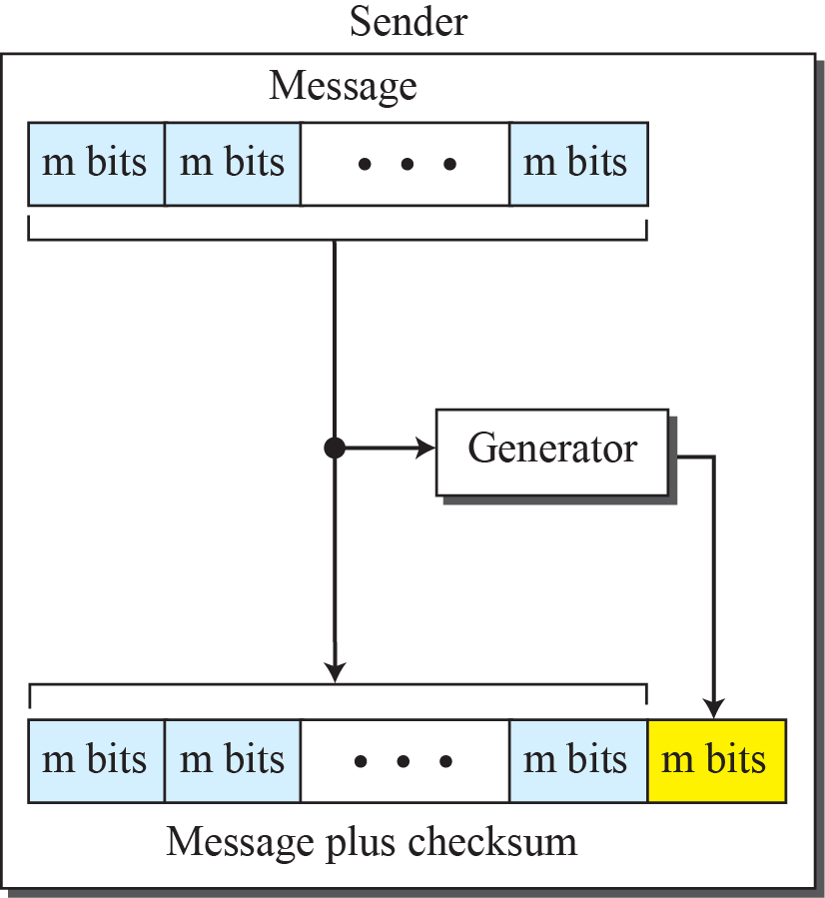
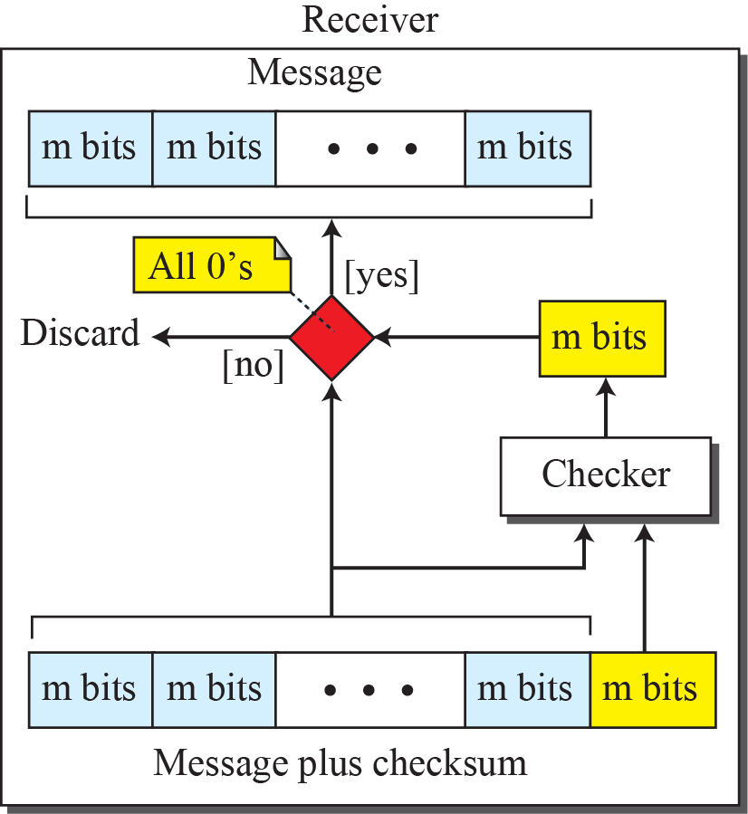
10-4
Checksum
Figure 10.15
Checksum
Works on a message of any length
Internet: network and transport layers, not data link
Sender: sum of data items, sent along
Receiver: recompute and compare

Slide 19
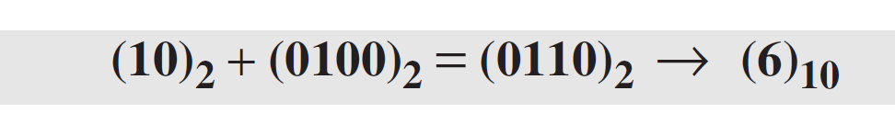
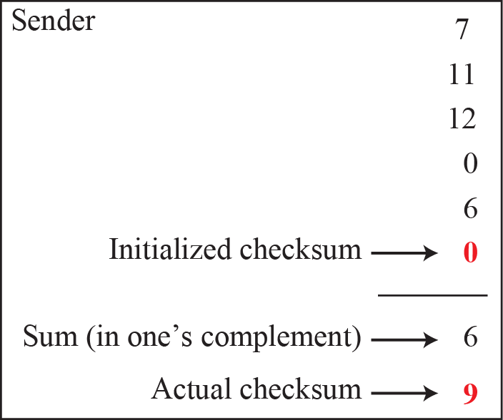
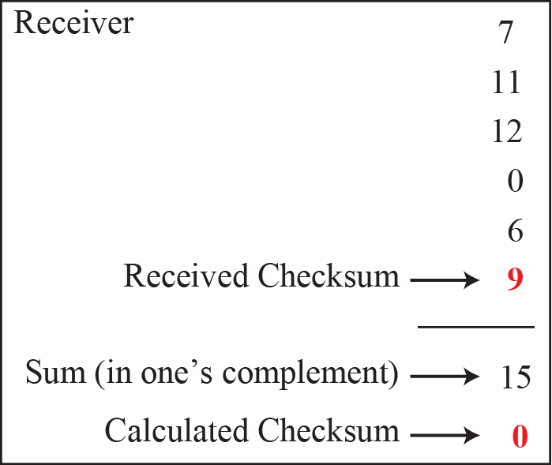
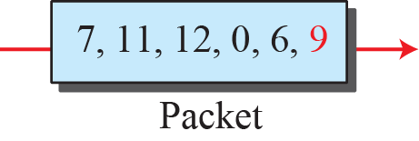
Example 10.11
Plain sum
Example 10.12
One's complement wrap
Numbers 7, 11, 12, 0, 6: send sum 36 as well
Receiver adds, compares with 36
36 = 100100 needs 6 bits
Wrap the extra bits: 0100 + 10 = 0110 = 6
Example 10.13
Complemented sum
Figure 10.16
Example 10.13
Sender: one's complement sum 6, complement → checksum 9
6 = 0110, 9 = 1001
Send 7, 11, 12, 0, 6, 9
Receiver: sum all six = 15 = 1111, complement = 0 → accept

Slide 20
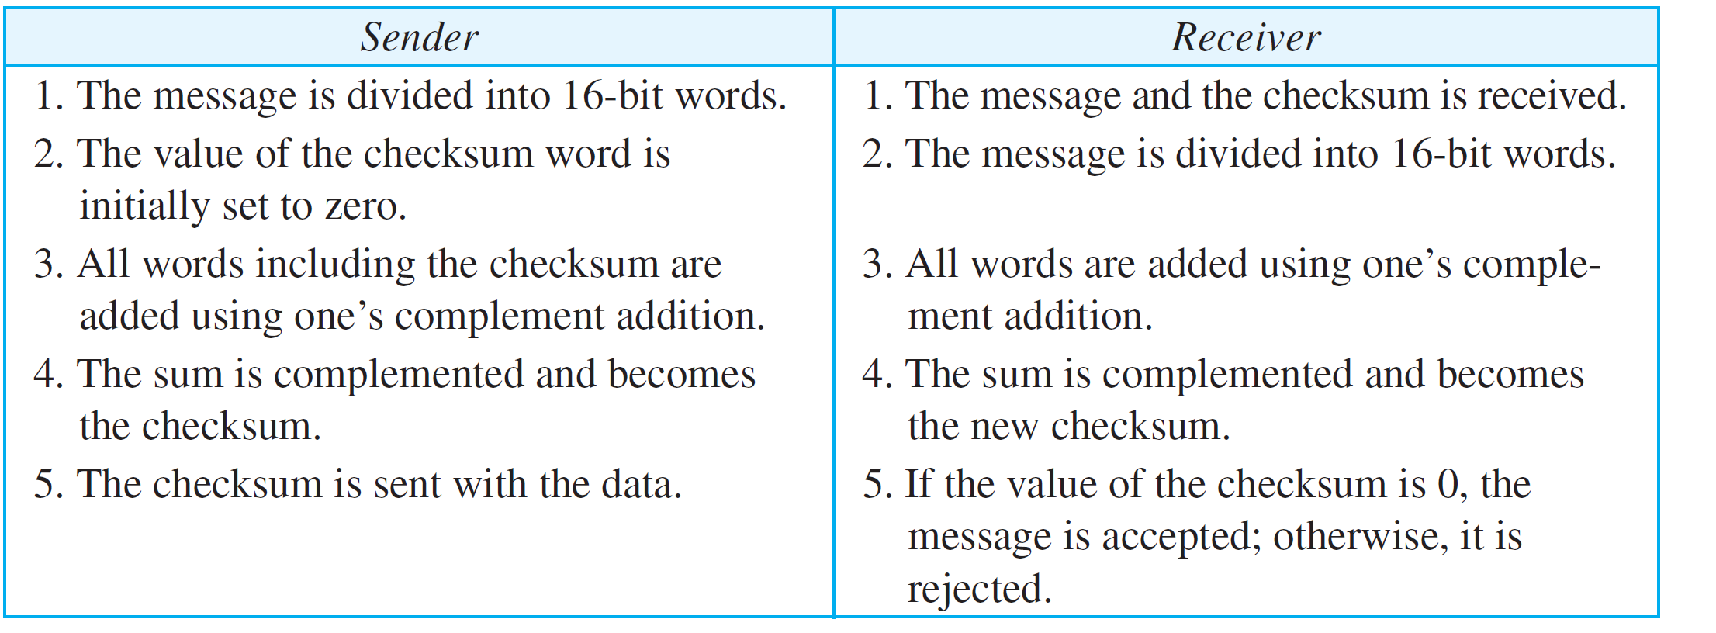
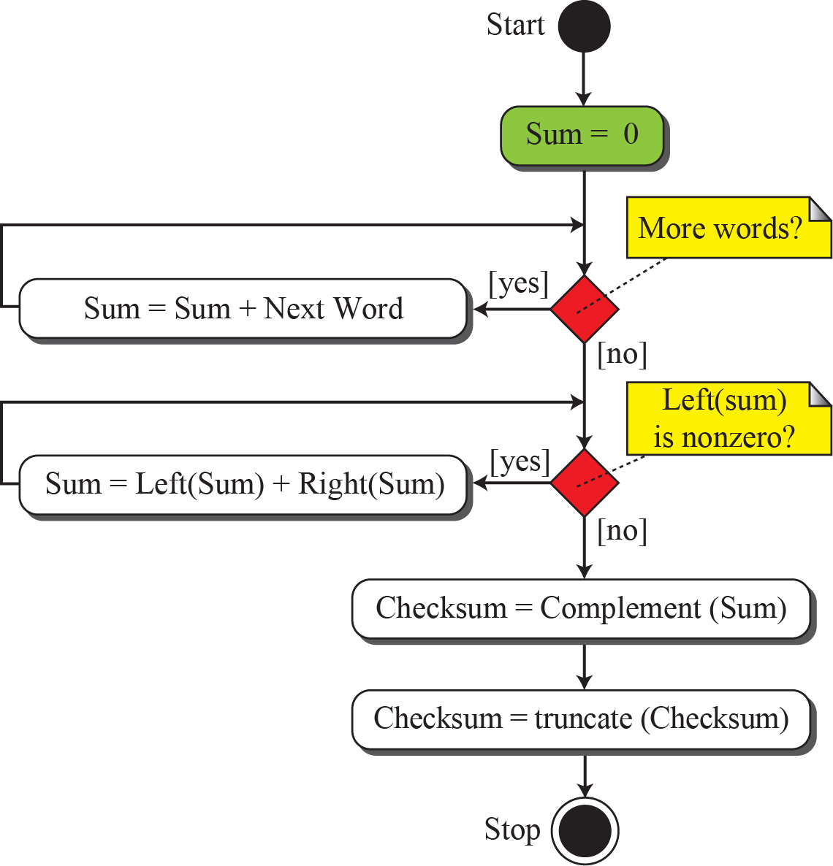
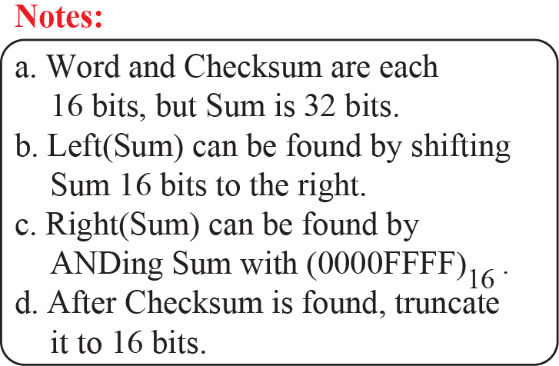
Table 10.5
Procedure to calculate the traditional checksum
Figure 10.17
Algorithm to calculate a traditional checksum
10.4.2
Weakness of the traditional checksum
10.4.2
Fletcher, missing from the deck
Not weighted: order of items does not matter
Two 16-bit items swapped: not detected
One item up by n, another down by n: not detected
Book: new Internet protocols move to CRC
Two accumulators: R adds data, L adds R
L weights each item by its position
8-bit Fletcher: bytes, mod 256, 16-bit result
RFC 1146 uses mod 255: the book shows a variant
16-bit Fletcher: 16-bit items, 32-bit result

Slide 21
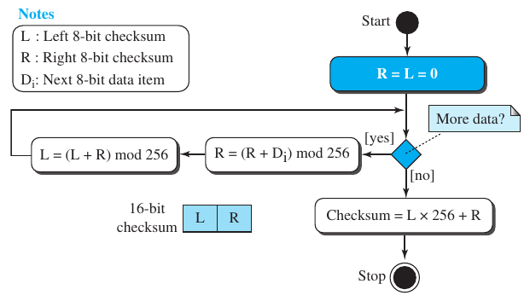
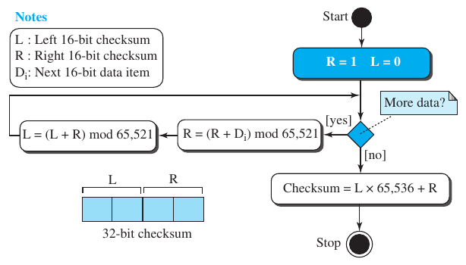
Figure 10.18
8-bit Fletcher checksum
Figure 10.19
Adler checksum
10.4.2
Adler, missing from the deck
Like 16-bit Fletcher, but bytes, mod 65,521 (a prime), running sum starts at 1
Book text says L starts at 1: the figure (R = 1) is right, as in RFC 1950
Figure note says 16-bit data items: Adler takes one byte at a time

Slide 22
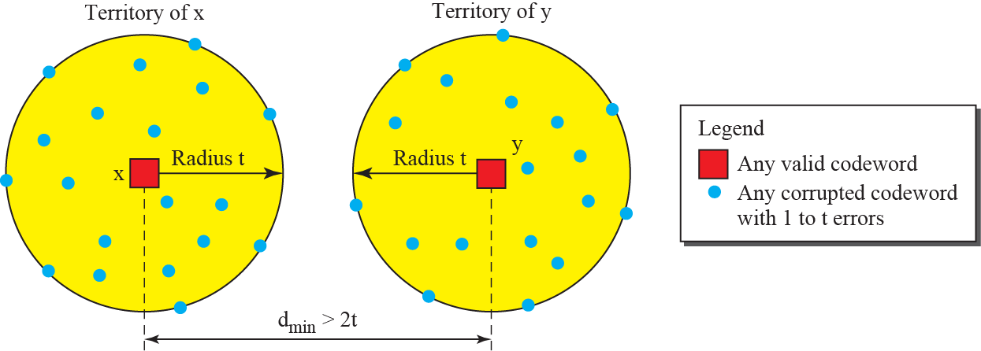


10-5
Forward error correction
10.5.1
Using Hamming distance
Retransmission adds delay: useless for real-time media
Correct or rebuild the packet at once
Detect s errors: d_{min} = s + 1
Correct t errors: d_{min} = 2t + 1
book and deck say detect, and error detection: both should be correction
Correct 10 bits: d_{min} = 21, heavy redundancy
BCH: 99 data bits in 255 to correct 23 errors
Figure 10.20
Hamming distance for error correction
10.5.2
Using XOR
R = XOR of N packets, sent as packet N + 1
Any one lost packet = XOR of R and the others
Overhead 1/N

Slide 23
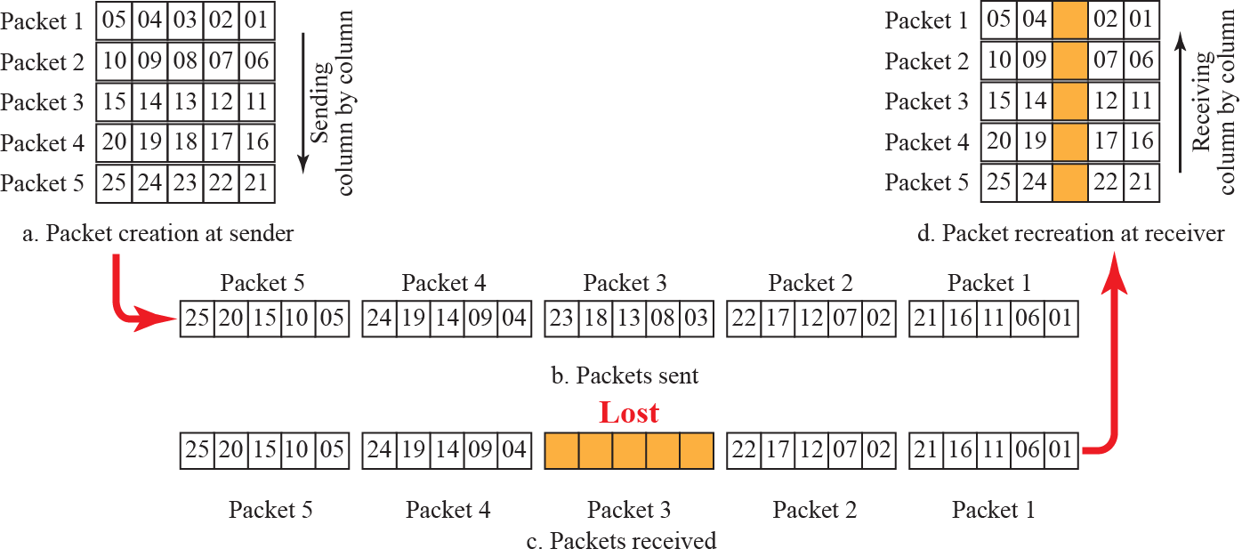
10.5.3
Chunk interleaving
Figure 10.21
Interleaving
Lose one chunk per packet, not a whole packet
Split packets into chunks, send chunk i of every packet together
One lost transmission costs each packet one chunk
10.5.4
Combining
10.5.5
Compounding
n-bit packets that each correct t errors
Interleave m rows, send column by column
Corrects bursts up to m × t bits
Low-resolution copy of each packet
Piggybacked on the next packet
Lost packet replaced by its lower-quality copy

Slide 24
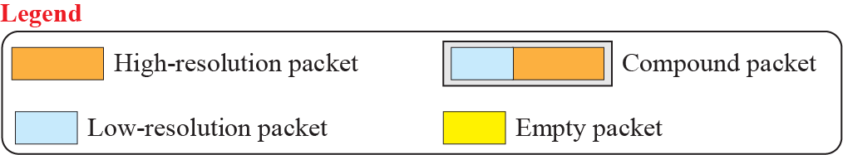
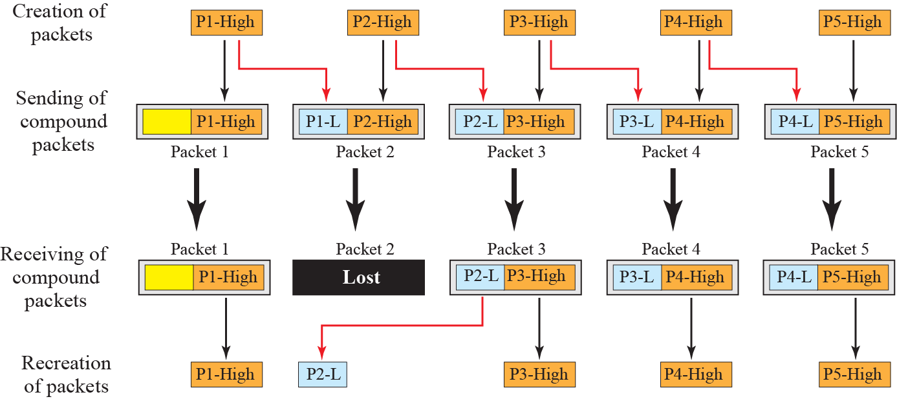
Figure 10.22
Compounding high- and low-resolution packets

Slide 25
Today
Forward error correction in use now
Code
Used in
Note
Hamming (SECDED)
ECC memory
corrects 1, detects 2 errors per word
Reed-Solomon
QR codes, CD and DVD, RAID 6, 100G and 400G Ethernet (RS 544,514)
corrects byte bursts
Convolutional
GSM, 802.11a/g, LTE control
Viterbi decoding
Turbo
3G and LTE data channels
near the Shannon limit
LDPC
5G NR data channels, Wi-Fi 802.11n onward, DVB-S2, 10GBASE-T
near the Shannon limit, parallel decoding
Polar
5G NR control channels
first codes proven to reach capacity
XOR, RaptorQ
WebRTC FlexFEC, broadcast file delivery
Section 10.5.2 grown up
HARQ in LTE and NR combines both halves of this chapter: FEC first, CRC to check, retransmission only when the CRC fails
EXPLORE
Codes in practice
Try it: divide 1001000 by 1011 by hand, then check a CRC-32 with Python zlib.crc32 on a byte string
Try it: flip two adjacent bytes of a file and compare its Internet checksum and CRC-32

Slide 26
Errata
Corrections to the printed slides and textbook
Where
Printed
Corrected
Deck 10.1.1, 10.3.2
0 to 10, coefficients 0 and 10
0 to 1, coefficients 0 and 1
Nine deck slides
title only, no content
filled from the textbook
Deck slides 37 to 39
repeat slides 30 to 32
removed
Example 10.9 question
two generators
four, matching the solution
Deck Example 10.7
dataword 10110
1011, k = 4
Book 10.5.1
error detection, to detect t errors
error correction, to correct t errors
Book Adler text
L initialized to 1
running sum R starts at 1, as in the figure
Book Figure 10.19
16-bit data items
one byte at a time
Book burst figures
1 in 10,000; 3 in 10 billion
1 in 8192; about 2 in 10 billion
Deck coverage
10.3.6, 10.3.7, 10.4.2 missing
added with Figures 10.11 to 10.14, 10.18, 10.19

