Slide 1
Ditio: Trustworthy Auditing of
Sensor Activities in Mobile & IoT Devices
Sensys 2017
Saeed Mirzamohammadi, Justin A. Chen, Ardalan Amiri Sani,
Sharad Mehrotra, Gene Tsudik
Hajin Jang
Sep 18, 2018

Slide 2
Motivation
Mobile and IoT devices comes with various sensors
Internet connected wall-mount camera
AI speaker which can recognize speech
Smartphone with GPS

Slide 3
Motivation
Sensitive private information can be captured by sensors
What if Amazon Echo record conversation from confidential meeting?
What if webcam send recordings to third-party server without permission?

Slide 4
Motivation
Private information leak is happening in real world!
Xiaomi Redmi 1S
  Sent sensitive information to China without permission
  IMEI Number, Contacts, Text Messages
Amazon Echo
  Recorded private conversation and sent to random contact
Notes:
(논문에 없지만 추가로 조사한 내용)
출처
샤오미
https://www.linkedin.com/pulse/xiaomi-phohnes-secretly-sending-users-sensitive-data-nasibov-mscm
https://www.f-secure.com/weblog/archives/00002731.html
아마존 에코
https://www.cnbc.com/2018/05/24/amazon-echo-recorded-conversation-sent-to-random-person-report.html
https://www.kiro7.com/www.kiro7.com/news/local/woman-says-her-amazon-device-recorded-private-conversation-sent-it-out-to-random-contact/755507974

Slide 5
Problems
Some scenarios require restriction of sensor activity for privacy reasons
Device must provide assurance about the use or non-use of sensors
Assurance for the owner
  Ex) Home assistants should be turned of when owner wants it.
Assurance for a third party
  Ex) In confidential meeting, all participant’s recording is prohibited.

Slide 6
Problems
Current Practices : Ad-Hoc
1. Unplug device physically
  Cut off power of AI speaker
  “Turn off all your cellphones before meeting!”
2. Request to device
  Press microphone disable button
  “Alexa, do not record nor response to conversation until 6:00 PM.”
No systematic and secure way to achieve this
Hard or inconvenient to enforce in real world

Slide 7
Problems
Limitations
Too restrictive
  Requires physical involvement
No guarantee
  Compromised device can ignore user’s request

Slide 8
Approach
Authors present Ditio, a system for auditing sensor activities
Designed for mobile and IoT devices
Generic enough to be device-agnostic
  Supports many sensor brands
  Supports different use cases
Comes with companion tool for auditing
  Formally verified companion tool

Slide 9
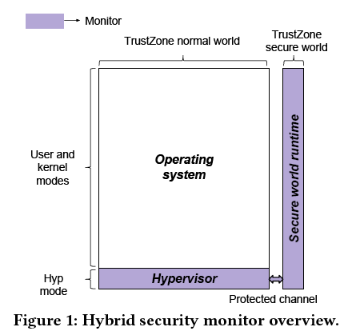
Approach
Key Component: Hybrid Security Monitor
Hypervisor
  Read sensor’s register information without modifying OS
TrustZone
  Seal logs to keep integrity, authenticity, and confidentiality
Small Trusted Computing Base
Notes:
많은 ARM 프로세서들이 이 두 요소를 지원하고 있습니다.
Google Home은 Cortex A7을 쓰는데, 2013년에 제작되었지만 둘 다 지원함. -> 고로 IoT 기기들에 이거 적용할 때 로우 엔드 CPU로 인해 발생하는 문제는 적을 것.
구형 기기 또는 하이버파이저/TrustZone에 접근 권한이 없는 기기를 위해 OS 커널을 변경해서 사용할 수도 있는데, 이건 TCB가 커져서 비추.

Slide 10
Approach
Terms
Sensor activity
  the use or non-use (state) of sensors
Client
  the device containing the sensor of interest
Trusted Computing Base (TCB)
  The set of all HW, FW, SW of a system critical to its security
Notes:
TCB는 작을수록 좋습니다

Slide 11
Approach
Main Idea
Sensor activities are logged to client from on-demand of owner
Auditor later audits client’s log and detect violation of policy
Owner != Auditor
Notes:
TCB는 작을수록 좋습니다

Slide 12
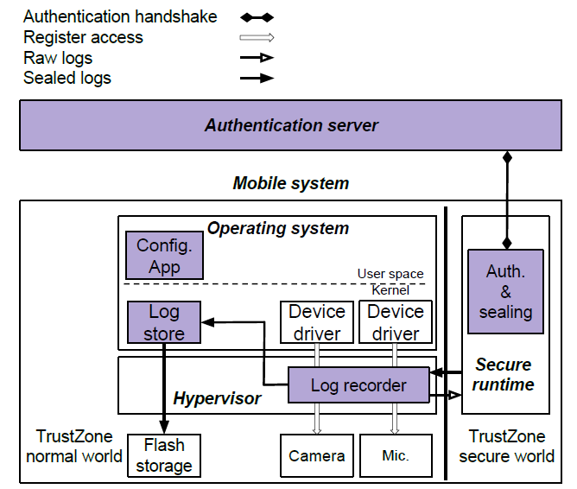
Design of Ditio
Trusted Log Recorder
  Record access to sensor registers
Trusted Authentication and Sealing Facilities
  (Sealing) Encrypt logs and append HMAC
  (Auth) Share session key with server
  Ensure integrity and authenticity of logs
Untrusted log store
  Log stored in normal world to minimize TCB size
Untrusted config app
  User starts/stops recording log

Slide 13
Design of Ditio
Authentication
  Session key is shared between server
  and client’s secure world
  Requires connection to external server
Auth protocol
  Inform client’s identity
  Set clock for timestamping
  Establish session key
Requires connectivity
Notes:
Connectivity – 외부 서버와 반드시 연결되어야 함.
그래야 session key를 받아올 수 있고
추후에 로그를 서버에 전송하여 audit이 가능하게 한다.

Slide 14
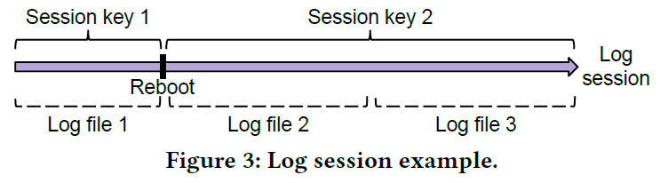
Design of Ditio
Log Session
  Can be started and stopped by config app
  Can expand over multiple boots
  One session can have multiple logs
Notes:
왜 굳이 파일을 쪼개는가?
재부팅하기 전에 log를 commi해야 함. (세션 키 때문에 이어서 쓰는게 힘듦)
Hypervisor, Normal World와 Secure World 사이 매우 적은 양의 메모리만이 할당됨 (8KB)

Slide 15
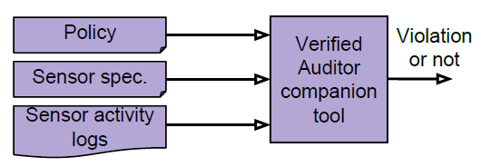
Design of Ditio
Auditing
  Unseal the logs from client
  Develop/check policy with companion tool
  Can be done only after logs are collected
    Does not support real time audit
Notes:
Deploy – 업데이트가 힘들어서 최대한 문제의 소지를 줄인 채로 출시해야 함
Ditio의 로그는 센서가 쓰이는지만 판단 가능. 그래서 개인정보 유출 소지는 없다

Slide 16
Deployment
1. By device vendor
  Use Hypervisor and TrustZone
  Prevent tampering by using SecureBoot
  Recommended way
  Need to trust vendor
2. By user (or old device without hardware virtualization)
  Patch operating system
  Backward-compatibility mode
  Need to trust OS kernel
Notes:
Deploy – 업데이트가 힘들어서 최대한 문제의 소지를 줄인 채로 출시해야 함
Ditio의 로그는 센서가 쓰이는지만 판단 가능. 그래서 개인정보 유출 소지는 없다

Slide 17
Threat Model
From OS compromise : Safe
  Safe by using hypervisor and TrustZone
From log store compromise : Safe
  Can keep integrity, authenticity and confidentiality
  Encrypted by private-key from the secure world
From DoS : Unsafe
  Secure world and auth server communicates via normal world
Do not cover physical defense
  Provide assurance for the owners, not third-party
  e.g. Attacker brings his own recorder device to off-the-record meeting

Slide 18
Threat Model
Q) What if hypervisor has a security vulnerabilities?
  Ditio does not use most of the features from general hypervisor
A) Solutions
  Use verified hypervisor
  Write a small hypervisor which has less attack vector

Slide 19
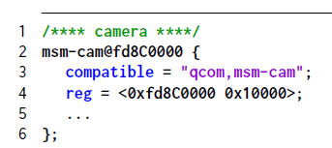
Recording
Logging of sensor activity
Read, Write access (offset, value) to sensor registers is recorded
All I/O device registers are memory-mapped in ARM architecture
The address of a MMIO can be found in client’s device tree
Recorder (inside hypervisor) observes and intercept Stage-2 page tables using trap
Notes:
넥서스 5에서 테스트할 때는 레지스터 하나만 켜도 감지가 됨.

Slide 20
Recording
Additional information is recorded for auditing
Start and stop times of a session
Timestamp of power-on / power-off
Timestamp correction offset

Slide 21
Recording
Log Store (Untrusted)
To reduce TCB, place it under normal world (OS kernel)
Hypervisor saves the log over shared memory page with the OS
Encrypted and authenticated in the secure world to prevent tampering
Saved into storage such as flash

Slide 22
Recording
Recording should not affect latency
High Latency can cause malfunction of device drivers
Optimizations
Asynchronous Commit of in-memory logs
Lock-free data structures
Dynamically-allocated log buffers (~16MB)
Trap-not-log

Slide 23
Sealing
Logs should be sealed to guarantee
Authenticity
Integrity
Confidentiality
Sealing is done by secure runtime and authentication server
<- For Auditor
<- For Device Owner

Slide 24
Sealing
Authentication Protocol
Client send none, timestamp, and session key to server
Server authenticates contents and origin of the message
Session key is shared between client and server

Slide 25
Audit Phase
Client provides a sessoin’s log files to auditor at the moment of audit
Auth server verify and decrypts the log files
Auditor uses Formally Verified Companion Tool to see if a client ensured sensor activity policy

Slide 26
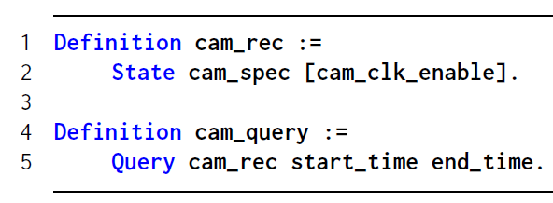
Audit Phase
Formally Verified Companion Tool
  Each sensor has a unique hardware, so help is required
  Frontend : Receives a policy query
    “Was the sensor in a given state between a start time and end time?”
  Backend : Generate low-level checker
  Translation of a policy query is formally verified

Slide 27
Implementation
1. ARM Juno Development Board r0
  Cortex-A57 and Cortex-A53 (ARMv8A)
  Has virtualization hardware and TrustZone
  Deployed on a hypervisor (Xen) and secure world runtime (Open-TEE)
  Represent recent devices
  Test a USB-based camera
2. Nexus 5
  No virtualization hardware and TrustZone
  Deployed on OS kernel
  Represent old devices
  Test internal camera and microphone
Notes:
Non Vendor가 TrustZone와 Hypervizer에 접근할 수 있는 유일한 플랫폼이 Juno 였음
스펙대로라면 Juno 보드가 제공해야 하는 기능 중 일부는 우리가 제대로 쓸 수 없었고, 우회하거냐 에뮬레이션을 해야 했다.

Slide 28
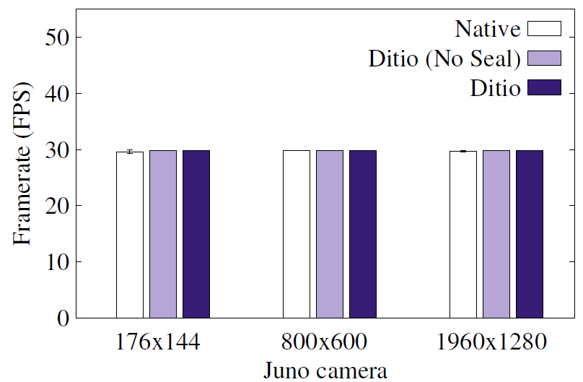

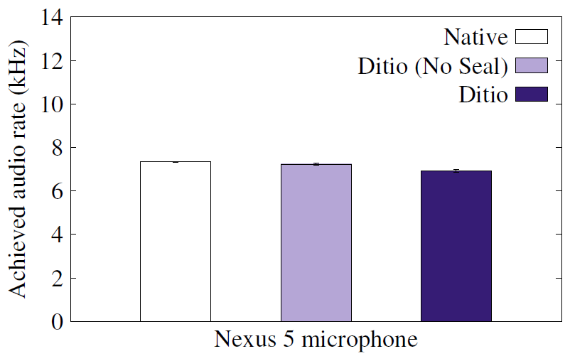
Evaluation
Performance Drop
  No impact on cameras
  Small impact on microphone
Notes:
Non Vendor가 TrustZone와 Hypervizer에 접근할 수 있는 유일한 플랫폼이 Juno 였음
스펙대로라면 Juno 보드가 제공해야 하는 기능 중 일부는 우리가 제대로 쓸 수 없었고, 우회하거냐 에뮬레이션을 해야 했다.

Slide 29
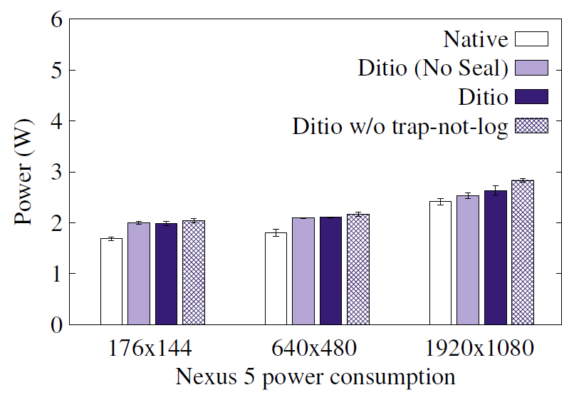
Evaluation
Power Consumption
  More power draw at most 17%
Log Size
  Juno + Camera (w/o TnL) : 10MB/min
  Nexus 5 + Camera (w TnL) : 16KB/min
    Without Trap-not-Log : 84MB/min
  Nexus 5 + Microphone : 8KB/min
Authentication Latency
  Network RTT : 38ms
  Auth Handshake RTT : 86ms
Notes:
Non Vendor가 TrustZone와 Hypervizer에 접근할 수 있는 유일한 플랫폼이 Juno 였음
스펙대로라면 Juno 보드가 제공해야 하는 기능 중 일부는 우리가 제대로 쓸 수 없었고, 우회하거냐 에뮬레이션을 해야 했다.

Slide 30
Conclusion
Ditio is for use cases that require auditing by device owners or third parties
Based on hybrid security monitor, leverage both ARM virtualization hardware and TrustZone
Auditor can verify logs using authentication protocol
Formally verified companion tool helps auditor to check policy violation, while ensures integrity and authenticity of logs

Slide 31
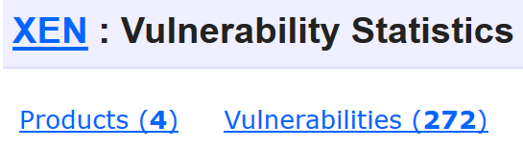
Critique
Interesting design with Hypervisor and TrustZone
  Vulnerabilities with hypervisor or secure world runtime can destory chain of trust
To correctly audit, policy must be written in advance
  Useful in controlled place, such as business
    e.g. Company meeting room
  Cannot cover all sensor products being used in real world
    e.g. Hotel conference room
Notes:
문제점 : 벤더가 Secure Boot로 펌웨어를 변조하지 못하게 막는다지만, 출시된지 시간이 지난 기기들은 펌웨어 업데이트가 중단되고 결국 취약점이 발견될 수 밖에 없다. (무력화 가능)

Slide 32
Thank You
<hajin_jang@korea.ac.kr>

