Slide 1



InSight: Recognizing Humans
without Face Recognition
He Wang
Xuan Bao
Romit Roy Choudhury
Srihari Nelakuditi

Slide 2
Contents
Motivation
What is InSight?
Idea solution approach
Detail performance property
Experiment
Result
Refining the system
Conclusion

Slide 3
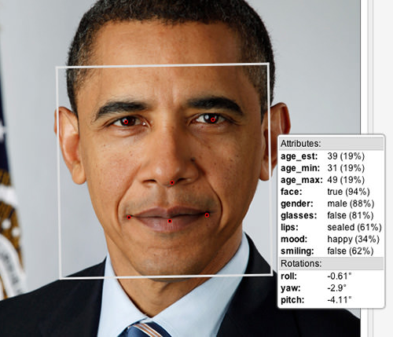
Motivation
Face recognition may not be always possible
-> Need new way to recognize person

Slide 4
What is InSight?
Insight
: The system which makes individual discriminant without face recognition
Colors/Patterns of clothes
Body structures
Decorations
Motion patterns
“visual fingerprint”

Slide 5
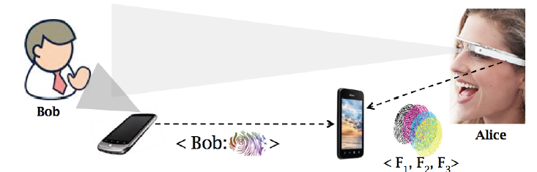
Idea solution approach
1. Smartphone takes a picture opportunistically while owner uses it
(checking e-mail etc.)
2. Image segmentation, processing
3. Making one’s self-fingerprint
4. Storing it on cloud / Transmitting it to around via BLE or WI-FI

Slide 6
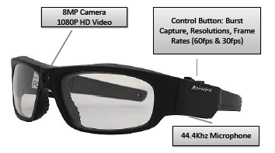
Idea solution approach
5. pressing a button on camera-enabled glasses and recording short video
6. Transferring it to smartphone and separates individuals
7. Extracting visual fingerprint each of them
8. Computing the similarity with data in the cloud
9. Comparing the similarity to confidence threshold
(higher : identifying, less : exploring motion pattern)

Slide 7
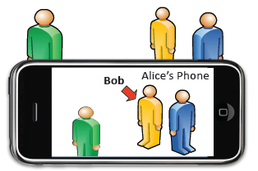
Idea solution approach
10. Labeling person who is identified through computing the similarity
between data from camera-enabled glass and self-fingerprint
11. User can view this label on glass or smartphone screen

Slide 8
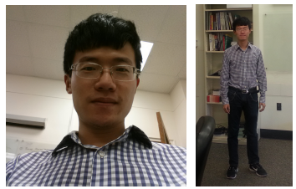
Detail performance property
Self-fingerprint
Cropping out a rectangular region
(below the face/neck)
Applying two techniques on the image
- Spatiogram
- Wavelet

Slide 9
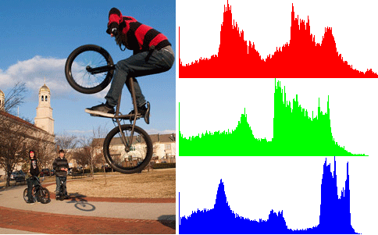
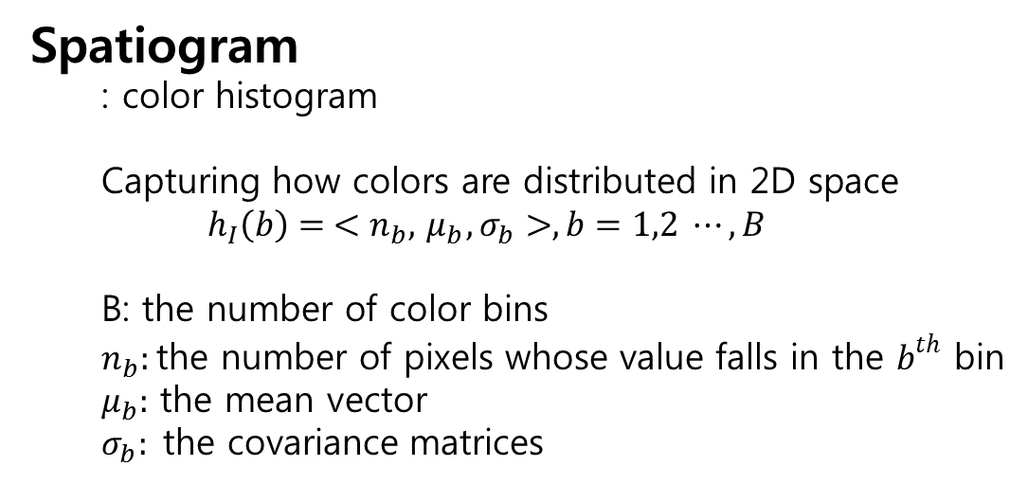
Detail performance property
Spatiogram
  : color histogram
  Capturing how colors are distributed in 2D space
  $$h_{I}\left(b\right)= <n_{b}, { μ}_{b}, σ_{b}>, b=1,2 ⋯, B$$
  B: the number of color bins
  $n_{b}:$ the number of pixels whose value falls in the $b^{th}$ bin
  $μ_{b}:$ the mean vector
  $σ_{b}:$the covariance matrices

Slide 10
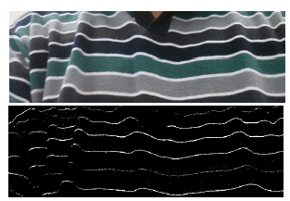
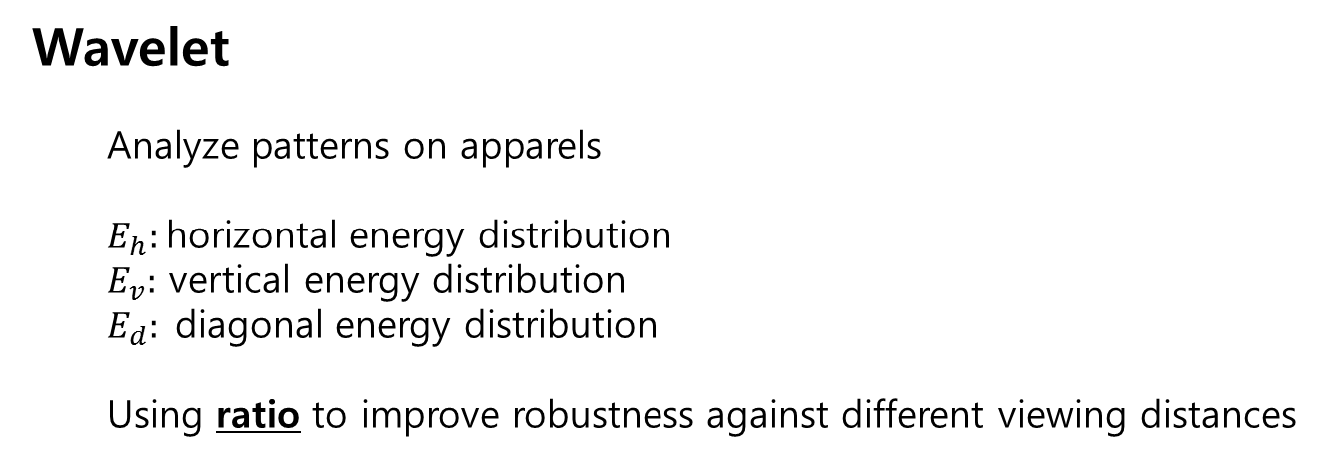
Detail performance property
Wavelet
  Analyze patterns on apparels
  $E_{h}:$ horizontal energy distribution
  $E_{v}:$ vertical energy distribution
  $E_{d}:$diagonal energy distribution
  Using ratio to improve robustness against different viewing distances

Slide 11
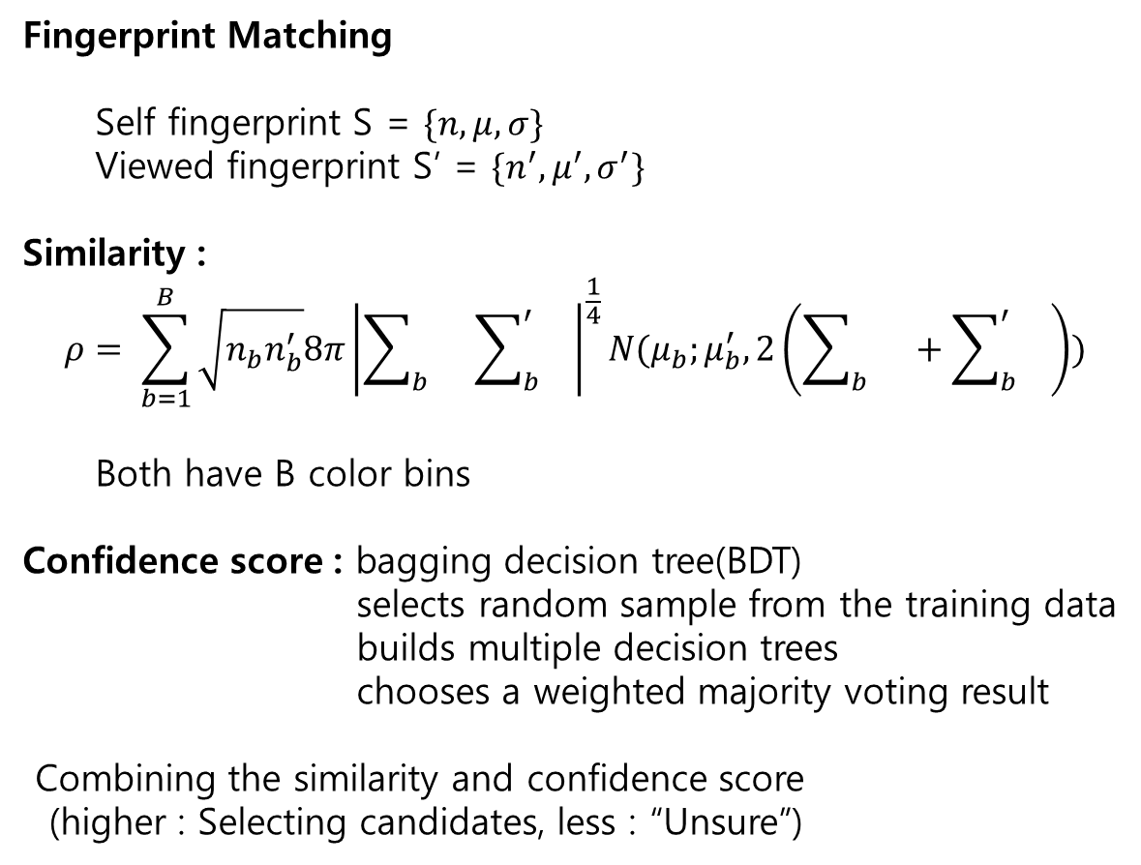
Detail performance property
Fingerprint Matching
  Self fingerprint S = $\{n, μ, σ\}$
  Viewed fingerprint S’ = $\{n^{′}, μ^{′}, σ^{′}\}$
Similarity :
$$ρ= \sum_{b=1}^{B}{\sqrt{n_{b}n_{b}^{′}}8π}{\left|\sum_{b}{}\sum_{b}^{′}{}\right|}^{\frac{1}{4}}N(μ_{b};μ_{b}^{′}, 2\left(\sum_{b}{}+\sum_{b}^{′}{}\right))$$
  Both have B color bins
Confidence score : bagging decision tree(BDT)
selects random sample from the training data
builds multiple decision trees
chooses a weighted majority voting result
Combining the similarity and confidence score
(higher : Selecting candidates, less : “Unsure”)

Slide 12
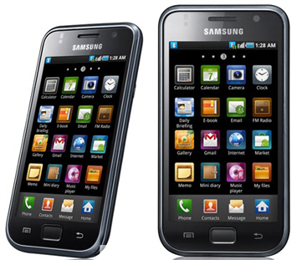
Experiment
15users dressed in regular attires
(actively use their smartphones)
PivotHead camera enabled glasses
(single user)
Samsung Galaxy phones
Montecarlo simulation

Slide 13
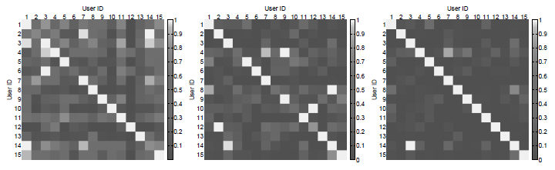
Experiment
Pre-Experiment
Similarity
(Spatiogram)
Confidence score
(Wavelet)
Combining 2datas
Lighter pixel : higher similarity(Confidence score)
Spatiogram and Confidence exhibit complementary behavior

Slide 14
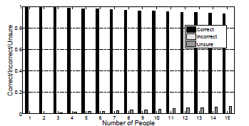
Result
Result – facing the glass
The average is computed over all the possible combinations
None of the users are recognized incorrectly

Slide 15
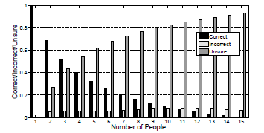
Result
Result – facing away from the glass
Increasing the users are recognized unsurely
Few users are recognized incorrectly

Slide 16
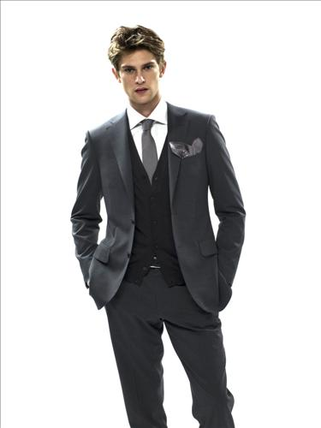
Refining the system
Ambiguity
Insufficient self-fingerprint
Uploading the additional data includes full clothing to
the cloud
Updating the visual feature of one’s back
->Utilizing enriched fingerprint(recursive process)

Slide 17
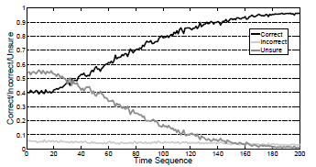
Refining the system
Result – Refined system
Randomly choose 4people with their backs facing the glass and add it
Time sequence : the number of repeating times

Slide 18
Conclusion
Colors and patterns on clothes may pose as a fingerprint
It can be used towards human recognition or content announcement

Slide 19
Thank you

Slide 20
Appendix
Why not utilize location information to identify?
  Precise location in indoor spaces is unavailable today.
  It may not be easy to extract depth information from video
  But, location and compasses can be used to narrow down the search space for visual recognition
  -> future work

Slide 21
Appendix
Spatiogram
  : Color histogram

Slide 22
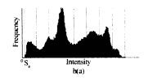

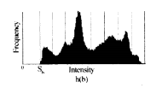
Appendix
Spatiogram(bin)

Slide 23
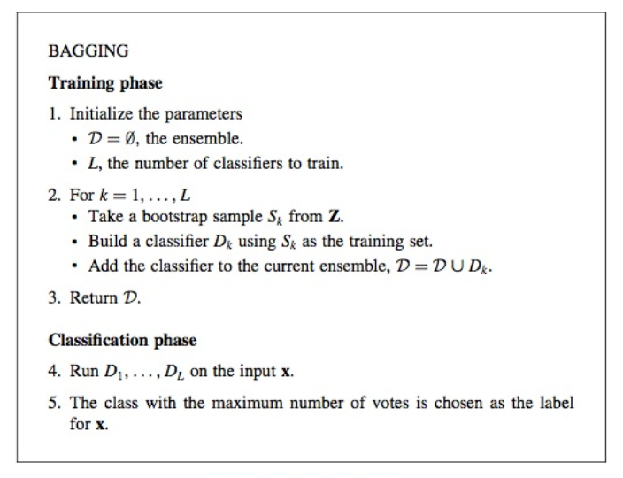
Appendix
Bagging decision tree(BDT)

Slide 24
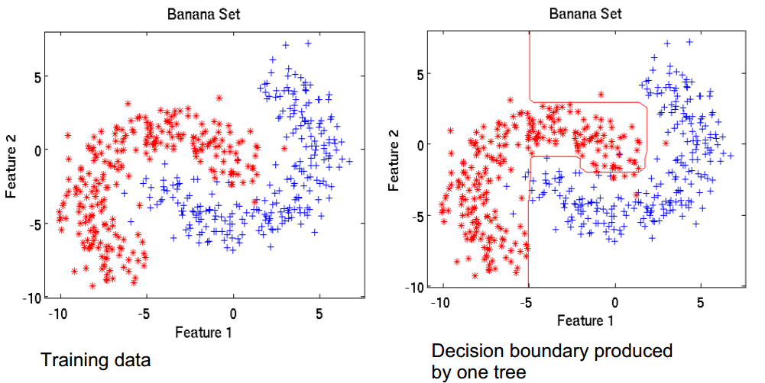
Appendix
Bagging decision tree(BDT)

Slide 25
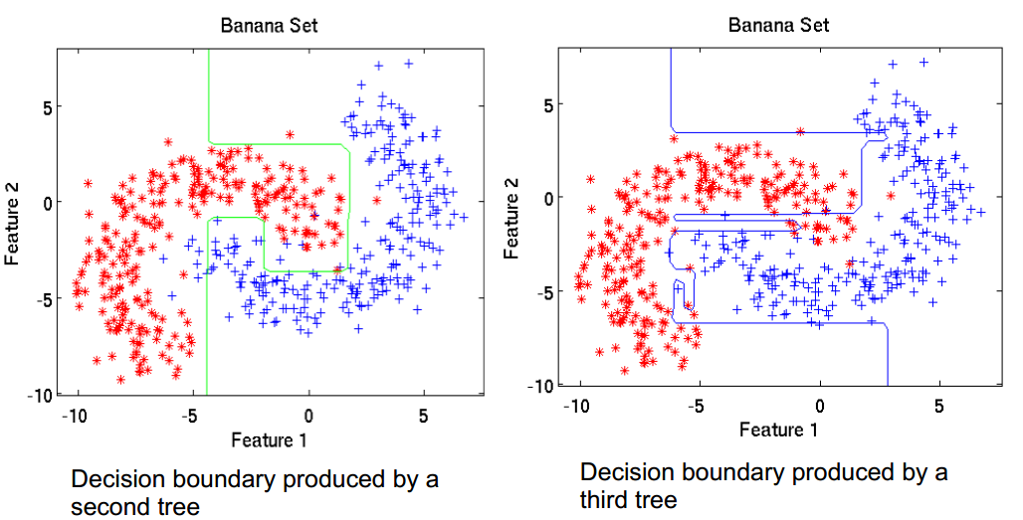
Appendix
Bagging decision tree(BDT)

Slide 26
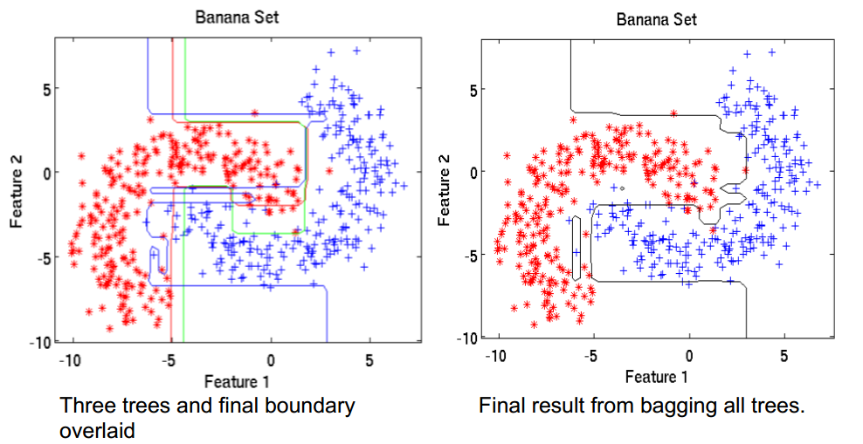
Appendix
Bagging decision tree(BDT)

Slide 27
Appendix
Montecarlo simulation
  : Simulated sampling technique
  Getting probability distribution of variables
  Setting cumulative probability distribution
  Allocating the range of random numbers to achieve variable value
  Simulation using random sampling

