Slide 1
Cloud-Enabled Privacy-Preserving Collaborative Learning for Mobile Sensing
Bin Liu, Yurong Jiang, Fei Sha, Ramesh Govindan
University of Southern California, SenSys‘12

Slide 2
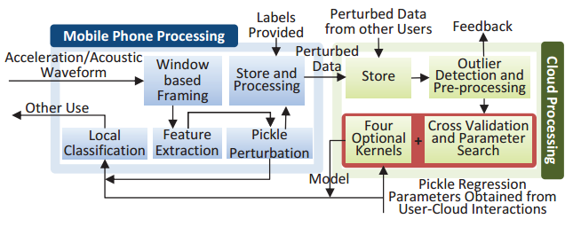
Index
1. Introduction
2. Motivation and Challenges
3. Privacy-Preserving Collaborative Learning
  Pickle Overview
  Regression Phase
  Model Generation and Return
  Privacy Analysis
  Other Properties of Pickle
4. Evaluation of Pickle
  Pickle Privacy: A User Study
  Pickle Resource Costs: Prototype Evaluation
  Accuracy/Privacy Tradeoffs and Comparisons: Dataset Evaluation
5. Related Work
6. Conclusion

Slide 3
Introduction
One way to build robust classiﬁers is through collaborative learning, in which mobile users contribute sensor data as training samples.
Generates statistical classiﬁers, and makes these classiﬁers available to mobile users
Incentivize users to participate in collaborative learning
Allows users to independently tune the level of privacy for perturbing their submitted training samples

Slide 4
What is Collaborative Learning?
Two or more people learn or attempt to learn something together.
ex) consider individual users who collect audio clips from their ambient environments

Slide 5
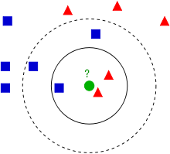
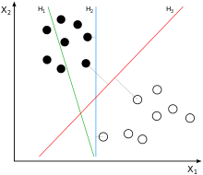
The Basics of Classification
The ﬁrst step in many machine-learning algorithms is feature extraction.
ex) For audio clips, the fundamental frequency, the spreads and the peaks of the spectrum, and the number of harmonics are all examples of features.
K-Nearest-Neighbor (kNN) classiﬁer
  The classiﬁer then outputs the majority of all the nearest neighbors’ labels as the label for x
Support Vector Machine (SVM)
  it then seeks a linear decision boundary that partitions the feature space into different classes

Slide 6
Design Goals and Challenges
It must support the most commonly-used classiﬁers such as the Support Vector Machine (SVM) classiﬁer and the k-Nearest Neighbor (kNN) classiﬁer described above
The system must scale to classiﬁers constructed using training samples from 100 or more users.
The system must have the right adoption incentives to enable disparate users to contribute training samples:
  The system must ensure the privacy of the submitted samples,
  It must be robust to data poisoning,
  It must dis-incentivize free-riders

Slide 7
Cloud-Enabled, Privacy-Preserving Classification
We propose to use an approach in which mobile users submit training samples (with associated labels) to a cloud, possibly at different times over a period of hours or days; the cloud computes the classiﬁer; the classiﬁer is then sent to mobile phones and used for local classiﬁcation tasks
However, using the cloud makes it harder to achieve an important design goal discussed above, privacy

Slide 8
Privacy and Threat Model
Each sample consists of a feature vector and the x associated label y
A commonly used feature vector in speech and music classiﬁcation is the Mel-frequency cepstrum coefﬁcients (MFCC), which are computed by a sequence of mathematical operations on the frequency spectrum of the audio signals
One way to preserve the privacy of x is to generate x˜ from x and send only x˜ the cloud, with the property that, with high likelihood, the cloud cannot reconstruct x from x˜

Slide 9
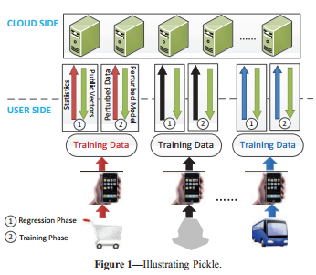
Pickle Overview [1/2]
Each user’s mobile phone takes N training feature vectors, where each vector has P elements, and pre-multiplies the resulting P × N matrix by a private, random matrix R.
The central contribution of this paper is the design of a novel approach to approximately reconstruct those relationships using regression, without compromising the privacy of the original feature vectors, while still respecting the processing and communication constraints of mobile devices.

Slide 10
Pickle Overview [2/2]
Users generate labeled raw data at their convenience: for example, Pickle software on the phone may collect audio clips, then prompt the user to label the clips.
Once a piece of raw data is labeled, the software will extract feature vectors, perturb them using R, and upload them, along with the corresponding label, to the cloud; as an optimization, the software may batch the extraction and upload.
When the cloud receives a sufﬁcient number of labeled perturbed feature vectors from contributors, it constructs the classiﬁer and sends a copy to each user.

Slide 11
Regression Phase
Step 1: Randomly Generate Public Feature Vectors.
  The cloud sends to each participating user a collection of public feature vectors.
Step 2: Perturb the Public Feature Vectors.
  The user perturbs the cloud-generated feature vectors using its private transformation matrix and returns the result to the cloud.
Step 3: Regress.
  The cloud employs regression methods to learn approximate functions for computing the desired mathematical relationships between feature vectors.

Slide 12
Step 1: Randomly Generate Public Feature vectors
The random public feature vectors have the same dimensionality as true feature vectors. Each user sends to the cloud the mean and the covariance matrix of its private training data,
The cloud generates a Z that approximates the statistical characteristics of the training feature vectors of all the U users;
Pickle generates sample statistics from a very small number (4P) of data samples.

Slide 13
Step 2: Perturb the Public Feature Vectors
The high level idea in this step is to perturb Z in exactly the same way as users would perturb the actual training feature vectors.
If Z is invertible, the private Ru can be recovered by the cloud when it receives the perturbed vectors RuZ: the cloud simply computes RuZZ⁻¹.
Pickle computes and sends Ru(Z+ eu) to the cloud, where eu is an additive noise matrix. Unlike the public feature vectors Z, however, eu is private to the user.

Slide 14
Step 3: Regress
Assume users U and V have chosen random matrices Ru, eu and Rv, ev respectively. The cloud receives Zu = Ru(Z +eu) and Zv = Rv(Z +ev). The key idea is to use Zu and Zv to approximate quantities which are pertinent to classification.
Instead of linear regression, we could have used Gaussian Process Regression (GPR).We have found in preliminary experiments that GPR marginally improves accuracy over LR but is significantly more compute-intensive.

Slide 15
Model Generation and Return
Building the Classifier
  Each perturbed feature vector, together with its label, is then sent to the cloud. Using perturbed feature vectors from each user, the cloud generates the classification model.
Model Return
  the cloud returns the model to users, so that classification may be performed on individual phones;
  The information returned depends upon the specific classifier, but must include all functions and associated parameters for every pair of users.

Slide 16
Privacy Analysis
In Step 1, U sends the mean and covariance matrix of a small number of its private training samples. Using this, the cloud can construct synthetic vectors whose first and second order statistics match that of U’s private data, but clearly cannot reconstruct Xu.
In Step 2, U sends R(Z +e) to the cloud. One might assume that the cloud can filter out the additive noise Re and then recover R by using the known Z−1.
Finally, in Step 4, U sends RX to the cloud.
Since each user U independently selects a secret R, and since its feature vectors are encoded using this secret, another user cannot directly compute any of U’s original feature vectors from perturbed feature vectors it receives from the cloud

Slide 17
Other Properties of Pickle
Pickle is computationally-efﬁcient on mobile devices, and incurs minimal communication cost.
Pickle requires no coordination among participants and provides ﬂexible levels of privacy
Pickle disincentivizes free-riding
Beyond SVM and kNN, Pickle can be applied to all kernel based classiﬁcation and regression methods that use distances or inner-products to establish relationships between training samples.
Pickle can be made robust to poisoning attacks in which a few malicious users attempt to inject bogus data in order to render the model unusable.

Slide 18
Evaluation of Pickle
a user-study which brings out the beneﬁts of Pickle, especially for applications like speaker recognition where the un-perturbed feature vectors are known to leak privacy;
measurements on a prototype that quantify the resource cost of Pickle;
an extensive characterization of the privacy-accuracy tradeoffs in Pickle, together with a comparison of alternatives, using an evaluation on public data-sets.

Slide 19
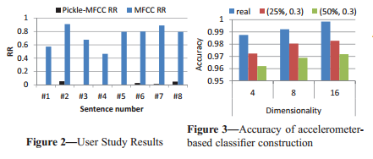
Pickle Privacy: A User Study
we demonstrate this using a small-scale user study on acoustic data,
  a) almost the entire audio clip can be reverse-engineered from unperturbed MFCC feature vectors;
  b) Pickle can mitigate this privacy leakage without significant loss(4.32%) in classification accuracy.
For each participant, we calculated two Recognition Ratios(RRs) for each sentence: Pickle offers very good privacy protection; Pickle has an RR of only 1.75%, while the MFCC-reconstructed clips have an RR of 73.88%.

Slide 20
Pickle Resource Costs: Prototype Evaluation (1/2)
Prototype System
  software for Android 2.3.4 and Windows Mobile 6.5 and software for the cloud, written with .Net 4.0 framework
  collection and processing of acceleration and acoustic data, and the cloud component builds a Pickle-SVM classifier
Experimental Methodology
  collected 16,000 accelerometer-based feature vectors, collected using smart phones, for the purpose of evaluating the resource costs for collaborative learning.
  we cluster these feature vectors among 160 users each of whom submits, on average, 100 training samples.

Slide 21
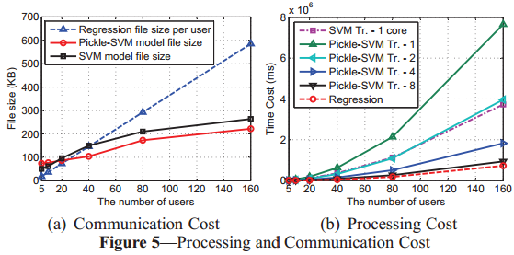
Pickle Resource Costs: Prototype Evaluation (2/2)
Communication Overhead
  we use a privacy transformation which reduces dimensionality by only 25%, and adds 0.3 intensity additive noise.
  perturbed training samples only requires 15KB for the transformed feature vectors with labels. the original training samples require 21KB. For 160 users, the former is 222 KB, and the latter is 585 KB per user
Computational Cost
  This computation requiring only 8.71s in our 160 users experiment

Slide 22
Methodology
Data Sets.
  Iris, Pima Indians Diabetes, Wine, and Vehicle Silhouettes
Users
  We partition each data set into several parts to simulate multiple users with private data using the standard K-means clustering algorithm. we randomly select 80% of the labeled feature vectors from each user as the training data, and use the remaining for testing.
Classifiers
  We evaluate the effectiveness of Pickle using two common pattern classifiers: Support Vector Machine (SVM) and k-Nearest Neighbor (kNN).

Slide 23
Evaluation Metrics
The Privacy Metric
  One way to measure privacy is to quantify the extent of this distortion.
  Measures the ‘distance’ between the original feature vector and an estimate for that vector derived by mounting a reconstruction attack.
  Then, we can define ℓud (0≤ ℓud ≤ 1) to be the difference in the distributions of these two quantities, Intuitively, the larger the ℓ, the more confident we are that privacy is preserved. When ℓ is zero, we are less confident.
Classification Accuracy
  A privacy transformation can adversely affect the classification accuracy, so we are interested in measuring classification accuracy under different privacy levels.

Slide 24
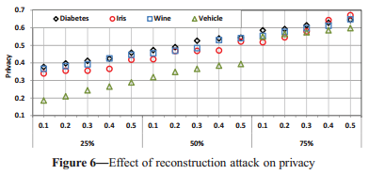
Attack models and Privacy
The Reconstruction Attack
  Dimensionality-reduction techniques can be attacked by approximate reconstruction.
  Even when this attack uses Gaussian Process Regression, Pickle still provides significant privacy.
  Pickle’s regression phase learns about relationships between users enough to discriminate amongst them. However, the regression is not powerful enough to generate the original samples;
Followup ICA Attack
  The ICA algorithm fails to converge to meaningful solutions.

Slide 25
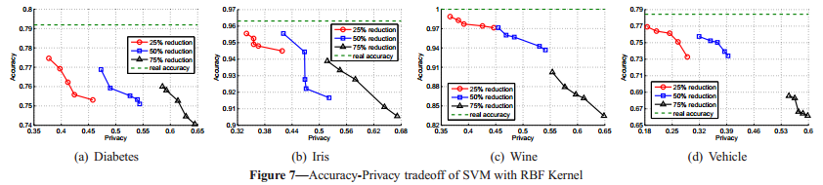
Classifier Accuracy
It plots the classification accuracy for each data set as a function of the privacy-level, for the SVM classifier. The loss in classification accuracy is less than 6% for privacy levels up to 0.5; in the worst case (Wine) classification accuracy drops by 15% for a privacy level of 0.65.
For LMNN with k = 5, Pickle is within 5% of the actual classification accuracy for each data set for privacy levels to 0.5, and in the worst case incurs a degradation of about 15%. Moreover, for LMNN, in some cases Pickle is even more accurate than without any privacy transformations.

Slide 26
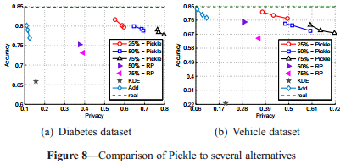
Comparison
Compare Pickle for SVM (with RBF kernel9), against three previously-proposed approaches for preserving the privacy of feature vectors.
Pickle outperforms all alternatives.
  The additive noise based approach produces acceptable accuracy, but almost no privacy.
  The KDE-based method offers a little bit more privacy than the additive noise method, but with a significantly degraded accuracy.
  The RP method provides lower privacy than Pickle, and also lower accuracy for data points with comparable privacy.

Slide 27
Impact of Design Choices
Is Regression Necessary?
  Our main contribution is the use of regression to learn function relationships. Turning off regression and using the transformed feature vectors directly for computing distances and inner products, leads to 15-35% accuracy degradations.
Other Design Choices
  Disabling the iPoD extension can reduce accuracy up to 7%for SVM and up to 6% for LMNN, so it is beneficial for Pickle to use iPoD.

Slide 28
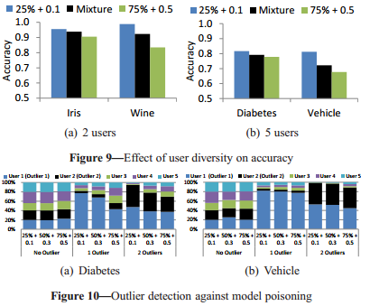
Illustrating Other Features of Pickle
User Diversity
  Pickle allows users to tune their own privacy transformations.
  The case of two different privacy settings: a 25% dimensionality reduction with 0.1 intensity additive noise and a 75% dimensionality reduction with 0.5 intensity additive noise.
Robustness to Poisoning
  the fraction of the top-100 suspicious feature vectors that belong to each user. that Pickle can be easily retrofitted into an existing poisoning detector. We simply discard all outliers before building the classifier.

Slide 29
Privacy-preserving SVM
Feature-perturbation
  The work of Lin and Chen only considers privacy-preserving classifier training for a single user, but Pickle explicitly supports multiple users.
Differential Privacy
  the classifier construction assumes all the original feature vectors are available and the outputs of the classifiers are perturbed such that individual features are not exposed as a result of small differences in two databases
Other Criptograpic Models
  A few use homomorphic encryption, but either discuss only SVM construction for two participants or would require peer-to-peer communication

Slide 30
Other Related Work
Navia-Vasquez et al. consider distributed SVM classifier construction, but do not consider privacy. SVM is often a popular choice. A few have examined collaborative learning.
In general, these methods do not scale to many users and require computationally intensive encoding and decoding operations.

Slide 31
Conclusion
We have described Pickle, an approach to preserving privacy in mobile collaborative learning. Pickle perturbs training feature vectors submitted by users, but uses a novel regression technique to learn relationships between training data
Pickle is robust to many kinds of attacks. Despite this, Pickle shows remarkable classification accuracy. Pickle requires minimal computing resources on the mobile device, and modest resources on the cloud.

