Slide 1
Section 2.6 : Allocation
김민수
2015011159
Notes:
https://www.iana.org/about
http://www.iana.org/numbers
https://www.apnic.net/about-APNIC/organization/history-of-apnic/history-of-the-regional-internet-registries
https://www.apnic.net/policy/resources
https://www.apnic.net/about-APNIC/organization/history-of-apnic/history-of-the-internet2

Slide 2
Allocation
IP address space is allocated, usually in large chunks by a collection hierarchically organized authorities.
The authorities are generally organizations that allocate address space to various owners.
(usually ISPs or other smaller authorities)
Top of the hierarchy is the IANA [IANA]
IANA has wide-ranging responsibility for allocating IP addresses and other types of numbers used in the Internet protocols.

Slide 3
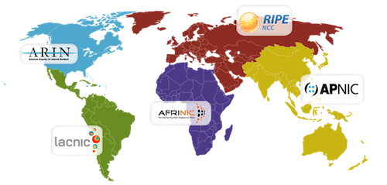
2.6.1 Unicast
IANA delegates much of its allocation authority to a few regional Internet registries(RIRs)
(For unicast IPv4, IPv6)
RIRs coordinate through the NRO(Number Resource Organization) formed in 2003.
RIR Name | Area of Responsibility
AfriNIC - African Network Information Center | Africa
APNIC – Asia Pacific Network Information Center | Asia/Pacific Area
ARIN – American Registry for Internet Numbers | North America
LACNIC – Regional Latin America and Caribbean IP Address Registry | Latin America and some Caribbean islands
RIPE NCC – Reseaux IP Europeens | Europe, Middle East, Central Asia
Table 2-14 Regional Internet registries that participate in the NRO
Notes:
Regional Internet Registry Creation
Criteria for Establishment of New Regional Internet Registries (ICP-2) (4 June 2001)
IANA Report on Recognition of LACNIC as a Regional Internet Registry (7 November 2002)
IANA Report on Recognition of AfriNIC as a Regional Internet Registry (8 April 2005)

Slide 4
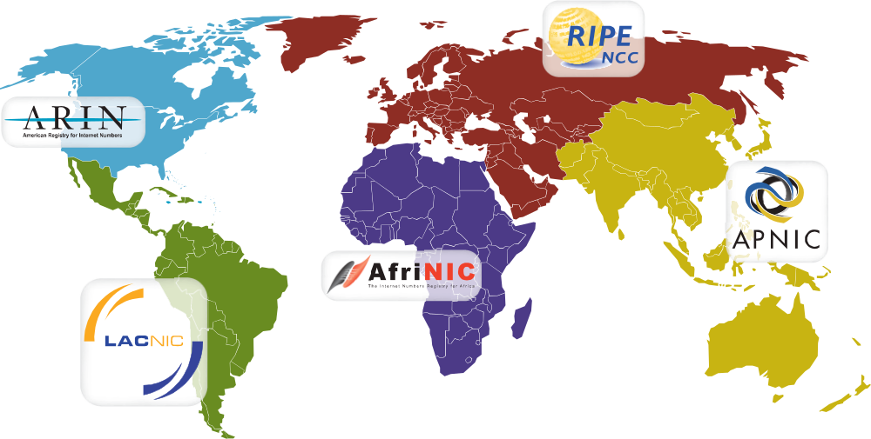
2.6.1 Unicast
Today, there are five RIRs.
Not-for-profit, membership-based organizations that operate in distinct regions.
They distributes the Internet number resources in its region according to the allocation and assignment policies defined by its own regional community.

Slide 5
2.6.1 Unicast
IANA
APNIC
Allocates
to APNIC Member
/8
APNIC Allocation
APNIC Member
/22
Allocates
to downstream
Allocates
to end-user
Member Allocation
Downstream
Allocates
to end-user
/24
Sub-
Allocation
Customer / End User
/27
/26
/25
/26
/27
Customer Assignments

Slide 6
2.6.1 Unicast
PA (Provider-aggregatable)
  Assigned to an Internet service provider (ISP)
  Improve Internet routing efficiency.
  End-users cannot reuse the address if they change connectivity providers.
PI (Provider-independent)
  Directly to an end-user organization.
  User must contract with an ISP to obtain routing of the address block within the Internet
  End-users can change service providers without renumbering of their networks.

Slide 7
2.6.2 Multicast
Multicast addresses(i.e., group addresses) can be described based on their scope, the way they are determined and whether they are used for ASM or SSM.
The groups that are not of global scope can be reused in various parts of the Internet and are either configured by a network administrator or selected automatically by end hosts.

