Slide 1
Doorjamb: Unobtrusive Room-level Tracking of People in Homes using Doorway Sensors
Timothy W. Hnat, Erin Griffiths, Ray Dawson, Kamin Whitehouse
SenSys 2012
Presenter: Chanyoung Lee
April 16^{th,} 2013

Slide 2
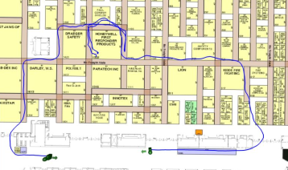
Introduction
Indoor tracking systems
  Intelligent home applications for elderly and patient monitoring
  Provide location-aware and individually tailored services, even in multi-person homes

Slide 3
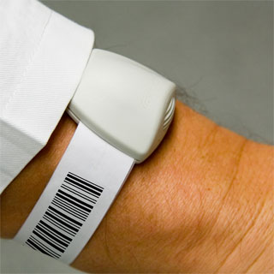
Introduction
Features of indoor tracking systems
  Tracking device
  Vision or audio system
  Non-intrusive tracking
  But people are not likely to carry it
  privacy leak and bothering, etc
Notes:
Most indoor tracking system require each person to carry or wear a powered device
Device : camera, microphones, other sensors
Some research using phone, but early morning, late at night, after showers

Slide 4
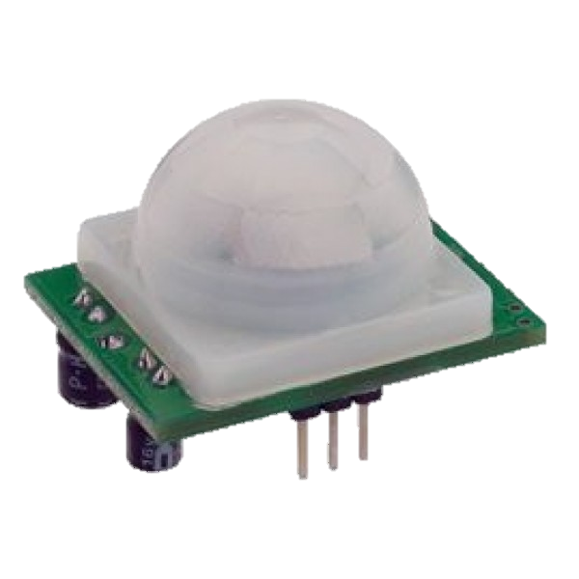
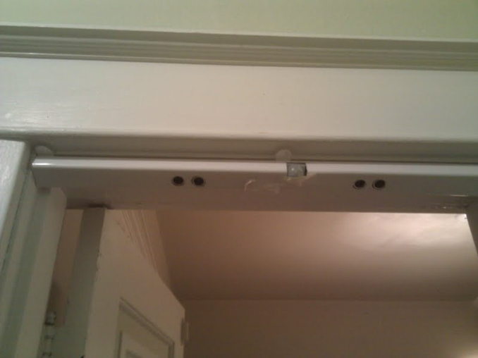
Introduction
Non-intrusive tracking
  Motion sensor
    Cannot detect the identify person
  Weight
    Changes in gait or carried object
  Doorjamb
    Inexpensive and low power ultrasonic
Notes:
Ideal way
20$

Slide 5
Goal
Making novel tracking system
  Convenient, non-intrusive, inexpensive system for homes
  Using ultrasonic, estimates the height of a person
  Can easily be extended
Notes:
Weight sensors, motion sensors, color sensors, or any other sensors

Slide 6

Design
Legal room transition
  People cannot move through walls or teleport between rooms
Assumption
  Each doorway crossing is assigned to
  only one person
  maximizing consistency between doorway
  assignments and height and direction estimates
  minimizing errors
Notes:
the number of false detections or missed detections in each path

Slide 7
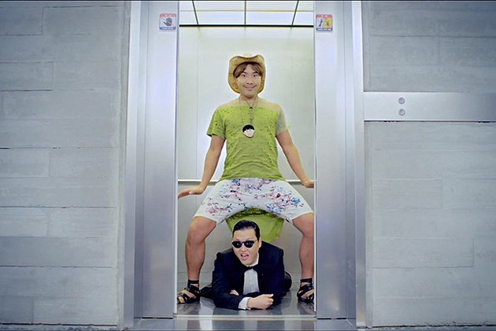
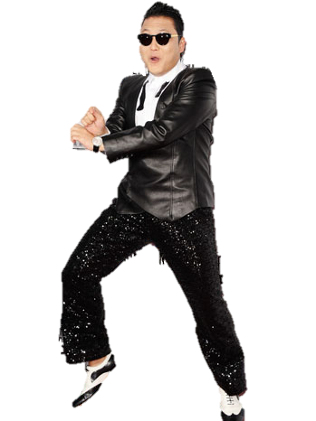
Design
Calculate person’s height
dp
df
h = df - dp
Notes:
Top of the head

Slide 8
Design
Calculate person’s height & direction
  Need a angled sensor
Notes:
Top of the head
Angle -> first 60 false alarms-> 40

Slide 9
Design
Final doorway sensor design
  Two to four Parallax PING ultrasonic range finders
  Passive infrared sensors facing to each side to sense motion activity in the two adjacent rooms
  Magnetic reed sensors to sense whether the door is open or closed
  Custom-designed power module to supply regulated 3V and 5V power to the devices
  Synapse Wireless SnapPY RF100 module, which consists of a Python programmable freescale processor and a 802.15.4 radio

Slide 10
Signal Processing
Doorway Crossing Detection
Noise Filtering
Height Estimation
Direction Estimation

Slide 11
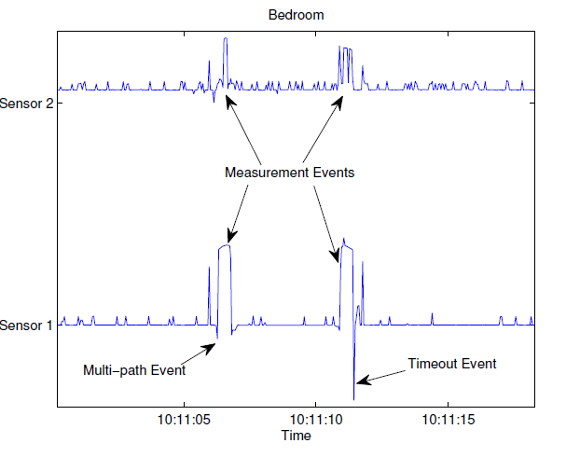
1. Doorway Crossing Detection
When a person walks under a PING range finder…
  Timeout Event : sensor has already transmitted an ultrasonic pulse, person may block the acoustic energy
    Cancel ranging process, transmit another pulse immediately

Slide 12
1. Doorway Crossing Detection
When a person walks under a PING range finder…
  Multi-path Event : person sometimes blocks the line-of-sight, but acoustic energy still reaches the transceiver
  Pulse reflect off the person and return to the transceiver

Slide 13
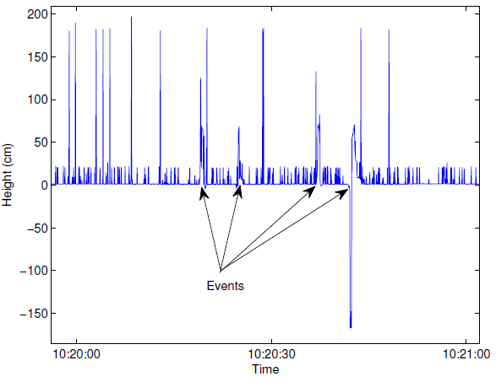
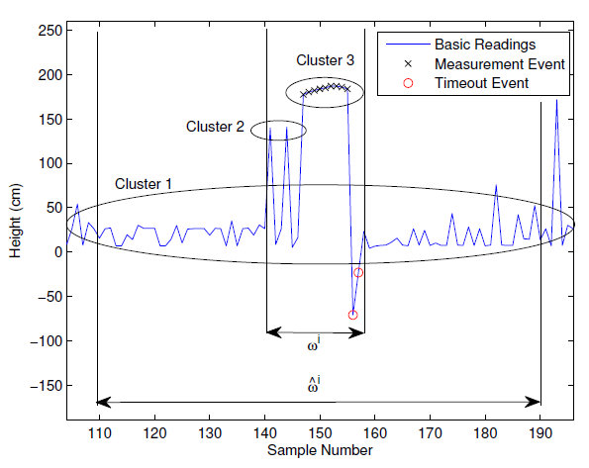
2. Noise Filtering
Ultrasonic range finders can be very noisy and cause false detection
  Cluster 1 : means baseline, remove
  Cluster 2 : if event has several values, then it is eliminated
  Cluster 3 : has measurement value
Notes:
picked up reflections from a nearby object and produced height measurements similar to a true person’s height
timeout or multi-path event

Slide 14
3. Height Estimation
Remove multi-path reflections error
Using “Noise Filtering“ value, calculate height

Slide 15
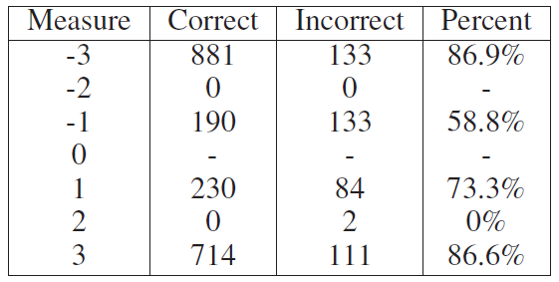
4. Direction Estimation
Applies three algorithms to estimate direction
The three algorithms vote on each event with
a +1 to declare an enter event,
a -1 to declare an exit event,
0 if it cannot decide

Slide 16
Tracking
4-tuple of event
  Timestamp, doorway ID, height measurement and walking direction
Create tracks
  Using adjacency matrix
  Djikstra’s shortest path algorithm
  Assume possible combination : k^2
Notes:
Signal Processing

Slide 17
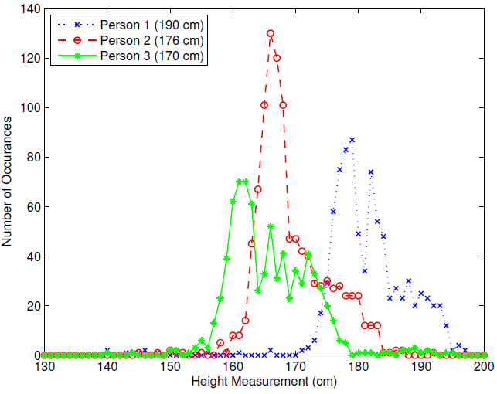
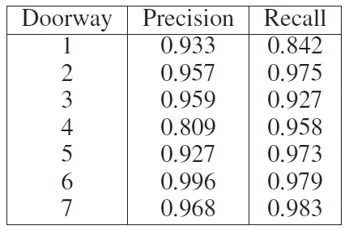
Result
The system produces more than 93% precision and 96% recall for most doorways
Differences happens in measure actual heights
Notes:
precision is the number of false detections divided by the number of total detections,
recall is the number of missed detections divided by the number of true doorway crossing events.
At most 4 person can be distinguishable, but accuracy will go lower

Slide 18
Conclusion
Doorjamb tracking system that can track people in homes with room-level accuracy
It works without requiring any user participation, wearable devices, privacy-intrusive sensors, or high-cost sensors
Achieve 90% tracking accuracy on average, and that accuracy is highest when the test subjects have different heights
Notes:
privacy invasion is significantly reduced because ultrasound range finders provide very little information other than height, direction, and location

Slide 19

Q&A

