Slide 1
Dynamic Host Configuration Protocol (DHCP)
6강

Slide 2
Lineage
Reverse ARP → BOOTP → DHCP
RARP for obtaining IP address only, for diskless workstations
Then use IP networking to contact servers for booting
Remaining bootstrap process required other protocols
  To fetch OS image, etc.

Slide 3
RARP
Use hard-wired MAC address + PROM program to bootstrap
Broadcast (ff-ff-ff-ff-ff-ff) RARP request : “what’s my IP?”
RARP server responds to the request

Slide 4
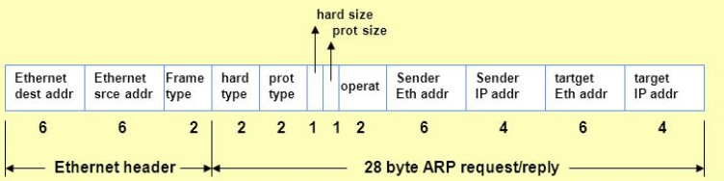
RARP message format
Looks very familiar, doesn’t it?
  It’s a member of the *ARP family
  Ethertype = 80-35 (cf. ARP → 08-06)
  OP: 3=request, 4=reply

Slide 5
Limitations of RARP
Not nearly enough for a full-fledged “auto-configuration” protocol
  Needed other protocols to finish bootstrapping
  Needed 1 RARP server per each subnet
  Implemented as a “hack”: device driver → application (skipping network/transport layers)

Slide 6
BOOTP
More complete protocol for the entire bootstrapping process (not only IP!)
Overcomes limitations of RARP: 1, 2, 3
Very similar to DHCP
  So we will go directly to DHCP
  Some differences: we will discuss them, too

Slide 7
What to configure?
Many things --- DHCP can configure close to 200 different things on a host
  http://www.iana.org/assignments/bootp-dhcp-parameters/bootp-dhcp-parameters.xml
IP address, router address, domain name server address, subnet mask, service gateways, ARP cache timeou, location of the bootstrapping files, etc, etc, etc.

Slide 8
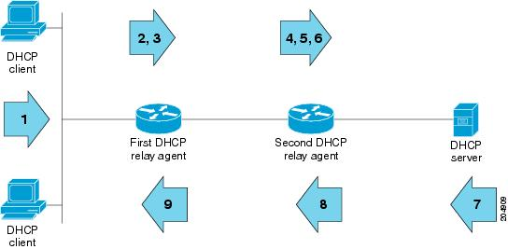
DHCP relay
Enables “remote configuration”
Modern configuration typically uses relays
  Between clients and the remote DHCP server(s)
  Routers are typically configured as relays: they have the IP address of the DHCP server

Slide 9
DHCP relay
Doesn’t need so many servers anymore
DHCP server can be anywhere, to which the request is forwarded in unicast
  No limitations of broadcast

Slide 10


“Normal” protocol
Uses UDP (server=67, client=68)
No kernel hacking
Auto-configuration
DHCP
UDP
IP
Link layer

Slide 11
DHCP
The most frequently used application layer protocol along with DNS (most users don’t know)
Client/server protocol
Evolved from BOOTP
  Which in turn evolved from RARP
Most noticeable change: “lease”

Slide 12
Why UDP for transport?
Maybe it’s because DHCP exchanges a small number of messages between client and server
But more fundamentally it’s because DHCP requests are IP broadcast (and some replies as well) to 255.255.255.255

Slide 13
Message format
Fig. 6-1
  Smells of ARP? It should.
Use “bootp” filter in Wireshark

Slide 14
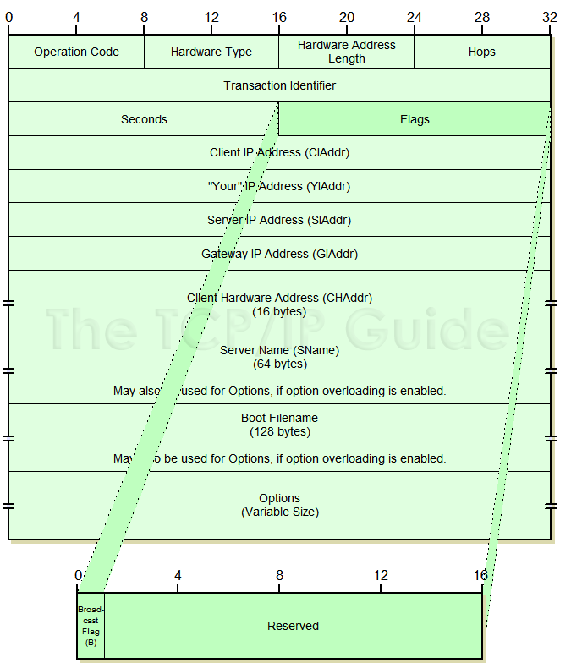

Slide 15
Message format
OP code: 1=request, 0=reply
Htype, hlen: same as in ARP/RARP
Hops: # of times relay agents have relayed the message
  If > 16, kill it, it’s probably a loop
Transaction ID: to match requests and replies
  Out-of-order delivery in IP network
  All application layer protocols using UDP transport uses similar mechanism

Slide 16
Message format
B=1 bit in flags field means that the client doesn’t have (know) its IP address
  Server broadcasts the reply
CIAddr: 0.0.0.0 when the client doesn’t know
YIAddr: IP address the server is assigning the client
SIAddr: address of the server that the client should use next in the bootstrap process != DHCP server address
  DHCP server address is in the options part

Slide 17
Message format
GIAddr: relay agent address
CHAddr: client’s MAC address, used as key
Sname: server can optionally tell the client its name
Boot filename: optionally used by a client to request a particular type of a boot file in a DHCPDISCOVER message
  Used by server in DHCPOFFER to fully specify file name

Slide 18
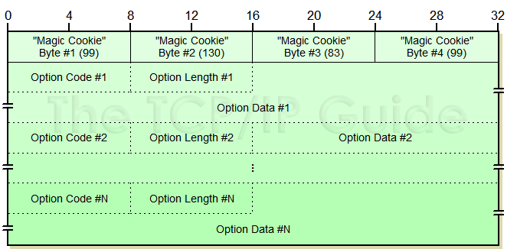
Message format
Options in TLV format
  Magic cookie: originally “OREO” but J. Postel changed it to the current value

Slide 19
Options
Essential in DHCP
IP host parameters, IP interface parameters, link layer parameters, TCP parameters, app/service parameters, DHCP extensions

Slide 20
Options – DHCP extensions
50 – requested IP address
51 – ip address lease time
53 – DHCP message type* (not really optional)
54 – server identifier
55 – parameter request list
58 – renewal time
59 – rebinding time
61 – client identifier

Slide 21
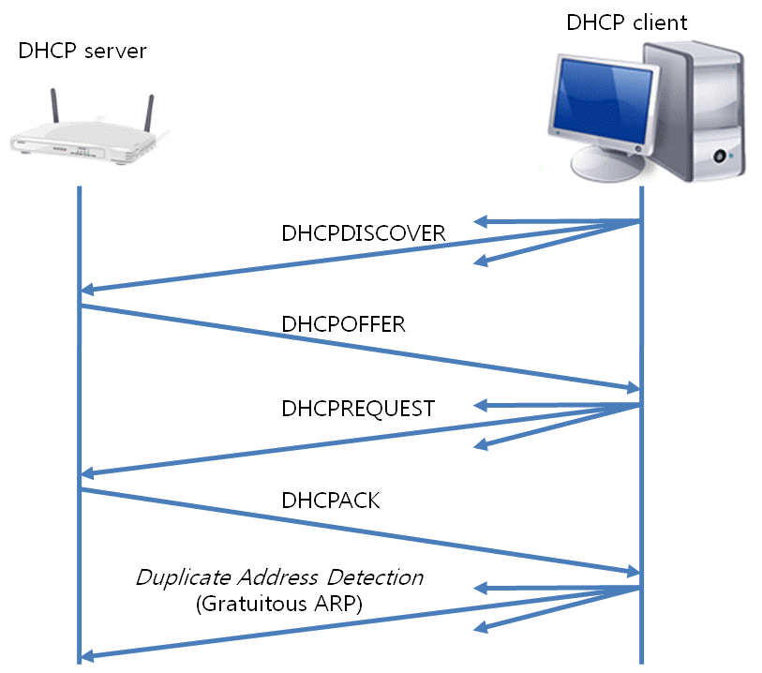
DHCP options
Message type option is important
  DISCOVER, REQUEST, ACK, NACK, INFORM

Slide 22
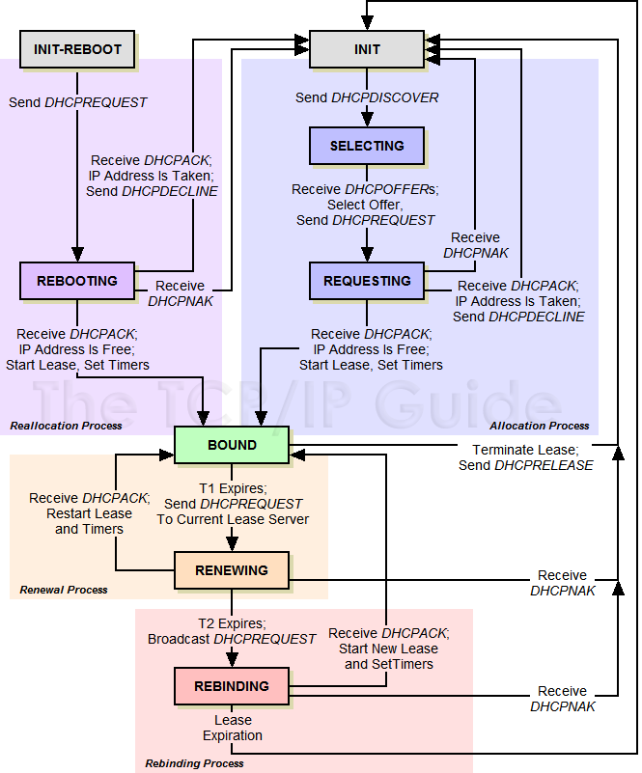
DHCP FSM

Slide 23
Lease
Address assignment with contracted duration
Duration depends on how much addresses are in need
Renew (T1) vs. Rebind (T2)
Try renew it by ‘ipconfig /renew’
Try release IP by ‘ipconfig /release’

Slide 24
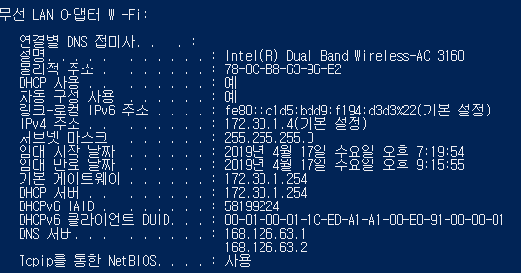
Lease

Slide 25
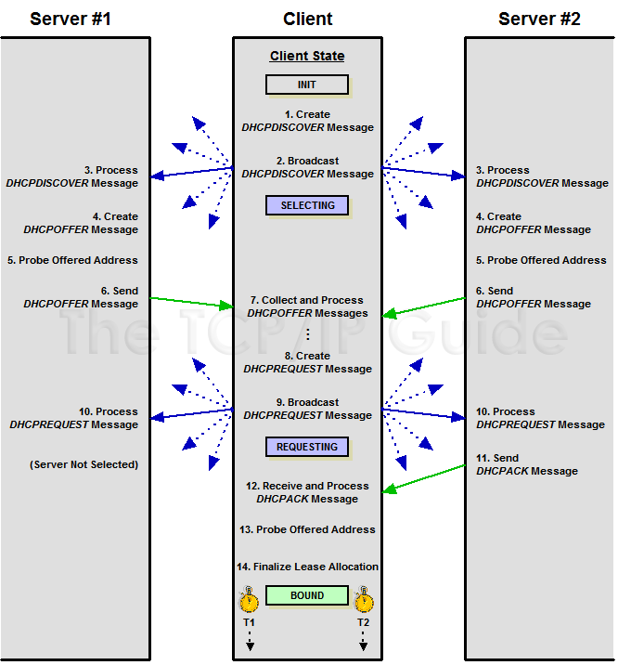
Lease

Slide 26
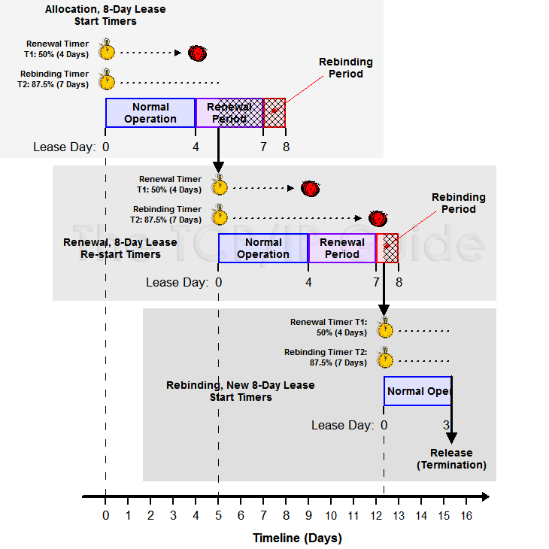
Lease

Slide 27
DAD by client

Slide 28
DHCP server conflict detection
Multiple servers, overlapping IP address pools
Before DHCPOFFER, ping the address to assign

Slide 29
Autoconfiguration
Plug and play
Two kinds of autoconfiguration in IPv4
  Stateful → DHCP
  Stateless → Automatic Private IP Addressing (APIPA; by Microsoft) uses 169.254.0.0/16 when DHCP fails

Slide 30
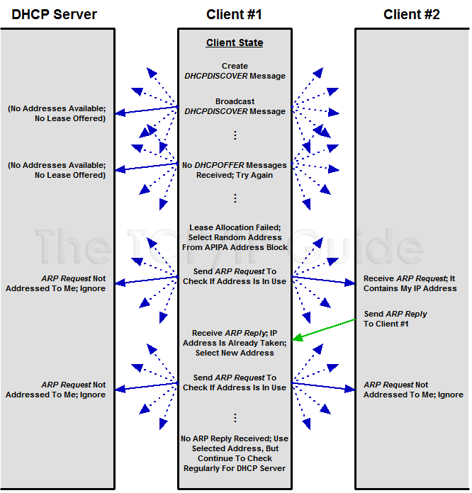
APIPA

