Slide 1
9.4:The Internet Group Management Protocol (IGMP) and Multicast Listener Discovery Protocol (MLD)
김대영
2014021627

Slide 2
Background
Multicast routing be enabled by one or more multicast routers.
Multicast routers require knowledge about which hosts are interested in what multicast groups.
- To arrange for multicast traffic to be delivered
appropriately.
Execute a special procedure called the Reverse Path
Forwarding (RPF) check.
- Performs a routing lookup on the source address
of an arriving multicast datagram.

Slide 3
Background
Two major protocols are used to allow multicast routers to learn the groups
- IPV4: Internet Group Management Protocol (IGMP)
- IPV6: Multicast Listener Discovery (MLD)
Let the multicast routers on a LAN (VLAN) know which
hosts currently belong to which multicast groups.

Slide 4
Background
IGMP version 3: [RFC3376]
MLD version 2: [RFC3810]
IGMPv3 and/or MLDv2 are required for supporting
SSM
- Add the ability to select the sources of multicast traffic and required for deployment of SSM.

Slide 5
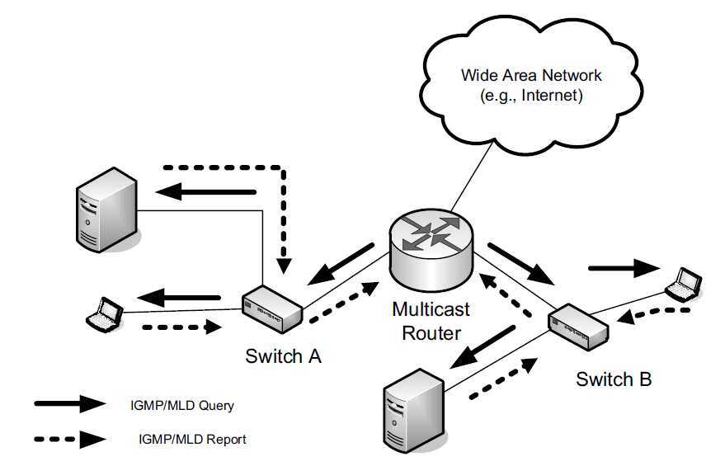
How IGMP (MLD) is used by an IPv4 (IPv6)
IGMP/MLD Query
  All Hosts multicast address, 224.0.0.1 (IGMP)
  Nodes link-scope multicast address, ff02::1 (MLD)
If membership changes occur, Hosts may also send unsolicited reports.

Slide 6
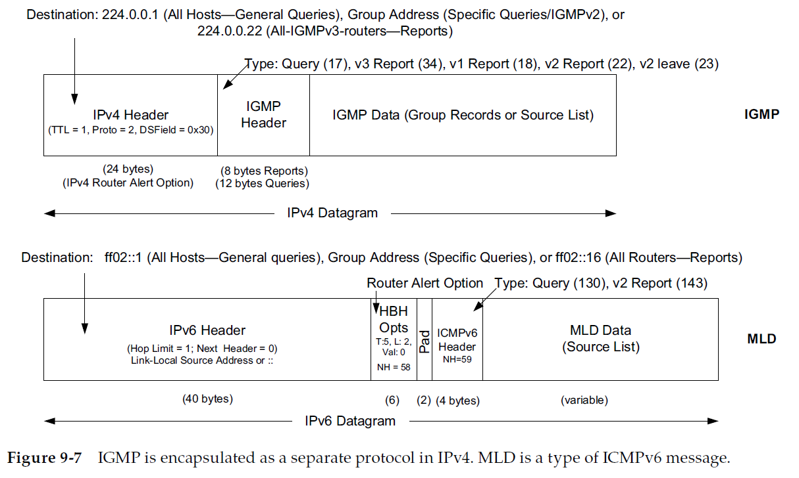
IGMP is encapsulated

Slide 7
9.4.1 IGMP and MLD Processing by Group Members (“Group Member Part”)
The group members’ portion of IGMP and MLD
- To allow hosts to specify what groups they are
interested in.
- Whether traffic sent from particular sources should
be accepted or filtered out.

Slide 8
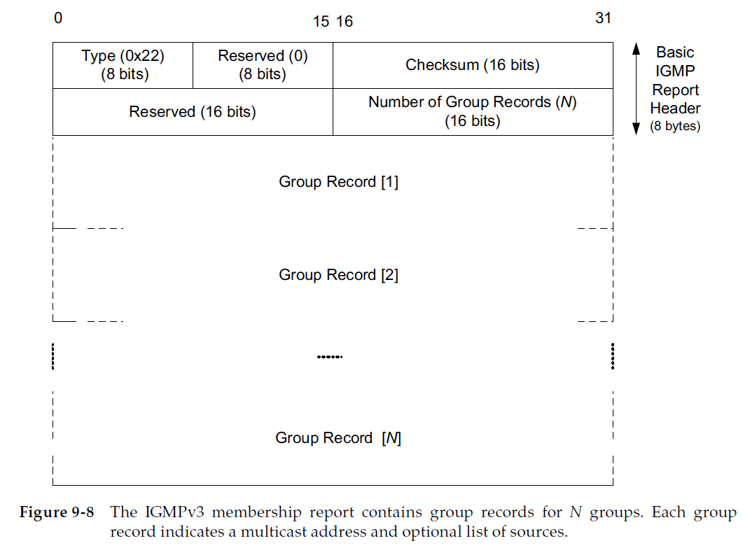
IGMPv3 reports

Slide 9
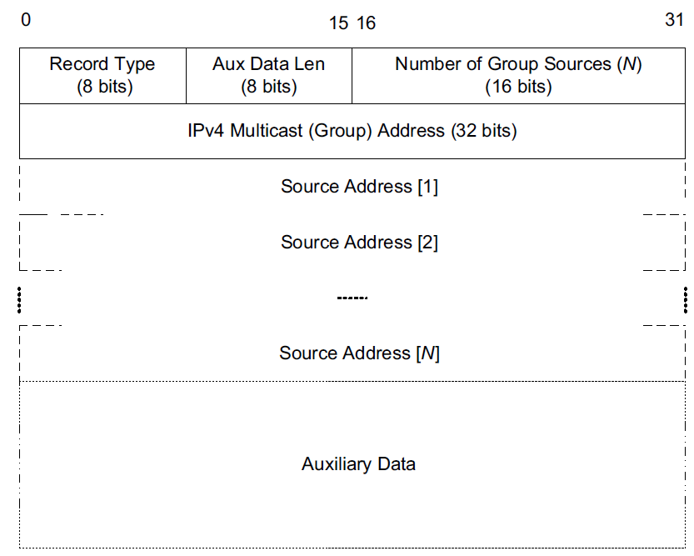
IGMPv3 group record
list of sources
- Include mode
only sources from which traffic
should be accepted.
- Exclude mode
the ones to be filtered out
(all others are allowed).

Slide 10
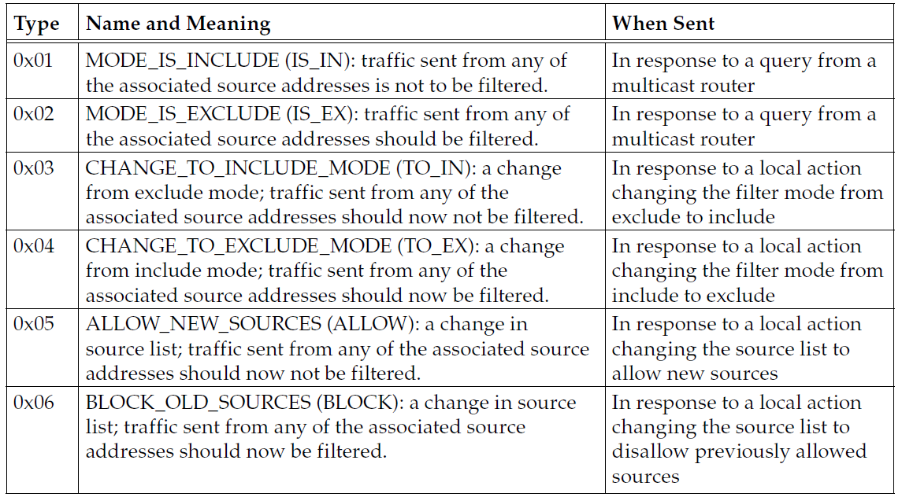
Significant flexibility

Slide 11
9.4.1 IGMP and MLD Processing by Group Members (“Group Member Part”)
When receiving a query, group members do not
respond immediately.
  - They set a random (bounded) timer to determine
  when to respond.
- During this delay interval, processes may alter their group/ source interests.
► saving overhead

Slide 12
9.4.2 IGMP and MLD Processing by Group Routers (“Multicast Router Part”)
Multicast router is to determine, whether at least one group member is present to receive corresponding
traffic.
Accomplished by sending queries and building state
describing the existence of such members based on
the reports they send.

Slide 13
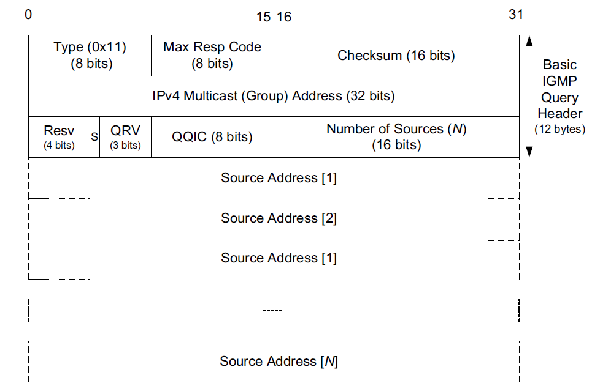
IGMPv3 query
Queries use a group address of 0
Sent to the All Hosts multicast
address
- 224.0.0.1
QRV value
- encodes the maximum number
of retransmissions
QQIC field
- The periodic query interval.

Slide 14
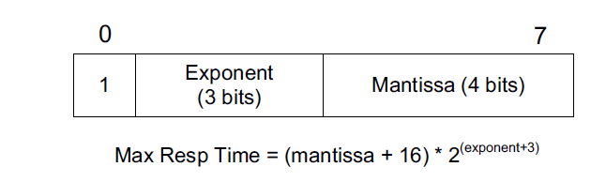
IGMPv3 query
Max Resp Code field
- encodes the maximum amount of time the receiver
of the query should delay before sending a report.
encoding provides for a possible range of (16)(8) = 128 to (31)(1024) = 31,744
(i.e., about 13s to 53 minutes).

Slide 15
IGMPv3 query
There are three variants of the query message
- general query,
used by the multicast router to update information regarding any multicast group
- group-specific query
similar to general queries but are specific to the
identified group.
- group-and-source-specific query
essentially a group-specific query with a set of
sources included.

Slide 16
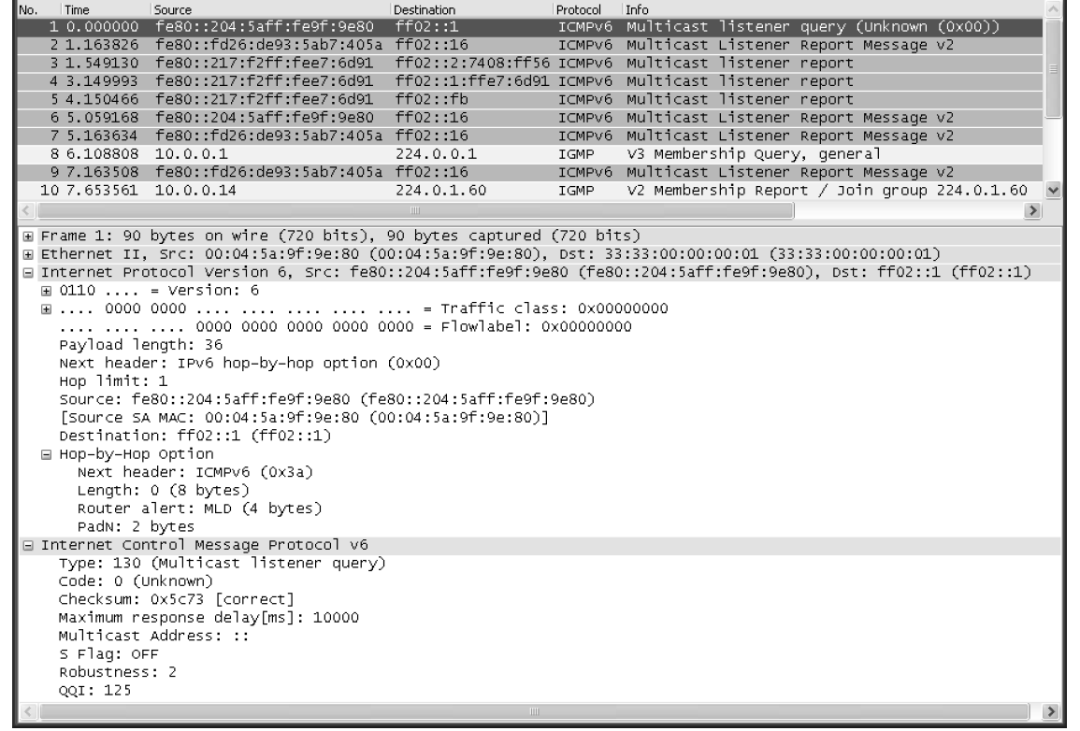
9.4.3 Example
Start
Hop-by-Hop option, header and Type, Code, Checksum, and Max Response fields of
the MLD message
MAC-layer addresses

Slide 17
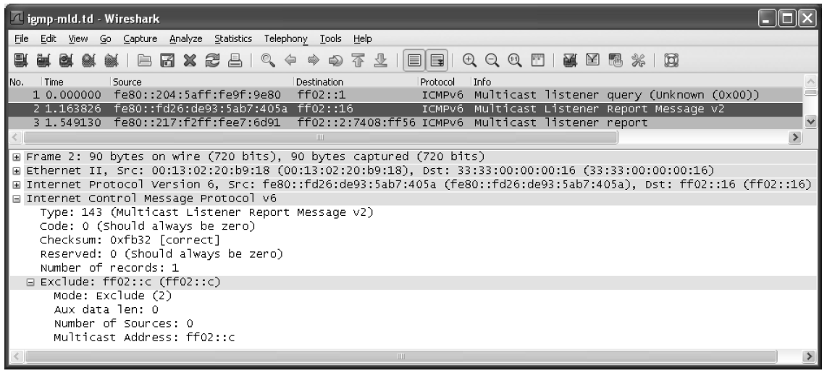
9.4.3 Example
Notes:
.

Slide 18
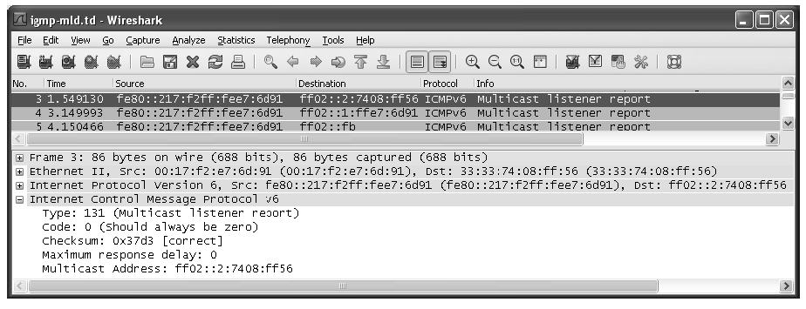
9.4.3 Example
The destination address of the report is the multicast address of
interest, ff02::2:7408:ff56
The MAC layer, this destination address is mapped to
33:33:74:08:ff:56

Slide 19
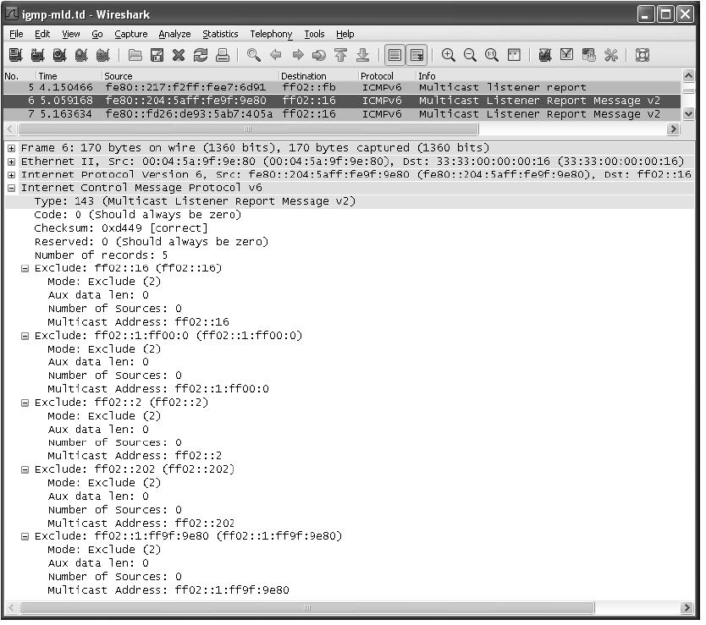
9.4.3 Example
All MLDv2-capable routers
First solicited-node address
All Routers
ONC RPC
The MLD querier

Slide 20
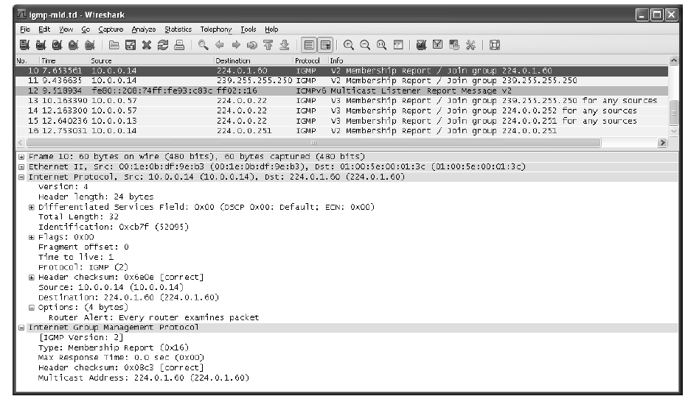
9.4.3 Example
IGMPv2 messages are sent to the IP address of the group.

Slide 21
9.4.4 Lightweight IGMPv3 and MLDv2
Simplified versions of IGMPv3
- Lightweight IGMPv3 (LW-IGMPv3)
Simplified versions of MLDv2
- Lightweight MLDv2 (LW-MLDv2)
LW-IGMPv3, LW-MLDv2
- Support both ASM and SSM
- use a message format compatible with IGMPv3
and MLDv2
- lack the specific source-blocking function

Slide 22
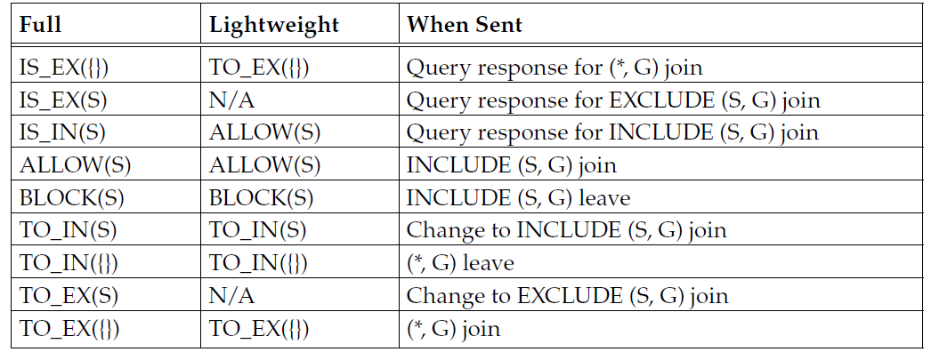
Comparison of operations
Empty set notation ({}): null source address list.
TO_EX({}): message of type 0x04 indicating a change
to EXCLUDE mode with no associated sources.
(*, G): group G associated with any source.
(S, G): group G associated with specific source S.

Slide 23
9.4.5 IGMP and MLD Robustness
Main concerns with the robustness and reliability
  Failures of IGMP or MLD, or multicast more generally
    can lead to either the distribution of unwanted multicast traffic.
    The inability to deliver desired multicast traffic.
  The loss of protocol messages
The potential failure of a multicast router
  handled by allowing more than one multicast router to
  operate on the same link.
To help guard against lost protocol messages, some
messages are retransmitted up to a small number of
times

Slide 24
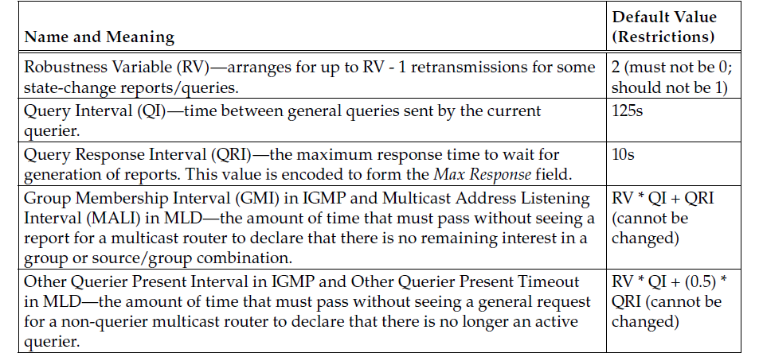
9.4.6 IGMP and MLD
Counters and Variables
IGMP and MLD are soft-state protocols
  deal with failures of routers, loss of protocol messages, and
  interoperability
  To enable these capabilities is based on timers that trigger
  state changes and protocol actions.

Slide 25
9.4.7 IGMP and MLD Snooping
IGMP and MLD manage the flow of IP multicast traffic among routers.
IGMP (MLD) snooping
  To optimize traffic, it is possible for layer 2 switches to
  become aware of whether certain multicast traffic flows are
  of interest or not by looking at layer 3 information.
Without IGMP snooping
  Switches typically send link-layer multicast traffic by
  broadcasting it along all the branches of the spanning tree
  formed among switches.

Slide 26
9.4.7 IGMP and MLD Snooping
Complicate the straightforward implementation of
IGMP/MLD snooping.
  If IGS switches were to forward reports to all attached
  interfaces, as hosts on some LAN (VLAN) segments with group
  members may not be noticed.
    Instead, they forward reports only to the nearest multicast router.
When implementing snooping relates to the differencein message formats between IGMP and MLD.
  Because MLD is encapsulated as part of ICMPv6 instead of its own separate protocol, MLD-snooping switches must process
  ICMPv6 information and be careful to separate the MLD
  messages from the others.

