Slide 1
Secure Bluetooth Connection for Unified Authentication Management System
Based on a paper presented in UBICOMP ‘15
2016.12.13
네트워크공학특론 – Choongin Lee

Slide 2
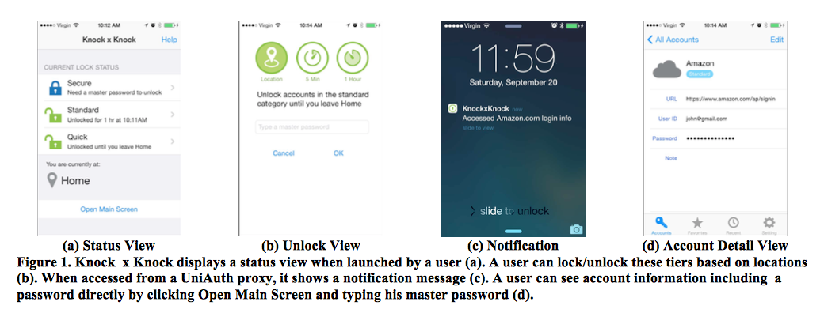
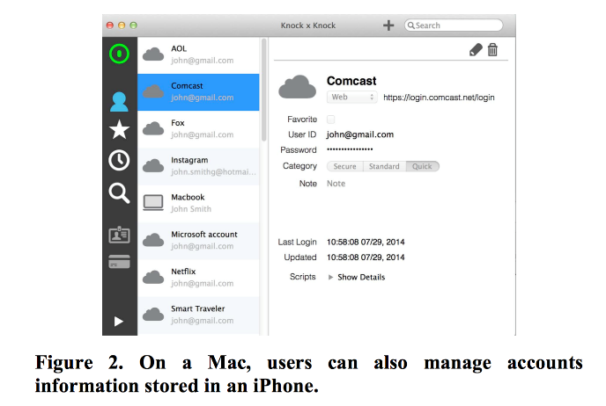
Architecture of Knock x Knock
UniAuth client on iphone
UniAuth proxy on Mac
All credentials are stored
Mutual auth with mac using pre-shared key
Browser extensions
Connects phone via Bluetooth LE and the browser using local web server
“All data exchanges after the mutual authentication are encrypted using AES-128”

Slide 3
Problem Definition
Weak threat model in the framework (based on the paper)
  Online/offline attacks against users’ accounts
    Dictionary attack, brute force attack
  Phishing attacks
  Physical security
False assumption: the framework still endangered
  “If secure cryptographic primitives and properly used, it is safe”
  “It relies on the Bluetooth property using pre-shared key”
  “All data exchanges after the mutual authentication are encrypted using AES-128”
New threat model to be considered
  Key can be stolen with sniffing
  Data over Bluetooth LE can be decrypted with the key

Slide 4

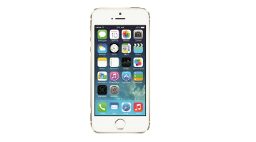


Proposed Approach
Mac
iPhone
Case Study : Bluetooth LE Decryption
  Sniffing pairing process
  Getting a key
  Decryption Bluetooth LE encrypted data
A method to mitigate sniffing attack
  Out-of-band pairing algorithm
    (For iPhone) QRcode-based authentication
    (For android) NFC-based authentication
Pair
Sniffed
Decrypt
Data
Get a key
Sniffed
Decrypt
w/ key
Get data

Slide 5
Bluetooth Pairing Feature
Pairing Auth Type
  Just works
    For no display of 6 digits
    Key value : 0x00
  Passkey
    For having display of 6 digits
    Key value : 000000 ~ 999999
  Out-of-Band (OOB)
    Using external interface
    Key value : Image, Signal, etc.
Basically, Mac and iPhone use passkey
  After the pairing process, all the data is encrypted with 128bit AES
  However, sniffing and brute-forcing passkey is possible before the encryption
Pairing Feature Exchange
Just works
Passkey
OOB
Encrypt Link using Generated STK

Slide 6
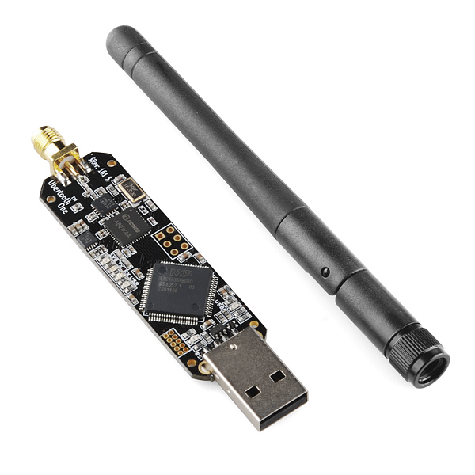
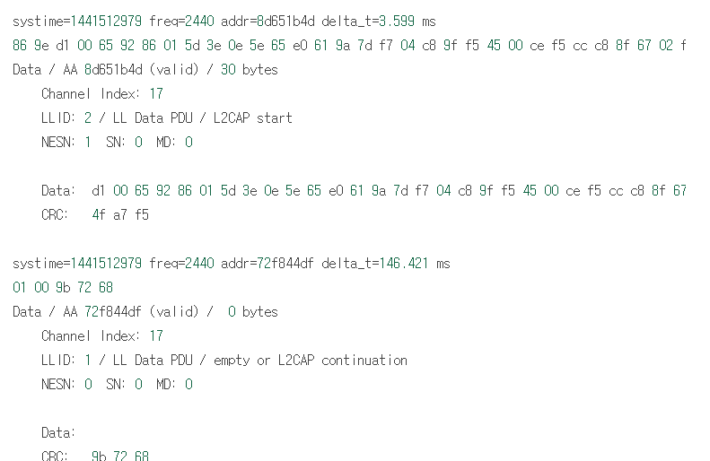
Case Study: Bluetooth LE Decryption
Sniffing BLE communication
  Sniffing nearby devices with “Ubertooth One”
  Pair both devices with TK ‘000000’
Packet sniffed
Ubertooth One
Sniffing process

Slide 7
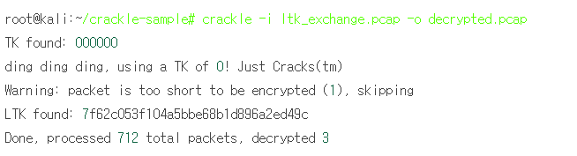
Case Study: Bluetooth LE Decryption
Cracking a Temporary Key (TK) and generate Long Term Key (LTK)
  Cracking a TK with “CrackLE”
    CrackLE : a Bluetooth LE key cracker with brute-force
  Based on the TK and communication, generate its LTK between two devices
Key found with brute-force
LTK generated
Sniffing process

Slide 8
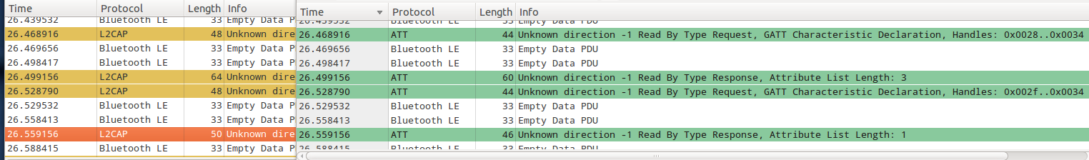
Case Study: Bluetooth LE Decryption
Decrypting future BLE communication
  With the LTK generated, decrypt encrypted BLE data
Encrypted packet
  Wireshark reports that it is malformed L2CAP packet
Decrypted packet
  Wireshark reports that it is clear ATT packet
Encrypted Packet
After Decryption with LTK

Slide 9

Mitigation: Out-of-Band Pairing
Mac
iPhone
Using QR-code or NFC instead of random number (TK)
  TK is easily brute-forced
QR-code (in Knock x Knock)
  Easily made from counterpart device
  But complex pairing key can be made
Pair request
Generate a QRcode
of complex key
Scan and
send response
Pairing success
Send Credential data
encrypted with 128b AES

Slide 10
Survey & Analysis
However, no support OOB in Apple iOS and OSX
  Tried to implement OOB pairing in OSX, but no API supported
    Only OOB with Apple Watch possible with images as a key
  Apple kernel is not available
    Custom kernel modification is not possible, either
Support OOB in Android
  API is publically announced
  Android is recommended for the client of UniAuth in the paper
Without API, “Knock x Knock” with Apple device is endangered
 | Mac | iPhone | Apple watch | Android
Passkey | O | O | O | O
OOB | X | X | O | O (from v4.1)

Slide 11
Conclusion
Knock x Knock
  iPhone prototype for mechanisms for streamlining authentication to devices and web service
  Manage (store and give back) credentials in mobile devices (phone, wearable devices)
Weak threat model & False assumption
  When using Bluetooth, credential data can be sniffed and decrypted
Demonstration of Bluetooth LE vulnerability
  Using sniffing device and packet cracking program
Out-of-Band pairing of Android as a mitigation
  For iPhone – QR code or images
    API not provided
  For Android (Recommended) – Use NFC
    API provided

