Slide 1
CarSafe App: Alerting Drowsy and Distracted Drivers using Dual Cameras on Smartphone
MobiSys 2013

Slide 2
ABSTRACT
CarSafe
  A new driver safety app for Android phones
    First dual-camera sensing app
    Using other embedded sensors
  Detect and alerts to dangerous driving conditions and behavior
    Inside : Drowsy driving
    Outside : Tailgating
  Using computer vision and machine learning algorithm

Slide 3
INTRODUCTION
Risk of distracted driving
  In 2010, 3092 people were killed and 416,000 injured in USA
  Difficult to recognize drivers are in a fatigued states
  → Tracking dangerous driving behavior can help
  raise drivers’ awareness
Risk of distracted driving
  In 2010, 3092 people were killed and 416,000 injured in USA

Slide 4
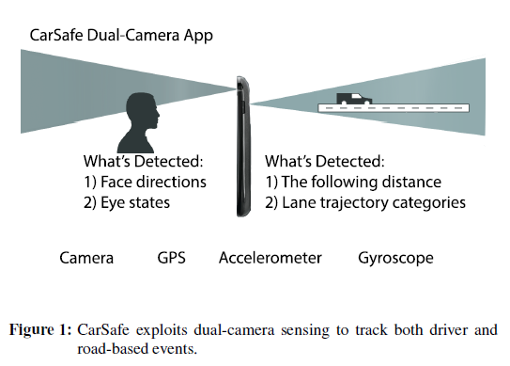
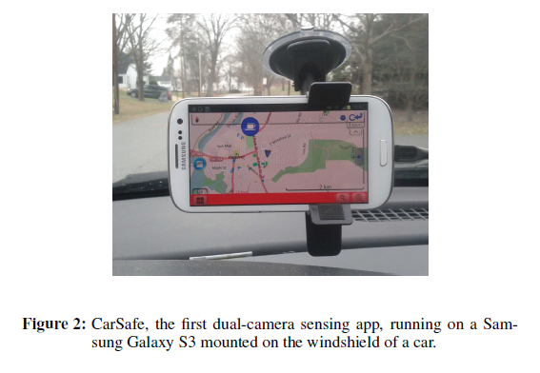
INTRODUCTION
CarSafe
  Concept & Operation

Slide 5
DESIGN CONSIDERATIONS
Dangerous Driving Event [16]
  Drowsy Driving(DD) : doing micro-sleep
  Inattentive Driving(ID) : not maintaining eye
  contact with the road
  Tailgating(TG) : not maintaining a safe minimum
  distance
  Lane Weaving and Drifting(LW) : erratic lane changing
  Careless Lane Changing(CLC) : do not check mirrors
[16] : NYS DMV(New York State Department of Motor Vehicle) – Driver’s Manual – Chapter 8 : Defensive Driving

Slide 6
DESIGN CONSIDERATIONS
Dual Camera Processing
  Cross Stream Event Correlation
    Correlation between Inside and outside
      Strong : drowsy state & tailgating
  Limited Dual Camera Access
    Not provide simultaneous access to both the front and rear
    Switching delay : 886(average)
  Blind Spot Processing
    Only one camera can be accessed at a time
    How determine the best time to switch cameras
    Use of other embedded sensors

Slide 7
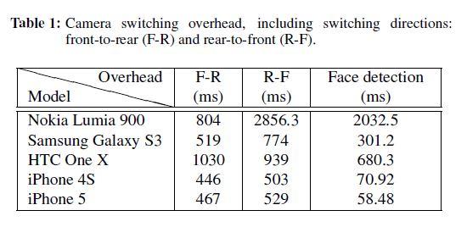
DESIGN CONSIDERATIONS
Real-time Performance

Slide 8
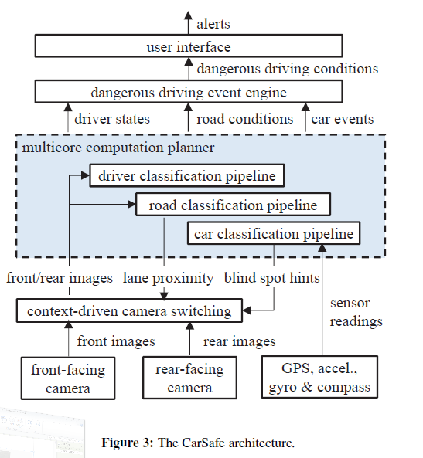
CARSAFE DETAILED DESIGN
Key Components
  Driver, car and road classification pipelines
  Dangerous driving event engine
  Context-driven camera switching
  Multi-core computation planner
  User interface

Slide 9
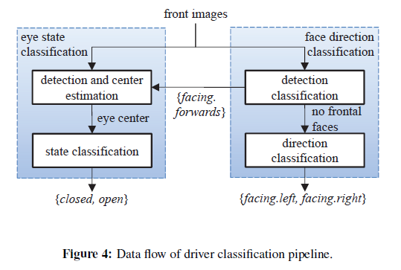
CARSAFE DETAILED DESIGN
Classification Pipelines
  Driver Classification Pipeline
    Face Direction Classification
    Eye State Classification
76 MUCT pre-defined visual
landmarks
* MUCT : Milborrow /
University of Cape town
Scanned to find the relative position of the driver’s face (iterative process)
200 X 200 → 70 X 70
Extraction of SURF features
SVM classifier
*SURF : Speeded Up
Robust Features
*SVM : Support Vector
Machine
Haar-like features
Adaboost decision-stump classifier
( > 15°)

Slide 10
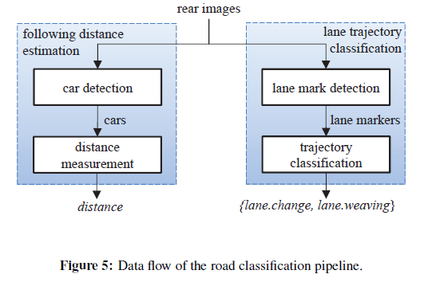
CARSAFE DETAILED DESIGN
Classification Pipelines
  Road Classification Pipeline
    Following Distance Estimation
    Lane Trajectory Classification
WalkSafe (Previous work)
MIT CBCL
*Center for Biological &
Computational Learning
Perspective transformation
Vertical-dege detection
Line detection
- Hough-line transformation
-Canny edge detector
- RANdom SAmple Consensus
Decision tree[27] trained by duration and frequency of crossing event

Slide 11
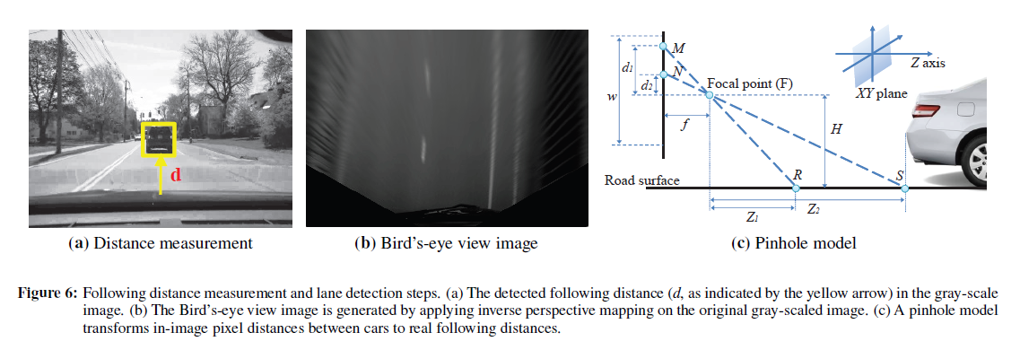

CARSAFE DETAILED DESIGN
Road Classification Pipeline
Z : Road distance
d : pixel distance
F : rear-camera focal length
H : smartphone mounting height

Slide 12
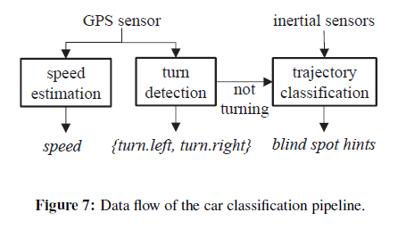
CARSAFE DETAILED DESIGN
Classification Pipelines
  Car Classification Pipeline
    Speed estimation
    Turn detection
    Trajectory classification

Slide 13
CARSAFE DETAILED DESIGN
Dangerous Driving Event Engine
  Drowsy Driving (DD)
    Adopt a standard metric for measuring alertness, PERCLOS
    (PERcentage of CLOSure of the eyeclid)
    Proportion of time within one minute that eyes are at least 80% closed
  Inattentive Driving (ID)
    Driver’s face is not facing forward for longer than three seconds while the care is moving forward
    No a head turn corresponding to a car turning event

Slide 14
CARSAFE DETAILED DESIGN
Dangerous Driving Event Engine
  Tailgating (TG)
    Calculation for a minimum following distance
    3 seconds check
  Lane Weaving and Drifting (LW)
    Lane weaving or lane drifting continuously longer than 2 seconds
  Careless Lane Change (CLC)
    No head turn corresponding to a lane change event
    (Occurring within 3 seconds prior to the lane change
    event detection)

Slide 15
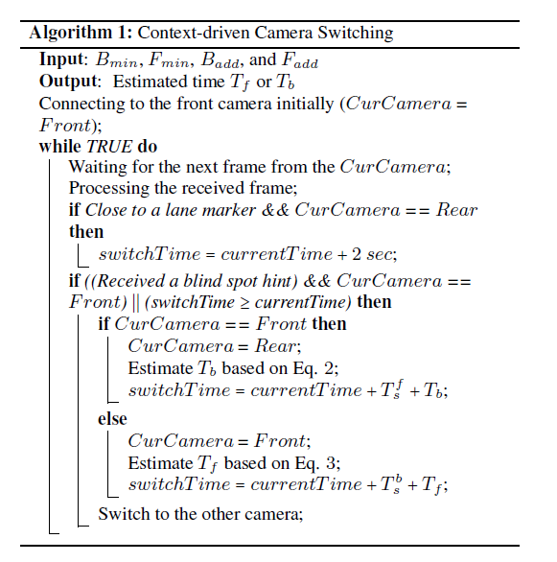


CARSAFE DETAILED DESIGN
Context-driven Camera Switching
  Front-Camera event
    Bmin, Badd
  Rear-Camera event
    Fmin, Fadd

Slide 16
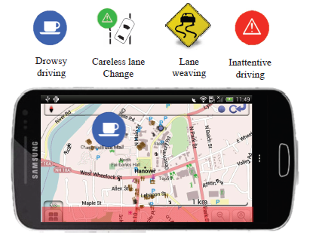
CARSAFE DETAILED DESIGN
Multi-core Computation Planner
  Dispatcher
    Maintaining a pool of threads
  Queue Manager
    No available when new data arrives
  De-multiplexer
User Interface

Slide 17
CARSAFE IMPLEMENTATION
multi-core Galaxy S3 android phone
  1.4GHz quad-core Cortex-A9 CPU
C, C++ based on the OpenCV libraries
Java using JNI wrappers
OsmAnd Navigation Map

Slide 18
EVALUATION
Datasets
  2 distinct experiments
    Controlled car maneuvers
    Normal daily driving
  12 participants
    23 to 53 years
    Undergraduates, graduates, postdoctoral researchers, etc
  Cars
    Dodge Stratus, Volkswagen Tiguan, Honda Civic, Subaru Outback, Nissan Camry, Volvo 850, Mazda familia
  300 minutes of driving data with 164 dangerous events
    121 from the controlled dataset
    43 from the normal daily driving dataset

Slide 19
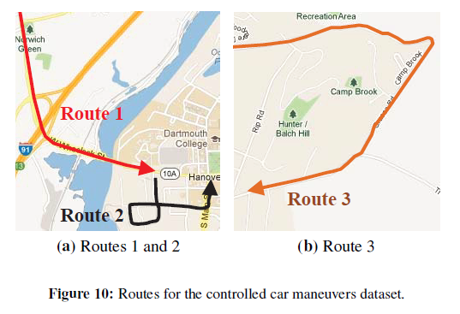
EVALUATION
Datasets
  Using 3 smartphones
    1 for running CarSafe
    2 for capture images &
    Sensor data
  Manually label dangerous
  driving events
    Replaying recorded video
    Segmenting the sensor

Slide 20
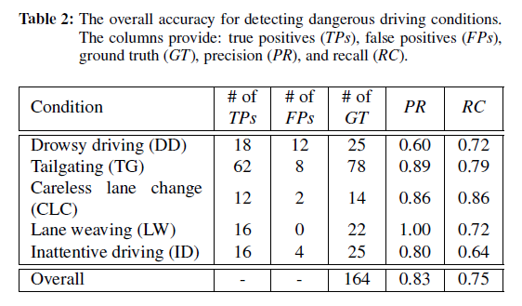
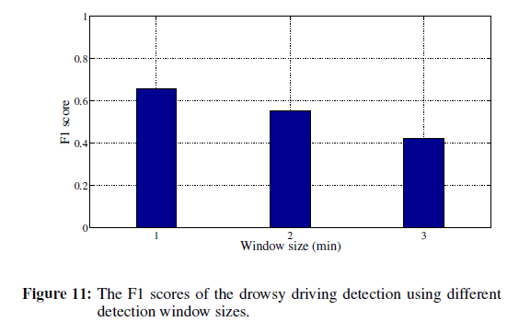
EVALUATION
Overall CarSafe Accuracy
  Window Size Tuning : Drowsy Driving Detection
    F1 score : harmonic mean of precision and recall[27]

Slide 21
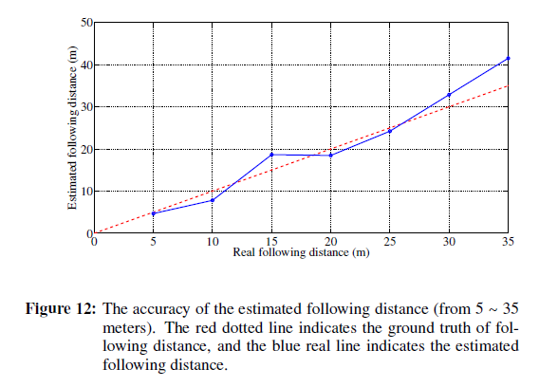
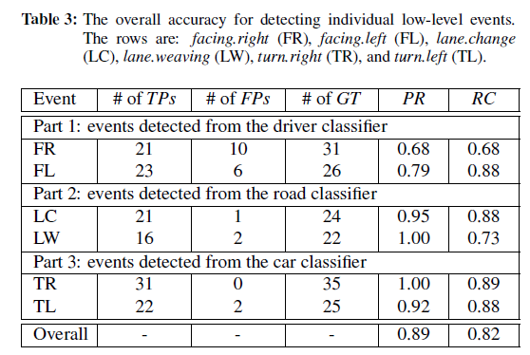
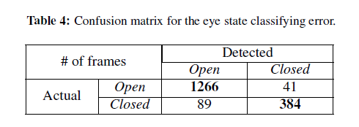
EVALUATION
Driver, Road, and Car Classification Pipline Benchmarks

Slide 22
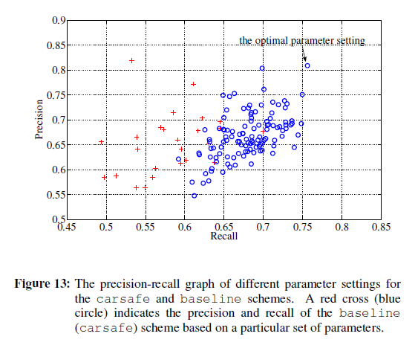
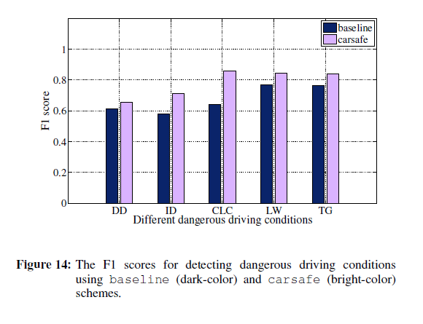
EVALUATION
Context-driven Camera Switching

Slide 23
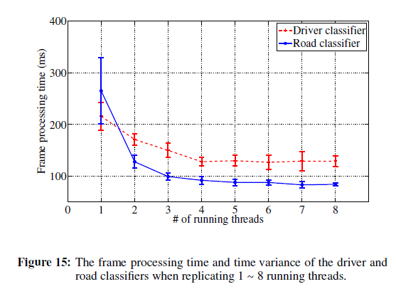
EVALUATION
Multi-core Computation Planner Benchmarks

Slide 24
CONCLUSION
Describes the design, implementation and evaluation of Carsafe
Performance of the overall system looks very promising
Future plan
  Improvements in the real-time performance of the CarSafe classification pipelines
  Develop a set of open APIs enabling full access to the front and rear cameras

Slide 25
Q&A

Slide 26
배경 | 차량의 BSM 메시지 전송은 평균 Inter-Message-Gap(IMG)값이 작은 것도 중요하지만, MAX IMG 값을 줄이는 것이 더 중요하다. (주기적으로 전송되는 차량의 안전 메시지를 연속해서 유실을 하여 Ghost Node가 발생하는 것이 차량 사고에 더 취약하다.)
아이디어 | BSM 메시지 전송에 성공한 Node는 일정 시간(Waiting Interval) 전송 시도를 하지 않는다. (전송을 성공하지 못한 Node에 우선 순위를 주어서, MAX IMG 값을 줄인다.) 전송시점을 매 Interval마다 Random하게 결정한다. (전송시점이 일정한 경우에는 특정 노드가 경쟁이 심화된 환경에서 계속 전송시도를 하게 되어 MAX IMG가 높아진다.) 100ms의 Interval을 0.5ms의 200개 Epoch 단위로 구분하며, 차량들은 이 Epoch를 선택하여 전송한다. (250byte의 데이터를 6Mbps의 속도로 전송하는 경우 0.5ms의 시간은 충분히 전송 가능한 시간이며, post backoff를 통하여 선택한 Epoch에서 확실히 전송하도록 한다.)

Slide 27
실험결과
Poisson Approximation 기반 분석
  실험환경
    Packet(payload) : 250Byte
    차량 분포 : one point
    알고리즘 : Standard , Epoch(Random)
    Epoch(Random + Waiting Interval D)

Slide 28
400대
RECEIVE PACKET # (6회실험 평균)
 | Standard | Epoch | Epoch with D
평균 | 55.5 | 58.4 | 73.0
MIN | 12.3 | 35.7 | 58.0
MAX | 223.3 | 84.2 | 88.5
MAX IMG (ms, 6회실험 평균)
 | Standard | Epoch | Epoch with D
평균 | 2175.7 | 1794.7 | 990.4
MIN | 299.8 | 909.0 | 615.3
MAX | 7732.7 | 4359.8 | 2051.0
MAX IMG > 5 second 개수
 | Standard | Epoch | Epoch with D
평균 | 8.3 | 0 | 0
MIN | 3 | 0 | 0
MAX | 18 | 0 | 0

Slide 29
800대
RECEIVE PACKET # (6회실험 평균)
 | Standard | Epoch | Epoch with D
평균 | 16.1 | 16.4 | 23.0
MIN | 3.5 | 4.7 | 12.3
MAX | 48.2 | 32.3 | 35.7
MAX IMG (ms, 6회실험 평균)
 | Standard | Epoch | Epoch with D
평균 | 5088.2 | 4836.0 | 3114.7
MIN | 1732.7 | 1950.7 | 1520.7
MAX | 15815.8 | 14426.8 | 8473.5
MAX IMG > 5 second 개수
 | Standard | Epoch | Epoch with D
평균 | 333.3 | 294.3 | 29.1
MIN | 318 | 279 | 21
MAX | 354 | 318 | 35

Slide 30
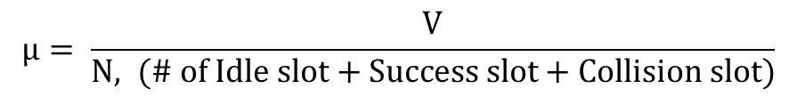
분석
Poisson Approximation
      $P_{idle}= e^{−μ}, { P}_{busy}= 1−P_{idle}$
$$μ= \frac{V}{N, (\# of Idle slot+Success slot+Collision slot)}$$
      $$P_{idle} ∗ N + P_{busy} ∗ N ∗ Nslot =Ntotal (slot 단위)$$

