Slide 1
IEEE 802.11ah: A Long Range 802.11 WLAN at Sub 1 GHz
Journal of ICT Standardization
, vol. 1, issue 1, May 2013.
Weiping Sun, Munhwan Choi and Sunghyun Choi

Slide 2
Contents
Introduction
Use Cases
PHY Layer
MAC Layer
Performance Evaluation
Conclusion

Slide 3
Introduction
3GPP, IEEE and other international organizations adopt their technologies to the emerging market of the IoT
However, the high frequency bands have put limits on the transmission ranges of the 802.11 WLAN
IEEE 802.11 working group has triggered a new project that attempts to enact an 802.11 standard at sub 1 GHz license-exempt bands for cost-effective and large scale wireless networks
The 802.11ah to define some new compact frame formats to reduce the protocol overhead without considering the backward compatibility
Low-cost and large coverage properties make the 802.11ah system highly attractive for large scale sensor networks
The standard is expected to be finalized and arrive in 2016, with chips and systems based on 802.11ah hitting the market as early as 2015. (Qualcomm, Broadcom, Huawei, Intel, LG, Marvell, NEC, Samsung and ZTE)

Slide 4
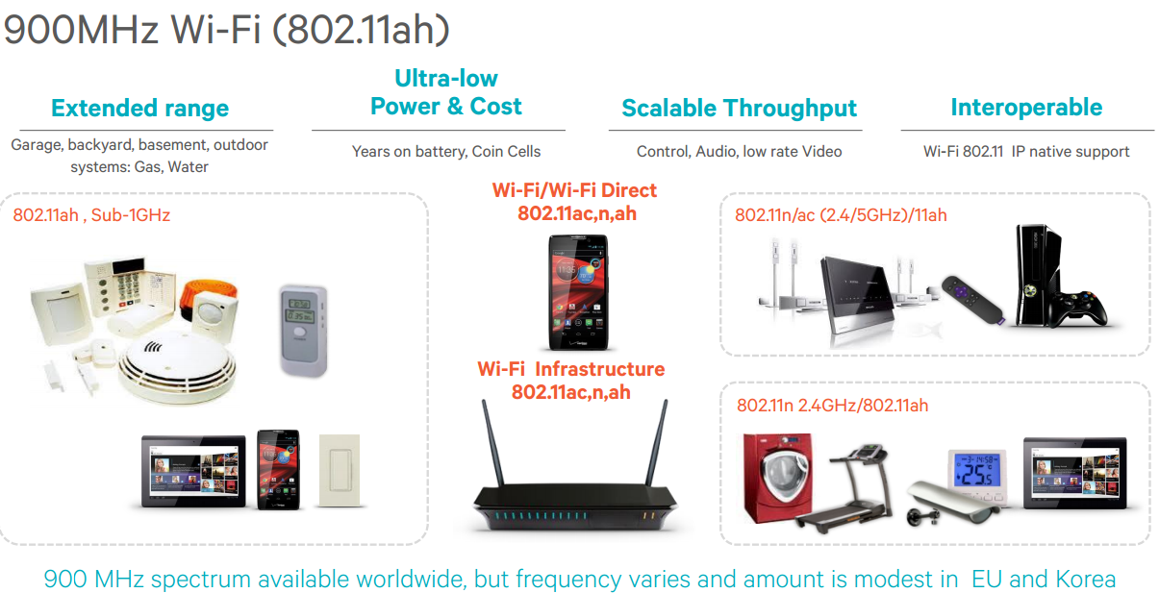
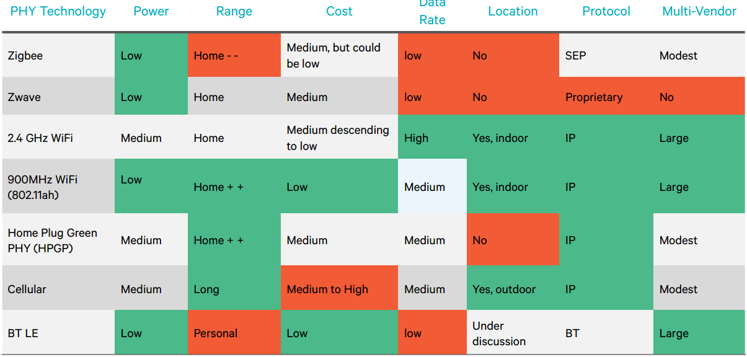
Introduction
Mapping the Future of the Internet of (Every)Thing(s), July 1st 2013 - Qualcomm

Slide 5
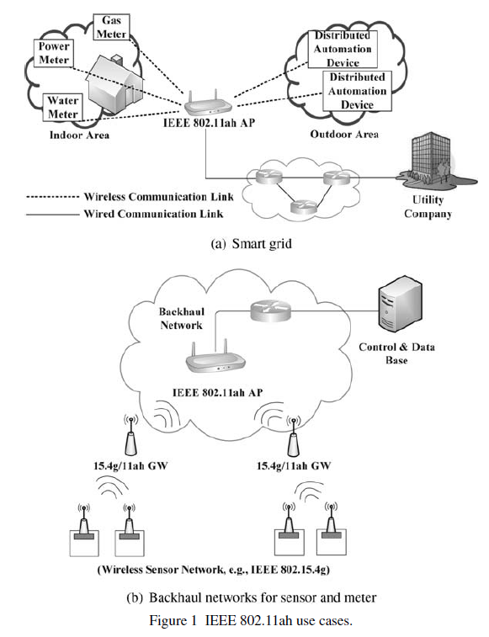
Use Cases
Smart sensors and meters
  smart meters (gas, water and power consumption), smart grids,
  environmental and agricultural monitoring (temperature, humidity, wind speed, water level, pollution, animal condition, forest fire detection, etc.),
  automation of industrial process (petroleum refinement, iron and steel, pharmacy),
  indoor healthcare/fitness system (blood pressure, heart rate, weight),
  elderly care system (fall detection, pill bottle monitor)
  A access point (AP) covers hundreds or even thousands of devices
  that periodically transmit short packets
  The energy consumption is the considered issue

Slide 6
Use Cases
Backhaul aggregation
  Widely used in industry, IEEE 802.15.4g wireless devices can operate on a battery for a long time, however the transmission range and available data rates are very low
  IEEE 802.15.4g routers gather data from leaf devices and forward information to the servers by .11ah links
Extended range hotspot and cellular offloading
  802.11n and 802.11ac data rates are comparable to or even higher than the rates of the modern mobile networks, e.g. LTE, they can hardly be used for offloading in outdoor scenarios because of short transmission range.
  802.11ah, extending the transmission range, will provide real additional value

Slide 7
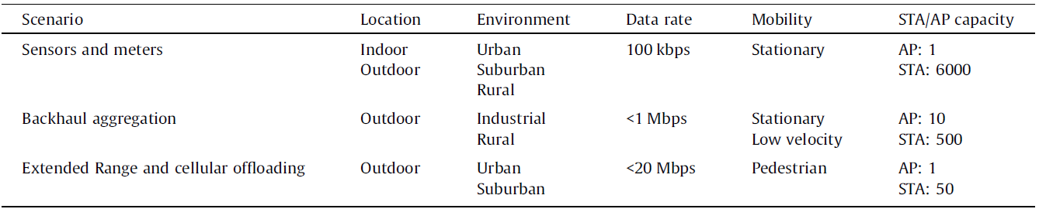
Use Cases
Requirements for different use cases
Not adopted use cases
  media streaming for home entertainment
  electronic menu in restaurants and coupon distribution in malls
  indoor and outdoor location (in mall, parking, etc.),
  AP power saving.

Slide 8
PHY Layer
The 802.11ah PHY features are based on the down-clocked operation of IEEE 802.11ac’s PHY
The 802.11ah defines 2 MHz, 4 MHz, 8 MHz, 16 MHz channels
For the purpose of extended coverage, 1 MHz channel is additionally defined by 802.11ah
802.11ah’s PHY features in terms of channelization and transmission modes are introduced newly

Slide 9
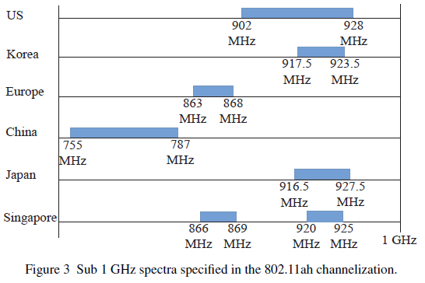
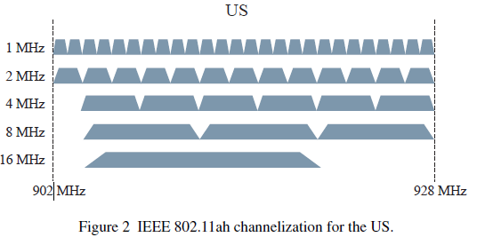
PHY Layer - Channelization
A 10-times down-clocked version of 802.11ac
In order to achieve a higher bandwidth, 802.11ah maintains the same channel bonding method as in 802.11n and 802.11ac
However, since various involved countries have different regulations and available spectra,
the maximum channel bandwidths obtained by the channel bonding could be different
16Mhz
4Mhz
2Mhz
8Mhz
1Mhz
4Mhz

Slide 10
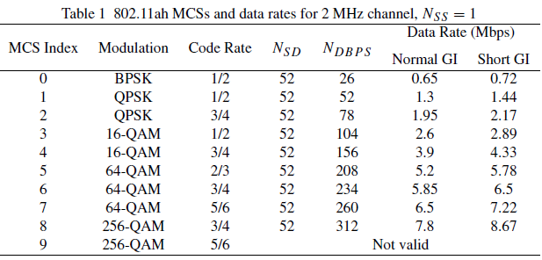
PHY Layer – Transmission Modes
There are two types of transmission modes – greater than or equal to 2MHz and 1Mz
For the greater than or equal to 2MHz,
  Techniques like OFDM(64 FFT is used), MIMO, MU-MIMO
  are adopted
  The set of supported MCSs is also the same as that of 802.11ac
  The maximum number of spatial stream supportable in 802.11ah
  is up to 4 (up to 8 in 802.11ac)
For the 1Mz,
  The goal of designing is to extend the transmission range
  A new MCS index (MCS 10) is included for long range transmission
  The number of data subcarriers per OFDM symbol is 24
  (32FFT is used)
  The MCS 10 is nothing but a mode of MCS 0 with 2x repetition
N_{SS} : the number of spatial streams
N_{SD} : the number of subcarriers
N_{DBPS} : the number of data bits per symbol (per subcarrier per symbol)
Normal GI : 4us
Short GI : 8us

Slide 11
MAC Layer
Some features are enhanced compared with the existing 802.11 MAC
  Support of large number of stations
  Power saving
  Medium access mechanisms
  Throughput enhancements

Slide 12
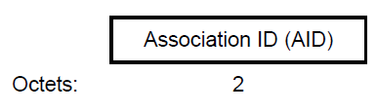
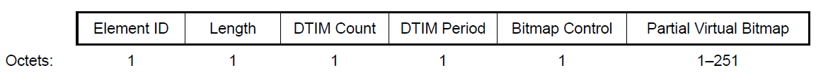
MAC Layer – Support of Large Number of Associated Stations
In 802.11 system, an AP allocates an identifier called Association IDentifier(AID)
  AID is a unique ID, through which the AP can indicate its associated stations
  The value assigned as the AID is in the range 1–2007 and is placed in the 14 LSBs of
  the AID field, with the two MSBs of the AID field set to 1
  This limitation is due to the limited length of the partial virtual bitmap of Traffic Indication Map(TIM) Information Element(IE)
Each bit indicates the corresponding station’s AID
AID format
TIM element format

Slide 13
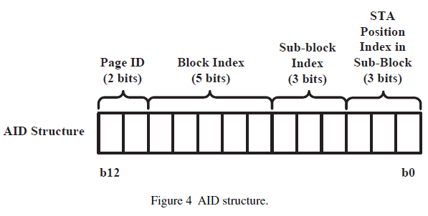
MAC Layer – Support of Large Number of Associated Stations
For increasing the number of supportable stations, a hierarchical AID structure is newly defined in 802.11ah
Hierarchical AID structure enables us to indicate more stations’ AID with a given length of partial virtual bitmap
Hierarchical structure can be adopted to facilitate
the grouping
We can easily group these stations based on
some specific properties, such as
power saving enhancement, resource allocation,
and efficient channel access

Slide 14
MAC Layer – Power Saving
The legacy 802.11 standard defines two power management modes
  Active mode : a station continually turns on the radio components (awake state)
  Power saving mode : a station alternates between awake state and doze state
The station in doze state turns off the radio
components such that it cannot sense incoming
signals at all → the AP buffers the packets until
the station wakes up and requests the delivery
of the buffered traffic
However, several undesirable phenomena could
happen, when there exist a large number of stations
  The length of the beacon frame could become extremely long
  The amount of the buffered traffic is too heavy
AP
Station
AP buffers the packet until the station wake up
doze state
Beacon
frame
Partial virtual bitmap field in the TIM IE
If there is buffered traffic
Control frame
Power Saving(PS)-poll frame
awake state
buffered packets
……..
Go back to doze state

Slide 15
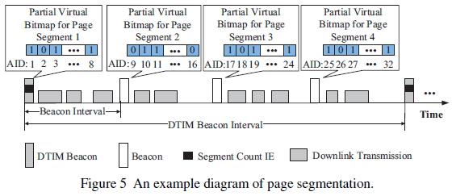
MAC Layer – Power Saving
802.11ah introduces a mechanism called TIM and page segmentation
  An AP splits the whole partial virtual bitmap corresponding to on page into multiple page segments
  Each power saving station wakes up at the transmission time of the beacon which carries the buffering information of the segments it belongs to
A Delivery TIM is a kind of TIM which informs the clients about the presence of buffered multicast/broadcast data on the access point
The length of each beacon frame can be shortened
because the partial virtual bitmap field of the TIM IE
Power saving stations can only be awake for the
beacon with their affiliated segments

Slide 16
MAC Layer – Channel Access
In 802.11ah system, power saving stations are categorized into two classes
  TIM station : The packet buffering information for these stations is included in TIM IE
  non-TIM station : the buffering information is not included in TIM IE
  non-TIM station can keep in doze state over a longer period without worrying about beacon reception
For non-TIM station, AP may allow them to request buffered downlink or uplink traffic at any time upon waking up → Uncontrollable traffic incurred by these non-TIM stations
The wake-up time of non-TIM stations and their channel access attempts could be spread out
  Target Wake Time (TWT) : association request and association response frames
    request type
    target wake time
    minimum wake duration
    wake interval mantissa
  Null Data Packet (NDP) paging frame : contains the information of buffering status

Slide 17
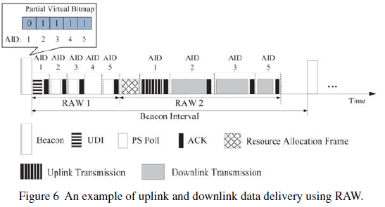
MAC Layer – Channel Access
For TIM station, 802.11ah has focused its efforts on defining a new type of contention-free channel access mechanism
An AP may indicate to a TIM station a time slot during which the station is allowed to transmit or to receive packets
  Restricted Access Window (RAW)
  : a time duration composed of several time slots
  RAW Parameter Set (RPS)
  : the parameters related with RAW
In order to enable the AP to adaptively manage the
RAW allocation, AP determine how to schedule the
uplink and downlink transmission efficiently
  Resource Allocation (RA) frame : the scheduling information of each individual station
  Uplink Data Indication (UDI) : indicate the existence of the uplink frame of a station

Slide 18
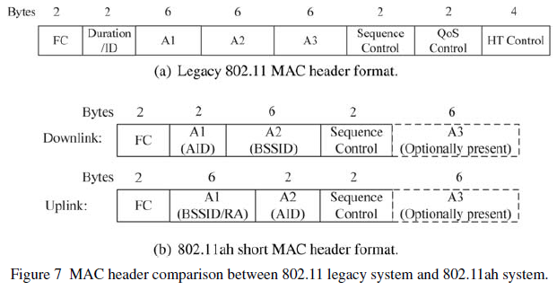
MAC Layer – Throughput Enhancements
A major deficiency of 802.11ah is its low data rates
To reduce protocol overheads, a more compact MAC header format has been proposed
The address 3 field is optionally included and its inclusion is indicated by the indication bit in FC field
Some necessary information contained in QoS filed and HT field is moved to SIG field in the PHY header
There is no duration/ID field so that virtual
carrier sensing is not supported
Alt lease 12 bytes overhead is saved in both
uplink and downlink

Slide 19
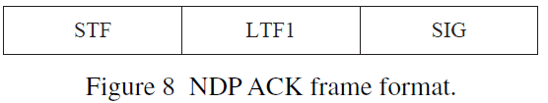
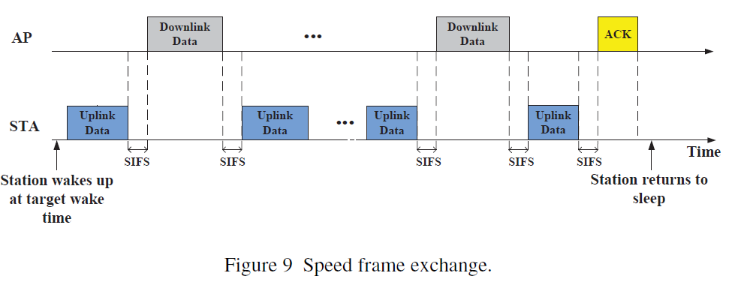
MAC Layer – Throughput Enhancements
In order to shorten the ACK frame, 802.11ah has proposed
a new ACK frame format called Null Data Packet (NDP) ACK
  NDP frames were included in .11ac as short frames used for channel calibration needed for beamforming
  802.11ah extends the concept of NDP, allowing to include some useful information in the SIG field of the PHY header
The reserved value is defined to indicate another feedback method, called speed frame exchange
  If the receiver has a frame destined to the
  transmitter, it can notify the successful reception
  by transmitting its data frame instead of ACK
  If the transmitter successfully receives the
  receiver’s data frame, it can reply with its data
  frame instead of other control frame

Slide 20
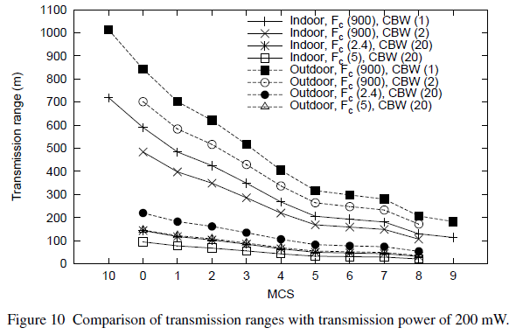
Performance Evaluation
We assume that
  The transmission range is calculated by only considering path loss effect
  The transmission are conducted with a single spatial stream
Transmission power : 200mW
FC(900) : 802.11ah
FC(2.4) : 802.11n
FC(5) : 802.11ac
CBW(20) : 20MHz channel bandwidth(2.4GHz, 5GHz band)
CBW(2) : 2MHz channel bandwidth(900MHz band)
CBW(1) : 1MHz channel bandwidth

Slide 21
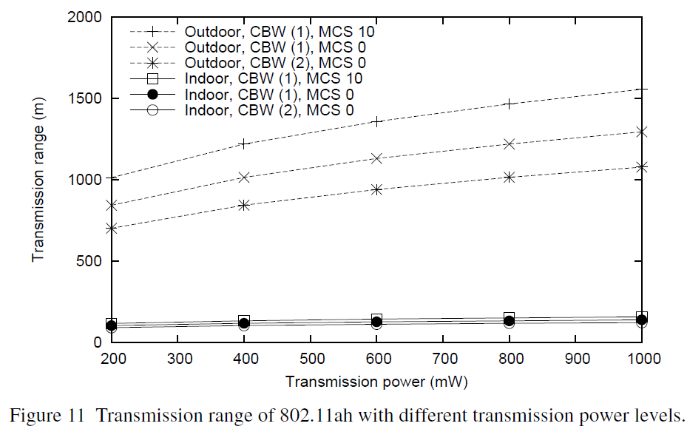
Performance Evaluation
Transmission power : 200mW
FC(900) : 802.11ah
FC(2.4) : 802.11n
FC(5) : 802.11ac
CBW(20) : 20MHz channel bandwidth(2.4GHz, 5GHz band)
CBW(2) : 2MHz channel bandwidth(900MHz band)
CBW(1) : 1MHz channel bandwidth

Slide 22
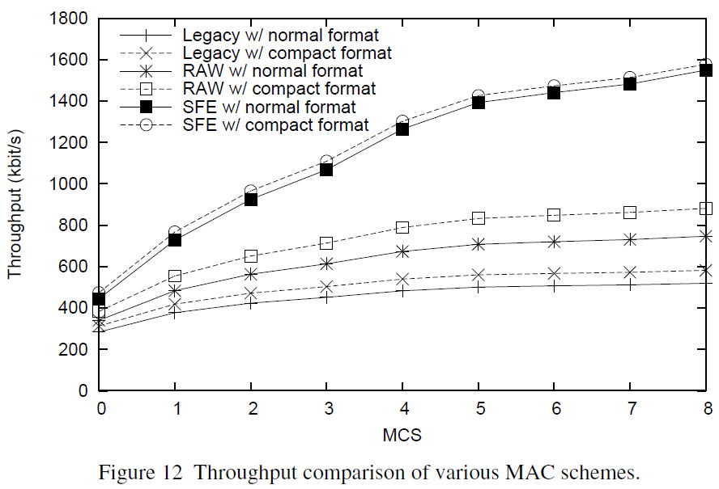
Performance Evaluation
We assume that
  A single transmitter and a single receiver without channel errors
  The transmission are conducted 2MHz channel with a single spatial stream
Due to traffic pattern of 802.11ah usage model, we set the packet size to a relatively small value (100 bytes)
compact format : short MAC header and NDPACK

Slide 23
Conclusion
The transmission range of 802.11ah is much longer than existing Wi-Fi systems
The throughput can be significantly improved by newly adopted medium access schemes
The standardization of 802.11ah is still on-going
There are some remaining issues need to be resolved
  Performance degradation due to the interference caused by neighboring AP
802.11ah will be used for many emerging applications over very large scale wireless networks

