Slide 1
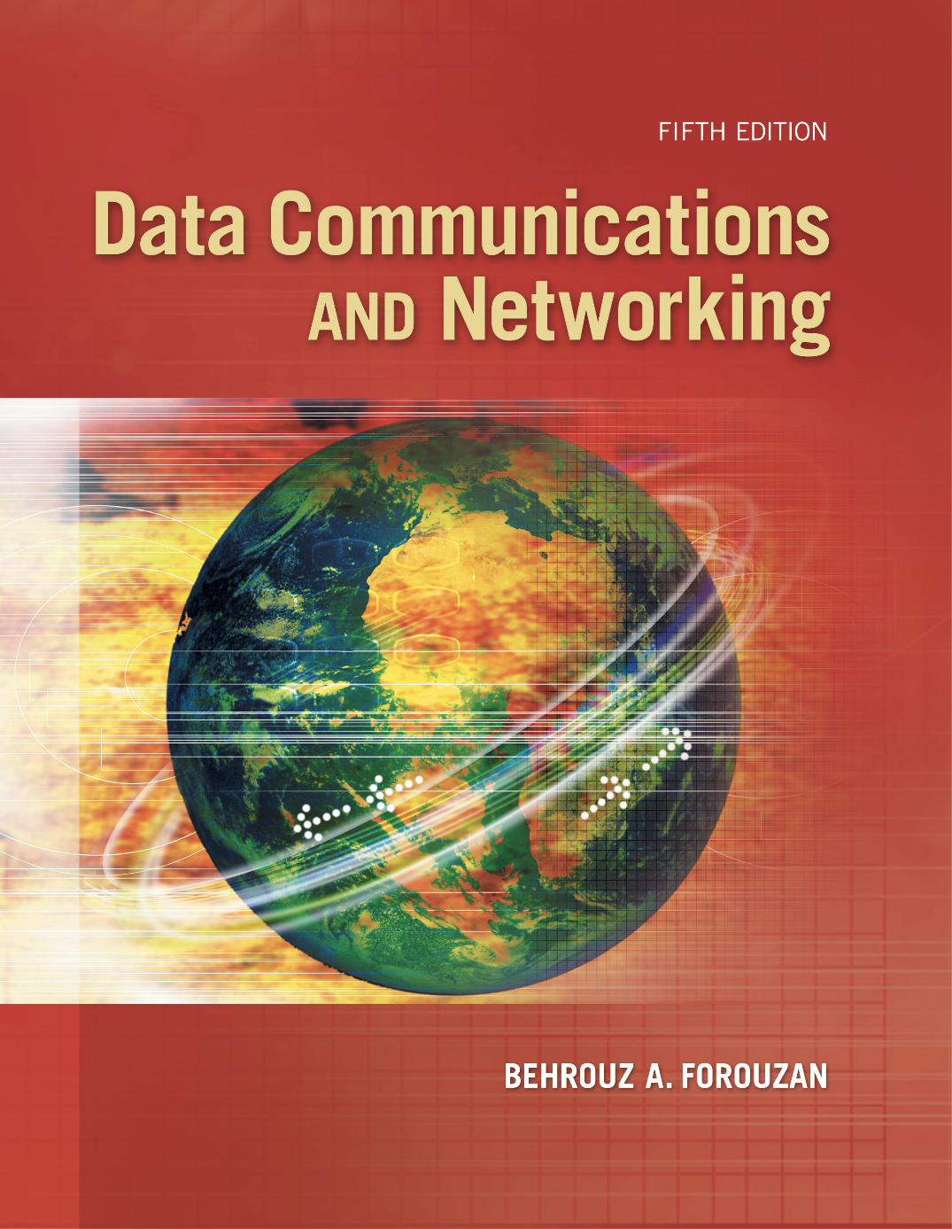
Data Communications
What this course covers
COSE242-02 · Fall 2026 · 3 credits · IT Building 609
• Theory and practice of data communications
• Protocol layers studied
- Physical layer
- Data link layer
- Media access control (MAC) layer
• Real-world case studies
- Ethernet, Wi-Fi
- Mobile and satellite communications
• Hardware for high-speed communications
INSTRUCTOR
• Hyogon Kim
- 3290-3204, hyogon@korea.ac.kr
TEACHING ASSISTANT
• Seungmin Lee
- 02-3290-3569, smlee03@korea.ac.kr
• No need to buy the textbook
• Do not buy a newer edition
- 6th differs from the 5th in content and structure
TEXTBOOK
• Data Communications and Networking, 5th Edition
- Behrouz A. Forouzan, McGraw-Hill
By the end of this course you will be able to
• Understand the foundations and core principles
• Explain the functions and operation of the layers
- Physical, data link, media access control
• Analyze the mechanisms of key technologies
- Ethernet, Wi-Fi, mobile, satellite
• Evaluate hardware for high-speed transmission
• Diagnose real-world communication scenarios
SCOPE
• Layers: physical, data link, medium access control
• Cases: Ethernet, Wi-Fi, cellular, satellite
Copyright © The McGraw-Hill Companies, Inc. Permission required for reproduction or display.

Slide 2
Grading
Evaluation criteria
Exams
Exam rules
Midterm Exam
50%
• Both exams strictly closed book
• No smart device of any kind
- No phone
- No watch
- No glasses
• Smart glasses
- Inspection at the exam room
- Wearing a pair: removal from the room
· Whether or not you have used them
• Missing either exam: F for the course
- The score on the other exam does not compensate
• Sit the exam in the room assigned to you
- Turning up elsewhere may cost you points
• Exam papers from previous years
- Released in the week before each exam
Final Exam
50%
Total
100%
Attendance
How attendance is taken
• Recorded by the smart attendance check system
• Absence from one third or more of the classes: grade F
- University regulation
- No exception
• Unavoidable absence
- Counted as attendance on submission of documentary evidence

Slide 3
Weekly plan
1
Introduction to Data Communications
9
Media Access Control (MAC) Layer
• Course overview, network models, protocols and standards, layering
• Random access (ALOHA, CSMA, CSMA/CD, CSMA/CA), controlled access
2
Physical Layer (1): Signals and Transmission
10
Wired LANs: Ethernet
• Analog and digital signals, impairment, data rate limits, performance
• Standard, Fast, Gigabit and 10-Gigabit Ethernet, switching and bridges
3
Physical Layer (2): Digital and Analog Transmission
11
Wireless LANs: Wi-Fi
• Line coding, analog-to-digital conversion, digital-to-analog modulation
• IEEE 802.11 architecture, physical layer, CSMA/CA, addressing
4
Physical Layer (3): Transmission Media and Multiplexing
12
Mobile (Cellular) Communications
• Guided and unguided media, multiplexing (FDM, TDM, WDM)
• Frequency reuse, handoff, 1G to 5G, mobility management
5
Data Link Layer (1): Error Detection and Correction
13
Satellite Communications
• Types of errors, block coding, cyclic codes (CRC), checksums
• GEO, MEO and LEO orbits, footprint, transmission bands, configurations
6
Data Link Layer (2): Data Link Control (DLC)
14
Hardware for High-Speed Communications
• Framing, flow and error control, Stop-and-Wait, Go-Back-N, Selective Repeat
• NICs, high-speed switches, routers, physical layer acceleration
7
Midterm Review and Introduction to MAC
15
No Classes
• Review of physical and data link layers, the MAC sublayer
• Reading week, self-study
8
Midterm Exam
16
Final Exam
• In-class, Weeks 1 to 7
• In-class, cumulative, emphasis on Weeks 9 to 14

Slide 4
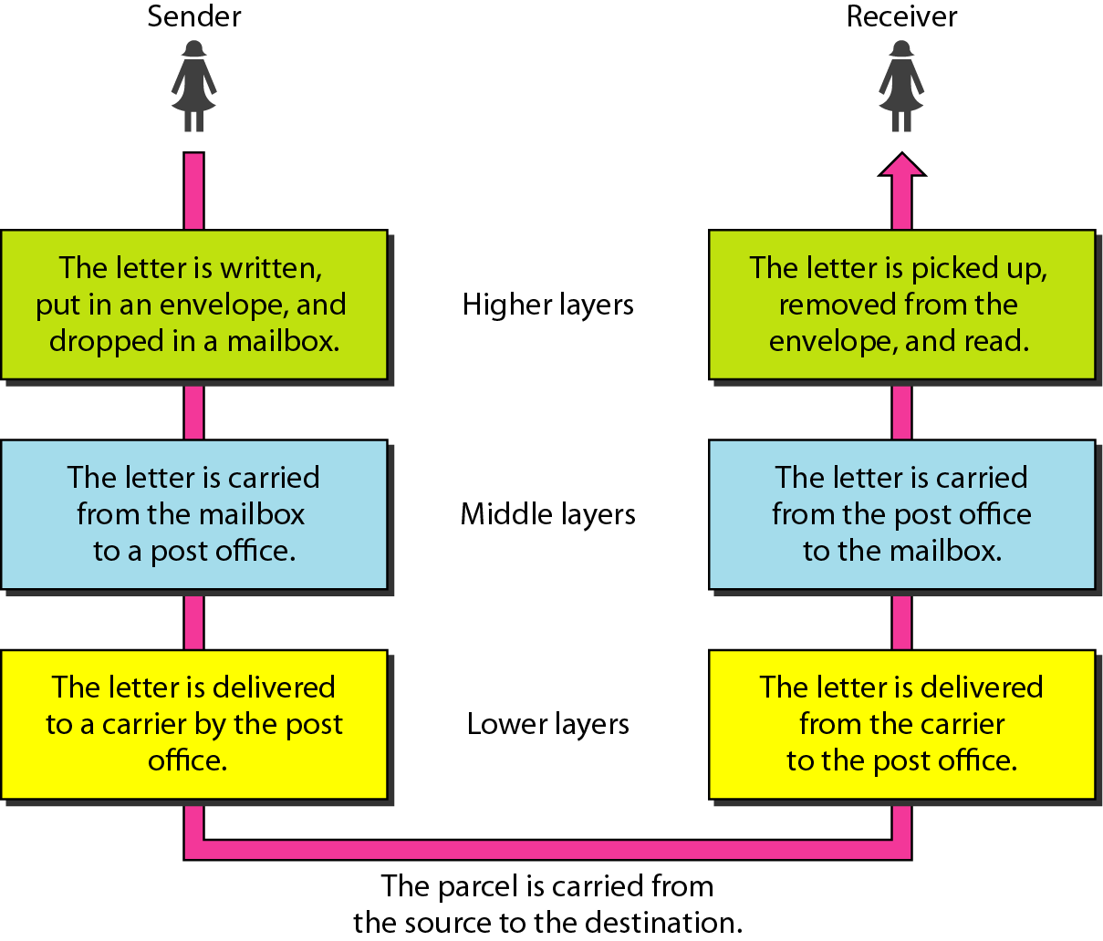
PART I
LAYERING:
THE PRINCIPLE
Figure 2.1
Tasks involved in sending a letter
2.3
• A network is built the way a tower is built.
• Each layer stands on the one below it and offers one service to the one above.
• Fix that discipline first, and every later question has a place to live.
• Start where everyone already knows the answer: the post office.
2-1
LAYERED TASKS
2.2
• We use the concept of layers in our daily life.
• As an example, let us consider two friends who communicate through postal mail.
• The process of sending a letter to a friend would be complex if there were no services available from the post office.
Topics discussed in this section:
Sender, Receiver, and Carrier
Hierarchy

Slide 5
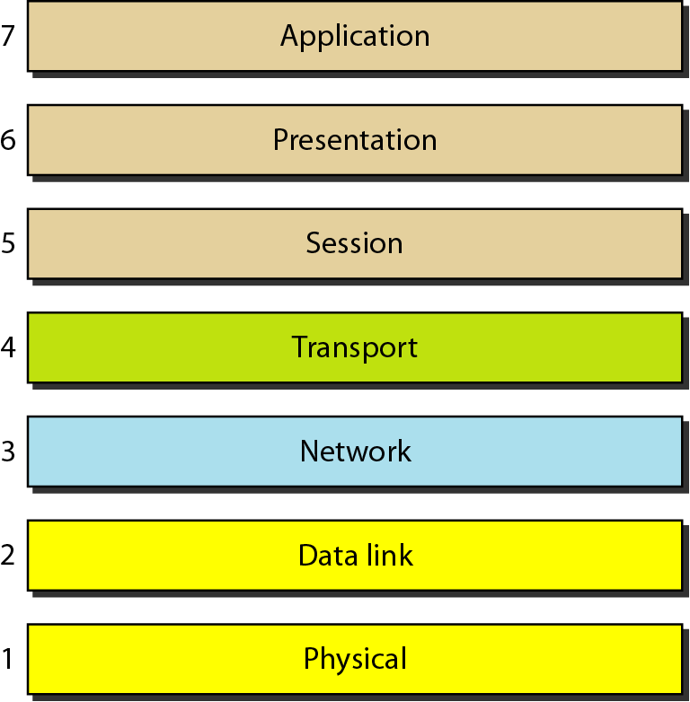
PART I
• The Internet does not run seven layers, it runs five.
• We take the TCP/IP suite as the working model and keep the OSI seven-layer model beside it as the reference vocabulary: the two agree exactly where it matters to us, at the bottom.
THE MODEL
Model
The TCP/IP protocol suite
Reading the two together
Application
messages
Seven layers of the OSI model
• Layers 1 to 4 carry the same names and the same duties in both models.
• OSI splits the top into session, presentation, and application; TCP/IP folds all three into one application layer.
• Nothing in this course depends on that difference.
• Everything in this course lives at layers 1 and 2, where the two models are identical.
5
Figure 2.2
2.4
Transport
segments
4
Network
packets
3
Data link
frames
2
Physical
bits
1

Slide 6
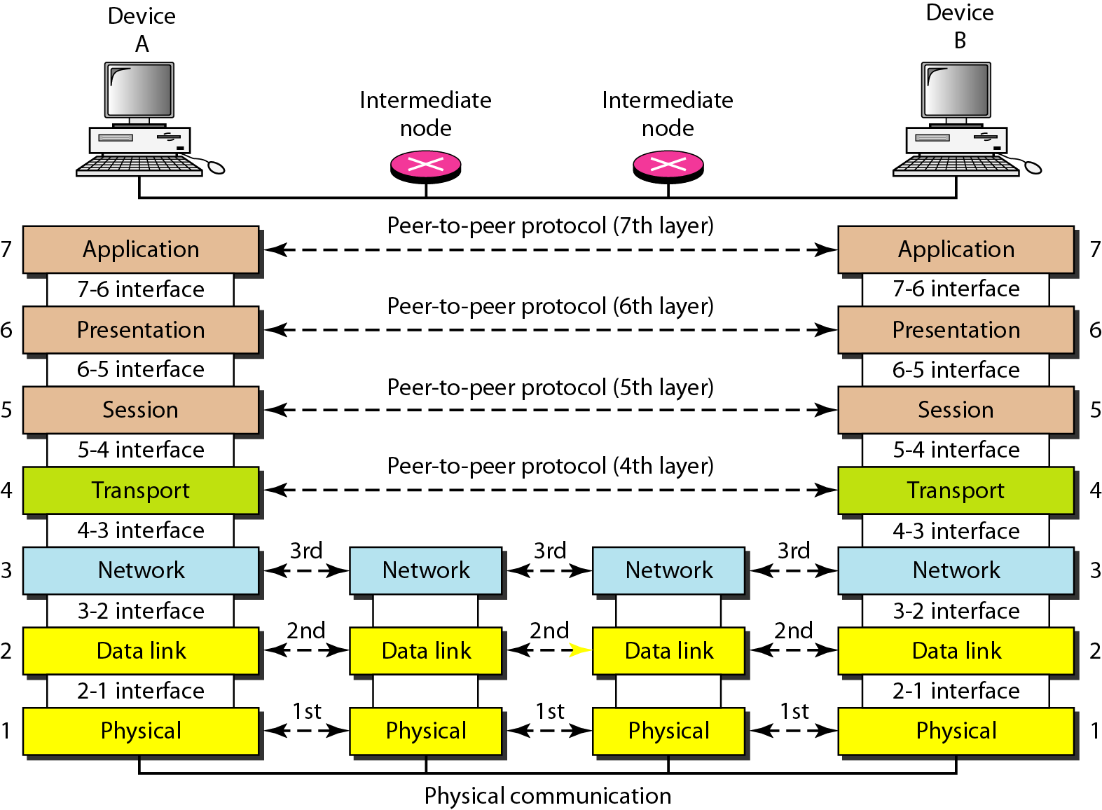
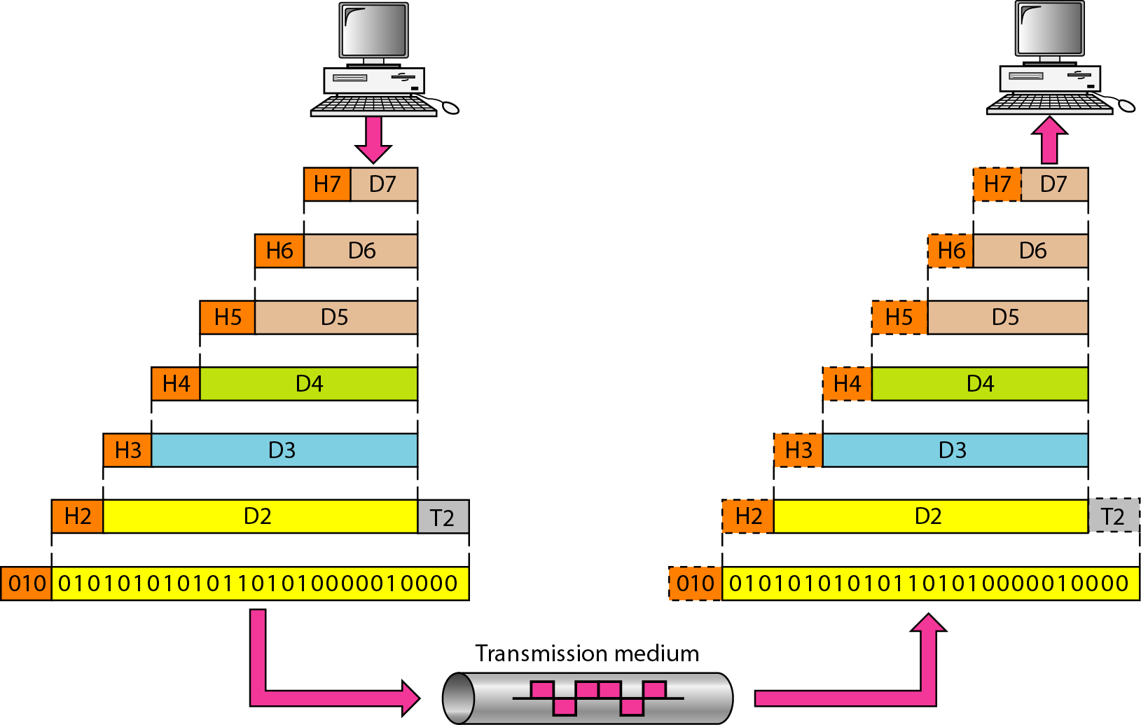
PART I
• Two rules hold the tower together.
• First, a layer talks only to the layer directly above and below it inside its own machine, through a fixed interface.
• Second, a layer behaves as if it were talking straight across to its counterpart on the far machine, a peer-to-peer protocol.
• The price of the second rule is paid by the first: each layer wraps what it receives in a header of its own, and the far side unwraps it in the same order.
• That is encapsulation, and it is the whole mechanism.
HOW LAYERS TALK
Figure 2.3
The interaction between layers in the OSI model
2.5
Figure 2.4
An exchange using the OSI model
2.6

Slide 7
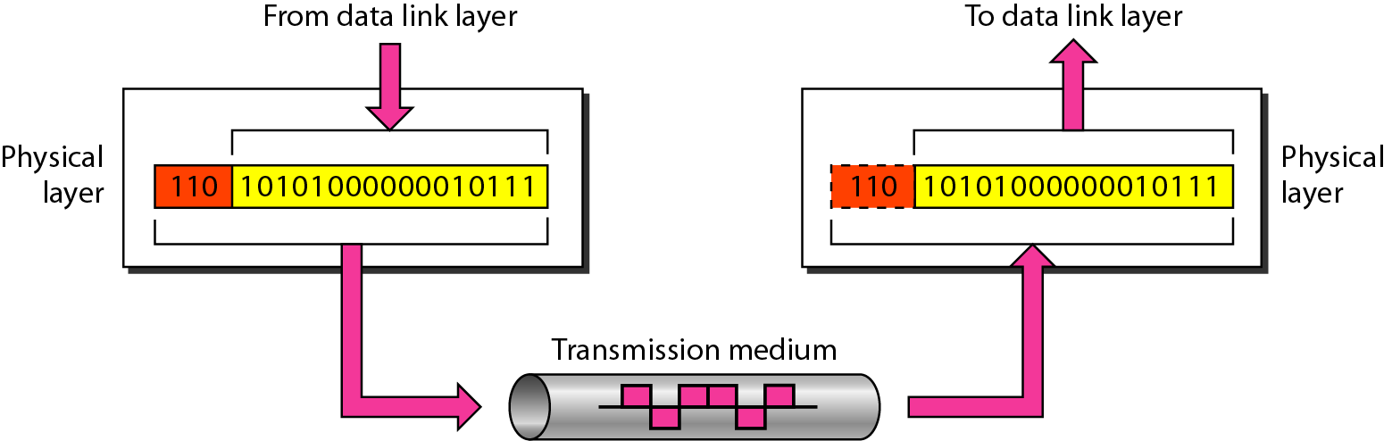
PART II
2-3
LAYERS IN THE MODEL
2.7
THE TOWER,
BOTTOM UP
• We climb from the ground.
• Each layer becomes possible only once the layer beneath it works, so we take them in the order in which they become available: physical, then data link, then network, then transport, then application.
• For each one, ask the same two questions.
• What does this layer move, and how far does it move it? The answers are what separate the layers from one another.
• Layer 1 has the crudest job and the hardest one.
• It puts a bit on a medium and gets that same bit off the other end, between two directly attached devices and no further.
Figure 2.5
Physical layer
2.8
Note
2.9
The physical layer is responsible for movements of individual bits from one hop (node) to the next.

Slide 8
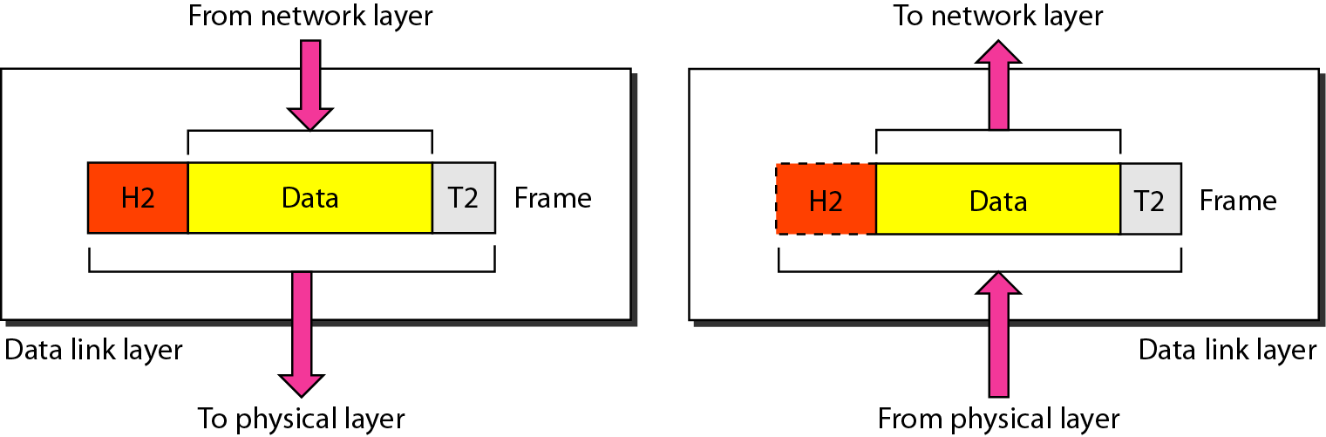
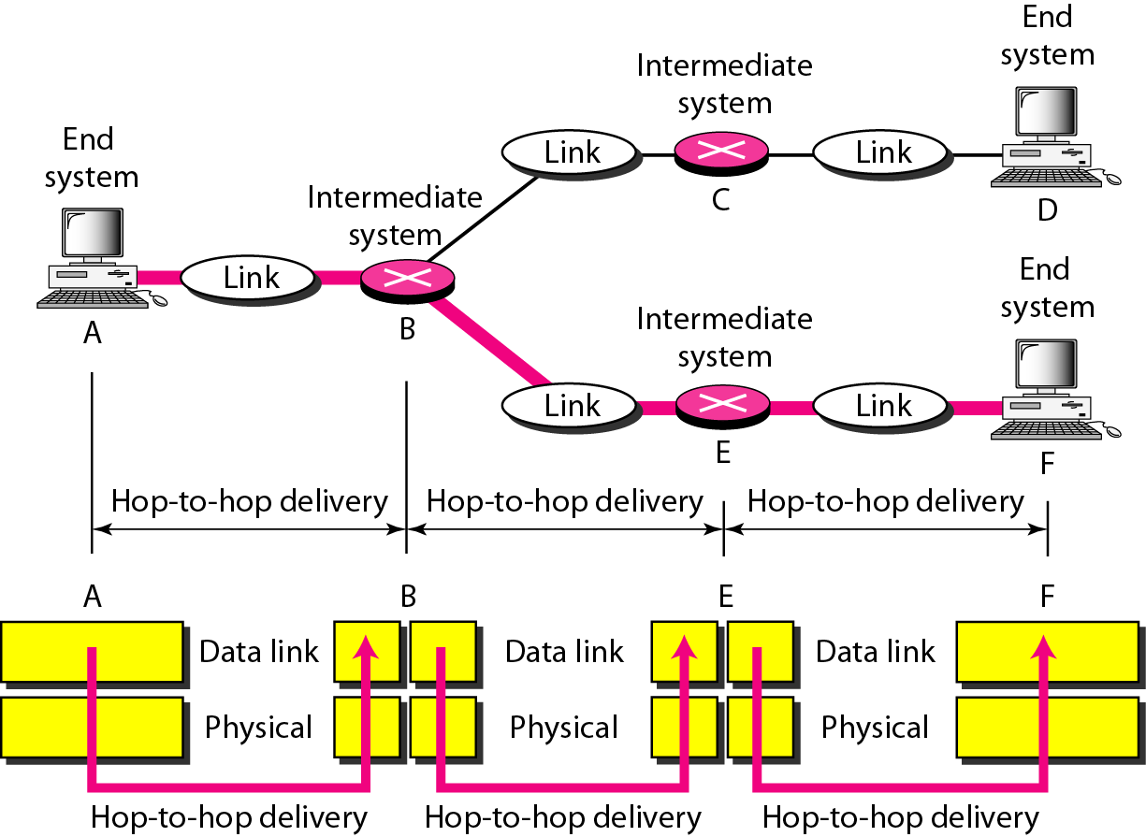
Figure 2.6
Data link layer
2.10
Figure 2.7
Hop-to-hop delivery
2.12
Note
2.11
The data link layer is responsible for moving frames from one hop (node) to the next.

Slide 9
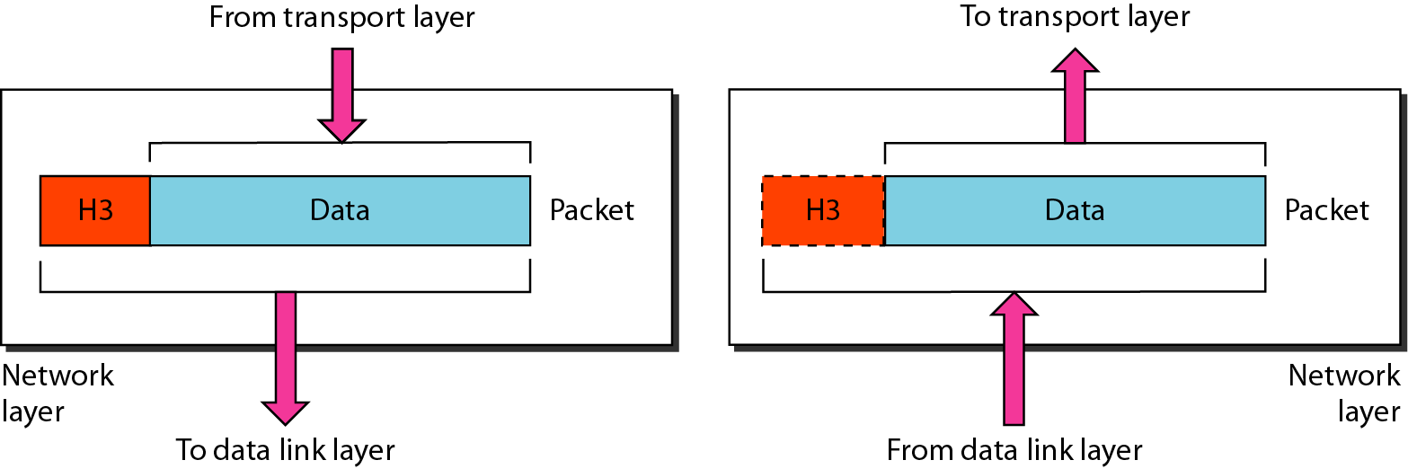
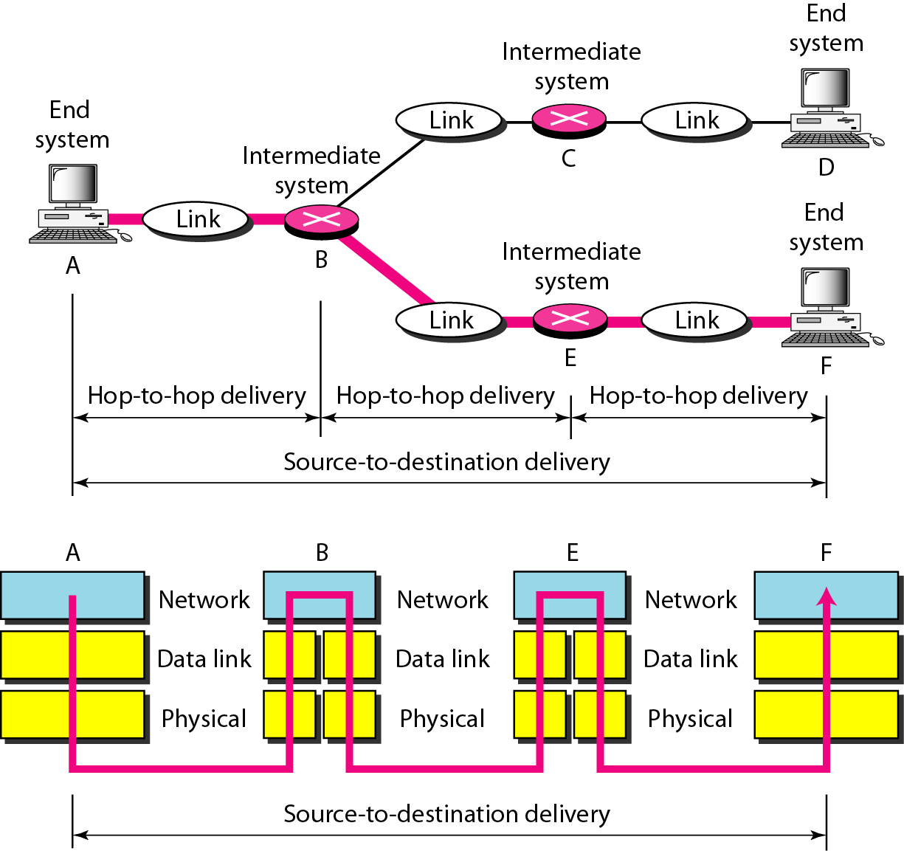
Figure 2.8
Network layer
2.13
Figure 2.9
Source-to-destination delivery
2.15
Note
2.14
The network layer is responsible for the delivery of individual packets from the source host to the destination host.

Slide 10
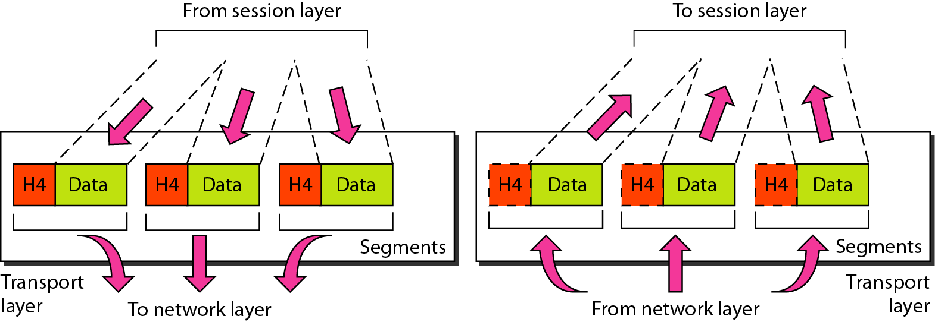
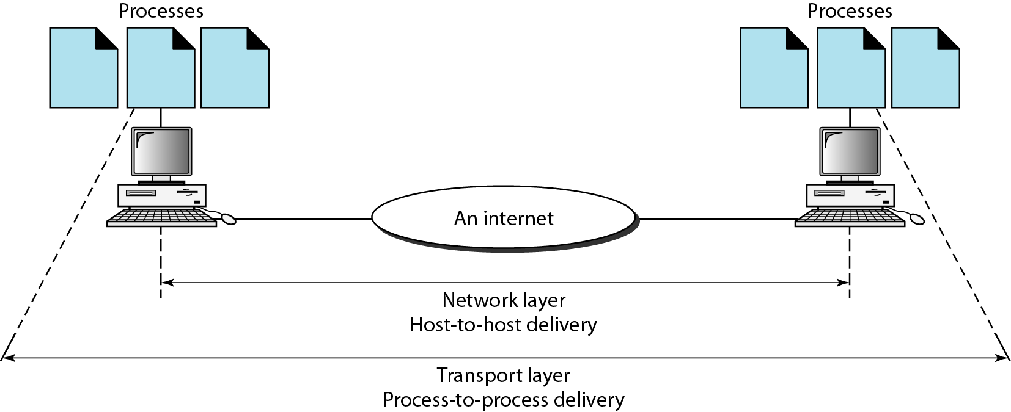
Figure 2.10
Transport layer
2.16
Note
2.17
The transport layer is responsible for the delivery of a message from one process to another.
Three deliveries, three layers
• Hop to hop, between two attached devices: the data link layer.
• Host to host, across an internet: the network layer.
• Process to process, between two running programs: the transport layer.
• Same bits, three different definitions of arrival.
Figure 2.11
Reliable process-to-process delivery of a message
2.18

Slide 11
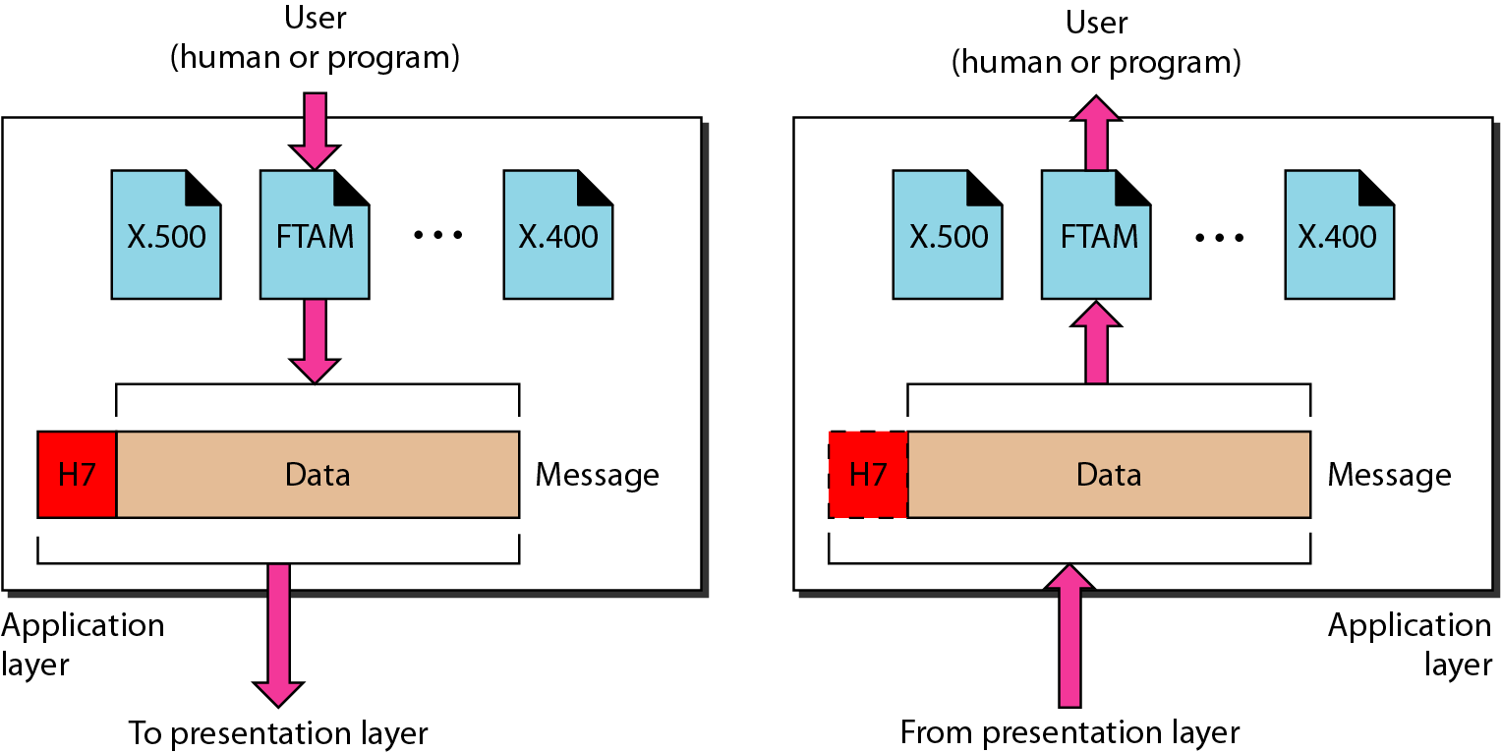
Figure 2.14
Application layer
2.19
Note
2.20
The application layer is responsible for providing services to the user.
• The tower is complete.
• Every layer above the second one is built on the assumption that a bit put on a wire comes off that wire, and that a frame handed to a neighbour arrives at that neighbour.
• Break either assumption and nothing above it survives.

Slide 12
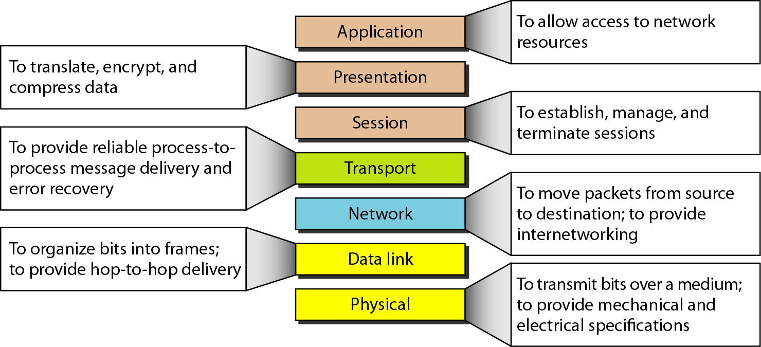
Figure 2.15
Summary of layers
2.21
Model
This course
Application
messages
5
Transport
segments
4
Network
packets
3
Data link
frames
2
Physical
bits
1
PART III
• Data communications is the study of the bottom two layers.
• A bit on a medium, and a frame between two devices that share it.
• Everything above that line is another course, and every course above this one assumes we did our job.
• So the rest of the semester has two halves.
• The principles that govern layers 1 and 2, and the practices that implement them: what a communication system is made of, how devices attach to a medium, and what shapes those attachments take.
OUR SCOPE:
LAYERS 1 AND 2

Slide 13
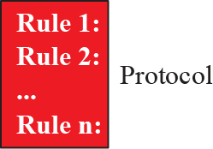
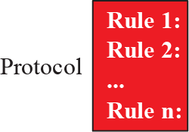
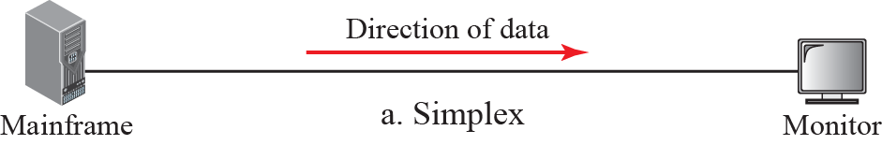
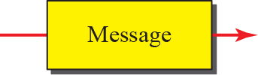
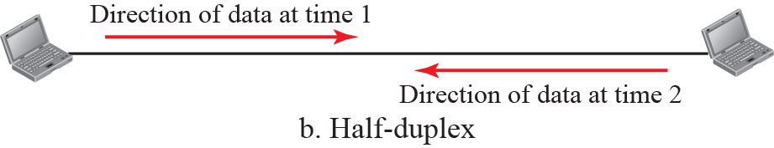


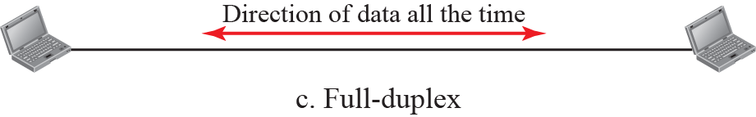
PART IV
1-1
DATA COMMUNICATIONS
1.5
LAYER 1
IN PRACTICE
• At the bottom of the tower: five parts, one medium, and two questions, what it carries and which way it runs.
1.1.1
Components
1.6
1.1.3
Data Flow
1.8
• A data communications system has five components (see Figure 1.1).
• Communication between two devices can be simplex, half-duplex, or full-duplex as shown in Figure 1.2.
1.1.2
Data Representation
1.7
• Information today comes in different forms such as text, numbers, images, audio, and video.
1
2
3
4
5
Text
Numbers
Images
Audio
Video

Slide 14
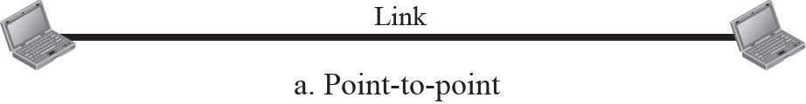
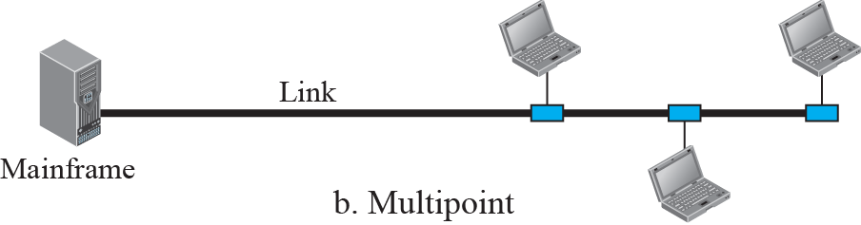
PART V
1-2
NETWORKS
1.9
LAYER 2
IN PRACTICE
• One medium, several devices, and a decision about who attaches to whom: the link layer's raw material.
• A network is the interconnection of a set of devices capable of communication.
• In this definition, a device can be a host such as a large computer, desktop, laptop, workstation, cellular phone, or security system.
• A device in this definition can also be a connecting device such as a router a switch, a modem that changes the form of data, and so on.
1.2.2
Physical Structures
1.10
• Before discussing networks, we need to define some network attributes.

Slide 15
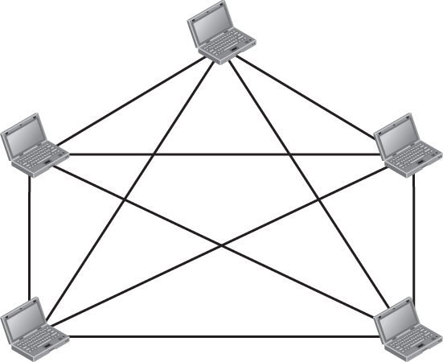
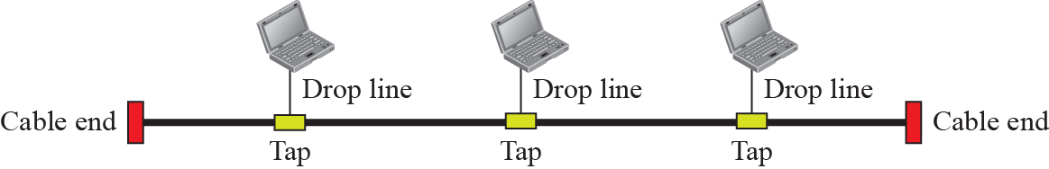


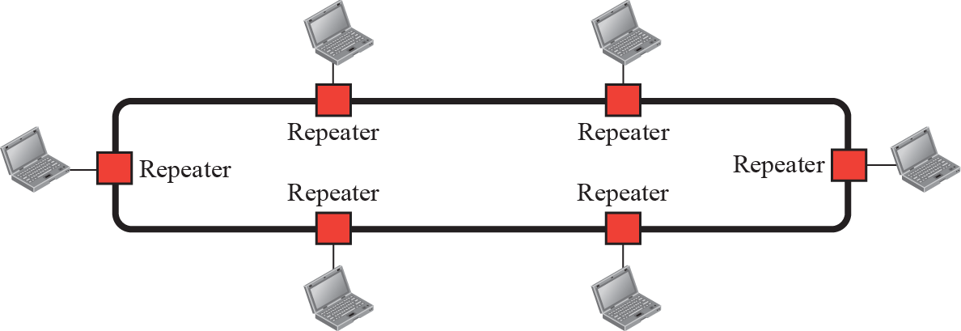
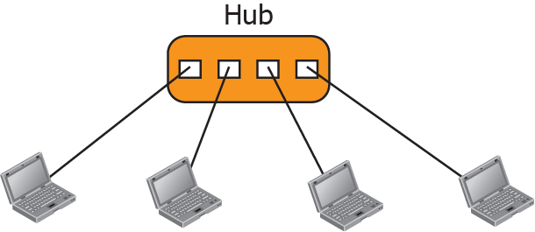
Figure 1.4
A fully-connected mesh topology
1.11
Figure 1.6
A bus topology
1.13
Figure 1.7
A ring topology
1.14
Figure 1.5
A star topology
1.12

Slide 16
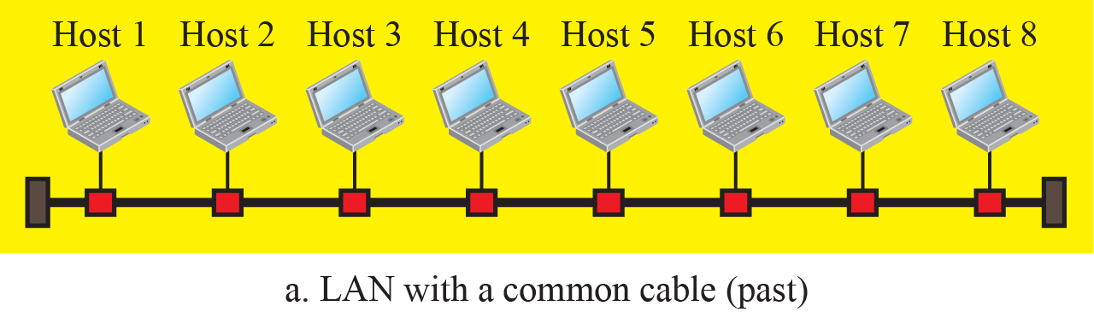
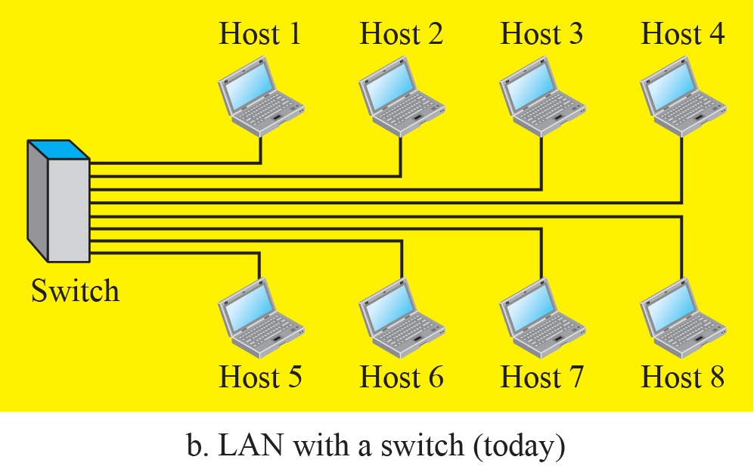
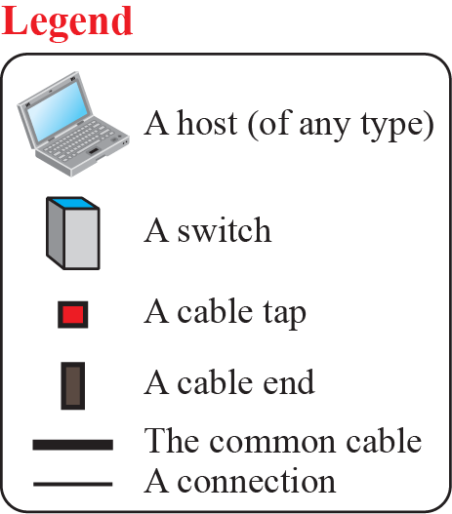
PART V
1-3
NETWORK TYPES
1.15
THE LAN
• Those shapes over a small area with one owner: the LAN, where layers 1 and 2 are the whole story.
• After defining networks in the previous section and discussing their physical structures, we need to discuss different types of networks we encounter in the world today.
• The criteria of distinguishing one type of network from another is difficult and sometimes confusing.
• We use a few criteria such as size, geographical coverage, and ownership to make this distinction.
1.3.1
Local Area Network
1.16
Figure 1.8
An Isolated LAN in the past and today
1.17
• A local area network (LAN) is usually privately owned and connects some hosts in a single office, building, or campus.
• Depending on the needs of an organization, a LAN can be as simple as two PCs and a printer in someone’s home office, or it can extend throughout a company and include audio and video devices.
• Each host in a LAN has an identifier, an address, that uniquely defines the host in the LAN. A packet sent by a host to another host carries both the source host’s and the destination host’s addresses.

Slide 17
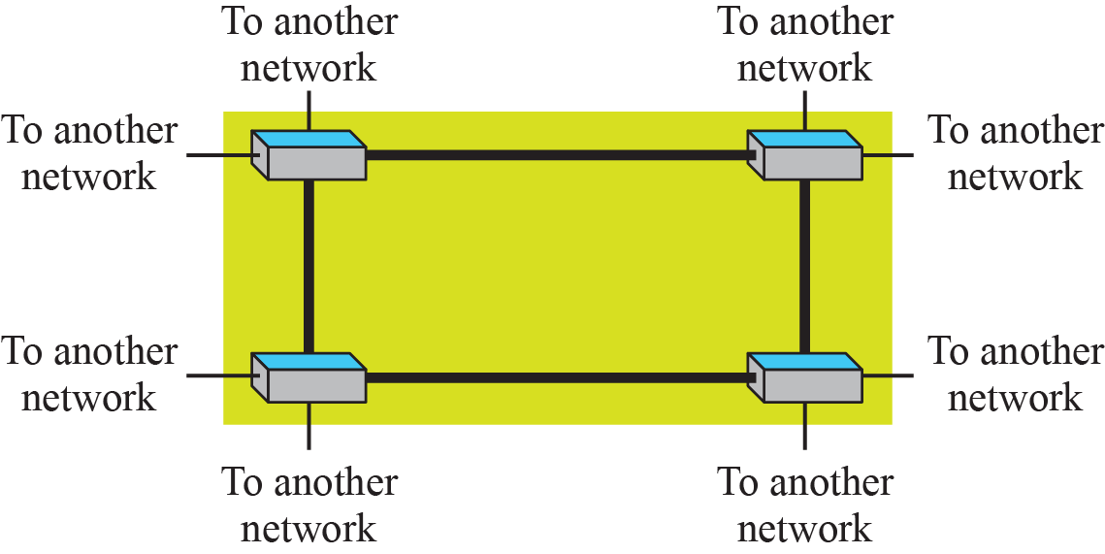
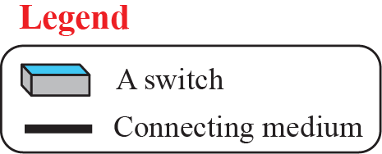
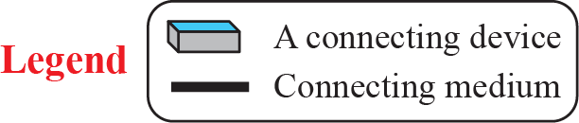
PART VI
1-3
NETWORK TYPES, CONTINUED
1.18
ABOVE THE LINE
• Join links into networks and networks into an internet and you have crossed into layer 3. We name what is up there so you can place it, not because we will study it here.
• Take these as landmarks, and expect to meet them again in another course.
1.3.2
Wide Area Network
1.18
• A wide area network (WAN) is also an connection of devices capable of communication.
• However, there are some differences between a LAN and a WAN. A LAN is normally limited in size; a WAN has a wider geographical span, spanning a town, a state, a country, or even the world.
• A LAN interconnects hosts; a WAN interconnects connecting devices such as switches, routers, or modems.
• A LAN is normally privately owned by the organization that uses it; a WAN is normally created and run by communication companies and leased by an organization that uses it.
Figure 1.10
A Switched WAN
1.20
Figure 1.9
A Point-to-Point WAN
1.19

Slide 18

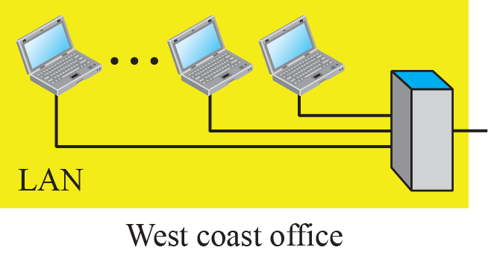
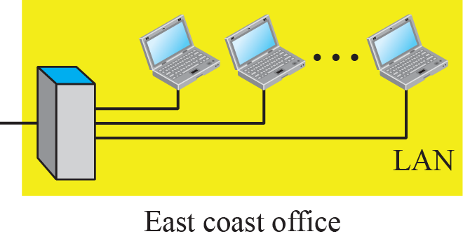
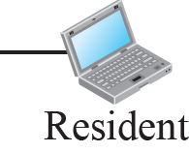
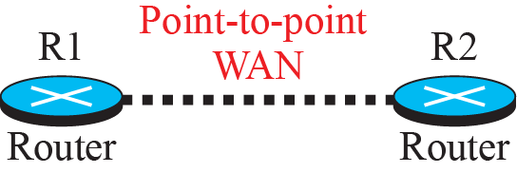
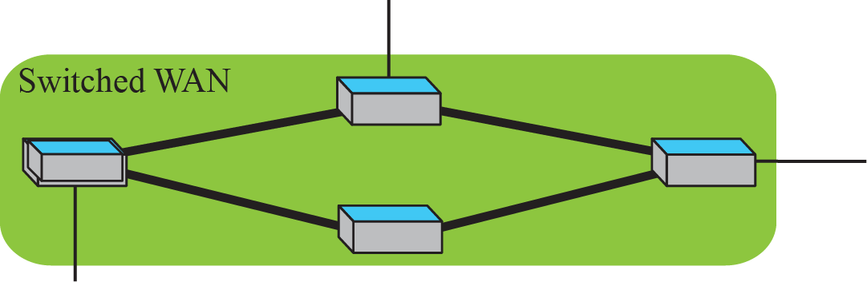
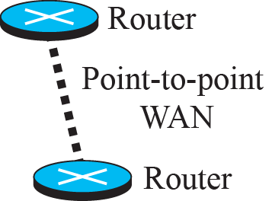
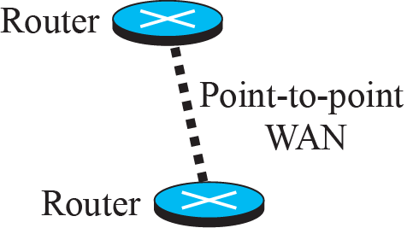
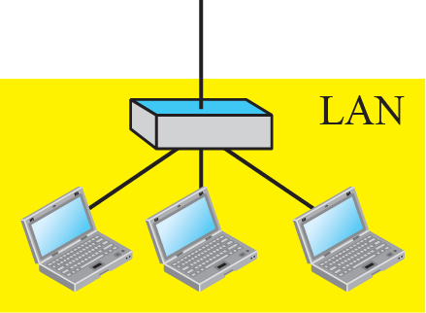
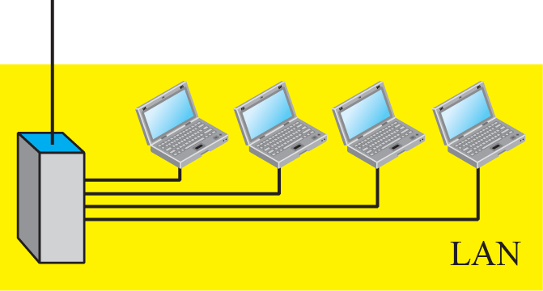
Figure 1.12
A heterogeneous network made of WANs and LANs
1.22
Figure 1.11
An internetwork made of two LANs and one WAN
1.21
1.3.3
Switching
1.23
• An internet is a switched network in which a switch connects at least two links together.
• A switch needs to forward data from a network to another network when required.
• The two most common types of switched networks are circuit-switched and packet-switched networks.
• We discuss both next.

Slide 19

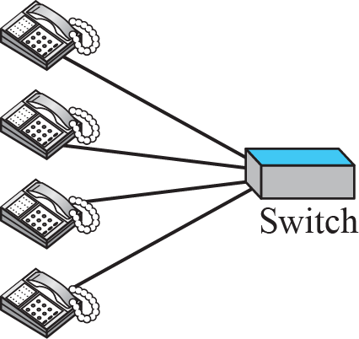
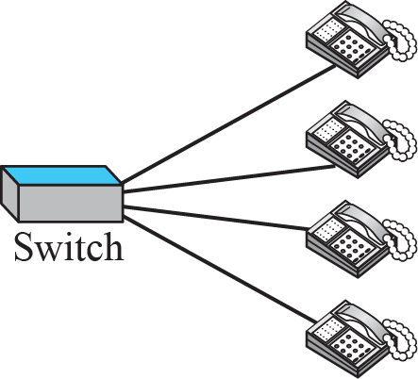

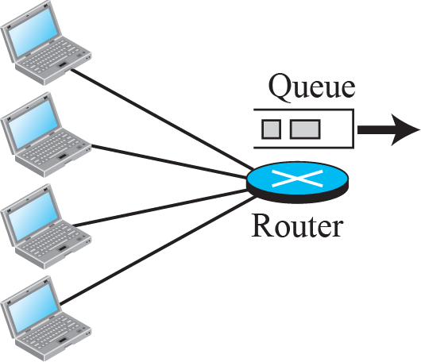
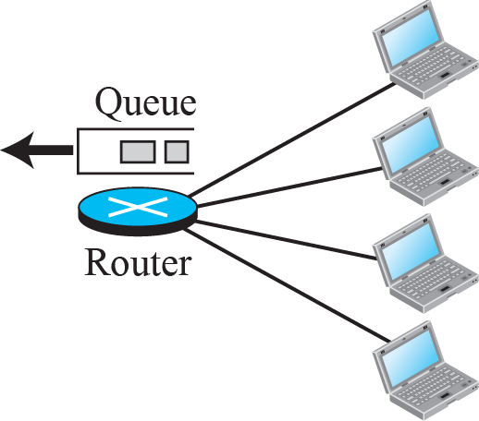
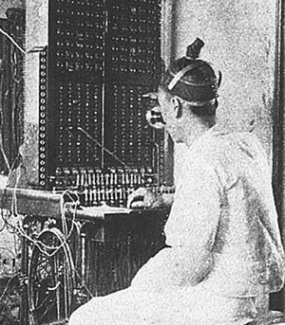
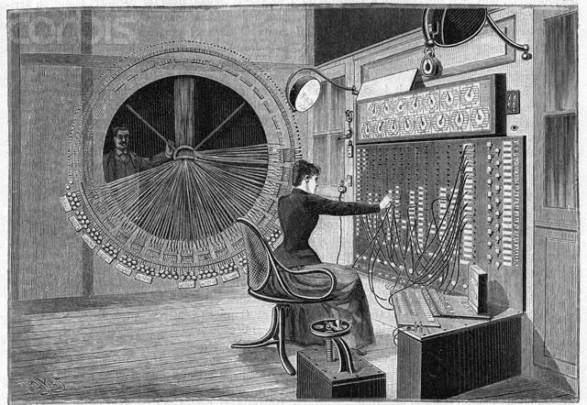
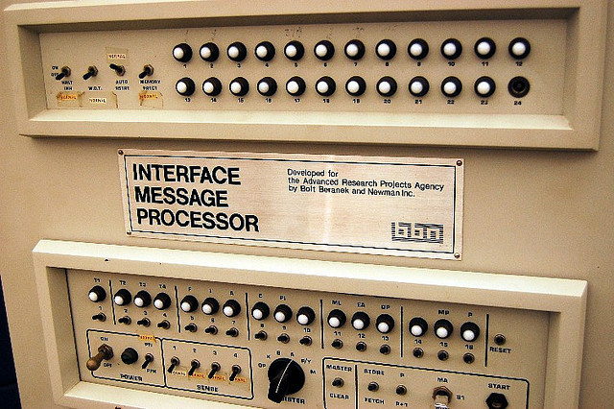
Figure 1.13
A circuit-switched network
1.24
Figure 1.14
A packet-switched network
1.25

