Slide 1
5.6 : Host Processing of
IP Datagrams
이홍원
2015020796

Slide 2
5.6 Host Processing of IP Datagrams
Hosts must consider which IP addresses to place in the Source IP Address and Destination IP Address fields
  Applications such as Web browsers may attempt to make connections to a named host or server that can have multiple addresses
  The client system making such connections may also have multiple addresses
question
  Which address (and version of IP) should be used to send a datagram?

Slide 3
5.6.1 Host Models
strong host model
  A datagram is accepted for delivery to the local protocol stack only if the IP address contained in the Destination IP Address field matches one of those configured on the interface upon which the datagram arrived
  sending datagrams from a particular interface only if on of the interfaces’ configured addresses matches the Source IP Address field in the datagram being sent
weak host model
  A datagram carrying destination address matching any of the local addresses may arrive on any interface and is processed by the receiving protocol stack, irrespective of the network interface upon which it arrived

Slide 4
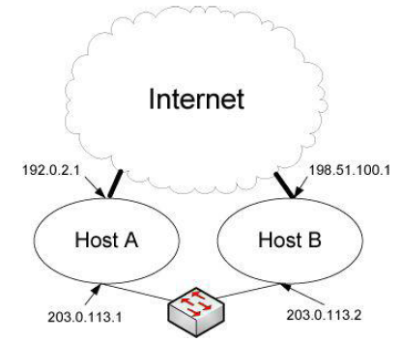
5.6.1 Host Models
IP Datagram
Src IP addresses: x.x.x.x
Dest. IP address: 203.0.113.1
IP Datagram
Src IP addresses: x.x.x.x
Dest. IP address: 203.0.113.2
IP Datagram
Src IP addresses: x.x.x.x
Dest. IP address: 192.0.2.1
IP Datagram
Src IP addresses: x.x.x.x
Dest. IP address: 108.51.100.1
- Host A: strong host model
- Host B: weak host model

Slide 5
5.6.1 Host Models
Why is it ever a good idea to use the strong host model?
  security concern
default host model
  Windows (Vista and later): strong host model
  Linux: weak host model
  BSD (including Mac OS X): strong host model
host model configuration (e.g. Windows)
  C:\> netsh interface ipvX set interface <ifname> weakhostreceive=Yabled
  C:\> netsh interface ipvX set interface <ifname> weakhostsend=Yabled

Slide 6
5.6.2 Address Selection
When a host sends an IP datagram, it must decide which of its IP addresses to place in the Source IP Address field of the outgoing datagram, and which destination address to use for a particular destination host if multiple addresses for it are known
source/destination address selection
  set of procedures to select the IP addresses
  Communication between two hosts implementing “dual-stack” hosts is complicated
  Failure to select the correct addresses can lead to asymmetric routing, unwanted filtering, or discarding of packets

Slide 7
5.6.2 Address Selection
the rules for selecting IPv6 default addresses(RFC3484)
  getaddrinfo() – a list of destination addresses to the application
  bind() – specifying a source address
  The source/destination selection algorithm is used to make a address list in order
several criteria in making their decisions
  source/destination address pairs in the same scope
  smaller scopes over larger scopes for the destination address
  non-deprecated source addresses
  avoiding the use of temporary addresses when other addresses are available → changed by RFC6724
  pairs with the longest common prefix
  global addresses when available → changed by RFC6724
Notes:
RFC3484 → RFC6724

Slide 8
5.6.2 Address Selection
Policy Table
  controlling to select the default addresses
  a longest-matching-prefix lookup table similar to a forwarding table used with IP routing
  P(A) – a precedence value for an address A; indicating greater preference if the precedence value is higher
  L(A) – a label for an address A; used for grouping
  (e.g. L(S) = L(D); pair(S, D) is used as a source/destination pair by the algorithm
  If no other policy is specified, the default host policy table suggested by RFC3484 is used

Slide 9
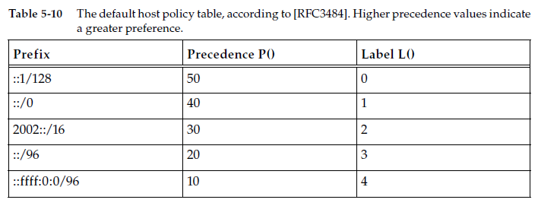
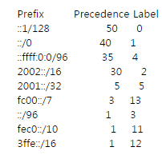
5.6.2 Address Selection
the default host policy (by RFC3484)
the default host policy (by RFC6724)
* IPv6 Special-user addresses

Slide 10
5.6.2 Address Selection
the notation for the address selection algorithm
  CPL(A, B): “common prefix length”, the longest common prefix between IPv6 addresses A and B
  S(A): the scope of IPv6 address A
  e.g. S(A) < S(B) if A is link-scoped and B is global scope
  M(A): mapping and IPv4 address A to an IPv4-mapped IPv6 address
  S(M(169.254.x.x)) = S(M(127.x.x.x)) < S(M(private address space)) < S(M(any other address))
  Λ(A): the lifecycle of the address
  Λ(A) < Λ(B) if A is a deprecated address
  H(A): a home address of A
  C(A): a care-of address of A

Slide 11
5.6.2.1 The Source Address Selection Algorithm
the notation for the source address selection algorithm
  CS(D): a candidate set of potential source addresses based on a particular destination address D
    → Anycast, multicast, and the unspecified address are never in CS(D) for any D
  R(A): the rank of address A in the set CS(D)
    → R(A) *>R(B): assigning A a higher rank than B in CS(D)
  I(D): indicating the interface selected to reach destination D
  @(i): the set of addresses assigned to interface I
  T(A): the Boolean true if A is a temporary address and false otherwise
    Q(D): The one with the largest rank is the selected source address for destination D
    → If Q(D) = Ø (null), no source could be determined for destination D

Slide 12
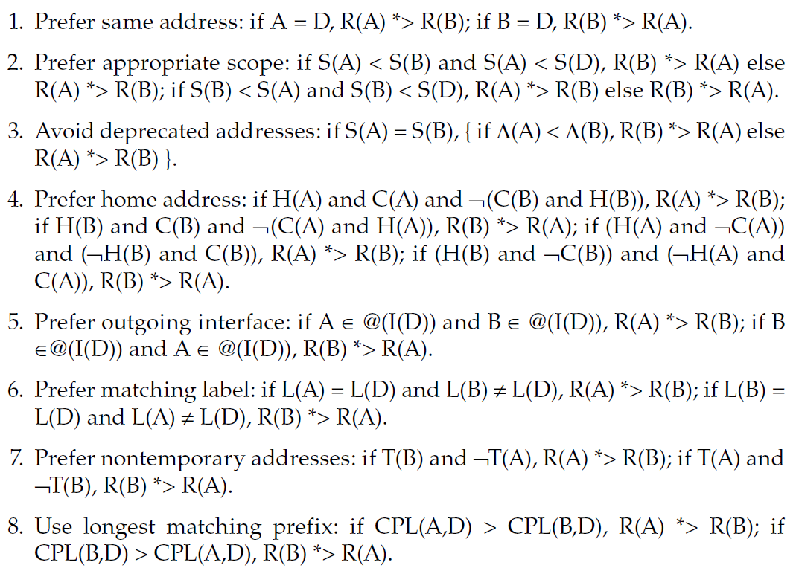
5.6.2.1 The Source Address Selection Algorithm
rules: a partial ordering between addresses A and B in CS(D) for destination D

Slide 13
5.6.2.1 The Source Address Selection Algorithm
About 7th rule
  Rule 7: Prefer public addresses by RFC 3484
    If SA is a public address and SB is a temporary address, then prefer SA. Similarly, if SB is a public address and SA is a temporary address, then prefer SB
    https://www.ietf.org/rfc/rfc3484.txt
  Rule 7: Prefer temporary addresses by RFC6724
    If SA is a temporary address and SB is a public address, then prefer SA. Similarly, if SB is a temporary address and SA is a public address, then prefer SB
    RFC6724 obsoletes RFC3484
    https://tools.ietf.org/html/rfc6724

Slide 14
5.6.2.1 The Source Address Selection Algorithm example
prefer appropriate scope
  Destination: 2001:db8:1::1
  Candidate Source Addresses: 2001:db8:3::1 or fe80::1
  Result: 2001:db8::1
  Destination: ff05::1
  Candidate Source Addresses: 2001:db8:3::1 or fe80::1
  Result: 2001:db8:3::1
  Destination: fe80::1
  Candidate Source Addresses: fe80::2 (deprecated) or 2001:db8:1::1
  Result: fe80::2

Slide 15
5.6.2.1 The Source Address Selection Algorithm example(continue)
prefer same address
  Destination: 2001:db8:1::1
  Candidate Source Addresses: 2001:db8:1::1 (deprecated) or 2001:db8:2::1
  Result: 2001:db8:1::1
longest matching prefix
  Destination: 2001:db8:1::1
  Candidate Source Addresses: 2001:db8:1::2 or 2001:db8:3::2
  Result: 2001:db8:1:::2

Slide 16
5.6.2.2 The Destination Address Selection Algorithm
the notation for the destination address selection algorithm
  Q(D): the source address selected to reach the destination D
    → If Q(D) = Ø (null), no source could be determined for destination D
  U(B): the Boolean true if destination B is not reachable
  E(A): indicating that destination A is reached using some “encapsulating transport” (e.g., tunneled routing)
  SD(S): a set of possible destination addresses based on a particular source address S

Slide 17
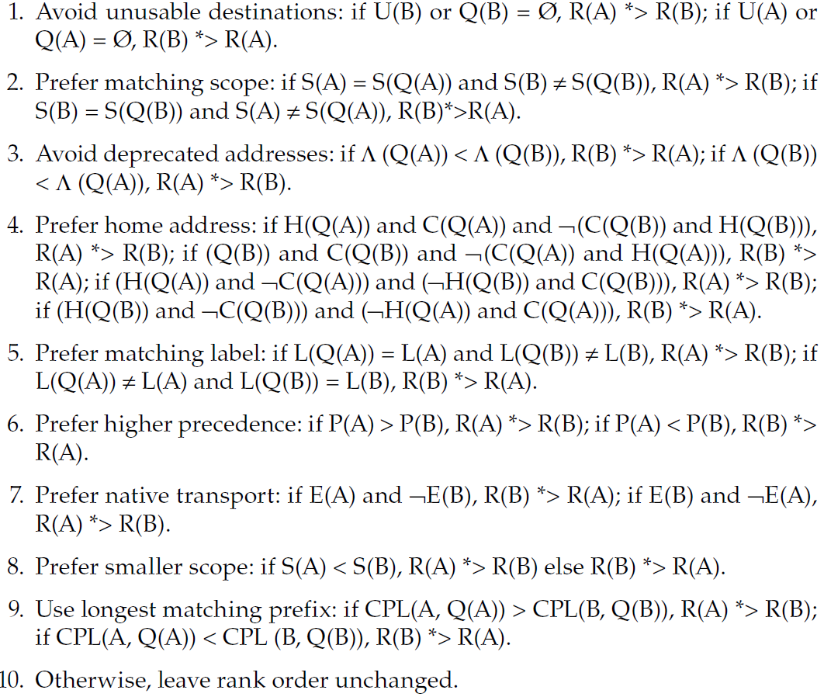
5.6.2.2 The Destination Address Selection Algorithm
rules: a partial ordering between addresses A and B in SD(S) for source S

Slide 18
5.6.2.1 The Destination Address Selection Algorithm example
prefer matching scope
  Candidate Source Addresses: 2001:db8:1::2 or fe80::1 or 169.254.13.78
  Destination Address List: 2001:db8:1::1 or 198.51.100.121
  Result: 2001:db8:1::1 (src 2001:db8:1::2) then 198.51.100.121 (src 169.254.13.78)
  Candidate Source Addresses: fe80::1 or 198.51.100.117
  Destination Address List: 2001:db8:1::1 or 198.51.100.121
  Result: 198.51.100.121 (src 198.51.100.117) then 2001:db8:1::1 (src fe80::1)

Slide 19
5.6.2.1 The Destination Address Selection Algorithm example(continue)
avoid deprecated addresses
  Candidate Source Addresses: 2001:db8:1::2 or fe80::2 (deprecated)
  Destination Address List: 2001:db8:1::1 or fe80::1
  Result: 2001:db8:1::1 (src 2001:db8:1::2) then fe80::1 (src fe80::2)
longest matching prefix
  Candidate Source Addresses: 2001:db8:1::2 or 2001:db8:3f44::2 or fe80::2
  Destination Address List: 2001:db8:1::1 or 2001:db8:3ffe::1
  Result: 2001:db8:1::1 (src 2001:db8:1::2) then 2001:db8:3ffe::1 (src 2001:db8:3f44::2)

Slide 20
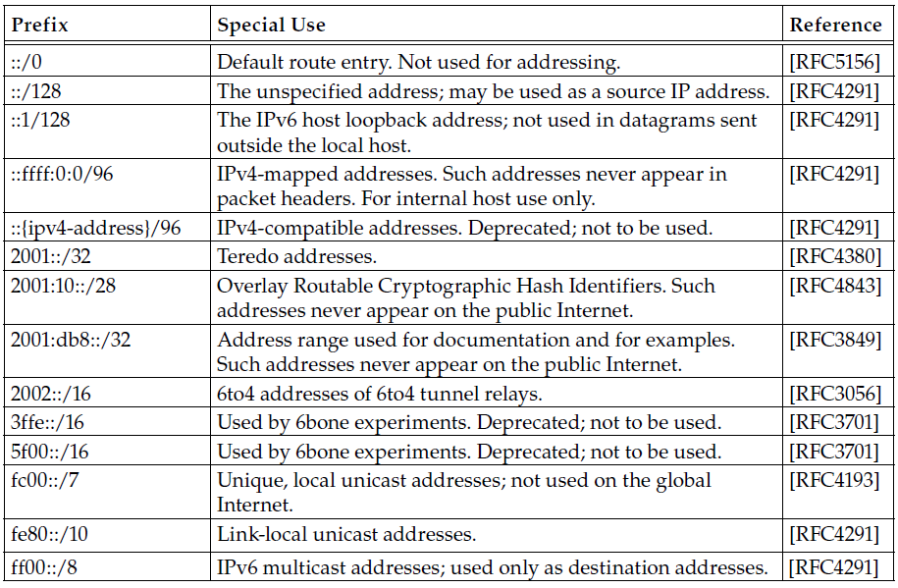
Appendix. IPv6 special-use addresses
::/96 IPv4-compatible addresses (deprecated)
fec0::/10 Site-local address (deprecated)

