Slide 1
8.1 Introduction
ICMP is used to provide diagnostics and control information related to the configuration of the IP protocol layer and the disposition of IP packets
It uses the IP protocol for transport
  A L3.5 protocol
ICMP messages are usually acted on by the IP layer itself, by higher-layer transport protocols (e.g., TCP or UDP), and in some cases by user applications
The most common cause of packet drops (buffer overrun at a router) does not elicit any ICMP information
  Other protocols, such as TCP, handle such situations

Slide 2
8.1 Introduction
Network administrators often arrange to block ICMP messages with firewalls, especially at border routers
  Hackers have used ICMP messages in a large number of attacks
  If ICMP is blocked, however, a number of common diagnostic utilities (e.g., ping, traceroute) do not work properly
ICMPv6 plays a far more important role in the operation of IPv6 than ICMPv4 does for IPv4

Slide 3
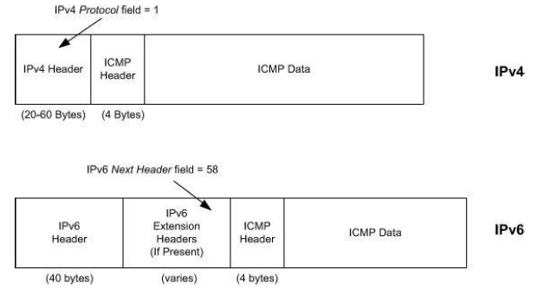
8.1.1 Encapsulation in IPv4 and IPv6
In IPv6, the ICMPv6 message may begin after zero or more extension headers
The last extension header before the ICMPv6 header includes a Next Header field with value 58

Slide 4
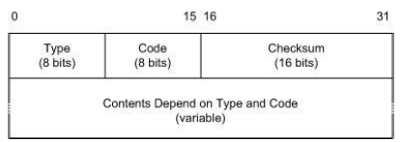
8.1.1 Encapsulation in IPv4 and IPv6
The first 4 bytes have the same format for all messages, but the remainder differ from one message to the next
Many types of ICMP messages also use different Code to further specify the meaning of the message
The Checksum field covers the entire ICMPv4 message; in ICMPv6 it also covers a pseudo-header derived from portions of the IPv6 header
  IPv6 checksum is end-to-end! (different from IPv4)

