Slide 1
Communication on mobile devices using various Wireless Communication Technologies
2015010662 이재혁

Slide 2
Why? (Motivation)
A student wants to communicate with other friends in a room using any type of wireless communication technologies such as the Bluetooth, Wi-Fi or Wi-Fi Direct and so on.

Slide 3
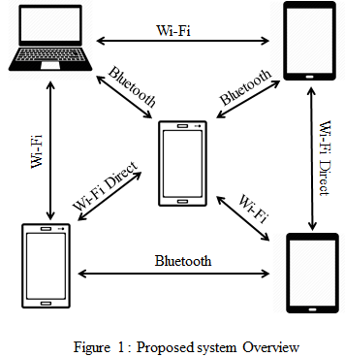
What? (Problem Definition)
To enable multiple mobile devices to communicate with each other regardless of wireless communication technologies

Slide 4
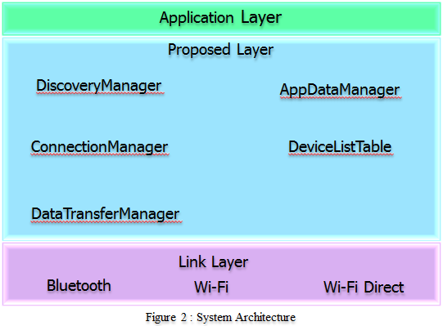
How? (Architecture)

Slide 5
How? (Architecture)
DiscoveryManager
  Is responsible for discovering the devices using the wireless communication technologies
ConnectionManager
  Is in charge of connection with a device which a user wants to connect
DataTransferManager
  Sending and receiving data about discovery, connection and which should be communicated between connected devices

Slide 6
How? (Architecture)
AppDataManager
  Plays a role of an interface between the application layer and proposed layer for sending and receiving data
DeviceListTable
  Is a database for storing devices’ information such as device name, IP and MAC addresses, and type of connection etc.

Slide 7
How? (Discovery)
Discover the devices which can be connected by using the Bluetooth, Wi-Fi, and Wi-Fi Direct
Each technology runs individually every 1 second
After discovery is finished, the results are stored/updated into the DeviceListTable

Slide 8
How? (Connection)
Connection can be established as selecting a device of the lists
At that time, the ConnectionManager checks the DeviceListTable to get information
A device can connect to multiple devices at the same time using the wireless communication technologies

Slide 9
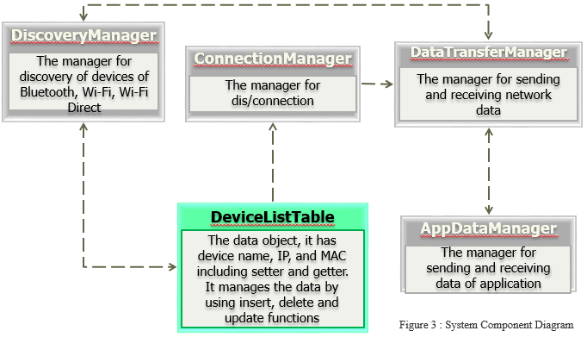
How? (Component Diagram)

Slide 10

Implementation
Using three smartphones, Samsung Galaxy S7(A), Samsung Galaxy S2(B), and Sky Vega LTE(C).
Using the Bluetooth and Wi-Fi Direct
Two scenarios
A
A
Bluetooth
Wi-Fi Direct
Wi-Fi Direct
Bluetooth
B
C
B
C

Slide 11
So What?
Future works
  Complete the implementation (the Wi-Fi Communication)
  Reducing the latency and improving the stability of connection
Significance (의의)
  For example, people who are in the same location and use this application can communicate with each other without invading privacy

Slide 12
Thank you
And
Question?

