Slide 1
Network-wide Consensus Utilizing the Capture Effect in Low-power Wireless Networks
Sensys 2017
Beshr Al Nahas, Simon Duquennoy, Olaf Landsiedel
Hajin Jang
Sep 18, 2018

Slide 2
Motivation and Problems
Many application scenarios build on low-power wireless network
These scenarios exhibit key differences compared to traditional data collection
  Demand of primitives for network-wide consensus at low latency
  Highly reliable data delivery with robustness to interference and channel dynamics
  Network-wide consensus protocol is necessary
    Mature solutions exist in a wired context, but not in low-power wireless settings

Slide 3
Background : Consensus
The problem of reaching agreement about a proposal
  Accept or decline it after a finite time of execution
  When faults occur, achieve of consensus is challenging
Widely used consensus protocols
  Two-phase commit (2PC)
  Three-phase commit (3PC)

Slide 4
Background : Two-phase commit (2PC)
Group
  One static coordinator
  A set of participants (cohort)
Phase 1 : Proposal Voting
  Coordinator broadcasts a proposal to the cohort
  Each member replies with its vote (yes or no)
Phase 2 : Decide
  Coordinator decides to commit if all cohort replied yes or abort
  Coordinator broadcasts the decision to the cohort
  Participant applies the commit/abort

Slide 5
Background : Two-phase commit (2PC)
Advantage
  Simple
  Low communication complexity
Disadvantage
  Blocking protocol
    If a node fails, other nodes will wait indefinitely
  Recovery scheme fall short if two or more node failed
    If the coordinator and a participant both fails, other nodes will be uncertain state

Slide 6
Background : Three-phase commit (3PC)
Phase 1 : Proposal Voting
  Coordinator broadcasts a proposal to the cohort
  Each member replies with its vote (yes or no)
Phase 2 : Pre-commit or Abort
  Coordinator decides to commit if all cohort replied yes or abort
  Coordinator broadcasts the decision to the cohort
  Abort is applied immediately, but no commit is applied.
Phase 3 : Do Commit
  Participant applies the commit
Notes:
Decision을 Commit에서 분리함

Slide 7
Background : Three-phase commit (3PC)
Advantage over 2PC
  Phase 3 guarantees if any node is uncertain, no node proceed to commit.
  Fail of single node
    Non-blocking protocol
    The other nodes can recover after timeout
  Fail of multiple node or coordinator
    Handled by a recovery scheme
    Termination protocol
      Working nodes agree to commit, abort, or take over the coordination role
      Resume operation after recovery

Slide 8
Background : Capture Effect
Left two signals on the same frequency in FM modulation
One signal is stronger than the other
  Only the stronger signal will be demodulated
Two signals are nearly equal in strength
  Receiver can switch from one to the other

Slide 9
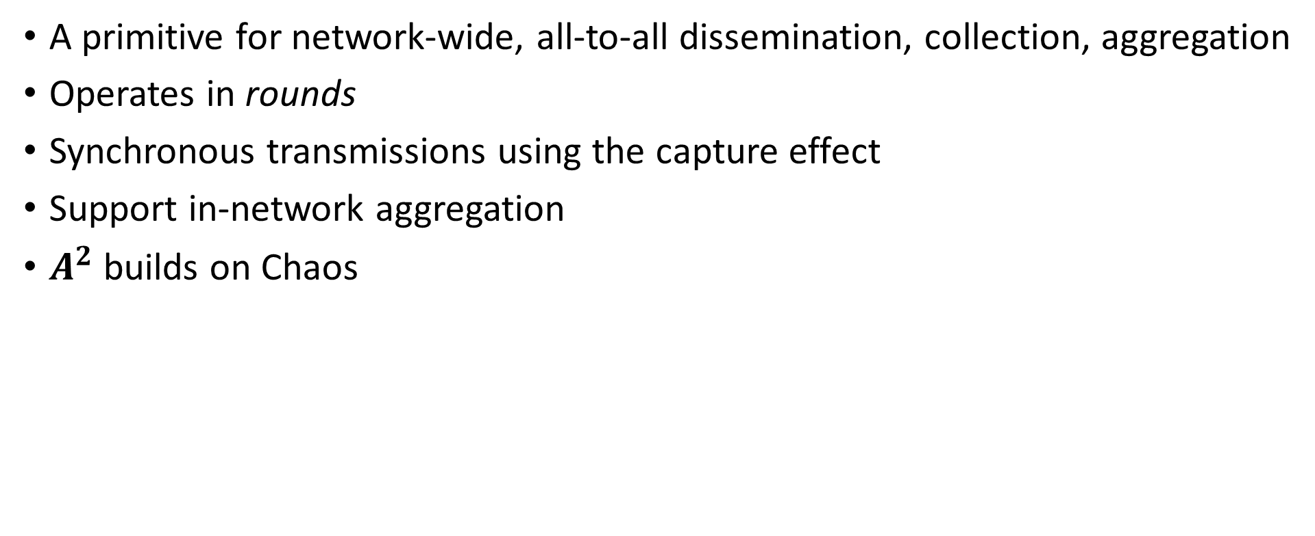
Background : The Chaos Primitive
A primitive for network-wide, all-to-all dissemination, collection, aggregation
Operates in rounds
Synchronous transmissions using the capture effect
Support in-network aggregation
$A^{2}$ builds on Chaos

Slide 10
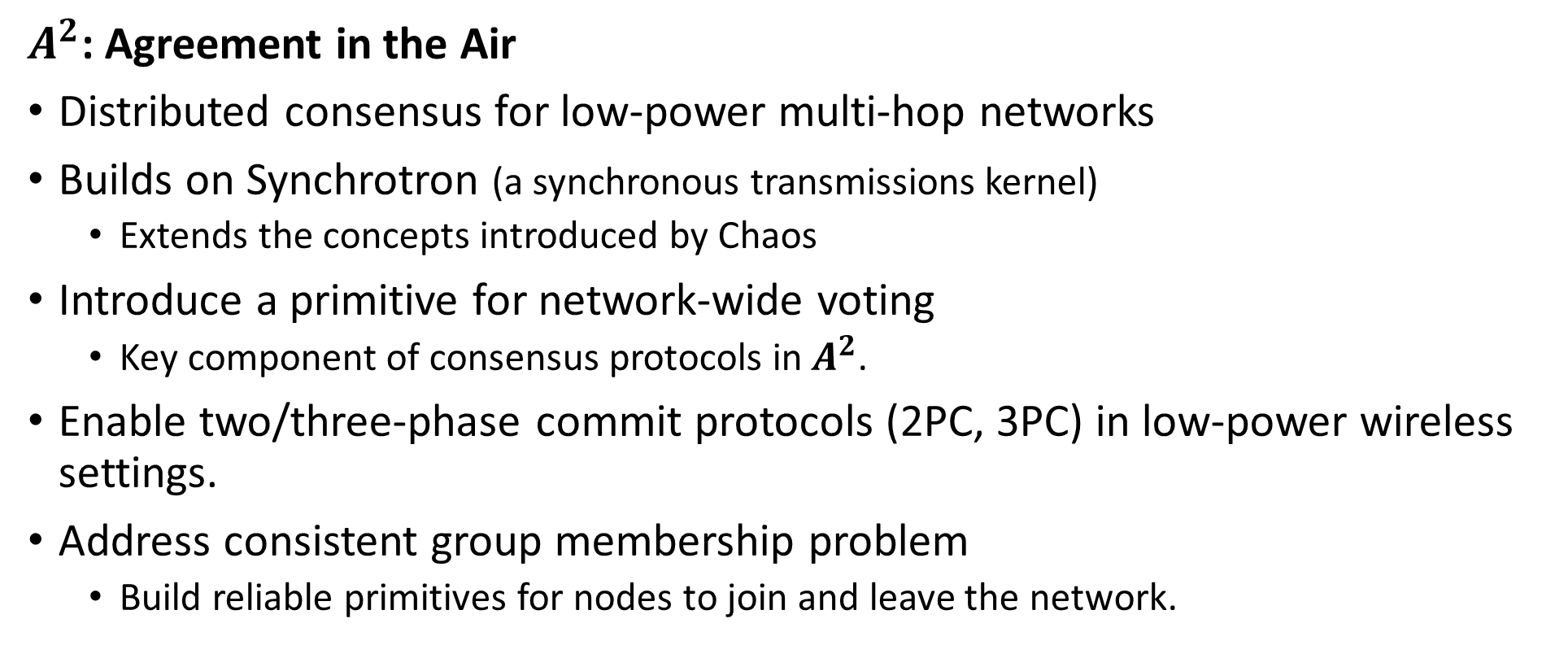
Approach
$A^{2}$: Agreement in the Air
Distributed consensus for low-power multi-hop networks
Builds on Synchrotron (a synchronous transmissions kernel)
  Extends the concepts introduced by Chaos
Introduce a primitive for network-wide voting
  Key component of consensus protocols in $A^{2}$.
Enable two/three-phase commit protocols (2PC, 3PC) in low-power wireless settings.
Address consistent group membership problem
  Build reliable primitives for nodes to join and leave the network.

Slide 11
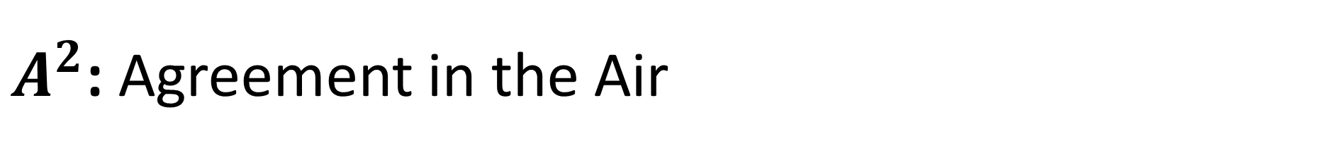
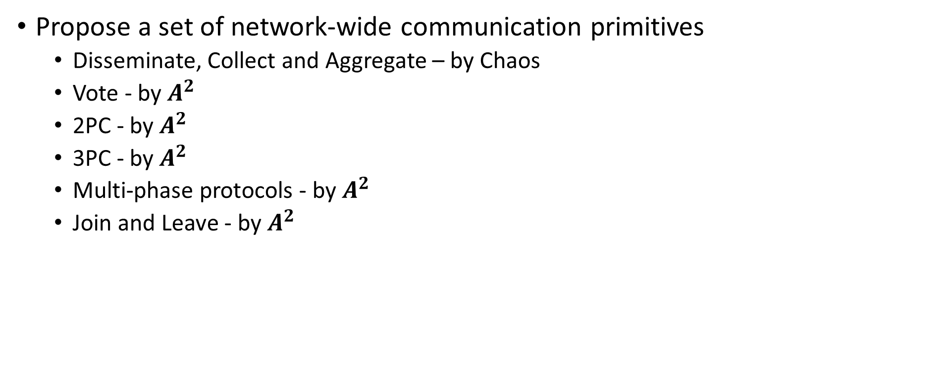
$A^{2}$: Agreement in the Air
Propose a set of network-wide communication primitives
  Disseminate, Collect and Aggregate – by Chaos
  Vote - by $A^{2}$
  2PC - by $A^{2}$
  3PC - by $A^{2}$
  Multi-phase protocols - by $A^{2}$
  Join and Leave - by $A^{2}$

Slide 12
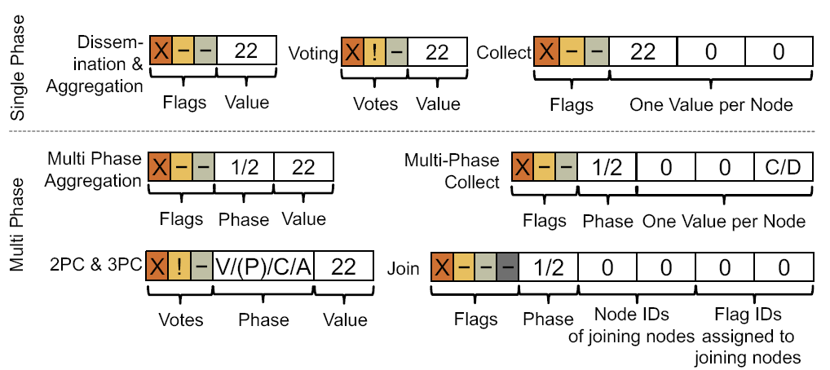
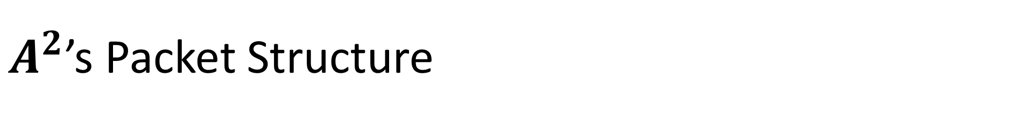
$A^{2}$’s Packet Structure

Slide 13
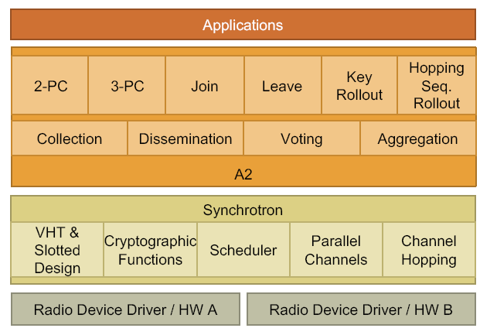
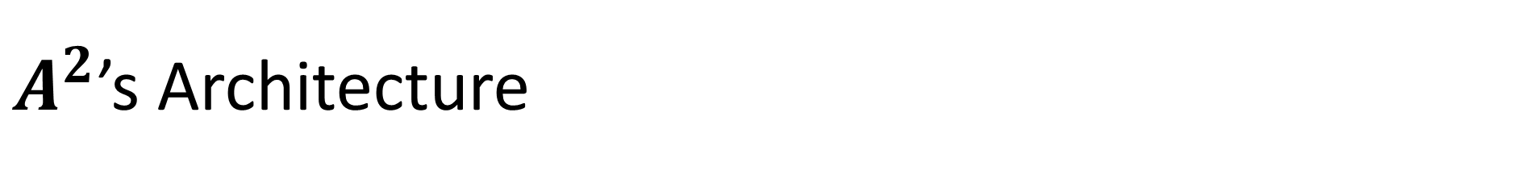
$A^{2}$’s Architecture
Service
Primitive

Slide 14
A Network-Wide Voting
The voting primitive
  Collect vote from all participant for/against proposed value
  The coordinator begins a round by proposing a value and voting
  Participant merges received information with its vote and retransmit
  If a node completes, transmit the final result aggressively to network
  At the end of voting round, the coordinator should be aware of vote results
Challenge
  These primitives is a best-effort
    No guarantee that every node received final vote results
  Adapt 2PC/3PC to achieve network-wide agreement
Notes:
For our discussion, we assume the existence of a group membership service within A2, i.e., that each node is aware of who else is participating and have been assigned a flag for voting.
부연설명 -> 다음 페이지의 그림을 보면서 할 것

Slide 15
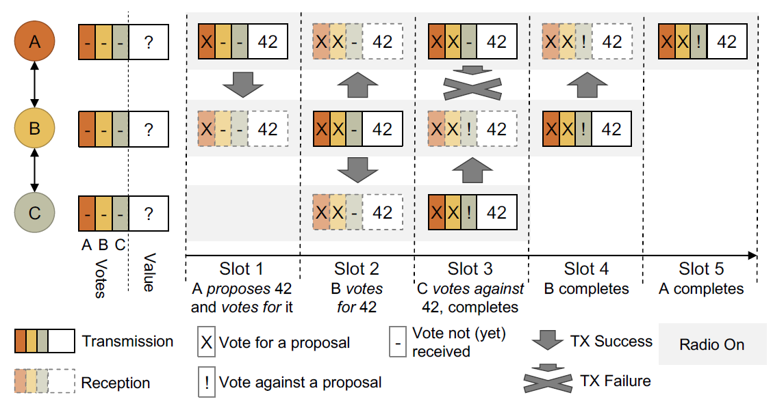
Notes:
여러 슬롯 동안 패킷을 받지 못했다면 타임아웃에 걸려 재송신을 한다. (손실에 대비)
주의사항 : Vote가 끝났다는 걸 알리는 것은 Best-effort이다. 각자가 Final payload를 받았다는 확신이 없다.

Slide 16
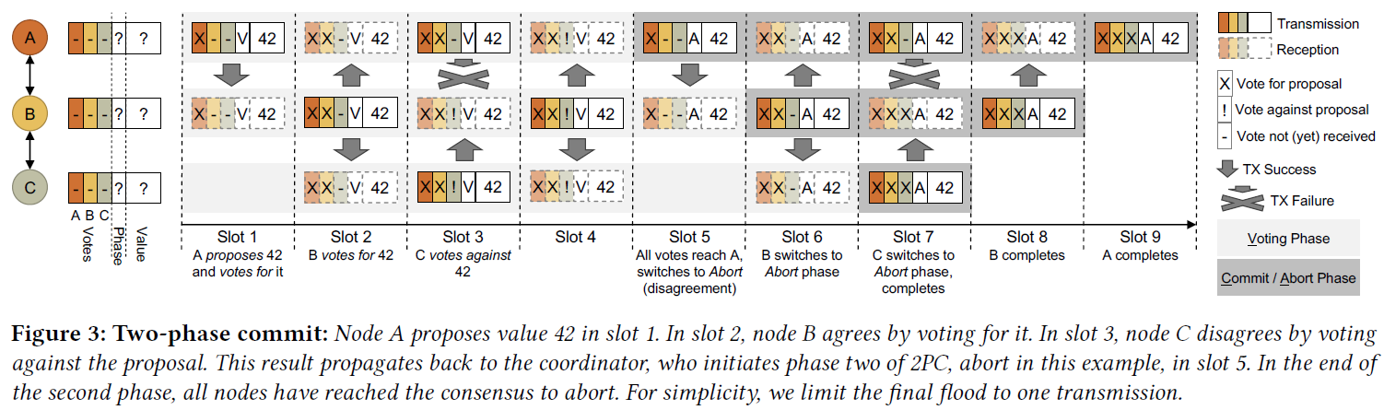
Network-wide Agreement : 2PC
Slightly modified from voting primitive
Notes:
컨센서스 프로토콜 중 가장 간단함
Node Failure ->
Yes Vote 전 / No vote 후 : Timeout. Coordinator가 timeout 걸고 abort 때림
Uncertain State : Blocking. 트랜잭션이 어떻게 끝났는지 알 수 있을 때까지 기다린다

Slide 17
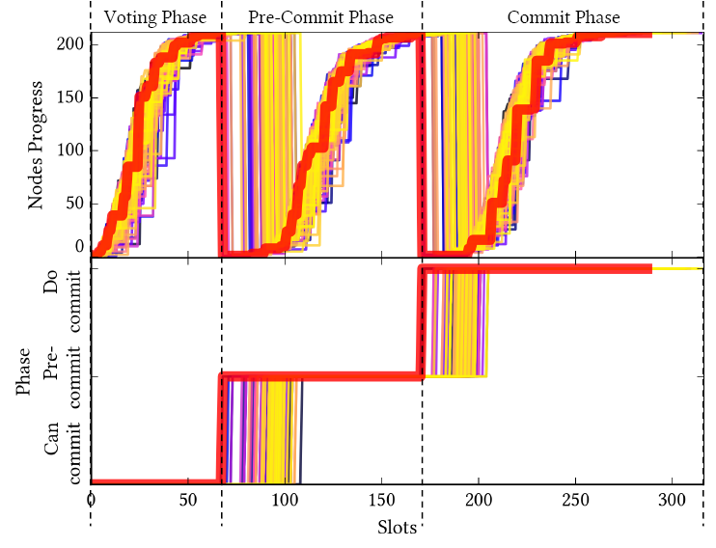
Network-wide Agreement : 3PC, Multi-Phase
3PC to overcome blocking
  2PC can result blocking even if
  a single node failed
  Add pre-commit/Abort phase
  Use dissemination primitive
Multi-Phase Protocols
  Useful if an application just need to
  collect value instead of voting
  Use variant of 2PC
Notes:
2PC에서 노드가 맛이 가면 blocking이 발생할 수 있음.

Slide 18
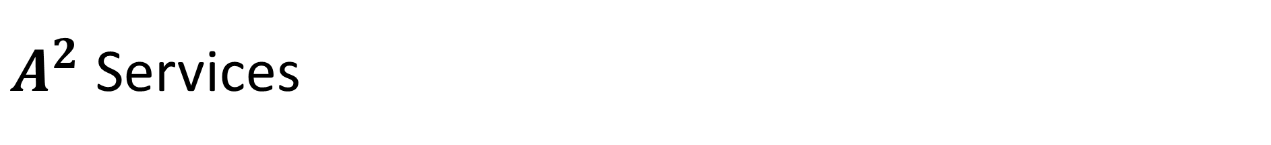
$A^{2}$ Services
Services
Join
Leave
Channel Hopping
Key Distribution
Sequence number is used to prevent inconsistency

Slide 19
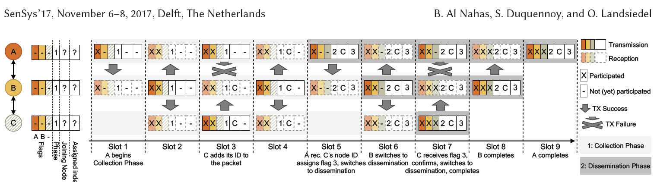
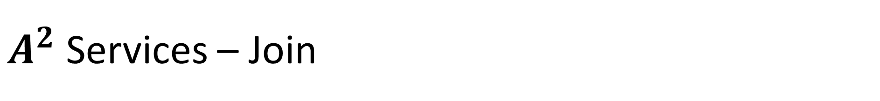
$A^{2}$ Services – Join
C wants to join network
Notes:
Collect Phase -> Disseminate Phase
Disseminate Phase를 2PC / 3PC로 교체하면 전체 노드가 flag 업데이트 때 컨센서스에 이루는 걸 보장할 수 있다.
간단해서 기본적으로 2PC를 쓴다. Seq#를 써서 inconsistency 해결 가능.

Slide 20
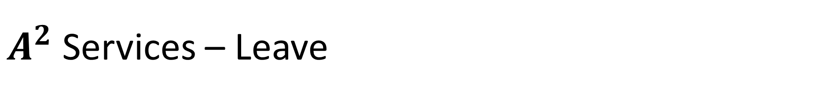
$A^{2}$ Services – Leave
A node is removed if it does not participate for a number of rounds
Coordinator schedules a leave round to remove a node
A simple dissemination round
Optionally employ 2PC/3PC
  Not mandatory, can resolve inconsistency using Seq#

Slide 21
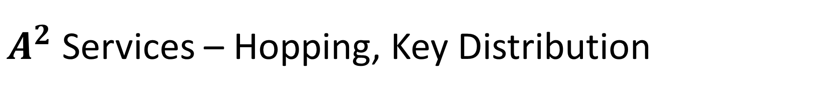
$A^{2}$ Services – Hopping, Key Distribution
Use the consensus primitives
  Can be done with 2PC/3PC

Slide 22
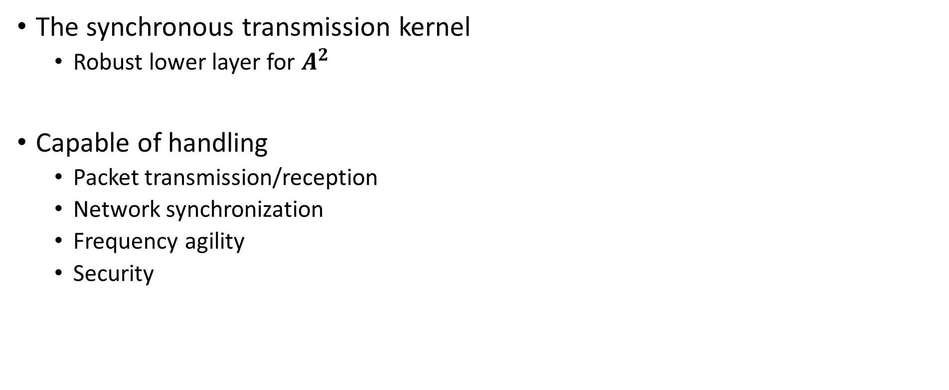
Synchrotron
The synchronous transmission kernel
  Robust lower layer for $A^{2}$
Capable of handling
  Packet transmission/reception
  Network synchronization
  Frequency agility
  Security

Slide 23
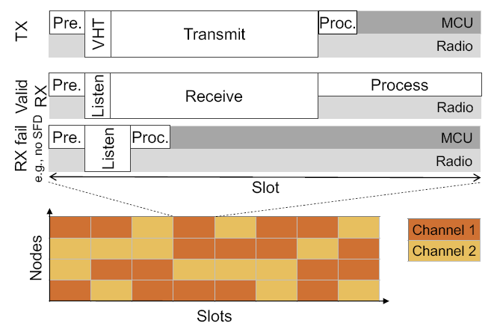
Synchrotron
Time-slotted protocol
Slot : minimum time unit
In-Slot Power Saving
  Turn off radio after TX/RX until
  new time slot starts.
Notes:
Sync with VHT?

Slide 24
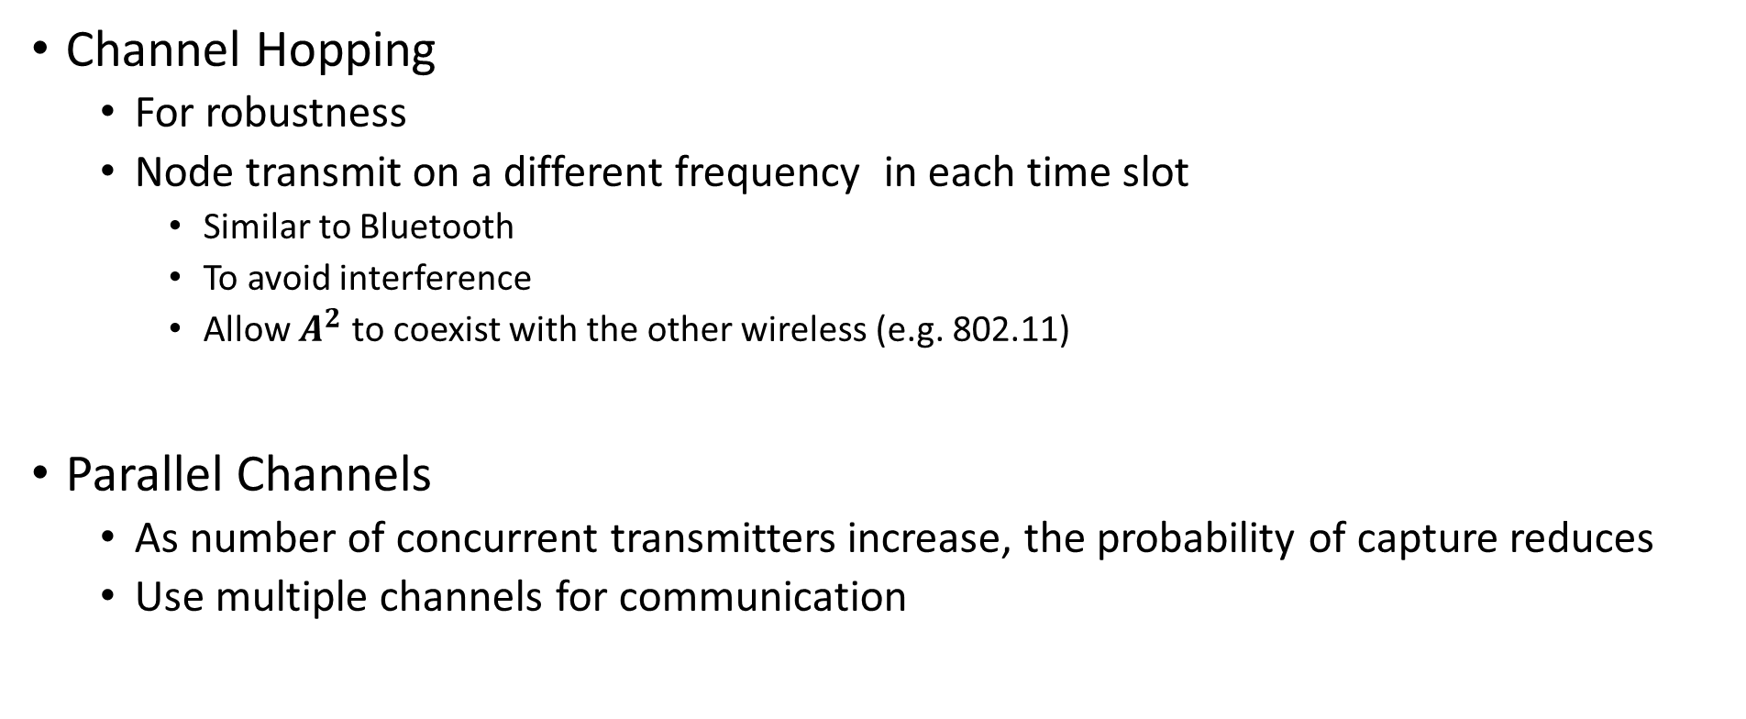
Synchrotron
Channel Hopping
  For robustness
  Node transmit on a different frequency in each time slot
    Similar to Bluetooth
    To avoid interference
    Allow $A^{2}$ to coexist with the other wireless (e.g. 802.11)
Parallel Channels
  As number of concurrent transmitters increase, the probability of capture reduces
  Use multiple channels for communication
Notes:
Parallel Channels -> Time slot마다 패킷 전송/수신할 때 랜덤으로 다른 채널 선택함
궁금증 : 채널이 다른데 남의 통신을 어떻게 들을 수 있는가?

Slide 25
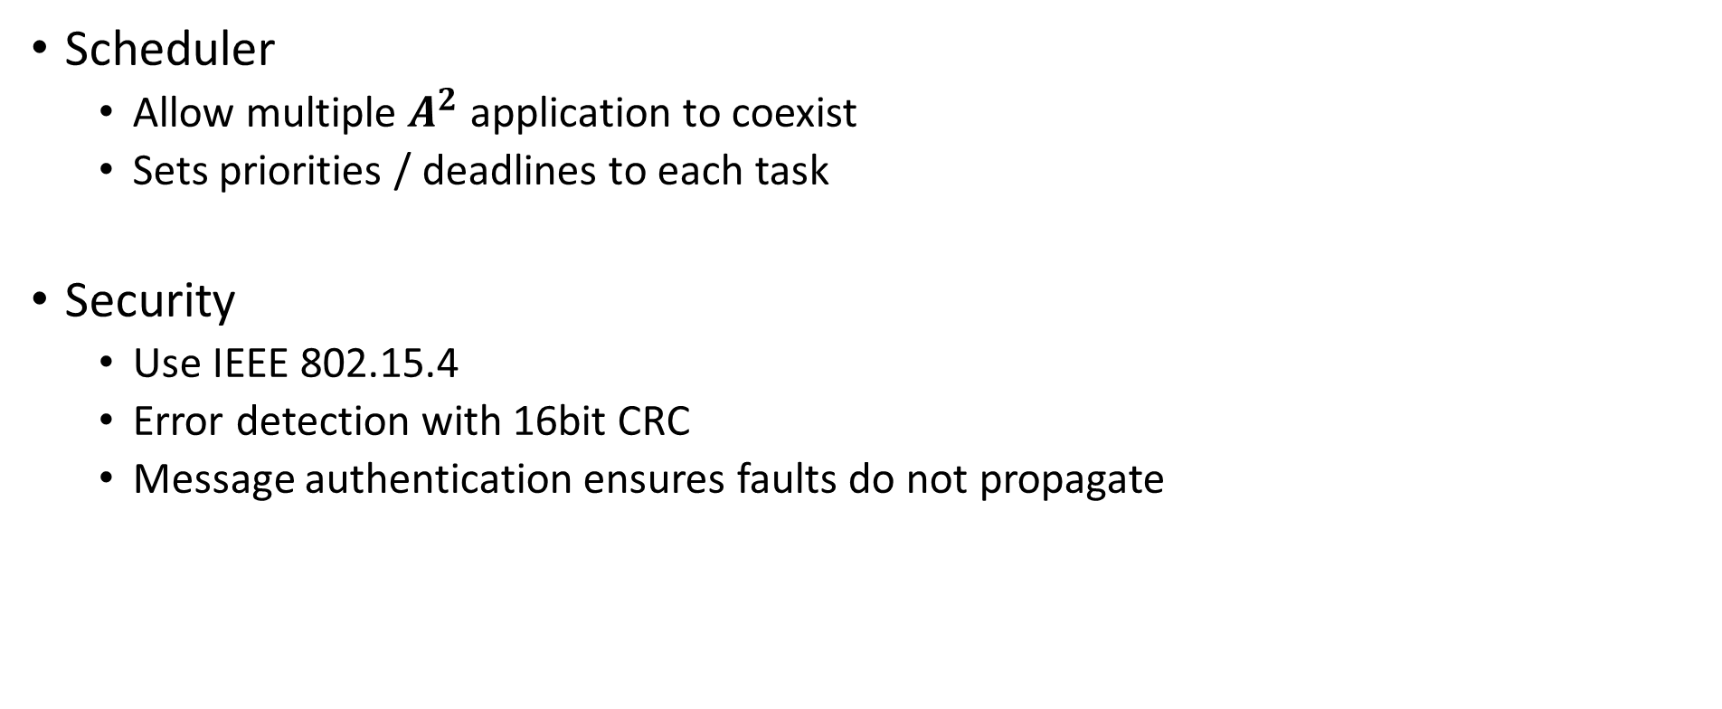
Synchrotron
Scheduler
  Allow multiple $A^{2}$ application to coexist
  Sets priorities / deadlines to each task
Security
  Use IEEE 802.15.4
  Error detection with 16bit CRC
  Message authentication ensures faults do not propagate
Notes:
802.15.4 : ZigBee 같은 저전력/근거리 통신이 씀. CSMA/CA 기반

Slide 26
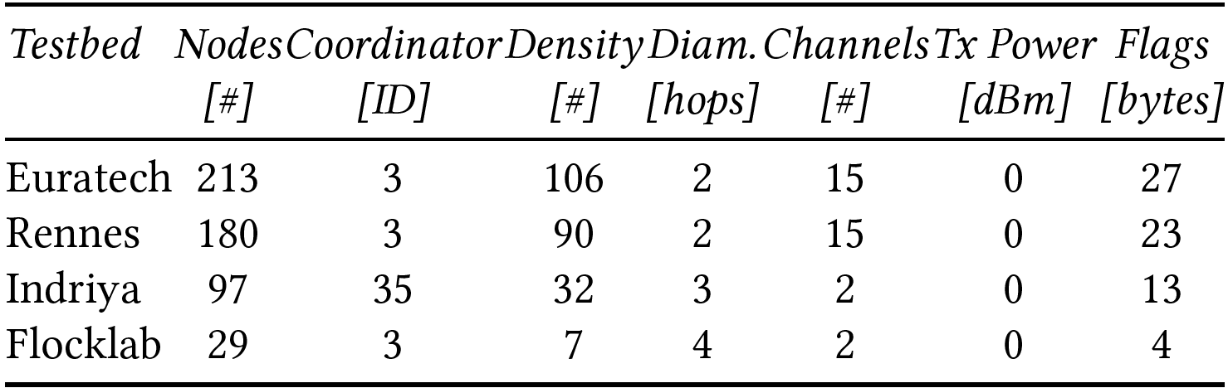
Evaluation
4 testbeds
  CPU : 16bit MSP430 4Mhz
  RAM : 10KB
  Radio : compatible with 802.15.4
Notes:
다양한 밀도와 노드 수를 가진 테스트베드를 준비

Slide 27
Evaluation
Metrics
End-to-End Loss Rate
  How many nodes successfully received the final value
Radio-on Time
  Total time the radio is active during a round
  Related to power consumption
Radio Duty Cycle
  Ratio of the time that radio is active over the total time
  Related to energy efficiency
Latency
  Duration of a round until they enter the final phase
Notes:
다양한 밀도와 노드 수를 가진 테스트베드를 준비

Slide 28
Evaluation - Consensus
Notes:
Non Vendor가 TrustZone와 Hypervizer에 접근할 수 있는 유일한 플랫폼이 Juno 였음
스펙대로라면 Juno 보드가 제공해야 하는 기능 중 일부는 우리가 제대로 쓸 수 없었고, 우회하거냐 에뮬레이션을 해야 했다.

Slide 29
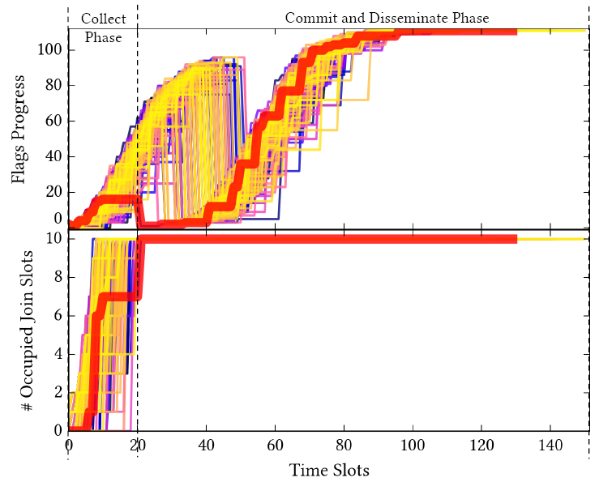
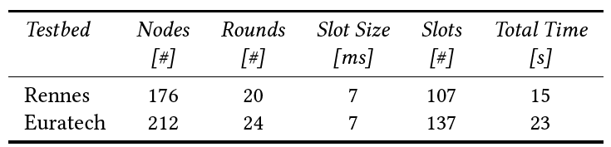
Evaluation - Join
Joined up to 10 nodes per round
  Require 20-24 rounds
  Took 15-23 seconds

Slide 30
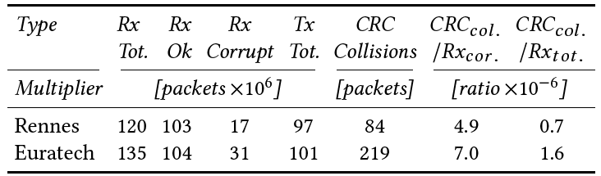
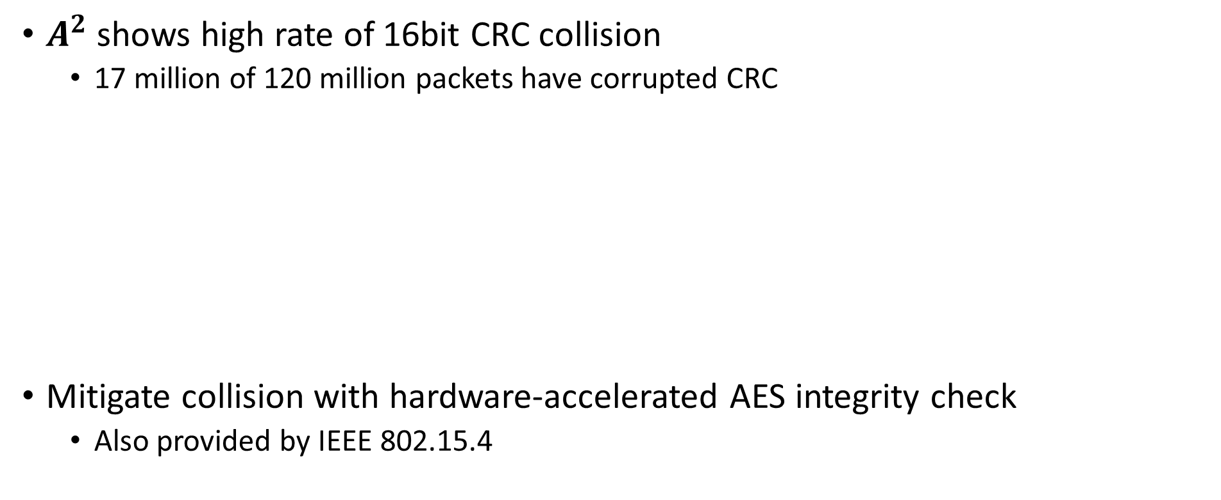
Evaluation – Packet Error Detection
$A^{2}$ shows high rate of 16bit CRC collision
  17 million of 120 million packets have corrupted CRC
Mitigate collision with hardware-accelerated AES integrity check
  Also provided by IEEE 802.15.4
Notes:
CRC 충돌 이유 : 송신 스케줄링이 빡빡해서 수신할 때 오류가 남
AES 암호화는 하드웨어 가속함

Slide 31
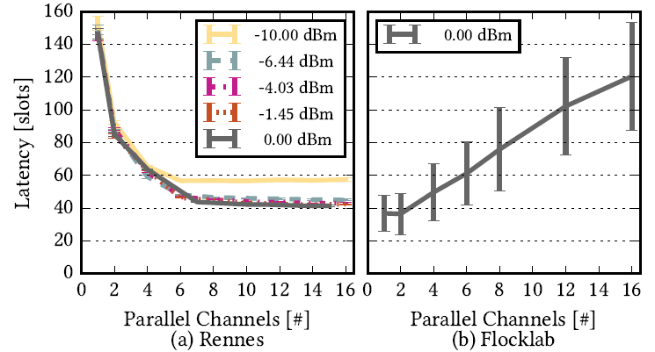
Evaluation – Parallel Channels
Effective in dense testbed
Not effective in sparse testbed

Slide 32
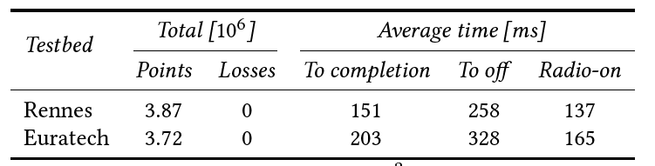
Evaluation – Long Term Performance
No loss over 3.8 million messages
Radio-on time is about 150ms

Slide 33
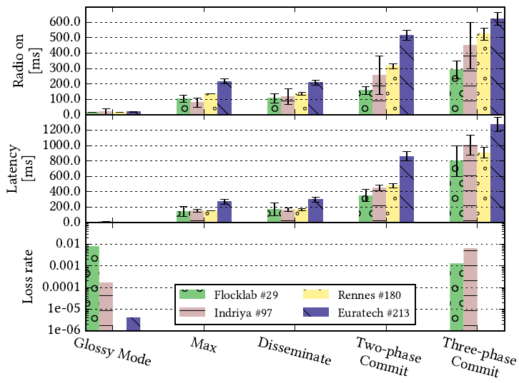
Evaluation – Cost of Consensus
More nodes, more cost

Slide 34
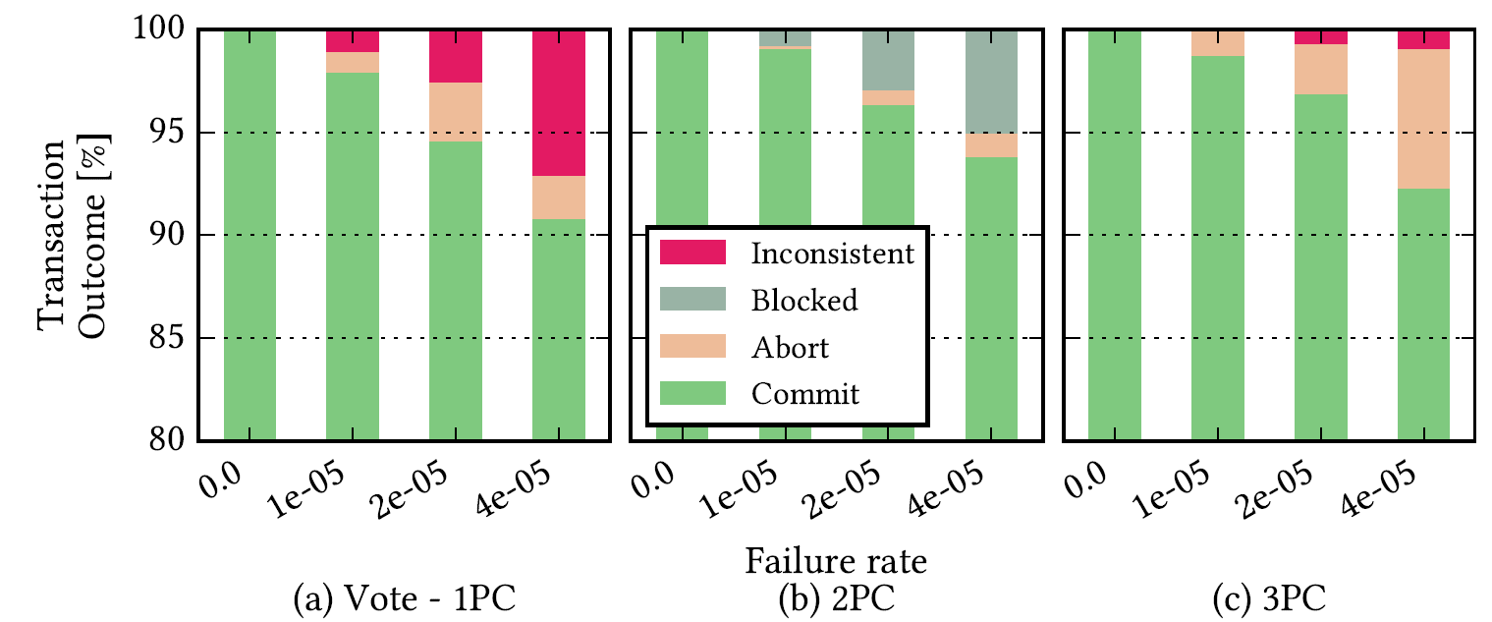
Evaluation – Consistency of Consensus Primitives

Slide 35
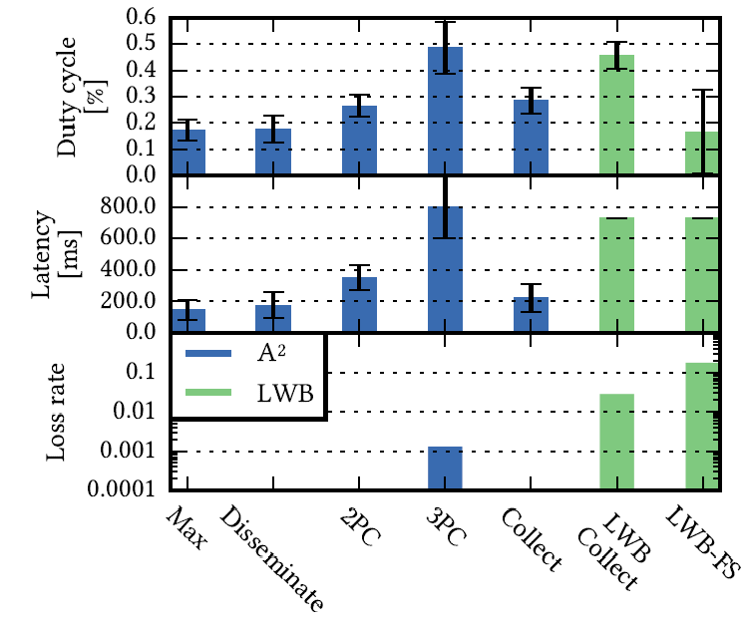
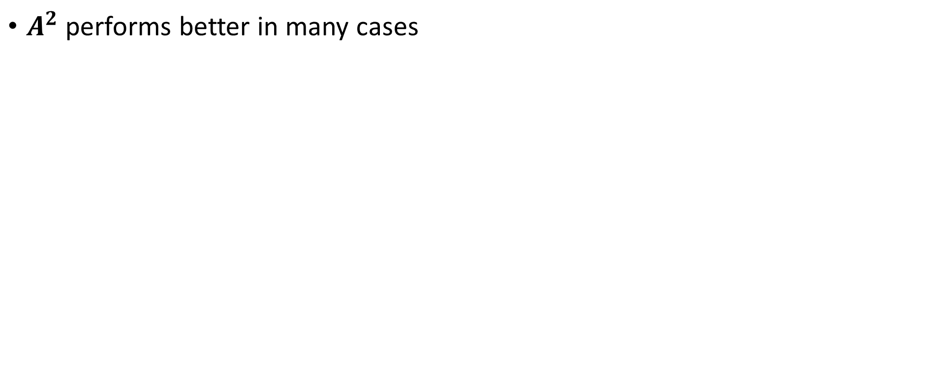
Evaluation – Comparison to the State of the Art
$A^{2}$ performs better in many cases

Slide 36
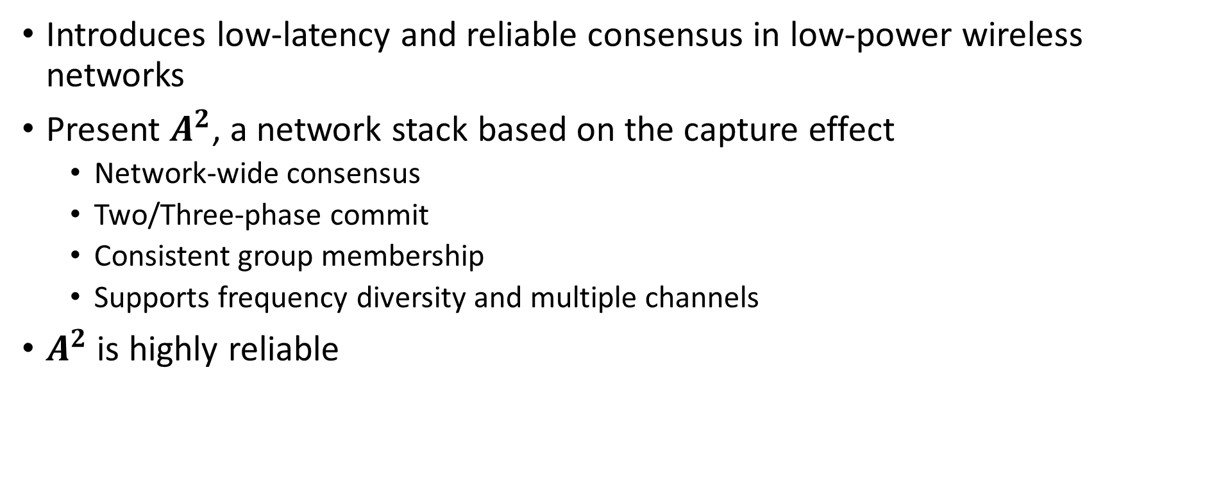
Conclusion
Introduces low-latency and reliable consensus in low-power wireless networks
Present $A^{2}$, a network stack based on the capture effect
  Network-wide consensus
  Two/Three-phase commit
  Consistent group membership
  Supports frequency diversity and multiple channels
$A^{2}$ is highly reliable

Slide 37
Critique
High rate of packet corruption rate
  Can be mitigated with AES integrity, though
Can adaptive use of parallel channel is possible?
  Parallel channel decreases performance in sparse network

Slide 38
Thank You
<hajin_jang@korea.ac.kr>

