Slide 1
CamForensics: Understanding Visual Privacy Leaks in the Wild
Seunghoon Woo
CCS Lab, Korea University
Sep 18, 2018

Slide 2
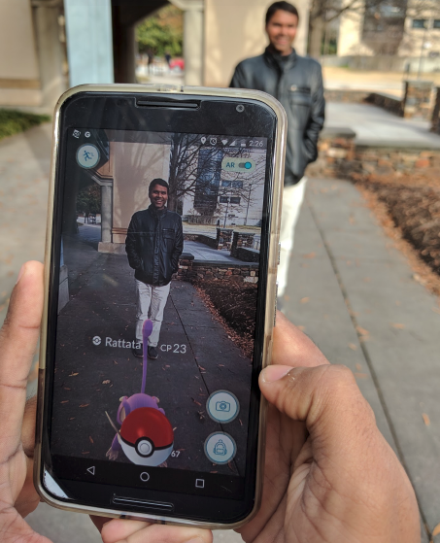
Motivation
Cameras are as essential to modern mobile devices
  Allows users to capture and share important moments
In these days, many mobile apps try to digitize information using a camera
  Physical world to live camera data
  E.g., Augmented-reality games, bar-code readers, and document scanners

Slide 3
Problem definition
Camera permissions for existing mobile operating systyem are very coarse
  An app can access all of a camera’s view or none of it
Apps can access both essential and inessential data within the same camera
  This could lead to unexpected app behavior from the perspective of a user
  For example,
    A camera app could perform a face recognition (Unexpected)
    Whenever the user takes a selfie (Expected)

Slide 4
Previous approaches
Some proposals try to protect visual privacy through finer-grained control
  However, they can only test with small data set
  They can not check for information leakage or visual privacy on a large scale
  Also several critical questions will remain unanswered
    What information mobile apps extract from camera data
    Users’ privacy expectations of camera apps

Slide 5
Solution
Develop an app analysis tool called CamForensics
  A custom Android environment
  A suite of test inputs that feeds an app simulated camera data
  It monitors an app’s execution and analyze app’s behavior for image processing
  Collect evidence and inform of any visual inference drawn from the camera feed,
  and users can deem it as expected or unexpected

Slide 6
Research questions
How prevalent smartphone apps with camera access?
What information do apps extract from camera data?
Does the extracted information from app match what the user expects?

Slide 7
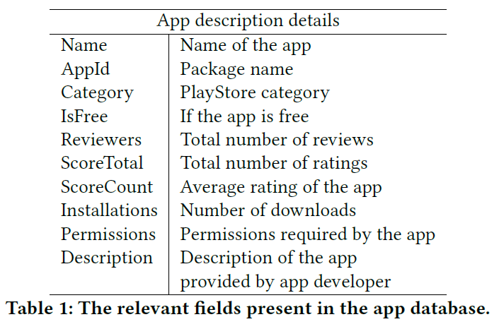
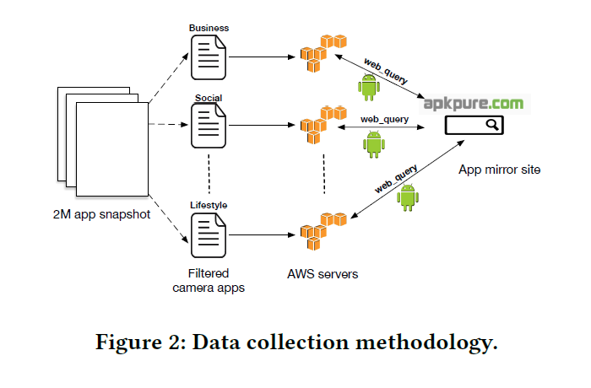
Dataset
  “TAKE PICTURES AND VIDEOS” permission
Among 327K camera-based apps, download and analyze 230K apps
  Crawling Google PlayStore -> IP blocking for aggressive polling
  Manually gathered -> May spend several months
  Therefore, they first crawl Metadata of snapshots of Google PlayStore apps (Table 1)
  Download real apk files from PlayStore mirror site (apkpure.com) (Figure 2)

Slide 8
Dataset
Use of third-party libraries
  The most camera apps from their dataset using thir-party image processing libraries
  Since libraries are used in a black-box manner, app developers typically include them
  Extract libraries from the apk file using the apktool
  On average, 3.8 libraries are utilized in the collected apps

Slide 9
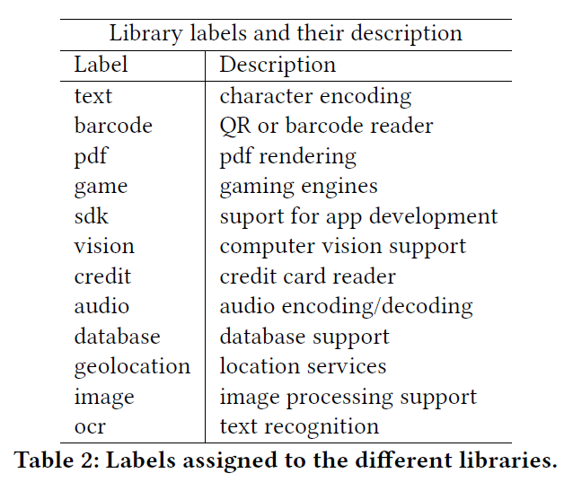
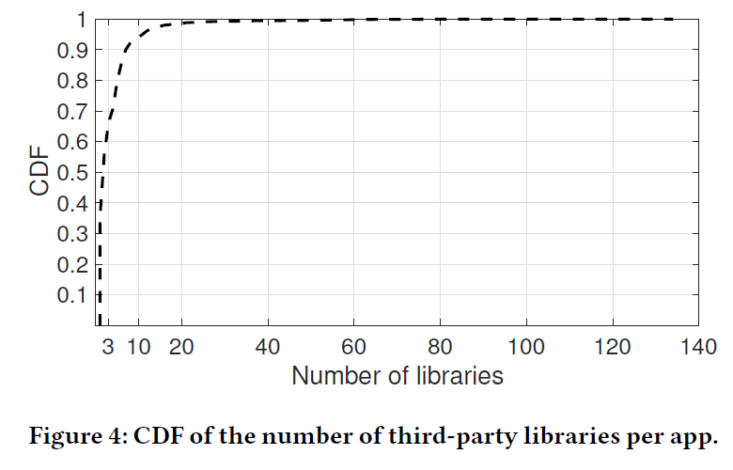
Dataset
Snapshot dated July 18, 2016
Spent 10 days to download
Use of third-party libraries
  A handful of apps contain a very large number of third-party libraries (Figure 4)
  33.3% (76,598/230,000) apps have at least one third-party libraries
  15,267 unique libraries are found, but most apps are not for image processing
    Manually label libraries (only top-100 frequently used) (Table 2)

Slide 10
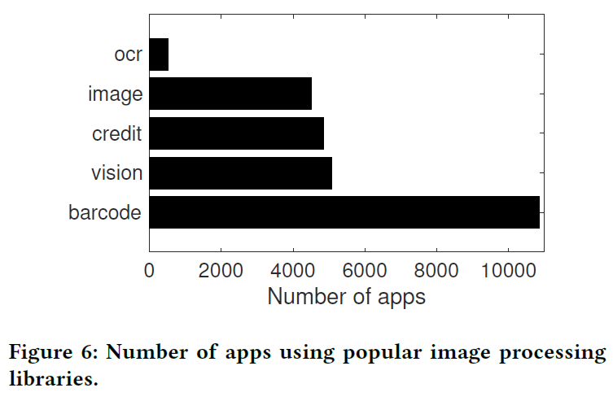
Dataset
3) Systems aspect of image processing
  What fraction of apps perform image processing on device?
    Among 100 most frequently used libraries, 34 allow image manipulation on the device
    These 34 libraries are present in 12.43% of camera-based apps
  What kind of image processing is performed?

Slide 11
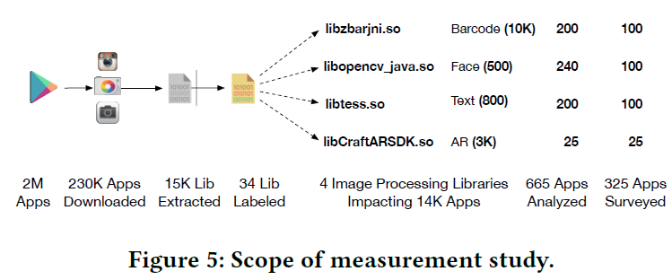
Dataset
Scope of Measurement Study
  Among 2M apps, identify 327K apps that use the camera, download 230K of them
  Extracted native libraries (total of 15K) from the 230K apps and identify 34 most popular image processing libraries
  Instrument 4 libraries
    Impact 10K barcode scanning, 800 text recognition, 500 face detection, and 25 AR apps
    They analyze only the most popular
    apps in these categories (665)
  Performed surveys on a handful of
  the analyzed apps to understand
  users’ expectation

Slide 12
User study
No consensus exist on a visual privacy leak’s definition or solution
Building a solution which is agreeable to the majority is a hard
They sought answers to the following questions
  Given real-world app descriptions, how informative are they in making users aware of the kind of image processing happening inside the app?
  Given real-world scenarios and apps performing certain image processing task, how do users perceive the situation?

Slide 13
User study
Study setup
  Using Amazon Mechanical Turk (AMT) for conducting user studies
    AMT provides an easy-to-use platform to support large scale user studies
    The questions are presented as Humman Intelligence Tasks (HITS)
      Each HIT typically has an associated monetary reward and upon completion
    A HIT requester (i.e., the survey creator) may select workers based on their qualifications
    They were able to distribute surveys which consist in total 325 HITS
Recruiting participants
  English speakers (e.g., the US, Canada, and the UK)
  1 – 10 cents per each HIT based on its complexity

Slide 14
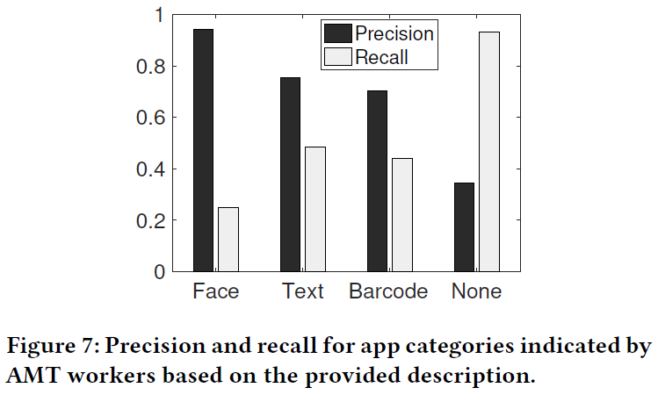
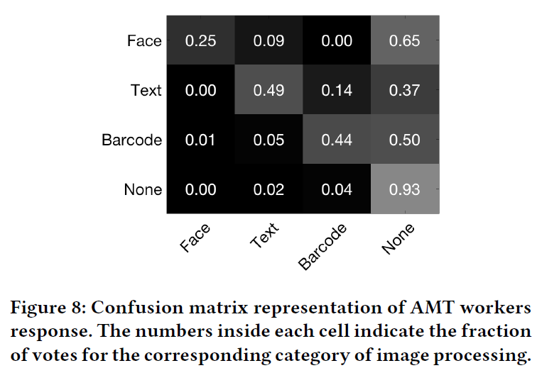
User study
User awareness of image processing
  Selected a set of 100 apps comprised of 25 each from the following four categories
    Face detection, OCR, barcode scanning, and apps that perform no image processing
  Based on the several information (e.g., app name, description),
    They asked whether the worker could infer what kind of image processing the apps perform

Slide 15
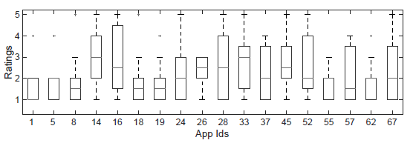
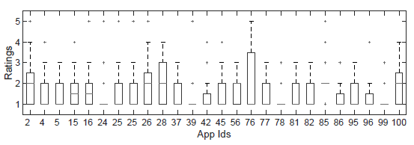
User study
Ratings
1: Strongly disagree
5: Strongly agree
User awareness of image processing
  They provide more stronger hints (e.g., correct app category) and
  asked how strongly workers believed that the app belonged in that category
  100 apps containing an OCR library and 100 apps performing face detection
  It is clear that app descriptions rarely allow users to understand what information the apps extract from camera data

Slide 16
User study
User perception of visual privacy
  Designed some real-world scenarios
    Involving apps performing image analysis and sharing the results
  In each scenario,
    Introduce study participants to methods in which an app might handle camera data
    And ask to what extent they are acceptable to them

Slide 17
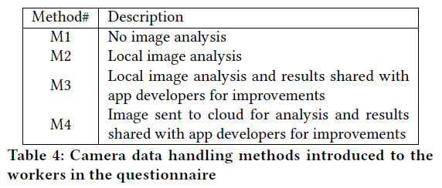
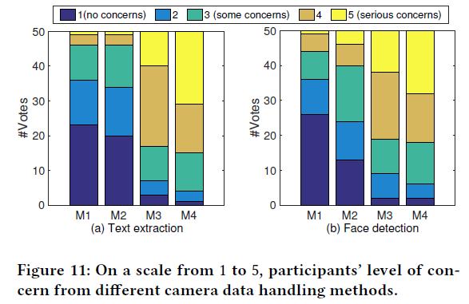
User study
User perception of visual privacy
  Asked 50 AMT workers to rate their concern based on the camera data handling method used by the app

Slide 18
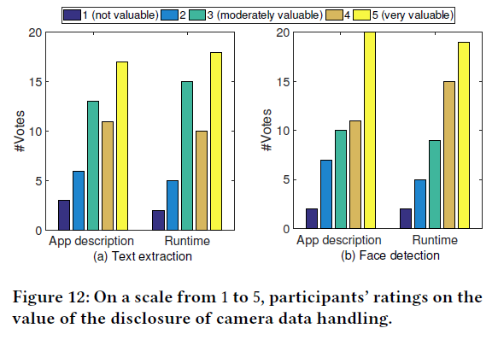
User study
User perception of visual privacy
  Another survey: If it valuable to have apps disclose their camera data handling
    Apps’s app store description of how images are processed and where are they stored
    Run-time app notification describing how images are processed and where are they stored

Slide 19
User study
In summary,
  Given current app store descriptions of the apps, it is hard for users to judge the kind of information app extracts from camera data
  Given a choice, users would like to know what kind of information apps extract from camera data, including the location

Slide 20
System overview
Design principles
  Logs as an evidence of image analysis
    To detect function calls in real-time and logs them along with the timestamps
  Testing apps without pre-processing
    Apps are run directly on the device without pre-processing
  Trigger image analysis
    Apps are designed to trigger image analysis if the image meets certain criteria
    CamForensics modifies the camera service to replay a pre-recorded video stored on the device
  Automate detection of image analysis
    CamForensics uses a machine learning based technique to skim through arbitrarily long function logs collected during an app’s run

Slide 21
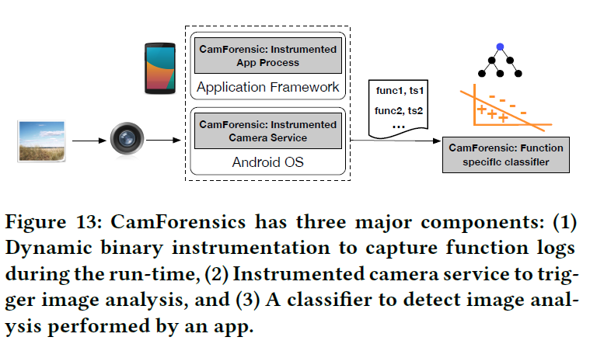
Implementation
CamForensics is built in three parts
  Module to instrument the app process
  Module to instrument camera service
  Module to detect the image analysis at app’s run-time
  Modifying Android 6.0.1
  Modifying Android 6.0.1
  Runs on a server

Slide 22
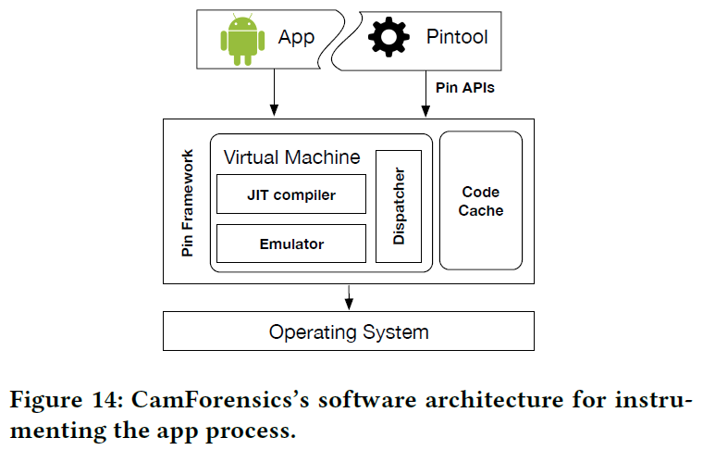
Implementation
Instrumenting the app process
  They used Intel’s Pin
    One of the most powerful, robust, and efficient platform for run-time process instrumentation
    They used Pin for it’s simplicity and performance reasons
  They developed Pintool to log function calls
  to the native libraries for all android apps

Slide 23
Implementation
Instrumenting the app process - When an app is invoked
  The operating system makes a calls to Android run-time (ART) to start a new process
  Originally, ART returns assigned process-id to the OS, but they changed Android to make a callback to pintool
  Pintool pauses the running process and attemps to identify the libraries

Slide 24
Implementation
Instrumenting the app process - When an app is invoked
  Pintool decides whether a recognizable image processing library is in the app, if present, Pintool continues further analysis of the app
    Open-sourced or Close-sourced
  Pin adds the instrumentation code only when those functions are invoked
  Finally, the Pintool start the paused app process
  Pintool collects ① thread id, ② function name, ③ name of the library containing the function, and ④ timestamp at which the function was invoked

Slide 25
Implementation
Camera service – record and replay
  Testing camera based apps is a tedious process
    Manual effort involved in running the camera and pinpointing it at a subject
    Even several apps need few hours to detect malicious behavior
    Moreover, an ideal experiment should be repeatable to confirm the vulnerability
  Therefore, they take an alternate approach
    Modifying camera service

Slide 26
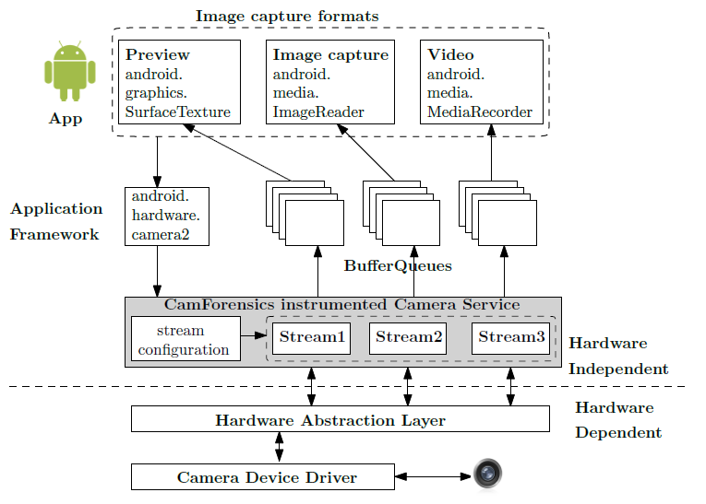
Implementation
Camera service – record and replay
  Camera service reads data from the sensor and supplies it to the layers above
  They modified camera service
    It starts reading from a video file,
    not an camera sensor (in mode 1)
    Then camera service supplies fabricated
    frame buffer to the app
      They feed data of their choice to make
      app trigger specific operations

Slide 27
Implementation
Camera service – record and replay
  They create a configuration file accessible to system service
    Mode and filename
  They modify the camera service to read this file when an app requests camera access
    Based on the mode,
      When mode is 0 (record), deliver the camera frames to the app, record the frames, and store them in a file pointed by filename
      When mode is 1 (replay): read frames from the file pointed by filename and deliver them to the app (instead of frames from the sensor)

Slide 28
Implementation
Classifying the logs
  They use a simple machine learning technique to monitor a log and determine the category of image analysis it belongs to
    Convert the traced function (string input) to a set of learning vectors using word2vec
    Train these vectors using a shallow convolutional neural network (CNN) for classfication

Slide 29
Evaluation
Measure accuracy of the prediction in classifying an image processing
Measure the overhead introduced by CamForensics
Categorized findings
Specifically look for the apps which use third-party native libraries for
  Barcode reader
  Text extraction
  Face detection
  Augmented reality

Slide 30
Evaluation
Measure accuracy of the prediction in classifying an image processing
  Environment
    Laptop with a 2.6 GHz Intel Core i5 processor with 8 GB RAM
  Run an app performing text extraction (libtess.so) and collect function call traces
    For the training
  Next, they run other apps which use the same library and collect traces for testing
    Testing logs contain 1000 instances of camera data
    Also provide 1000 frames in which no text extraction was performed
  Randomly split the dataset into 80-20 partition (training-testing) and repeat 10 times!
  Very quick training period (~20 minutes)
  The median precision and recall is 0.96 and 0.966 respectively

Slide 31
Evaluation
Measure the overhead introduced by CamForensics
  The performance drop comes from two components
    Pin Framework that resides between the app process and the OS
    Pintool which injects instrumentation code and traces function calls
  To measure the drop in performance
    They perform matrix multiplication of size 200 x 200 on the device for 50 times
    Measure total time under
      Without any instrumentation
      With instrumented function calls to one library
      With instrumented all function calls to all libraries

Slide 32
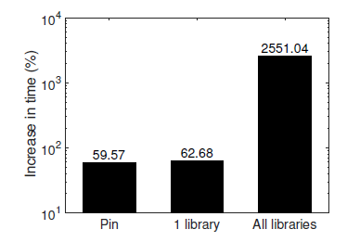
Evaluation
Measure the overhead introduced by CamForensics
  Without any instrumentation
  With instrumented function calls to one library
  With instrumented all function calls to all libraries

Slide 33
Evaluation
Categorized findings
  Barcode reader
    Analyzed top 200 apps which contain Zbar (libzbarjni.so)
    45 of them do not provide any camera-based functionality (have camera permission)
    Another 15 apps do not use barcode scanning (have camera permission)
    9 apps bundle multiple barcode libraries (Zbar, Zxing and Google native barcode scanner)
  AliveOneScan Pro app
    QR code scanning app
    But also recognizes colored images and sends to the cloud
  Tesco Lotus, MANGO

Slide 34
Evaluation
Categorized findings
  OCR
    Analyzed 200 apps which use tesseract library (libtess.so)
      Document scanning, language translation, dictionaries, passport scanner, etc..
    Dictionary-based apps state the use of OCR library clearly in their description
    OCR has a different sequence of function calls than other areas (e.g., face detection)
      For example, in the case when enough lines of text are not detected, it tries to increase the
      contrast of the image

Slide 35
Evaluation
Categorized findings
  OpenCV and face detection
    Instrument 240 apps using OpenCV library (libopencv_java.so) and analyze their traces
    10 of them use face detection functionality
      Used in two categories of apps: face-based screen unlocking and fashion makeup
      Screen unlocking apps run seek explicit approval -> do not violate!
      However, the fashion app runs the face detection right after launching -> violate!
    Moreover, a large number of apps access face data directly through the camera drivers
      120 apps use native camera driver for active face detection

Slide 36
Evaluation
Categorized findings
  Augmented reality
    They find two popular AR SDKs
      Vuforia (by Qualcomm, 3092 apps) and CraftAR (25 apps)
      CraftAR emphasizes object recognition both ways: on-device and in the cloud
    Not only running apps through CamForensics, but also capturing network packets
      They find 10 apps that send data over the network
        In all these apps, the packet send timestamps are tightly correlated to camera trigger event
        It is a strong indication that an information related to the camera may be transmitted

Slide 37
Future work
User study improvement
  A user study based on users’ experience of using the apps can provide a better estimate of the discrepancy between user’s awareness and apps’ descriptions
Minimize user intervention
Same native library, different version
  Developer may change the name of the functions
  More and more training…
Performance overhead

Slide 38
Conclusion
This paper presents the results of a large-scale study of visual privacy
  An app violates visual privacy if it extracts information from camera data that a user
  does not expect
CamForensics
  Monitors how camera data is handled by third-party libraries at runtime
  They characterize how over 600 Android apps extract information such as text, faces, and QR codes from devices’ camera
Performed several surveys
  What information users expected these apps to extract based on their app store descriptions
  To gauge their attitudes toward visual privacy
Results show that apps frequently defy users’ expectations, based on their descriptions, and that users care about how apps process their camera data

Slide 39
Critique
안드로이드에서의 coarse 한 camera permission 으로 인해 생길 수 있는 Visual privacy 를 다루고 있다
실제 user study 를 반영하여 시스템을 구축한 점, 단순한 아이디어제시가 아닌 구현을 통해서 증명한 점, 흥미로운 real-world findings 에 강점이 있다고 생각한다
하지만 large-scale 이라고 보기에는 실험이 적용된 데이터셋은 너무
사이즈가 작고, time overhead 가 상당한점 (25배), 한계에서도 나와
있지만 함수의 이름으로 feature 를 선정하는것은 상당히 부족해 보인다

Slide 40
Thank you
<seunghoonwoo@korea.ac.kr>

Slide 41
Findings
Most apps with camera-access use third-party libraries for image processing
  It is difficult to implement image-processing algorithms
Apps routinely defy users’ expectations
  In 61% of apps, users are unable to identify the type of image processing
  19% of apps extract unexpected information from camera data
Offloading image processing is not uncommon and presents a gray area for visual privacy

Slide 42
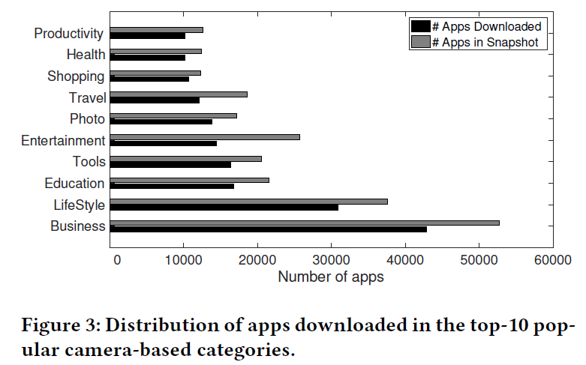
Dataset
Download and analyze 230K camera-based Android apps
  They only downloaded apps with permission “TAKE PICTURES AND VIDEOS”
  They able to download 230K of 327K apps that had camera permission
    The apps belong to 20 different categories
    Only free apps!

Slide 43
User study
Collecting responses
  Put up the user study on AMT and set its expiration period to be 10 days
    Actually, they were able to collect the responses within 7 days
  For each question, they collected 16 responses and they set the number of votes to
  be at least 10 in order to make a consensus
  For stricter vetting on HIT workers,
    They relied on AMT’s rating system where workers were selected with higher ratings

Slide 44
Evaluation
Measure accuracy of the prediction in classifying an image processing
  The heterogeneity of function call sequences makes classification non-trivial
    Developers design their apps perform the same operation even a different sequence of functions
      E.g., some apps choose to improve the contrast of the image and threshold the image before they perform text extraction, while others tend to detect paragraph before they perform text extraction
  Therefore, they choose topic modeling technique
    The aim is to provide a document containing function names, thread ids and timestamps,
    and determine the image analysis performed on the camera data

