Slide 1
Section 5.4: IP Forwarding
문영주
2014010492

Slide 2
IP Forwarding
IP forwarding is simple, especially for a host. If the destination is directly connected to the host (e.g., a point-to-point link) or on a shared network (e.g., Ethernet), the IP datagram is sent directly to the destination—a router is not required or used.
Otherwise, the host sends the datagram to a single router (called the default router) and lets the router deliver the datagram to its destination.

Slide 3
IP Forwarding
In our general scheme, the IP protocol can receive a datagram either from another protocol on the same machine (TCP, UDP, etc.) or from a network interface.
If the datagram is not destined for one of the IP addresses being used locally by the IP module, then
(1) if the IP layer was configured to act as a router, the datagram is forwarded or
(2) the datagram is silently discarded. Under some circumstances (e.g., no route is known in case 1), an ICMP message may be sent back to the source indicating an error condition.

Slide 4
Forwarding Table
Destination: This contains a 32-bit field (or 128-bit field for IPv6) used for matching the result of a masking operation (see the next bulleted item).
Mask: This contains a 32-bit field (128-bit field for IPv6) applied as a bitwise AND mask to the destination IP address of a datagram being looked up in the forwarding table.

Slide 5
Forwarding Table
Next-hop: This contains the 32-bit IPv4 address or 128-bit IPv6 address of the next IP entity (router or host) to which the datagram should be sent.
Interface: This contains an identifier used by the IP layer to reference the network interface that should be used to send the datagram to its next hop.

Slide 6
IP Forwarding Actions
1. Search the table for all entries for which the following property holds: (D ^ mj) = dj, where mj is the value of the mask field associated with the forwarding entry ej having index j, and dj is the value of the destination field associated with ej. This means that the destination IP address D is bitwise ANDed with the mask in each forwarding table entry (mj), and the result is compared against the destination in the same forwarding table entry (dj). If the property holds, the entry (ej here) is a “match” for the destination IP address. When a match happens, the algorithm notes the entry index (j here) and how many bits in the mask mj were set to 1. The more bits set to 1, the “better” the match.
2. The best matching entry ek (i.e., the one with the largest number of 1 bits in its mask mk) is selected, and its next-hop field nk is used as the next-hop IP address in forwarding the datagram.

Slide 7
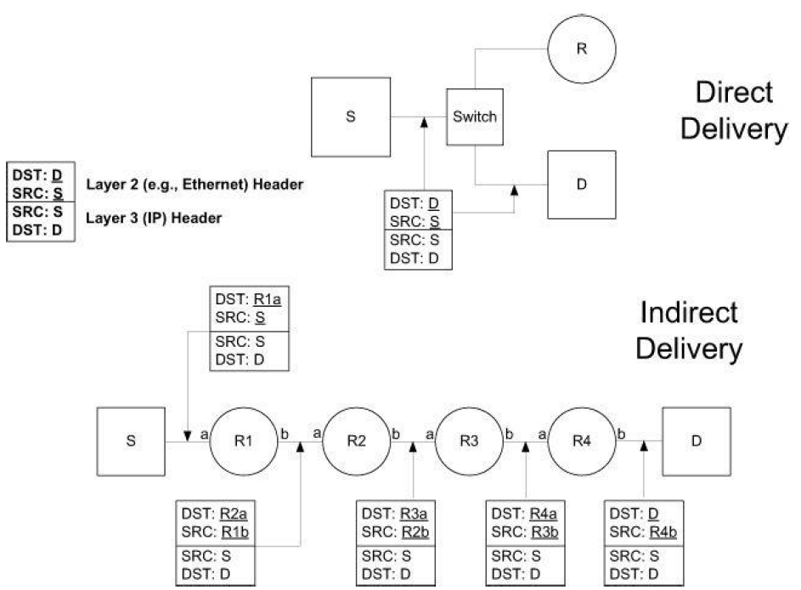
Examples - Direct Delivery

Slide 8
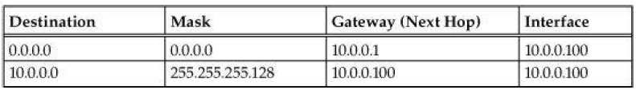
Examples - Direct Delivery
The (unicast) IPv4 forwarding table at host S contains only two entries. Host S is configured with IPv4 address and subnet mask 10.0.0.100/25.
Datagrams destined for addresses in the range 10.0.0.1 through 10.0.0.126 use the second forwarding table entry and are sent using direct delivery.
All other datagrams use the first entry and are given to router R with IPv4 address 10.0.0.1.

Slide 9
Examples - Indirect Delivery
C:\> ping6 fe80::204:5aff:fe9f:9e80
Pinging fe80::204:5aff:fe9f:9e80 with 32 bytes of data:
No route to destination.
Specify correct scope-id or use -s to specify source address.
...
C:\> ping6 fe80::204:5aff:fe9f:9e80%6
Pinging fe80::204:5aff:fe9f:9e80%6
from fe80::205:4eff:fe4a:24bb%6 with 32 bytes of data:
Reply from fe80::204:5aff:fe9f:9e80%6: bytes=32 time=1ms
Reply from fe80::204:5aff:fe9f:9e80%6: bytes=32 time=1ms
Reply from fe80::204:5aff:fe9f:9e80%6: bytes=32 time=1ms
Reply from fe80::204:5aff:fe9f:9e80%6: bytes=32 time=1ms
Ping statistics for fe80::204:5aff:fe9f:9e80%6:
Packets: Sent = 4, Received = 4, Lost = 0 (0% loss),
Approximate round trip times in milli-seconds:
Minimum = 1ms, Maximum = 1ms, Average = 1ms

Slide 10
Examples - Indirect Delivery
Linux% traceroute -n ftp.uu.net
traceroute to ftp.uu.net (192.48.96.9), 30 hops max, 38 byte
packets
1 70.231.159.254 9.285 ms 8.404 ms 8.887 ms
2 206.171.134.131 8.412 ms 8.764 ms 8.661 ms
3 216.102.176.226 8.502 ms 8.995 ms 8.644 ms
4 151.164.190.185 8.705 ms 8.673 ms 9.014 ms
5 151.164.92.181 9.149 ms 9.057 ms 9.537 ms
6 151.164.240.134 9.680 ms 10.389 ms 11.003 ms
7 151.164.41.10 11.605 ms 37.699 ms 11.374 ms
8 12.122.79.97 13.449 ms 12.804 ms 13.126 ms
9 12.122.85.134 15.114 ms 15.020 ms 13.654 ms
MPLS Label=32307 CoS=5 TTL=1 S=0
10 12.123.12.18 16.011 ms 13.555 ms 13.167 ms
11 192.205.33.198 15.594 ms 15.497 ms 16.093 ms
12 152.63.57.102 15.103 ms 14.769 ms 15.128 ms
13 152.63.34.133 77.501 ms 77.593 ms 76.974 ms
14 152.63.38.1 77.906 ms 78.101 ms 78.398 ms
15 207.18.173.162 81.146 ms 81.281 ms 80.918 ms
16 198.5.240.36 77.988 ms 78.007 ms 77.947 ms
17 198.5.241.101 81.912 ms 82.231 ms 83.115 ms

Slide 11
Examples - Indirect Delivery
MPLS Label=32307 CoS=5 TTL=1 S=0
This indicates that Multiprotocol Label Switching (MPLS) is being used on the path, and the label ID is 32307, class of service is 5, TTL is 1, and the message is not the bottom of the MPLS label stack (S = 0; see [RFC4950]). MPLS is a form of link-layer network capable of carrying multiple network-layer protocols.

Slide 12
Thank you

