Slide 1
A Wearable System That Knows Who Wears It
Cory Cornelius
Security and Privacy Research Intel Labs Hillsboro, OR
Ronald Peterson
Institute for Security, Technology, and Society & Dept. of Computer Science Dartmouth College Hanover, NH
Joseph Skinner
Thayer School of Engineering Dartmouth College Hanover, NH
Ryan Halter
Thayer School of Engineering & Geisel School of Medicine Dartmouth College Hanover, NH
David Kotz
Institute for Security, Technology, and Society & Dept. of Computer Science Dartmouth College Hanover, NH
2014.07.04 박해월

Slide 2
Introduction
Fundamental problem involving wearable devices
  Who is wearing the device?
  Essential for many applications like Entertainment device, Home climate control, Health-monitoring device, etc.
Vision
  Recognize the wearer automatic and unobtrusive
  Share that identity with the body-area network of other devices
    Discover each other’s presence
    Recognize that they are on the same body
    Develop shared secrets, establish reliable and secure communications
Previous Work

Slide 3
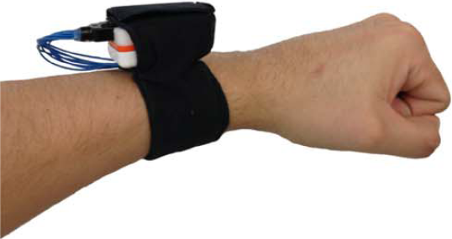
Approach
Bioimpedance
- a physiological property related to a tissue’s resistance to electrical current flow and its ability to store electrical charge.
Specific tissue types (e.g., blood, adipose, muscle, bone)
Anatomic configuration (i.e., bone or muscle orientation and quantity)
The state of the tissue (normal or osteoporotic bone, edematous versus normally hydrated tissue, and so forth)

Slide 4
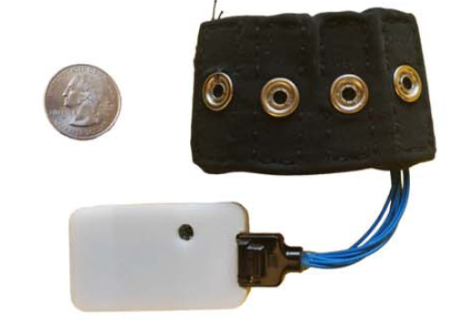
Wearable Sensor System – Hardware

Slide 5
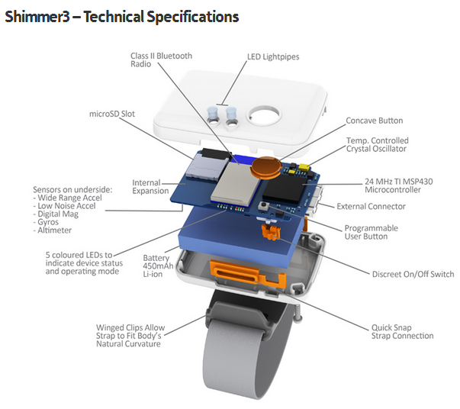
53mm x 32mm

Slide 6
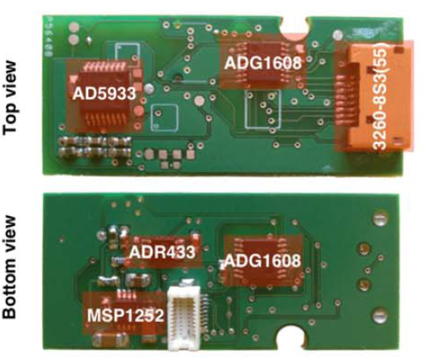
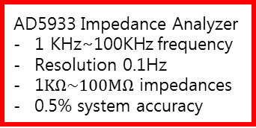
AD5933 Impedance Analyzer
1 KHz~100KHz frequency
Resolution 0.1Hz
1$KΩ\sim 100MΩ$ impedances
0.5% system accuracy
8-pin Hirose 3260-8S3(55) Connector
- GPIO pins
ADG1608 8-Channel Multiplexors
ADR433
- ultra-low noise voltage for impedance analyzer (3V)
Microchip MCP1252
- Charge pump (5V) for multiplexors
45mm x 19mm

Slide 7
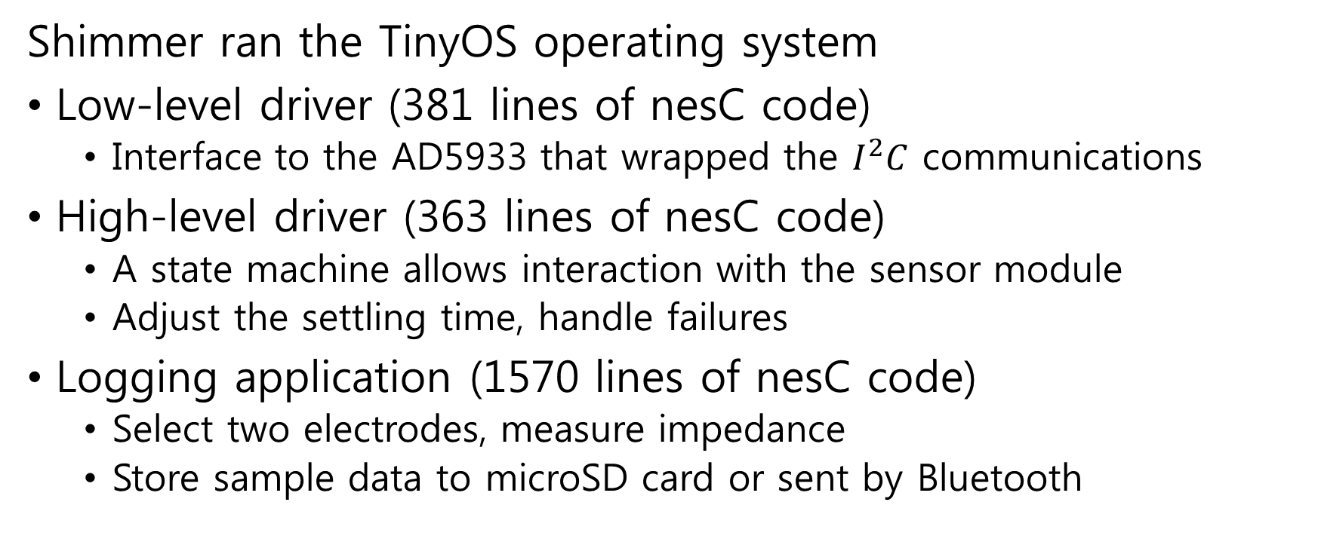
Wearable Sensor System - Software
Shimmer ran the TinyOS operating system
Low-level driver (381 lines of nesC code)
  Interface to the AD5933 that wrapped the $I^{2}C$ communications
High-level driver (363 lines of nesC code)
  A state machine allows interaction with the sensor module
  Adjust the settling time, handle failures
Logging application (1570 lines of nesC code)
  Select two electrodes, measure impedance
  Store sample data to microSD card or sent by Bluetooth

Slide 8
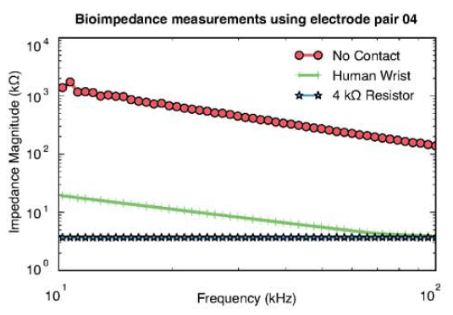
Detecting Presence

Slide 9
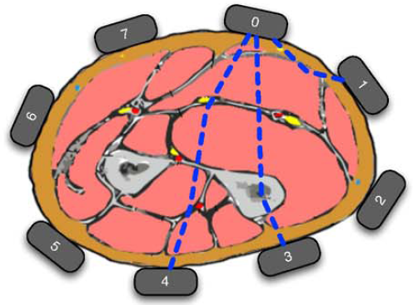
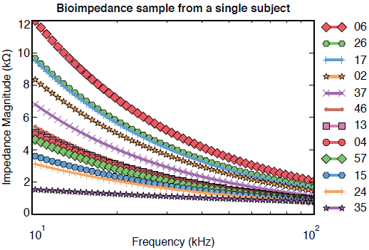
Bioimpedance Samples

Slide 10
Feature Extraction
Extract four features from each bioimpedance sample
  Consider two components:
  bioimpedance magnitude, bioimpedance phase
  Fit one line to each component in log-log space
  Get a slope and intercept for each line
Reduced the dimensionality of the data from 100 to 4
Final feature vector consisted of the concatenation of these features for each electrode pair (12 electrode pairs)
Reduced the dimensionality of the feature vector from 12x50x2=1200(raw data) to 12x4=48

Slide 11
Enrollment
Enrollment mode
  Capture bioimpedance samples to get training feature vectors
  Learn the model of a subject’s bioimpedance samples using the enrollment algorithm
Two modes of operation for enrollment algorithms:
  Identification: many-to-one matching
    Determine which person from a population is wearing the device
  Verification: one-to-one matching
    Confirm that a chosen person is wearing the device

Slide 12
Enrollment – Identification
One-versus-all strategy
  Target subject’s feature vectors as positive, all others as negative
Naïve Bayes (NB) classifier
  Independently models the mean and variance of each feature
Support Vector Machine (SVM) classifier
  Finds the hyperplane that best separates the positive examples from the negative samples
    To choose parameters, ran a 10-fold cross-validation Looked at different kernels, soft-margin costs, respective kernel coefficient gamma if needed
  Using a grid search, find that a 3rd degree polynomial kernel with a cost of 32 and gamma of 0.03125 was optimal

Slide 13
Enrollment – Verification
Gaussian Mixture Model (GMM)
  Model the bioimpedance samples using a weighted linear combination of Gaussian densities
    Choose initial Gaussian densities by clustering the set of feature vectors using k-means clustering
    Iteratively refined these initial Gaussian densities using the expectation-maximization algorithm until the maximum likelihood remained stable (<0.01) or a maximum number of iterations (100)
    Model the full covariance since the dimensionality of a bioimpedance sample was relatively low (in the case of outliers, enforce a variance floor of 0.001)
  Find that 4 Gaussian densities best model a subject’s bioimpenace samples

Slide 14
Recognition
Recognition mode
  Periodically determine whether it was on a human body
  Collect bioimpedance samples
  Use a recognition algorithm to determine whether a bioimpedance sample matches the enrollee’s model
Two modes of operation for recognition algorithms
  Identification
    Choose which subject best matched a test feature vector from an unknown subject
  Verification
    Decide whether a test feature vector come from a known subject

Slide 15
Recognition – Identification
Match
  A feature vector that was classified as positive for a given subject’s model was said to match that subject’s bioimpedance
Naïve Bayes (NB) classifier
  Compute the Gaussian probability density function for the test feature vector given each label
  The label with the maximum value is the classification
Support Vector Machine (SVM) classifier
  Compute the linear transformation of the test feature vector and returns the sign of that value as the predicted label
  The best match is chosen with the largest margin between the support vectors and the sample

Slide 16
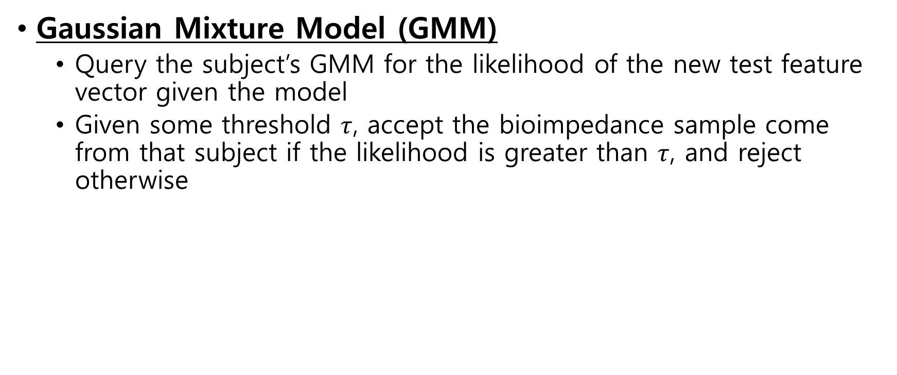
Recognition – Verification
Gaussian Mixture Model (GMM)
  Query the subject’s GMM for the likelihood of the new test feature vector given the model
  Given some threshold $τ$, accept the bioimpedance sample come from that subject if the likelihood is greater than $τ$, and reject otherwise

Slide 17
Metrics
False Accept Rate (FAR)
  The fraction of negatively labeled feature vectors that were misclassified (if perfect, 0%)
False Reject Rate (FRR)
  The fraction of positively labeled feature vectors that wear misclassified (if perfect, 0%)
Balanced Accuracy (BAC)
  The sum of half of the true accept rate (1-FRR) and half of the true reject rate (1-FAR) (if perfect, 100%)
Equal Error Rate (EER)
  The rate at which the FAR equals the FRR (if perfect, 0%)

Slide 18
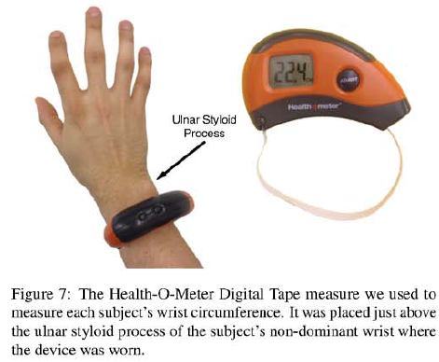
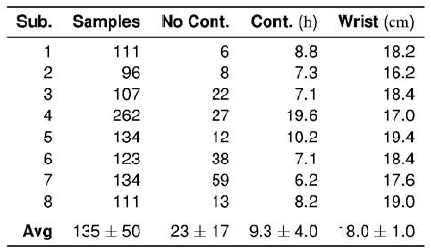
Experimental Results – Dataset
3 femal, 5 male, average of 27 years old

Slide 19
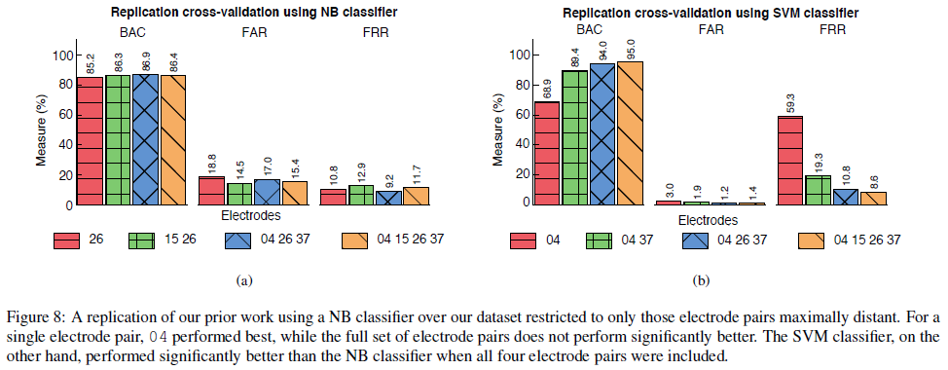
Experimental Results – Replication

Slide 20
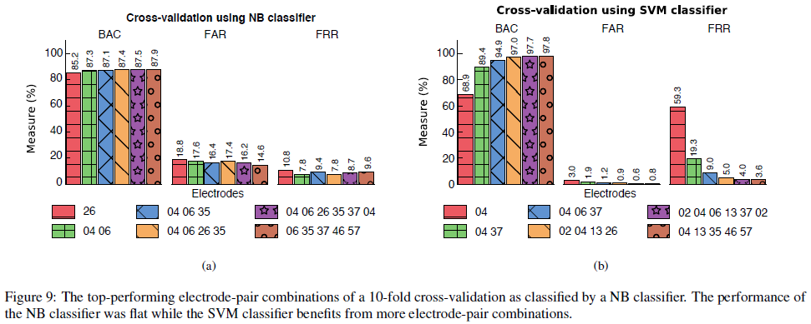
Experimental Results – Identification

Slide 21
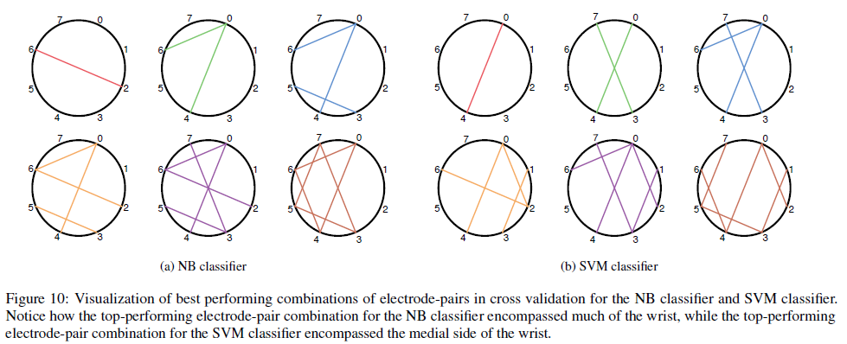
Experimental Results – Identification

Slide 22
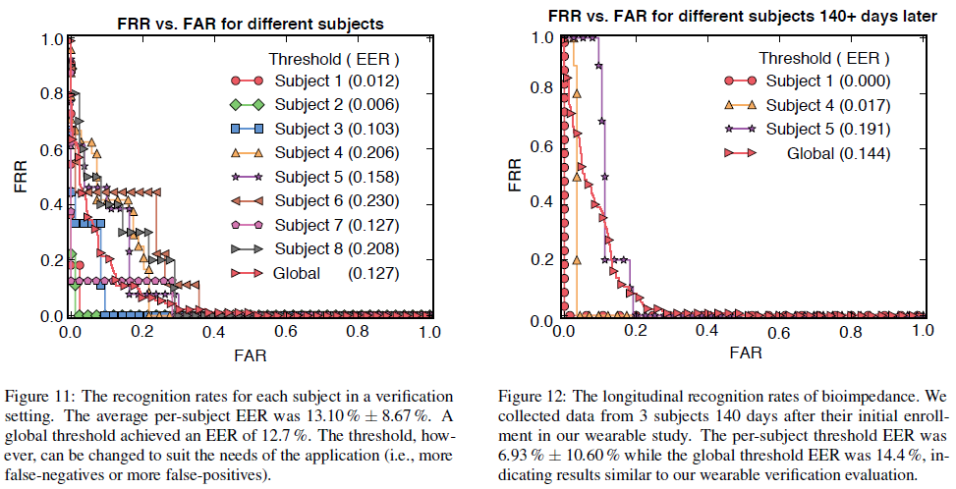
Experimental Results – Verification

Slide 23
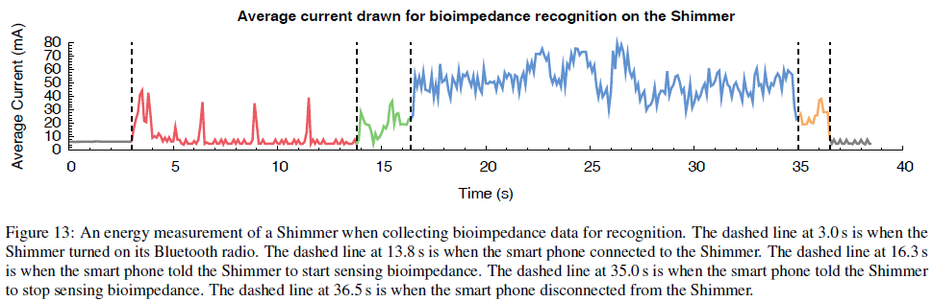
Energy Measurements – Shimmer

Slide 24
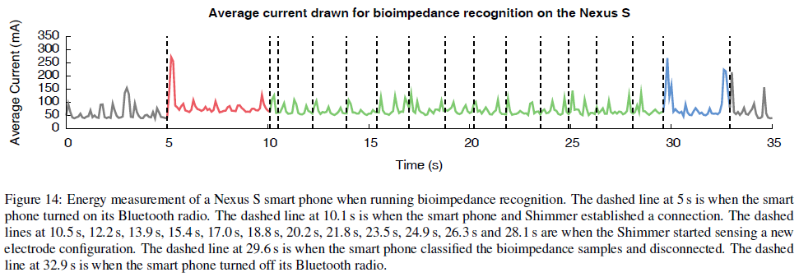
Energy Measurements – Smart Phone

Slide 25
Discussion and Future Work
Distinguish individuals in a larger population
A better physical design, bracelet size
Variations in the bioimpedance or body condition
The threshold for verification algorithms
Optimization for lower cost or reducing energy consumption
Other presence detection mechanism
  SemTech SX9300, Specific Absorption Rate (SAR) controller
Integration with electric-field sensing technology

Slide 26
Conclusion
A wearable system that can continuously recognize the person wearing the system
  Custom-designed bioimpedance sensor
The system is successful in recognizing its wearer almost 98% of the time using data collected outside of the lab
The recognition method does not adversely affect the battery-life of a smart phone
A wearable bioimpedance system works provides the foundation for future studies of bioimpedance as a biometric

