Slide 1
EasyTracker: Automatic Transit Tracking, Mapping, and Arrival Time Prediction Using Smartphones
SeonMi Lee
2012010714

Slide 2
Introduction
Transit information is developed
  From the printed paper schedules to web
  More advanced services, such as integration with Google maps, real-time tracking and arrival time prediction is existed
Real-time transit tracking is a highly desired feature among transit riders
  Accurate digital route maps
  Online tracking website
  Accurate arrival time predictions
  But, for smaller transit operators hard to implement it

Slide 3
Goal
Call it EasyTracker!
  For the ease with which it allows transit agencies to add transit tracking to their list of services
Reduce the cost and complexity of offering services
Automatic system for transit tracking, mapping, and arrival time prediction

Slide 4
Background & Motivation
Minimum requirement for a real-time transit tracking system
  In-vehicle device
  Back-office component
To make arrival time prediction
  Route shape file
  List of stops
  Planned schedule
  Route driven by each active vehicle at all times
No manual input for back-end processing
  Manual labor will be reduced
Use off-the-shelf smart phones for in-vehicle device
  Initial and recurring costs will be dramatically reduced

Slide 5
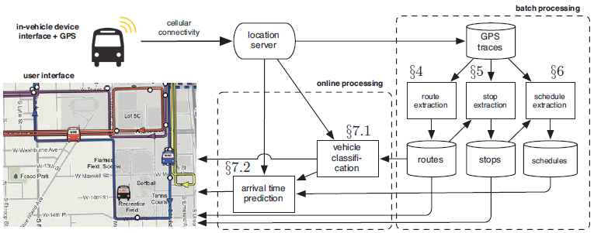
System Overview
Data collection unit in each vehicle
  Periodically transmit its GPS coordinates to a central location server
A number of algorithms for online and batch data processing
  Batch processing: a large set of recorded GPS traces are processed to produce route shapes, stop locations, schedules
  Online processing: matches vehicles to routes, performs arrival time prediction
User interfaces for the transit user

Slide 6
System Overview - Batch Processing
Route extraction algorithm
  It doesn’t make use of an existing road map
  A sufficiently accurate digital road map may not be freely available for the area of interest.
  Since transit routes do not necessarily follow public roadways, a road map may be misleading.
Each route shape fed to stop extraction algorithm
  Produces a set of bus stops based on the vehicles’ movements along the shape
Stop locations can make determine the raw arrivals by schedule estimation algorithm
  To estimate the planned schedule of the route

Slide 7
System Overview - Online Processing, User Interface
Online Processing
Route classification
  Classifies vehicles as “in-service” or “out-of-service”
Arrival time predictions
  Uses the recent location trace of the vehicle and the relevant route schedule
User Interface
Vehicles are matched to routes by their color
Clicking on a shuttle stop or vehicle brings up the arrival time predictions

Slide 8
System Overview - GPS Traces and Ground Truth Data
Evaluation
  Based on recorded GPS traces from campus shuttle service
  Captured data from the Chicago Transit Authority real-time bus tracker feed
  Compared with ground truth manually
Campus shuttle
  One month of GPS traces with 13 campus shuttle buses
  4 Route (6 including minor variations)
  Vehicle ID number is existed
    Every vehicle can be serving any route at any given time
  Locations are recorded any time the ignition is on
CTA
  100 days of traces from a single route
  Provide locations once every sixty seconds

Slide 9
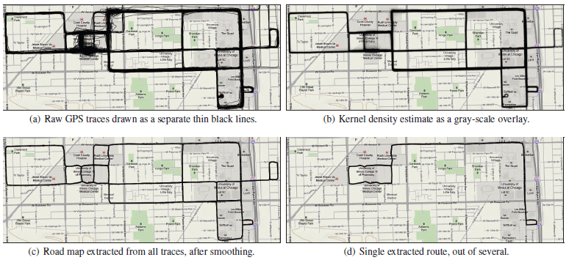
Route Extraction
Automated route extraction process
  Input of raw GPS traces
  Kernel density estimate of the full set of traces is computed
  Road map is extracted by smoothing
  Each trace can determined as a discrete route

Slide 10
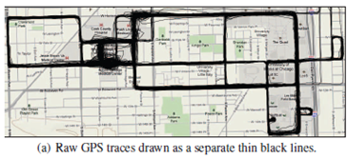
Raw Data Pre-Processing
GPS location
  MAC address (identifying the vehicle)
  Timestamp
Each trace is broken up into several drives separated by long intervals (10 minute) without location reports
Each direction of one point for every 20 meters to thin the trace

Slide 11
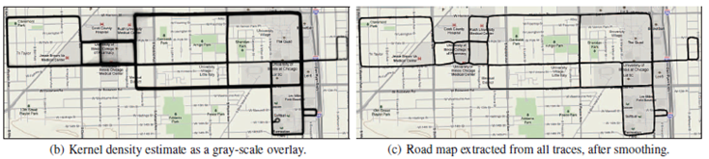
Map Generation
Use scheme proposed by “Scalable, distributed, real-time map generation”
  1. Computing an approximate, grid-based kernel density estimate of the traces provided
  2. Extract the road outlines and remove edges that fall outside the road
  3. Using the Douglas-Peucker algorithm smoothing each road segment which does adjusting edges with no intersections

Slide 12
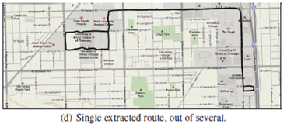
Route Extraction
Several steps are needed
  1. Using the Viterbi algorithm which provides the maximum-probability sequence of edges traversed.
  2. Iterating through the edge-sequence sequentially until a repeated series of edges of a minimum sum length
  3. Result of edges is considered as a route candidate
  4. Using Welch’s t-test, representative route candidate is made

Slide 13
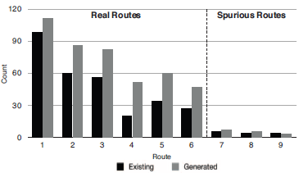
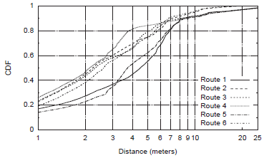
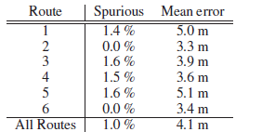
Route Extraction Performance
1. Compare with existing map and generated map route extraction
2. Compare between generated route and ground truth per route
3. Spurious parts from ground truth

Slide 14
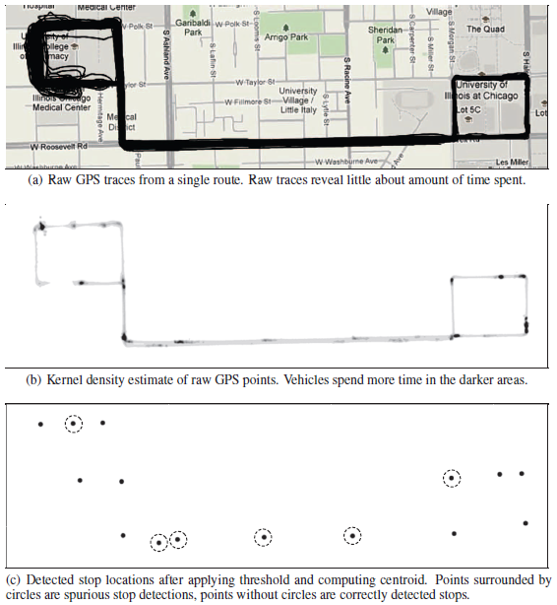
Stop extraction
Stop extraction is the process of turning a set of raw GPS traces to a location of transit stops
  1. Input of raw GPS traces
  2. Compute the density
  3. 80% above density of non-zero density is potential stop

Slide 15
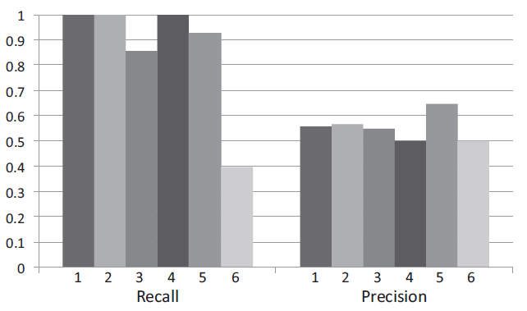
Stop Extraction Performance
Precision and recall performance of the stop extraction algorithm on 6 routes, using an 80% cut-off
  Recall : fraction of correctly detected stops with respect to the total number of ground truth bus stops
  Precision : fraction of detected stops that were true bus stops with respect to the total number of detected stops

Slide 16
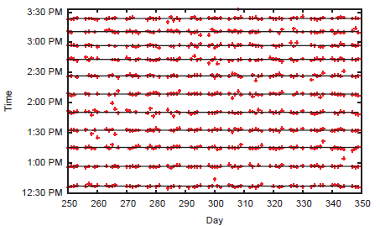
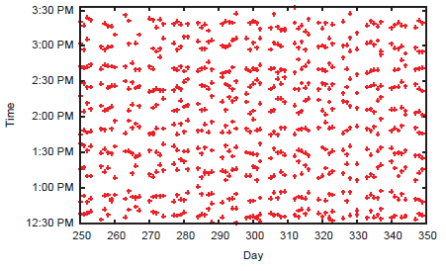
Schedule Extraction - 1
Arrival times for first stop and last stop
  First stop arrival times can be predicted with the lines
    Lines indicate the result of k-means clustering
  Last stop arrival times can’t be predicted with the lines
  <first stop arrival times> <Last stop arrival times>
Hard to predict arrival time for each stop with just raw data!

Slide 17


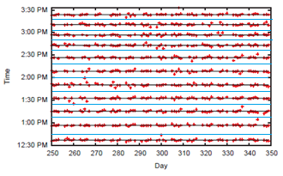
Schedule Extraction - 2
Calculate each stop arrival time by mean times
  Predict the first stop arrival times with a k-means clustering
    Lines indicate the result of k-means clustering
  Predict the each stop arrival times with mean times

Slide 18
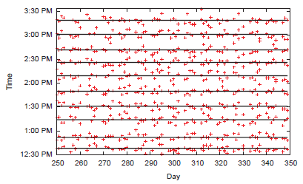
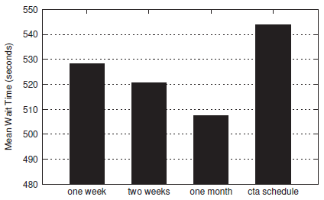
Schedule Extraction Performance
1. Schedule for the last stop based on the first stop schedule and mean travel time
2. Mean wait times for a selected bus route for several training set sizes and the official CTA schedule

Slide 19

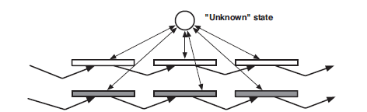
Route Classification
Route-matching with one route
Route-matching with multiple routes in a single drive
  To reflect a more realistic usage model
  Need of Hidden Markov Model map matching
  Use Viterbi algorithm to decode the most probable sequence of states

Slide 20
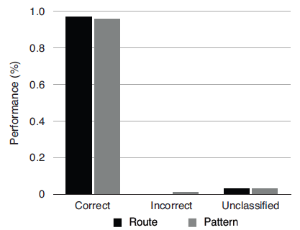
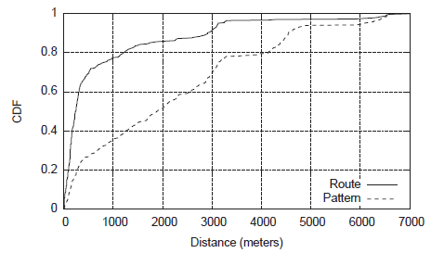
Route Classification Perfromance
1. Classification performance of HMM-based vehicle classifier
2. Distance traveled before a correct pattern or route classification was made

Slide 21

Arrival Time Prediction
Assume every vehicle serving the route is equipped with a working in-vehicle device
If no vehicle is present on the route
  Use the schedule extraction
If a vehicle is present,
  Mean pairwise travel time between its current location and Si
    Sprev is the most recent stop served
    is the fraction of the distance between sprev, sprev+1 and already traversed
    t is current trip

Slide 22
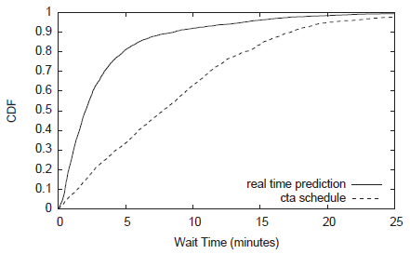
Arrival Time Prediction Performance
Wait times for 5,000 real time arrival predictions vs. the CTA schedule

Slide 23
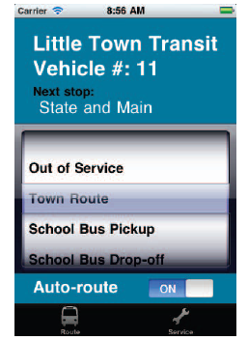
Optional Interface
Interface which cannot be automatically derived from GPS traces
  Ex) elevator available
Interface which can be trained to provide additional information
  Ex) driver may manually override the automatic route classification In case of a misclassification

Slide 24
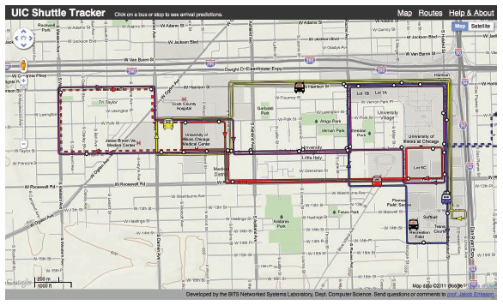
Current Prototype System
Parts of EasyTracker are currently in use on the UIC campus shuttle system
Vehicles are auto-classified as belonging to a red, blue, purple or yellow route and arrival times are predicted

Slide 25
Conclusion
EasyTracker consists of in-vehicle device and back-end processing
In-vehicle device uses smart phones which can reduce the cost
Back-end processing automatically does batch and online processing which can reduce the labor of human
This system produces route maps, extracts transit stop locations, and constructs transit schedules
Also can provides accurate transit tracking and real-time arrival time predictions
Most of processes have high performance to use in real
It can have optional interface and be used in real

Slide 26
Thank you for listening !
Q & A

