Slide 1

Chapter 4
Digital
Transmission
Copyright © The McGraw-Hill Companies, Inc. Permission required for reproduction or display.

Slide 2
Chapter 4: Outline
4.1 DIGITAL-TO-DIGITAL CONVERSION
4.2 ANALOG-TO-DIGITAL CONVERSION
4.3 TRANSMISSION MODES

Slide 3
Information → Signal ↓ | Analog | Digital
Analog (Ch. 5) | Analog-to-Analog Conversion | Digital-to-Analog Conversion
Digital (Ch. 4) | Analog-to-Digital Conversion: “Sampling” | Digital-to-Digital Conversion: “Line Coding”

Slide 4
    4-1 DIGITAL-TO-DIGITAL CONVERSION
In Chapter 3, we discussed data and signals. We said that data can be either digital or analog. We also said that signals that represent data can also be digital or analog. In this section, we see how we can represent digital data by using digital signals. The conversion involves three techniques: line coding, block coding, and scrambling. Line coding is always needed; block coding and scrambling may or may not be needed.

Slide 5
4.4.1 Line Coding
Line coding is the process of converting digital data to digital signals. We assume that data, in the form of text, numbers, graphical images, audio, or video, are stored in computer memory as sequences of bits (see Chapter 1). Line coding converts a sequence of bits to a digital signal. At the sender, digital data are encoded into a digital signal; at the receiver, the digital data are recreated by decoding the digital signal. Figure 4.1 shows the process.

Slide 6
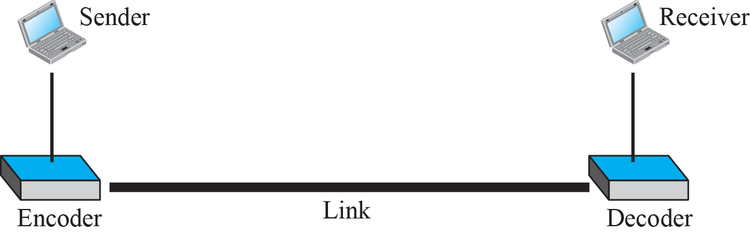
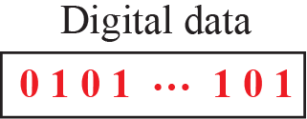
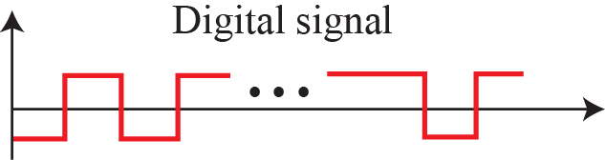
Figure 4.1: Line coding and decoding
“data elements” ≡ “bits” (in general)
“signal elements” ≡ “symbols”

Slide 7
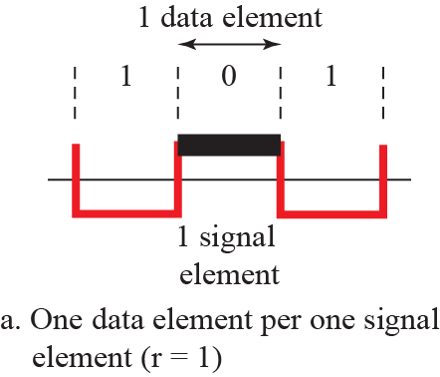
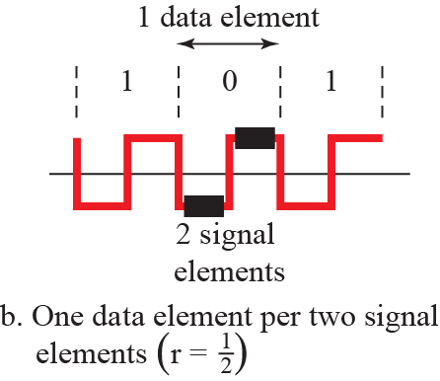
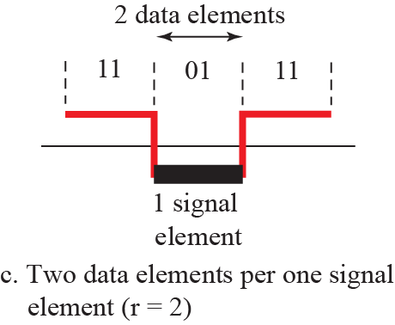
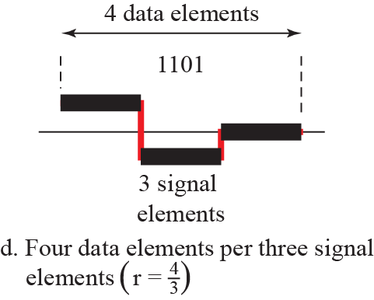
Figure 4.2: Signal elements versus data elements

Slide 8
Data rate vs. signal rate
Data rate: # of bits sent in 1 second (bps)
Signal rate: #of signal elements (i.e. symbols) sent in 1 second (baud)
Goal in data communications: data rate ⇑, signal rate ⇓

Slide 9
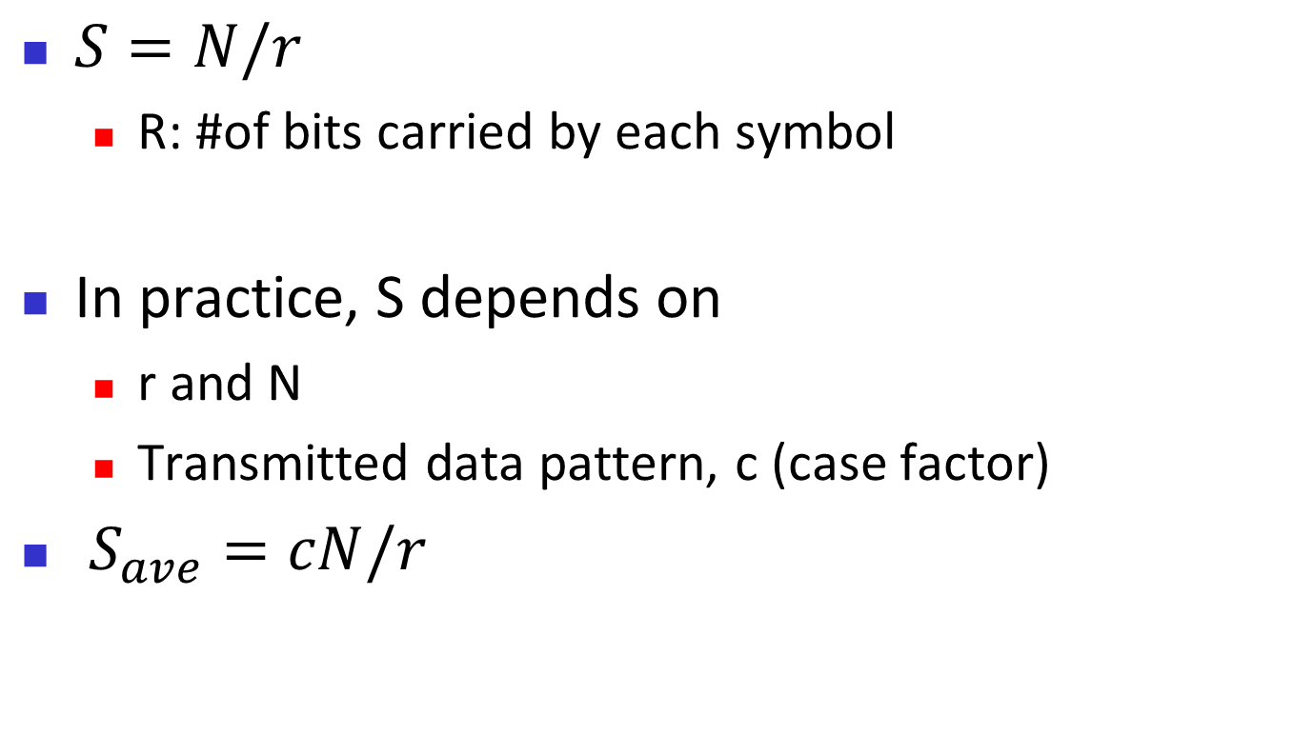
Relation between the two rates
$S=N/r$
  R: #of bits carried by each symbol
In practice, S depends on
  r and N
  Transmitted data pattern, c (case factor)
$S_{ave}=cN/r$

Slide 10
Example 4.1
A signal is carrying data in which one data element is encoded as one signal element (r = 1). If the bit rate is 100 kbps, what is the average value of the baud rate if c is between 0 and 1?
Solution
We assume that the average value of c is 1/2. The baud rate is then
4.10

Slide 11
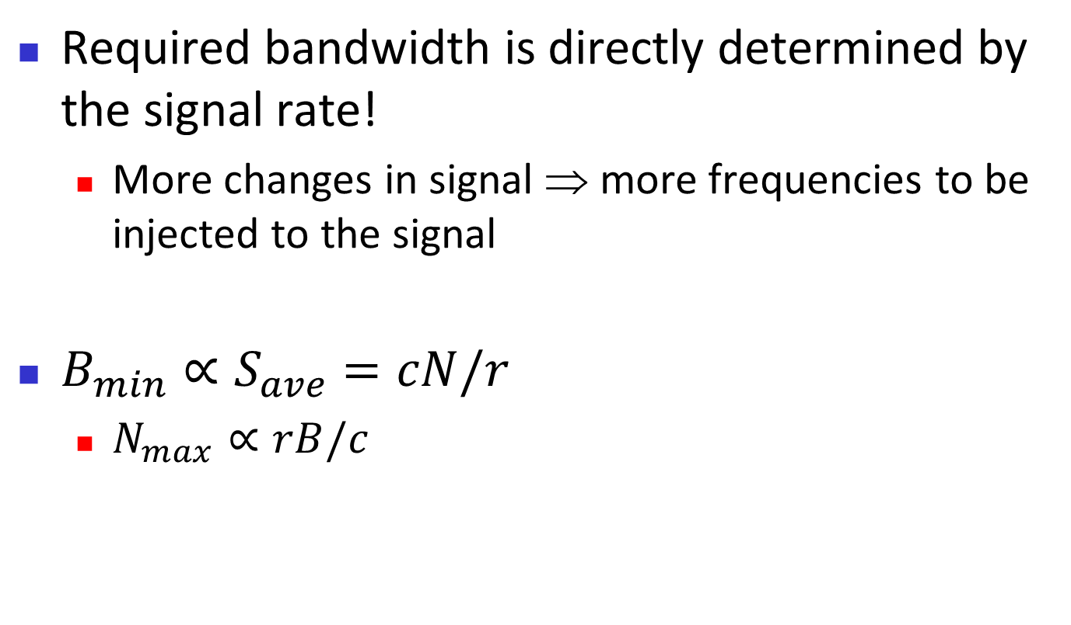
Bandwidth
Required bandwidth is directly determined by the signal rate!
  More changes in signal ⇒ more frequencies to be injected to the signal
$B_{min}∝S_{ave}=cN/r$
  $N_{max}∝rB/c$

Slide 12
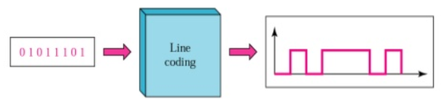
LINE CODING – things to consider
Bad things to avoid
  “Baseline wandering”
  “DC components”
  Complexity
Good things to pursue
  Self-synchronization
  Built-in error detection
  Immunity to noise and interference

Slide 13
Baseline wandering
In decoding a digital signal, the receiver calculates a running average of the received signal voltage, called “baseline”
Incoming signal is evaluated against the baseline
A long string of 0s or 1s can cause a drift in the baseline, which makes it difficult for the receiver to decode correctly

Slide 14
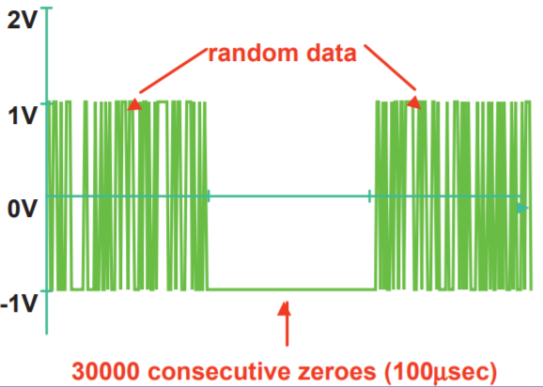
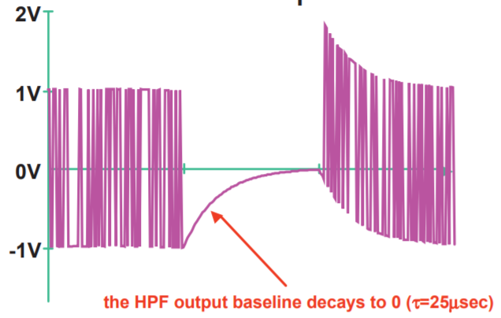
Baseline wandering
A long string of 0s or 1s can cause a drift in the baseline, which makes it difficult for the receiver to decode correctly

Slide 15
DC components
Frequencies around 0
Happens if signal voltage remains constant for a while with non-zero average
Problematic if the channel is not low-pass
  E.g. telephone line cannot pass f < 200 Hz
DC components are extra energy and inefficient

Slide 16
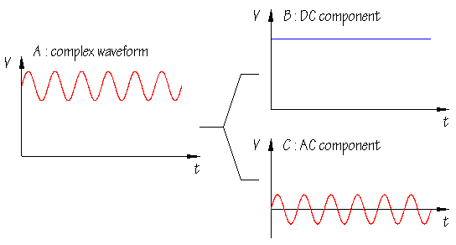
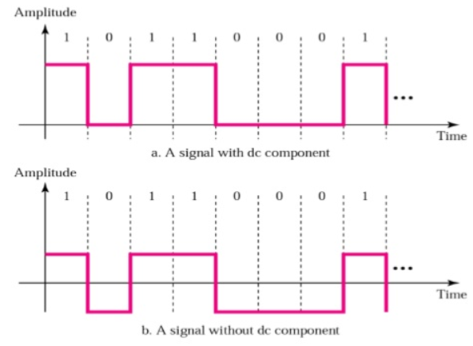
DC components

Slide 17
Self-synchronization
To correctly interpret the received signals, the receiver’s bit intervals must correspond exactly to the sender’s bit intervals
  Clock speed matters
Self-synchronizing digital signal includes timing information in the data

Slide 18
Example 4.3
In a digital transmission, the receiver clock is 0.1 percent faster than the sender clock. How many extra bits per second does the receiver receive if the data rate is 1 kbps? How many if the data rate is 1 Mbps?
Solution
At 1 kbps, the receiver receives 1001 bps instead of 1000 bps.
At 1 Mbps, the receiver receives 1,001,000 bps instead of 1,000,000 bps.
4.18

Slide 19
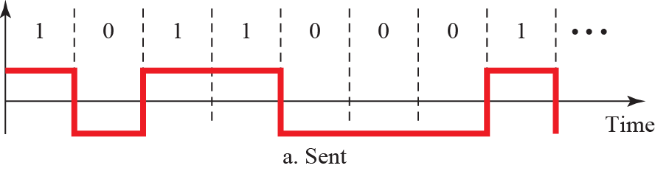
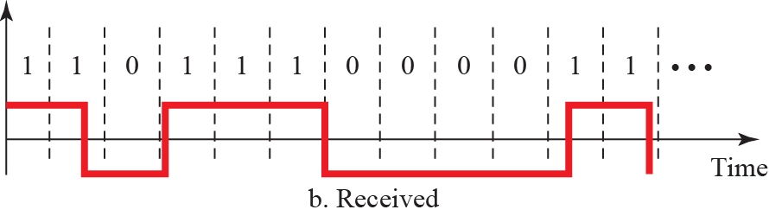
Figure 4.3: Effect of lack of synchronization

Slide 20
4.4.2 Line Coding Schemes
We can roughly divide line coding schemes into five broad categories, as shown in Figure 4.4.
There are several schemes in each category. We need to be familiar with all schemes discussed in this section to understand the rest of the book. This section can be used as a reference for schemes encountered later.

Slide 21
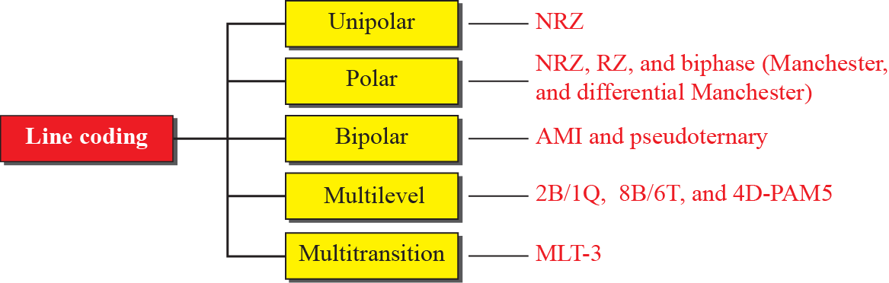
Figure 4.4: Line coding scheme

Slide 22
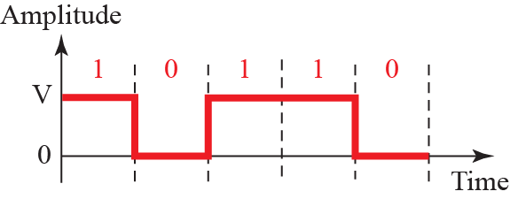
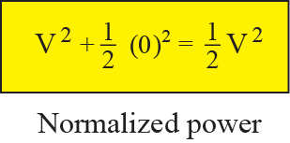
Figure 4.5: Unipolar NRZ scheme
All signal levels are on one side of time axis
  Not used today for power inefficiency

Slide 23
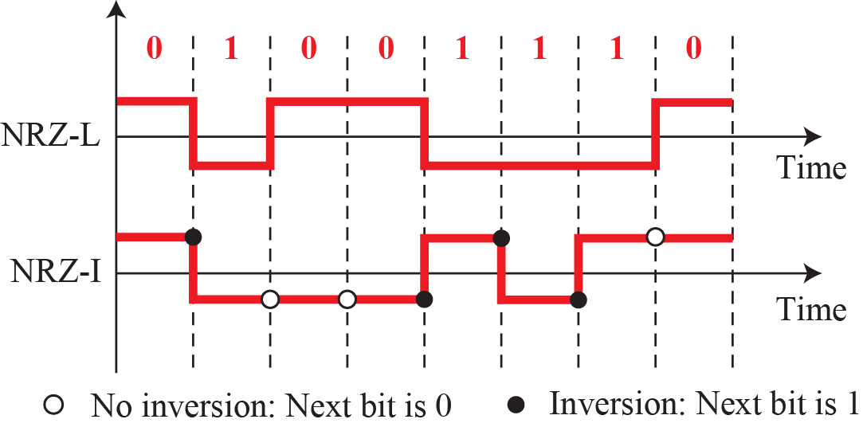
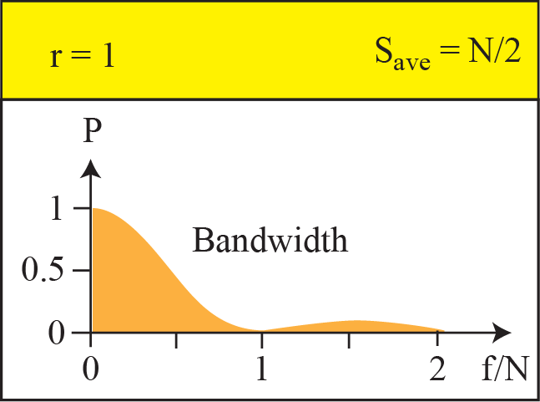
Figure 4.6: Polar schemes (NRZ-L and NRZ-I)
NRZ-L used in automobiles
NRZ-I used in USB

Slide 24
NRZ-L and NRZ-I properties
Baseline wandering (twice as severe in NRZ-L)
Synchronization problem
Power density is very high around f = 0
Bandwidth is only N/2
Signal rate is N/2

Slide 25
Example 4.4
A system is using NRZ-I to transfer 1 Mbps data. What are the average signal rate and minimum bandwidth?
Solution
The average signal rate is S = N/2 = 500 kbaud. The minimum bandwidth for this average baud rate is
B_{min} = S = 500 kHz.
4.25

Slide 26
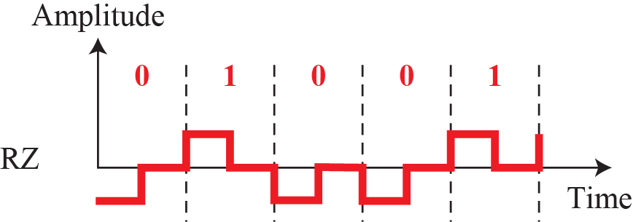
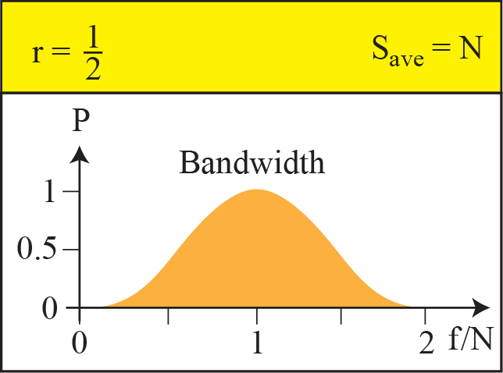
Figure 4.7: Polar schemes (RZ)
Self-synchronization: signal changes during bit
No DC component
Complex: 3 levels ⇒ not used

Slide 27
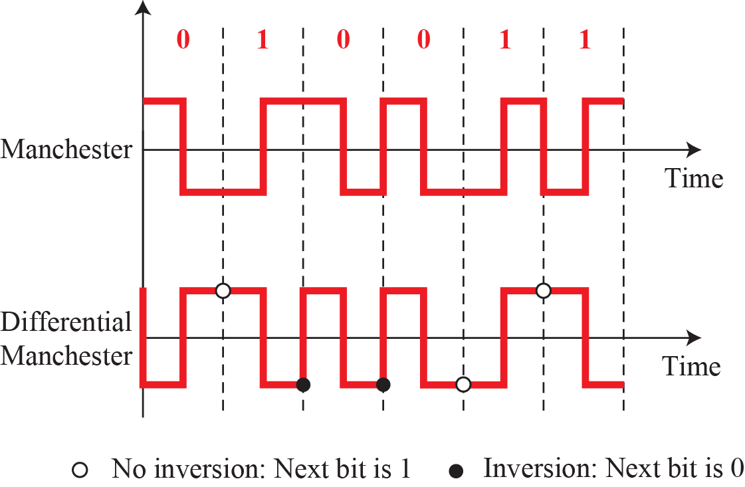
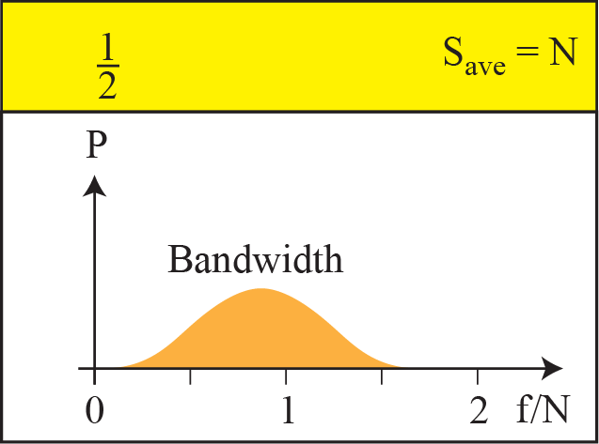
Figure 4.8: Polar biphase
Used in Ethernet, IrDA, RFID, NFC, …
No baseline wandering
Signal rate and bandwidth is 2X NRZ

Slide 28
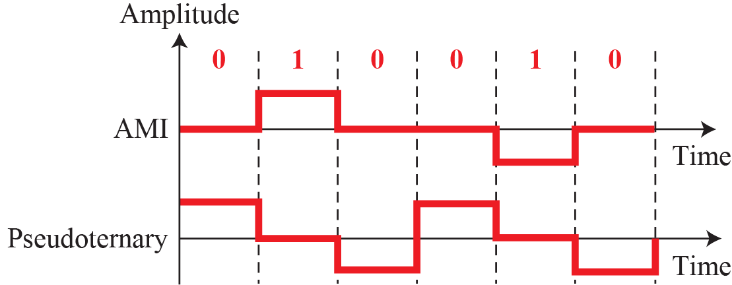
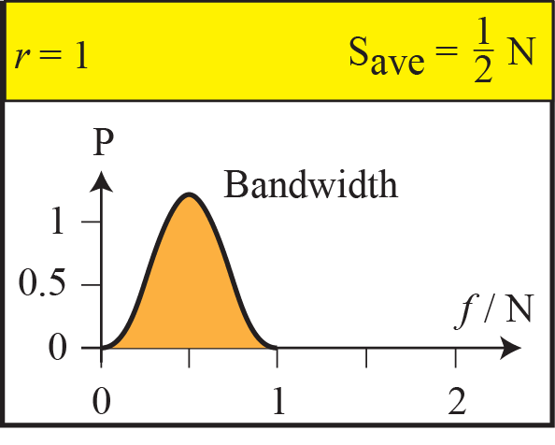
Figure 4.9: Bipolar schemes: AMI and pseudoternary
Voltage is 0 for one data element, alternating for the other
  M (“mark”) means bit 1

Slide 29
Bipolar: discussion
Developed as an alternative to NRZ
Same signal rate as NRZ, but with no DC component
  Amplitude is 0 at f=0
Commonly used in long-distance communication
  T1/E1
Synchronization problem

Slide 30
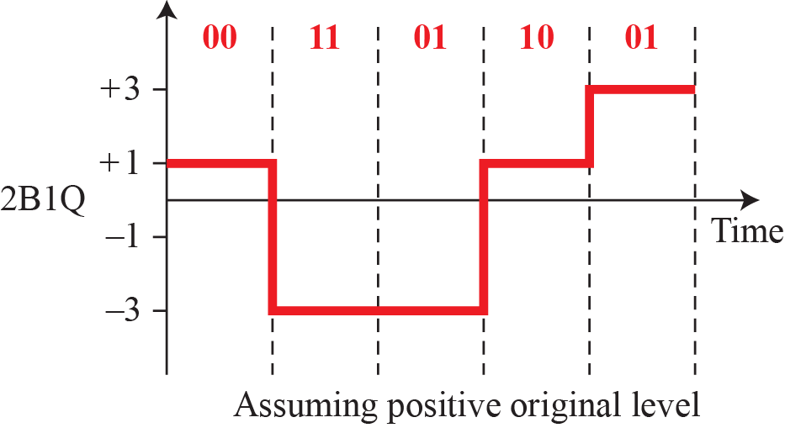
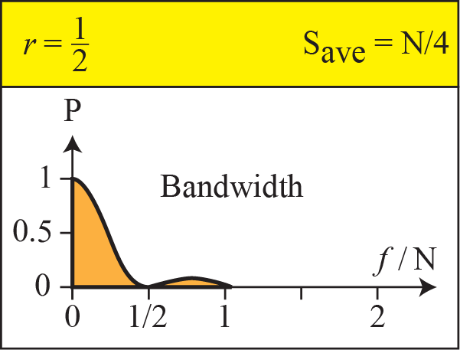
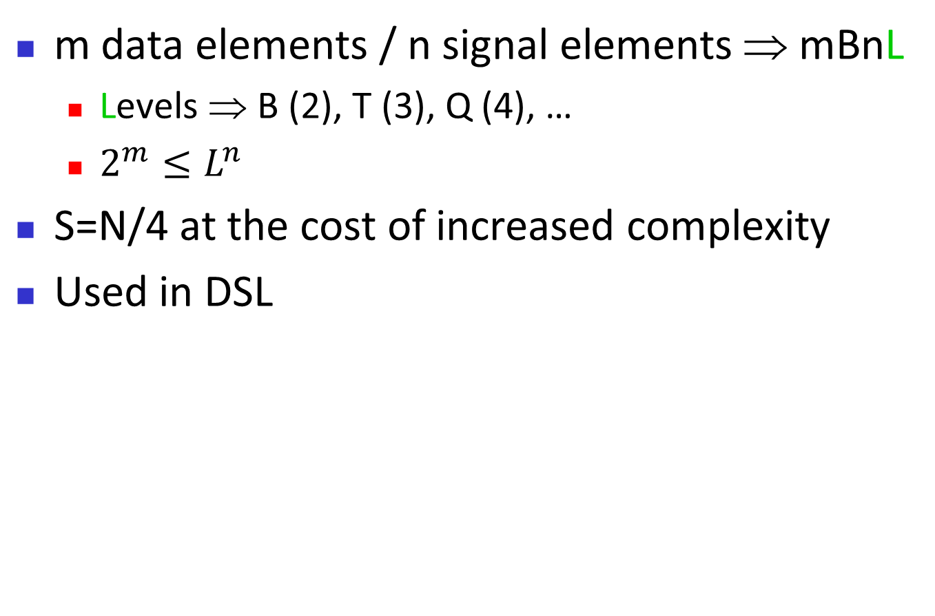
Figure 4.10: Multilevel: 2B1Q
m data elements / n signal elements ⇒ mBnL
  Levels ⇒ B (2), T (3), Q (4), …
  $2^{m}≤L^{n}$
S=N/4 at the cost of increased complexity
Used in DSL

Slide 31
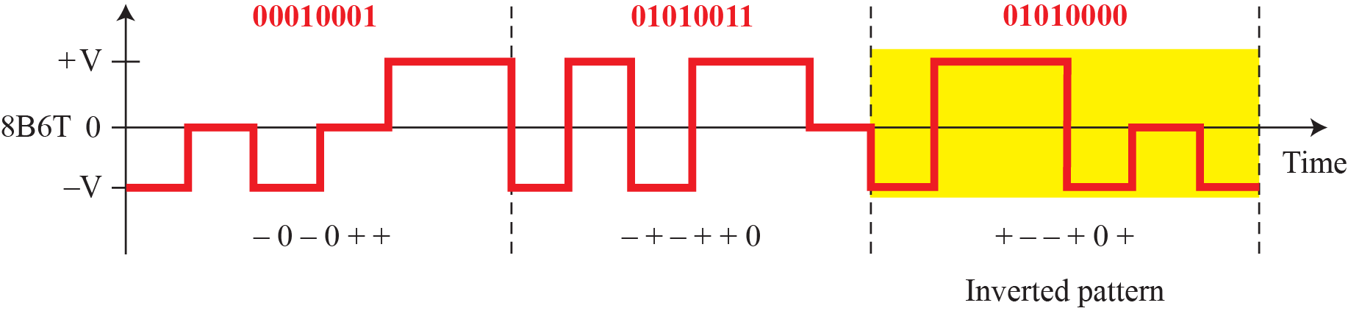
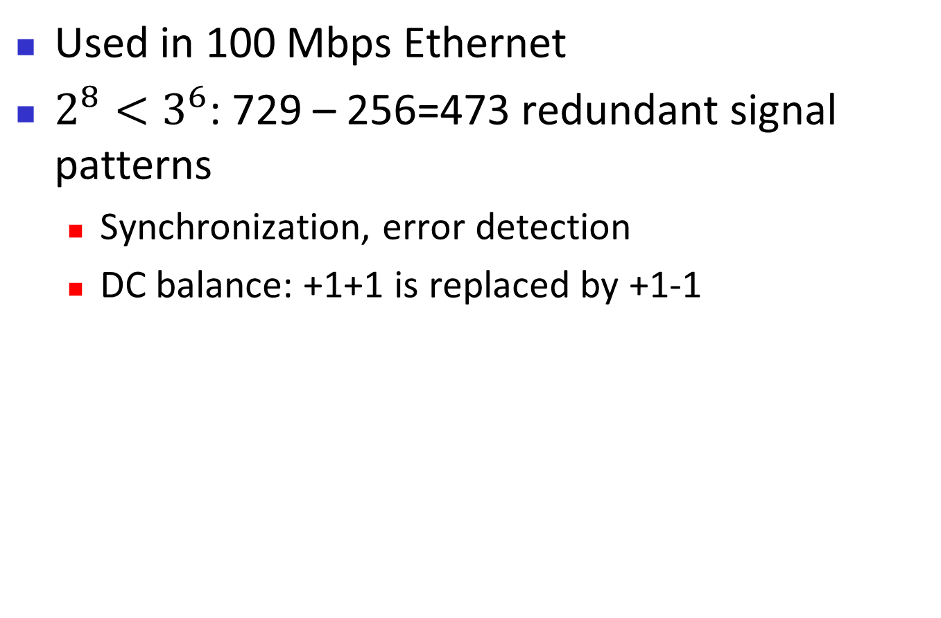
Figure 4.11: Multilevel: 8B6T
Used in 100 Mbps Ethernet
$2^{8}<3^{6}$: 729 – 256=473 redundant signal patterns
  Synchronization, error detection
  DC balance: +1+1 is replaced by +1-1

Slide 32
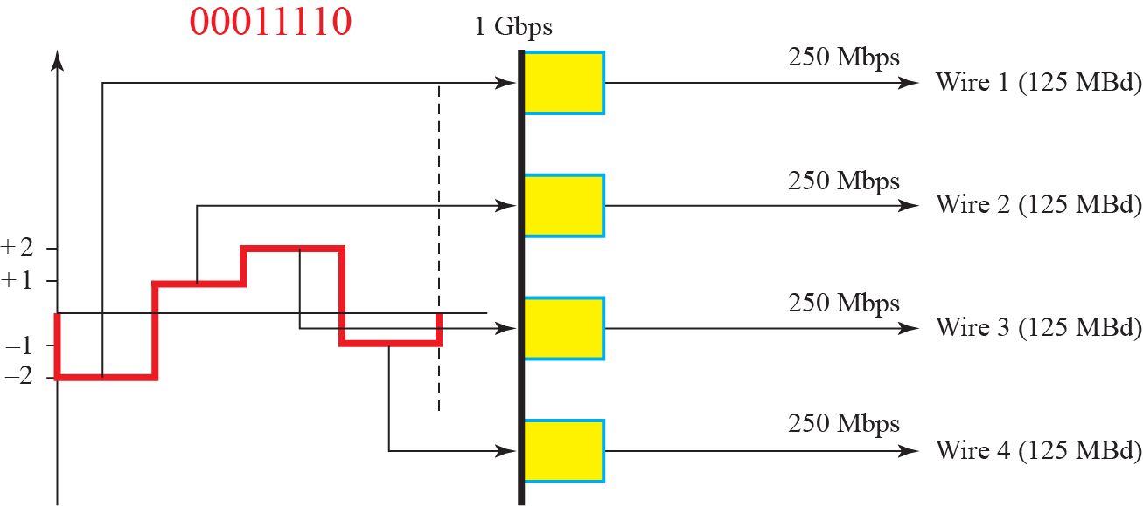
Figure 4.12: Multilevel: 4D-PAMS scheme
Used in Gigabit Ethernet

Slide 33
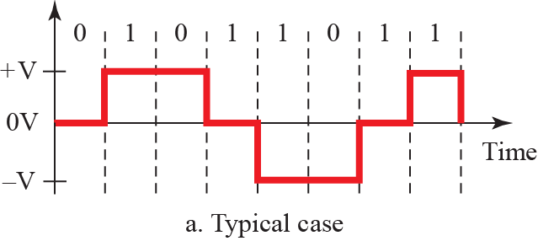
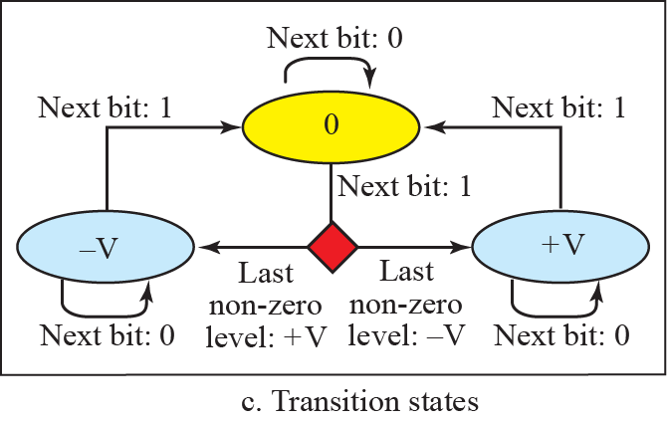
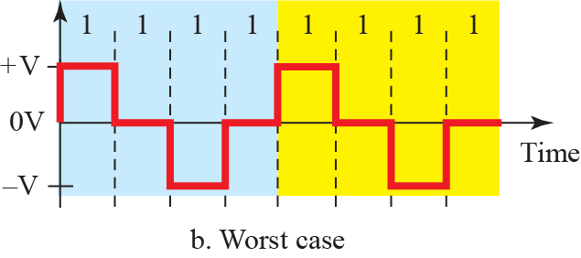
Figure 4.13: Multi-transition MLT-3 scheme

Slide 34
MLT-3
Transition rules
  If (Nbit == 0) Nlevel=Clevel /* no transition */
  If (Nbit == 1 && Clevel !=0) Nlevel = 0
  If (Nbit ==1 && Clevel ==0) Nlevel = ~(last nonzero level)
Signal shape reduces required bandwidth
  Change non-periodic signal to periodic!
  Signal rate = ¼ N
  Enables 100 Mbps with less than 32 MHz

Slide 35
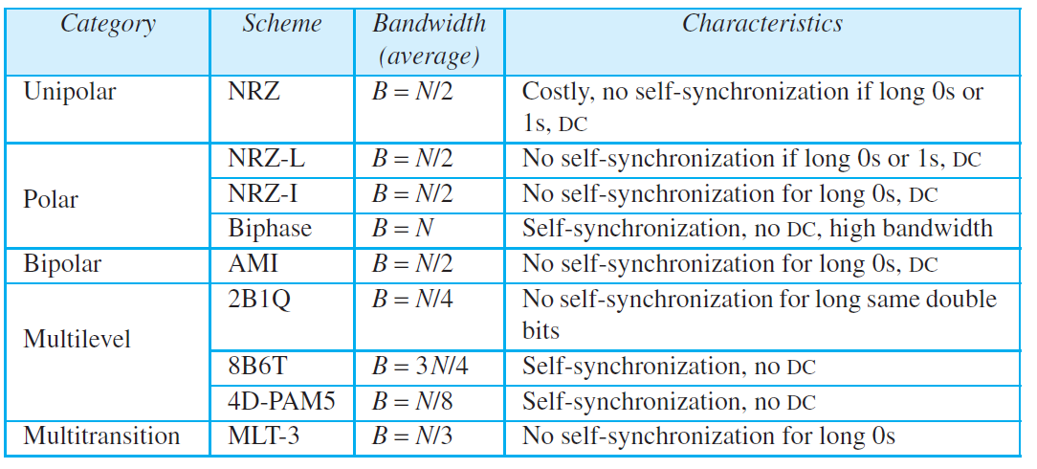
Table 4.1: Summary of line coding schemes
No DC
DC
4.35

Slide 36
4.4.3 Block Coding
We need redundancy to ensure synchronization and to provide some kind of inherent error detecting. Block coding can give us this redundancy and improve the performance of line coding. In general, block coding changes a block of m bits into a block of n bits, where n is larger than m. Block coding is referred to as an mB/nB encoding technique.

Slide 37
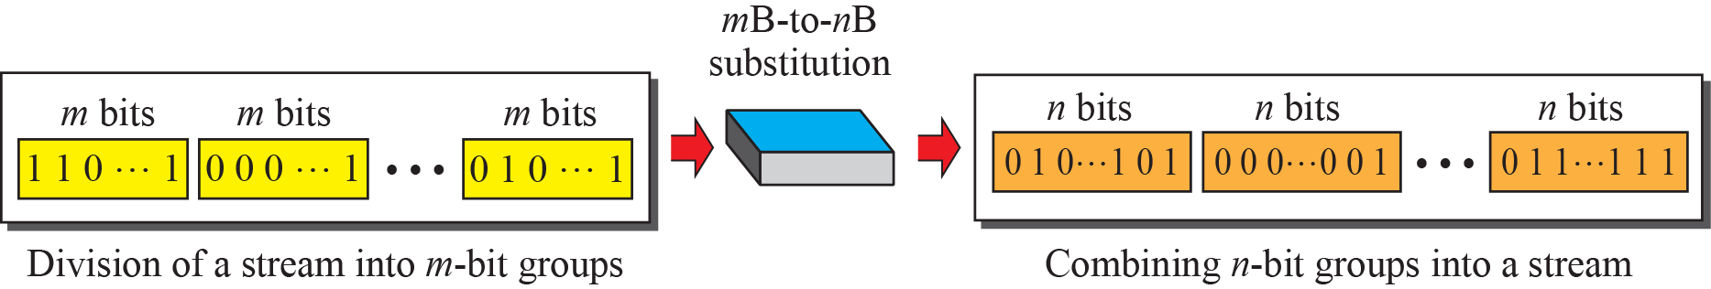
Figure 4.14: Block coding concept

Slide 38
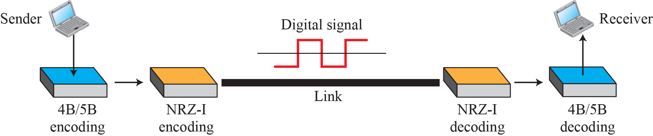
Figure 4.15: Using block coding 4B/5B with NRZ-I line coding scheme
NRZ-I has synchronization problem (0000…0)
4B/5B block-coded stream does not have more than 3 consecutive 0’s
Signal rate ⇑ (20%), DC component problem

Slide 39
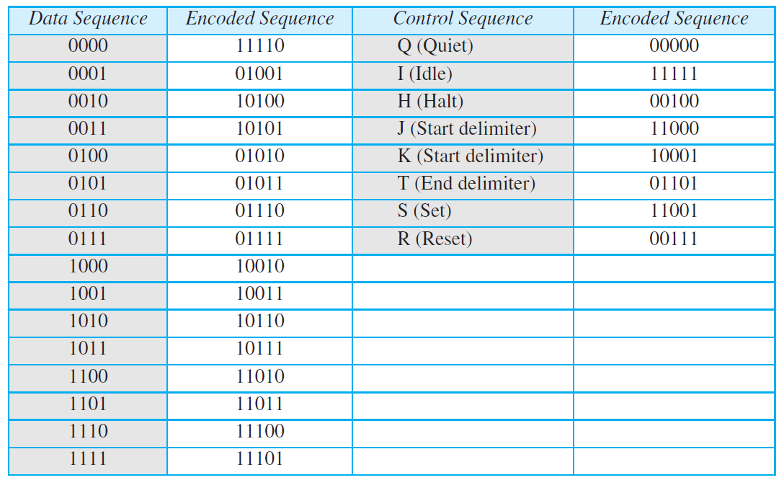
Table 4.2: 4B/5B mapping codes
?
4.39

Slide 40
Example 4.5
We need to send data at a 1-Mbps rate. What is the minimum required bandwidth, using a combination of 4B/5B and NRZ-I or Manchester coding?
Solution
First 4B/5B block coding increases the bit rate to 1.25 Mbps. The minimum bandwidth using NRZ-I is N/2 or 625 kHz. The Manchester scheme needs a minimum bandwidth of 1 MHz. The first choice needs a lower bandwidth, but has a DC component problem; the second choice needs a higher bandwidth, but does not have a DC component problem.
4.40

Slide 41
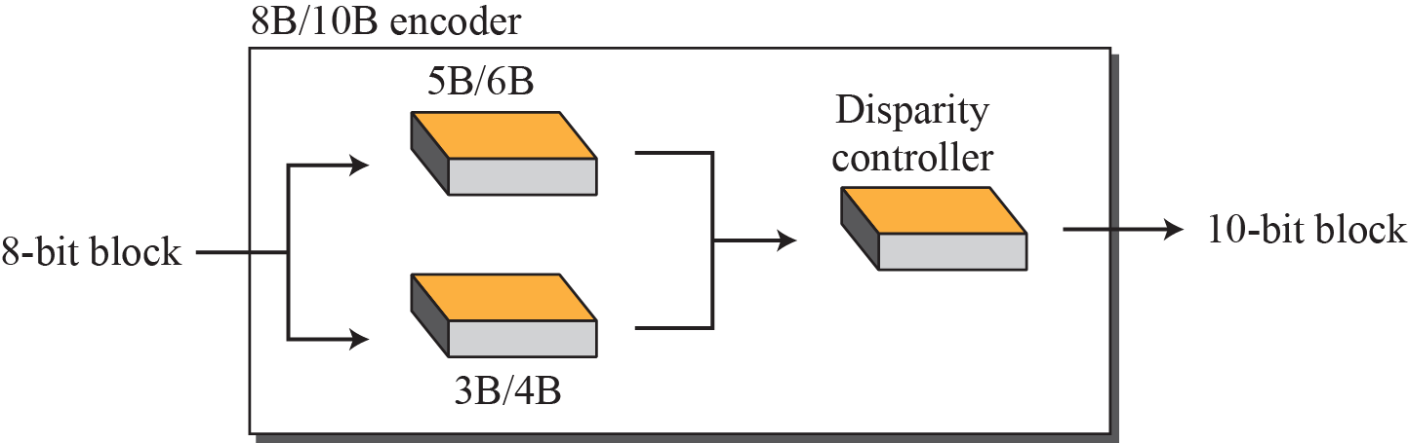
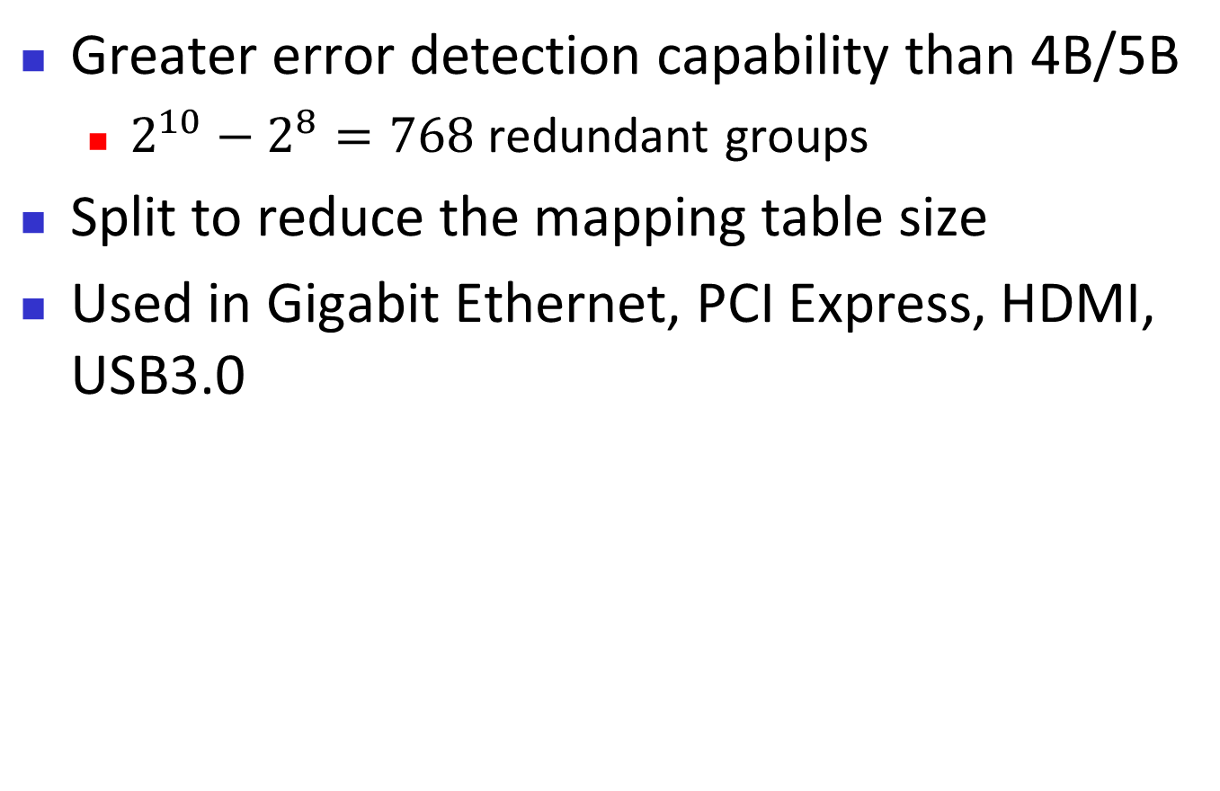
Figure 4.17: 8B/10B block encoding
Greater error detection capability than 4B/5B
  $2^{10}−2^{8}=768$ redundant groups
Split to reduce the mapping table size
Used in Gigabit Ethernet, PCI Express, HDMI, USB3.0

Slide 42
4.4.4 Scrambling
We modify line and block coding to include scrambling, as shown in Figure 4.18. Note that scrambling, as opposed to block coding, is done at the same time as encoding. The system needs to insert the required pulses based on the defined scrambling rules. Two common scrambling techniques are B8ZS and HDB3.

Slide 43
Scrambling
Not good for long-distance communication
  Biphase: wide bandwidth
  Block coding + NRZ: DC component
  Bipolar AMI: long sequence of 0s upsets sync
Need a solution that
  Does not increase number of bits (≠ block coding)
  Provides sync
Substitute long zero-level pulses with a combination of other levels

Slide 44
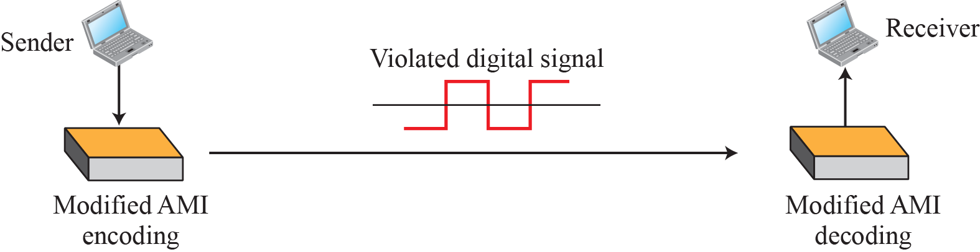
Figure 4.18: AMI used with scrambling

Slide 45
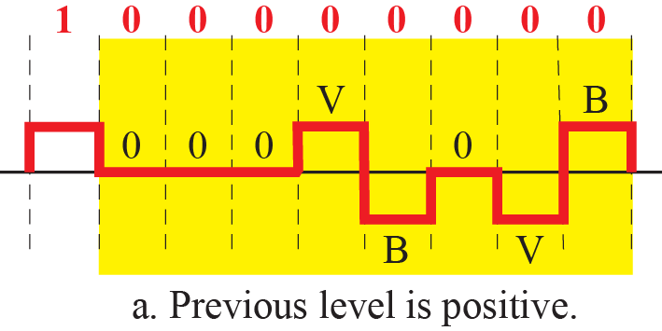
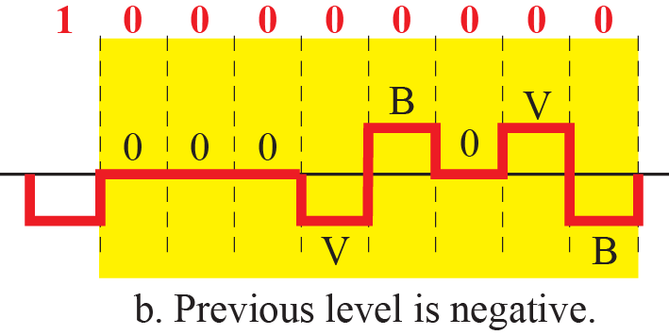
Figure 4.19: Two cases of B8ZS scrambling technique
Replace 8 consecutive 0s with 000VB0VB
No DC component

Slide 46
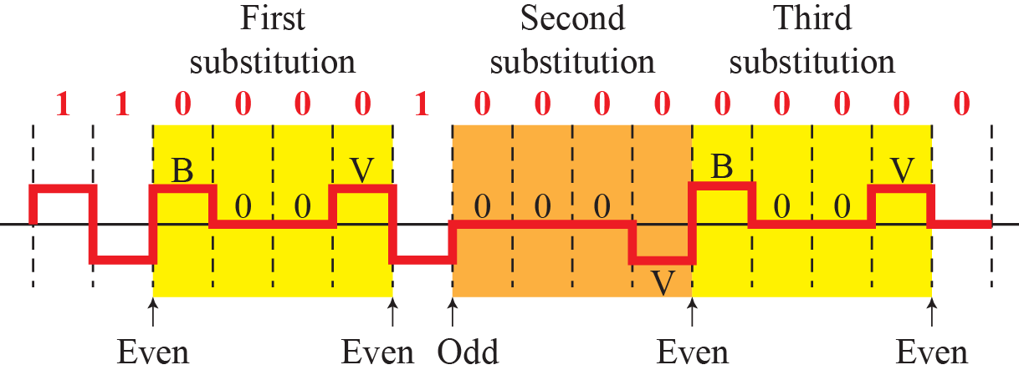
Figure 4.20: Different situations in HDB3 scrambling technique
Replace 4 consecutive 0s with 000V or B00V
  000V: Odd # nonzero pulses after last substitution
  B00V: Even

Slide 47
    4-2 ANALOG-TO-DIGITAL CONVERSION
The techniques described in Section 4.1 convert digital data to digital signals. Sometimes, however, we have an analog signal such as one created by a microphone or camera. We have seen in Chapter 3 that a digital signal is superior to an analog signal. The tendency today is to change an analog signal to digital data. In this section we describe two techniques, pulse code modulation and delta modulation.

Slide 48
4.2.1 Pulse Code Modulation (PCM)
The most common technique to change an analog signal to digital data (digitization) is called pulse code modulation (PCM). A PCM encoder has three processes, as shown in Figure 4.24.

Slide 49
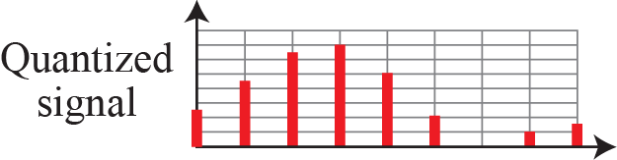
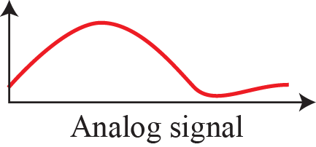
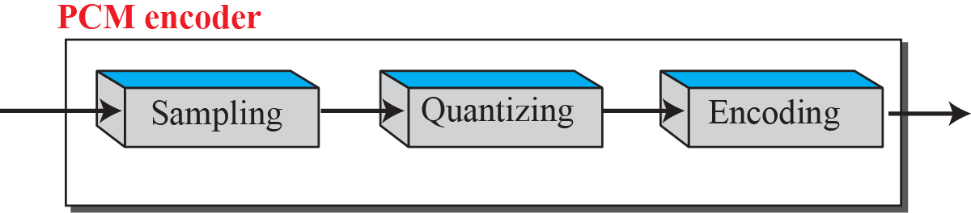
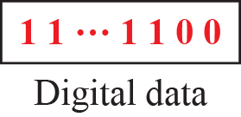

Figure 4.21: Components of PCM encoder

Slide 50




Figure 4.22: Three different sampling methods for PCM
Sampling frequency (rate): $f_{s}=\frac{1}{T_{s}}$

Slide 51


Figure 4.23: Nyquist sampling rate for low-pass and bandpass signals

Slide 52
Sampling Rate
(Nyquist) To reproduce the original analog signal, one necessary condition is that the sampling rate be at least twice the highest frequency in the original signal
  Not the bandwidth

Slide 53
Example 4.6
For an intuitive example of the Nyquist theorem, let us sample a simple sine wave at three sampling rates: f_{s} = 4f (2 times the Nyquist rate), f_{s} = 2f (Nyquist rate), and f_{s} = f (one-half the Nyquist rate). Figure 4.24 shows the sampling and the subsequent recovery of the signal. It can be seen that sampling at the Nyquist rate can create a good approximation of the original sine wave (part a). Oversampling in part b can also create the same approximation, but it is redundant and unnecessary. Sampling below the Nyquist rate (part c) does not produce a signal that looks like the original sine wave.
4.53

Slide 54



Figure 4.24: Recovery of a sine wave with different sampling rates.

Slide 55



Figure 4.25: Sampling of clock with only one hand.

Slide 56

Example 4.8
An example related to Example 4.7 is the seemingly backward rotation of the wheels of a forward-moving car in a movie. This can be explained by undersampling. A movie is filmed at 24 frames per second. If a wheel is rotating more than 12 times per second, the undersampling creates the impression of a backward rotation.
“Aliasing”
4.56

Slide 57
Example 4.9
Telephone companies digitize voice by assuming a maximum frequency of 4000 Hz. The sampling rate therefore is 8000 samples per second.
4.57

Slide 58
Example 4.10
A complex low-pass signal has a bandwidth of 200 kHz. What is the minimum sampling rate for this signal?
Solution
The bandwidth of a low-pass signal is between 0 and f, where f is the maximum frequency in the signal. Therefore, we can sample this signal at 2 times the highest frequency (200 kHz). The sampling rate is therefore 400,000 samples per second.
4.58

Slide 59
Example 4.11
A complex bandpass signal has a bandwidth of 200 kHz. What is the minimum sampling rate for this signal?
Solution
We cannot find the minimum sampling rate in this case because we do not know where the bandwidth starts or ends. We do not know the maximum frequency in the signal.
4.59

Slide 60

Quantization
  Discretization on time axis has been done …
Discretization on value axis should be done now: divide the range into L zones
  For audio, L=256 is frequently chosen (e.g. CD)
Quantization error is inevitable
  Larger L reduces quantization error
  Changes SNR → affects Shannon capacity
  ${SNR}_{dB}=6.02n_{b}+1.76$

Slide 61

Figure 4.26: Quantization and encoding of a sampled signal

Slide 62
Example 4.12
What is the SNR_{dB} in the example of Figure 4.26?
Solution
We can use the formula to find the quantization. We have eight levels and 3 bits per sample, so
SNR_{dB} = 6.02(3) + 1.76 = 19.82 dB. Increasing the number of levels increases the SNR.
4.62

Slide 63

Example 4.13
A telephone subscriber line must have an SNR_{dB} above 40. What is the minimum number of bits per sample?
Solution
We can calculate the number of bits as
Telephone companies usually assign 7 or 8 bits per sample.
4.63

Slide 64

Encoding
$n_{b}=\log_{2}L$
Bit rate = $f_{s}n_{b}$

Slide 65

Example 4.14
We want to digitize the human voice. What is the bit rate, assuming 8 bits per sample?
Solution
The human voice normally contains frequencies from 0 to 4000 Hz. So the sampling rate and bit rate are calculated as follows:
4.65

Slide 66




Figure 4.27: Components of a PCM decoder

Slide 67

PCM Bandwidth
Consider a low-pass analog signal with bandwidth $B_{analog}$
If we digitize it, what is the minimum bandwidth of the channel that can pass the digitized signal?
$B_{min}=\frac{cN}{r}=\frac{cn_{b}f_{s}}{r}=\frac{2cn_{b}B_{analog}}{r}$
  If r=1, c=1/2, $B_{min}=n_{b}B_{analog}$
  This is the price to pay for digitization

Slide 68
Example 4.15
We have a low-pass analog signal of 4 kHz. If we send the analog signal, we need a channel with a minimum bandwidth of 4 kHz. If we digitize the signal and send 8 bits per sample, we need a channel with a minimum bandwidth of 8 × 4 kHz = 32 kHz.
4.68

Slide 69
4.2.2 Delta Modulation (DM)
PCM is a very complex technique. Other techniques have been developed to reduce the complexity of PCM. The simplest is delta modulation. PCM finds the value of the signal amplitude for each sample; DM finds the change from the previous sample. Figure 4.28 shows the process. Note that there are no code words here; bits are sent one after another.

Slide 70

Figure 4.28: The process of delta modulation

Slide 71

Figure 4.29: Delta modulation components

Slide 72

Figure 4.30: Delta demodulation components

Slide 73
    4-3 TRANSMISSION MODES
Of primary concern when we are considering the transmission of data from one device to another is the wiring, and of primary concern when we are considering the wiring is the data stream. Do we send 1 bit at a time; or do we group bits into larger groups and, if so, how? The transmission of binary data across a link can be accomplished in either parallel or serial mode (see Figure 4.31).

Slide 74

Figure 4.31: Data transmission modes

Slide 75
4.3.1 Parallel Transmission
Line coding is the process of converting digital data to digital signals. We assume that data, in the form of text, numbers, graphical images, audio, or video, are stored in computer memory as sequences of bits (see Chapter 1). Line coding converts a sequence of bits to a digital signal. At the sender, digital data are encoded into a digital signal; at the receiver, the digital data are recreated by decoding the digital signal. Figure 4.1 shows the process.

Slide 76



Figure 4.32: Parallel transmission

Slide 77
4.3.2 Serial Transmission
In serial transmission one bit follows another, so we need only one communication channel rather than n to transmit data between two communicating devices (see Figure 4.33).

Slide 78



Figure 4.33: Serial transmission

Slide 79




Figure 4.34: Asynchronous transmission
Without synchronization at byte level

Slide 80



Figure 4.35: Synchronous transmission
No gaps between bytes

Slide 81
Isochronous transmission
Entire stream of bits must be synchronized
No gaps between frames or bytes
E.g. TV broadcast

