Slide 1

Lossy Links, Low Power,
High Throughput
Simon Duquennoy, Fredrik Ősterlind,
Adam Dunkels
SenSys 2011
Swedish Institute of Computer Science

Slide 2
Outline
Introduction
A Case for General-Purpose Forwarding in Low-Power Wireless Networks
Burst Forwarding
TCP for Low-Power Wireless
Evaluation
Conclusion

Slide 3
Introduction
Sensor networks move from single-purpose to multi-purpose
Many protocols have typically been considered in isolation:
  A focus on low power consumption
  A focus on throughput
  → Yet the two purposes must be combined in emerging networks!
Bulk transfer protocols monopolize multi-hop path and disable radio duty cycling to achieve high throughput
  → Multi-purpose low power networks need a generic forwarding technique

Slide 4
A Case for General-Purpose Forwarding in Low-Power Wireless Networks

Slide 5
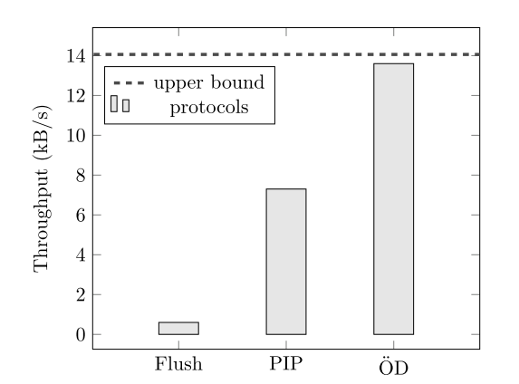
High Throughput in Senornets
Optimizing the throughput of bulk transfer is a natural goal
Flush provides reliable data transmission with rate control
PIP uses TDMA, multiple-channels and conditional immediate transmission (52%)
ŐD is the conditional immediate transmission mechanism (97%)

Slide 6
High Throughput is not enough
Flush and ŐD force every node to keep its radio on until the end of the transfer
  Flush : neighbor overhearing
  OD : sending and receiving continuously
Since existing protocols have their radios turned on for the full duration of the transfer, a loss period will cause a significant waste of energy
High throughput data transfer in low-power wireless must be evaluated in
  Energy efficiency
  Throughput

Slide 7
Burst Forwarding
Support high throughput data transport in low-power multi-purpose wireless networks with potentially high-loss links
Operation with mechanisms at two timescales
  Low-power packet bursting
    Transmission of a burst of packet over a single hop
  Burst coordination
    Transmission of bursts across multiple hops and over timescales of tens of seconds

Slide 8
Low-Power Packet Bursting
Radio duty cycling mechanism
  The sender and the receiver can sleep between transmissions
  It provides a periodic wakeup mechanism
    Wakeup mechanism consists of two consecutive channel samples with an interval
Implementation runs over the sender initiated ContikiMAC protocol
ContikiMAC
  A low-power listening protocol
  Using data packets as wakeup signals
    two consecutive channel samples

Slide 9
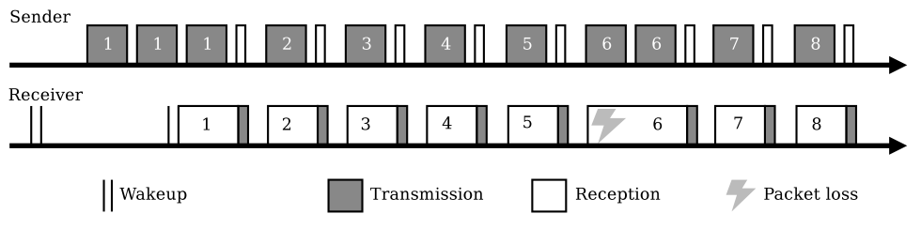
Bursts in ContikiMAC
Every packet is repeatedly sent until
  reception of a link layer acknowledgment
  the end of the wakeup transmission period
Combined with the ContikiMAC data-packets-as-wake-up mechanism, the bursts provide a rapid retransmission mechanism

Slide 10
Inter-Packet Sleeping
Burst forwarding allows the radio of the sender and the receiver to be switched off between the transmissions in a burst
  Packet is loaded into the radio chip of the sender
  The receiver may be switched off while the packet is loaded
Requires careful timing
  The radio must be turned on before reception of the next packet in the burst
  → each packet reception sets a new timer

Slide 11
Storage Interleaving
Leverages flash memory to spill over long buffer queues
  To overcome the memory limitations
Using the flash memory only for long bursts
  When only a few packets are to be forwarded, packets are buffered in RAM instead
The power consumption is low
  Using the flash for packet queuing consumes power

Slide 12
Burst Coordination
To coordinate the bursts across multiple hops and on longer timescales
  Two-level retransmission mechanism
  Network-layer fragmentation
  Multi-channel operation

Slide 13
Two-Level Retransmission
Packet losses occur because of a number of reasons
  interference from other radio sources, propagation loss, self-interference, cross-traffic, and packet collision…
Link-layer retransmissions can address packet loss
  Combined with MAC-layer retransmissions

Slide 14
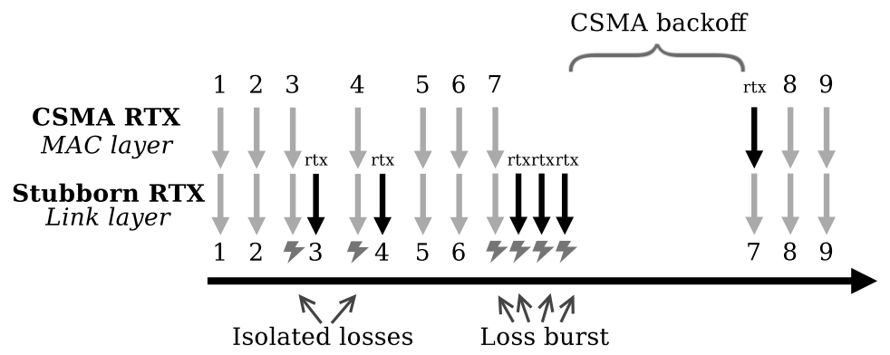
First-Level Retransmission
Link-layer
The retransmission is atomic
  no other packet is transmitted or received between retransmissions
Recovery from isolated losses and high-frequency radio interference (ex. microwave oven)

Slide 15
Second-Level Retransmission
When link-layer retransmissions fail to transmit a packet, the burst is stopped, and a loss is reported to CSMA
MAC-layer
CSMA with increasing back-off
CSMA retransmissions adapt to long-lasting or low-frequency interference (ex. WiFi file transfer)

Slide 16
Fragmentation
Use datagram fragmentation
  6lowpan fragmentation
To save time and energy throughput the path
  Fragment at the IP source and reassemble at the IP destination (do not every hop)
Basic trade-off between speed and reliability
The loss of a single fragment may result in the loss of a larger datagram
  Two-level retransmissions mechanism will provide enough reliability for fragmentation

Slide 17
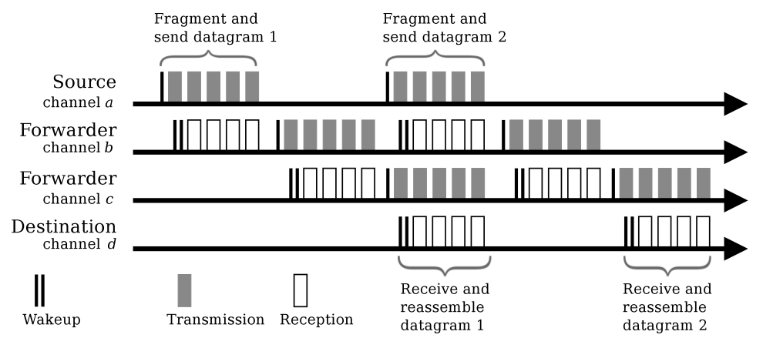
Multi-Channel Operation
Burst forwarding uses multiple channels to avoid both intra-path interference and inter-path interference
Allowing burst transmissions to be pipelined over multiple hops
Remembers the correct channel

Slide 18
TCP for Low-Power Wireless
To provide a generic mechanism for supporting transport-layer protocols including TCP
Using TCP with burst forwarding has benefits
  Flow control and congestion control
TCP is known to be ill-suited for used over lossy links
  TCP treats packet loss
  TCP headers are large
  TCP uses positive acknowledgments
  TCP timing may interfere with link-layer recovery

Slide 19
TCP for Low-Power Wireless
Loss-is-congestion
  Interpretation of segments losses as congestion
  Two-level retransmissions
TCP header overhead
  20 byte overhead for every segment
  Using large TCP segments together with link-layer fragmentation
TCP ACK implosion
  Extra traffic
  Use of large segments
Too-persistent link layer
  Increase round trip time
  Large TCP segments and hiding isolated link losses

Slide 20
Evaluation
Packet Burst Efficiency
Fragmentation under Interference
Retransmissions under Interference
Cross-Traffic: Data Collection and Bulk Transfer

Slide 21
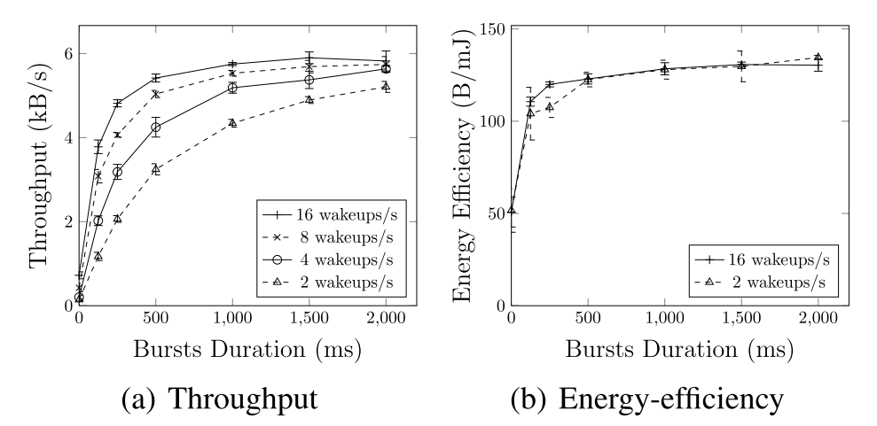
Packet Burst Efficiency
Efficiency of low-power packet bursting over a duty cycled radio

Slide 22
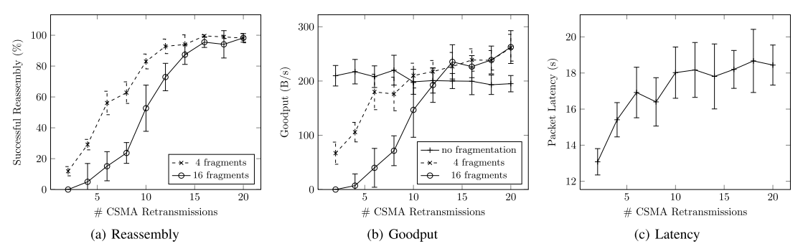
Fragmentation under Interference
The rate of successful reassembly grows with the number of CSMA retransmissions
In the non-fragmented case, a decrease in good put as well they use more retransmissions
The queue at intermediate nodes overflows increasing the transmission back-off

Slide 23
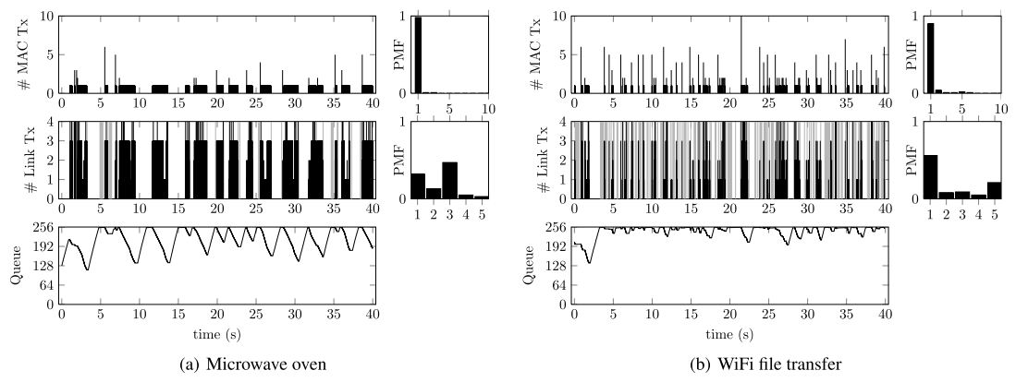
Retransmissions under Interference
Microwave oven: average RSSI -98dBm. 52% link losses
WiFi file transfer: average RSSI 96dBm. 51% link losses
The two-level of retransmission are complementary and allow burst forwarding to adapt to different interference patterns

Slide 24
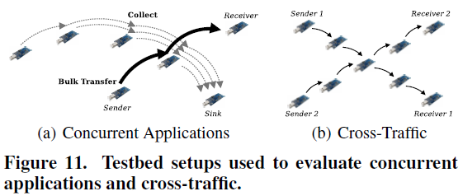
Cross-Traffic: Data Collection and Bulk Transfer
It is designed to allow cross traffic and concurrent applications

Slide 25
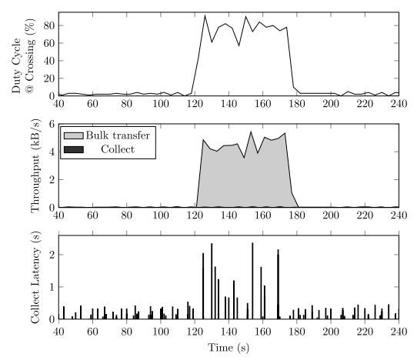
Concurrent Applications
4-hop data collection tree crossed by a bulk transfer
The radio duty cycle adapts from less than 4% to about 80% during the transfer
The throughput of the transfer is 82% of the isolated stream case
The impact on the collection is a latency increase about 2 seconds

Slide 26
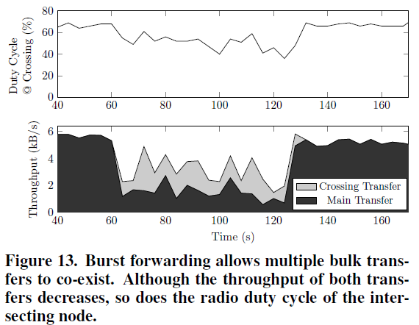
Cross Traffic
Two crossing bulk transfers over 4-hop paths

Slide 27
Conclusion
High throughput with a high energy efficiency without monopolizing network resources
Two-level retransmissions survive heavy interference
TCP can be efficiently adapted to lossy low-power wireless networks

