Slide 1
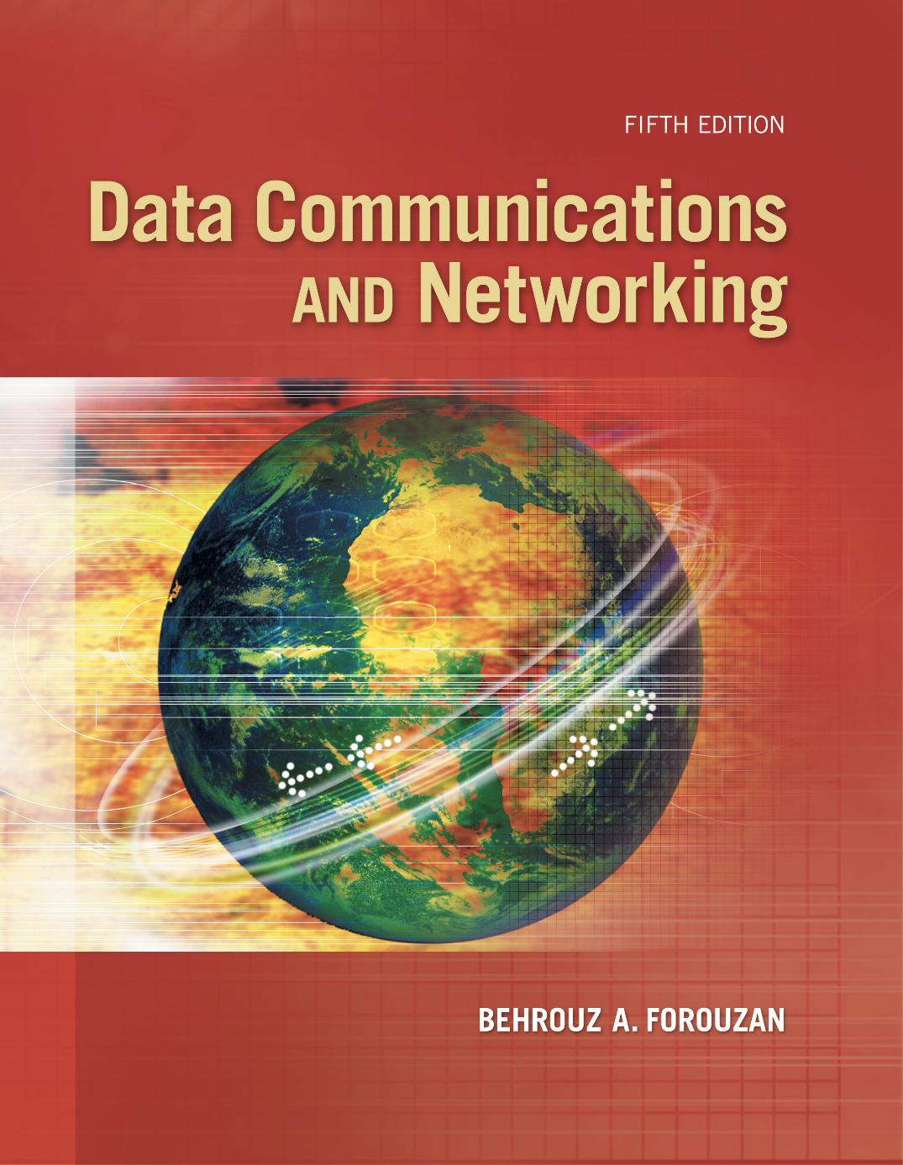
Chapter 5
Analog
Transmission
Copyright © The McGraw-Hill Companies, Inc. Permission required for reproduction or display.

Slide 2
Chapter 5: Outline
5.1 DIGITAL-TO-ANALOG CONVERSION
5.2 ANALOG-TO-ANALOG CONVERSION

Slide 3

Chapter 5: Objective
The first section discusses digital-to-analog conversion. The section shows how we can change digital data to an analog signal when a band-pass channel is available. The first method described is called amplitude shift keying (ASK), in which the amplitude of a carrier is changed using the digital data. The second method described is called frequency shift keying (FSK), in which the frequency of a carrier is changed using the digital data. The third method described is called phase shift keying (PSK), in which the phase of a carrier signal is changed to represent digital data. The fourth method described is called quadrature amplitude modulation (QAM), in which both amplitude and phase of a carrier signal are changed to represent digital data.

Slide 4
Chapter 5: Objective (continued)
The second section discusses analog-to-analog conversion. The section shows how we can change an analog signal to a new analog signal with a smaller bandwidth. The conversion is used when only a band-pass channel is available. The first method is called amplitude modulation (AM), in which the amplitude of a carrier is changed based on the changes in the original analog signal. The second method is called frequency modulation (FM), in which the phase of a carrier is changed based on the changes in the original analog signal. The third method is called phase modulation (PM), in which the phase of a carrier signal is changed to show the changes in the original signal.

Slide 5
    5-1 DIGITAL-TO-ANALOG CONVERSION
Digital-to-analog conversion is the process of changing one of the characteristics of an analog signal based on the information in digital data. Figure 5.1 shows the relationship between the digital information, the digital-to-analog modulating process, and the resultant analog signal.

Slide 6
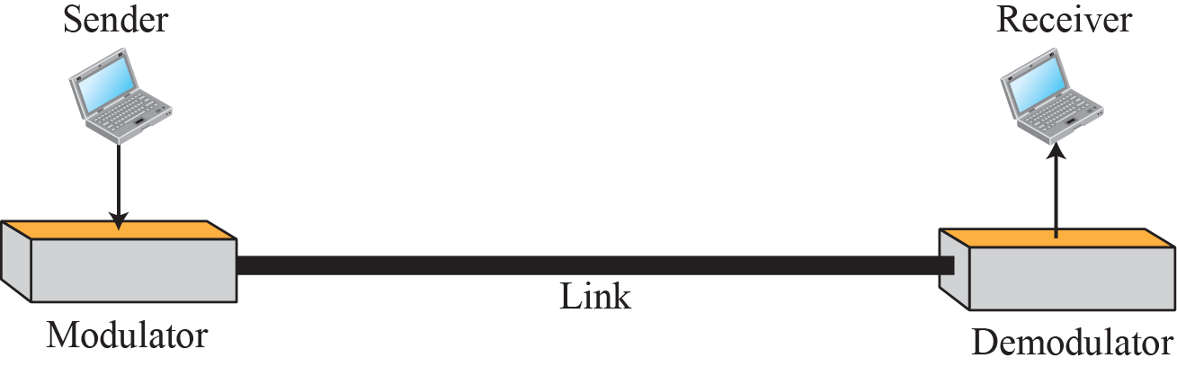
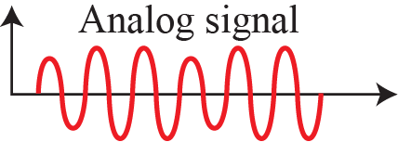
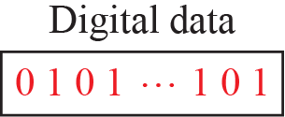
Figure 5.1: Digital-to-analog conversion

Slide 7
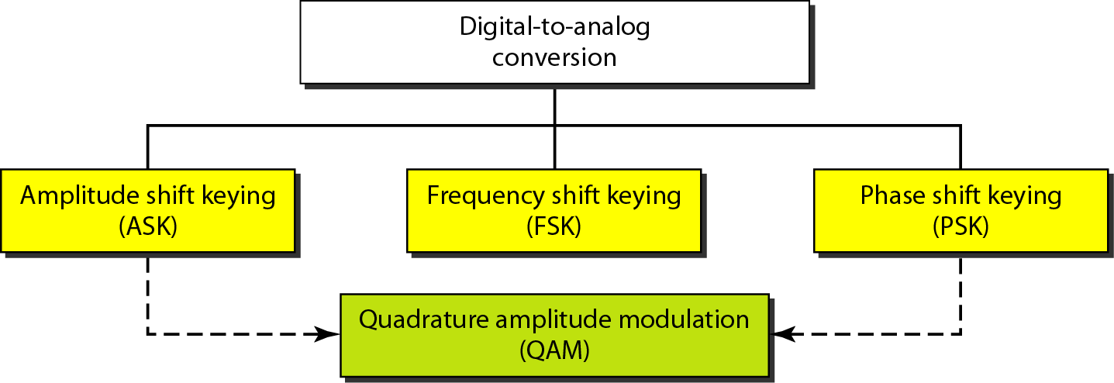
Figure 5.2: Types of digital to analog conversion

Slide 8
5.5.1 Aspects of Conversion
Before we discuss specific methods of digital-to-analog modulation, two basic issues must be reviewed: bit and baud rates and the carrier signal.

Slide 9
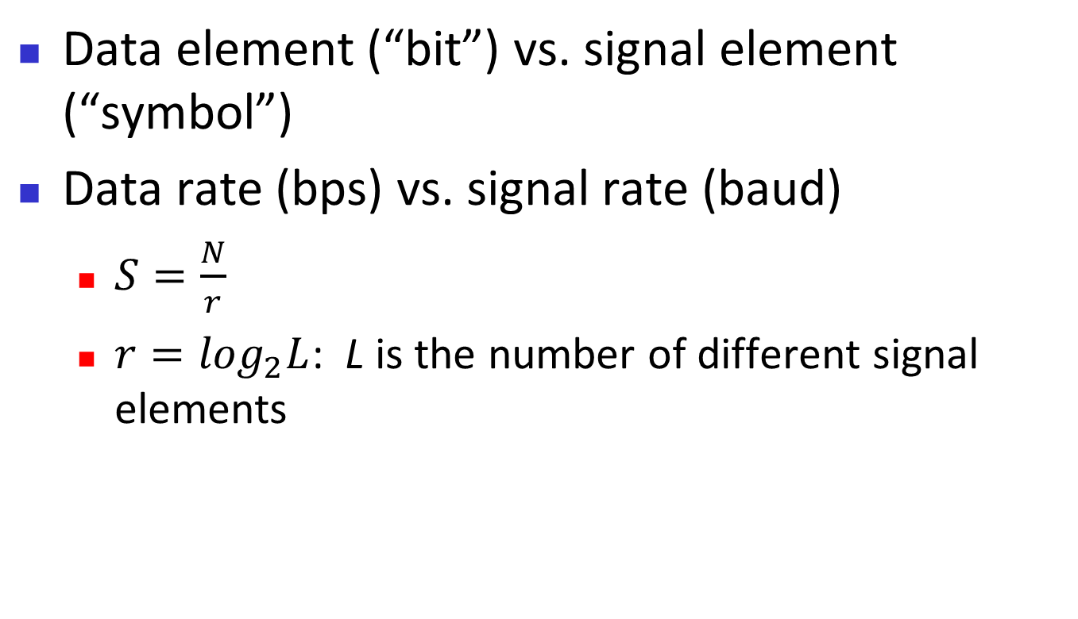
Data vs. Signal
Data element (“bit”) vs. signal element (“symbol”)
Data rate (bps) vs. signal rate (baud)
  $S=\frac{N}{r}$
  $r=\log_{2}L$: L is the number of different signal elements

Slide 10
Example 5.1
An analog signal carries 4 bits per signal element. If 1000 signal elements are sent per second, find the bit rate.
Solution
In this case, r = 4, S = 1000, and N is unknown. We can find the value of N from
5.10

Slide 11
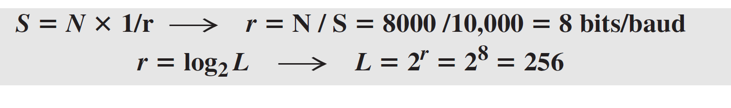
Example 5.2
An analog signal has a bit rate of 8000 bps and a baud rate of 1000 baud. How many data elements are carried by each signal element? How many signal elements do we need?
Solution
In this example, S = 1000, N = 8000, and r and L are unknown. We first find the value of r and then the value of L.
5.11

Slide 12
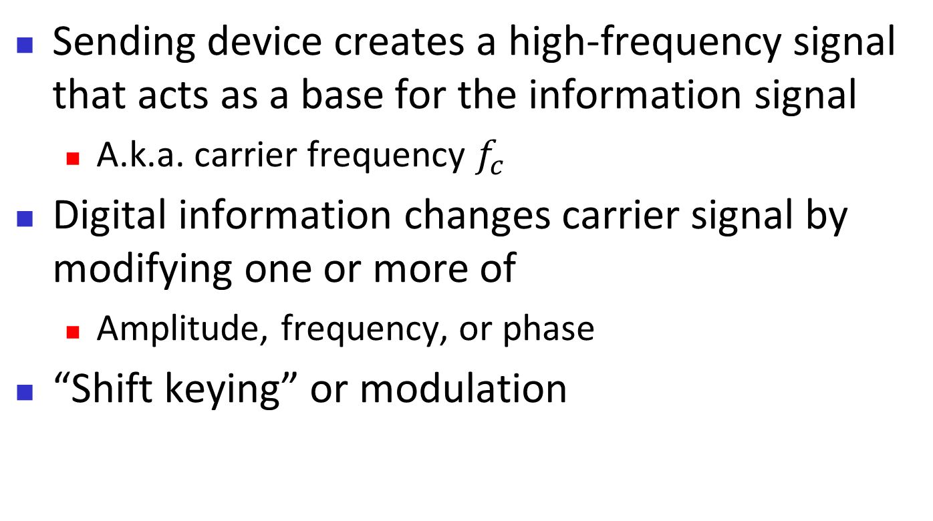
Carrier signal
Sending device creates a high-frequency signal that acts as a base for the information signal
  A.k.a. carrier frequency $f_{c}$
Digital information changes carrier signal by modifying one or more of
  Amplitude, frequency, or phase
“Shift keying” or modulation

Slide 13
5.5.2 Amplitude Shift Keying
In amplitude shift keying, the amplitude of the carrier signal is varied to create signal elements. Both frequency and phase remain constant while the amplitude changes.

Slide 14
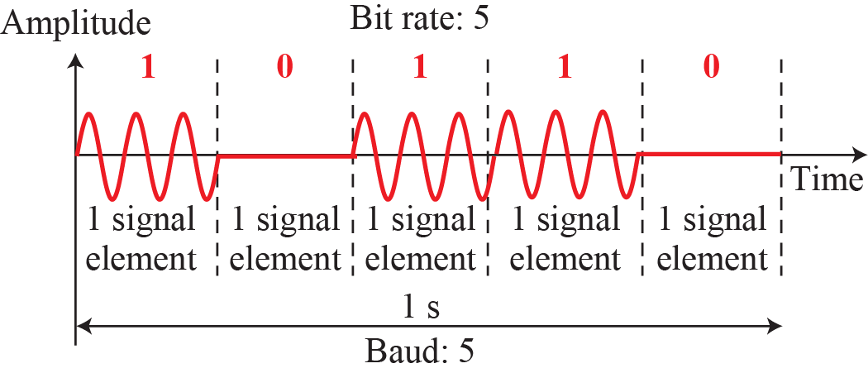
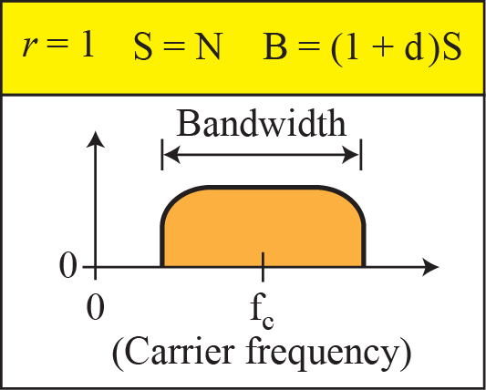
Figure 5.3: Binary amplitude shift keying

Slide 15
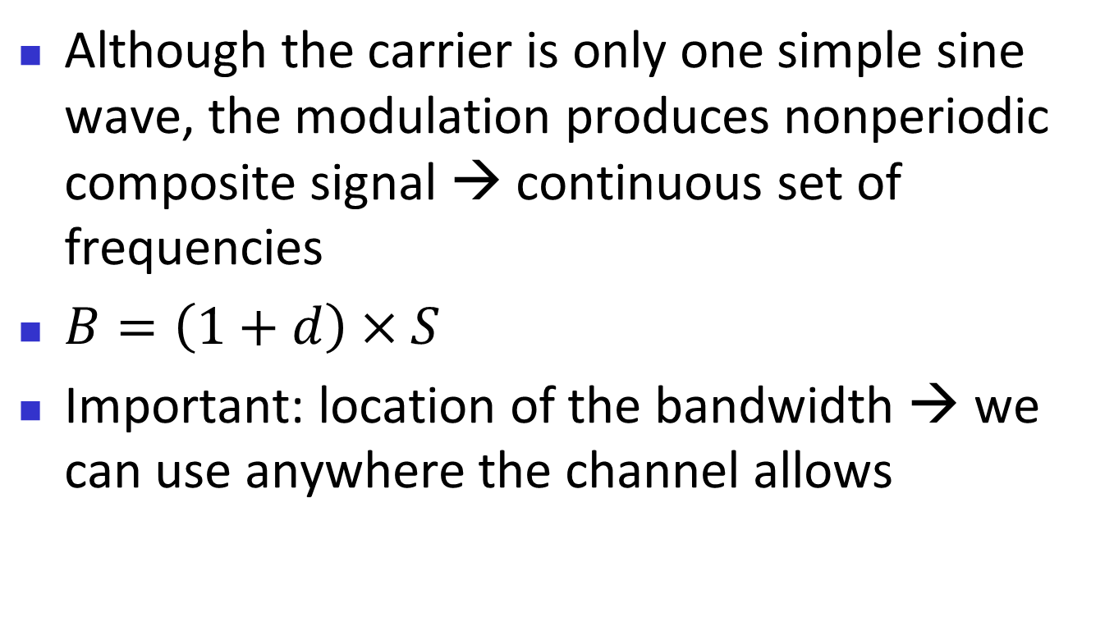
Discussion on ASK bandwidth
Although the carrier is only one simple sine wave, the modulation produces nonperiodic composite signal → continuous set of frequencies
$B=\left(1+d\right)×S$
Important: location of the bandwidth → we can use anywhere the channel allows

Slide 16
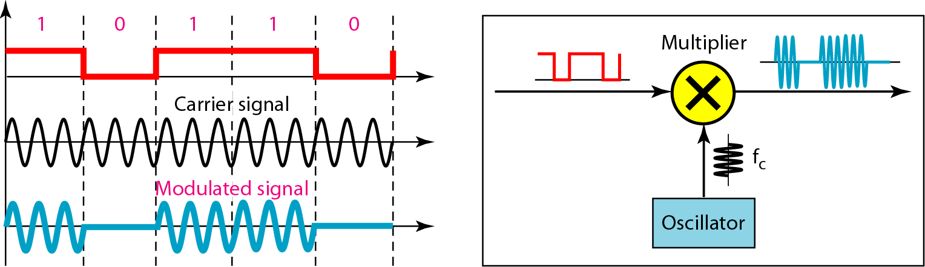
Figure 5.4: Implementation of binary ASK

Slide 17
Example 5.3
We have an available bandwidth of 100 kHz which spans from 200 to 300 kHz. What are the carrier frequency and the bit rate if we modulated our data by using ASK with d = 1?
Solution
The middle of the bandwidth is located at 250 kHz. This means that our carrier frequency can be at fc = 250 kHz. We can use the formula for bandwidth to find the bit rate (with d = 1 and r = 1).
5.17

Slide 18
Example 5.4
In data communications, we normally use full-duplex links with communication in both directions. We need to divide the bandwidth into two with two carrier frequencies, as shown in Figure 5.5. The figure shows the positions of two carrier frequencies and the bandwidths. The available bandwidth for each direction is now 50 kHz, which leaves us with a data rate of 25 kbps in each direction.
5.18

Slide 19
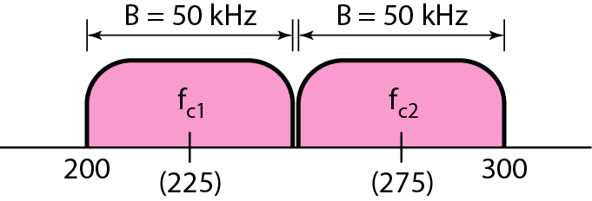
Figure 5.5: Bandwidth of a full-duplex ASK in Example 5.4

Slide 20
5.5.3 Frequency Shift Keying
In frequency shift keying, the frequency of the carrier signal is varied to represent data. The frequency of the modulated signal is constant for the duration of one signal element, but changes for the next signal element if the data element changes. Both peak amplitude and phase remain constant for all signal elements.

Slide 21
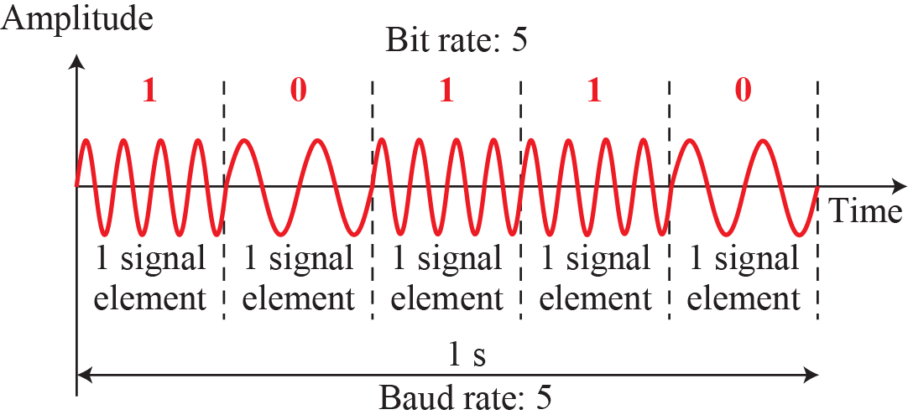
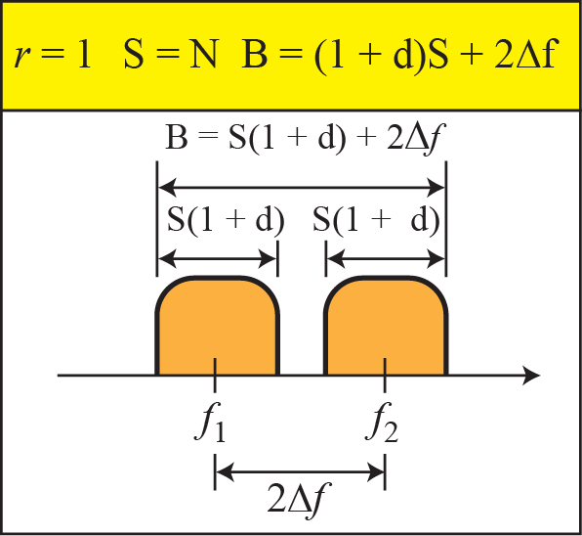
Figure 5.6: Binary frequency shift keying

Slide 22
Example 5.5
We have an available bandwidth of 100 kHz which spans from 200 to 300 kHz. What should be the carrier frequency and the bit rate if we modulated our data by using FSK with d = 1?
Solution
This problem is similar to Example 5.3, but we are modulating by using FSK. The midpoint of the band is at 250 kHz. We choose 2Δf to be 50 kHz; this means
This is half the bitrate of ASK!
5.22

Slide 23
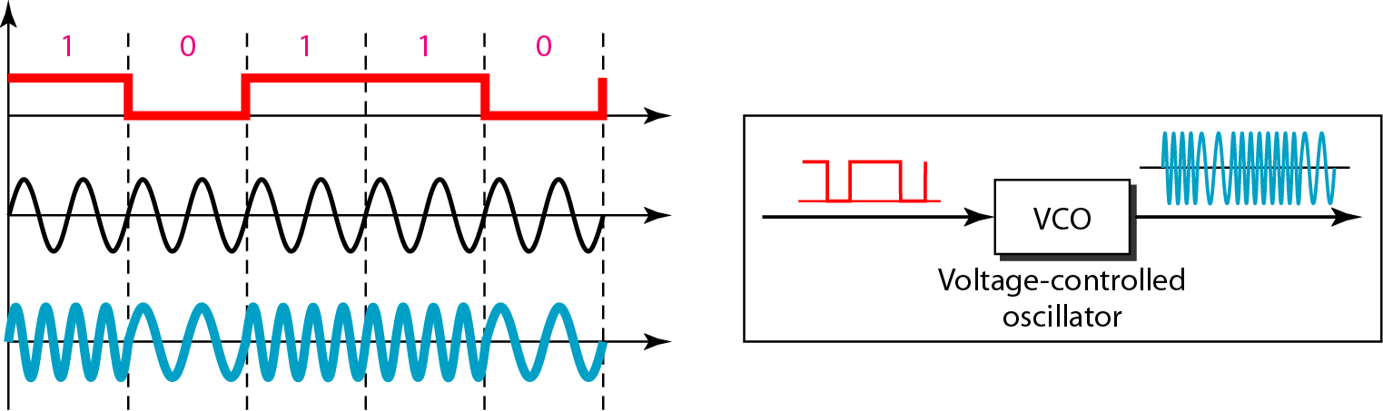
Figure 5.7: Implementation of BFSK

Slide 24
Example 5.6
We need to send data 3 bits at a time at a bit rate of 3 Mbps. The carrier frequency is 10 MHz. Calculate the number of levels (different frequencies), the baud rate, and the bandwidth.
Solution
We can have L = 23 = 8. The baud rate is S = 3 MHz/3 = 1 Mbaud. This means that the carrier frequencies must be 1 MHz apart (2Δf = 1 MHz). The bandwidth is B = 8 × 1 = 8 MHz. Figure 5.8 shows the allocation of frequencies and bandwidth.
5.24

Slide 25
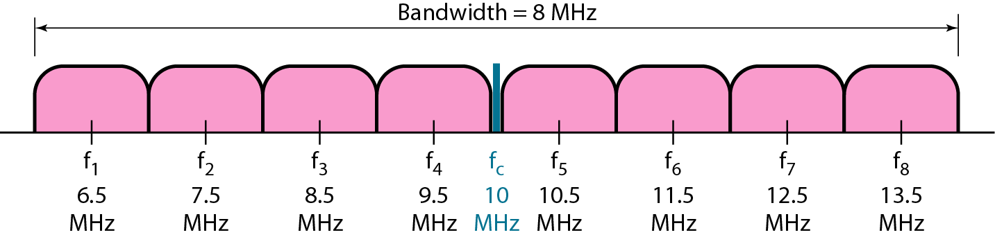
Figure 5.8: Bandwidth of MFSK used in Example 5.6

Slide 26
5.5.4 Phase Shift Keying
In phase shift keying, the phase of the carrier is varied to represent two or more different signal elements. Both peak amplitude and frequency remain constant as the phase changes. Today, PSK is more common than ASK or FSK. However, we will see shortly that QAM, which combines ASK and PSK, is the dominant method of digital-to-analog modulation.

Slide 27
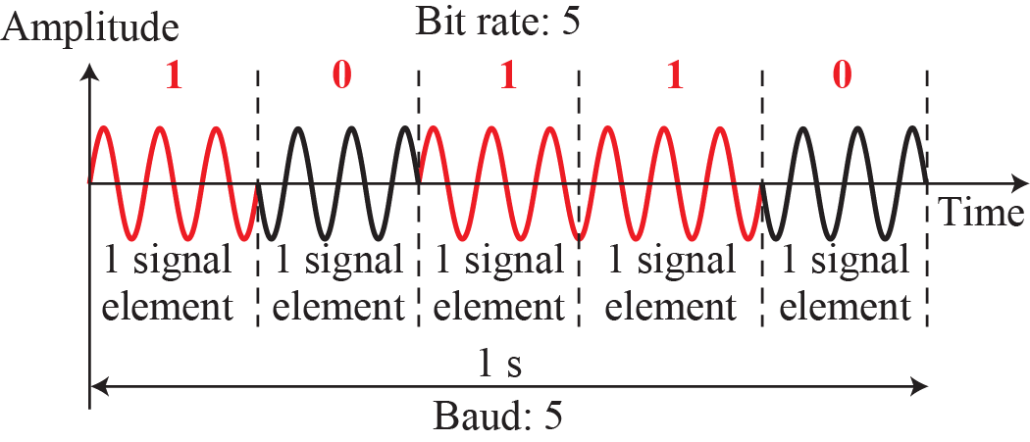
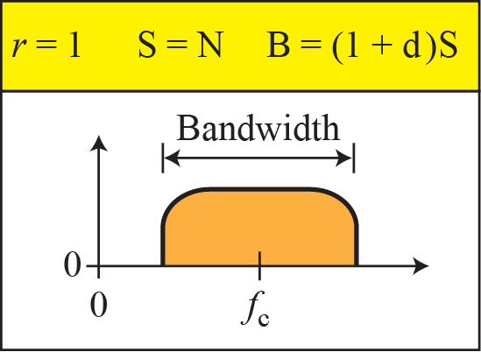
Figure 5.9: Binary phase shift keying

Slide 28
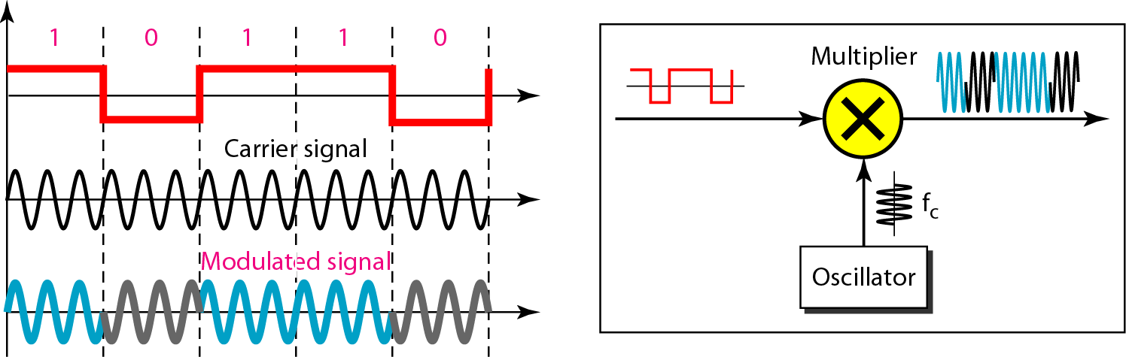
Figure 5.10: Implementation of BASK

Slide 29
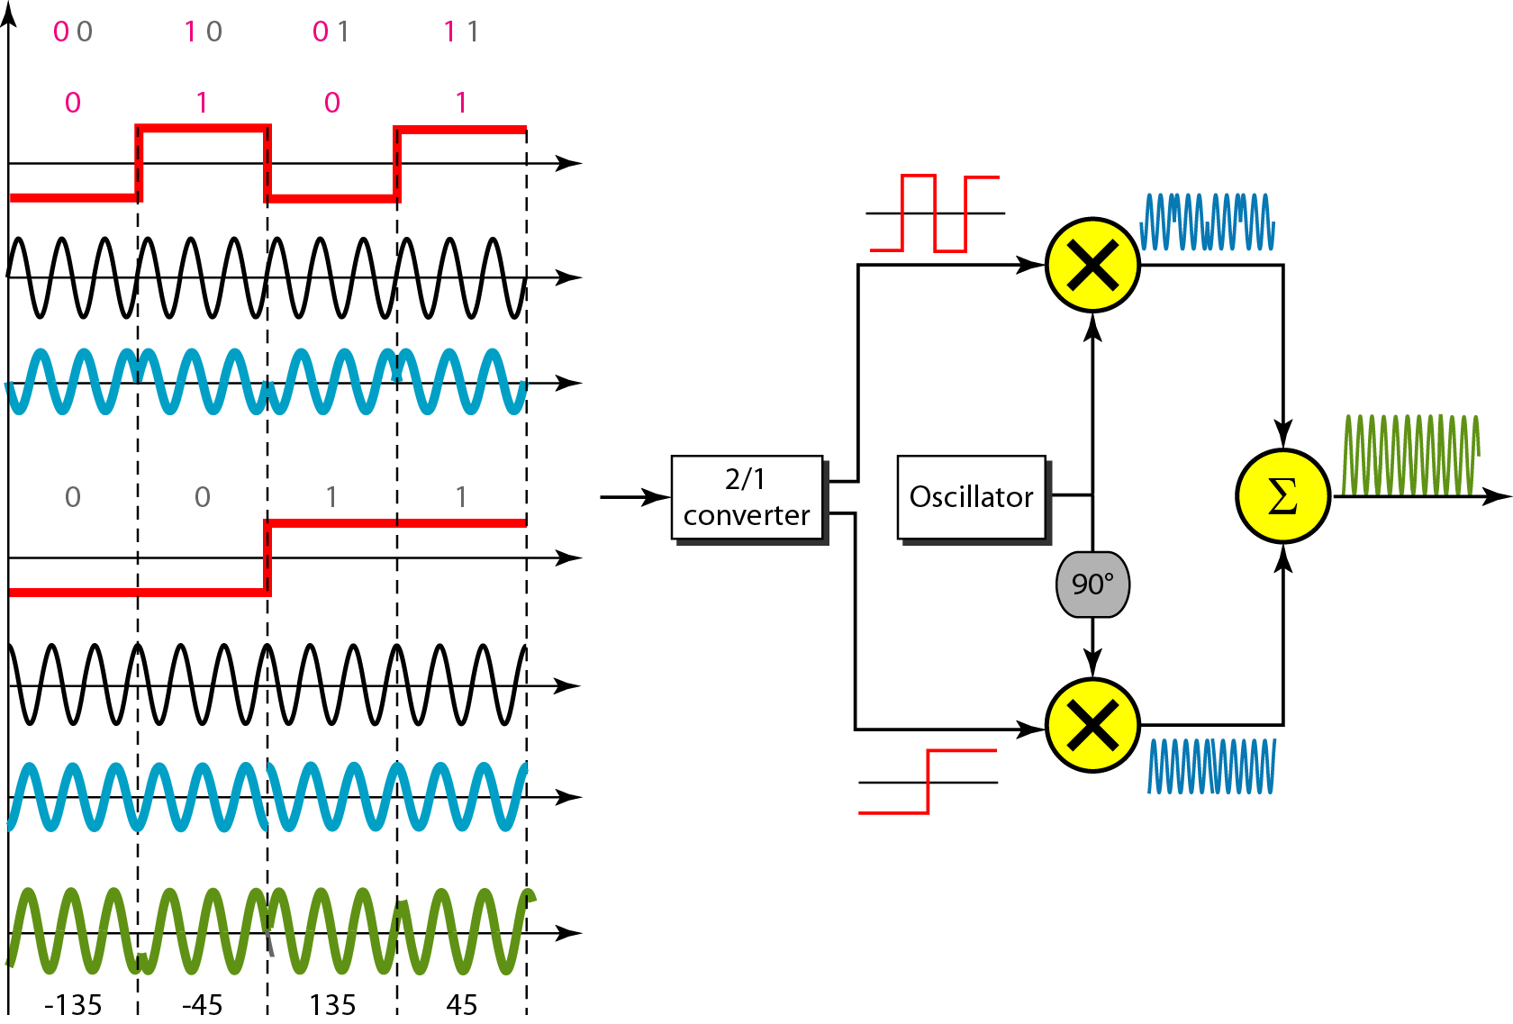
Figure 5.11: QPSK and its implementation

Slide 30
Discussion on PSK
PSK is more common than ASK or FSK
But QAM (ASK+PSK) is the dominant method of digital-to-analog

Slide 31
Example 5.7
Find the bandwidth for a signal transmitting at 12 Mbps for QPSK. The value of d = 0.
Solution
For QPSK, 2 bits are carried by one signal element. This means that r = 2. So the signal rate (baud rate) is S = N × (1/r) = 6 Mbaud. With a value of d = 0, we have B = S = 6 MHz.
5.31

Slide 32
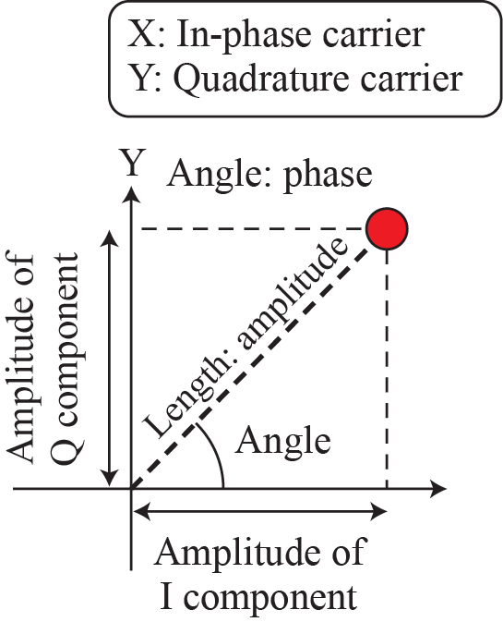
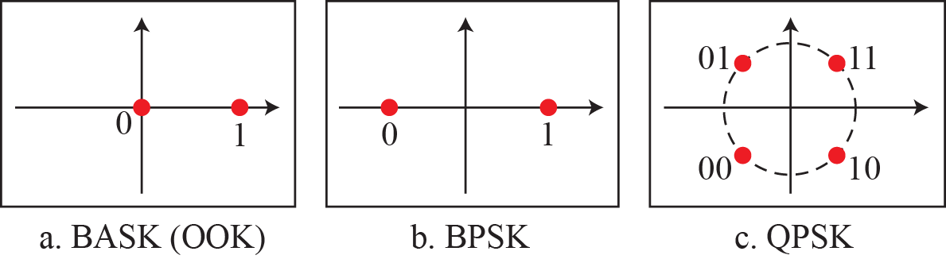
Figure 5.12: Concept of a constellation diagram

Slide 33
Example 5.8
Show the constellation diagrams for ASK (OOK), BPSK, and QPSK signals.
Solution
Figure 5.13 shows the three constellation diagrams. Let us analyze each case separately:
5.33

Slide 34
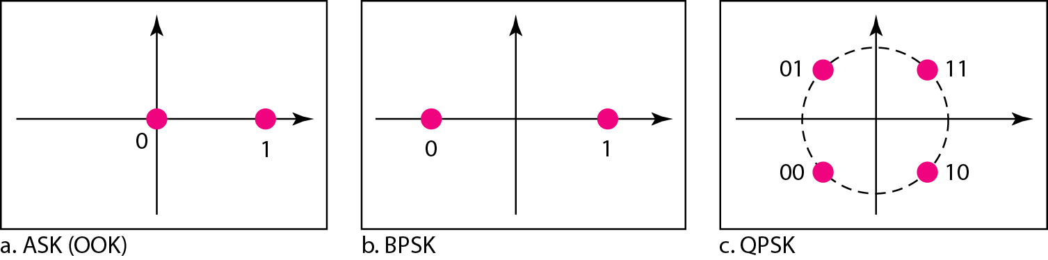
Figure 5.13: Three constellation diagrams

Slide 35
5.5.5 Quadrature Amplitude Modulation
PSK is limited by the ability of the equipment to distinguish small differences in phase. This factor limits its potential bit rate. So far, we have been altering only one of the three characteristics of a sine wave at a time; but what if we alter two? Why not combine ASK and PSK? The idea of using two carriers, one in-phase and the other quadrature, with different amplitude levels for each carrier is the concept behind quadrature amplitude modulation (QAM).

Slide 36
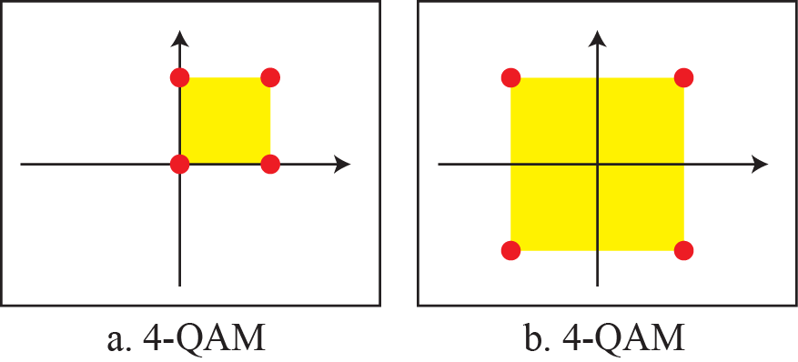
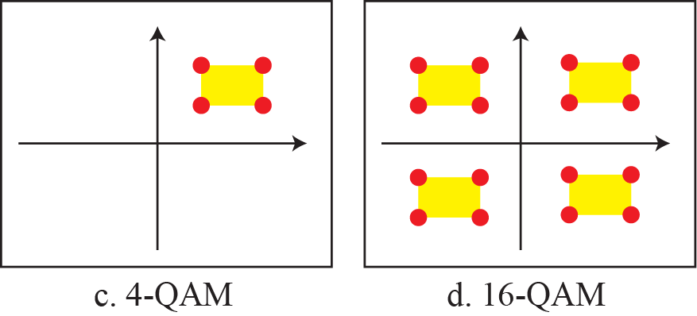
Figure 5.14: Constellation diagrams for some QAMs

Slide 37
    5-2 ANALOG-TO-ANALOG CONVERSION
Analog-to-analog conversion, or analog modulation, is the representation of analog information by an analog signal. One may ask why we need to modulate an analog signal; it is already analog. Modulation is needed if the medium is bandpass in nature or if only a bandpass channel is available to us. Analog-to-analog conversion can be accomplished in three ways: AM FM and PM.

Slide 38
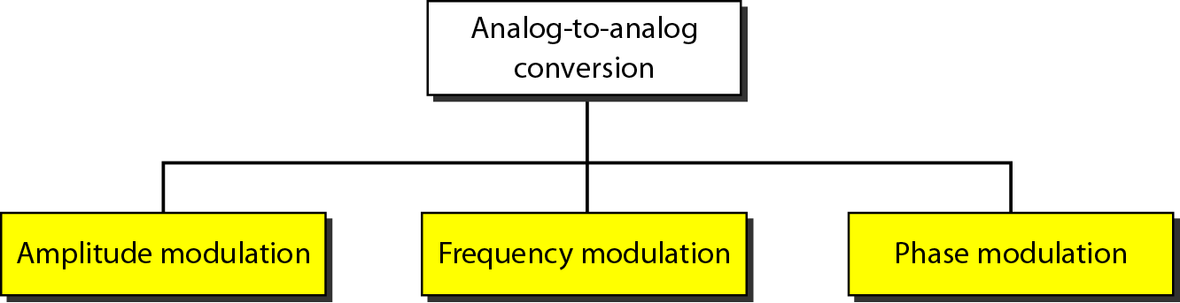
Figure 5.15: Types of analog-to-analog modulation

Slide 39
5.2.1 Amplitude Modulation (AM)
In AM transmission, the carrier signal is modulated so that its amplitude varies with the changing amplitudes of the modulating signal. The frequency and phase of the carrier remain the same; only the amplitude changes to follow variations in the information. Figure 5.16 shows how this concept works. The modulating signal is the envelope of the carrier. As Figure 5.16 shows, AM is normally implemented by using a simple multiplier because the amplitude of the carrier signal needs to be changed according to the amplitude of the modulating signal.

Slide 40
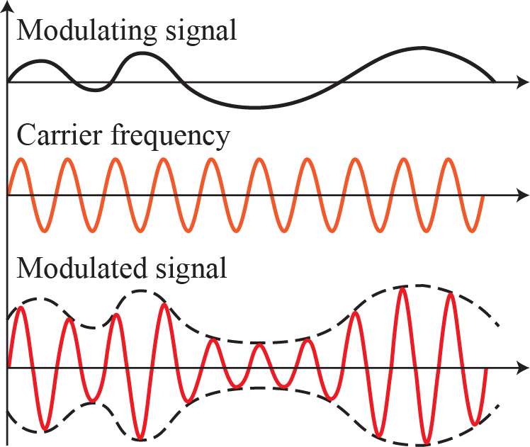
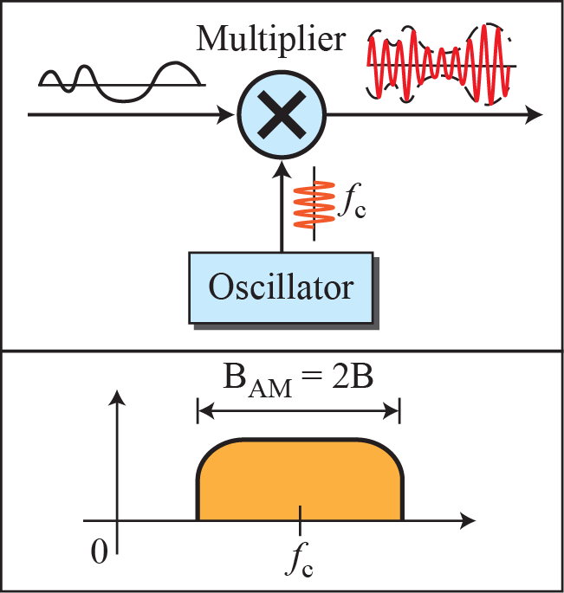
Figure 5.16: Amplitude modulation

Slide 41
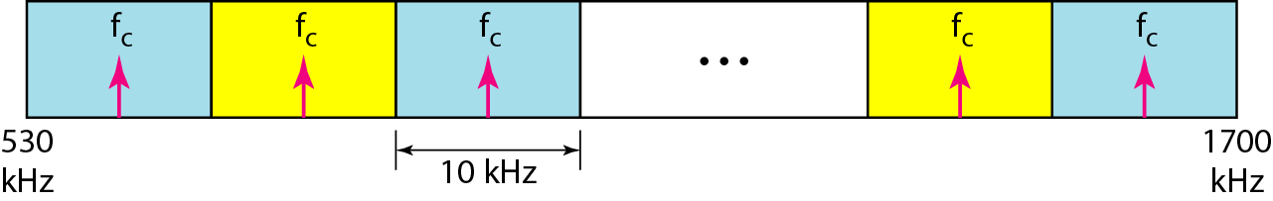
Figure 5.17: AM band allocation

Slide 42
5.2.2 Frequency Modulation (FM)
In FM transmission, the frequency of the carrier signal is modulated to follow the changing voltage level (amplitude) of the modulating signal. The peak amplitude and phase of the carrier signal remain constant, but as the amplitude of the information signal changes, the frequency of the carrier changes correspondingly. Figure 5.18 shows the relationships of the modulating signal, the carrier signal, and the resultant FM signal.

Slide 43
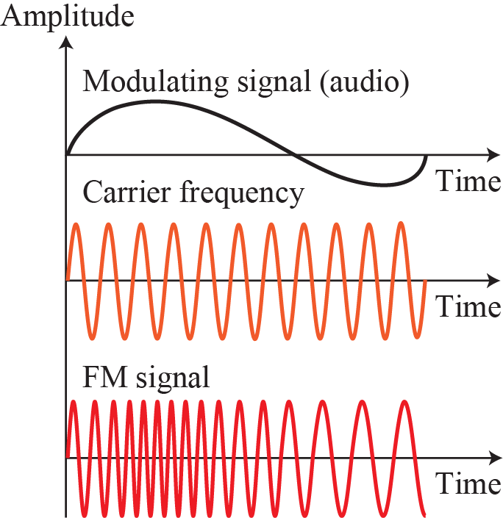
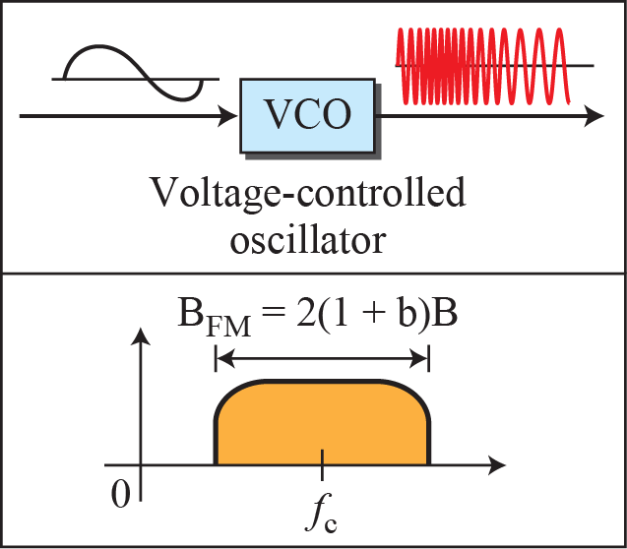
Figure 5.18: Frequency modulation

Slide 44
Figure 5.19: FM band allocation

Slide 45
5.2.3 Phase Modulation (PM)
In PM transmission, the phase of the carrier signal is modulated to follow the changing voltage level (amplitude) of the modulating signal. The peak amplitude and frequency of the carrier signal remain constant, but as the amplitude of the information signal changes, the phase of the carrier changes correspondingly.

Slide 46
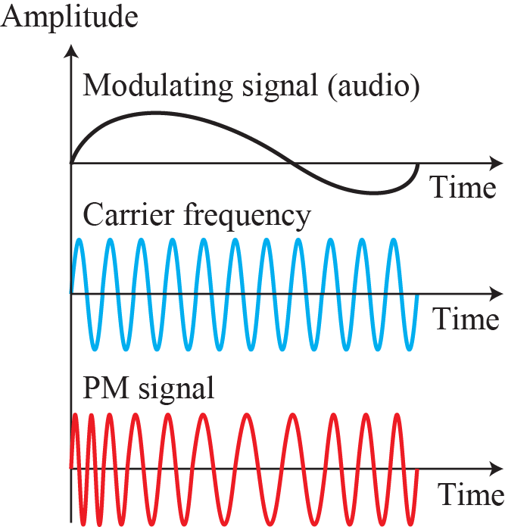
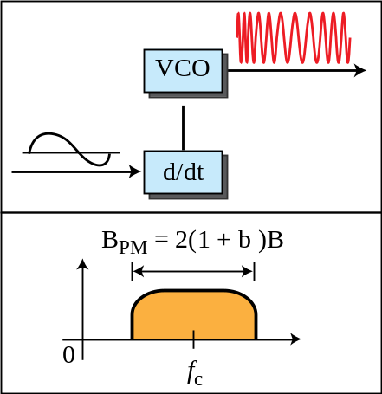
Figure 5.20: Phase modulation

