Slide 1
Section 9.2. : Broadcasting
유형식
2015020799

Slide 2
9.2. Broadcasting
Ethernet frame contains the source and destination MAC addresses (48-bit values). Normally, each IP packet is destined for a single host, so unicast addressing is used and the destination’s unique MAC address is determined using ARP or IPv6 ND.
broadcast
When a host wants to send a frame to every other
host on the network (or VLAN).
Broadcasting refers to sending a message to all possible receivers in a network.
A router simply forwards a copy of any message it receives out of every interface other than the one on which the message arrived.

Slide 3
9.2.1. Using Broadcast Addresses
A multicast MAC address has the low-order bit of the high-order byte turned on. - 01:00:00:00:00:00.
Ethernet broadcast - ff:ff:ff:ff:ff:ff
A special case of the Ethernet multicast address.
Subnet-directed broadcast address
network prefix | host portion of the address
limited broadcast address
ff.ff.ff.ff

Slide 4
9.2.1. Using Broadcast Addresses
Linux% ifconfig eth0
eth0 Link encap:Ethernet HWaddr 00:08:74:93:C8:3C
inet
addr:10.0.0.13 Bcast:10.0.0.127 Mask:255.255.255.128
Subnet-directed broadcast address
10.0.0.0/25 | 0x7F = 10.0.0.127

Slide 5
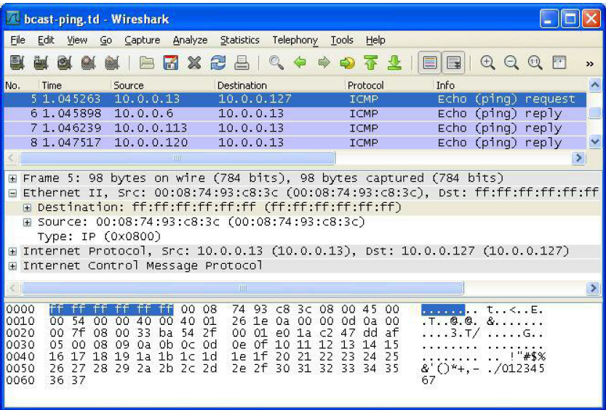
9.2.1. Using Broadcast Addresses
Linux# ping –b 10.0.0.127
WARNING: pinging broadcast address
PING 10.0.0.127 (10.0.0.127) 56(84) bytes of data.
64 bytes from 10.0.0.6: icmp_seq=1 ttl=64 time=1.05 ms
64 bytes from 10.0.0.113: icmp_seq=1 ttl=64 time=1.55 ms (DUP!)
64 bytes from 10.0.0.120: icmp_seq=1 ttl=64 time=3.09 ms (DUP!)

Slide 6
9.2.2. Sending Broadcast Datagrams
To determine which interfaces are used for broadcasting, the IPv4 forwarding table (called “routing table” here) is consulted.
IPv4 Route Table(netstat –rn)
===========================================================
Active Routes:
Network Destination Netmask Gateway Interface Metric
0.0.0.0 0.0.0.0 10.0.0.1 10.0.0.57 25
10.0.0.127 255.255.255.255 Onlink 10.0.0.57 281
127.255.255.255 255.255.255.255 Onlink 127.0.0.1 306
169.254.255.255 255.255.255.255 Onlink 169.254.57.240 286
255.255.255.255 255.255.255.255 Onlink 127.0.0.1 306
255.255.255.255 255.255.255.255 Onlink 169.254.57.240 286
255.255.255.255 255.255.255.255 Onlink 10.0.0.57 281
default route (mask 0.0.0.0)
It matches any destination. This could be used by broadcasts directed
beyond the local network. But not used.
The directed subnet broadcast addresses
The limited broadcast address, 255.255.255.255

