Slide 1
Chapter 1
The Internet, Protocols,
and the Layering Principle
Internet Protocol Textbook | Sections 1.1-1.7 | Pages 001-026

Slide 2
1.1 The Beginning of the Internet
1968-69
DARPAnet (later ARPAnet)
Funded by DARPA (Defense Advanced Research Projects Agency), a research funding org within the U.S. Department of Defense. Launched 1969, funded by DoD until 1990.
1984
NSFnet established
National Science Foundation builds a national backbone network connecting supercomputer centers.
1990
DARPAnet decommissioned
DARPA shuts down DARPAnet. NSFnet becomes the new Internet backbone.
1994
NSF contracts Baby Bells
NSF contracts with regional telephone companies (Baby Bells) to replace and manage the backbone network.
1995
Full commercialization
NSF fully transfers the backbone to Baby Bells for commercial operation. This marks the beginning of the Internet as we use it today.

Slide 3
1.2 The Internet: A Network of Networks
"Inter" = between, "Net" = network → "a network of networks"
The Incompatibility Problem
World has many incompatible network technologies: Ethernet, FDDI, ATM, Frame Relay, SNA, Bluetooth, wireless LAN, LTE
Like different languages that cannot communicate with each other
E.g., PC on Ethernet cannot talk to smartphone on LTE directly (neither understands the other's "language")
Without interconnection: only small-scale LANs possible; a global network would be impossible
Naive Solution: Pairwise translators
Place a translator between every pair of technologies
Cost: n(n-1)/2 translators. Each new technology requires ~n new translators
Growth is quadratic → highly unscalable
Better Solution: A single common language (IP)
Translate to/from one common language at each boundary
Cost: only n translators total; each new technology needs only 1 new translator
This common language = IP (Inter-networking Protocol), specifically designed to solve the interconnection problem

Slide 4
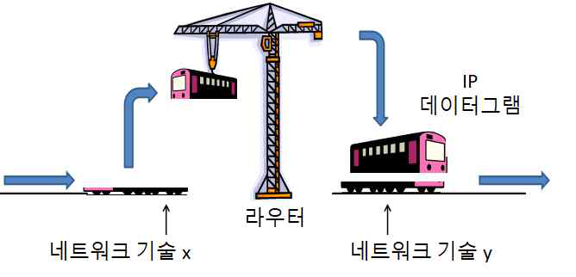
1.2 How IP Routers Work: The Trans-Siberian Railway Analogy
Router Operation
Incompatible technologies x and y → IP router at junction
Technology x carries IP data in its own frame → delivers to router
Router extracts IP data from x-frame → places into y-frame → transmits across y-link
At next router: IP data extracted from y-frame → placed into z-frame → one more step
This technology-switching repeats at every hop until destination
Figure 1-1. The Internet's method of overcoming incompatible technologies
Trans-Siberian Railway Analogy
Moscow → Mongolia → Beijing route
Russia/Mongolia: broad-gauge tracks. China: standard-gauge (different rail spacing)
At Mongolia-China border: special facility with 3 rails on floor (both gauges)
Carriages lifted by hydraulic cranes → broad-gauge wheel units removed → standard-gauge units slid beneath → carriages lowered
Border facility = IP router, broad-gauge = tech x, standard-gauge = tech y, carriage = IP datagram

Slide 5
1.2 Hop Count, Diameter, and Traceroute
C:\Users\User>tracert www.unipi.it
1 1ms <1ms <1ms 192.168.0.1
2 1ms 1ms 1ms 172.30.1.254
3 5ms * 6ms 125.143.149.126
4 9ms 11ms 9ms 61.78.43.71
5 7ms 4ms 5ms 112.189.0.93
6 * * * Request timed out.
7 6ms 6ms 8ms 112.174.48.10
8 22ms 22ms 16ms 112.174.85.154
9 135ms 134ms 134ms 112.174.87.18
10 150ms 133ms 134ms ...lax05 [38.104.85.145]
... ..... ..... ..... ...............................
22 302ms 304ms 302ms ...rom01 [154.54.57.65]
24 306ms 312ms 307ms ...pi1.garr.net
26 306ms 305ms 306ms wwwnew2.unipi.it [131.114.21.42]
Key Concepts
Hop: Each router-to-router step = 1 hop
~30 hops max: Even the farthest destination can be reached within approximately 30 routers
Diameter: The maximum hop count on the Internet. As connections are added, diameter shrinks (like adding a new subway line bringing distant destinations closer)
Korea → Pisa breakdown:
26 hops total
8 hops to exit Korea
Cross Pacific → San Jose, San Francisco, Salt Lake City, Denver, Kansas City, Chicago, Cleveland, New York
Cross Atlantic → Marseille, Genoa, Rome
6 hops within Europe, 2 to reach Univ. of Pisa
Hop 10 = LA, Hop 22 = Rome
Figure 1-2. Internet path from Korea to the University of Pisa

Slide 6
1.2 Encapsulation and "IP Runs on Everything"
What interoperating with IP requires
At minimum: the network technology's frame must indicate whether IP data is in its payload
Example: Ethernet marks type field = 0x0800 to indicate IP data inside
Necessary so routers/computers can extract IP datagram and deliver to IP (not some other protocol)
IP is NOT the only "customer" in a frame's payload (analogy: public transit carries all passengers, not just IP)
Frame header must express what's inside → this is encapsulation
"IP runs on everything"
As long as a technology supports encapsulation, ANY information delivery technology can interoperate with IP
IP demands almost nothing from the underlying network technology
This extreme inclusiveness enabled IP to accommodate all heterogeneous technologies into a worldwide network
RFC 1149: "IP over Avian Carriers" (April Fool's 1990)
Published by D. Waitzman of BBN as a joke
April 2001: Bergen Linux User Group actually tested it: 9 pigeons, each carrying one ping packet over ~5 km (written on paper attached to feet)
Received 4 "responses" within 2 hours
A romantic joke illustrating IP's most important property: it truly runs on anything
Note: RFCs archive informational, experimental, and standard-track documents. As of end 2018, RFC 8521+. Waitzman's RFC = experimental.

Slide 7
1.3 Protocol: Definition and Three Aspects
Protocol = A "strictly agreed-upon language" between two or more "parties" (computers/software) cooperating to achieve a specific objective. Unlike human language, protocols have rigid, unambiguous structure because computers cannot tolerate mistakes or ambiguity.
Three required aspects:
1. Message Format (= grammar)
If format is broken, computers cannot understand (analogy: "help-may-what-I-you?")
Defines exact structure of each message
In IP, messages = datagrams; format shown in Figure 1-3
All messages are ultimately bit sequences; presented in aligned 4-byte units in textbook
2. Message Exchange Sequence (= correct ordering)
Even if each message is well-formed, wrong ordering breaks communication
E.g., employee says "What may I help you with?" AFTER customer already asked "Where is the milk?"
Protocol precisely defines acceptable sequences of exchange
3. Local Action (= what happens when message arrives)
Receiver performs some action (e.g., employee points to milk shelf)
Protocol must precisely define what action to perform for each received message
This is the ultimate purpose of every protocol

Slide 8
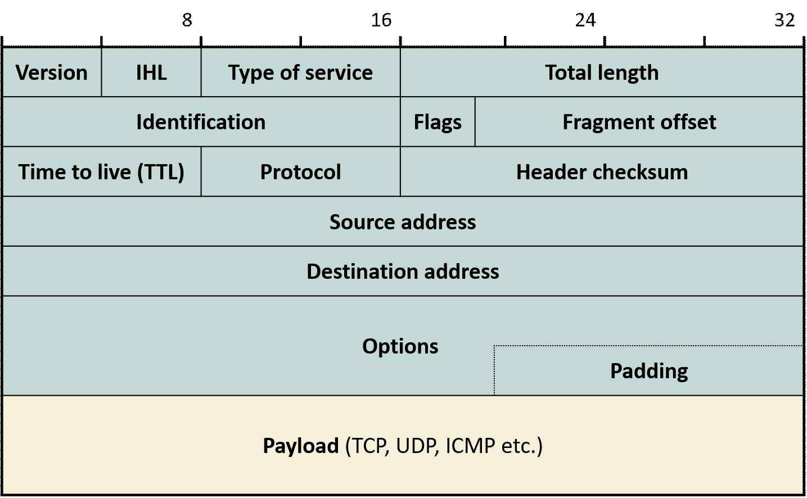
1.3 IP Datagram Format (Figure 1-3) - All Fields
All Header Fields:
Version: IPv4 (4) or IPv6 (6)
IHL: Internet Header Length (header size in 4-byte words)
Type of Service: QoS/priority bits (DSCP + ECN)
Total Length: Entire datagram size in bytes (header+payload)
Identification: Unique ID for reassembling fragmented datagrams
Flags: Fragmentation control (DF=Don't Fragment, MF=More Fragments)
Fragment Offset: Position of this fragment within original datagram
TTL: Decremented at each hop; prevents infinite routing loops
Protocol: Identifies upper layer (6=TCP, 17=UDP, 1=ICMP) for demux
Header Checksum: Error detection for header integrity
Source Address: 32-bit IP address of sender
Destination Address: 32-bit IP address of receiver
Options + Padding: Variable-length optional fields; pad to 4-byte boundary
Payload: Upper-layer data (TCP, UDP, ICMP, etc.)
Figure 1-3. IP Datagram Format (aligned 4-byte units)

Slide 9
1.3 TCP/IP Protocol Suite & IETF Standardization
TCP/IP Protocol Suite
Standard Track:
Many protocols that assist or utilize IP → collectively called TCP/IP protocol suite (or Internet protocol suite)
Why "TCP" in the name? TCP is the most widely used protocol after IP (web, email, FTP all use TCP). Two flagship representatives.
Suite continues to expand as Internet adds new applications and architecture grows more complex
IETF & RFC Standardization
Working Group drafts spec through multiple meetings
Referred to IESG (Internet Engineering Steering Group) for approval
→ Proposed Standard (enters standard track, auto-archived as RFC)
→ Draft Standard (2+ independent implementations, no interop problems)
→ Standard (final status)
Example: IPv4 = Standard, specified in RFC 791. Fifth protocol to achieve Standard status on the Internet.
All Internet protocols defined by IETF (Internet Engineering Task Force)
Standards permanently archived as RFCs
IETF meets 3x/year, forming working groups as needed
Working groups disband when work is complete

Slide 10
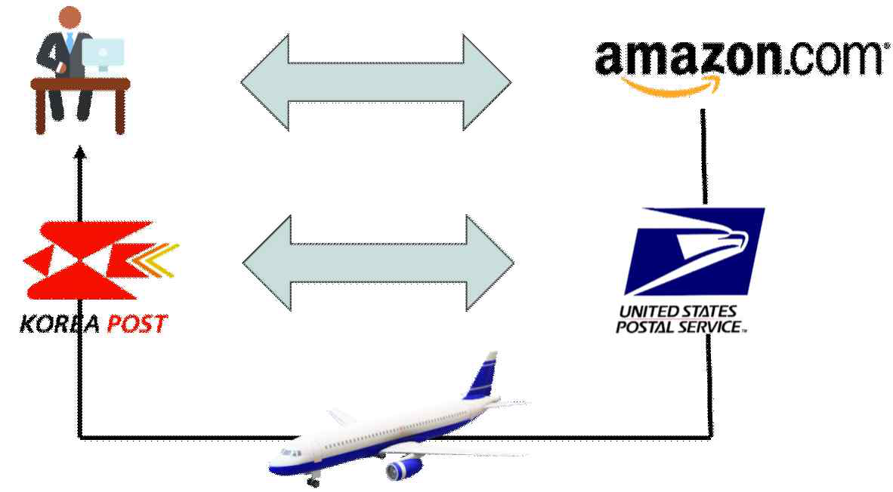
1.4 The Layering Principle: Real-Life Example
Amazon Book Ordering Example
Someone orders a book from Amazon US.
Amazon doesn't deliver directly. Retrieves book from warehouse, packages it
Hands to postal service (USPS). USPS didn't fly to Korea either.
USPS contracted an airline to carry across Pacific
Book arrives at Korean postal service → delivered to customer
Each entity interacts only with its immediate counterpart
Figure 1-4. The layering principle in everyday life
Key Insight from Figure 1-4
The person interacts with only two counterparts: (1) Amazon ("protocol" for selecting & paying), (2) postal service (receive the book)
NO interaction whatsoever with USPS or the airline
Why layering must exist: impossible for one entity to do everything (stock books, warehouse, take orders, truck to airport, fly across Pacific, truck again, deliver)
Tasks must be divided into layers, each with a specific role

Slide 11
1.4 Layers, Recursive Relation, and the Protocol Stack
Layers and Indirect Communication
No single piece of software handles all communication; multiple protocols work at different "levels" (layers)
Same-layer peers exchange data using the same protocol, but NOT directly
They use services from the layer immediately below (Amazon works with you, but postal service carries the book)
Analogy: calling a friend, Korean is the "protocol," but the telephone service is the layer below
Recursive Relation → Protocol Stack
Each layer communicates with its counterpart using an indirect method through the layer below
That lower layer similarly relies on services from yet another layer below
This recursive stacking = a "stack" (protocols stacked on top of one another)
OSI 7-Layer Model vs. Internet 5-Layer Model
OSI 7-layer model was actually implemented; competed fiercely with TCP/IP through late 1980s
By mid-1990s, TCP/IP won; OSI became history in textbooks
OSI's clear conceptual structure remains useful for learning
Layer 3 formally = "inter-network" layer (bridging different data link technologies); shortened to "network layer"
Do NOT confuse with data link layer's "network" technologies (Ethernet, Wi-Fi)
This book: Layer 3 = network layer, Layer 2 technologies = data link technologies

Slide 12
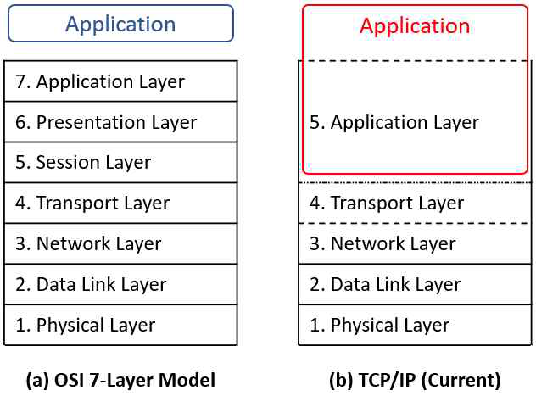
1.4 OSI 7-Layer vs. Internet 5-Layer Model (Figure 1-5)
# | Layer | Key Role
5 | Application | End-user protocols (HTTP, SMTP, FTP, DNS). Implemented in user-space apps, not kernel.
4 | Transport | Process-to-process delivery (TCP, UDP). Uses port numbers. IPC.
3 | Network | Host-to-host routing across networks. Only ONE protocol: IP. Hourglass.
2 | Data Link | One-hop frame delivery (Ethernet, Wi-Fi, PPP). MAC addressing. Framing.
1 | Physical | Raw bit transmission over physical medium (copper, fiber, radio, water).
Figure 1-5. OSI vs. Internet protocol stack
OSI adds: Session layer (manages sessions/dialogues) and Presentation layer (data format conversion, encryption) between Transport and Application. Both subsumed into the Application layer in the Internet model.
In both models, layer 3 = network layer. Both models agree on layers 1-4. The difference is OSI's extra layers 5-6.

Slide 13
1.4 Physical Layer & Data Link Layer (Detailed)
Physical Layer
Carries bits across diverse physical media while coping with their varying characteristics
Media types: empty space (wireless), copper wire (Ethernet/telephony), optical fiber, water (underwater)
Signal representation differs per medium: light wavelengths (optical), voltage changes (copper)
Goal: reliably represent 0 and 1 on the given medium
Foundation: upper layers assume physical layer can reliably deliver binary info ("no 2nd floor without a 1st floor")
Data Link Layer (Link Layer)
Connects only two adjacent machines (computers/routers) joined by a single link. Cannot deliver globally. After one link, frame is disassembled, IP datagram re-encapsulated into next link's technology (Trans-Siberian Railway). From the data link layer's perspective, whether it carries IP or another protocol's packet, it is simply a bundle of bits. Loads bits into a transmission unit called a frame. Reason: efficient management, like sending students on a field trip by bus rather than individually.
Four main functions:
Error Control: if a frame has errors, retransmit or correct without retransmission
Flow Control: sender must match receiver's speed. Incoming frames queued in buffer; if buffer overflows, frames lost. Sender adjusts rate to prevent overflow.
Medium Access Control (MAC): in shared-medium technologies (Wi-Fi, Ethernet), decides which device may use the medium at any given moment
Framing: composing bits into frames
Key insight: The network layer (IP) needs to know very little about data link details. Like the book buyer not needing to know how the postal system works. This enables IP to accommodate diverse data link technologies easily. If IP had to know every detail, building the Internet would have been extremely difficult.

Slide 14
1.4 Network Layer (IP) - Detailed
Only ONE protocol at the network layer: IP
Hourglass design: every path up/down the protocol stack passes through IP (narrow waist). Other layers have multiple protocols; network layer has exactly one.
1. Bridging heterogeneous data link technologies
Overcoming incompatibility between different link technologies (IP's most important job)
Once interconnected network ("Internet") is formed → connectivity from any computer to any other = global connectivity
2. Routing (pathfinding)
When a frame carrying an IP datagram arrives at a router, router extracts IP datagram
Examines destination IP address in datagram header to determine which next link to use
Constructs a frame per that link's data link technology, loads IP datagram, sends out
Routing is NOT IP's job but separate routing protocols that assist IP
Computed routes stored in a routing table; IP consults it by matching destination address → correct next hop
Routers typically have many links (like 3-way, 4-way intersections; some have dozens of links)
Analogy: network layer = building a road network and posting road signs at every junction

Slide 15
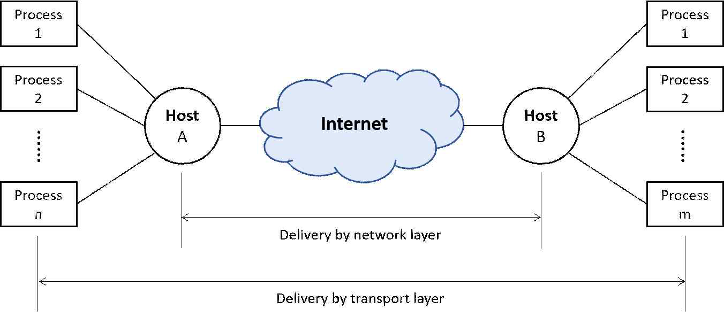
1.4 Transport Layer & Application Layer
Transport Layer
Delivery scope: process ↔ process
Once network layer provides computer-to-computer connectivity, transport layer provides process-to-process delivery
Amazon analogy: airline delivers to Incheon airport (= network layer). Postal service delivers to the actual person (= transport layer).
Applications: web browser, online game, messenger, Twitter, YouTube
Technical term: Inter-Process Communication (IPC). TCP/IP suite = one method for IPC.
Figure 1-6. Network layer vs. transport layer delivery scope
Application Layer
Application protocols ≠ applications (Korean the language ≠ Koreans the people)
Languages for exchanging app messages between processes (e.g., HTTP for web pages + metadata)
HTTP entrusts delivery to TCP (like Amazon handing package to USPS); cares nothing about how transport delivers
Each layer focuses exclusively on its duties, uses layer below for the rest
Modular design: modify each layer independently without affecting others (keep interfaces same)

Slide 16
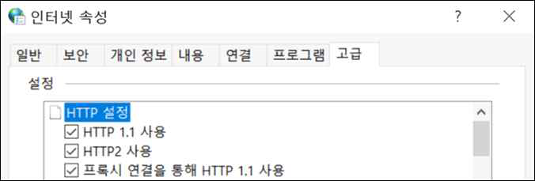
1.4 Where Protocol Layers Live in the Computer
OS Kernel
The core of the operating system (Windows, Linux). "Kernel" = the hard pit at the center of a fruit (like a peach). Various utility programs attach around it.
Protocol layer placement:
Figure 1-7. HTTP settings in browser (HTTP is part of the app)
Transport layer down to upper half of data link layer → inside the kernel
Application layer protocols → implemented inside the application program (user-space). Developer must implement. E.g., HTTP is inside the browser/web server (Figure 1-7: HTTP settings changeable in browser = proof HTTP is part of the app)
Socket: the most common interface for communication between application programs and the kernel
Lower data link layer + physical layer → implemented in hardware (Ethernet cards, NIC chips). Physical + lower data link operations are computationally intensive; software (kernel) would be too slow.
Device drivers: kernel communicates with hardware through device driver software within the OS. (Like installing a printer driver when adding a new printer. Communication hardware is the same.)

Slide 17
1.5 Encapsulation: Headers, SDU, and PDU
Header
Before handing data down to the layer below, each layer attaches a header ("header," not "head"). In IP datagram (Figure 1-3), everything except the payload is the header.
What's in a header? All information needed for payload delivery. Like an envelope: stamp (proof of payment), destination address (for delivery), sender's address (for return). Information varies by layer and can be very diverse.
Example sizes: UDP header = only 8 bytes. HTTP header = can exceed several hundred bytes.
SDU (Service Data Unit): Data received from the upper layer, before header attachment.
PDU (Protocol Data Unit): Data with header attached (after "packaging"). PDU = Header + SDU. Each layer has its own SDU and PDU.
Encapsulation = the act of attaching a header. Similar to placing a letter in an envelope.
Destination address differs by layer:
Network layer (IP): destination = destination computer's IP address
Transport layer: destination = port number (kernel uses port to find the correct application process on receiving side)
Data link layer: destination = device one link away. Some technologies need addresses (MAC address), others don't.

Slide 18
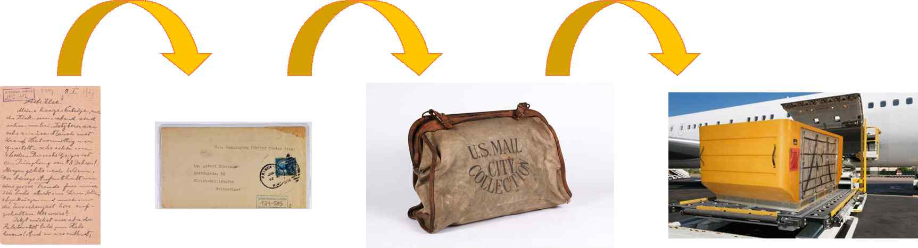
1.5 Repeated Encapsulation Through the Stack
Encapsulation occurs repeatedly as data descends:
App data (e.g., web page) → application layer protocol attaches app header (e.g., HTTP) → ASDU becomes APDU
Passed to transport layer → TCP attaches transport header to TSDU → forms TPDU (= TCP segment)
Passed to network layer → IP attaches network header to NSDU → forms NPDU (= IP datagram)
Passed to data link layer → header AND trailer appended (trailer = link layer feature for error checking) → forms MPDU (= Ethernet frame)
Passed to physical layer → preamble prepended → physical PDU → transmission across network begins
Figure 1-8. Repeated encapsulation (overseas mail: letter → envelope → mail pouch → air freight container)
Mail analogy: Sending letter to friend in Vancouver. Letter → placed in envelope → given to post office. Post office places letters for Canada → into a mail pouch. Airline places mail pouches → into air freight container. Like a matryoshka doll: packaging on top of packaging. The successive layering of headers across the protocol stack is not strange at all.

Slide 19
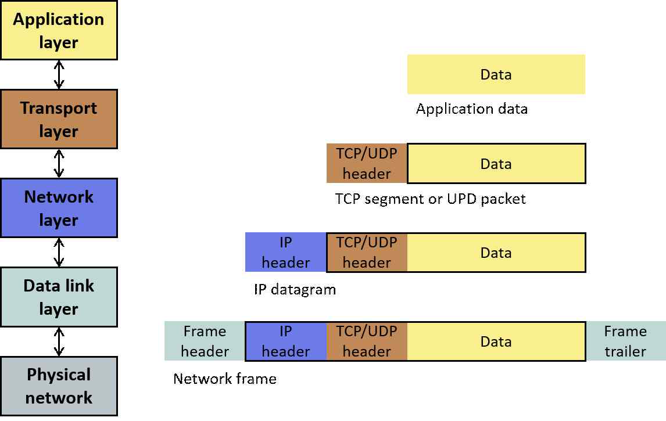
1.5 Decapsulation (Reverse Process)
Vancouver Airport Example
Air freight container opened (removed) - airplane's scope ended at that airport
Postal worker takes mail pouches to post office
Pouches opened, letters retrieved - pouch needed only up to post office
Mail carriers deliver letters, envelope torn open → friend reads letter
Key: each packaging layer removed once its delivery segment ends
Protocol Decapsulation
Figure 1-9. Encapsulation at each layer
Data link header: stripped after crossing one link (like wheel units removed on Trans-Siberian Railway). New header attached for next link. If 30 hops, this removal/reattachment occurs 30 times.
IP header: NOT removed while traversing Internet interior. Removed only at destination computer (network layer scope = source to destination).
Transport header: removed after delivery to correct process. Application message extracted.
Application header: removed, pure application data delivered to the application.
This successive stripping = decapsulation. Figure 1-9 shows headers added going down, stripped going up.

Slide 20
1.5 Multiplexing and Demultiplexing
The Hourglass Problem
IP is the ONLY network layer protocol → every path passes through IP. But other layers have MULTIPLE protocols. During decapsulation, how does the receiver know which upper-layer protocol to deliver to?
Answer: identifier fields in headers
Example: Transport layer has TCP, UDP, SCTP. When IP datagram is decapsulated, which transport protocol gets the payload? The sending side's TCP wrote "TCP" in the IP header's Protocol field. Receiving IP reads this field and hands payload to TCP (not UDP or SCTP). The payload itself does NOT say who sent it.
Layer | Mux/Demux Field | How It Works
Data Link | Ethertype | Ethernet frames have Ethertype field. If IP filled payload, IP writes its identity. Driver checks Ethertype → delivers to IP (not ARP, etc.)
Network (IP) | Protocol field | Values: 6=TCP, 17=UDP, 1=ICMP. Sending TCP writes 6; receiving IP reads it → delivers to TCP, not UDP.
Transport | Port number | Determines which application process receives the payload. E.g., 80=HTTP, 443=HTTPS, 25=SMTP.
Multiplexing: lower layer delivering various upper-layer protocols (like a taxi carrying different passengers). Occurs on sending side.
Demultiplexing: inverse on receiving side. Reading identifier field to route payload to correct upper-layer entity.

Slide 21
1.6 Classification (1): Duplex vs. Simplex
Three criteria for classifying communication technologies/protocols (beyond layers).
1.6.1 Directionality
Simplex
Information flows in only one direction at all times
Example: broadcast television. Road analogy: one-way street
Debatable whether it truly qualifies as "communication"
Full-Duplex
Data flows in both directions simultaneously; no restriction that one direction prevents the other
Road analogy: most roads with lanes in both directions
Internet protocols at Layer 3 and above are full-duplex
Half-Duplex
Data flows in both directions, but NOT simultaneously
Road analogy: construction blocks one lane; flaggers alternate direction
Classic example: walkie-talkies (one speaks at a time, says "over" or "roger" to hand channel)
Many technologies use half-duplex, including Ethernet

Slide 22
1.6 Classification (2): Connection-Oriented vs. Connectionless
1.6.2 Whether a "connection" is needed
Connectionless: IP, UDP
Send data immediately without any prior connection
No state management, no bookkeeping overhead
Connection-oriented: TCP
Connection must be established before data exchange is possible
Tracks and manages: packet loss, reordering, resource consumption
Requires bookkeeping: define connection identifier, remember and manage state of data transmission
What is a "connection"?
No precise universal definition
Early telephony: actual electrical circuit connected
Now: complex logical protocols layered on physical entities; each protocol defines "connection" differently
Which is better? Wrong question.
Connection-oriented does more work, but is NOT always superior
Choice depends on application requirements and task nature
Example: IPTV applications CANNOT use TCP at all

Slide 23
1.6 Classification (3): Packet Switching vs. Circuit Switching
1.6.3 How switching is realized
The Problem: Shared resources are unavoidable
Dedicated resources between every pair of nodes is impossible (10 phones → n(n-1)/2 = 45 circuits; growth ∝ n^2)
Solution: sharing via switching (intersections + traffic lights / telephone exchanges)
Circuit Switching (analog era)
Circuits physically connected; voice sent as continuous stream
Stopping the flow was impossible → shared resources by switching circuits between connections
Old films: telephone operators plugging in phone lines at switchboards to create circuits
Packet Switching (digital era, used by the Internet)
Digital technology enables: digitize, process, store information → cut data into pieces called packets
Resources shared on a per-packet basis (much more flexible than circuit switching)
At a router: packets arrive → transmitted using router's resources according to processing order
"Packet" naming by layer
"Packet" = British-origin generic term for a small unit of split data
Data link layer: frame
Network layer (IP): datagram
Transport layer: TCP → segment, UDP → datagram
All may be called "packets" but each has slightly different packaging

Slide 24
1.7 Exercises
1
Use the tracert command in Windows to determine how many links are traversed to reach www.unza.zm (the web server of the University of Zambia in Africa). On Linux, use the traceroute command.
2
The Session Description Protocol (SDP), one of the protocols used for Internet telephony, is defined in RFC 4566. Which of the three elements of a protocol does SDP lack?
3
From the perspective of the OSI 7-layer model, what are practical examples of the session layer and presentation layer?
End of Chapter 1

