Slide 1
Ad hoc and Sensor Networks
Chapter 5: Medium access control protocols
Holger Karl

Slide 2
Goals of this chapter
Controlling when to send a packet and when to listen for a packet are perhaps the two most important operations in a wireless network
  Especially, idly waiting wastes huge amounts of energy
This chapter discusses schemes for this medium access control that are
  Suitable to mobile and wireless networks
  Emphasize energy-efficient operation

Slide 3
Overview
Principal options and difficulties
Contention-based protocols
Schedule-based protocols
IEEE 802.15.4

Slide 4
Principal options and difficulties
Medium access in wireless networks is difficult mainly because of
  Impossible (or very difficult) to sende and receive at the same time
  Interference situation at receiver is what counts for transmission success, but can be very different from what sender can observe
  High error rates (for signaling packets) compound the issues
Requirement
  As usual: high throughput, low overhead, low error rates, …
  Additionally: energy-efficient, handle switched off devices!

Slide 5
Requirements for energy-efficient MAC protocols
Recall
  Transmissions are costly
  Receiving about as expensive as transmitting
  Idling can be cheaper but is still expensive
Energy problems
  Collisions – wasted effort when two packets collide
  Overhearing – waste effort in receiving a packet destined for another node
  Idle listening – sitting idly and trying to receive when nobody is sending
  Protocol overhead
Always nice: Low complexity solution

Slide 6
Main options
Wireless medium access
Centralized
Distributed
Schedule-
based
Contention-
based
Schedule-
based
Contention-
based
Fixed
assignment
Demand
assignment
Fixed
assignment
Demand
assignment

Slide 7
Centralized medium access
Idea: Have a central station control when a node may access the medium
  Example: Polling, centralized computation of TDMA schedules
  Advantage: Simple, quite efficient (e.g., no collisions), burdens the central station
Not directly feasible for non-trivial wireless network sizes
But: Can be quite useful when network is somehow divided into smaller groups
  Clusters, in each cluster medium access can be controlled centrally – compare Bluetooth piconets, for example
! Usually, distributed medium access is considered

Slide 8
Schedule- vs. contention-based MACs
Schedule-based MAC
  A schedule exists, regulating which participant may use which resource at which time (TDMA component)
  Typical resource: frequency band in a given physical space (with a given code, CDMA)
  Schedule can be fixed or computed on demand
    Usually: mixed – difference fixed/on demand is one of time scales
  Usually, collisions, overhearing, idle listening no issues
  Needed: time synchronization!
Contention-based protocols
  Risk of colliding packets is deliberately taken
  Hope: coordination overhead can be saved, resulting in overall improved efficiency
  Mechanisms to handle/reduce probability/impact of collisions required
  Usually, randomization used somehow

Slide 9
Overview
Principal options and difficulties
Contention-based protocols
  MACA
  S-MAC, T-MAC
  Preamble sampling, B-MAC
  PAMAS
Schedule-based protocols
IEEE 802.15.4

Slide 10
Distributed, contention-based MAC
Basic ideas for a distributed MAC
  ALOHA – no good in most cases
  Listen before talk (Carrier Sense Multiple Access, CSMA) – better, but suffers from sender not knowing what is going on at receiver, might destroy packets despite first listening for a
! Receiver additionally needs some possibility to inform possible senders in its vicinity about impending transmission (to “shut them up” for this duration)
Hidden terminal scenario:
Also: recall exposed terminal scenario
A
B
C
D

Slide 11
Main options to shut up senders
Receiver informs potential interferers while a reception is on-going
  By sending out a signal indicating just that
  Problem: Cannot use same channel on which actual reception takes place
  ! Use separate channel for signaling
  Busy tone protocol
Receiver informs potential interferers before a reception is on-going
  Can use same channel
  Receiver itself needs to be informed, by sender, about impending transmission
  Potential interferers need to be aware of such information, need to store it

Slide 12
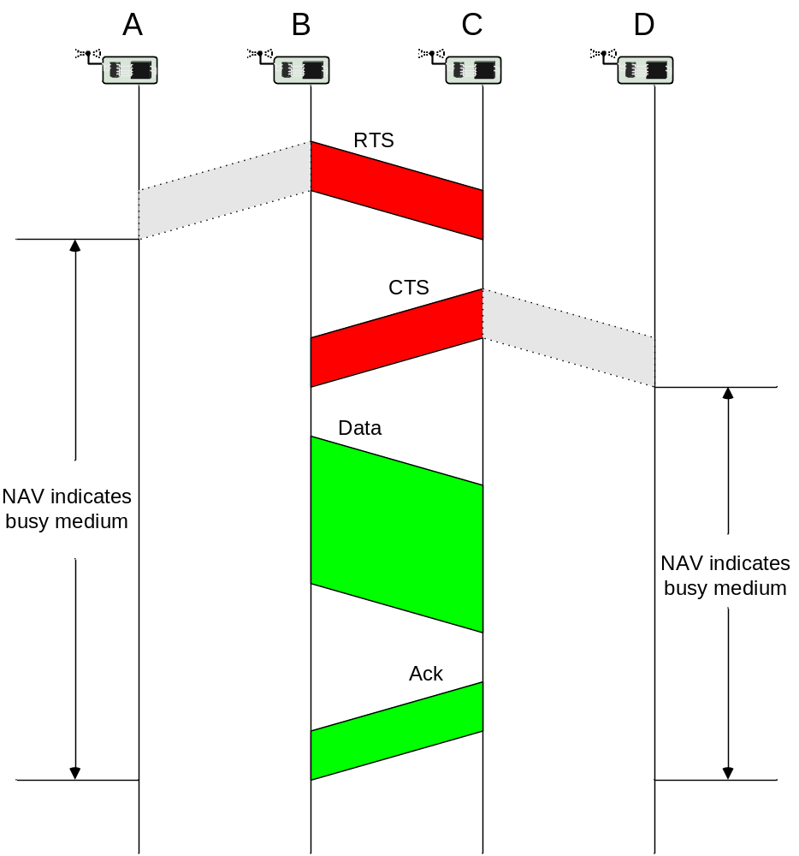
Receiver informs interferers before transmission – MACA
Sender B asks receiver C whether C is able to receive a transmission
Request to Send (RTS)
Receiver C agrees, sends out a Clear to Send (CTS)
Potential interferers overhear either RTS or CTS and know about impending transmission and for how long it will last
  Store this information in a Network Allocation Vector
B sends, C acks
! MACA protocol (used e.g. in IEEE 802.11)

Slide 13
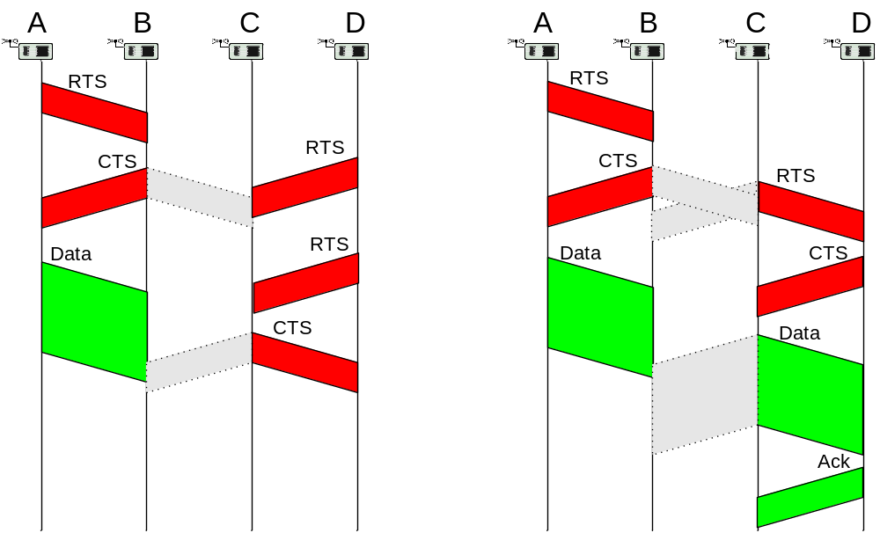
RTS/CTS
RTS/CTS ameliorate, but do not solve hidden/exposed terminal problems
Example problem cases:

Slide 14
MACA Problem: Idle listening
Need to sense carrier for RTS or CTS packets
  In some form shared by many CSMA variants; but e.g. not by busy tones
  Simple sleeping will break the protocol
IEEE 802.11 solution: ATIM windows & sleeping
  Basic idea: Nodes that have data buffered for receivers send traffic indicators at pre-arranged points in time
  Receivers need to wake up at these points, but can sleep otherwise
Parameters to adjust in MACA
  Random delays – how long to wait between listen/transmission attempts?
  Number of RTS/CTS/ACK re-trials?
  …

Slide 15
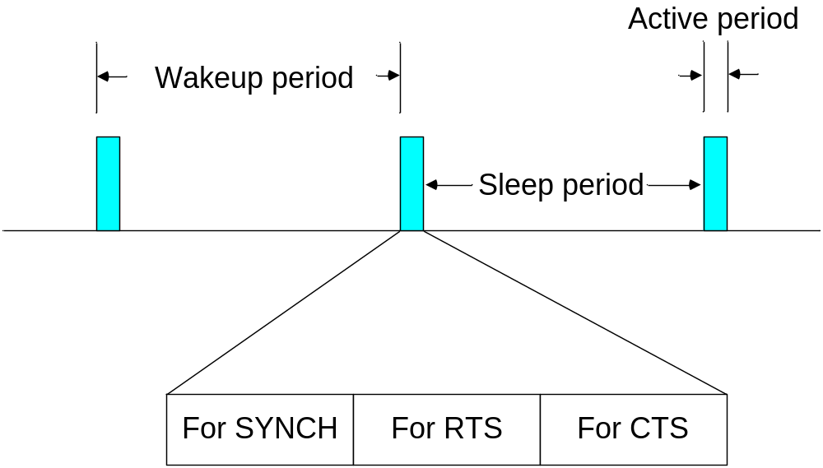
Sensor-MAC (S-MAC)
MACA’s idle listening is particularly unsuitable if average data rate is low
  Most of the time, nothing happens
Idea: Switch nodes off, ensure that neighboring nodes turn on simultaneously to allow packet exchange (rendez-vous)
  Only in these active periods, packet exchanges happen
  Need to also exchange wakeup schedule between neighbors
  When awake, essentially perform RTS/CTS
Use SYNCH, RTS, CTS phases

Slide 16
S-MAC synchronized islands
Nodes try to pick up schedule synchronization from neighboring nodes
If no neighbor found, nodes pick some schedule to start with
If additional nodes join, some node might learn about two different schedules from different nodes
  “Synchronized islands”
To bridge this gap, it has to follow both schemes
A
A
B
A
A
A
A
E
B
B
B
B
C
E
E
E
E
E
E
C
D
C
C
C
D
D
D
Time

Slide 17
Timeout-MAC (T-MAC)
In S-MAC, active period is of constant length
What if no traffic actually happens?
  Nodes stay awake needlessly long
Idea: Prematurely go back to sleep mode when no traffic has happened for a certain time (=timeout) ! T-MAC
  Adaptive duty cycle!
One ensuing problem: Early sleeping
  C wants to send to D, but is hindered by transmission A! B
  Two solutions exist – homework!
A
B
C
D
RTS
CTS
May not
send
DATA
ACK
Timeout,
go back to
sleep as
nothing
happened
RTS
Notes:
Solutions to early sleeping as homework?

Slide 18
Preamble Sampling
So far: Periodic sleeping supported by some means to synchronize wake up of nodes to ensure rendez-vous between sender and receiver
Alternative option: Don’t try to explicitly synchronize nodes
  Have receiver sleep and only periodically sample the channel
Use long preambles to ensure that receiver stays awake to catch actual packet
  Example: WiseMAC
Start transmission:
Long preamble
Actual packet
Check
channel
Check
channel
Check
channel
Check
channel
Stay awake!
Notes:
Das gibt eine SEHR schöne Übungsaufgabe!

Slide 19
B-MAC
Combines several of the above discussed ideas
  Takes care to provide practically relevant solutions
Clear Channel Assessment
  Adapts to noise floor by sampling channel when it is assumed to be free
  Samples are exponentially averaged, result used in gain control
  For actual assessment when sending a packet, look at five channel samples – channel is free if even a single one of them is significantly below noise
  Optional: random backoff if channel is found busy
Optional: Immediate link layer acknowledgements for received packets

Slide 20
B-MAC II
Low Power Listening (= preamble sampling)
  Uses the clear channel assessment techniques to decide whether there is a packet arriving when node wakes up
  Timeout puts node back to sleep if no packet arrived
B-MAC does not have
  Synchronization
  RTS/CTS
  Results in simpler, leaner implementation
  Clean and simple interface
Currently: Often considered as the default WSN MAC protocol

Slide 21
Power Aware Multiaccess with Signaling – PAMAS
Idea: combine busy tone with RTS/CTS
  Results in detailed overhearing avoidance, does not address idle listening
  Uses separate data and control channels
Procedure
  Node A transmits RTS on control channel, does not sense channel
  Node B receives RTS, sends CTS on control channel if it can receive and does not know about ongoing transmissions
  B sends busy tone as it starts to receive data
Control
channel
RTS
A ! B
CTS
B ! A
Busy tone
sent by B
Time
Data
channel
Data
A ! B

Slide 22
PAMAS – Already ongoing transmission
Suppose a node C in vicinity of A is already receiving a packet when A initiates RTS
Procedure
  A sends RTS to B
  C is sending busy tone (as it receives data)
  CTS and busy tone collide, A receives no CTS, does not send data
?
B
C
A
Similarly: Ongoing transmission near B destroys RTS by busy tone
Busy tone by C
Control
channel
RTS
A ! B
CTS
B ! A
Time
Data
channel
No data!
Notes:
Probing protocol of PAMAS as exercise?

Slide 23
Overview
Principal options and difficulties
Contention-based protocols
Schedule-based protocols
  LEACH
  SMACS
  TRAMA
IEEE 802.15.4

Slide 24
Low-Energy Adaptive Clustering Hierarchy (LEACH)
Given: dense network of nodes, reporting to a central sink, each node can reach sink directly
Idea: Group nodes into “clusters”, controlled by clusterhead
  Setup phase; details: later
  About 5% of nodes become clusterhead (depends on scenario)
  Role of clusterhead is rotated to share the burden
  Clusterheads advertise themselves, ordinary nodes join CH with strongest signal
  Clusterheads organize
    CDMA code for all member transmissions
    TDMA schedule to be used within a cluster
In steady state operation
  CHs collect & aggregate data from all cluster members
  Report aggregated data to sink using CDMA

Slide 25
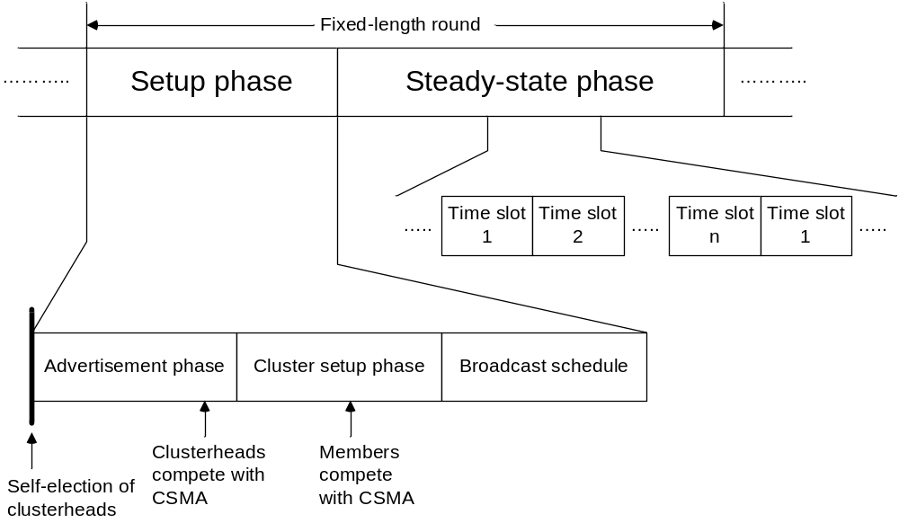
LEACH rounds

Slide 26
SMACS
Given: many radio channels, superframes of known length (not necessarily in phase, but still time synchronization required!)
Goal: set up directional links between neighboring nodes
  Link: radio channel + time slot at both sender and receiver
  Free of collisions at receiver
  Channel picked randomly, slot is searched greedily until a collision-free slot is found
Receivers sleep and only wake up in their assigned time slots, once per superframe
In effect: a local construction of a schedule

Slide 27
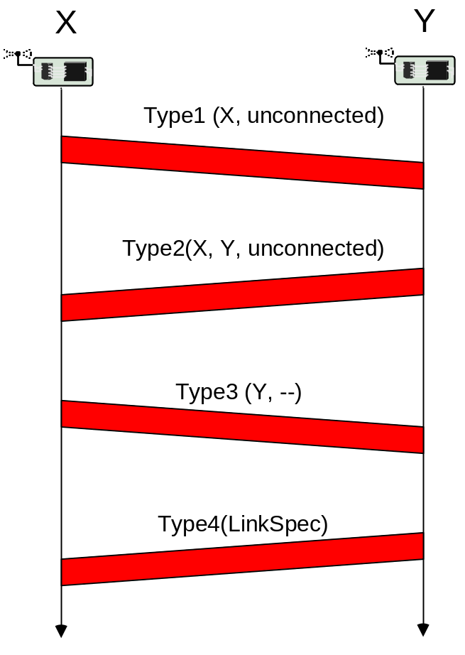
SMACS link setup
Case 1: Node X, Y both so far unconnected
  Node X sends invitation message
  Node Y answers, telling X that is unconnected to any other node
  Node X tells Y to pick slot/frequency for the link
  Node Y sends back the link specification
Case 2: X has some neighbors, Y not
  Node X will construct link specification and instruct Y to use it (since Y is unattached)
Case 3: X no neighbors, Y has some
  Y picks link specification
Case 4: both nodes already have links
  Nodes exchange their schedules and pick free slots/frequencies in mutual agreement
Message exchanges protected by randomized backoff

Slide 28
TRAMA
Nodes are synchronized
Time divided into cycles, divided into
  Random access periods
  Scheduled access periods
Nodes exchange neighborhood information
  Learning about their two-hop neighborhood
  Using neighborhood exchange protocol: In random access period, send small, incremental neighborhood update information in randomly selected time slots
Nodes exchange schedules
  Using schedule exchange protocol
  Similar to neighborhood exchange

Slide 29
TRAMA – adaptive election
Given: Each node knows its two-hop neighborhood and their current schedules
How to decide which slot (in scheduled access period) a node can use?
  Use node identifier x and globally known hash function h
  For time slot t, compute priority p = h (x © t)
  Compute this priority for next k time slots for node itself and all two-hop neighbors
  Node uses those time slots for which it has the highest priority
Priorities of node A and its two neighbors B & C
 | t = 0 | t = 1 | t = 2 | t=3 | t = 4 | t = 5
A | 14 | 23 | 9 | 56 | 3 | 26
B | 33 | 64 | 8 | 12 | 44 | 6
C | 53 | 18 | 6 | 33 | 57 | 2

Slide 30
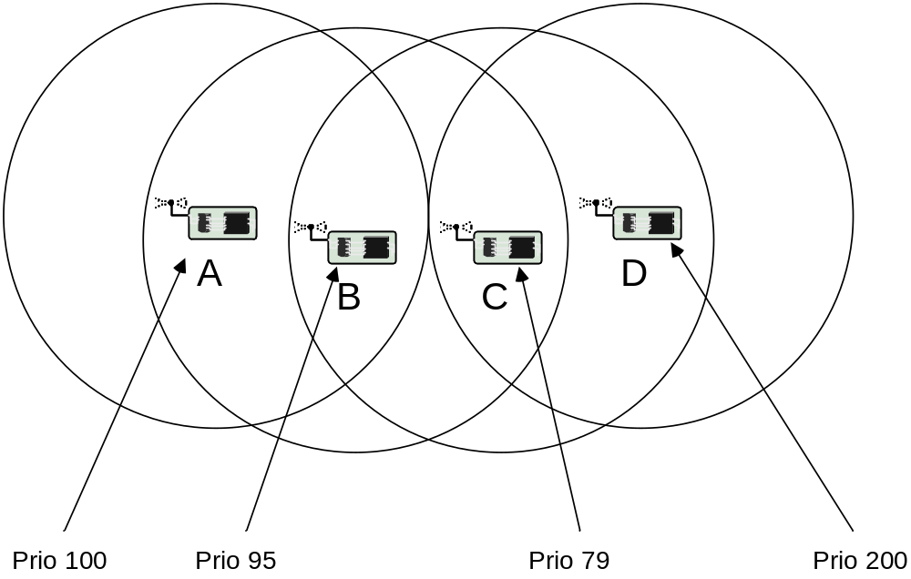
TRAMA – possible conflicts
When does a node have to receive?
  Easy case: one-hop neighbor has won a time slot and announced a packet for it
  But complications exist – compare example
What does B believe?
  A thinks it can send
  B knows that D has higher priority in its 2-hop neighborhood!
Rules for resolving such conflicts are part of TRAMA

Slide 31
Comparison: TRAMA, S-MAC
Comparison between TRAMA & S-MAC
  Energy savings in TRAMA depend on load situation
  Energy savings in S-MAC depend on duty cycle
  TRAMA (as typical for a TDMA scheme) has higher delay but higher maximum throughput than contention-based S-MAC
TRAMA disadvantage: substantial memory/CPU requirements for schedule computation

Slide 32
Overview
Principal options and difficulties
Contention-based protocols
Schedule-based protocols
IEEE 802.15.4

Slide 33
IEEE 802.15.4
IEEE standard for low-rate WPAN applications
Goals: low-to-medium bit rates, moderate delays without too stringent guarantee requirements, low energy consumption
Physical layer
  20 kbps over 1 channel @ 868-868.6 MHz
  40 kbps over 10 channels @ 905 – 928 MHz
  250 kbps over 16 channels @ 2.4 GHz
MAC protocol
  Single channel at any one time
  Combines contention-based and schedule-based schemes
  Asymmetric: nodes can assume different roles

Slide 34
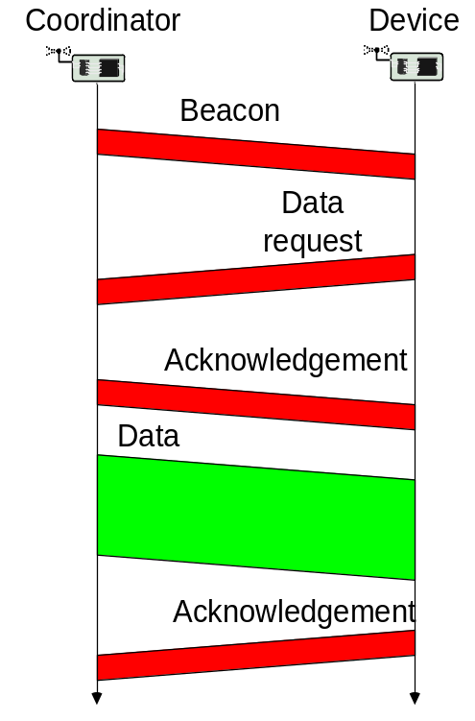
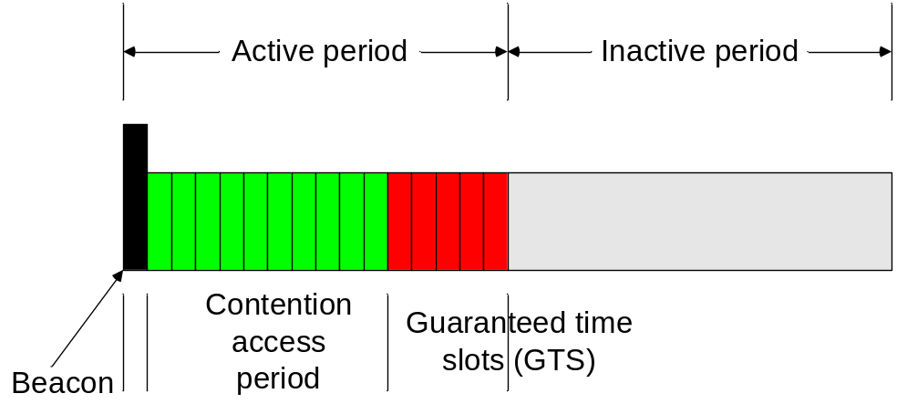
IEEE 802.15.4 MAC overview
Star networks: devices are associated with coordinators
  Forming a PAN, identified by a PAN identifier
Coordinator
  Bookkeeping of devices, address assignment, generate beacons
  Talks to devices and peer coordinators
Beacon-mode superframe structure
  GTS assigned to devices upon request

Slide 35
Wakeup radio MAC protocols
Simplest scheme: Send a wakeup “burst”, waking up all neighbors ! Significant overhearing
  Possible option: First send a short filter packet that includes the actual destination address to allow nodes to power off quickly
Not quite so simple scheme: Send a wakeup burst including the receiver address
  Wakeup radio needs to support this option
Additionally: Send information about a (randomly chosen) data channel, CDMA code, … in the wakeup burst
Various variations on these schemes in the literature, various further problems
  One problem: 2-hop neighborhood on wakeup channel might be different from 2-hop neighborhood on data channel
  Not trivial to guarantee unique addresses on both channels

Slide 36
Further protocols
MAC protocols for ad hoc/sensor networks is one the most active research fields
  Tons of additional protocols in the literature
  Examples: STEM, mediation device protocol, many CSMA variants with different timing optimizations, protocols for multi-hop reservations (QoS for MANET), protocols for multiple radio channels, …
  Additional problems, e.g., reliable multicast
This chapter has barely scratched the surface…

Slide 37
Summary
Many different ideas exist for medium access control in MANET/WSN
Comparing their performance and suitability is difficult
Especially: clearly identifying interdependencies between MAC protocol and other layers/applications is difficult
  Which is the best MAC for which application?
Nonetheless, certain “common use cases” exist
  IEEE 802.11 DCF for MANET
  IEEE 802.15.4 for some early “commerical” WSN variants
  B-MAC for WSN research not focusing on MAC

