Slide 1
Section 9.3: Multicasting
권현수
2014021626

Slide 2
9.3 Multicasting
To reduce the amount of overhead involved in broadcasting
Send traffic only to those receivers that are interested in multicasting
Accomplished by either having the sender indicate the receivers, or instead having the receivers independently indicate their interest
Multicasting state must be maintained by hosts and routers

Slide 3
9.3 Multicasting
TCP/IP model, receivers indicate their interest in what traffic they wish to receive by specifying a multicast address and optional list of sources
The inefficiencies of broadcast: every host that can be reached on the same LAN or VLAN must process broadcast packets
IP multicasting provides a more efficient way to carry out the same types of tasks

Slide 4
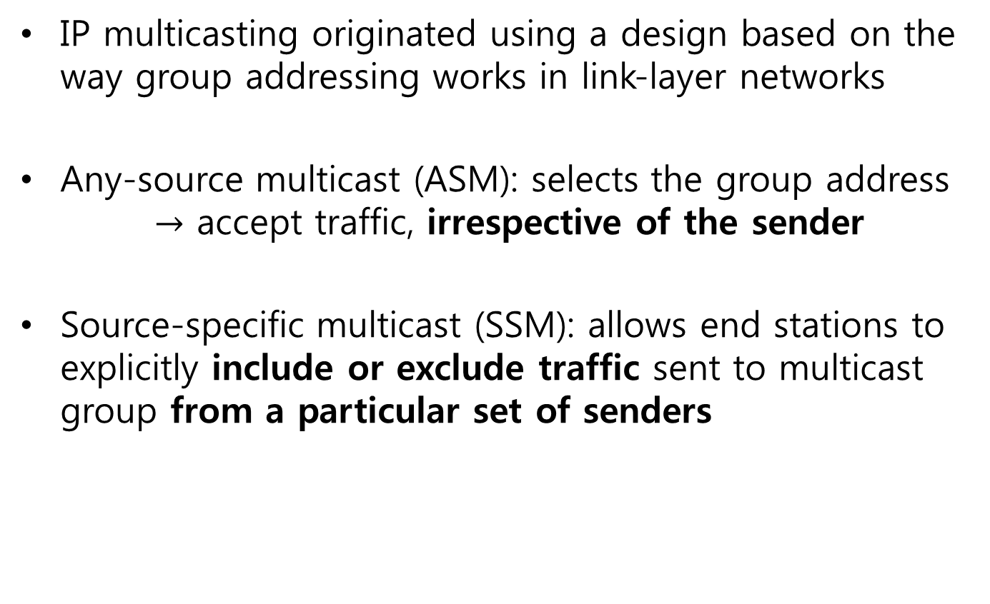
9.3 IP Multicasting
IP multicasting originated using a design based on the way group addressing works in link-layer networks
Any-source multicast (ASM): selects the group address $→$ accept traffic, irrespective of the sender
Source-specific multicast (SSM): allows end stations to explicitly include or exclude traffic sent to multicast group from a particular set of senders

Slide 5
9.3.1 Converting IP Multicast addr to
802 MAC addr
When using unicast address
  IPv4 address: Address Resolution Protocol (ARP)
  IPv6: Neighbor Discovery (ND)
When we wish to send multicast traffic
  Simply map an IP multicast address to some corresponding MAC address
Focus on IEEE 802 networks
  Especially Ethernet and Wi-Fi
  Most common types of networks where IP multicasting is used

Slide 6
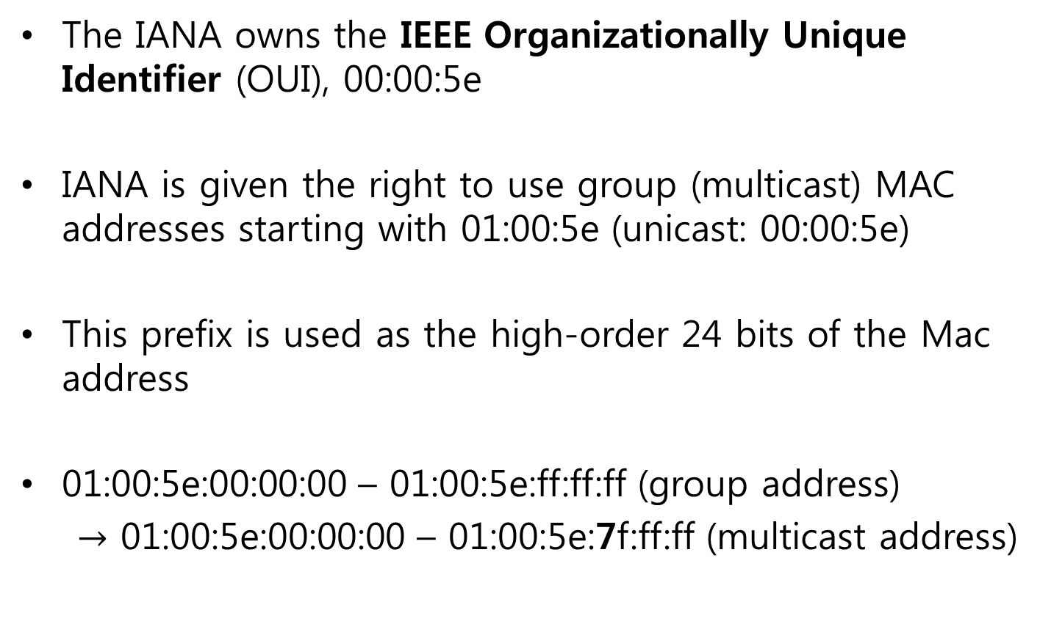
9.3.1 Converting IP Multicast addr to
802 MAC addr
The IANA owns the IEEE Organizationally Unique Identifier (OUI), 00:00:5e
IANA is given the right to use group (multicast) MAC addresses starting with 01:00:5e (unicast: 00:00:5e)
This prefix is used as the high-order 24 bits of the Mac address
01:00:5e:00:00:00 – 01:00:5e:ff:ff:ff (group address)
$→$ 01:00:5e:00:00:00 – 01:00:5e:7f:ff:ff (multicast address)

Slide 7
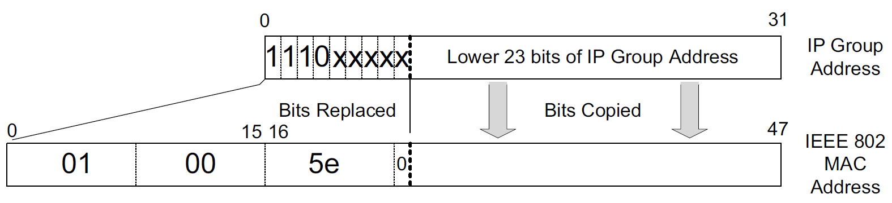
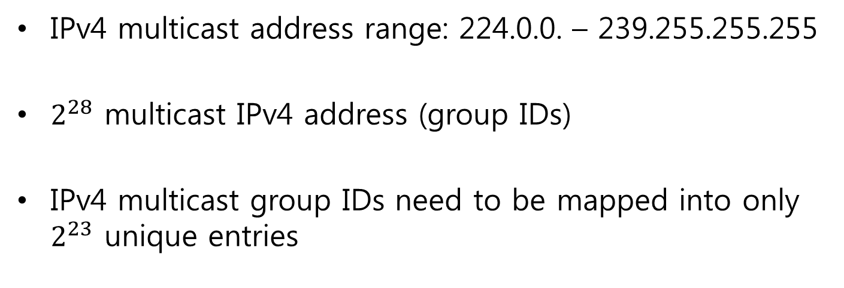
9.3.1 Converting IP Multicast addr to
802 MAC addr
IPv4 multicast address range: 224.0.0. – 239.255.255.255
$2^{28}$ multicast IPv4 address (group IDs)
IPv4 multicast group IDs need to be mapped into only $2^{23}$ unique entries

Slide 8
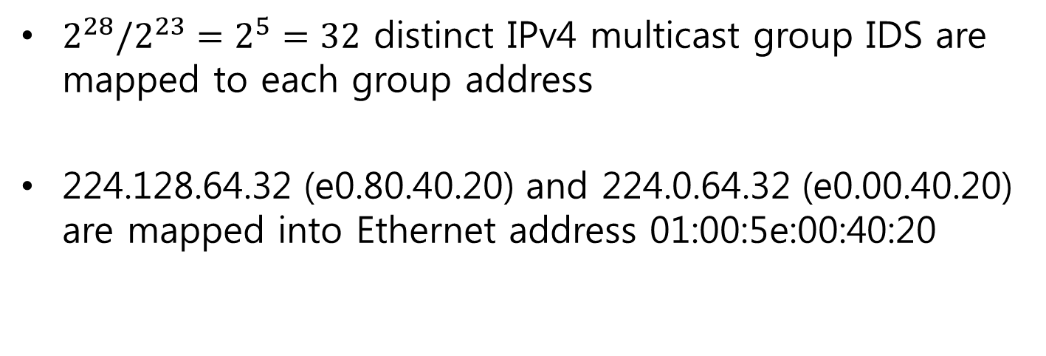
9.3.1 Converting IP Multicast addr to
802 MAC addr
$2^{28}/2^{23}=2^{5}=32$ distinct IPv4 multicast group IDS are mapped to each group address
224.128.64.32 (e0.80.40.20) and 224.0.64.32 (e0.00.40.20) are mapped into Ethernet address 01:00:5e:00:40:20

Slide 9
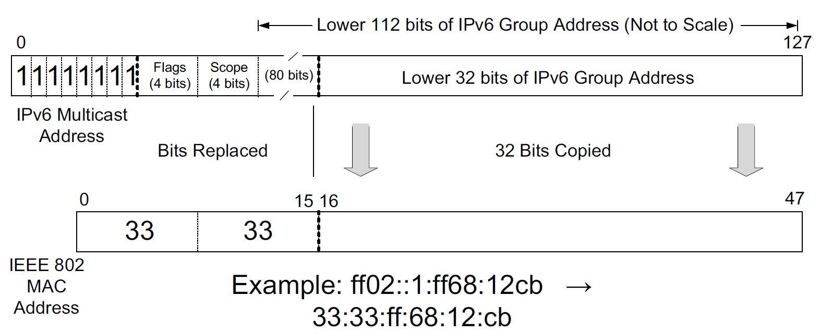
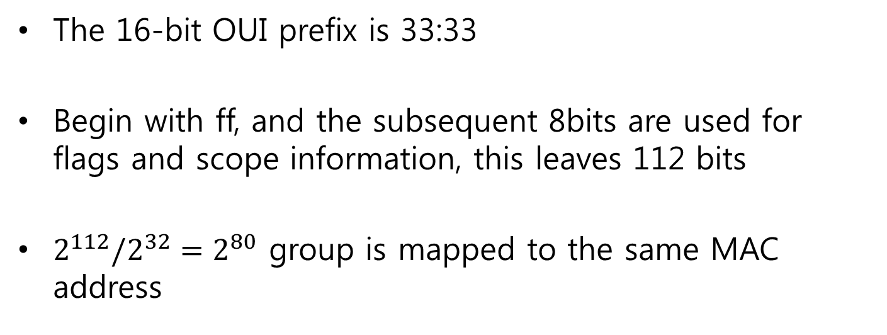
9.3.1 Converting IP Multicast addr to
802 MAC addr
The 16-bit OUI prefix is 33:33
Begin with ff, and the subsequent 8bits are used for flags and scope information, this leaves 112 bits
$2^{112}/2^{32}=2^{80}$ group is mapped to the same MAC address

Slide 10
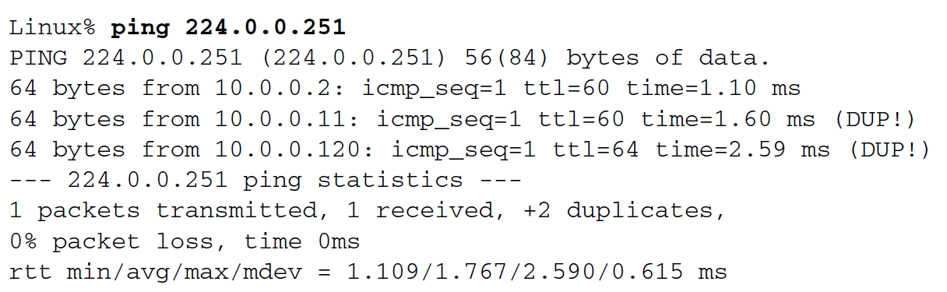
9.3.2 Examples
Can send an ICMPv4 echo request to those hosts that respond to the Multicast DNS address 224.0.0.251
Respond messages indicate that they are subscribed to the mDNS group

Slide 11
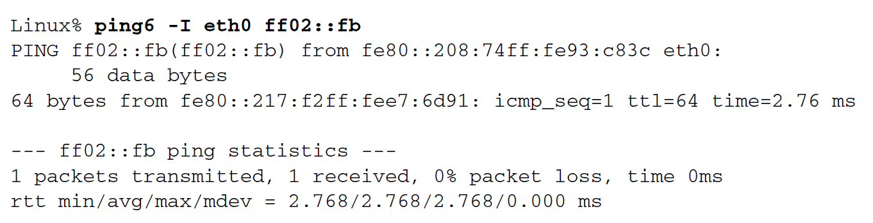
9.3.2 Examples
Provide the outgoing interface as input to the ping6 program
Allows the program to select the appropriate outgoing IPv6 address

Slide 12
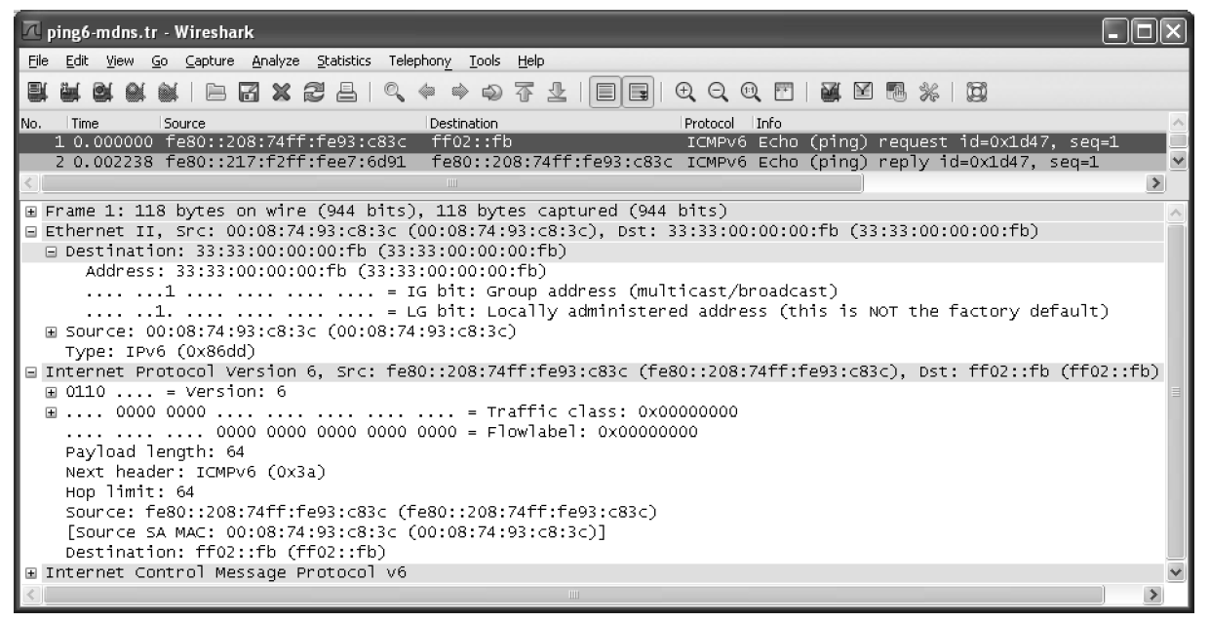
9.3.2 Examples

Slide 13
9.3.3 Sending Multicast Datagrams
When sending any IP packet, a decision must be made as to which source address and interface to use
netstate comman can be used to determine this

Slide 14
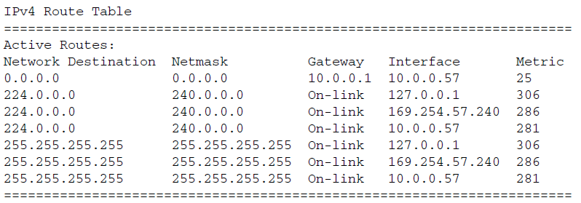
9.3.3 Sending Multicast Datagrams
Default route for IPv4 traffic goes to 10.0.0.1 using interface 10.0.0.57
224.0.0.0/4 indicate that three different interfaces can carry outgoing multicast traffic

Slide 15
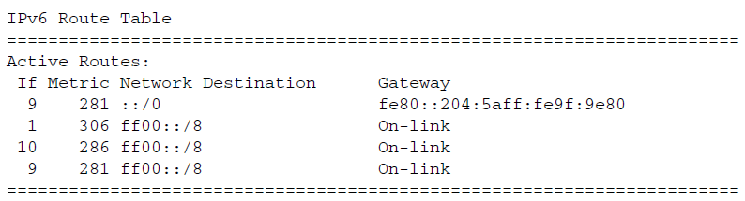
9.3.3 Sending Multicast Datagrams
All multicast addresses begin with ff, and there are no broadcast address
Interfaces 1, 9, and 10 can all be used

Slide 16
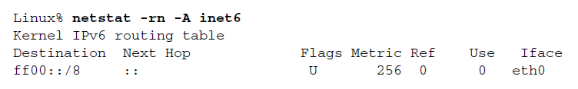
9.3.3 Sending Multicast Datagrams
Separate for different protocol families
For IPv4, there is nothing to show
A conventional default route handles the multicast traffic
There is no direct “next hop”

Slide 17
9.3.4 Receiving Multicast Datagrams
Fundamental to multicasting is the concept of a process joining or leaving one or more multicast groups
Membership in a multicast group on a given interface is dynamic
Additional methods are needed if a process wishes to specify sources it cares to hear from or exclude
These are requied parts of any API on a host that supports multicasting

Slide 18
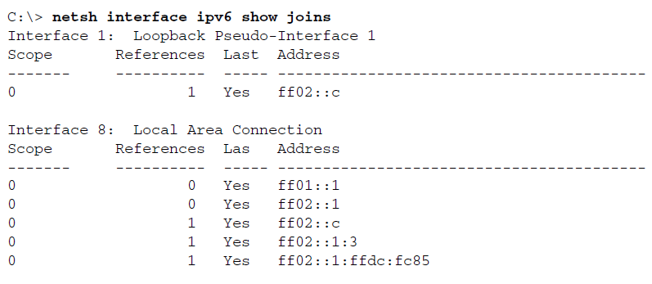
9.3.4 Receiving Multicast Datagrams
The only multicast group used on loopback interface is the link-local scoped Simple Service Discovery Protocol (SSDP) multicast address
ff01::1 (node-local All Nodes address)
ff02::1 (link-local All Nodes address)
ff02::c (SSDP)

Slide 19
9.3.4 Receiving Multicast Datagrams
ff02::1:3 (for support of LLMNR, a local multicast name resolution system)
ff02::1:ffdc:fc85 (the Solicited-Node multicast address, used by IPv6 ND)

Slide 20
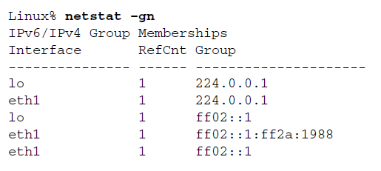
9.3.4 Receiving Multicast Datagrams
Includes the join information for multiple interfaces and for both IPv4 and IPv6
224.0.0.1 on both the Ethernet interface as well as the local loopback interface
ff02::1:ff2a:1988 (Solicited-Node arress)

Slide 21
9.3.5 Host Address Filtering
Filtering takes place on each host’s network interface card (NIC), each time a frame is presented to it for possible reception
Broadcast and multicast frames are replicated on all segment within a VLAN, along a spanning tree formed among the switches
Delivered to the NIC, checks the correctness of the frame (using the CRC)
Makes a decision about whether to receive the frame and deliver it to the device driver and network stack

Slide 22
9.3.5 Host Address Filtering
NICs tend to come in two varieties
Filtering based on the hash values of the multicast hardware address in which the process has expressed interest
Listens for a finite table of multicast addresses, meaning that if the host needs to receive frames destined for more multicast addresses than can fit in the table, the NIC is put into a “multicast-promiscuous” mode

Slide 23
9.3.5 Host Address Filtering
Both type of interfaces require that the device driver or higher-layer software perform checking that the received frame is really wanted
The mapping from a multicast IPv4 or IPv6 address to a 48-bit hardware address is not unique
Despite this imperfect address mapping and hardware filtering, multicasting is still more efficient than broadcasting

Slide 24
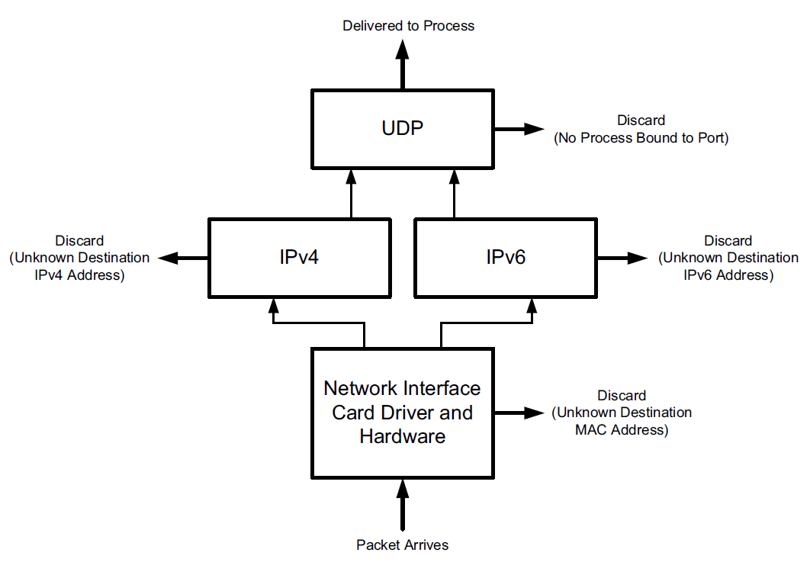
9.3.5 Host Address Filtering

Slide 25
9.3.5 Host Address Filtering
NIC support a multi-entry address table
The destination address on each received frame is compared against this table
If the address is found in the table, the frame is received and processed by the device driver
Another method, apply a hash function to the destination address, forming an index into a binary vector

Slide 26
9.3.5 Host Address Filtering
When the indexed entry in the vector contains a 1 bit, the corresponding address is deemed to be acceptable
Save memory on the NIC, but incur collisions in the hash function, some frames may be considered admissible when they should not be
This is not a fatal problem, because higher layers of the stack also perform filtering

Slide 27
9.3.5 Host Address Filtering
Device driver performs additional filtering
The frame type must specify a protocol that is supported
Additional multicast filtering may be performed to check whether the host belong to the addressed multicast group

Slide 28
9.3.5 Host Address Filtering
Device driver passes the frmat to the next layer (IP)
Performs more filtering, based on the source and destination IP address
IP passes the datagram up to the next layer (TCP/UDP)
Performs filtering based on the destination port number and sometimes the source port number

Slide 29
9.3.5 Host Address Filtering
One of the primary motivations behind the development of the multicast addressing features was to avoid the overhead of broadcasting
If there are 50 hosts on UDP broadcasts, but only 20 are participating in the application, every time one of the 20 sends a UDP broadcast
All of machinery offers less overhead imposed on the host, in exchange for additional complexity in manageing multicast addresses and group memberships

