Slide 1
E-eyes: In-home Device-free Activity Identification
Using Fine-grained WiFi Signatures
Yan Wang, Jian Liu, Yingying Chen, Marco Gruteser, Jie Yang, Hongbo Liu
MobiCom 2014

Slide 2
Contents
Introduction
Design
Implementation
Evaluation
Conclusion

Slide 3
Introduction
Activity monitoring in home environments
  has become increasingly important
  has the potential to support a broad array of applications
  including elder care, well-being management, and latchkey child safety
Traditional approaches involve wearable sensors and specialized hardware installations

Slide 4
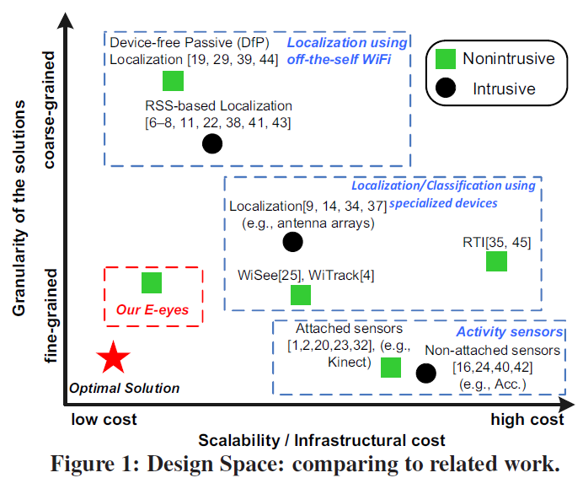
Introduction
Sensors can be either attached to a person’s body, or placed on target objects with which people interact.
(an accelerometer, motion sensor, acoustic sensor, Vision based systems such as Leap and Kinect)
→ They need the installation and maintenance of dedicated sensors which usually entail high costs and are thus not scalable

Slide 5
Introduction
These systems localize a wireless emitter using
Received Signal Strength (RSS),
OFDM channel state information,
antenna arrays, RFID tags,
visible LED lights
These systems provide various accuracy ranging from several meters (e.g., RSS based) to sub-meter
but require people to carry a wireless emitter
This can be intrusive and poses the problem of people forgetting to carry such a device

Slide 6
Introduction
The radio tomography imaging (RTI) device-free
passive (DfP) localization do not require a device be attached to or carried by the user.
The state of RTI requires tens or hundreds of wireless sensors to achieve sub-meter accuracy.
DfP localization with four WiFi APs has an accuracy of several meters.

Slide 7
Introduction
Recent work in using a single wireless monitor to detect human movement or location can be used for activity recognition as well.
(such as Wi-Vi, WiSee and WiTrack)
However, these systems all require a specialized WiFi monitor (e.g., USRP) for extracting the carrier wave

Slide 8
Introduction
E-eyes can provide fine-grained activity
recognition by re-using existing home WiFi network and thus has much higher scalability for wide deployment.

Slide 9
Contents
Introduction
Design
- Intuition and Basic Idea
- System Overview
Implementation
Evaluation
Conclusion

Slide 10
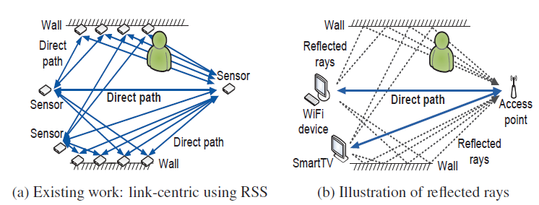
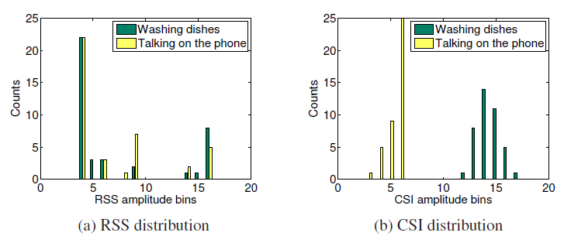
Intuition and Basic Idea
Increasing availability of WiFi signals in home environments
WiFi provides fine-grained channel state information (CSI)
Use CSI to capture changes of multipath environment
Since an activity involves a series of body movements during a certain period of time, the distribution of CSI amplitudes is a desirable channel statistic that can capture unique characteristics of activities

Slide 11
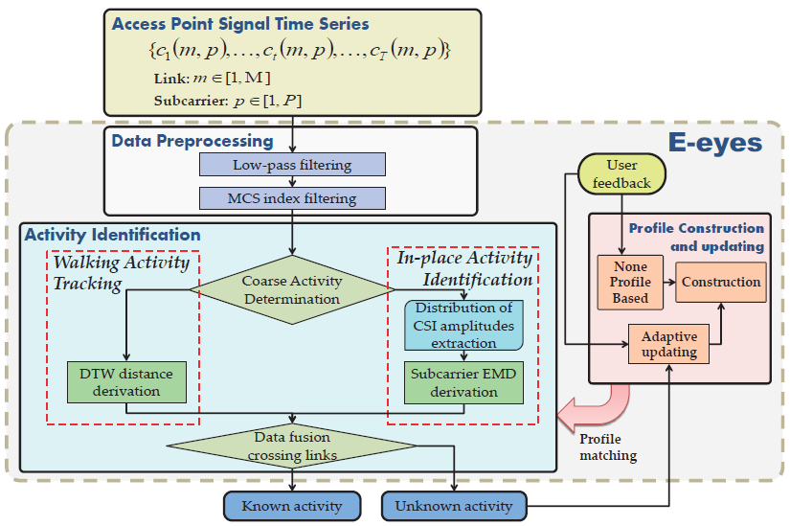
System Overview

Slide 12
Contents
Introduction
Design
Implementation
- Activity Identification
- Profile Construction
- Non-profiling Clustering
- Data Calibration
- Data Fusion Crossing Multiple Links
Evaluation
Conclusion

Slide 13
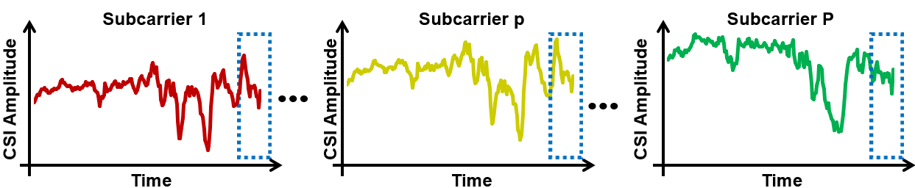
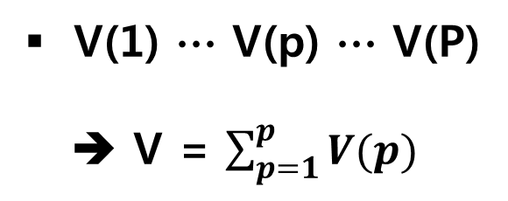
Coarse Activity Determination
V(1) ∙∙∙ V(p) ∙∙∙ V(P)
➔ V = $\sum_{p=1}^{p}{V(p)}$
Walking activity
  Large moving variance due to significant body movements and location changes
In-place activity
  Small moving variance due to smaller body movements
➔ max(V) is larger than the threshold $τ$v the CSI samples are determined to contain a walking activity, otherwise they contain an in-place/no activity

Slide 14
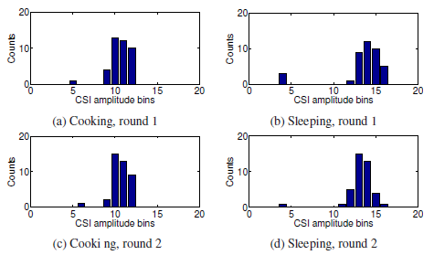
In-place Activity Identification
Different in-place activities cause different distributions of CSI
Different rounds of same in-place activities result in similar distributions of CSI
➔ A particular in-place activity can be identified by comparing against known profiles

Slide 15
In-place Activity Identification
Compare the distribution of the testing CSI measurements to those of the known in-place activity profiles by using the EMD metric
The earth mover’s distance(EMD) technique, which is a well-known approach for evaluating the similarity between two probability distributions
The EMD calculates the minimal cost to transform one distribution into the other
➔ The candidate known in-place activity is confirmed if the minimal EMD distance is less than the threshold, otherwise, it will be identified as an unknown activity

Slide 16
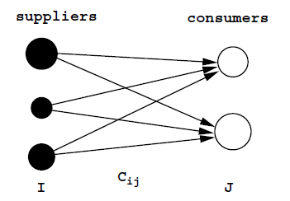

The earth mover’s distance(EMD)
Given two distributions, one can be seen as a mass of earth properly spread in space, the other as a collection of holes in that same space
The EMD measures the least amount of work needed to fill the holes with earth
The transportation problem
- signature matching
2. Find optimal flow F
I → a set of suppliers
J → a set of consumers
c_{ij} → the cost to ship
The EMD naturally extends the notion of distance between single elements to distance between sets of elements or distributions → the EMD applies to signatures, which subsume histograms
The costs of moving ‘earth’ reflect the notion of nearness properly, without the quantization problems of most current measures
The EMD allows for partial matches in a natural way

Slide 17
Walking Activity Tracking
The CSI pattern is dominated by the unique path of each walking activity
Since there are always in-place activities before and after a walking activity,
ideally we can identify the walking activity by identifying the in-place activities at both ends
However, the starting and ending points of the walking activity can be anywhere inside the space. It is possible that the two endpoints are not that meaningful and thus no such in-place activity profiles are constructed
➔ By identifying the doorway the person moves through,
system can determine a walking activity in high level

Slide 18
Walking Activity Tracking
Walking Path Discrimination
Using Dynamic Time Warping (DTW) to align the testing CSI measurements to those of known activities in the profile
System distinguishes each walking activity by calculating the MD-DTW distance between the testing CSI measurements and all the known walking activities in CSI profiles
If the MD-DTW distance is less than a threshold (i.e., considering it as a known activity), we then regard the corresponding CSI measurements labeled in the CSI profiles

Slide 19
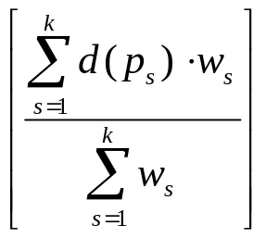
Dynamic Time Warping (DTW)
i
➔ A non-linear (elastic) alignment produces a more intuitive similarity measure, allowing similar shapes to match even if they are out of phase in the time axis.
i
i
i
i+2
time
time
Time Series A
1
i_{s}
n
Time-normalized distance between A and B :
m
p_{k}
Restrictions :
- monotonicity
- continuity
- boundary conditions
- warping window
- slope constraint
D(A , B ) =
j_{s}
p_{s}
d(p_{s}) : distance between i_{s} and j_{s}
w_{s} >0 : weighting coefficient
Time Series B
1
p₁

Slide 20
Walking Activity Tracking
Doorway Discrimination
Handle the case where the testing CSI measurements are unknown after attempting to match them with the profile database
Identify which doorway the person passes through and the corresponding walking activity can then be recognized in a high-level
The EMD distance used in in-place activity recognition is applied for such comparison

Slide 21
Profile Construction
Collect the CSI measurements of typical activities for profile construction
Use the distribution of CSI amplitude to profile in-place activities and
the sequence of CSI amplitude for walking activities

Slide 22
Non-profiling Clustering
Adaptively update activity profiles → non-profiling clustering
Semi-supervised approach to cluster the daily activities and update CSI profiles
The non-profiling clustering is also utilized to construct CSI profiles when our system starts without any CSI profile

Slide 23


Non-profiling Clustering
R sets of CSI samples from K different unknown activity instances
Exploit the K-Means clustering technique to discriminate different activity instances based on the EMD between CSI samples
First calculate the EMD between any particular CSI sample set C^{r} and all the sample sets
E^{r} = [E(C^{r},C¹), · · · ,E(C^{r},C^{R})]
μ_{k} is the mean value of the EMD vectors in s_{k}
Searches for K appropriate clusters (S = s₁, · · · , s_{K}) satisfying the following equation:

Slide 24
Data Calibration
Low-pass Filtering
- To remove high frequency noises, we adopt the dynamic exponential smoothing filter (DESF)
- The DESF can remove high frequency noise and preserve the features affected by human activities in the CSI measurements
Modulation and Coding Scheme Index Filtering
- To get the changing CSI patterns only affected by human activities, we need to remove the CSI measurements affected by a different MCS index (indicates different channel condition)
- filter out the CSI measurements with MCS value less than 263 and keep the rest of them for activity identification.

Slide 25


Data Fusion Crossing Multiple Links
E-eyes can exploit a number of WiFi links to improve the activity recognition accuracy
L WiFi devices collecting CSI measurements independently and each device has J activity profiles denoted as {a^{l}₁, . . . , a^{l}_{j} , . . . , a^{l}_{J}}, l = {1, . . . ,L. }
D^{l}_{j} is the EMD or DTW distance between the CSI measurements and the j^{th} activity profile on the l^{th} WiFi device
w^{l}_{j} (a^{l}₀, a^{l}_{j}) is the normalized weight dominated by the significance of the j^{th} activity on the l^{th} WiFi device
a^{l}₀ denotes the profile for empty room on the l^{th} WiFi device, and X(a^{l}₀, a^{l}_{j}) is the cross correlation between the profile of the empty room and the j^{th} activity on the l^{th} WiFi device

Slide 26
Contents
Introduction
Design
Implementation
Evaluation
Conclusion

Slide 27
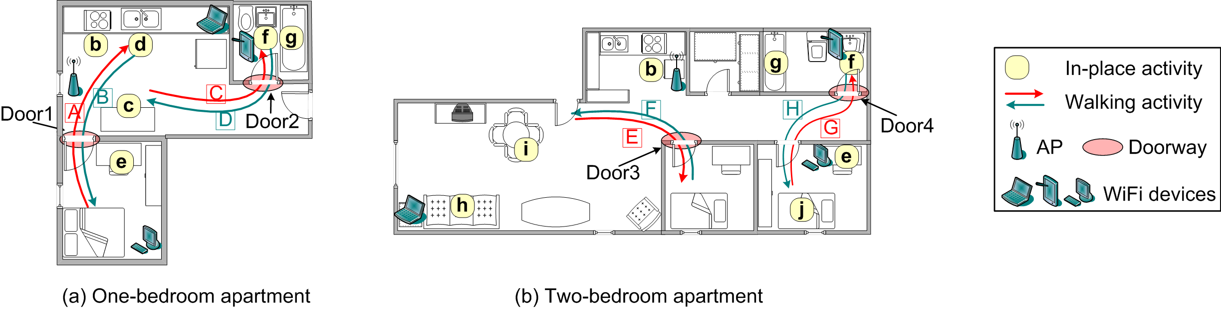
Experimental Setup
Devices and Network - 802.11n WiFi network with three off-the-shelf WiFi devices
- Lenovo T500, T61 laptop (Intel WiFi Link 5300 NIC)
- Cisco Linksys E2500 AP
Apartments and Activities

Slide 28
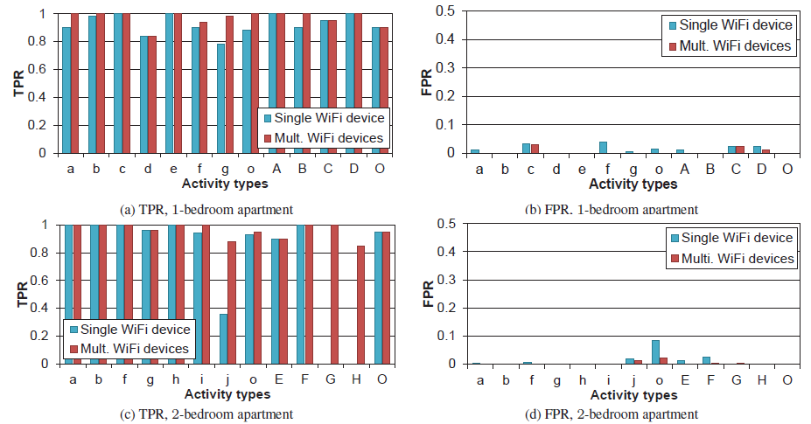
Performance of In-place Activity
Identification
Q) How robust is the system in typical indoor environments?
True Positive Rate (TPR) :
TPR for an activity A is defined as
the proportion of the instances that are correctly recognized as the
activity A among actual A performed.
False Positive Rate (FPR) :
FPR for an activity A is defined as
the percentage of the instances that are incorrectly recognized as A
among all testing instances other than A.

Slide 29
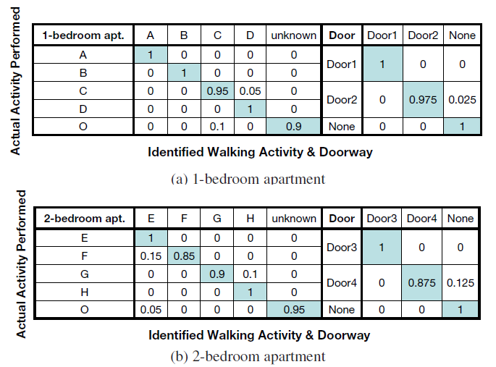
Performance of Walking Activity Tracking and Doorway Identification
Q) How robust is the system in typical indoor environments?
Each row represents the actual activity performed by the user and each column shows the activity it was classified as by system

Slide 30
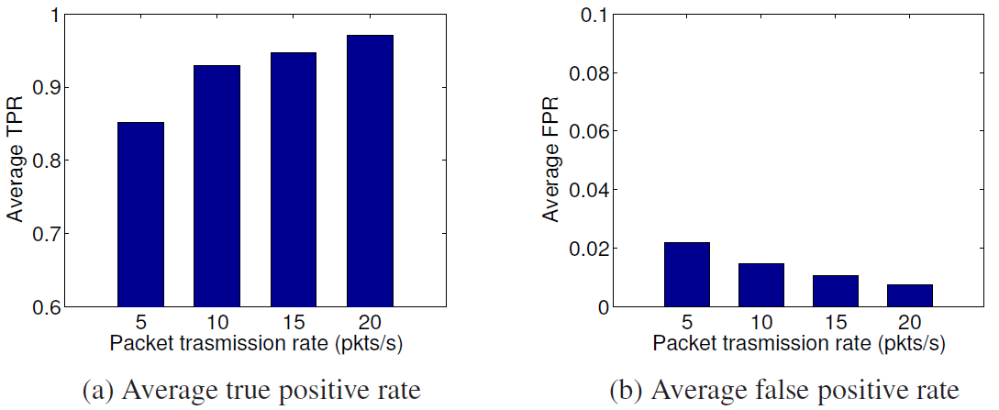
Performance of Different Packet Rate
Q) Is WiFi traffic in home environment feasible to identify activities?

Slide 31
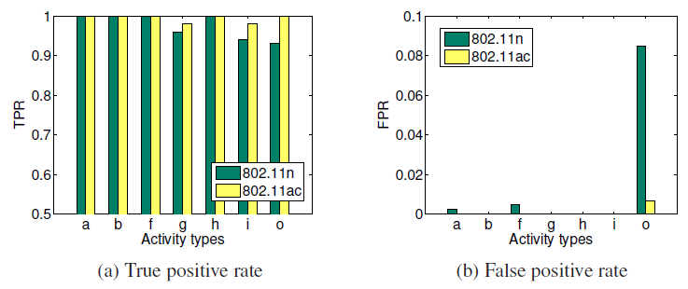
Performance comparison 802.11n and ac
the wider channels (e.g., 802.11ac) can improve the recognition accuracy since
it allows measurements over many additional subcarriers.

Slide 32
Contents
Introduction
Design
Implementation
Evaluation
Conclusion

Slide 33
Conclusion
Show that the channel state information (CSI) from off-the-shelf 802.11n devices can be utilized to identify and distinguish in-place activities inside a home
Develop a monitoring framework that can run on a single WiFi AP and use the associated profile matching algorithms to compare amplitude profiles against those from known activities
Dynamic profile construction to accommodate the movement or replacement of wireless devices and day-to-day profile calibration
Extensive experiments in two apartments of different size demonstrates the generality of our approach

