Slide 1
Scout: An Asymmetric Vehicular Network Design over TV Whitespaces
Hotmobile 2013
Tan Zhang, Sayandeep Sen, Suman Banerjee
University of Wisconsin-Madison

Slide 2
Table of Contents
Introduction
Experiment Setup
Feasibility of Scout
Design
Implementation
Evaluation
Future Work
Related Work
Conclusion

Slide 3
Introduction
TV Whitespaces (512 ~ 698MHz) released by FCC
Abundant spectrum resource (180MHz)
Excellent propagation (~1.9Km)
Provide long-range and high-speed network (Internet) connectivity to moving vehicle
Base station mounted on roadside connected to proxy server
Whitespace gateway nodes mounted on top of the buses
Wi-Fi Hotspot in the bus (client)

Slide 4
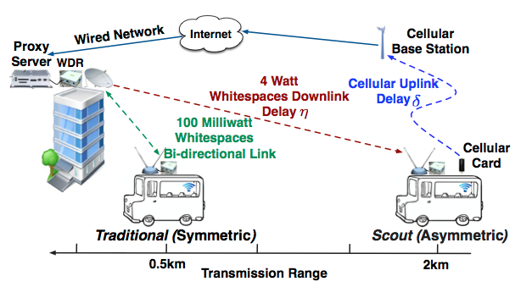
Introduction(Cont.)
Figure 1: Traditional (symmetric) Whitespaces Network v.s. Scout (asymmetric) Whitespaces Network.

Slide 5
Introduction(Cont.)
Tx Power restriction
  Mobile client is allowed to transmit lower than 100mW
  Station client is allowed to transmit lower than 4W
  40 times difference in power limit
Test bed of Whitespace Network at base station
  1.9Km transmission range at 4W
  0.5Km transmission range at 100mW

Slide 6
Introduction(Cont.)
Downlink : WhiteSpaces, Uplink : Cellular (3G)
Use Cellular link to extend the coverage of each base station
  High feedback latency at cellular network uplink
  Exacerbated by vehicle mobility
Use extra scouting radio to compensate for the effects of feedback delay over the cellular link
  Front radio passively monitors the downlink traffic at current location
  Observed channel information is used to decide protocol
  Enhance the performance of rate adaptation
Cellular technology v.s. Whitespaces
  Control base station transmission power, interference, devices

Slide 7
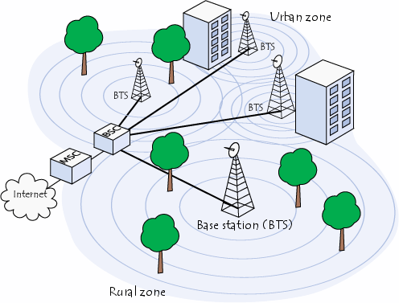
Introduction(Cont.)

Slide 8
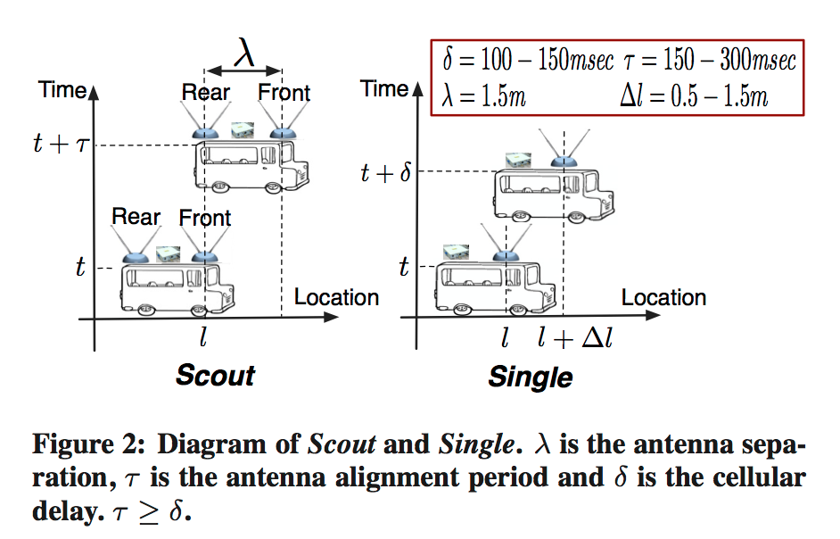
Introduction(Cont.)

Slide 9
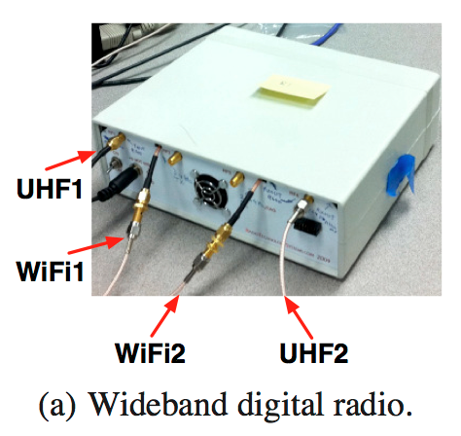
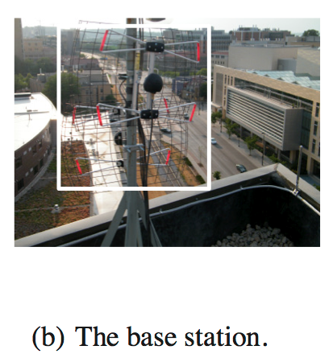

Experiment Setup
Radio platform
  Wide Band Digital Radio (WDR)
  Support 802.11 b/g up to 18Mbps
Testbed
  Base station, mobile client
  Use 652MHz ~ 672MHz (20MHz)
Metrics
  Loss rate
  Magnitude of difference in
  loss rate

Slide 10
Feasibility of Scout
200m road stretch, 12 equally spaced locations
Single
  Static
  5m/s (18km/h)
  10m/s (36km/h)
Scout
  Variable speed
Lag (ms)
Typical cellular (3G) delay δ = 100ms ~ 150ms

Slide 11
Feasibility of Scout(Cont.)

Slide 12
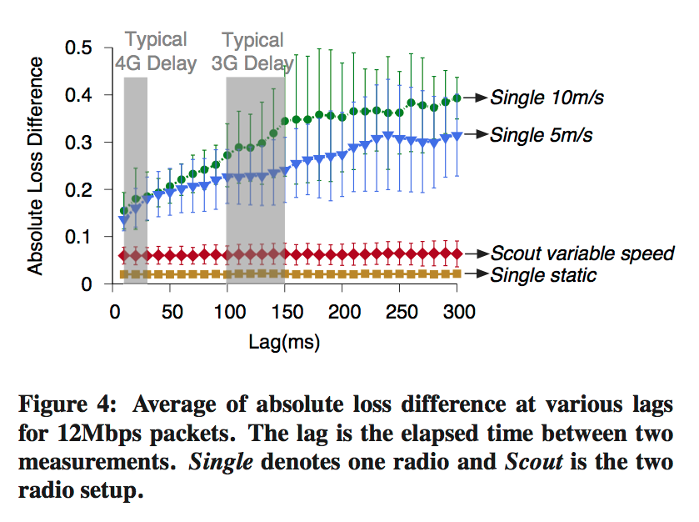
Feasibility of Scout(Cont.)

Slide 13
Design
Base station
  Single radio for downlink transmission
  Combine feedback
Client
  Rear radio for packet reception
  Front radio for monitor the downlink traffic
  Packet acknowledgment generated by both radio are sent over cellular link
  GPS device (1Hz)

Slide 14
Design(Cont.)
Combining feedback from dual radios
  Observed mismatched reception performance between two radios
  Selecting data rates solely based on the feedback from the front radio leads to sub-optimum performance
  Use SampleRate, select preliminary data rate based on the stale feedback from the rear radio
Relating feedback to the observed location
  Monitored location significantly affects the performance of Scout
  GPS modules have a positioning inaccuracy, use speed reading instead of geo-location reading.
  Put speed reading v in to τ = λ/v, λ is the fixed antenna separation
  v remains constant in GPS updating interval (1 second)

Slide 15
Design(Cont.)
Detecting channel variation
  Loss rate of a given data rate in W_{cur} changed by at least given threshold fold over W_{prev}, can conclude error performance of that data rate has changed
  Voting mechanism to combine results for all the data rates to determine the trend of channel variation
  Prevent Scout from reacting to random channel fluctuation
Adjusting data rates in response to channel variation
  Based on detected trend of channel variation
  From a set of candidate rates recently succeeding at the rear radio

Slide 16
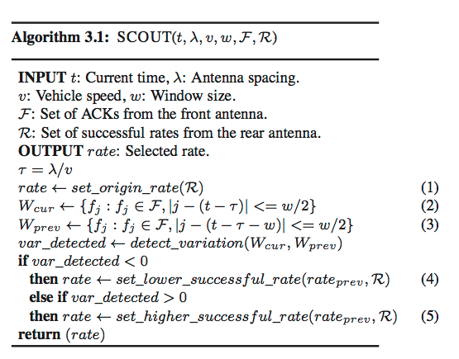
Design(Cont.)

Slide 17
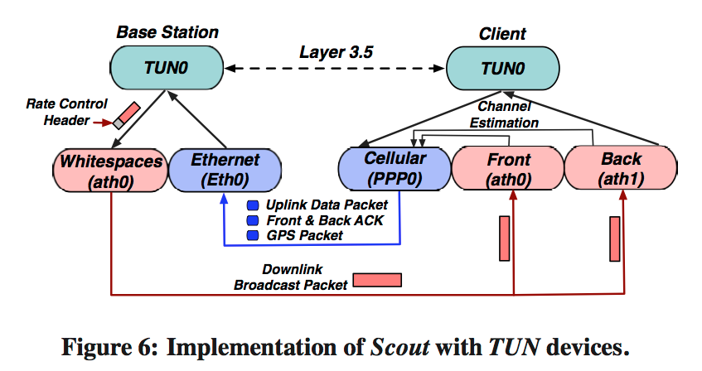
Implementation
3.5 layer on top of the cellular and whitespaces link
Use Virtual-network kernel device TUN

Slide 18
Evaluation
SampleRate, RRAA -> Scout-Sample, Scout-RRAA
Methodology
  Trace-driven emulation as preliminary evaluation of Scout, real trace captured in TV whitespaces
  Two radios at the client to capture packet traces from 10 drives along a 1.5km bus route.
  Distance between base station and client is about 200 ~ 750m
  Antenna spacing 1.5m
  Packet train : set of 8 contiguous packets at all different rates.
  Consider feedback delay (100ms) over cellular link when apply rate.

Slide 19
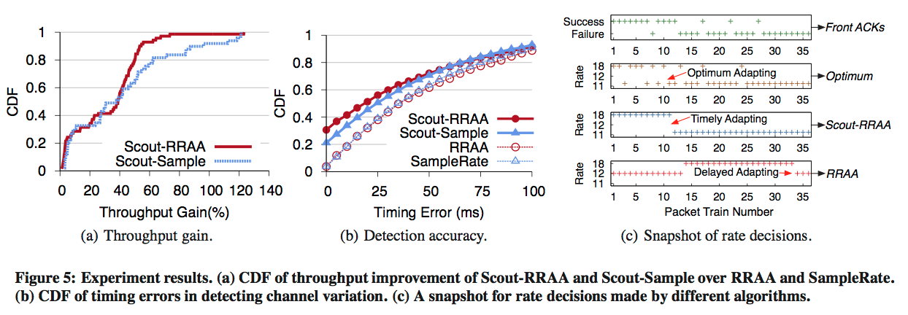
Evaluation
Throughput
  Each 50m road segment to evaluate performance improvement of Scout under different road conditions

Slide 20
Evaluation(Cont.)
Timeliness in adapting to channel variation
  Optimum algorithm selects the highest successful data rate in each train
  Record the time of data rate changes made by different algorithms
  Measure the absolute time difference for each rate change
Snapshot of different algorithms in operation
  Observe a similar trend of channel condition observed by the two radios at the same location
  Accurately detects the channel variation, and adapts to a lower rate at the same time as a the optimum algorithm does
  Directly selects 11Mbps rate based on those candidate rates successfully received at the rear radio

Slide 21
Future work
Improving channel estimation
  Front radio monitors the downlink traffic broadcasted to all the clients for channel estimation
  Base station to periodically send probe traffic upon detecting the downlink to be idle
Fully leveraging the dual radio
  Investigate different schemes in combining signals received by both radios to improve reception diversity
Scouting at different layers
  Generalize the application of Scout feedback to enhance the performance of all layers of the network stack

Slide 22
Related work
Whitespaces networking
  WhiteFi, SenseLess
Vehicular networking
  MAR, WiRover, ViFi, MobiSteer, Wiffler
Multi-antenna systems
  MIMO
Location-based channel estimation
  Bartendr, BreadCrumbs, MobiSteer
Rate adaptation
  SampleRate, RRAA

Slide 23
Conclusion
Asymmetric network design Scout
Provide wide-area network connectivity over whitespaces
Circumvents the bottleneck of the whitespaces uplink with the cellular technology
Deal with the feedback delay in the cellular uplink
Base station with this more accurate channel information to select transmission parameters for receiving radio.
4 times improvement in network coverage
1.4 times improvement in downlink throughput

