Slide 1
Ad hoc and Sensor Networks
Chapter 7: Naming & Addressing
Holger Karl

Slide 2
Goals of this chapter
This short chapter looks at non-standard options for denoting the senders/receivers of messages
  Traditional (fixed, wireless, ad hoc): Denote individual nodes by their identity
  WSN: Content-based addresses can be a good complement
When addresses are not given a priori, they have to be determined “in the field”
  Some algorithms are discussed

Slide 3
Names vs. addresses
Name: Denote/refer to “things”
  Nodes, networks, data, transactions, …
  Often, but not always, unique (globally, network-wide, locally)
  Ad hoc: nodes – WSN: Data!
Addresses: Information needed to find these things
  Street address, IP address, MAC address
  Often, but not always, unique (globally, network-wide, locally)
  Addresses often hierarchical, because of their intended use in, e.g., routing protocols
Services to map between names and addresses
  E.g., DNS
Sometimes, same data serves as name and address
  IP addresses are prominent examples

Slide 4
Issues in address management
Address allocation: Assign an entity an address from a given pool of possible addresses
  Distributed address assignment (centralized like DHCP does not scale)
Address deallocation: Once address no longer used, put it back into the address pool
  Because of limited pool size
  Graceful or abrupt, depending on node actions
Address representation
Conflict detection & resolution (Duplicate Address Detection)
  What to do when the same address is assigned multiple times?
  Can happen e.g. when two networks merge
Binding
  Map between addresses used by different protocol layers
  E.g., IP addresses are bound to MAC address by ARP

Slide 5
Distributed address assignment
Option 1: Let every node randomly pick an address
  For given size of address space, unacceptable high risk of duplicate addresses (see exercise)
Option 2: Avoid addresses used in local neighborhood
Option 3: Repair any observed conflicts
  Temporarily pick a random address from a dedicated pool and a proposed fixed address
  Send an address request to the proposed address, using temporary address
  If address reply arrives, proposed address already exists
  Collisions in temporary address unlikely, as only used briefly
Option 4: Similar to 3, but use a neighbor that already has a fixed address to perform requests

Slide 6
Content-based addresses
Recall: Paradigm change from id-centric to data-centric networking in WSN
Supported by content-based names/addresses
  Do not described involved nodes (not known anyway), but the content itself the interaction is about
Classical option: Put a naming scheme on top of IP addresses
  Done by some middleware systems

Slide 7
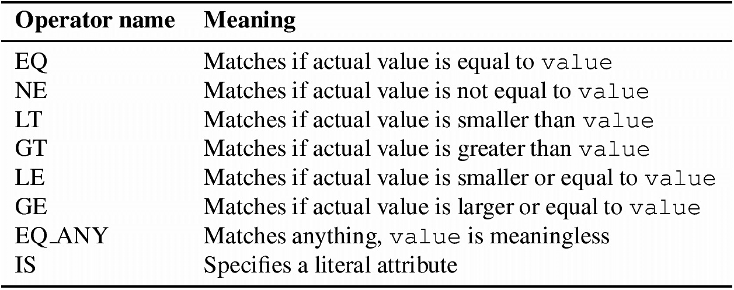
Content-based addressing: Describe interests
Interests describe relevant data/event
  Used, e.g., by directed diffusion (see later chapter)
  Nodes match these interests with their locally observed data
Format: Attribute-Value-Operation
  <attribute, value, operation>, e.g.: <TEMP, 20° C, GE>
  Attributes: temperature, pressure, concentration, …
  Operations:

Slide 8
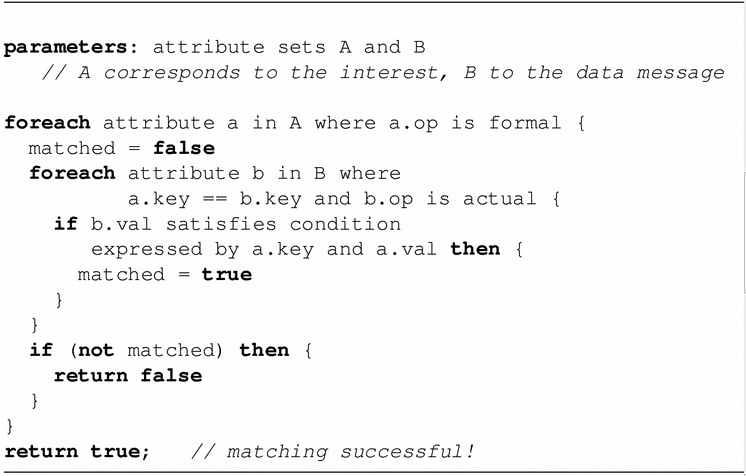
Matching algorithm
Check whether an interest matches the locally available data

Slide 9
Geographic addressing
Express addresses by denoting physical position of nodes
  Can be regarded as a special case of content-based addresses
  Attributes for x and y coordinates (and maybe z)
Options
  Single point
  Circle or sphere centered around given point
  Rectangle by two corner points
  Polygon/polytope by list of points
  …

Slide 10
Conclusion
Addresses can be assigned distributedly
Non-id-centric addresses give additional expressiveness, enables new interaction patterns than only using standard addresses
These addresses have to be supported by specific protocols, in particular, routing protocols

