Slide 1
Chapter 6
Bandwidth Utilization
Sharing one link among many sources, and spreading one signal over many hertz
Forouzan, Data Communications and Networking, 5th ed., Chapter 6
6.1 Multiplexing: FDM, WDM, TDM
6.2 Spread spectrum: FHSS, DSSS
Textbook figures, plus Figures 6.19 to 6.21 missing from the original deck
Printed errors corrected and marked

Slide 2
6.1
Multiplexing
6.2
Spread spectrum
Many signals → one link
FDM: split the bandwidth (analog)
WDM: same idea on fibre, split by wavelength
TDM: split the time (digital)
Goal: bandwidth efficiency
One signal → much wider bandwidth
FHSS: hop the carrier
DSSS: replace each bit with n chips
Goal: privacy, anti-jamming, not efficiency
Chapter 6
Where we are
Chapter 3: what a link can carry. Chapters 4 and 5: how one signal is built
Chapter 6: one link, many users
divide the resource: frequency, wavelength, time
or trade bandwidth for robustness
Every access scheme in Wi-Fi, LTE and NR is one of these, or a mix

Slide 3
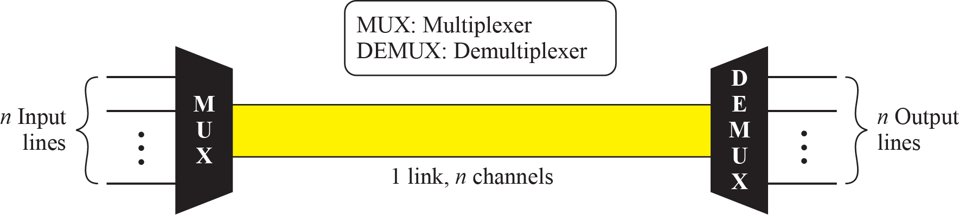
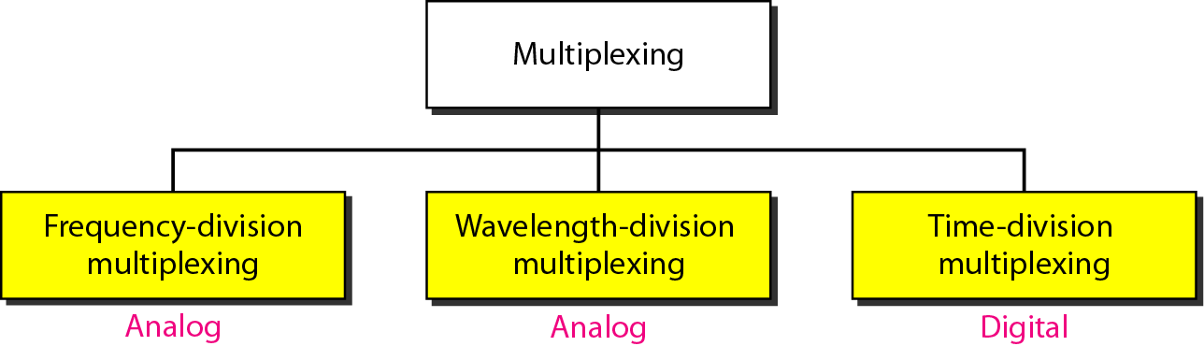
6-1
Multiplexing
Figure 6.1
Dividing a link into channels
Traffic grows: add links, or share a wide one
Link bandwidth > sum of signal bandwidths → share
MUX at sender, DEMUX at receiver
One link, n channels
Figure 6.2
Categories of multiplexing
6.1
Three categories
FDM, WDM: analog, share frequency
TDM: digital, share time
synchronous or statistical
Link vs. channel
link: physical path
channel: one carried signal

Slide 4
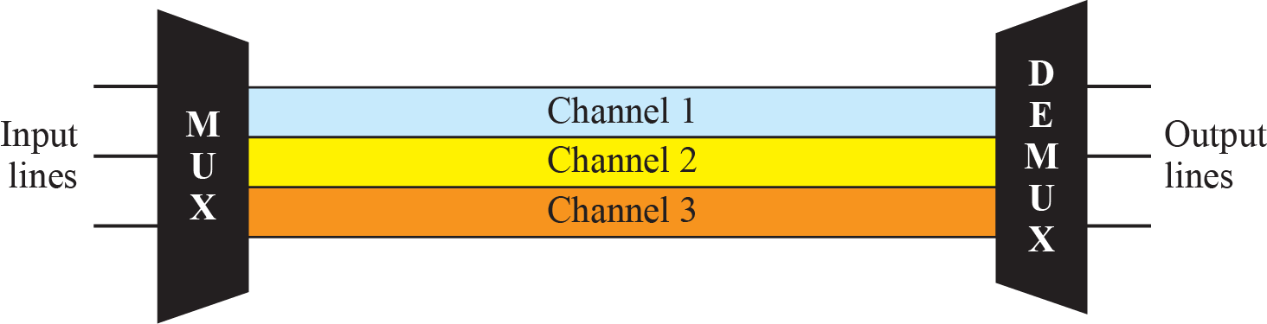
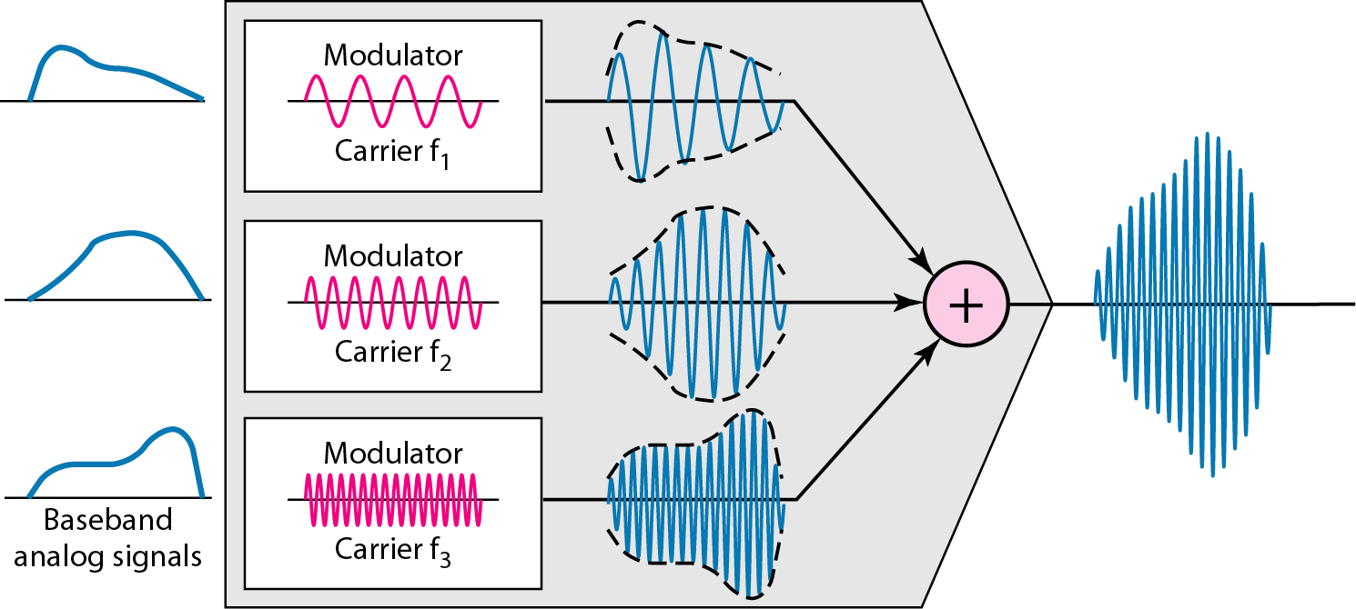
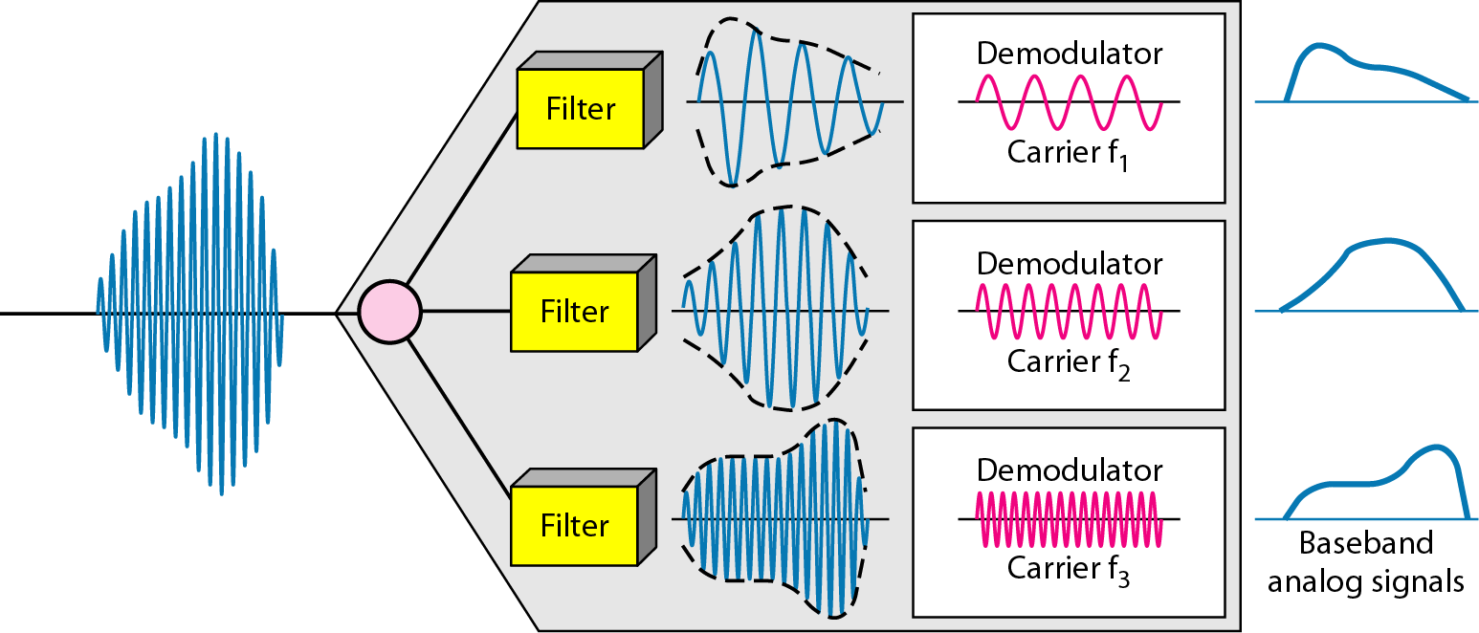
6.1.1
Frequency-division multiplexing
Figure 6.3
Frequency-division multiplexing
Analog technique
Condition: link bandwidth (Hz) > sum of signal bandwidths
Each source modulates a different carrier
Modulated signals combined into one composite signal
Guard bands keep channels apart
Section headings in the original deck read 6.6.1 to 6.6.3: corrected to 6.1.x
Figure 6.4
FDM multiplexing process
Figure 6.5
FDM demultiplexing

Slide 5
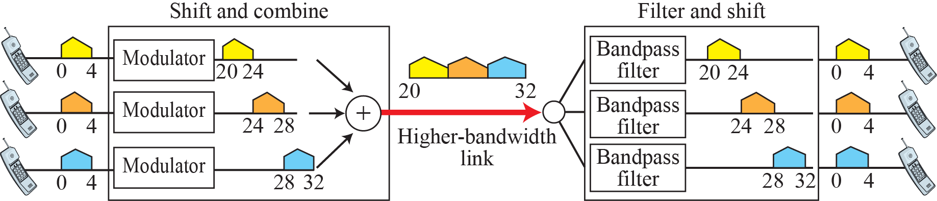
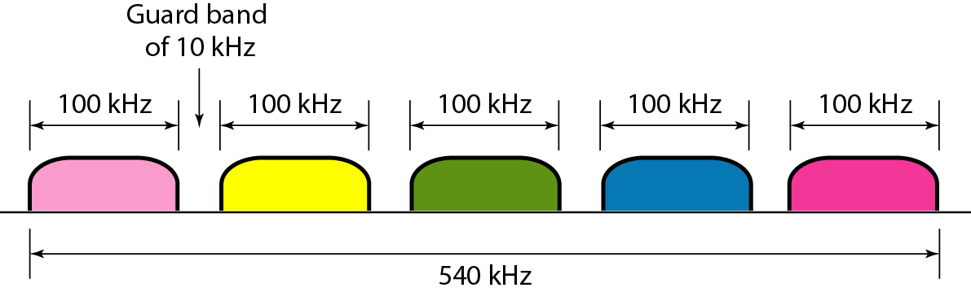
Example 6.1
Three voice channels in 12 kHz
Figure 6.6
Example 6.1
Voice 4 kHz each, link 20 to 32 kHz, no guard bands
Shift each channel to its own band
Example 6.2
Five channels with guard bands
Figure 6.7
Example 6.2
5 × 100 kHz, guard band 10 kHz
4 guard bands for 5 channels
B = 5 × 100 + 4 × 10 = 540 kHz

Slide 6
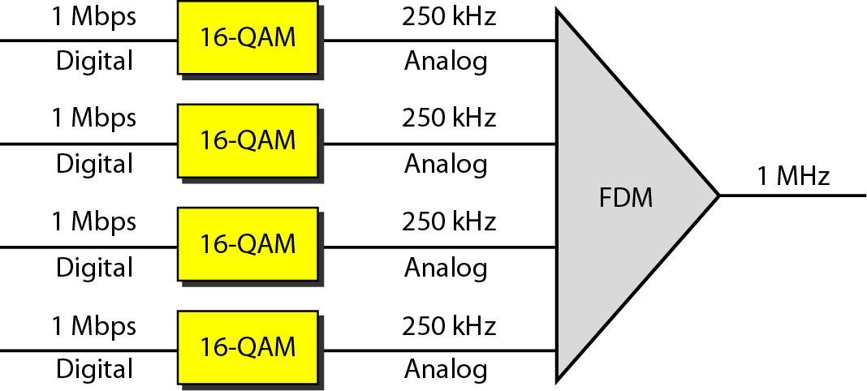
Example 6.3
Four digital channels on a satellite
Figure 6.8
Example 6.3
4 × 1 Mbps, satellite channel 1 MHz, analog
Divide into 4 × 250 kHz
Each 1 Mbps digital channel modulated at 4 bits per Hz
16-QAM, Chapter 5
Digital data, analog link: modulate first, then FDM

Slide 7
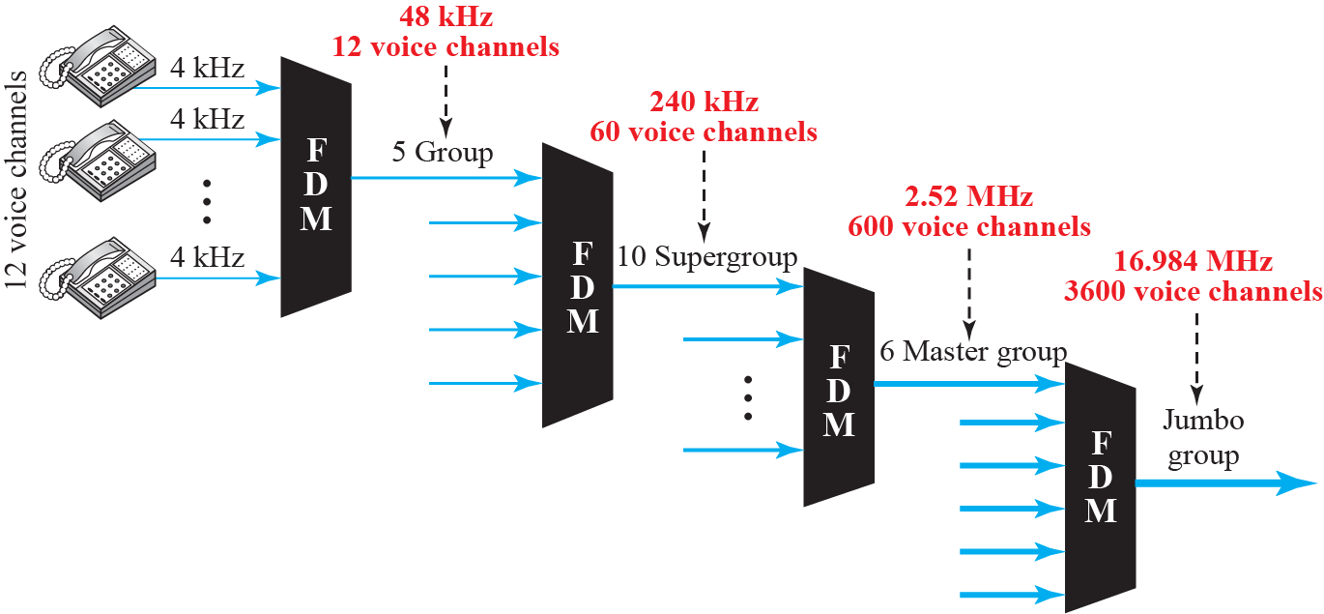
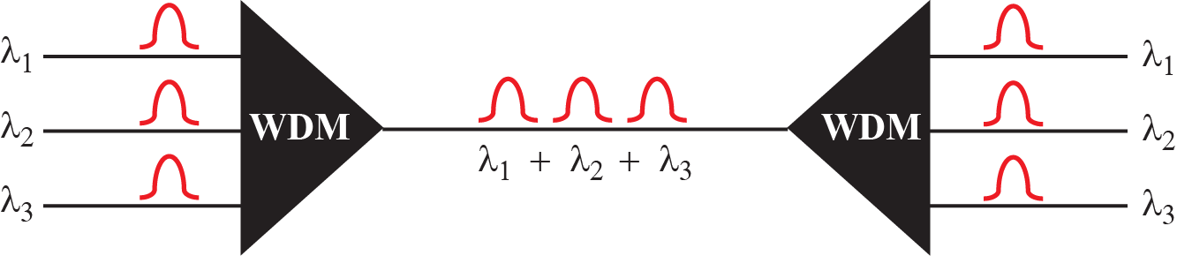
Figure 6.9
Analog carrier hierarchy
6.1.1
Analog hierarchy, and where FDM lives now
Telephone plant built groups from 12 voice channels, then supergroups
AM and FM broadcast, cable TV: FDM by nature
Modern form: OFDM and OFDMA
subcarriers instead of filters
Wi-Fi, LTE, NR downlink
Example 6.4
AMPS capacity
824 to 849 MHz uplink, 869 to 894 MHz downlink → 25 MHz each
30 kHz per user per direction
25 MHz / 30 kHz = 833, in practice 832 channels
42 channels for control → 790 usable
6.1.2
Wavelength-division multiplexing
Figure 6.10
Wavelength-division multiplexing
FDM applied to fibre, very high frequencies
Combine light beams of different wavelengths
Prism or diffraction grating splits and recombines
Fibre rate exceeds any single source: one line wastes it
DWDM packs dozens of wavelengths per fibre

Slide 8
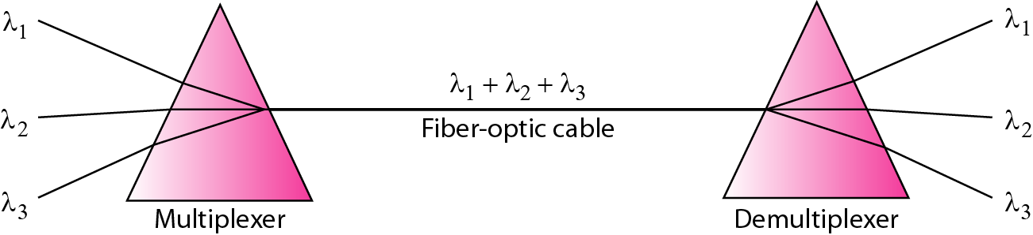
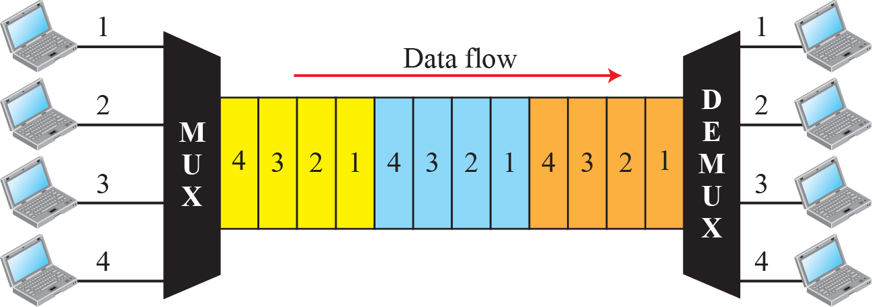
Figure 6.11
Prisms in WDM
6.1.3
Time-division multiplexing
Figure 6.12
TDM
Digital technique, time is shared, not bandwidth
Each connection occupies the link for a slot
Link carries the sum of the input rates
Synchronous: slots preassigned
Statistical: slots on demand

Slide 9
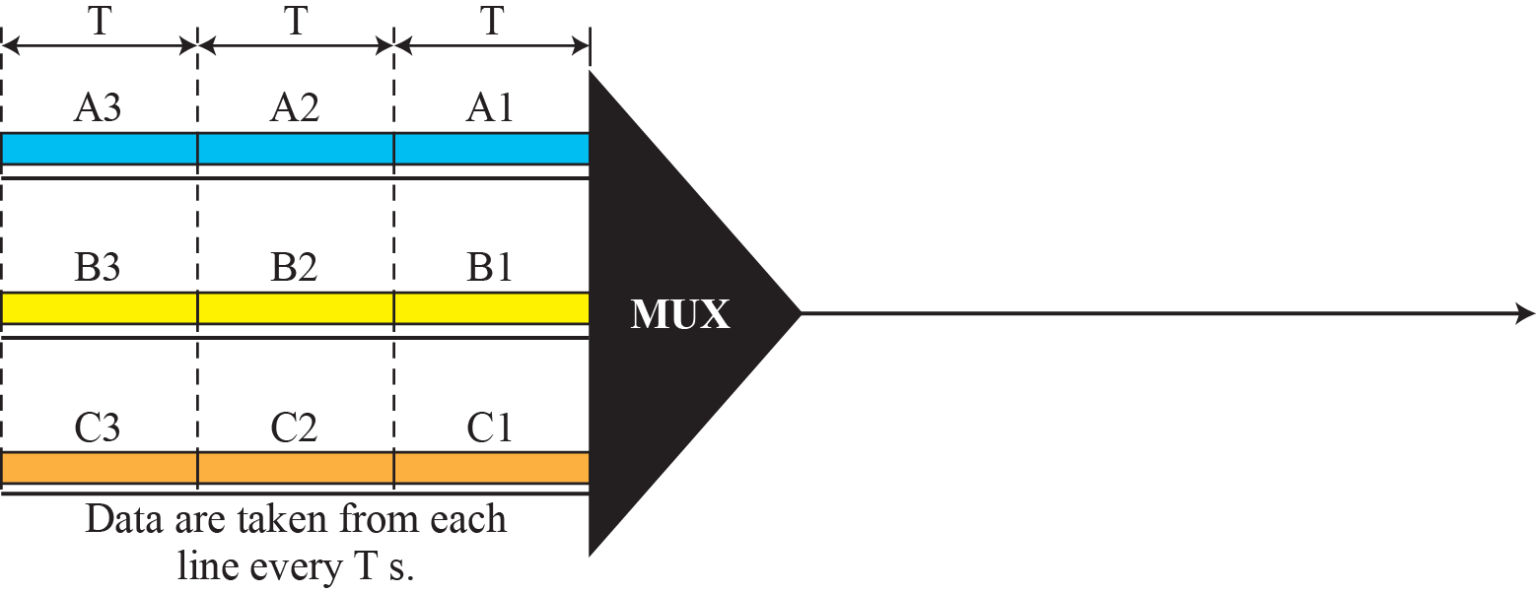
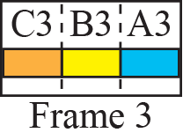
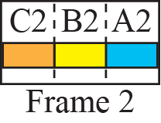
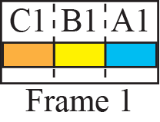
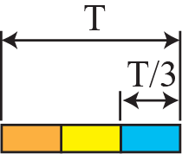

Figure 6.13
Synchronous TDM
Example 6.5
Slot durations
3 inputs at 1 kbps, 1 bit per slot
Input bit and input slot: 1 ms
Output slot: 1/3 ms
Frame = 3 slots = 1 ms

Slide 10
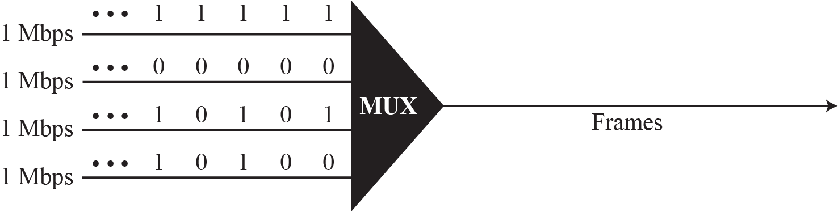
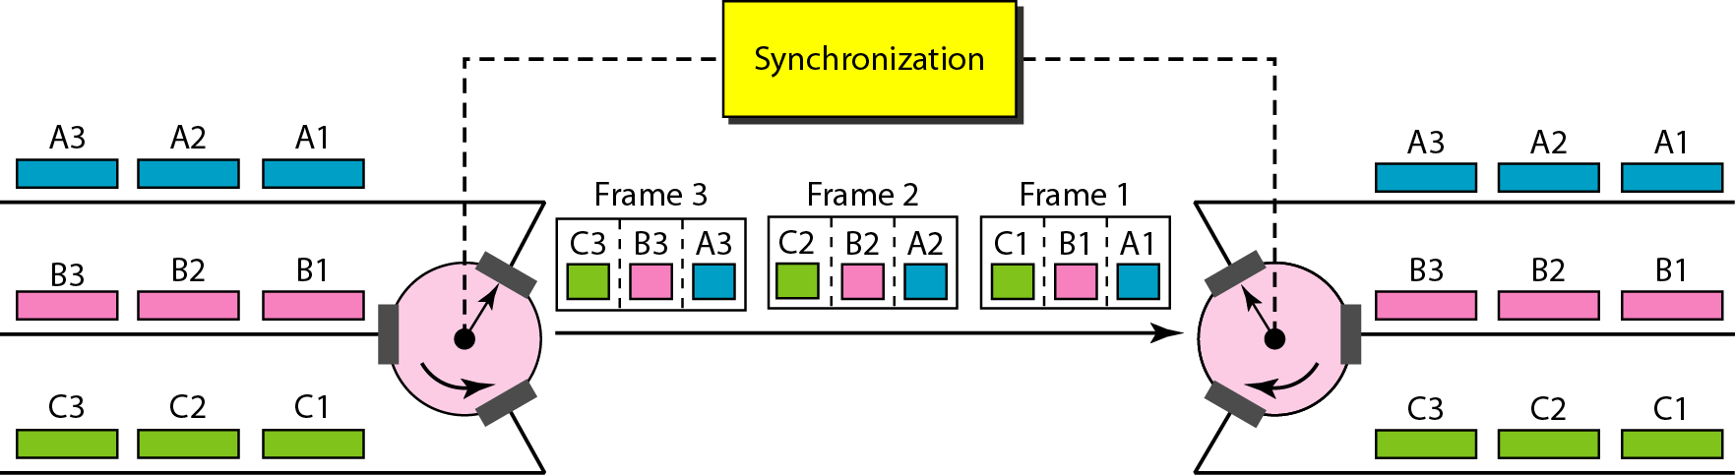
Figure 6.14
Example 6.6
Example 6.6
Rates from the figure
Input bit duration 1 ms, output bit duration 1/3 ms
Output rate 3 kbps, frame rate 1000 frames/s
Frame duration = input bit duration
Example 6.7
Four 1-kbps connections
Bit before multiplexing: 1 ms
Link rate 4 kbps, slot 1/4 ms, frame 1 ms
Figure 6.15
Interleaving
6.1.3
Interleaving
MUX and DEMUX as fast rotating switches
Switch opens on each connection in turn
Same order at both ends
Synchronization is the whole problem

Slide 11
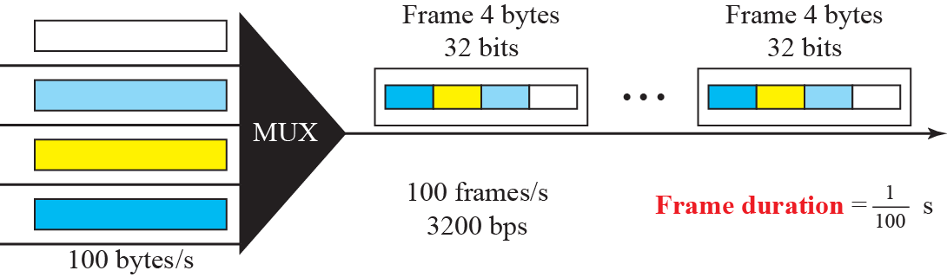
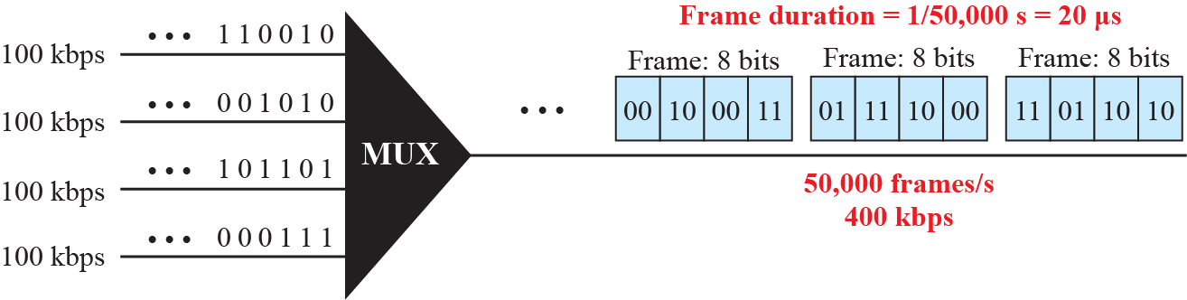
Example 6.8
Byte interleaving
Figure 6.16
Example 6.8
4 channels × 100 bytes/s, 1 byte per slot
Frame = 4 bytes = 32 bits, 100 frames/s
Link rate = 100 × 32 = 3200 bps
Example 6.9
Two-bit slots
Figure 6.17
Example 6.9
4 × 100 kbps, slot = 2 bits
50,000 frames/s, frame 20 μs
Frame = 8 bits → 400 kbps, bit 2.5 μs

Slide 12
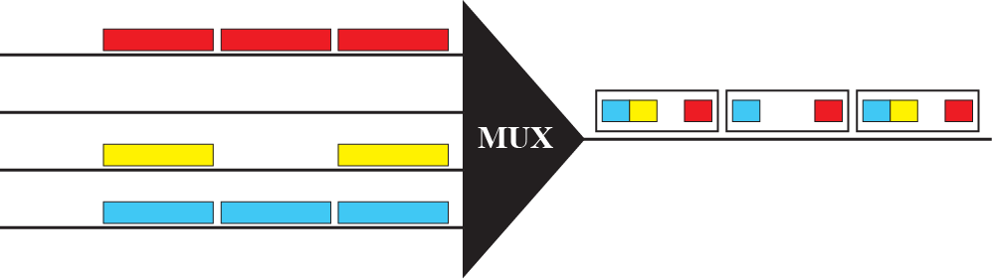
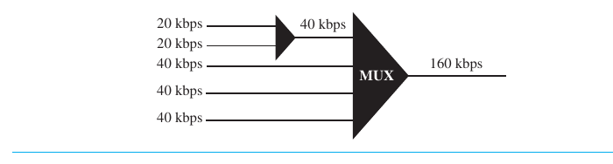
Figure 6.18
Empty slots
6.1.3
Cost of preassigned slots
Idle input still owns its slot
Empty slots waste link capacity
Statistical TDM removes them
6.1.3
Data rate management
Figure 6.19
Multilevel multiplexing
Problem: input rates not equal
Three strategies, or a mix
multilevel multiplexing
multiple-slot allocation
pulse stuffing
Missing from the original deck: Figures 6.19 to 6.21 recovered from the textbook

Slide 13
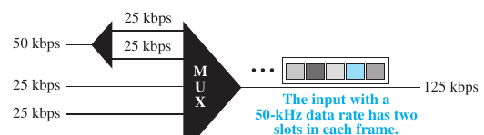
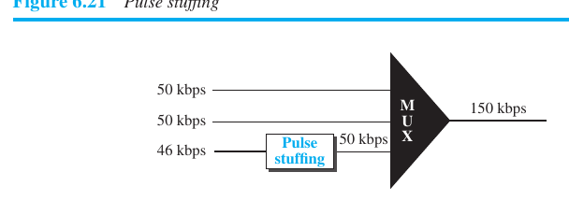
6.1.3
Multilevel
Figure 6.20
Multiple-slot multiplexing
One rate is a multiple of others
2 × 20 kbps → 40 kbps, then 4 × 40 → 160 kbps
6.1.3
Multiple-slot
Faster input gets more slots per frame
50 kbps input: 2 slots, via a demultiplexer
6.1.3
Pulse stuffing
Figure 6.21
Pulse stuffing
Rates not integer multiples of each other
Highest rate is the dominant rate
Add dummy bits to slower inputs: 46 → 50 kbps
Also called bit padding or bit stuffing

Slide 14
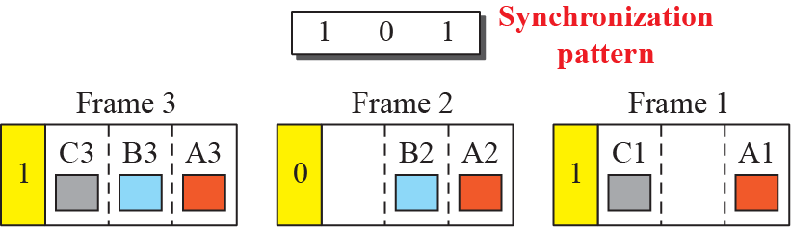
Figure 6.22
Framing bits
6.1.3
Frame synchronizing
MUX and DEMUX out of step → bits land in the wrong channel
Framing bits added at the start of each frame
Usually 1 bit per frame, alternating 0 and 1
DEMUX locks to the pattern, then separates slots
Example 6.10
Character interleaving with a sync bit
Example 6.11
Unequal rates, 100 and 200 kbps
4 sources × 250 characters/s → 2 kbps each
Character 4 ms, 250 frames/s, frame 4 ms
Frame = 4 × 8 + 1 = 33 bits
Link = 250 × 33 = 8250 bps, not 8000
1 slot to the first, 2 slots to the second
Frame = 3 bits, 100,000 frames/s
Frame duration 10 μs, printed as 10 ms: wrong
Link = 300 kbps, each input rate preserved

Slide 15
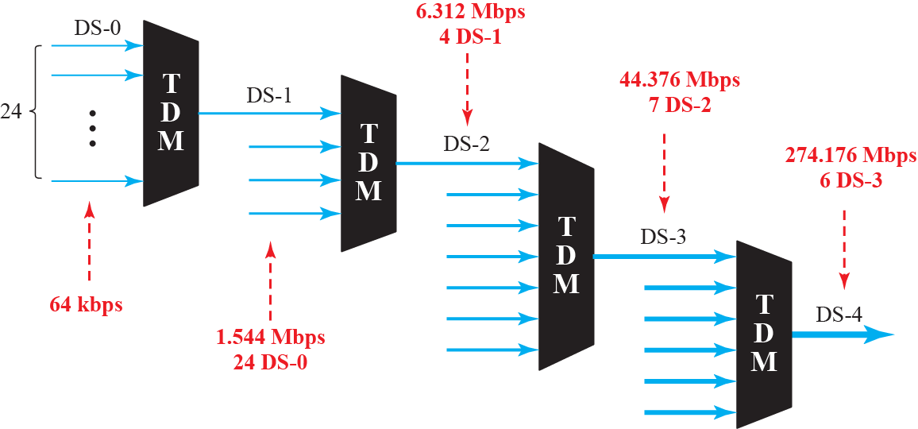
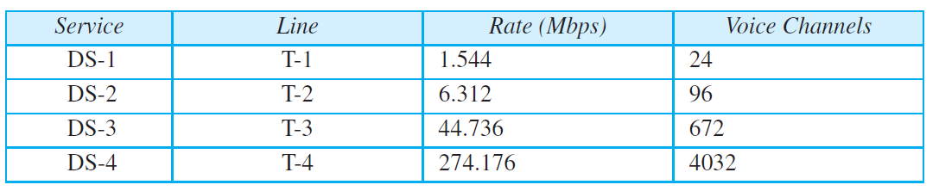
Figure 6.23
Digital hierarchy
Table 6.1
DS and T line rates
6.1.3
Digital signal service
Table 6.2
E line rates, missing from the original deck
DS-0: 64 kbps, one voice channel
DS-1: 24 × 64 kbps + 8 kbps overhead = 1.544 Mbps
DS-2: 96 channels, 6.312 Mbps
DS-3: 672 channels, 44.736 Mbps
body text prints 44.376, Table 6.1 is right
DS-4: 4032 channels, 274.176 Mbps
T lines carry DS services, T-1 and T-3 sold commercially
Line
Rate (Mbps)
Voice channels
E-1
2.048
30
E-2
8.448
120
E-3
34.368
480
E-4
139.264
1920

Slide 16
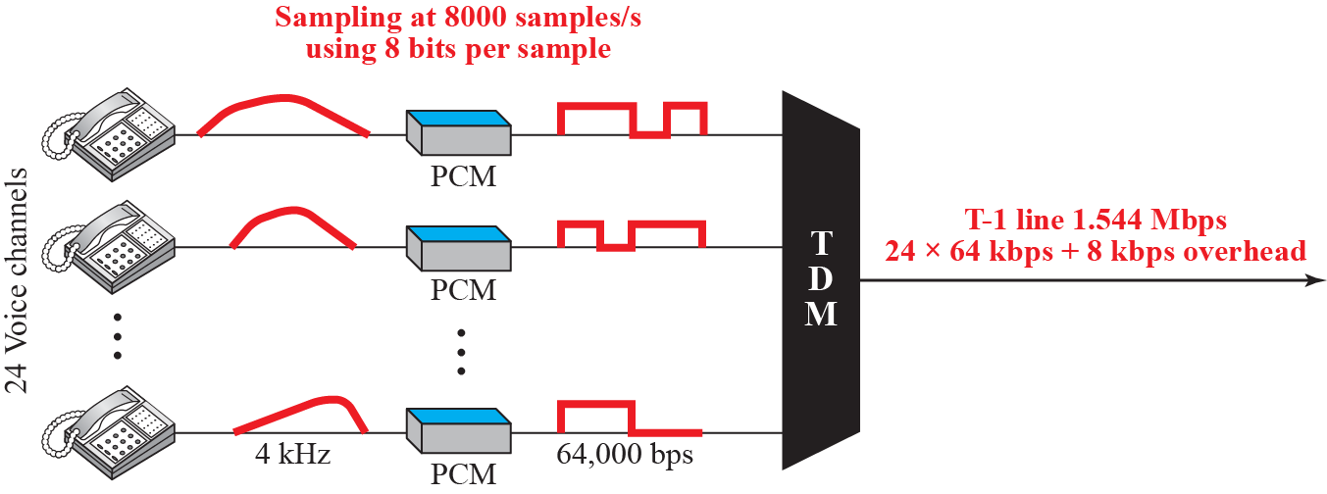
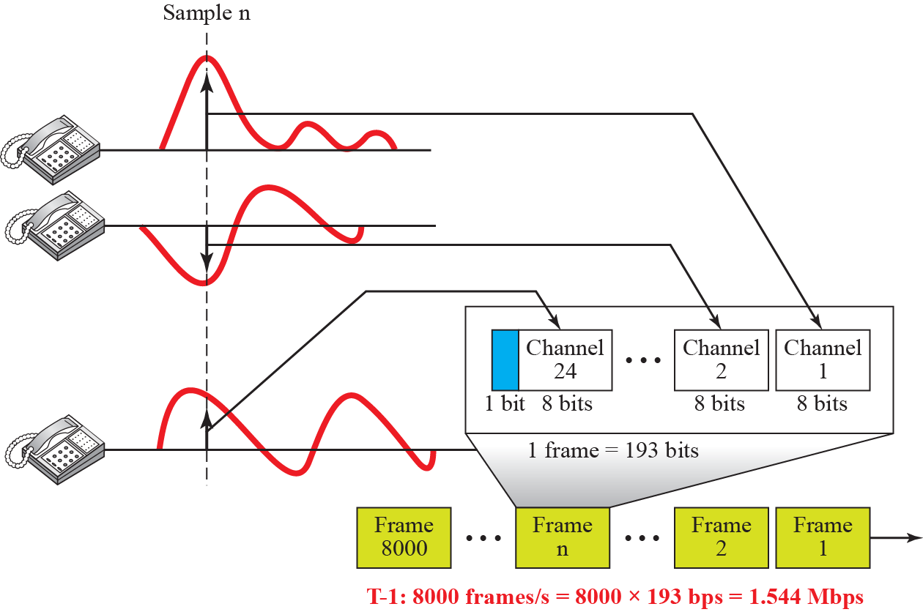
Figure 6.24
T-1 line for 24 voice channels
Figure 6.25
T-1 frame structure

Slide 17
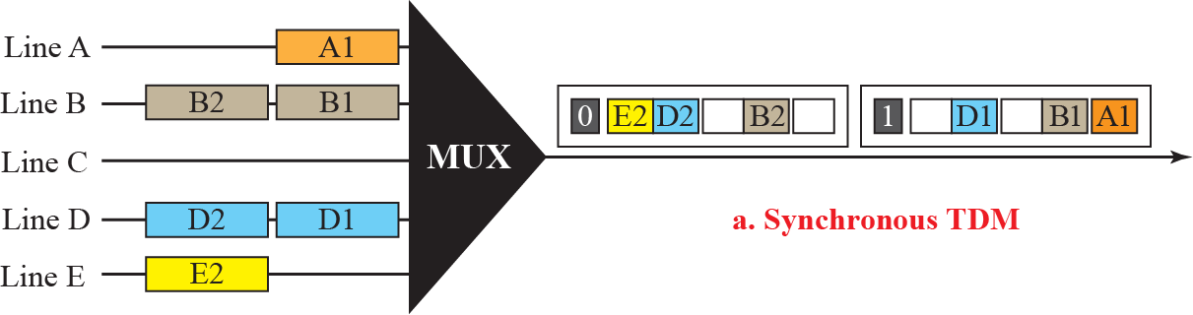
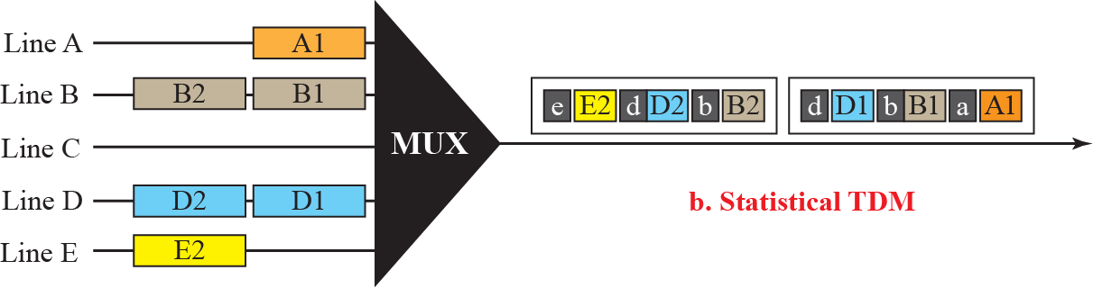
6.1.3
T-1
6.1.3
The 193-bit frame
24 voice channels, PCM from Chapter 4
Sampling 8000 samples/s, 8 bits per sample
24 × 64 kbps + 8 kbps overhead = 1.544 Mbps
24 slots × 8 bits + 1 framing bit = 193 bits
8000 frames/s × 193 = 1.544 Mbps
The 8 kbps overhead is that one bit per frame
Figure 6.26
Synchronous and statistical TDM compared
6.1.3
Statistical TDM
Slots allocated on demand, round robin
Slots per frame < number of inputs
No empty slots while any input has data
Slot must carry an address as well as data
synchronous TDM needs none: position is the address
Frame size varies, so framing bits are needed
6.1.3
Synchronous TDM in practice
2G digital cellular: 30 kHz band split into 6 time slots
six users per band, Chapter 16
Statistical TDM is what packet switching became
address in the header, no reserved slot

Slide 18
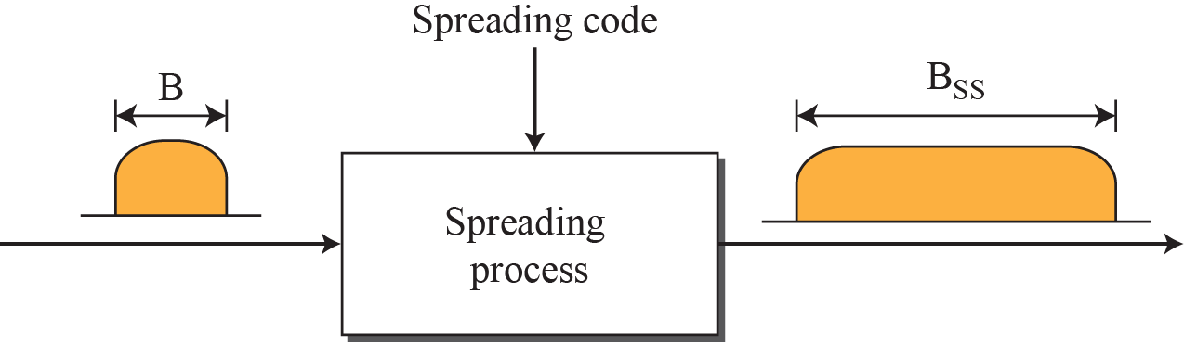
6-2
Spread spectrum
Figure 6.27
Spread spectrum
Wireless: all stations share air
Concerns that outweigh efficiency
eavesdropping, jamming
Add redundancy: B → Bss, Bss >> B
Two rules
allocated bandwidth far larger than needed
spreading independent of the signal, applied after it is created
6.2
Spreading code
Series of numbers that look random but are not
Both ends know it, an eavesdropper does not
FHSS and DSSS are the two techniques

Slide 19
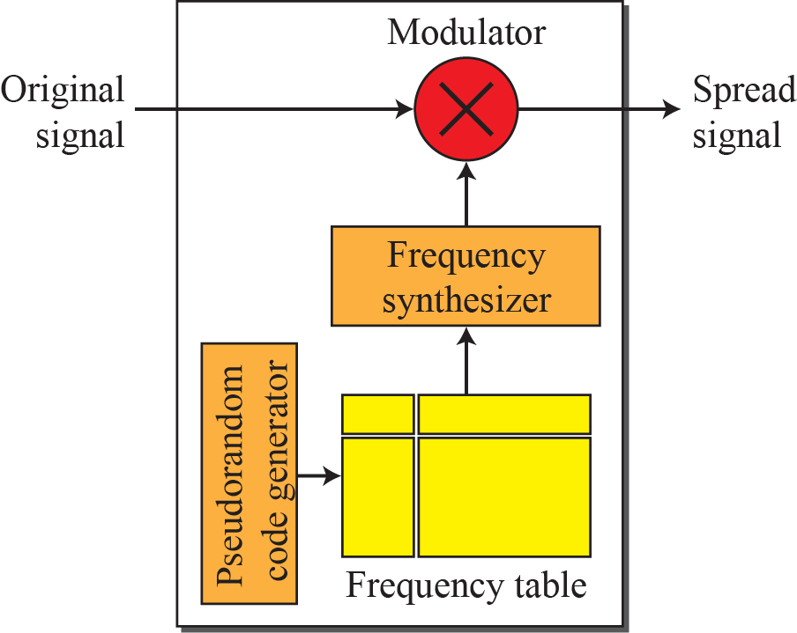
6.2.1
Frequency hopping spread spectrum
Figure 6.28
FHSS transmitter
M carrier frequencies, one at a time
PN generator: k-bit pattern per hopping period Th
Frequency table maps pattern → carrier
Synthesizer builds that carrier, source modulates it
M = 8 → k = 3 in the book's example
History: frequency hopping patented in 1942 by Hedy Lamarr and George Antheil

Slide 20
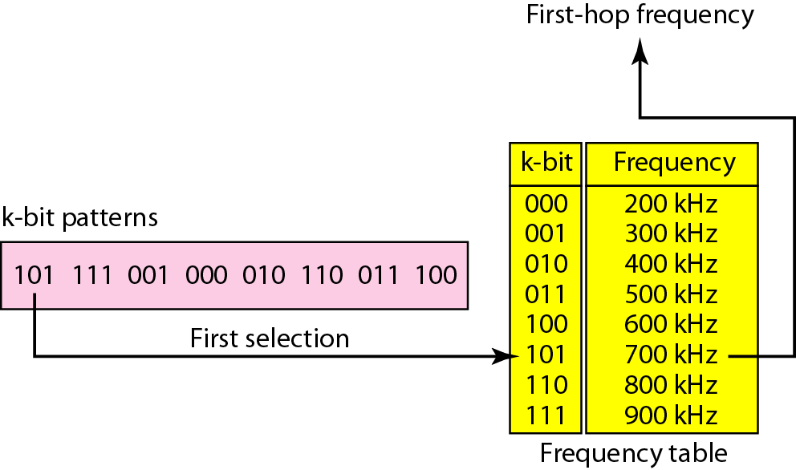
Figure 6.29
Frequency selection in FHSS
6.2.1
Reading the table
Pattern 101, 111, 001, 000, 010, 110, 011, 100
101 → 700 kHz, 111 → 900 kHz, 100 → 600 kHz
Repeats after 8 hops
Book's body text lists only 7 of the 8 patterns

Slide 21
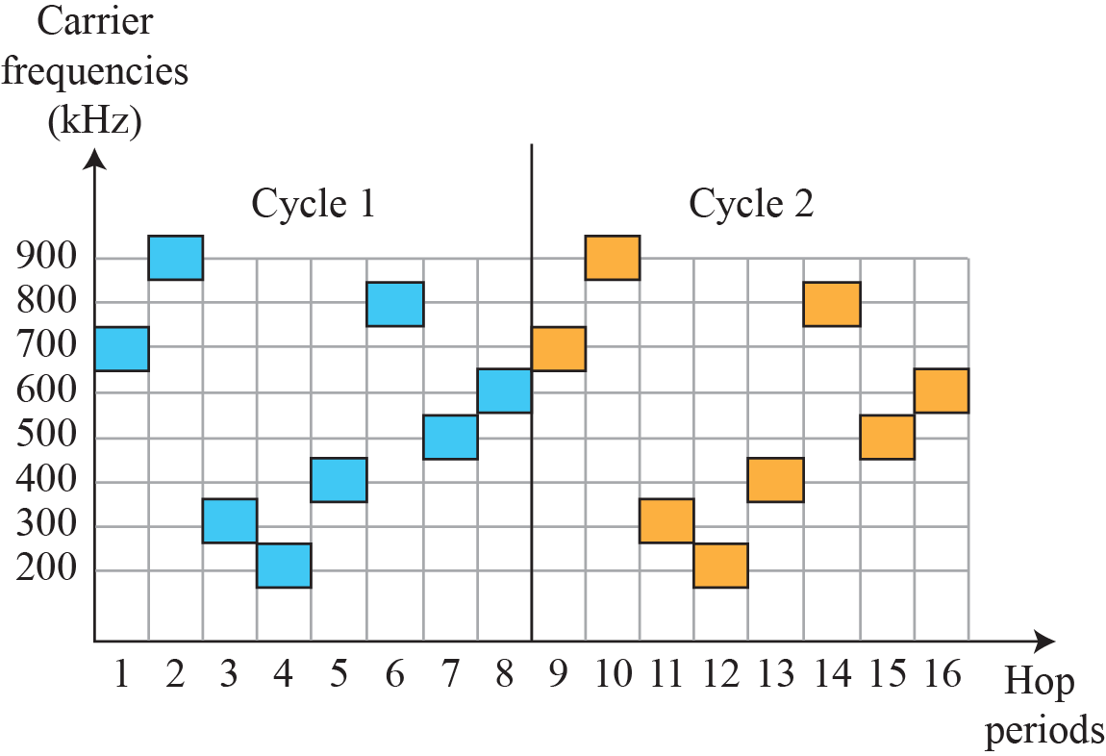
Figure 6.30
FHSS cycles
6.2.1
What hopping buys
Privacy: intruder catches one hop, not the sequence
Anti-jamming: jammer blocks one hop period, not all
M stations can share Bss, one frequency each per period
needs MFSK-type modulation
Bluetooth: 79 channels of 1 MHz, 1600 hops/s
adaptive hopping skips channels Wi-Fi is using

Slide 22
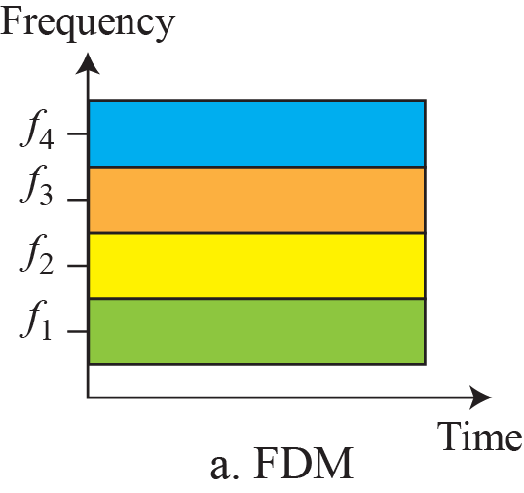
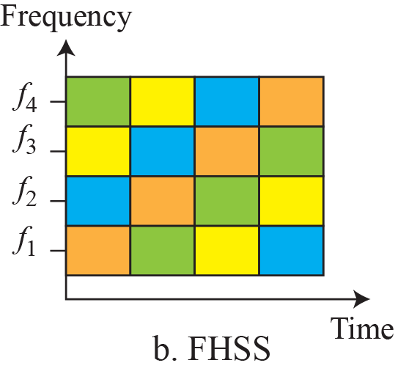
Figure 6.31
Bandwidth sharing, FDM against FHSS
6.2.1
FHSS against FDM
FDM: each station keeps one band all the time
FHSS: each station uses all bands, one at a time
Same total bandwidth, different occupancy in time

Slide 23
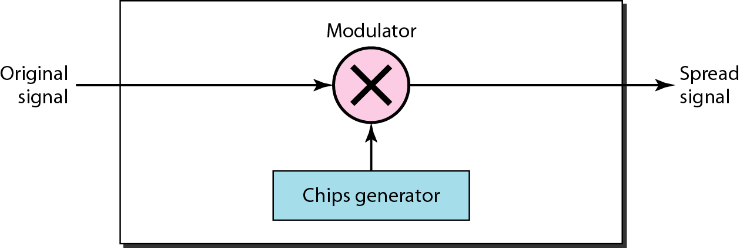
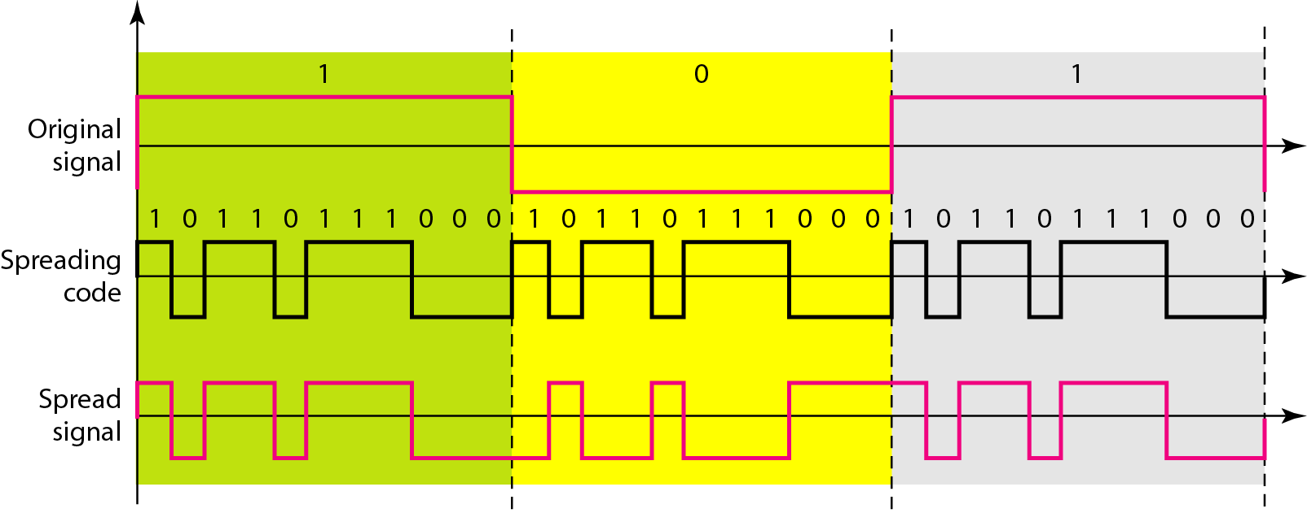
6.2.2
Direct sequence spread spectrum
Figure 6.32
DSSS
Each data bit replaced by n chips from a spreading code
Chip rate = n × bit rate → bandwidth × n
Original data and chips: polar NRZ, multiplied together
Receiver multiplies by the same code to recover the bit
Figure 6.33
DSSS with the 11-chip Barker sequence
6.2.2
Barker and sharing
Barker sequence, n = 11, pattern 10110111000
Rate N → 11N, bandwidth 11 times wider
802.11b uses it at 1 and 2 Mbps
Sharing: only with codes that combine and separate
that is CDMA, used by 3G, Chapter 16
Deck labels this Figure 6.32: it is Figure 6.33

Slide 24
6.1-6.2
Where each technique is used today
Technique
Used in
Note
FDM
AM and FM broadcast, cable TV, DSL subcarriers
analog filters, guard bands
OFDM, OFDMA
Wi-Fi, LTE, NR, DVB
FDM built with orthogonal subcarriers, no guard bands between them
WDM, DWDM
long-haul and metro fibre
dozens of wavelengths on one fibre
Synchronous TDM
T-1 and E-1 carriers, 2G voice, NR slot structure
position is the address
Statistical TDM
packet switching, Ethernet, IP
address in the header, no reserved slot
FHSS
Bluetooth, Bluetooth Low Energy
79 × 1 MHz, 1600 hops/s, adaptive hopping
DSSS
802.11b at 1 and 2 Mbps, GPS
11-chip Barker code
CDMA
3G cellular
DSSS with codes that allow sharing
Read it as one line of descent: divide the resource, or spread and share it. The choice follows the medium and the threat, not the theory.

Slide 25
Errata
Corrections to the printed slides and textbook
Where
Printed
Corrected
Section headings
6.6.1, 6.6.2, 6.6.3
6.1.1, 6.1.2, 6.1.3
Example 6.11
frame duration 10 ms
10 μs, 1/100,000 s
DS-3 rate, body text
44.376 Mbps
44.736 Mbps, as in Table 6.1
FHSS pattern, body text
7 patterns listed
8 patterns, M = 8
DSSS example caption
Figure 6.32
Figure 6.33
Figures 6.19 to 6.21
missing from the deck
recovered from the textbook
Table 6.2, E lines
missing from the deck
added
Statistical TDM text
missing from the deck
added, including addressing

Slide 26
EXPLORE
Multiplexing
EXPLORE
Spread spectrum
Wikipedia, Multiplexing: the family tree, FDM to CDM
https://en.wikipedia.org/wiki/Multiplexing
Wikipedia, FDM: guard bands, and DSL as a modern case
https://en.wikipedia.org/wiki/Frequency-division_multiplexing
Wikipedia, Channel access method: FDMA, TDMA, CDMA, OFDMA compared
https://en.wikipedia.org/wiki/Channel_access_method
Wikipedia, TDM: synchronous and statistical, with T-carrier
https://en.wikipedia.org/wiki/Time-division_multiplexing
Wikipedia, WDM: CWDM and DWDM grids on fibre
https://en.wikipedia.org/wiki/Wavelength-division_multiplexing
MathWorks, Bluetooth and WLAN coexistence: FHSS hopping against a 22 MHz DSSS channel
https://www.mathworks.com/help/wlan/ug/bluetooth_wlan_coexistence.html
EE Times, avoiding interference in the 2.4 GHz band: Barker, CCK, and hopping in one place
https://www.eetimes.com/avoiding-interference-in-the-2-4-ghz-ism-band/
WebSDR, University of Twente: watch FDM on a live waterfall
http://websdr.ewi.utwente.nl:8901/
Wikipedia, OFDMA: where FDM went after guard bands
https://en.wikipedia.org/wiki/Orthogonal_frequency-division_multiple_access

