Slide 1
Section 2.3: Basic IP Address Structure
허완
2015010644

Slide 2
Classful Addressing (1)
Originally, every unicast IP address had a network portion and a host portion
  Network : to identify the network on which the interface using the IP address was to be found
  Host : to identify the particular host on the network
Different networks might have different numbers of hosts, the partitioning of the address space involved five classes
  The class A, B, C were used for unicast addresses
  The classes are defined by the first few bits in the address
    0 for class A, 10 for class B, 110 for class C
    1110 for class D, 1111 for class E

Slide 3
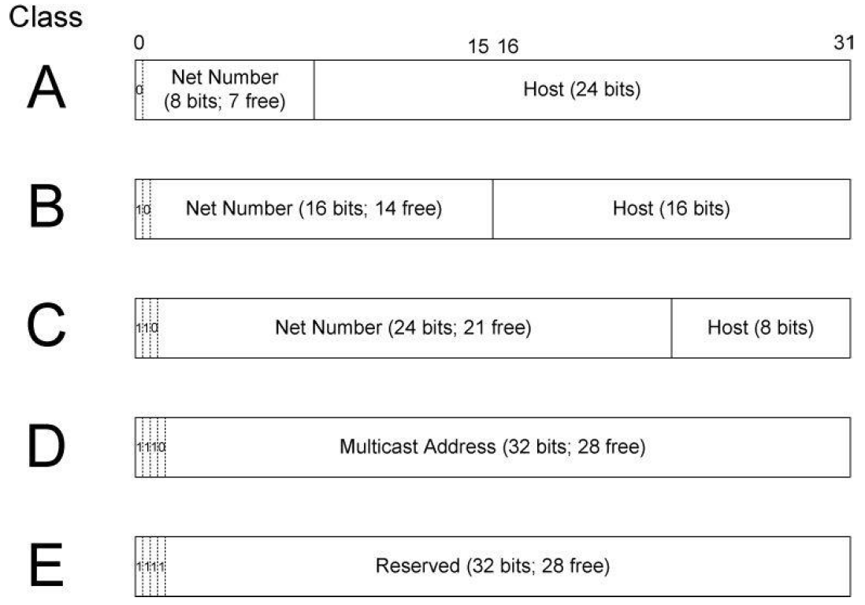
Classful Addressing (2)

Slide 4
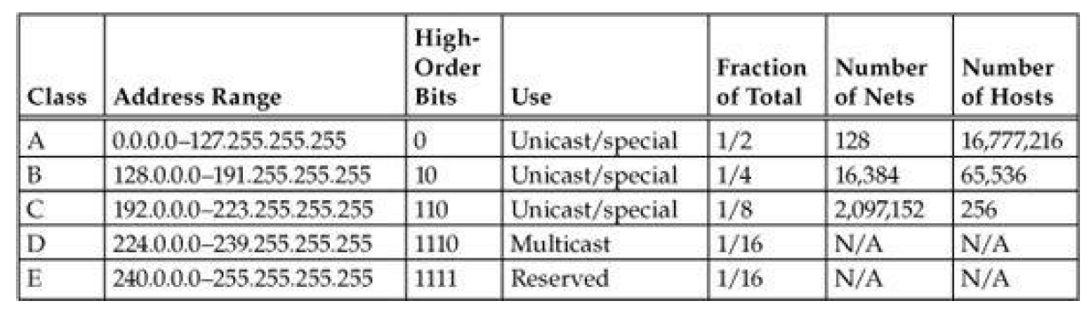
Classful Addressing
The original IPv4 address space partitioning
With the Internet’s growth (early 1980s), the scailing problems arose
  too inconvenient to centrally coordinate the allocation of a new class A, B, or C network number every time a new network segment was added to the Internet

Slide 5
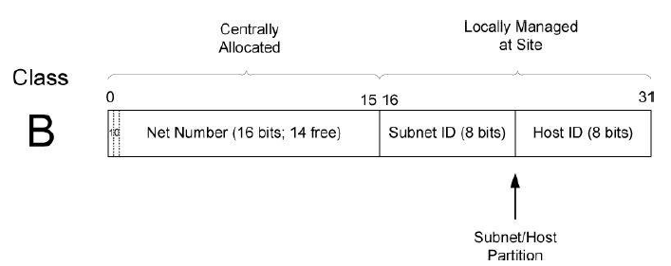
Subnet Addressing
One of the way to solve the problem is
  Allocating classful network to a site administrator and the administrator subdivides network and allocates subnetwork
  This is a subnet addressing
Implementing this idea would require the ability to alter the line between the network portion and the host portion, but only for local purposes at a site

Slide 6
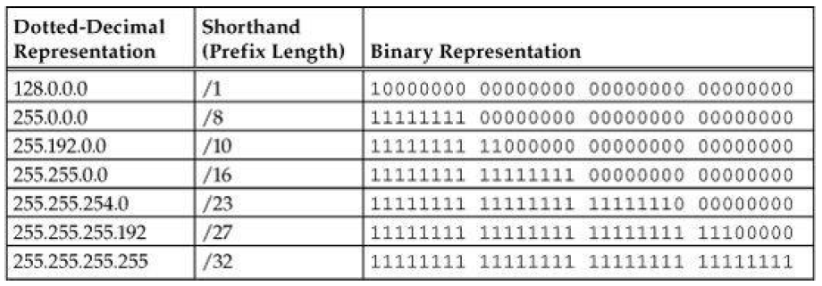
Subnet Masks (1)
Used to determine how the network and subnetwork information is partitioned from the host information
Subnet masks are structured as some number of 1 bits followed by some number of 0 bits
It is possible to use a shorthand format for expressing masks that simply gives the number of contiguous 1 bits in the mask – prefix length
  163.152.26.120/24 : An IP address in a C class

Slide 7
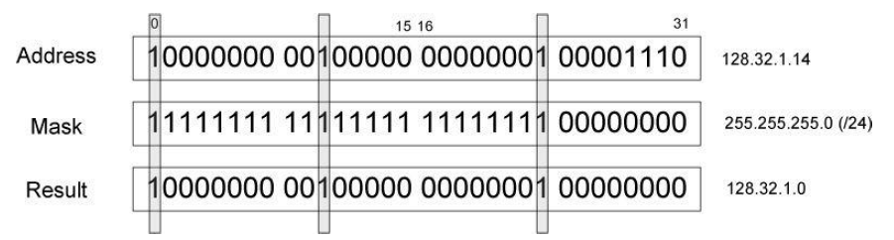
Subnet Masks (2)
Masks are used by routers and hosts to determine where the network/subnetwork portion of an IP address ends and the host part begins
A bit set to 1 in the subnet mask correspond with network portion of an address
  It is determined with a bitwise AND operation

Slide 8
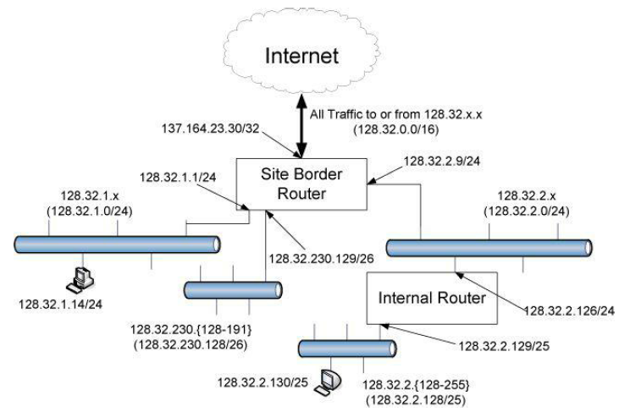
Variable-Length Subnet Masks (VLSM)
Using a different-length subnet mask applied to the same network number in different portions of the same site
It adds flexibility to the subnet structure

Slide 9
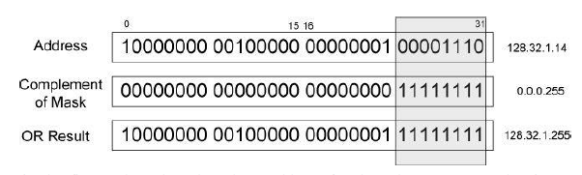
Broadcast address (1)
A special address that has all bits in the Host field to 1
  ex) the broadcast address of subnet 128.32.1.0/24 is 128.32.1.255
  Each IPv4 subnetwork has a broadcast address
Constructed by
  Invert the subnet mask
  Perform a bitwise OR with the address of any computers on the subnet

Slide 10
Broadcast address (2)
Directed broadcast : A message sent to a broadcast address is received by all hosts on the subnetwork
Local net broadcast
  The special-use address 255.255.255.255
  Similar with directed broadcast, datagram which has the address are not forwarded by routers

Slide 11
IPv6 Addresses and Interface Identifiers
IPv6 addresses have some additional structure. The scope is one of them
Scope refers to the portion of the network where it can be used
  Node-local : used only for communication on the same computer
  Link-local : used only among nodes on the same network link or IPv6 prefix
  Global : Internet-wide

