Slide 1
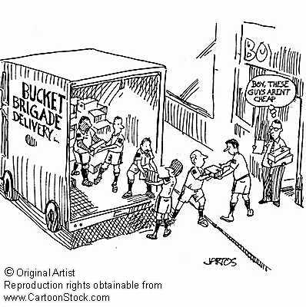
Introduction
Lecture 1

Slide 2
Protocol
(Formal) Language
3 elements

Slide 3
Internet
Internet = Inter + Net
Inter
Net

Slide 4

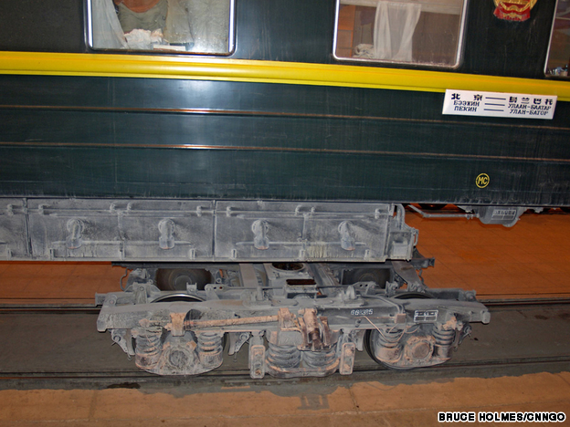
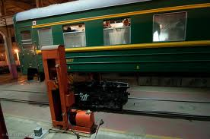
Internet(working) Protocol

Slide 5
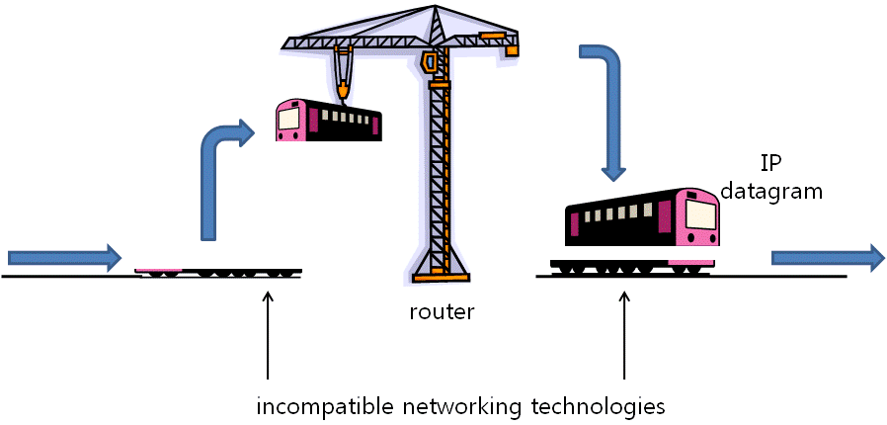
I P

Slide 6
How Internet works
Like a bucket brigade

Slide 7
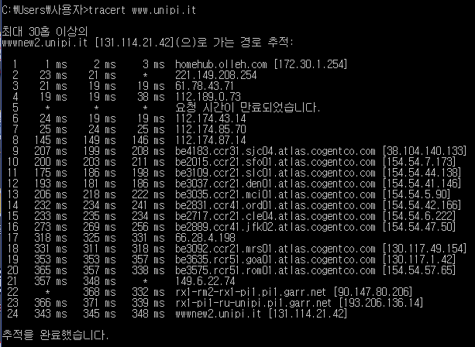
How Internet works

Slide 8
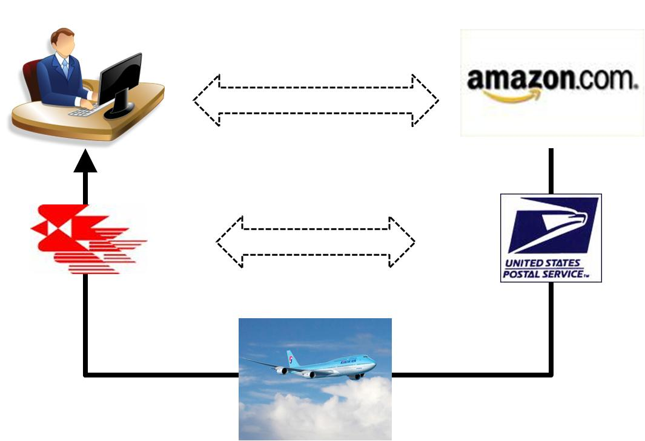
Layering principle

Slide 9
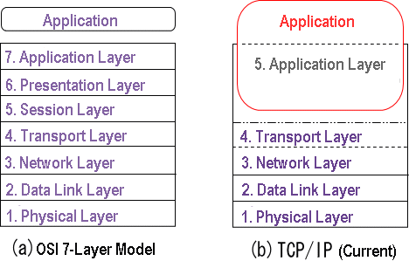
Layering principle

Slide 10
Layering principle
Physical
(Data)Link
(Inter)Network
Transport
Application

Slide 11

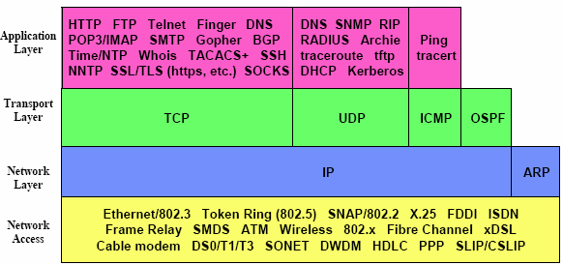
Internet protocol suite
Not just IP!

Slide 12
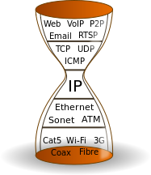
Hourglass model

Slide 13
Encapsulation
Encapsulation
Decapsulation
Multiplexing
Demultiplexing

Slide 14

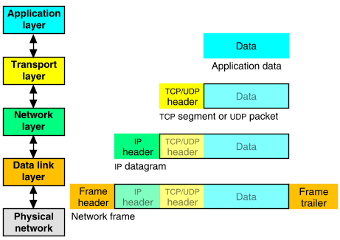
Encapsulation and decapsulation

Slide 15
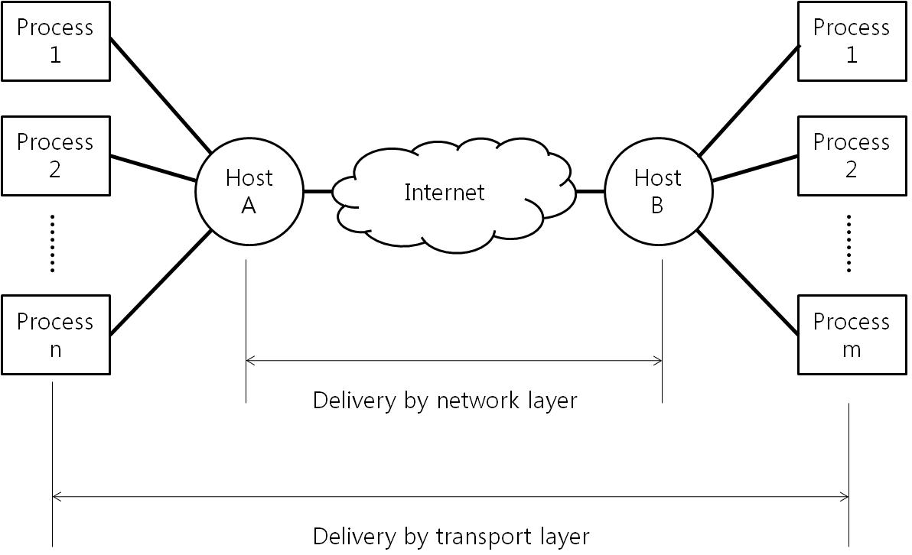
Encapsulation and decapsulation

Slide 16
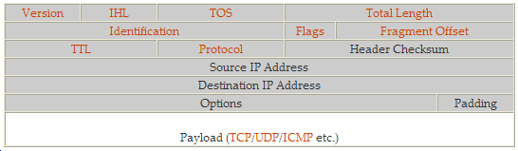
Multiplexing and demultiplexing

Slide 17
How Internet is structured
Tier 1 ISP
Tier 1 ISP
Google
IXP
IXP
IXP
Regional ISP
Regional ISP
access
ISP
access
ISP
access
ISP
access
ISP
access
ISP
access
ISP
access
ISP
access
ISP

Slide 18
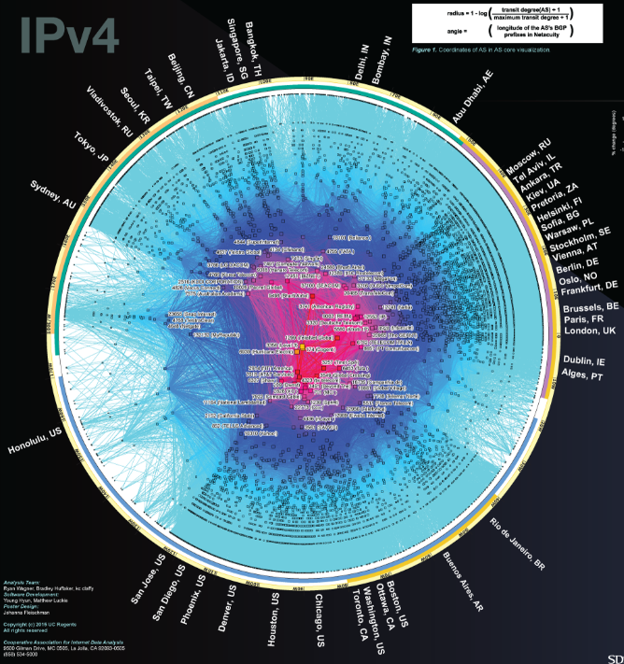
How Internet is structured

Slide 19
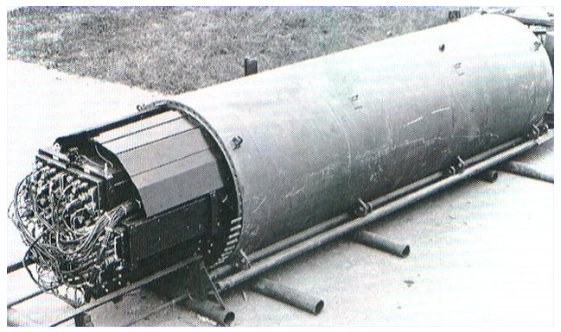
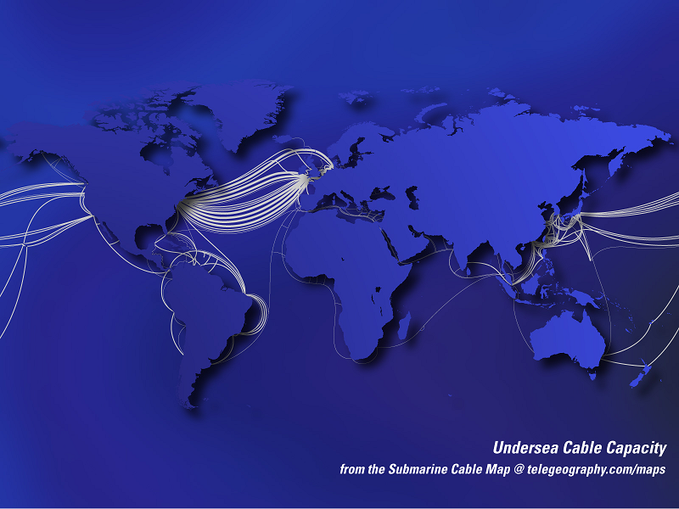
How Internet is connected

Slide 20
Standardization
Internet Engineering Task Force (IETF)
Internet Engineering Steering Group (IESG)
Internet Architecture Board (IAB)

Slide 21
Backup slides

Slide 22
Switching
Packet switching
  Datagram
  Virtual circuit
Circuit switching

Slide 23
Duplex modes
Simplex
Duplex
  Half duplex
  Full duplex

Slide 24
Connection
Connectionless
Connection-oriented

