Slide 1
On the Feasibility of Real-Time Phone-to-Phone 3D Localization
Jian Qui, David Chu, Xiangying Meng, Thomas Moscibroda
Sensys 2011
Jung Ho Lee

Slide 2
Motivation
The proliferation of smartphones has given rise to effective solutions for countless applications scenarios
But even with the most modern and sophisticated of smartphones, certain classes of applications remain elusive
So, enable new class of applications on today`s phones
HLLP: a new class of apps
  High-Speed, Real-Time
  Locational
  Phone-to-Phone
Location, orientation, movement is an integral part of the app

Slide 3

Motivation
Example: face-to-face sword fight game between phone users
Ping-pong type of game
Combining screens into one

Slide 4
HLPP design considerations
Centimeter-resolution accuracy
No infrastructure support
No hardware changes
Mobility tolerant
Face-to-face

Slide 5
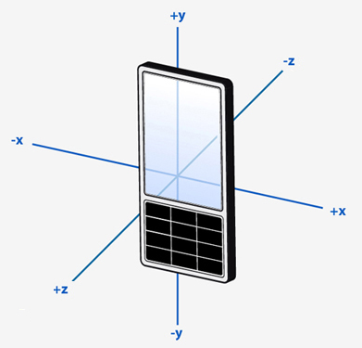
Technical challenge
accurate, relative 3D localization between phones in real-time
    Relative location of one phone to another
Phone 1
Phone 2

Slide 6
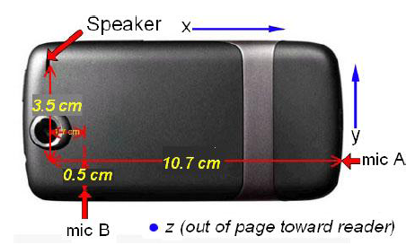
Phone-to-phone 3D localization
Idea: use multiple microphones & sensors on the phone
- Multiple microphones : acoustic 3D triangulation

Slide 7
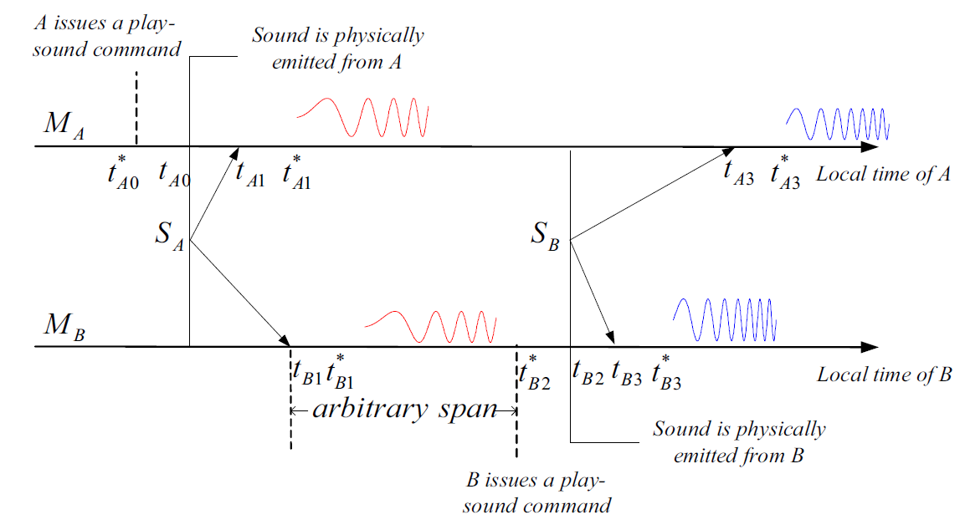
Acoustic ranging (1D) review
C. Peng, G. Shen , “Beepbeep: a high accuracy acoustic ranging system using cots mobile devices,” Sensys`07
Distance measurement between M_{A} and M_{B}
Acoustic time-difference-of-arrival based
Pros: accurate, error in cms
Cons:
- distance measurement only
- works only for static scenario

Slide 8
Design overview (primary mode)
Initialization
  perform loose time synchronization (calculating Wi-Fi round trip time and exchanging local clock value)
Exchange acoustic tones
    Scheduling transmit timing based on time sync info.
    Record accelerometer and compass measurements for rotation matrix
Calculate distance and angle measurements
  Two types of acoustic cues (ToA cue & power cue)
  Exchange measurements
Estimate 3D position
    Kalman-filter based

Slide 9
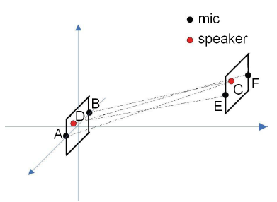

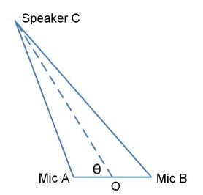

Time-of-arrival cues
Use Multiple Localization Cues:
Time-of-Arrival Cues
use ranging as a subroutine

Slide 10
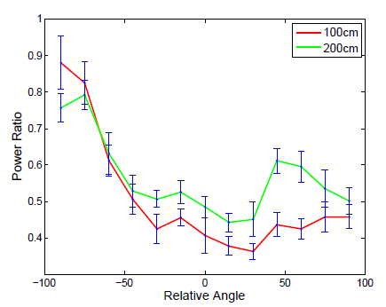
Power cues
Use Multiple Localization Cues:
Power Cues
Observation: two mics experience different attenuation of received

Slide 11
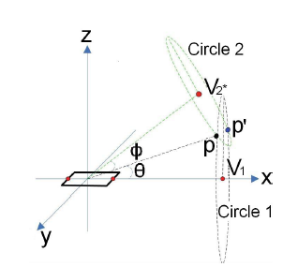
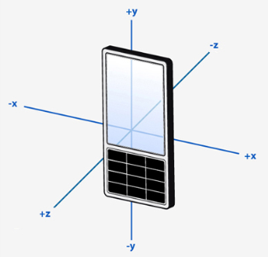
Static 3D localization
Two microphones on one phone is not enough for 3D localization
- each phone only obtains one relative angle to the other phone
- one angle does not define a unique position, but rather a “cone of confusion”
Two angles in two different planes → 3D localization
Phone 1
Phone 2

Slide 12
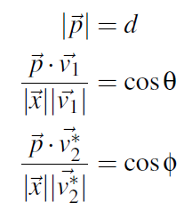
Angle to 3D position translation
Combine two angle measurements to calculate 3D location
- obtain rotation matrix of each phone on earth (from accelerometer + compass)
- convert coordinate systems by applying rotation matrices
- find the intersection point(s) by closed form or least square method
- two points remain: eliminate one by tracking
z coordinate

Slide 13
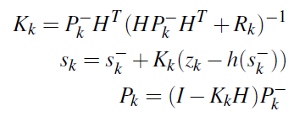

Continuous 3D localization
Use Extended Kalman Filtering for continuous localization
- predict next possible position based on current position, velocity and acceleration
- correct the estimate by:
- new measurement of angles and distance
- pre-calculated static angle and distance measurement error
- use both ToA and Power cues
- weight cues based on expected standard deviation of the angle calculated by the cues
Robust to motion
- < 1° error for up to ~5 m/s

Slide 14
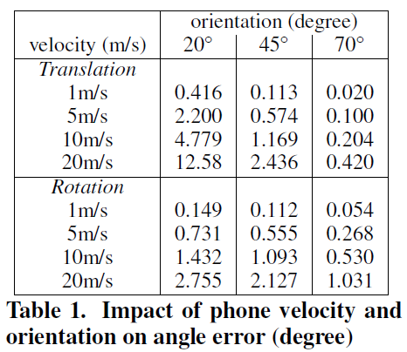

Augmenting acoustic localization fallback mode
Phones may exhibit poor acoustic alignment (e.g. when mic is facing away from remote speaker)
- Initialization establishes initial coordinates based on
the last primary mode coordinates
- Phones continuously exchange accelerometer and
compass readings
- Based on local and remote accelerometer and
compass updates its position estimate
- If it is detected that the phones are back within
the alignment region, primary mode is restarted
- A comparison of θ > ρ servers to indicate
whether the remote phone is outside the alignment
region

Slide 15
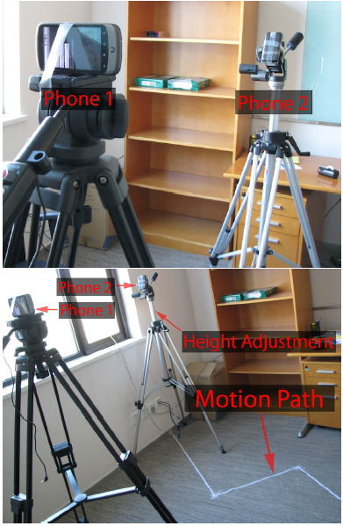
Implementation & evaluation
Implementation choices
- tone selection: 2-4kHz, 25ms (duration time),
BPSK codes; partial tone overlap
- Nexus One (simultaneous mic recording blocked)
- latency: 35-50ms for tone exchange, 3.2s for
signal processing, <1ms for location
calculation
Evaluation
- primary mode only
- tested both static positioning and simulated
motion paths
- tested ToA and Power cue angle errors individually
- tested full path error

Slide 16
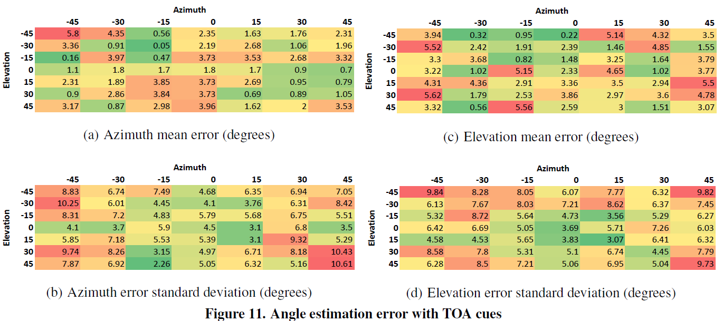
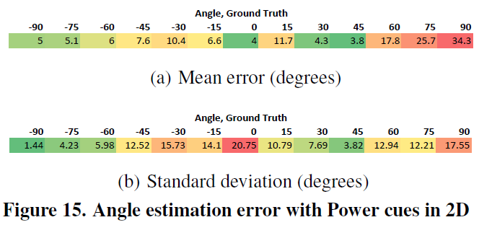
ToA cue performance

Slide 17
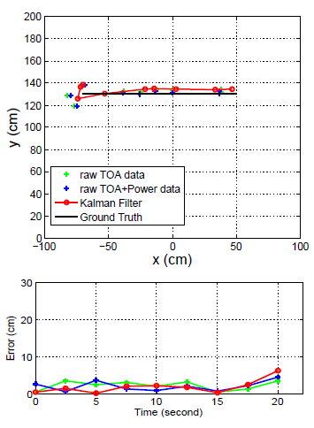
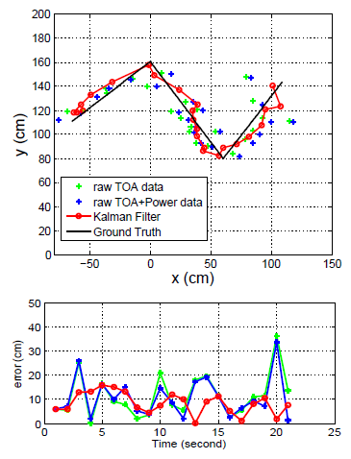
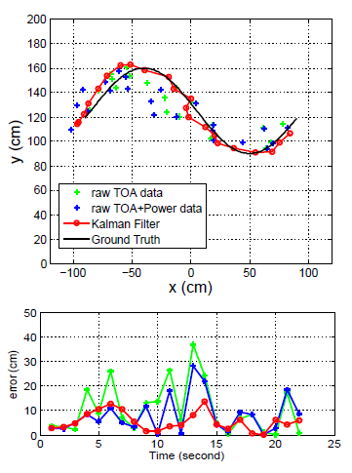
Motion Path examples
Phone 1 is fixed at (0,0)
Phone 2 is moving along Ground Truth path

Slide 18
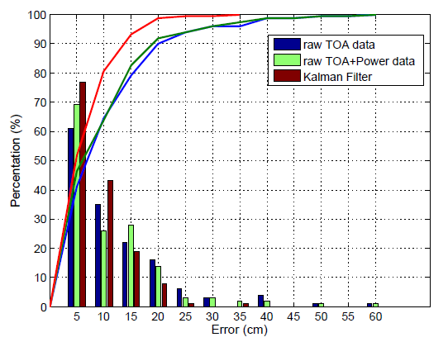
Position error across all motion paths

Slide 19
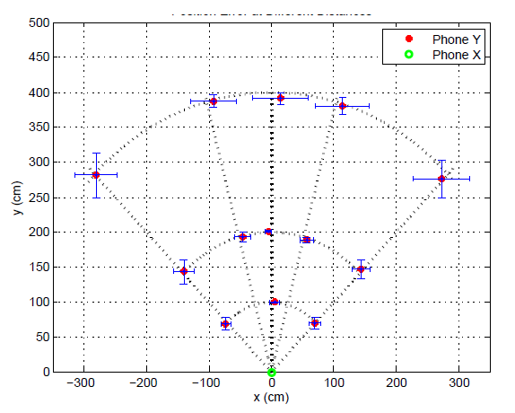
Position error at various distances
Reasonable error in room-size environment

Slide 20
Conclusion
3D localization with just two regular phones by combining available sensors
90th percentile accuracy: 13.9 cm
50th percentile accuracy: 4.9 cm
Potential for new class of High-Speed, Real-time, Locational Phone-to-Phone apps and games

