Slide 1
Address Resolution Protocol (ARP)
Chapter 3

Slide 2

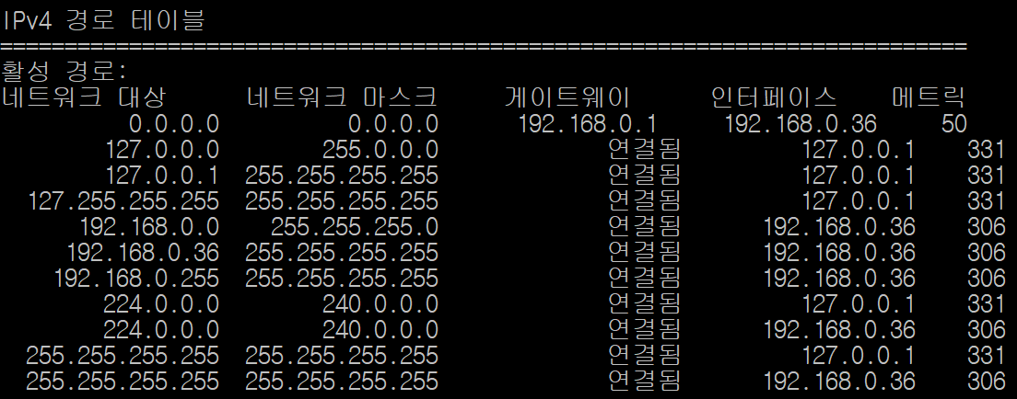
3.1 Concept of ARP
Required for shared links
  Ethernet, Wi-Fi
Which of the multiple interfaces attached to a shared medium should receive?
  MAC address
IP knows the next hop's IP address but not its MAC address

Slide 3
3.2 Overview of ARP Protocol Operation
Implemented in the kernel of every computer connected to a shared link
  e.g., used when a smartphone is connected to Wi-Fi
An IP datagram for the next hop IP address arrives: operating condition
  Only operates when the MAC address for the next hop IP is unknown: ARP request
  Operates at most once per IP datagram
    No retransmission
    The IP datagram waits in queue until an ARP reply arrives
    Discarded if a pending request for the same destination already exists

Slide 4
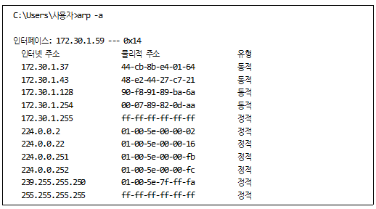
3.2 Overview of ARP Protocol Operation
ARP Cache
  arp –a
  Temporary storage: lifetime = 1200 seconds
    In recent implementations, refreshed by 1200 seconds on each cache hit
  For IPv4; in IPv6, called neighbor cache

Slide 5
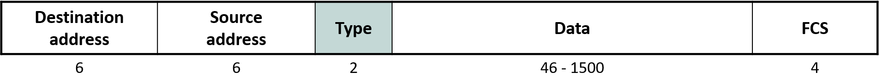
3.2 Overview of ARP Protocol Operation
Final Destination IP  (Routing Table)  Next Hop IP  (ARP Cache)  Next Hop MAC

Slide 6
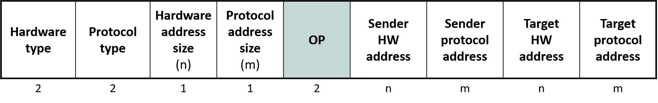
3.3 ARP Packet Format
ARP
  Hardware = data link layer technology: e.g., Ethernet = 0x0001
  Protocol = network layer technology: e.g., IPv4 = 0x0800
  OP: 1=request, 2=reply
  Sender = originator of the message (request/reply)

Slide 7
3.3 ARP Packet Format
Why include the sender's protocol address (i.e., IP address) in the request?
  Reason:

Slide 8
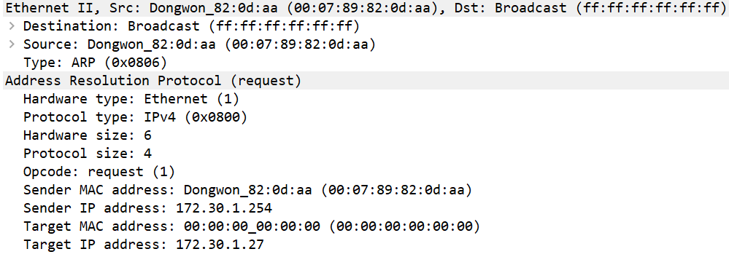
3.3 ARP Packet Format
ARP Request: Link-layer broadcast

Slide 9
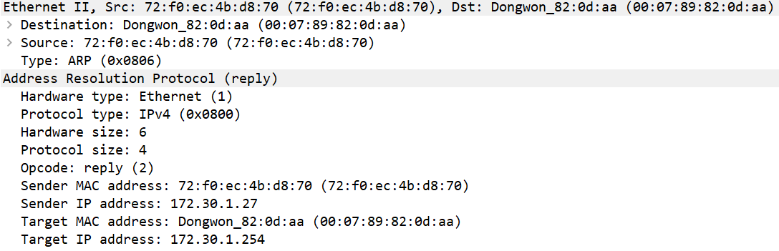
3.3 ARP Packet Format
ARP Reply: Unicast

Slide 10
3.4 ARP Cache Update Rules
When host A receives a request from host B (MACB)
  If Target Proto = A:
    Store Sender Proto = B → Sender HW = MACB in A's ARP cache
    Put Sender Proto = A → Sender HW = MACA in an ARP reply and send to MACB
    B stores A's mapping carried in the reply
  If Target Proto = C  A:
    If A's ARP cache has (B → ?): overwrite with mapping B → MACB from current request
    Otherwise, not applicable; ignore
Rule 2- is used for automatic update of new mappings due to MAC address changes

Slide 11
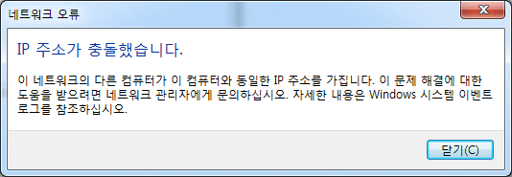
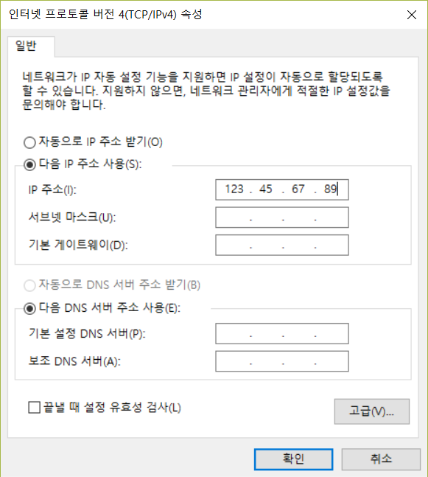
3.5 Special ARP Cases
Uses of Gratuitous ARP (request!)
  Mapping update due to MAC address change: using rule 2-
    When new interface HW is installed
    Failover of a redundant server
  IP Address Conflict Detection (Duplicate Address Detection; DAD)
    Sender Proto = Target Proto = self
    If anyone replies, it is abnormal: IP address conflict
    Always run DAD first whenever a new IP address is assigned
      e.g., when a new IP address is assigned due to a Wi-Fi AP change

Slide 12
3.5 Special ARP Cases
Address Conflict Detection (ACD)
  Used in recent OSes instead of GARP to avoid the side effects of rule 2-
    What is the side effect of GARP if a request is sent using another host's IP address as Source Proto?
  Procedure
    Set (Source Proto = 0.0.0.0, Target Proto = desired new IP address) (Probe)
    Send ARP request
    If a reply is received, it is abnormal: IP address conflict
    If no reply, set Source Proto = desired new IP address and resend ARP request (Announcement)
      Apply rule 2-

Slide 13
3.5 Special ARP Cases
Consequences of ARP Cache Poisoning
  ARP poisoning, ARP spoofing
  Can intercept others' IP packets (hijacking)
  Why do modern routers unnecessarily(?) repeat ARP requests every few tens of seconds?
    Cf. random access MAC of shared links
    Can the victim recover?
  Effect of slowing down the victim's internet access

Slide 14
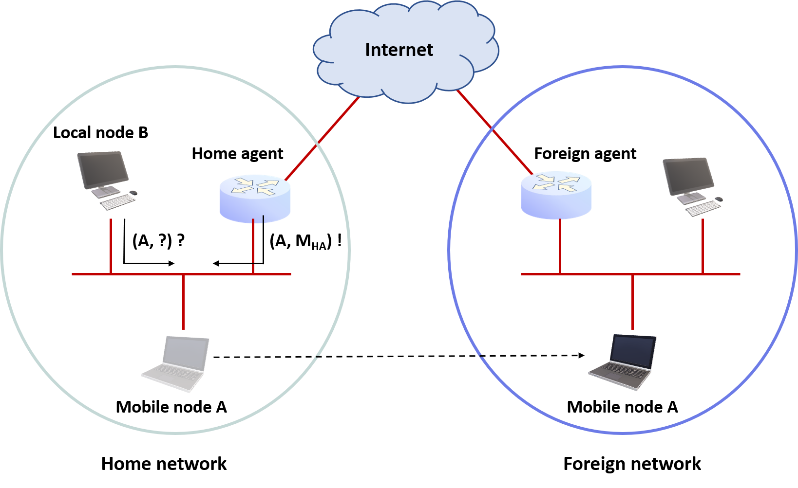
3.5 Special ARP Cases
Proxy ARP
  There are cases where a reply that intentionally maps another host's IP address to one's own MAC address is needed

Slide 15
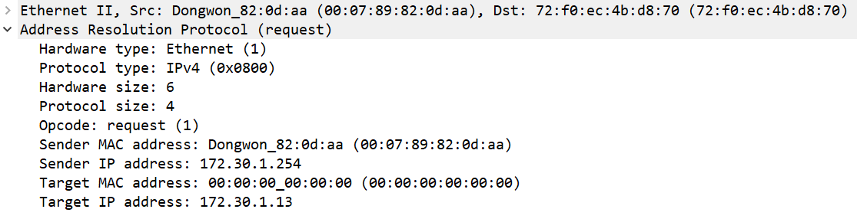
3.5 Special ARP Cases
Directed ARP
  Unicast ARP request: “Unicast poll”
  Validity check for entries whose 1200-second lifetime has expired

Slide 16
3.6 ARP Cache Manipulation Commands
C:\Users\User>arp -a -v Interface: 127.0.0.1 --- 0x1 Internet Address Physical Address Type 224.0.0.2 static 224.0.0.22 static 224.0.0.251 static 224.0.0.252 static 224.0.1.60 static 239.255.255.250 static Interface: 172.30.1.59 --- 0x14 Internet Address Physical Address Type 172.30.1.20 f4-42-8f-5c-93-bf dynamic 172.30.1.37 44-cb-8b-e4-01-64 dynamic 172.30.1.43 00-00-00-00-00-00 invalid 172.30.1.44 4a-45-27-22-90-37 dynamic 172.30.1.128 90-f8-91-89-ba-6a dynamic 172.30.1.254 00-07-89-82-0d-aa dynamic 172.30.1.255 ff-ff-ff-ff-ff-ff static 224.0.0.2 01-00-5e-00-00-02 static 224.0.0.22 01-00-5e-00-00-16 static 224.0.0.251 01-00-5e-00-00-fb static 224.0.0.252 01-00-5e-00-00-fc static 224.0.1.60 01-00-5e-00-01-3c static 239.255.255.250 01-00-5e-7f-ff-fa static 255.255.255.255 f-ff-ff-ff-ff-ff static
Based on Windows
  arp –a, arp –a –v, netsh interface ipv4 show neighbor
  arp –d, netsh interface ipv4 delete arpcache [neighbors]
  arp –s <IP address> <MAC address>

