Slide 1
An Experimental Study of the Learnability of Congestion Control
Sigcomm 2014
Anirudh Sivaraman, Keith Winstein, Pratiksha Thaker, and Hari Balakrishnan
MIT

Slide 2
Contents
Introduction
Tractable attempts at optimal protocols (Tao)
Experimental setup
Investigating the learnability of congestion control
Conclusion

Slide 3
Contents
Introduction
Tractable attempts at optimal protocols (Tao)
Experimental setup
Investigating the learnability of congestion control
Conclusion

Slide 4
Introduction
As the Internet grows and evolves, it appears likely that new network protocols will continue to be developed
  Some of these are for broad use across the wide-area Internet or over cellular network paths
In practice, however, it is challenging to guarantee that performance on well-characterized test networks will extend to real networks
  This uncertain generalizability presents an obstacle to any new protocol’s deployment.

Slide 5
Introduction (Cont.)
Formalizing the design process for generating end-to-end congestion-control protocols, given imperfect model of the networks
What knowledge about the network is important when designing a congestion-control protocol and what simplifications are acceptable
  Knowledge of network parameter
  Structural knowledge
  Knowledge about other endpoints
  Knowledge of network signal

Slide 6
Contents
Introduction
Tractable attempts at optimal protocols (Tao)
Experimental setup
Investigating the learnability of congestion control
Conclusion

Slide 7
Tractable attempts at optimal protocols (Tao)
There is no tractable way to calculate the optimal congestion-control protocol for a given network
Using the Remy automatic protocol-design tool, a heuristic search procedure that generates congestion-control protocols, as a proxy for the optimal solution
  Tao

Slide 8
Tractable attempts at optimal protocols (Cont.)
To characterize how close the Tao protocols come to the bound, they formalize the notion of a hypothetical “omniscient” protocol
  Omniscient protocol knows
    Topology of network
    Link speeds
    Locations of senders and receivers
    Times at which they turn on/off

Slide 9
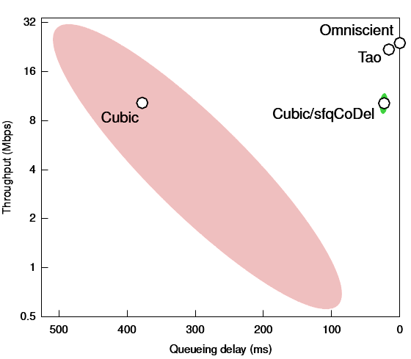
Tractable attempts at optimal protocols (Cont.)
Tao protocol can approach the omniscient protocol and outperform existing human-designed protocols
Tao protocols can be used as tractable proxies for an optimal protocol
  The ellipse representing one standard deviation of variation

Slide 10
Contents
Introduction
Tractable attempts at optimal protocols (Tao)
Experimental setup
Investigating the learnability of congestion control
Conclusion

Slide 11
Experimental setup
Experimental procedure
  Specifying a set of training scenarios
  Specifying an objective function
  Synthesizing a congestion-control protocol that maximizes the value of objective function (Protocol-design process)
  Specifying the testing scenarios of network configurations, which may be similar or dissimilar to the training scenarios

Slide 12
1. Specifying a set of training scenarios
A training scenarios specify the set of network configurations
A network configurations specifies
  The topology : the link speed and propagation delay of each link
  The locations and the paths of senders and receivers
  A model of the workload generated by the application running at each endpoint
  The buffer size and queueing discipline at each gateway

Slide 13

2. Specifying an objective function
Objective function
  Expressing the protocol designer’s figure of merit for the goodness of a congestion-control protocol
    E.g) flow completion time
  In this study, they considered objective functions of the form
    ‘throughput’ : average information transmission rate of a sender-receiver pair
    ‘delay’ : average per-packet delay of packets in the connection, including propagation delay and queueing delay
    ‘δ’ : relative preference between high throughput and low delay

Slide 14
3. Protocol-design process
Remy models a congestion-control protocol as a set of match-action rules, mapping between the state maintained by the sender and an action to be executed
  State : tracks a small set of congestion signals, updated on every acknowledgment
  Action : specifies changes in the behavior of the congestion-control protocol
Remy searches for the mapping that maximizes the average value of the objective function
Remy then simulates the protocol on the training scenarios
  Refine the mapping by the result of simulation

Slide 15
3. Protocol-design process (cont.)
For the experiments, a Remy tracks these for signals
  Rec_ewma : an exponential-weighted moving average (EWMA) of interarrival time between new ACKs received
    Weight of 1/8 for new samples
  Slow_rec_ewma : the same as rec_ewma, but with a weight of 1/256 new samples
  Send_ewma : EWMA of the inter-send time between sender timestamps echoed in the received ACKs
  Rtt_ratio : the ratio between the most recent RTT and the minimum RTT seen during the current connection

Slide 16
4. Specifying the testing scenarios
Evaluation procedure
  All evaluations are performed in the ns-2 simulator
  Comparing the performance of below protocols for measuring how faithfully protocol designers need to understand the network
    Accurate models of the network
    Various kinds of imperfect models
  For reference, they also compare the Tao protocols with two common schemes
    TCP Cubic : default congestion-control protocol in Linux
    Cubic over sfqCoDel : scheduling algorithm runs on bottleneck routers

Slide 17
Contents
Introduction
Tractable attempts at optimal protocols (Tao)
Experimental setup
Investigating the learnability of congestion control
  Knowledge of link speed
  Knowledge of the degree of multiplexing
  Knowledge of propagation delays
  Structural knowledge
  Knowledge about incumbent endpoints
Conclusion

Slide 18
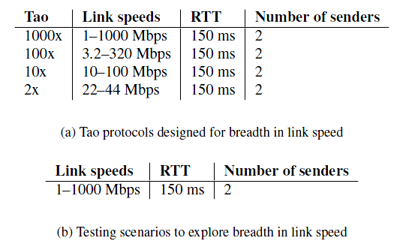
Knowledge of link speed
Are “one size fits all” protocols inherently at a disadvantage, because of a tradeoff between the “operating range” of a protocol and its performance?

Slide 19
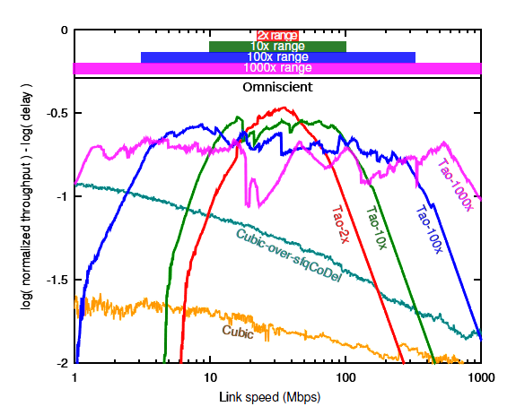
Knowledge of link speed (Cont.)
The improvements in objective from narrowing down the operating range were modest
  Though optimizing for a smaller range did help modestly over that range

Slide 20
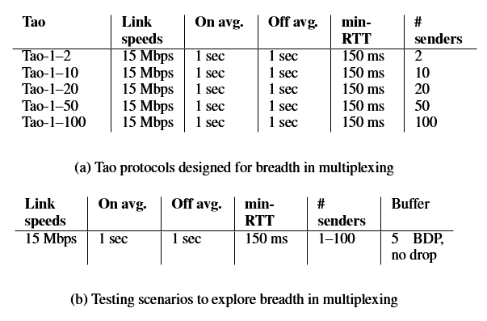
Knowledge of the degree of multiplexing
Congestion-control protocols have to cope with uncertainty in the degree of multiplexing
  from one use to the next even when running on a network with a fixed and known topology
Evaluate whether it is possible to learn a protocol that is robust to such uncertainty
  Increasing the degrees of multiplexing
  Dumbbell topology

Slide 21
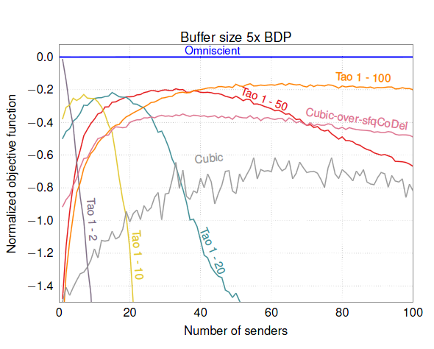
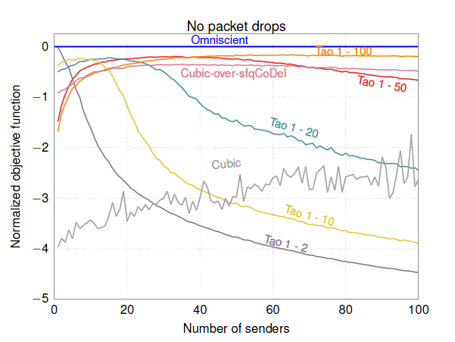
Knowledge of the degree of multiplexing (Cont.)
Results for two cases
  Buffer size of five times the bandwidth-delay product
  The link doesn’t drop any packet

Slide 22
Knowledge of the degree of multiplexing (Cont.)
Prior knowledge of the expected degree of multiplexing is beneficial when designing a congestion-control protocol
  Unlike with link speed

Slide 23
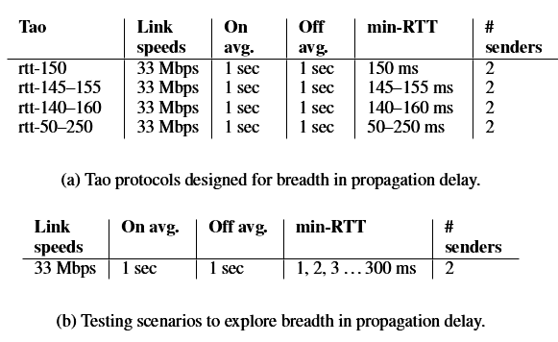
Knowledge of propagation delays
Today, some specialized congestion-control protocols are tailored for networks with
  Either large propagation delays or short delays
Evaluate whether it is possible to design a single congestion-control protocol with good performance
  Without making strong assumptions about the propagation delay a priori

Slide 24
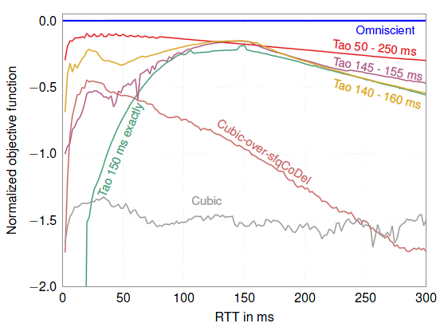
Knowledge of propagation delays (Cont.)
Adding a little diversity to the training results in performance over the 1-300 ms range
  145 – 155 ms
Prior knowledge of the propagation delay of a target network may not be particularly necessary or valuable to the protocol designer

Slide 25
Structural knowledge
Protocol designers expect that they can reason about the performance of a distributed network algorithm by modeling the network as something simpler than it is
To capture that intuition by studying how difficult it is to learn a congestion-control protocol for a more-complicated network, given a simplified model of that network’s structure

Slide 26
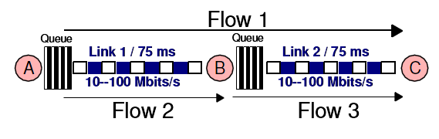
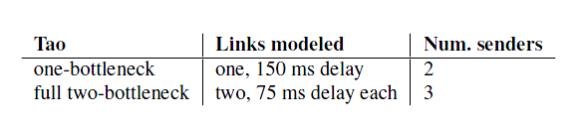
Structural knowledge (Cont.)
Simulated a network with two bottlenecks in parking-lot topology
  Flow 1 crosses both links ( both bottlenecks )
  Flow 1 contends Flow 2 & Flow 3 at each bottleneck

Slide 27
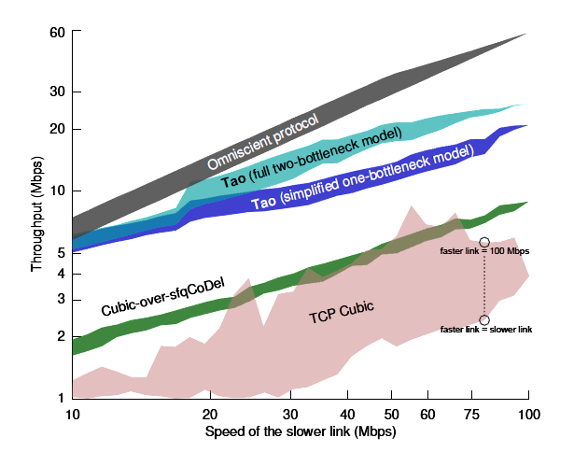
Structural knowledge (Cont.)
Results for Flow 1
  Shaded area is the full locus of throughputs seen by Flow 1
A congestion-control protocol designed for a simplified model of the network’s structure will experience a small penalty to its performance
Understanding the true network in all its complexity may not be crucial

Slide 28
Knowledge about incumbent endpoints
On the broad Internet today, cross-traffic will typically be the product of traditional loss-triggered TCP congestion-control protocol
  NewReno or Cubic
Ideally, a newly-designed protocol would
  Perform well when interacting with other endpoints running same protocol
  Share a network with incumbent endpoints running traditional TCP

Slide 29
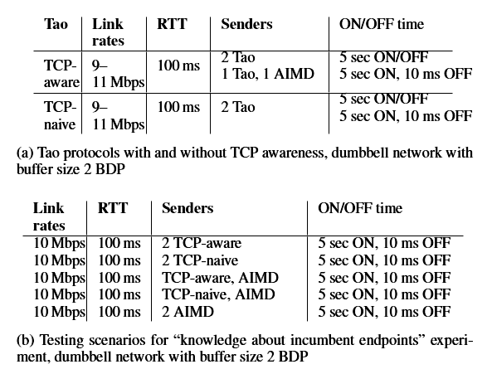
Knowledge about incumbent endpoints (Cont.)
What are the consequences of building “TCP-awareness” into a protocol?
By designing two Tao protocols
  TCP-Naïve : competing against cross-traffic would be from the same TCP-Naïve protocol
  TCP-Aware : competing against cross-traffic was from traditional TCP half the time

Slide 30
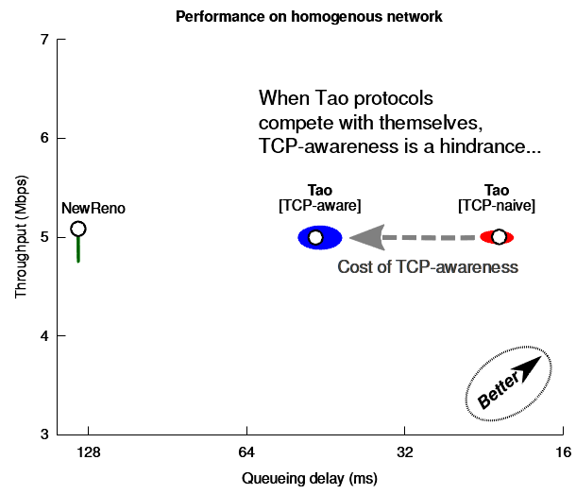
Knowledge about incumbent endpoints (Cont.)
Compete only with cross-traffic from the same protocol
In this homogeneous setting, adding TCP-Aware to a Tao protocol builds up standing queues
  more than doubling the queueing delay without affecting throughput

Slide 31
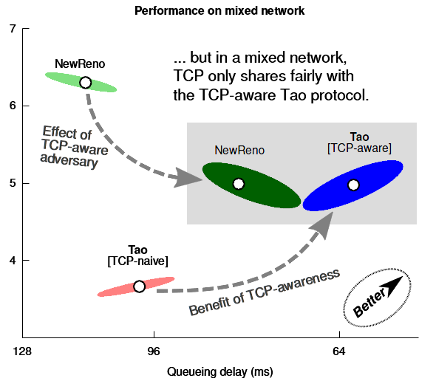
Knowledge about incumbent endpoints (Cont.)
Compete with TCP NewReno
  TCP-Naive is squeezed out and doesn’t get fair share of the link
  TCP-Aware gets fair share of the link and reduces the queueing delay
    Both by itself and by TCP NewReno

Slide 32
Contents
Introduction
Tractable attempts at optimal protocols (Tao)
Experimental setup
Investigating the learnability of congestion control
Conclusion

Slide 33
Conclusion
This study represents an early step towards a rigorous understanding of the tradeoffs and compromises of network protocol design
  It may be acceptable to simplify some characteristics of the network
    Topology
  In contrast, features such as the degree of multiplexing and the aggressiveness of contending endpoints were important to capture

Slide 34
Conclusion
Much remains to be understood about the protocol-design problem before computer-generated protocols will be practically deployable across the broad Internet
In the future, they envision network protocols will be developed mechanistically from first principles
  With human designers documenting objectives
  Assumptions that a new protocols will have
  Automatic processes synthesizing the resulting protocols itself

