Slide 1
Address resolution protocol
Lecture 4

Slide 2
Introduction
ARP required for any shared medium type link layer
Was first developed for Ethernet
Translates IP address into the link layer address (but it is designed to deal with others)

Slide 3
Introduction
ARP is another protocol from the perspective of Ethernet (or any link layer protocol)
  IPv4: 0x0800
  ARP: 0x0806
Implication – link layer address is one on the current link! (not far away)
Example: Fig. 4-1

Slide 4
Introduction
ARP never translates for remote interface
It is to cross a single shared-medium link! (with an IP address)
Ad the IP address is not the address of the final destination

Slide 5
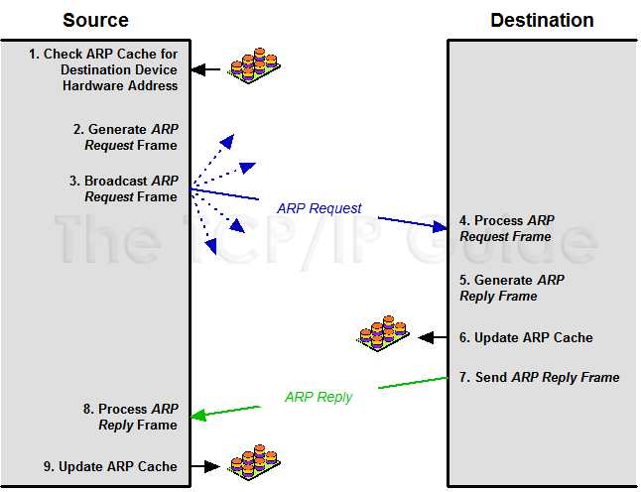
Introduction

Slide 6



Introduction
Remember: every interface has an IP address
D,M_{D}
A, M_{A}
B,M_{B}
C,M_{C}
S
M_{B} | M_{A} | 0800 | IP datagram: S →D | CRC

Slide 7
What ARP doesn’t do
ARP does NOT translate multicast or broadcast addresses
They have their own mapping rules
Only unicast

Slide 8
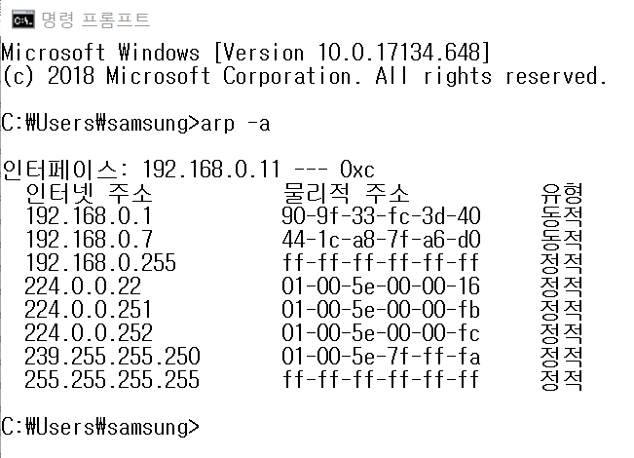
ARP cache
Every computer (router) has it if a connected link is shared-medium type

Slide 9
ARP cache
ARP entries are made
  Either by ARP protocol
  Or statically
Entries made by ARP protocol is “dynamic” and has lifetime = 1200s
  Refreshed upon use
  Otherwise purged
Try arp command with (-a, -d, -s)

Slide 10
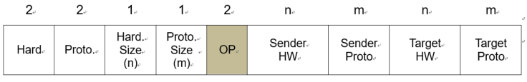
ARP frame format
Fig. 4-2
Short (28B) → requires padding in Ethernet frame (46B minimum payload)
Sender/target address switched
  Request vs. reply

Slide 11
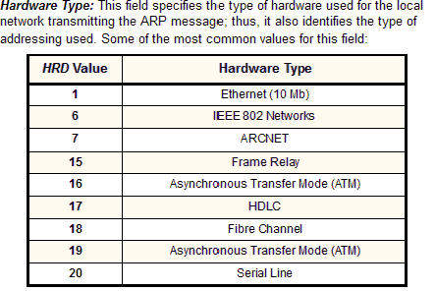
ARP frame format

Slide 12
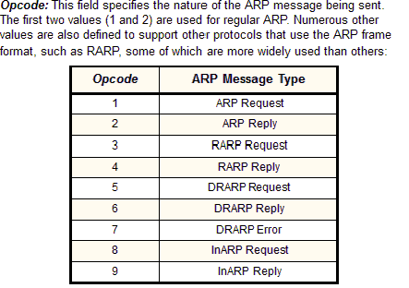
ARP frame format

Slide 13
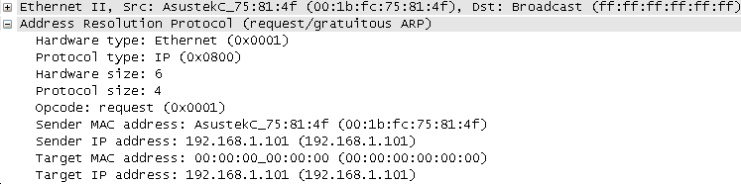
ARP frame format

Slide 14
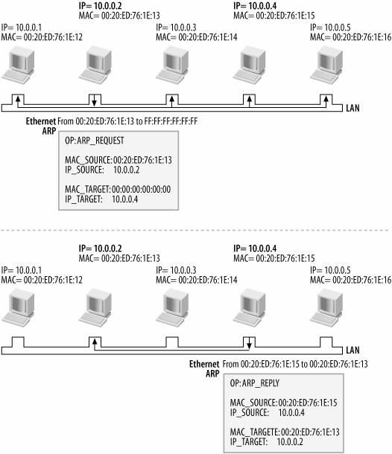
ARP operation

Slide 15
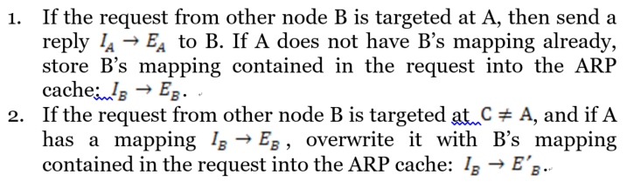
ARP cache update rules
Suppose we are on host A

Slide 16
ARP
ARP can fail → incomplete entry is purged in time
Proxy ARP is used for gateways

Slide 17
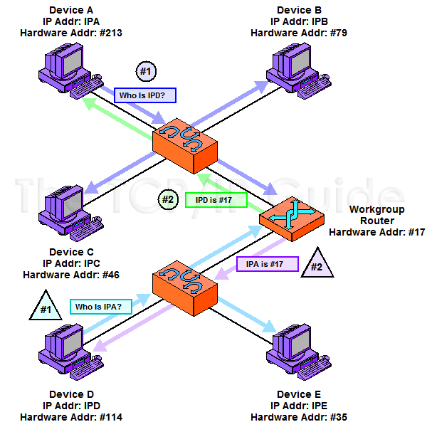
Proxy ARP

Slide 18
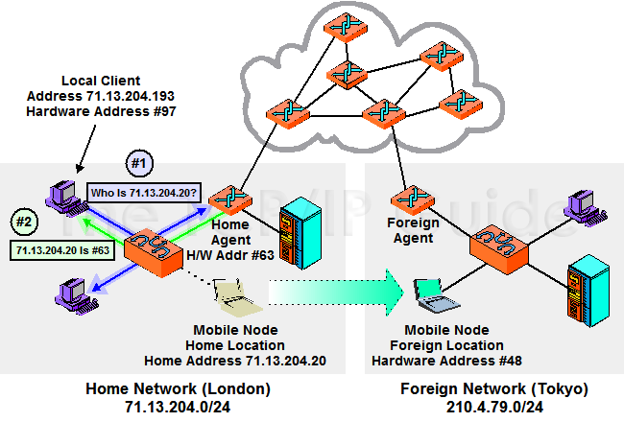
Proxy ARP as part of mobile IP

Slide 19
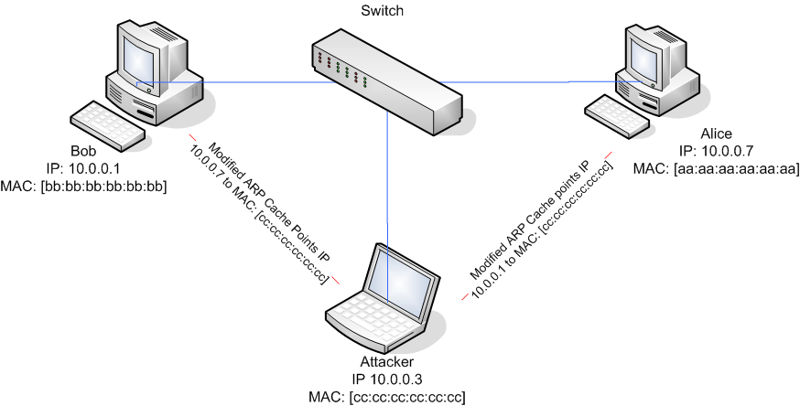
ARP spoofing

Slide 20
Gratuitous ARP and ACD
Gratuitous ARP is sent as a request by the target itself
  Duplicate address detection (DAD)
  Update stale ARP entries on the link
ACD fills the source IP address with 0.0.0.0
  Prevents ARP cache poisoning
  0.0.0.0 cannot be a destination address

Slide 21
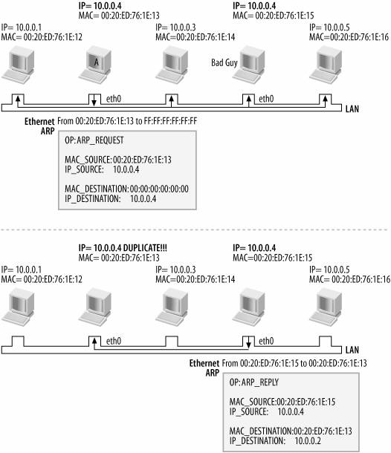
DAD by gratuitous ARP

Slide 22
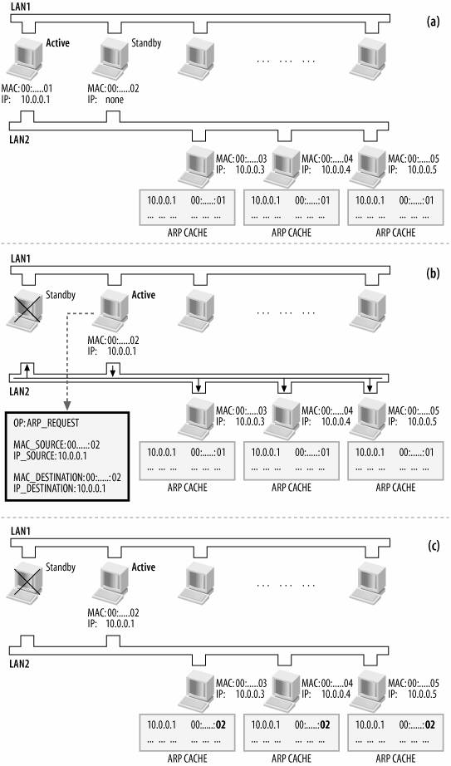
Gratuitous ARP and server failover

Slide 23
Labs
Try Wireshark with filter “arp”
  Find if ACD is being used
  Find if gratuitous ARP is used
Try “arp –a”, “arp –d”, “arp –s”
Try “mtupath” on Windows to see the path MTU

Slide 24
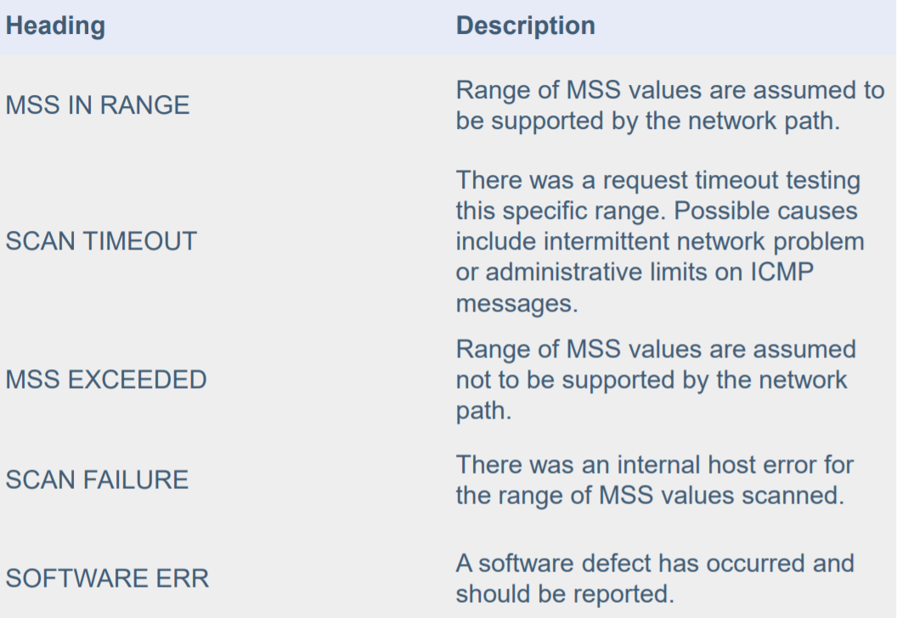
mtupath

