Slide 1
6.2 Dynamic Host Configuration Protocol(DHCP) Part.1
곽종원
2015020798

Slide 2
DHCP [RFC2131]
  address management
    dynamic allocation from IP pool.
    automatic allocation ( never revoked )
    manual allocation
  delivery of configuration data
IPv6 [RFC3315]
RARP → BOOTP → DHCP
  DHCP extends the BOOTP model with the concept of leases.
UDP / IP
  Client : port 68 / Server : port 67

Slide 3
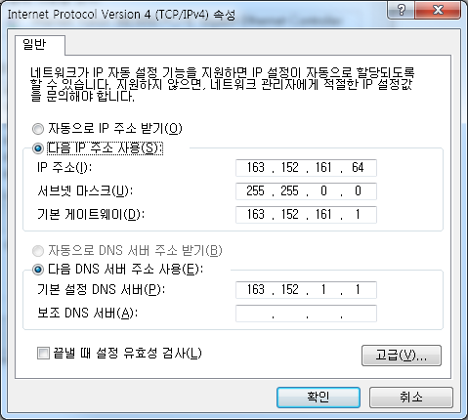
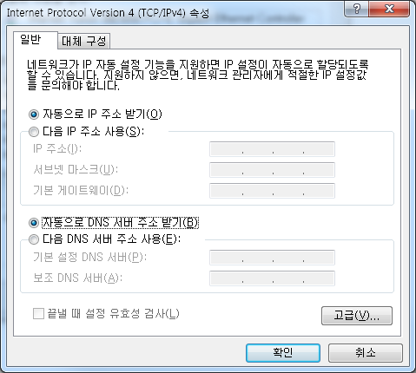

Slide 4
6.2.1 Address Pools and Leases
lease duration
  client uses IP address until the lease expires.
  A few minutes ~ infinite.
renew leases

Slide 5
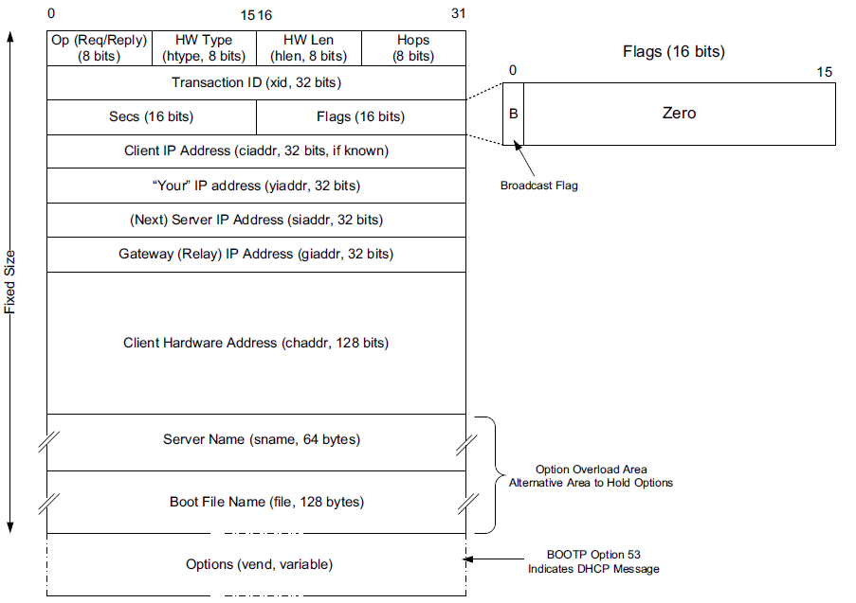
6.2.2 DHCP and BOOTP Message Format

Slide 6
6.2.2 DHCP and BOOTP Message Format
Op
  1 = request, 2 = reply
HW Type / HW
  Link layer (e.g. Ethernet = 1)
HW length
Hops
  Number of DHCP (bootp) relays that this message have been through so far
Transaction ID
  Like in any other application protocol that uses UDP, this matches a response with the request that triggered the repsonse

Slide 7
6.2.2 DHCP and BOOTP Message Format
Secs
  Number of seconds since the first attempt
Flags
  “B”: broadcast = reply should be broadcast
Client IP address
  If nothing is assigned yet, 0.0.0.0
  Otherwise, the assigned IP address
Your IP address
  This is the IP address that the DHCP server offers to the client
Next server address
  The IP address of the “next” server to go to
    E.g. After address assignment, go to the boot image server to download OS

Slide 8
6.2.2 DHCP and BOOTP Message Format
Gateway (relay) IP address
  The DHCP (bootp) relay address to use
  Usually the router
  Today’s first-hop routers run DHCP relay
Server name & boot file name
  Boot image server and the location of the bootfile
  When DHCP is used to bootstrap a client computer

Slide 9
6.2.2 DHCP and BOOTP Message Format
Options
  TLV ( type – length – value )
  Pad (0), Subnet Mask (1), Router Address (3), Domain Name Server (6), Domain Name (15), Requested IP Address (50), Address Lease Time (51), DHCP Message Type (53), Server Identifier (54), Parameter Request List (55), DHCP Error Message (56), Lease Renewal Time (58), Lease Rebinding Time (59), Client Identifier (61), Domain Search List (119), End (255).
  DHCP Message Type (53) has below value.
    DHCPDISCOVER (1), DHCPOFFER (2), DHCPREQUEST (3), DHCPDECLINE (4), DHCPACK (5), DHCPNAK (6), DHCPRELEASE (7), DHCPINFORM (8), DHCPFORCERENEW(9) [RFC3203], DHCPLEASEQUERY (10), DHCPLEASEUNASSIGNED (11), DHCPLEASEUNKNOWN (12), and DHCPLEASEACTIVE (13).

Slide 10
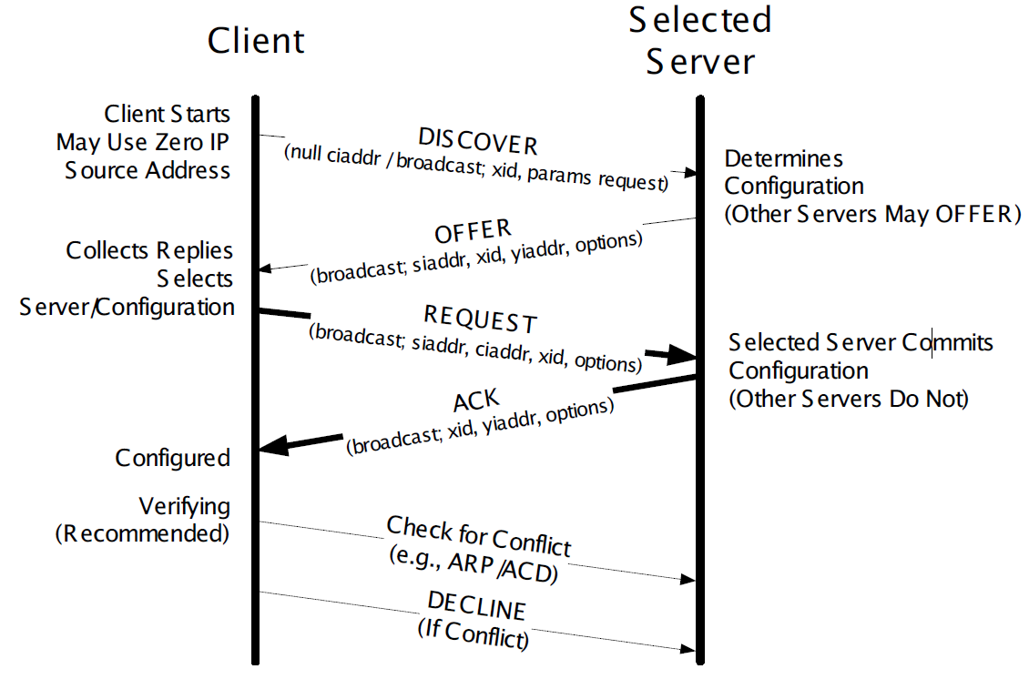
6.2.4 DHCP Protocol Operation

Slide 11
6.2.4 DHCP Protocol Operation
DHCPDISCOVER
DHCPOFFER
  includes the lease time (T), renewal time (T1), rebinding time (T2)
DHCPREQUEST
DHCPACK
ARP/ACD
( if conflict ) DHCPDECLINE
DHCPRELEASE

Slide 12
6.2.4 DHCP Protocol Operation
if a client already has an IP address and wishes only to renew its lease,
  C→S : DHCPREQUEST
  S→C : DHCPACK or DHCPNAK
If a client already has an address, does not need to renew it, but requires other (non-address) configuration information.
  C→S : DHCPINFORM
  S→C : DHCPACK

Slide 13
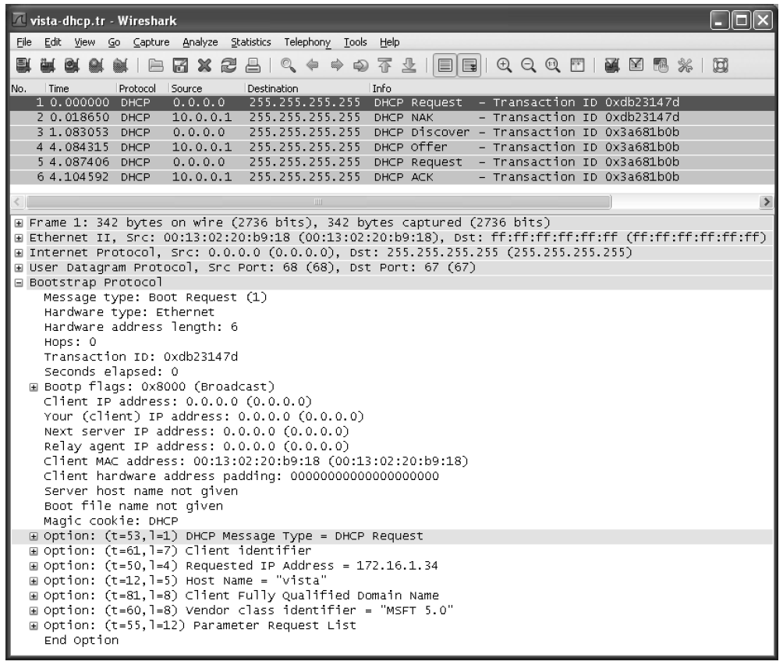
6.2.4.1 Example
  C→S : DHCPREQUEST

Slide 14
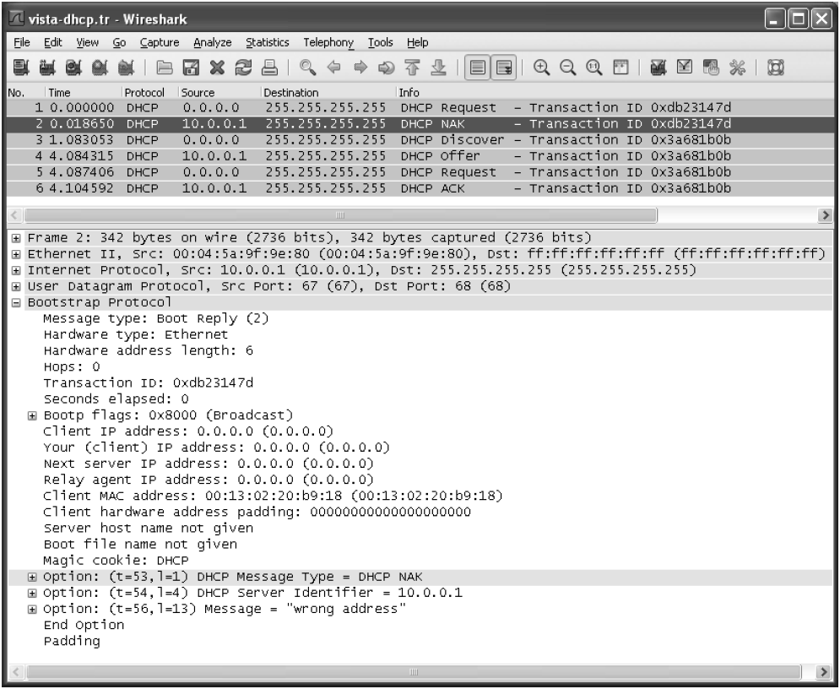
6.2.4.1 Example
  S → C : DHCPNAK

Slide 15
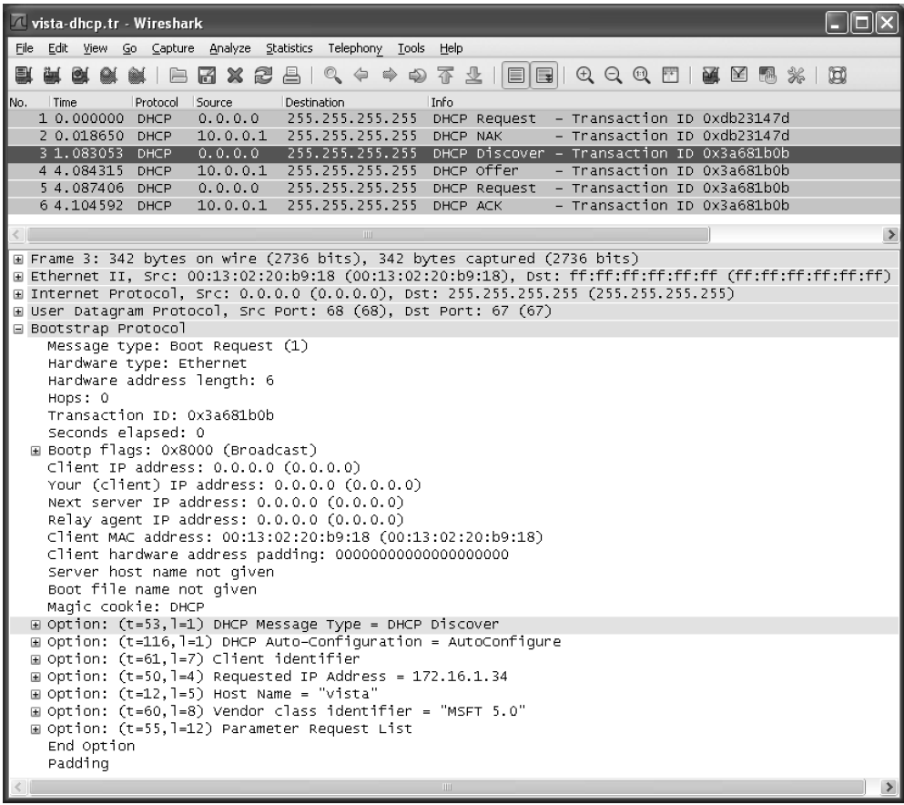
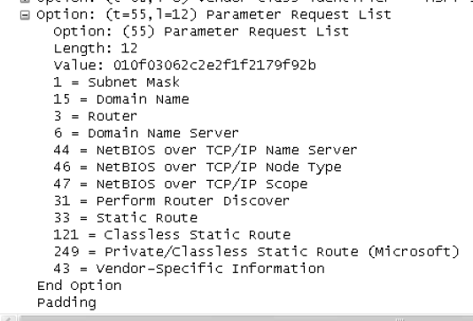
6.2.4.1 Example
  C→S : DHCPDISCOVER

Slide 16
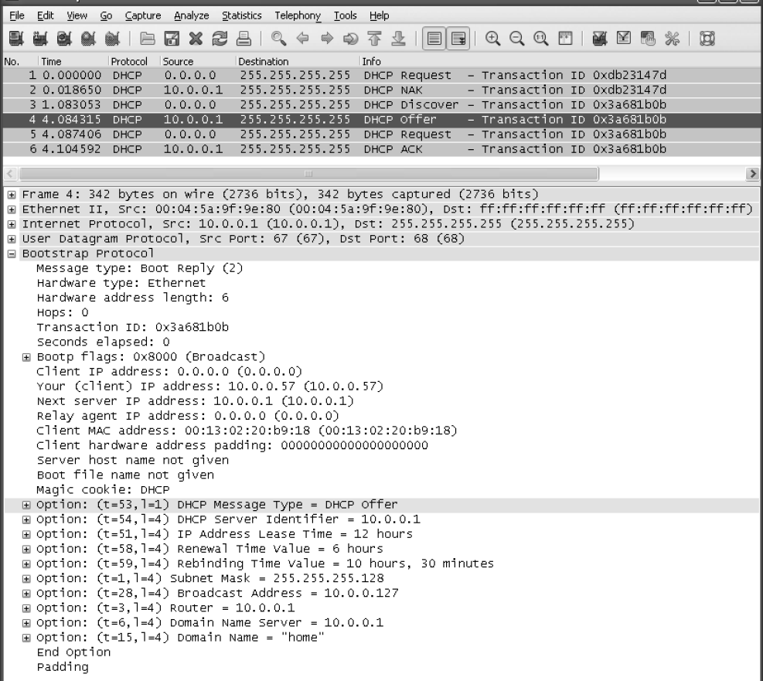
6.2.4.1 Example
  S→C : DHCPOFFER

Slide 17
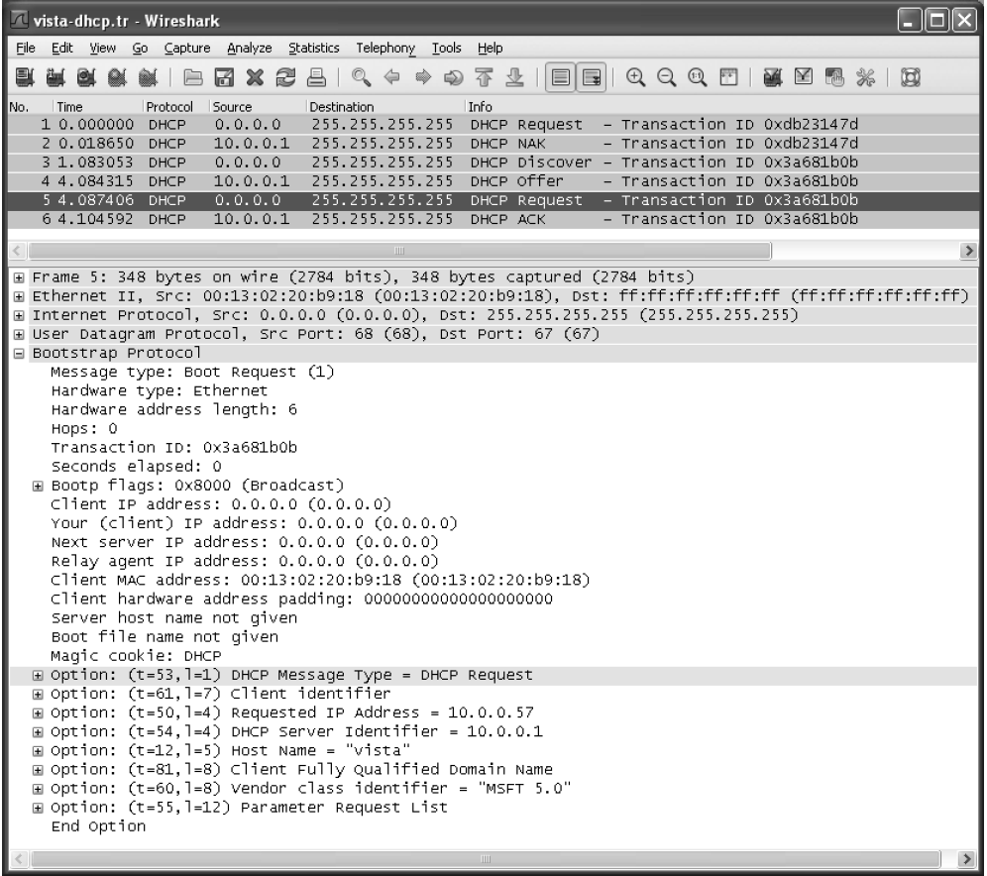
6.2.4.1 Example
  C→S : DHCPREQUEST

Slide 18
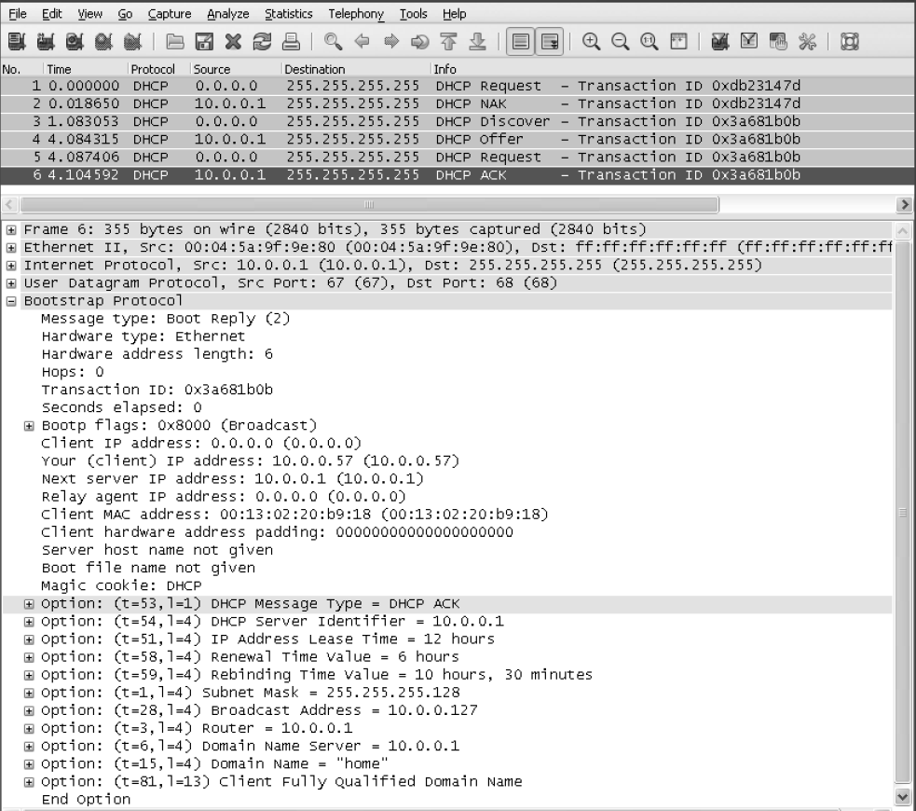
6.2.4.1 Example
  S→C : DHCPACK

Slide 19
6.2.4.1 Example
Windows
  ipconfig /release
  ipconfig /renew
Linux
  dhclient -r
  dhclient

Slide 20
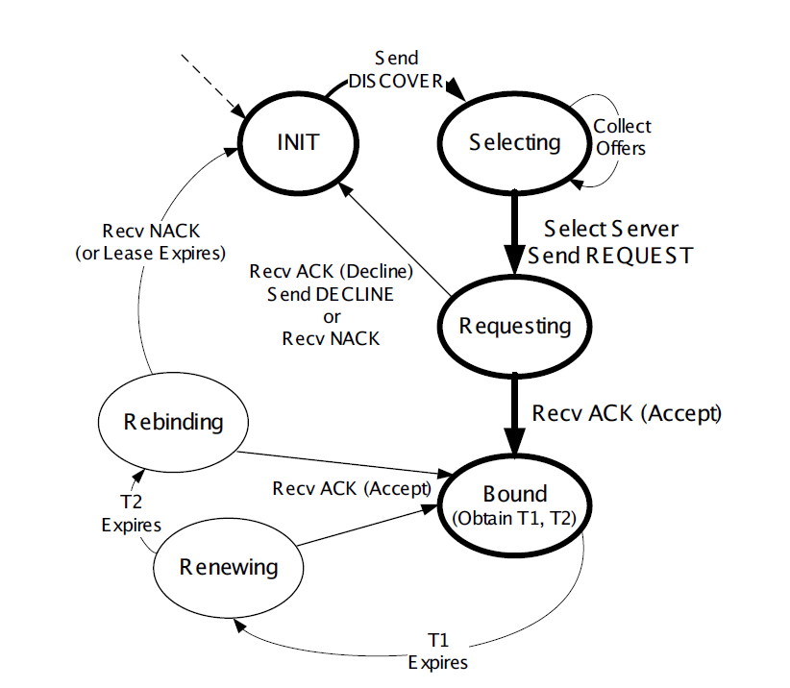
6.2.4.2 The DHCP State Machine

Slide 21
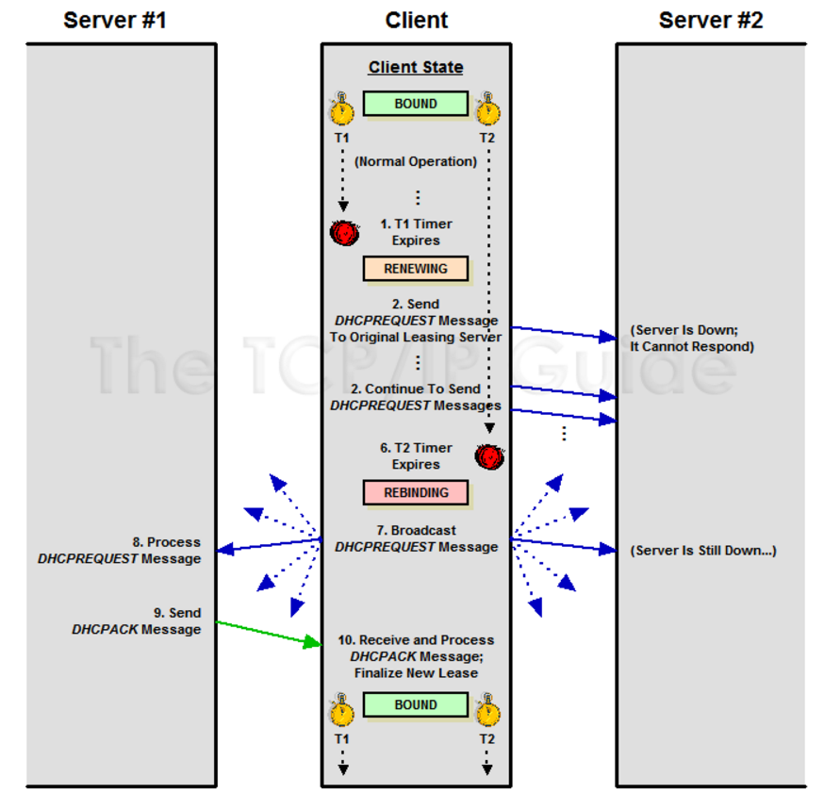
6.2.4.2 The DHCP State Machine

Slide 22
6.2.5 DHCPv6
Stateful mode – like DHCPv4.
Stateless mode - stateless address autoconfiguration.

Slide 23
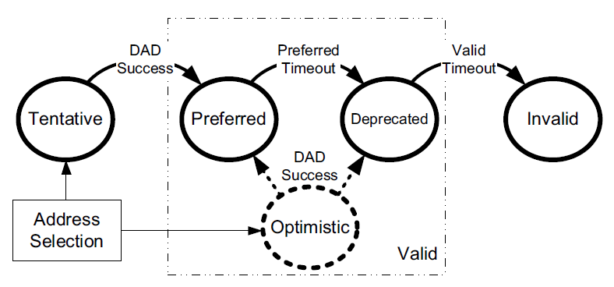
6.2.5.1 IPv6 Address Lifecycle

Slide 24
6.2.5.1 IPv6 Address Lifecycle
Tentative – not used until DAD
Optimistic – used as limited purpose until DAD
Preferred – used
Deprecated – used, but not used new connection.
Invalid

Slide 25
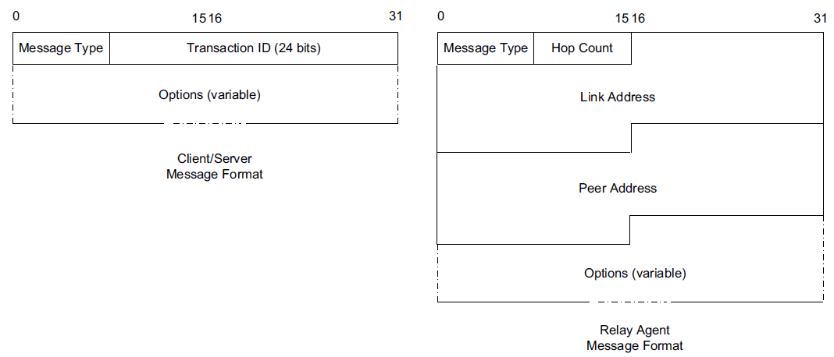
6.2.5.2 DHCPv6 Message Format

Slide 26
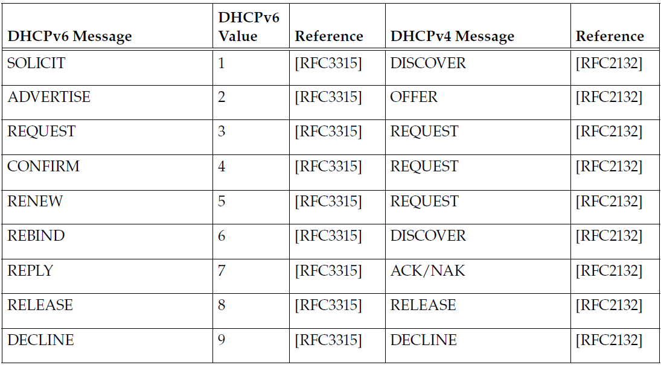
6.2.5.2 DHCPv6 Message Format
Clients send requests to the All DHCP Relay Agents and Servers multicast address (ff02::1:2).

Slide 27
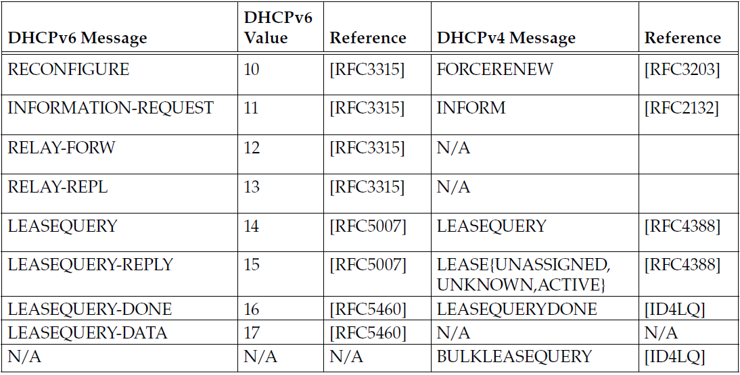
6.2.5.2 DHCPv6 Message Format

Slide 28
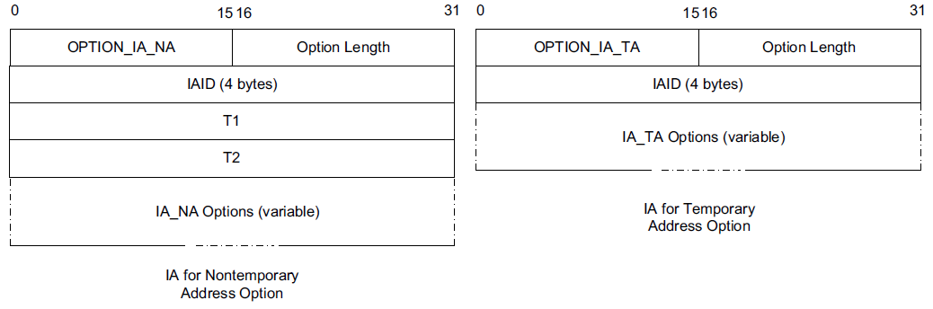
6.2.5.3 Identity Association (IA)
An Identity Association (IA) is an identifier used between a DHCP client and server to refer to a collection of addresses.
  IA identifier (IAID) and associated configuration information.

Slide 29
6.2.5.4 DHCP Unique Identifier (DUID)
A DHCP Unique Identifier (DUID) identifies a single DHCPv6 client or server and is designed to be persistent over time.
  DUID-LLT: a DUID based on link-layer address plus time
  DUID-EN: a DUID based on enterprise number and vendor assignment
  DUID-LL: a DUID based on link-layer address only

Slide 30
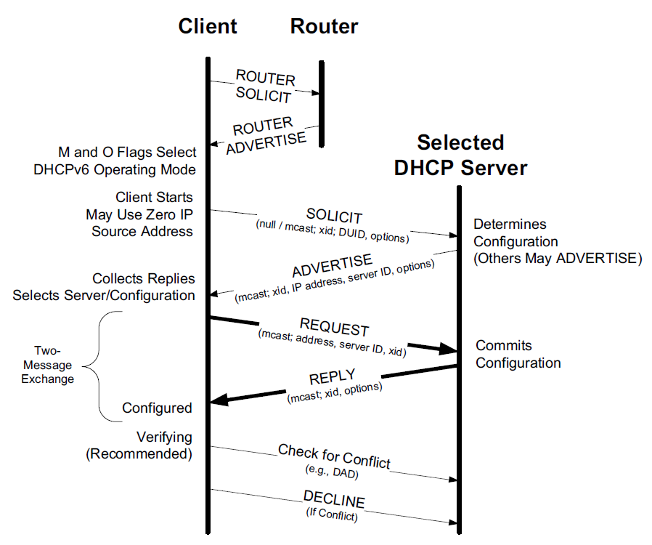
6.2.5.5 Protocol Operation

Slide 31
6.2.5.5 Protocol Operation
ICMPv6 Router Advertisement message
  The M field is the Managed Address Configuration flag.
  The O field is the Other Configuration flag.

Slide 32
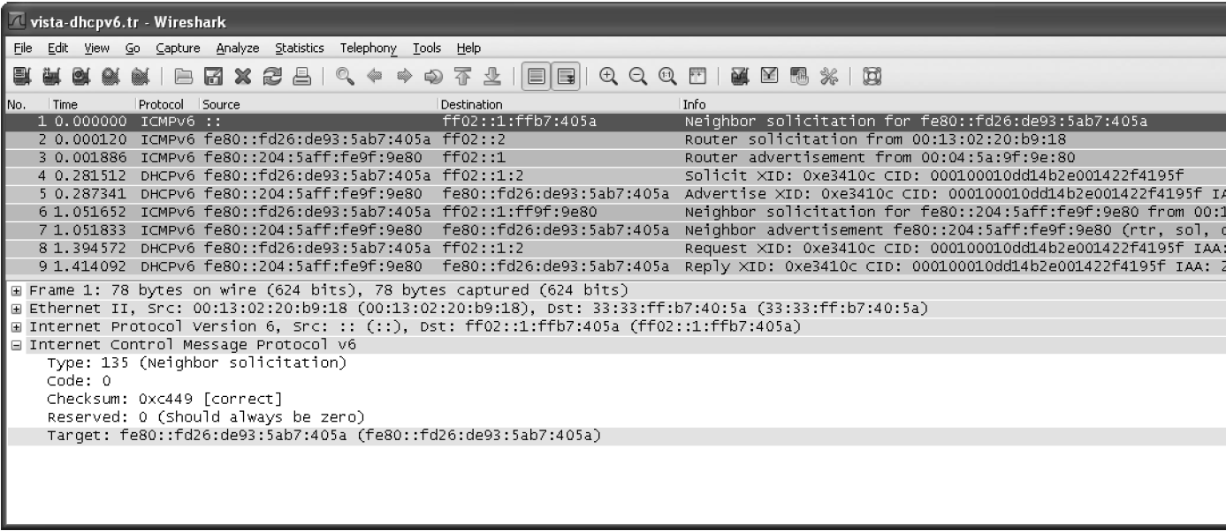
6.2.5.6 Extended Example
C → : Neighbor Solicitation / IMCPv6
  efficient communication. It may communicate with the server directly using unicast addressing.

Slide 33
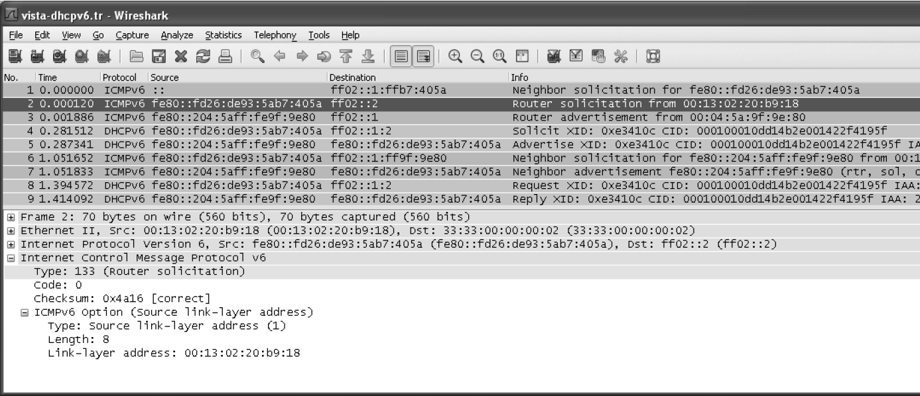
C→ R(outer) : Router Solicitation (All Routers address - (ff02::2) ) / IMCPv6

Slide 34
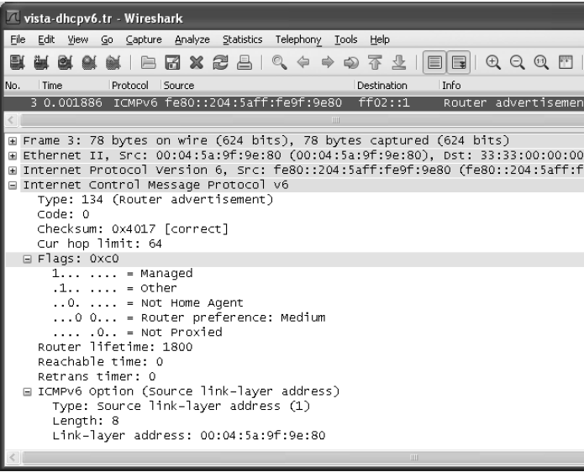
6.2.5.6 Extended Example
C→ R(outer) : A Router Advertisement / IMCPv6

Slide 35
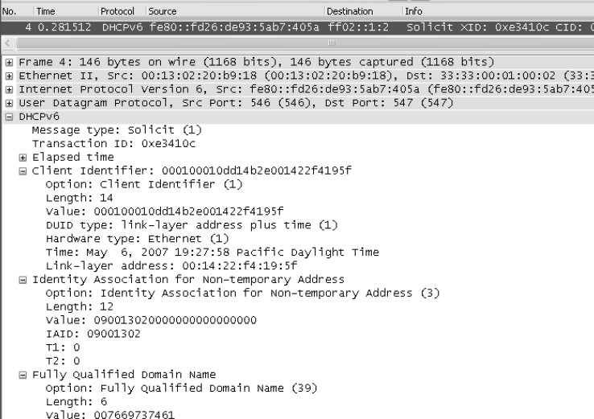
6.2.5.6 Extended Example
C → S ( DHCPs ) : DHCPv6 SOLICIT

Slide 36
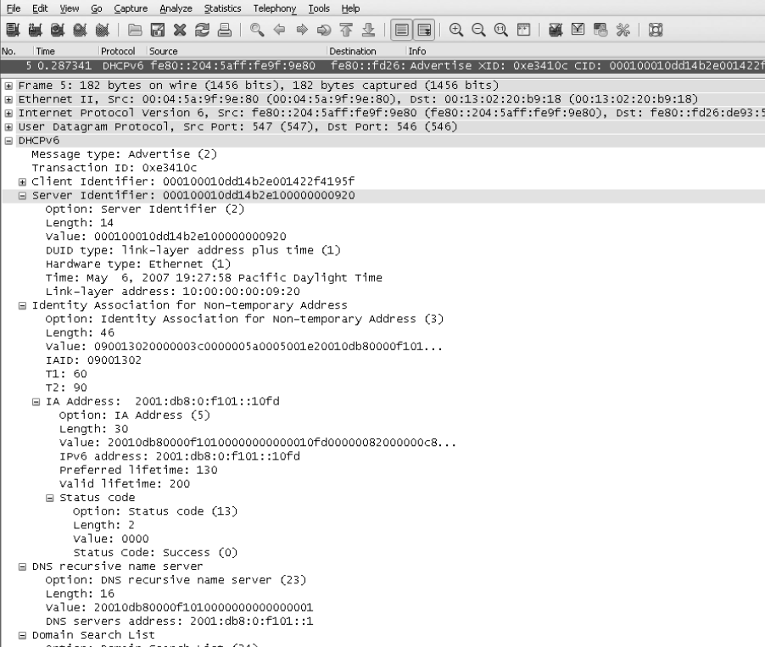
6.2.5.6 Extended Example
S → C : DHCPv6 ADVERTISE

Slide 37
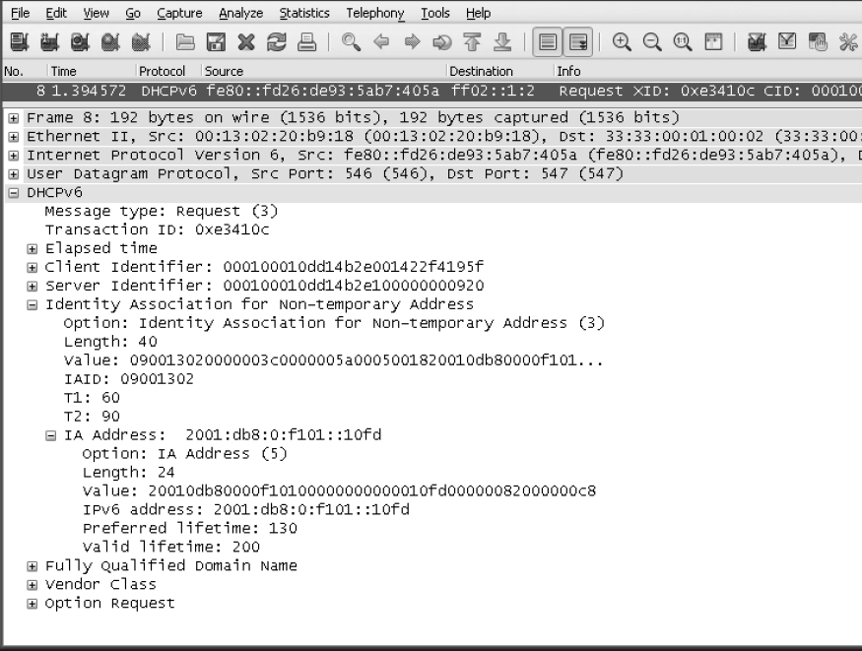
6.2.5.6 Extended Example
C → S ( DHCPs ) : DHCPv6 REQUEST

Slide 38
6.2.5.6 Extended Example
C:\> ipconfig /release6
C:\> ipconfig /renew6

Slide 39
6.2.5.7 DHCPv6 Prefix Delegation (DHCPv6-PD and 6rd)
DHCPv6-PD
  DHCPv6 can also be used to configure routers. one router delegates a range of address space to another router.
  Using IA_PD.
6rd
  A special form of PD has been created for supporting IPv6 rapid deployment by service providers.

