Slide 1
Kyun Queue:
A Sensor Network System to Monitor Road Traffic Queues
SENSYS 2012
Indian Institute of Technology,
Bombay

Slide 2
Contents
Introduction
Traffic sensing with wireless across road
Design of the Kyun Queue system
Hardware prototypes
Deployment based evaluation
Self localization
Conclusions

Slide 3
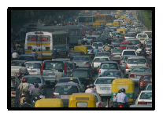
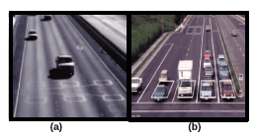
Introduction
The Problem of Road congestion is currently plaguing most cities in the world
  Unpredictable travel times
  Fuel inefficiency
Automated traffic management solutions
  Developed for western traffic
  Characteristics of traffic in developing country
    non-lane based, highly heterogeneous

Slide 4
Introduction
Ideal traffic sensing system’s requirements
  Sense road occupancy even if traffic is chaotic and non-lane based
  Deployable without interrupting traffic flow
  Capable of real time sensing and classification to support applications like traffic signal control
  Low installation and maintenance costs

Slide 5
Introduction
Kyun Queue
  A sensor network system for real time traffic queue monitoring
  To sense road occupancy, based on how RF link quality suffers in absence of line of sight
    IEEE 802.15.4 transmitter-receiver pair across the road.
Design & Build Embedded platform
  Sensing and computation for binary classification
  Communication to combine the decisions of multiple sensors to know the length of traffic queue
  Communication of the queue length values to a remote server

Slide 6
Traffic sensing with wireless across road
Design a system for traffic queue length measurement in chaotic road conditions
  Rather than exact vehicle counts
  Queue length is proportional to traffic volume.
Using wireless transmitter-receiver pair to measure road traffic density
Question
  Can traffic states be quantitatively inferred from RF link characteristics?
  Can classifications be done in order of tens of seconds to support applications like traffic light control?
  What wireless features and algorithms can be used for high classification accuracy?

Slide 7
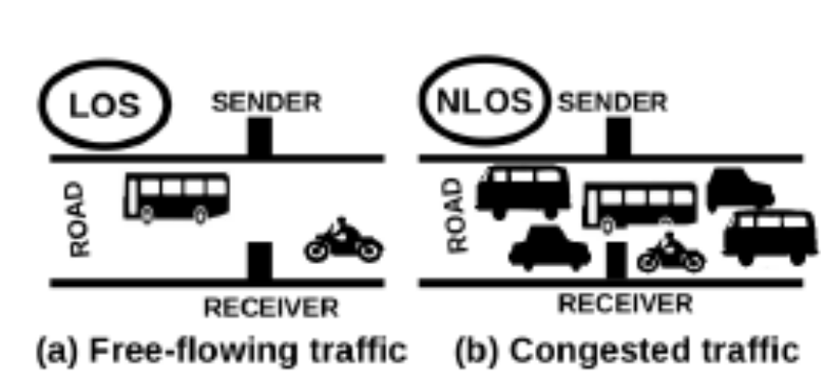
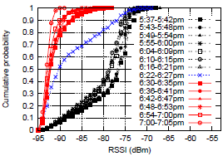
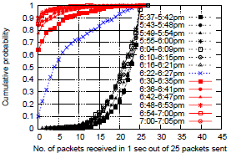
Does road traffic affect wireless links?
802.15.4 compliant Telosb motes
Tx sends 25 pkt/sec, payload 100bytes at -25dBm power
Measure RSSI, PRR
25m

Slide 8
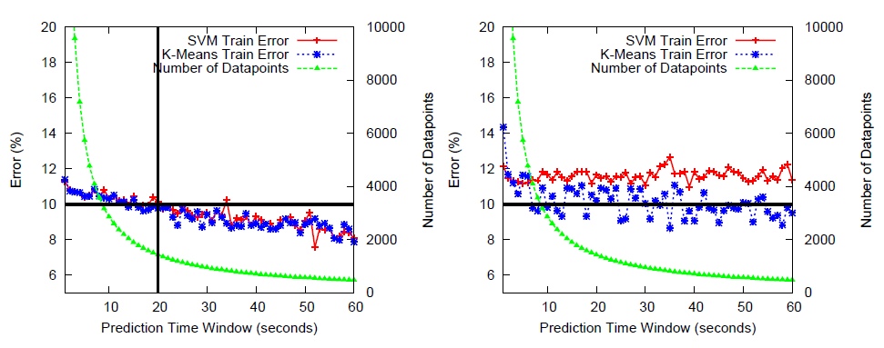
Classification Algorithm
Binary traffic state classification
  Congested traffic
  Free-flowing traffic
Four machine learning algorithm
  FeatureClassifier (FC) algorithm with K-means
  FeatureClassifier (FC) algorithm with SVM
  SignalClassifier (SC) algorithm with K-means
  SignalClassifier (SC) algorithm with SVM

Slide 9
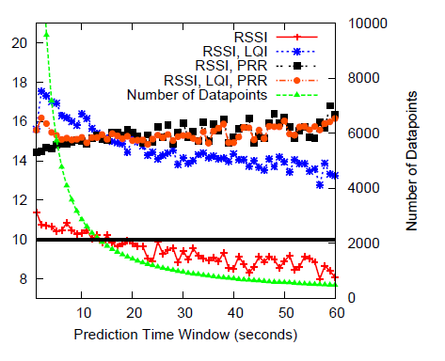
Choice of features
LQI (link quality index), RSSI, PRR
  RSSI percentile-based features yield better accuracies than the others
  Non-intuitive observation : RSSI is much more strongly correlated with line-of-sight than LQI or PRR
Summary
  Use FeatureClassifier(FC) algorithm with K-Means
    Built over 20 seconds
    Feature : RSSI

Slide 10
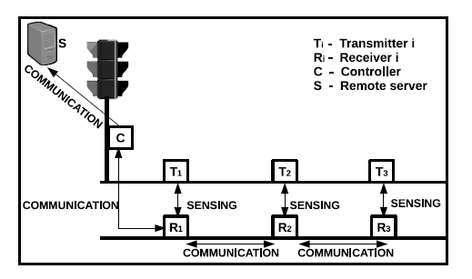
Design of the Kyun Queue System
Architecture
  3 pairs of transmitter (T_{i}) – receiver (R_{i})
    Perform sensing and computation to know the traffic condition.
  Central controller unit (C)
    Receive the road occupancy observation values from Tx-Rx pairs
  Server (S)
    Receiving road occupancy information
    Implement other applications like coordinated signal control, bottleneck identification and congestion mapping

Slide 11
Design of the Kyun Queue System
Which RF technology to use for sensing
  Wi-Fi
    large energy consumption
    Connection oriented protocol, may induce long delay in re-establishing connection following packet losses
  Bluetooth
    Poor range, hard to establish for wide roads of 25m
  802.15.4 seems to be a better choice

Slide 12
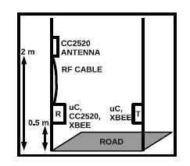
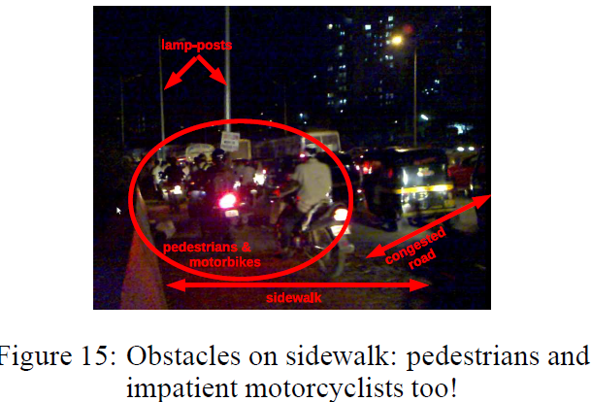
Design of the Kyun Queue System
Two types of wireless links
  sensing links
    across the road from T and R
    should be affected by the traffic flow on the road
  communication links
    along the road, from on R to R
    have to be reliable as well

Slide 13
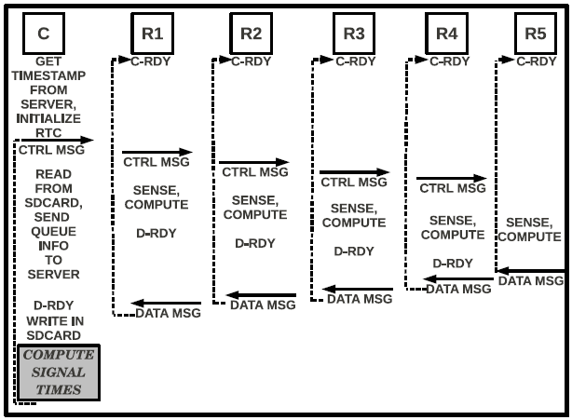
Software Protocol
Ensure that all R’s perform sensing and computation simultaneously
  C centrally controls measurement cycle
  No need of any explicit time synchronization mechanism
MAC protocol
  Simple CSMA-CA with 4 tries
C-RDY: receiver ready mode waiting for a control message
C sends a control message
1. Write in micro-SD card and Compute the traffic signal schedule from the queue length information in the data message (every 30s)
2. Send to S by GPRS
Compute sensing decision
Decision results send to the next R

Slide 14
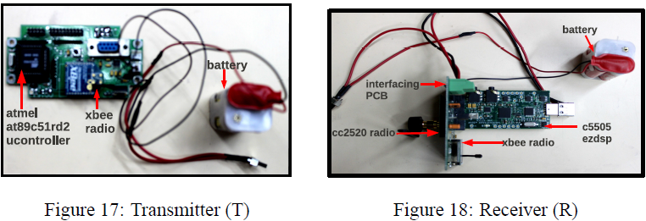
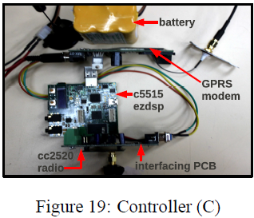
Hardware prototypes

Slide 15
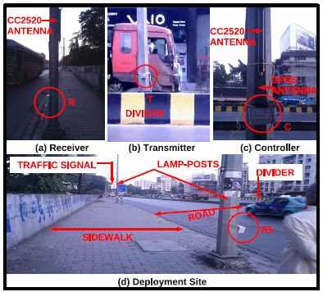
Deployment based evaluation
Evaluation
  R has a stored K-Means clustering model using nine RSSI percentile, measured over t=20 secs, as features.
  8 hours data set
    Training classifier

Slide 16
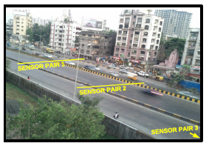
Deployment based evaluation
Deployment
Nov. 17(Thu), 18(Fri), 19(Sat), 2011 6pm – 9pm
  Image based manual verification scheme
    Samsung Google Nexus phone
    to capture image ever 30 seconds
    Can only cover T-R pair 1-3
  1st person observes offline and estimates
  the queue length
  2nd person as consulter
C R1 R2 R3 R4 R5
3
1 | 1 | 1 | 0 | 0

Slide 17
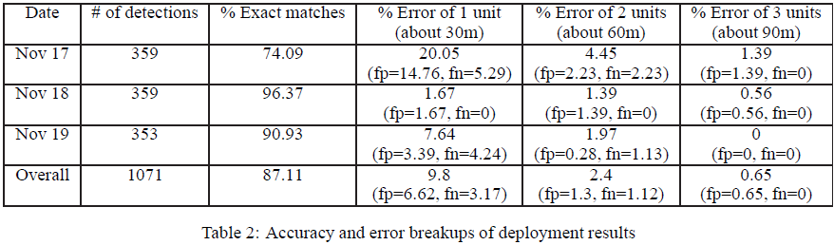
Deployment based evaluation
Only cover 0-3, error up to 3 units

Slide 18
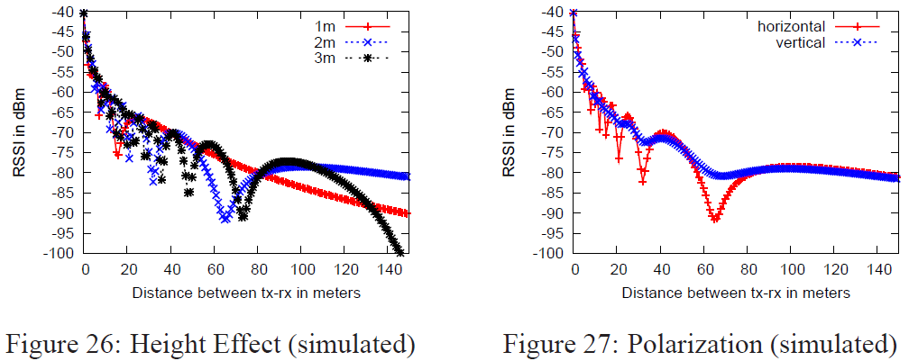
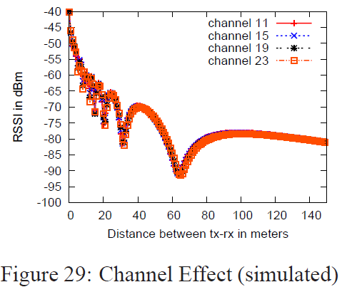
Self Localization
Without pre-defined order and program R unit
To use RSSI ranging
  It is not a monotonically decreasing function of distance
  Two-ray model equation: lower antenna heights seem to give less oscillations

Slide 19
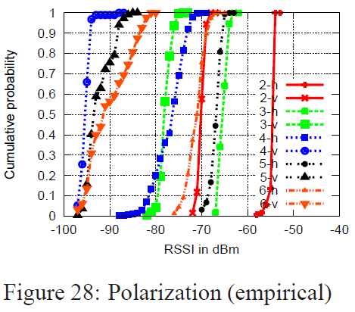
Self Localization
Vertical polarization seems to give far less oscillations than horizontal polarization
  Horizontal: {2, 3, 5, 6, 4} Vertical: {2, 3, 6, 5, 4}
  Reordering occur independent of antenna orientation and polarization
  Vertical orientation gives worse RSSI values
    Fading effect of the metal body of the lamp-post with which the vertical antenna is parallel

Slide 20
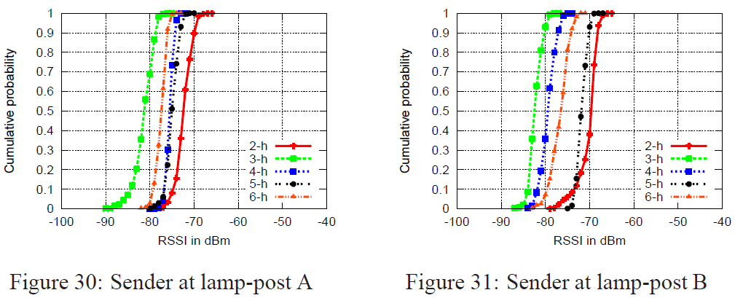
Self Localization
Fig. 30: {node 2, node 5, node 4, node 6, node 3}
  31 116 95 144 70
Fig. 31: {node 2, node 5, node 6, node 4, node 3}
  39 113 140 85 64
Alternative
  The R recording the best RSSI is marked as the first node
  Continue iteratively

Slide 21
Conclusion
Design and implement a new sensing system to detect road occupancy based on RF link quality degradation
Design and implement a sensor network to distributedly decide traffic queue length in real time
Achieve up to 96% accuracy in queue length estimation

Slide 22
Q & A

