Slide 1
6.2 Dynamic Host Configuration Protocol (DHCP) – Part.2
김혜영
2015020806

Slide 2
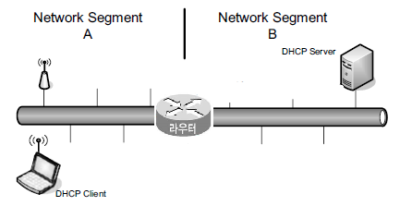
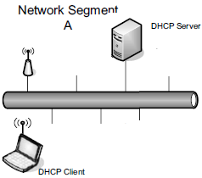
6.2.6 Using DHCP with Relays
A single DHCP server is made available directly to clients on the same LAN.
The operation of DHCP across multiple network segments need to be extends.
DHCP Message
(Broadcast)
DHCP Message
DHCP Message
(Broadcast)
[single network segment]
[multiple network segments]

Slide 3
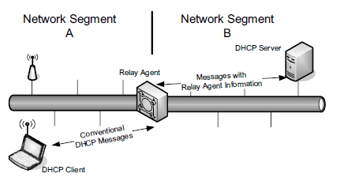
6.2.6 Using DHCP with Relays
In more complicated enterprises it may be necessary or convenient to relay DHCP traffic through one or more DHCP relay agents.

Slide 4
6.2.6 Using DHCP with Relays
The Relay agent
  forwards DHCP messages and may annotate the messages with additional information using options or by filling in empty fields.
  relays only those messages that are broadcast (or multicast in IPv6).
  can carry out a unicast conversation with the server that does not involve the relay, once a client has acquired an IP address and the server’s IP address using the Server Identification option(54).
Relay agent message for DHCPv6
RELAY-FORW
with msg from the previous relay agent
DHCP Server
or
Relay Agent
Relay Agent
RELAY-REPL
with msg for the next relay agent

Slide 5
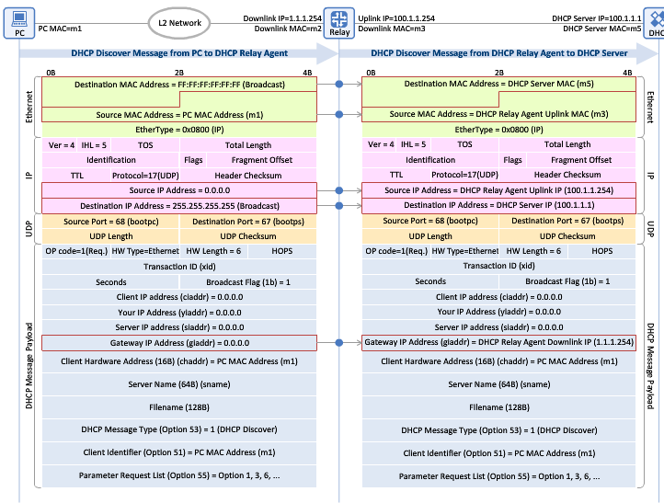
6.2.6 Using DHCP with Relays
Example - DHCPDISCOVER
[www.netmanias.com]

Slide 6
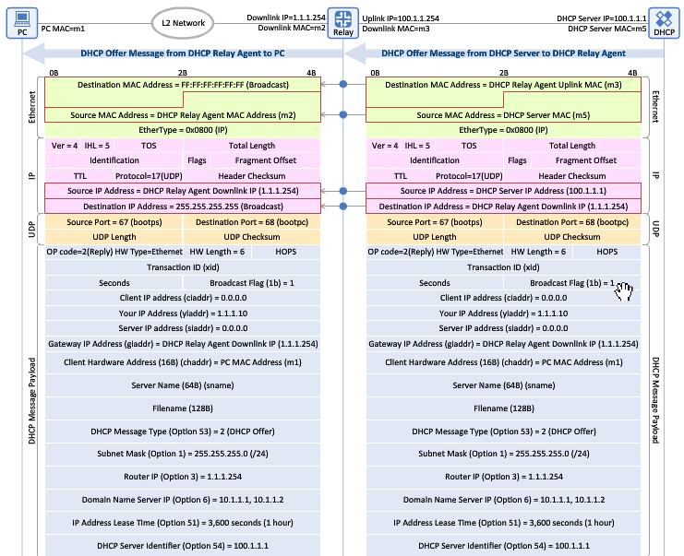
6.2.6 Using DHCP with Relays
Example - DHCPOFFER
[www.netmanias.com]

Slide 7
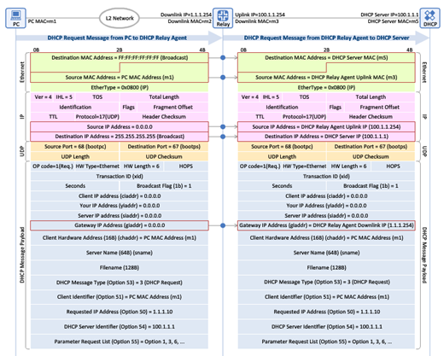
6.2.6 Using DHCP with Relays
Example - DHCPREQUEST
[www.netmanias.com]

Slide 8
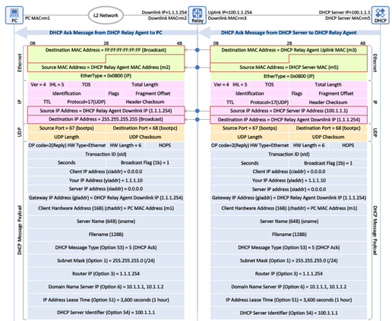
6.2.6 Using DHCP with Relays
Example - DHCPACK
[www.netmanias.com]

Slide 9
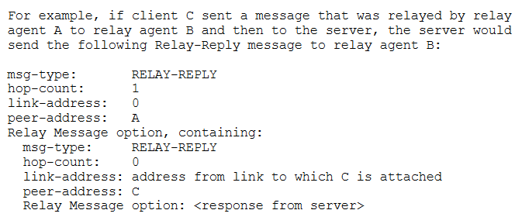
6.2.6 Using DHCP with Relays
Example – DHCPv6 RELAY-REPL

Slide 10
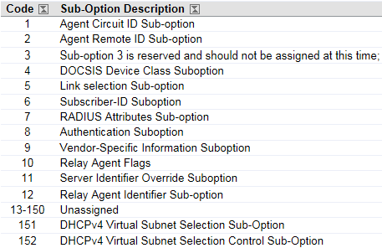
6.2.6.1 Relay Agent Information Option(RAIO)
It has become useful to include extra information in the messages that pass between the relay and the server.
  e.g.) the ISP may not trust the subscriber completely, or billing and logging may be associated with other information not available in the basic DHCP protocol.
DHCPv4 Option# 82 : Relay Agent Information
Sub-Option Codes
HMAC-SHA1 Algorithm

Slide 11
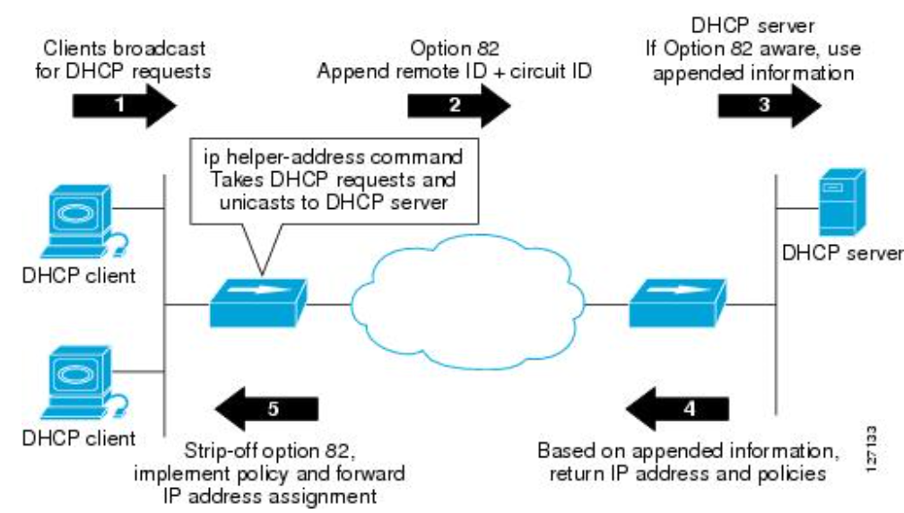
6.2.6.1 Relay Agent Information Option(RAIO)
Example

Slide 12
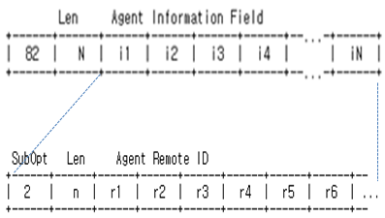
6.2.6.2 Relay Agent Remote-ID Suboption and IPv6 Remote-ID Option
The remote-ID suboption(2) provides a way to identify the requesting DHCP client using a number of naming approaches that are locally interpreted
  e.g.) caller ID, user name, modem ID, remote IP address of a point-to-point link
  The remote ID MUST be globally unique.
Option
Notes:
Servers recognizing the Relay Agent Information option may use the information to implement IP address or other parameter assignment policies.

Slide 13
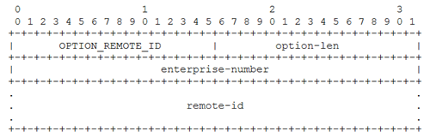
6.2.6.2 Relay Agent Remote-ID Suboption and IPv6 Remote-ID Option
The DHCPv6 Relay Agent Remote-ID option provides the remote ID but also includes an extra field, the enterprise number.
  Enterprise number : The vendor`s registered enterprise Number as registered with IANA.
  Each vendor must ensure that the remote-id is unique for its enterprise-number. (A common method is to use a DUID)
(37)
Notes:
The information that relay agents supply can also be used in the server's decision making about the addresses, delegated prefixes [4], and configuration parameters that the client is to receive

Slide 14
6.2.6.3 Server Identifier Override
Once a client receives and selects its address, it can talk directly to the DHCP server based upon the server’s identity carried in the Server Identifier option.
It is often useful to allow the relay to include a variety of options (e.g., RAIO carrying a circuit ID) for other types of messages, such as REQUEST, in addition to SOLICIT.
  This option includes a 4-byte value specifying the IPv4 address to use in the Server Identifier option present in DHCPREPLY messages formed by servers.
  The Server Identifier Override option(10) is supposed to be used in conjunction with the Relay Agents Flag suboption(11).
    Suboption#11 : Broadcast or unicast → IP allocation decision.

Slide 15
6.2.6.4 Lease Query and Bulk Lease Query
In some environments it is useful to allow a third-party system (such as a relay or access concentrator) to learn the address bindings for a particular DHCP client.
In the case of DHCPv6, it can also provide lease information for delegated prefixes.
Relay
Agent
DHCP Server
Relay
Agent
DHCP Server
DHCPLEASEQUERY(10)
LEASEQUERY(14)
DHCPLEASEUNASSIGNED(11)
or DHCPLEASEUNKNOWN(12)
or DHCPLEASEACTIVE(13)
LEASEQUERY-REPLY(15)
[For DHCPv4]
[For DHCPv6]
*(number) : Message Number

Slide 16
DHCPv4 LEASE QUERY Message
DHCPLEASEQUERY
  Types of queries for DHCPv4: IPv4 address, MAC address, Client Identifier, and Remote ID.
DHCPLEASEUNASSIGNED
  The responding server is authoritative for the queried value but no current associated lease is assigned.
DHCPLEASEACTIVE
  A lease is active, and the lease parameters (including T1 and T2) are provided.
DHCPLEASEUNKNOWN
  The server does not manage the IP address or the client specified in the DHCPLEASEQUERY message does not currently have a lease on an IP address.

Slide 17
DHCPv6 LEASE QUERY Message
LEASEQUERY
  Types of queries for DHCPv6 (OPTION_LQ_QUERY) : IPv6 address and Client Identifier (DUID)
LEASEQUERY-REPLY message
  Client Data option includes Client ID, IPv6 Address, IPv6 Prefix, and Client Last Transaction Time.
  Relay Data option provides the relay agent information used when the client last communicated with the server.
  Client Link option identifies the links on which the client has one or more bindings.
This information is used for whatever purposes the requestor desire.

Slide 18
Bulk Leasequery (BL)
Bulk Leasequery (BL) allows multiple bindings to be queried simultaneously, uses TCP/IP rather than UDP/IP, and supports a wider range of query types.
BL is designed as a special service and clients wishing to obtain conventional configuration information do not use BL.
One particular use of BL is when DHCP is being used for prefix delegation.
  A router as a DHCP-PD client obtains a prefix and then provides an address from the address range represented by the prefix as an assignment to conventional DHCP clients.
  If such a router fails or reboots, it may lose the prefix information and have a difficult time recovering, BL helps this situation, and others, by generalizing the set of possible query types.

Slide 19
Bulk Leasequery (BL)
BL provides several extensions to basic lease query
  It uses TCP/IP (port 547 for IPv6 and port 67 for IPv4) instead of UDP/IP. This change allows for large amounts of query information (delegated prefixes) to be returned for a single query.
  A BL query can then be based on relay identifier, link address (network segment), or relay remote ID.
  Relay Identifier option(The Relay ID DHCPv6 option and Relay ID DHCPv4 suboption) may include a DUID that identifies the relay agent.
BL supports queries by address and DUID (old queries).

Slide 20
Bulk Leasequery (BL)
When responding successfully to a query, a server first includes a LEASEQUERY-REPLY message.
If additional information is available, it includes a set of LEASEQUERY-DATA messages, one per binding.
The server completes the set with a LEASEQUERY-DONE message.
All messages pertaining to the same group of bindings share a common transaction ID.
Relay Agent
DHCP Server
LEASEQUERY
LEASEQUERY-REPLY
LEASEQUERY-DATA
LEASEQUERY-DONE

Slide 21
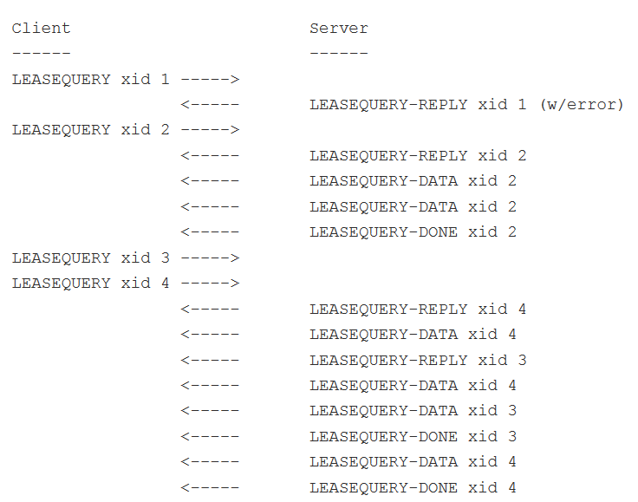
Bulk Leasequery (BL)
Example

Slide 22
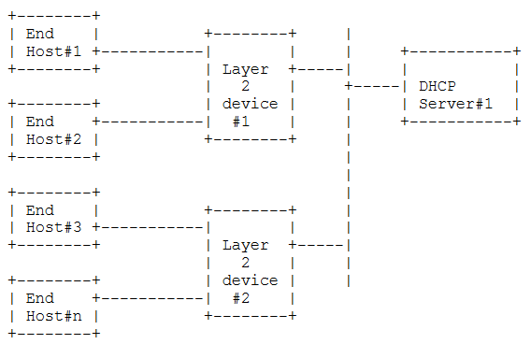
6.2.6.5 Layer 2 Relay Agents
In some network environments, there are layer 2 devices (e.g., switches, bridges) that are located near end systems that relay and process DHCP requests.
  These layer 2 devices do not have a full TCP/IP implementation stack and are not addressable using IP.
To deal with this issue, [IDL2RA] and [RFC6221] specify how layer 2 “lightweight” DHCP relay agents (LDRAs) should behave, for IPv4 and IPv6, respectively.
Labeling : client-facing/network-facing, trusted/untrusted

Slide 23
6.2.6.5 Layer 2 Relay Agents (DHCPv4)
The primary issue for IPv4 LDRAs is
  How to handle the DHCP giaddr field
  How to insert a RAIO
The approach recommended by [IDL2RA] is to have LDRAs insert the RAIO into DHCP requests received from clients but not fill in the giaddr field (in broadcast fashion).
  LDRAs receiving such a message already including a RAIO do not add another such option but perform flooding.
  Responses (e.g., DHCPOFFER messages) sent using broadcast may be intercepted by the LDRA, which in turn strips the RAIO and uses its information to forward the response to the original requesting client.
  Many LDRAs also intercept unicast DHCP traffic. In these cases, the RAIO is also created or stripped as necessary.

Slide 24
6.2.6.5 Layer 2 Relay Agents (DHCPv6)
RELAY-FORW messages are built containing options that identify the client-facing interface.
  The Link-Address field is set to 0, the Peer-Address field is set to the client’s IP address, and the Interface-ID option is set to a value configured in the LDRA.
When receiving a RELAY-REPL message containing a Link-Address field with value 0, the LDRA decapsulates the included message and sends it to toward the client on the interface specified in the received Interface-ID option (provided by the server).
RELAY-FORW messages received on client-facing interfaces are modified by incrementing the hop count.

Slide 25
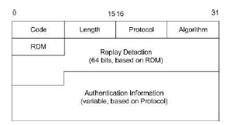
6.2.7 DHCP Authentication
The purpose of the Authentication option is to help determine whether a DHCP message has come from an authorized sender.
  If the Protocol and Algorithm fields have the value 0,
  the Authentication Information field holds a simple shared configuration token(e.g. password or similar text string.)
  this method is not very secure.
(90)

Slide 26
6.2.7 DHCP Authentication
if the Protocol and Algorithm fields are set to 1.
  A somewhat more secure method involves so-called deferred authentication.
  The authentication information includes a message authentication code (MAC), which provides authentication of the sender and an integrity check on the message contents.
DHCP Client
DHCP Server
DHCPDISCOVER/DHCPINFORM
with authentication option
DHCPOFFER/DHCPACK
with authentication information (MAC)

Slide 27
6.2.7 DHCP Authentication
The replay detection method (RDM) is determined by the value of the RDM field.
For RDM set to 0, the Replay Detection field contains a monotonically increasing value (e.g., timestamp).
  Checked to ensure that this value always increases.
There are (at least) two reasons why DHCP authentication has not seen widespread use.
  First, the approach requires shared keys to be distributed between a DHCP server and each client requiring authentication.
  Second, the Authentication option was specified after DHCP was already in relatively widespread use.
Nonetheless, [RFC4030] builds upon this specification to help secure DHCP messages passed through relay agents.

Slide 28
6.2.8 Reconfigure Extension
The purpose of this extension is to cause the client to reestablish an address or to cause it to lose its address as the result of some significant change of state within the network.
It must be authenticated using DHCP authentication
DHCP Client
DHCP Server
DHCP Client
DHCP Server
DHCPFORCERENEW
DHCPFORCERENEW
to renewing state
to renewing state
DHCPREQUEST
DHCPREQUEST
DHCPACK
DHCPNACK
to init state
DHCPDISCOVER

Slide 29
6.2.9 Rapid Commit
The motivation for this option is to quickly configure hosts that may change their point of network attachment frequently (i.e., mobile hosts).
When only a single DHCP server is available and addresses are plentiful, this option should be of no significant concern.
DHCP Client
DHCP Server
DHCPDISCOVER with Rapid Commit(80)
DHCPACK
If it should determine later that the address is already in use by another system(e.g., via ARP)
[Opt1 or Opt2]
[Opt1] DHCPDECLINE
[Opt2] DHCPRELEASE

Slide 30
6.2.10 Location Information (LCI and LoST)
In some cases, it is useful for a host being configured to become aware of its location in the world.
An IETF specifies how to provide such geospatial Location Configuration Information (LCI) to clients.
  GeoConf (123) and GeoLoc (144) DHCP options.
  Latitude, longitude, altitude and resolution indicators
  Using an IP phone requests emergency assistance
Civic location information can be provided using DHCP in the same way a physical location can, using the same LCI structure as is used with geospatial LCI.
  GEOCONF_CIVIC (99) option
  Geopolitical institutions such as country, city, district, street, and other such parameters.
There is also a concern regarding the privacy of location
  in a framework called “Geopriv” (Not DHCP)

Slide 31
6.2.10 Location Information (LCI and LoST)
An alternative high-layer protocol known as the HTTP-Enabled Location Delivery (HELD) protocol [RFC5985] may also be used to provide location information.
Instead of encoding the LCI directly in DHCP messages, DHCP options provide the FQDN(fully qualified domain name) of a HELD server for IPv4 and IPv6, respectively [RFC5986].
  OPTION_V4_ACCESS_DOMAIN (213)
  OPTION_V6_ACCESS_DOMAIN (57)

Slide 32
6.2.10 Location Information (LCI and LoST)
Once a host knows its location, it may need to contact services associated with the location (e.g., the location of the nearest hospital).
The IETF Location-to-Service Translation (LoST) framework [RFC5222] accomplishes this using an application-layer protocol accessed using a location-dependent URI.
  OPTION_V4_LOST (137) and OPTION_V6_LOST (51) provide for variable length encodings of an FQDN specifying the name of a LoST server for DHCPv4 and DHCPv6, respectively [RFC5223].

Slide 33
6.2.11 Mobility and Handoff Information (MoS and ANDSF)
In response to the increased use of mobile computers and smartphones accessing the Internet with cellular technology, frameworks and related DHCP options have been specified to convey information about the cellular configuration and handovers between different wireless networks.
  IEEE 802.21 Mobility Services (MoS) Discovery
    The IEEE 802.21 standard [802.21-2008] specifies a framework for media-independent handoff (MIH) services between various network types.
  Access Network Discovery and Selection Function (ANDSF)
    3GPP 23.402 ANDSF Specification

Slide 34
6.2.11 Mobility and Handoff Information (MoS and ANDSF)
MoS provides three types of services
  Information Services (1) : available networks
  Command Services (2) : functions for controlling link parameters
  Event Services (3) : notification of link status changes
DHCP options for providing a means for a mobile node to acquire the addresses or domain names of servers providing each of MoS services[RFC5678].
  IP addresses : OPTION-IPv4_Address-MoS (139), OPTION-IPv6_Address-MoS (54)
  FQDNs : OPTION-IPv4_FQDN-MoS option (140), OPTION-IPv6_FQDN (55)

Slide 35
6.2.11 Mobility and Handoff Information (MoS and ANDSF)
ANDSF servers may hold information such as the availability and access policies of multiple transport networks (e.g., simultaneous use of 3G and Wi-Fi).
ANDSF servers are configured by cellular infrastructure operators.
DHCP options for carrying ANDSF information[RFC6153].
  ANDSF IPv4 Address (142), ANDSF IPv6 Address (143)
DHCP Client
DHCP Server
DHCP message from DHCP Client
with Parameter Request List(DHCPv4)
or Option Request Option(DHCPv6)
DHCP messages from DHCP Server
with requested values

Slide 36
6.2.12 DHCP Snooping
DHCP “snooping” is a capability that some switch vendors offer in their products that
  inspects the contents of DHCP messages.
  ensures that only those addresses listed on an access control list are able to exchange DHCP traffic.
This can help to protect against two potential problems.
  First, a “rogue” DHCP server is limited in the damage it can do because other hosts are not able to hear its DHCP address offers.
  Also, the technique can limit the allocation of addresses to a particular set of MAC addresses (only limited protection).
This technique offers only limited protection.
  e.g. changing MAC address

