Slide 1
We Can Hear You with Wi-Fi!
Guanhua Wang, Yongpan Zou, Zimu Zhou, Kaishun Wu, Lionel M. Ni
Hong Kong University of Science and Technology
MobiCom’14

Slide 2
Contents
Introduction
Related Work
Overview
Detail the System Design
Implementation
Performance Evaluation
Conclusion

Slide 3
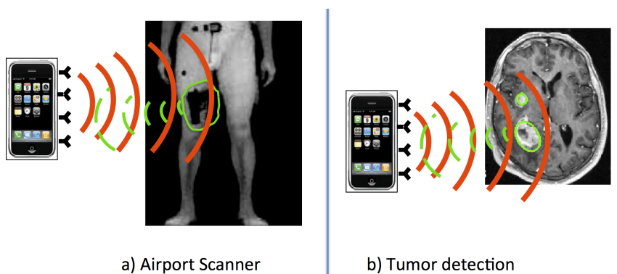
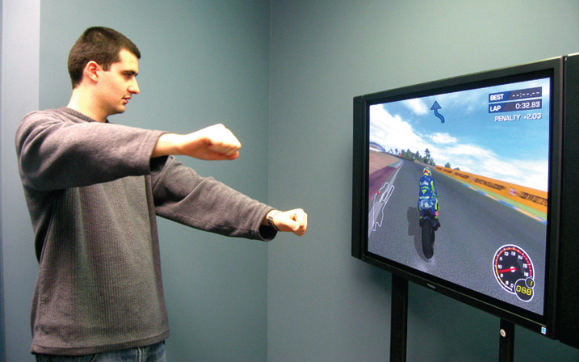
Introduction
Recent literature advances Wi-Fi signals to “SEE” people’s motions and location
Can we use Wi-Fi signals to “HEAR” talks?
WiHear
  Wi-Fi Hearing
  Enables Wi-Fi signals to “HEAR” our talks without deploying any devices.
Figure 1-1: Gesture Recognition
Figure 1-2: Object Detection

Slide 4
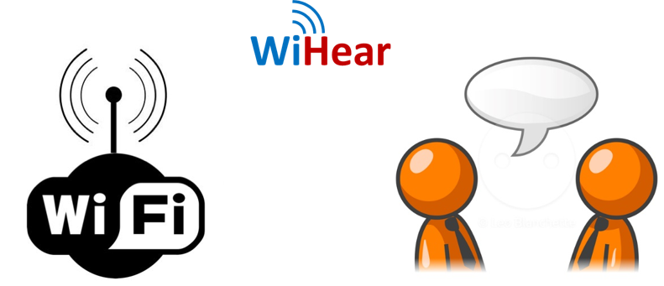
Related Work
Vision/Sensor based Motion Sensing
  Ex) Xbox Kinect, Leap Motion
    Be limited to the field of view and be sensitive to lighting conditions
Wireless-based Motion Detection and Tracking

Slide 5
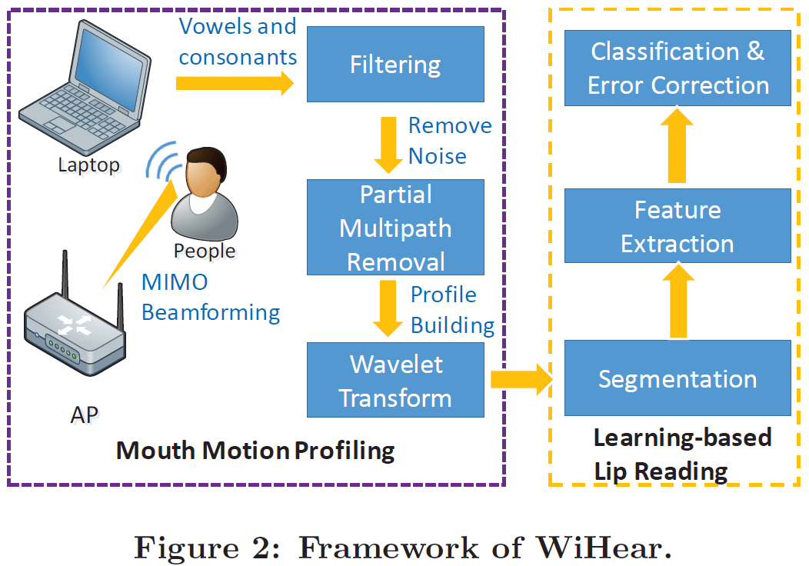
Overview
WiHear is a wireless system that enables commercial Wi-Fi devices to hear people talk using OFDM Wi-Fi devices.
1. Wavelet-based Mouth Motion Profiling
- WiHear sanitizes received signals by filtering out-band interference and partially eliminating multipath.
- It then constructs mouth motion profiles via discrete wavelet packet decomposition.
2. Learning-based Lip Reading
- Once WiHear extracts mouth motion profiles, it applies machine learning to recognize pronunciations, and translates them via classification and context-based error correction.

Slide 6
Detail the System Design Ⅰ
Mouth Motion Profiling

Slide 7
Locating on Mouth
Due to the small size of the mouth and the weak extent of its movements, it is crucial to concentrate maximum signal power towards the direction of the mouth
WiHear exploit MIMO beamforming techniques to locate and focus on the mouth, thus both introducing less irrelevant multipath propagation and magnifying signal changes induced by mouth motions

Slide 8

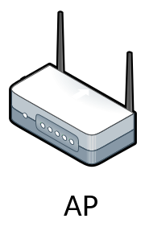
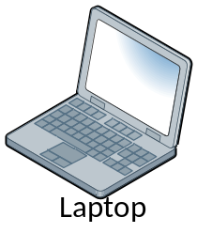
Locating on Mouth
T1
The locating process works as follows:
  The transmitter sweeps its beam for multiple rounds while the user repeats a predefined gesture (e.g. pronouncing [æ] once per second). Meanwhile, the receiver searches for the time when the gesture pattern is most notable during each round of sweeping.
  The receiver sends the selected time stamp back to the transmitter and the transmitter then adjusts and fixes its beam accordingly.
The whole locating process usually costs around 5-7 seconds
T2
T3
T3

Slide 9
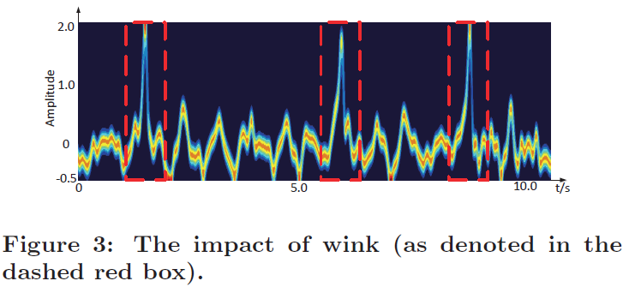
Filtering Out-Band Interference
Signal changes caused by mouth motion in the temporal domain are often within 2-5 Hz.
Therefore, apply band-pass filtering on the received samples to eliminate out-band interference.
Adopt a 3-order Butterworth IIR band-pass filter
  cancel the DC component
  cancel the wink issue (<1 Hz)
  cancel the high frequency interference.

Slide 10
Partial Multipath Removal
Mouth motion are non-rigid compared with arm or leg movements.
  It is common for the tongue, lips, and jaws to move in different patterns and deform in shape sometimes.
  Consequently, a group of multipath reflections with similar delays may all convey information about the movements of different parts of the mouth
WiHear need to remove reflections with long delays (often due to reflections from surrounding), and retain those within a delay threshold (corresponding to non-rigid movements of the mouth)
WiHear exploit CSI of commercial OFDM based Wi-Fi device
  IFFT↔FFT
Multipath removal threshold: >500 ns
  For indoor channel, the maximum excess delay is usually less than 500㎱

Slide 11
Mouth Motion Profile Construction
Apply identical and synchronous sliding windows on all subcarriers and compute a coefficient C for each of them in each time slot
  The coefficient C is defined as the peak to peak value on each subcarrier within a sliding window
  the peak-to-peak value can represent human talking behaviors
pick a series of waveform segments from different subcarriers and assemble them into a single one by arranging them one by one
  By sliding the window on each subcarrier synchronously
define the assembled CSIs as a Mouth Motion Profile

Slide 12
Detail the System Design Ⅱ
Lip Reading

Slide 13
Segmentation
Inner word segmentation
  Each word is divided into multiple phonetic events
  WiHear use the training samples of pronouncing each syllable (e.g. sibilants and plosive sounds) to match the parts of the word and then using the syllables’ combination to recognize the word
Inter word segmentation
  There is usually short interval (e.g. 300 ㎳) between pronouncing two successive word
  WiHear detects the silent interval to separate words apart

Slide 14
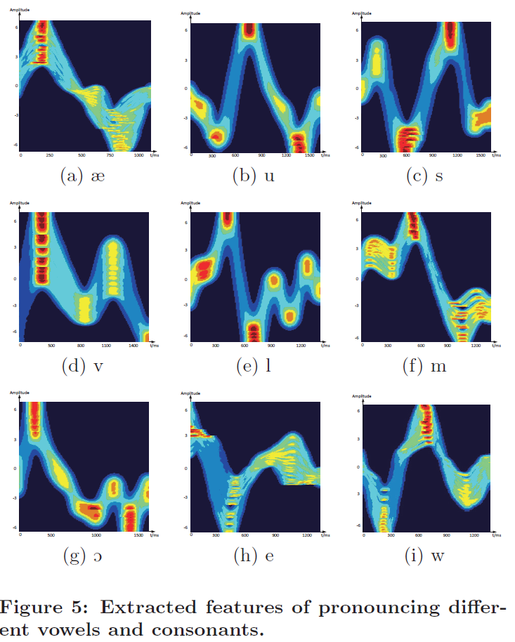
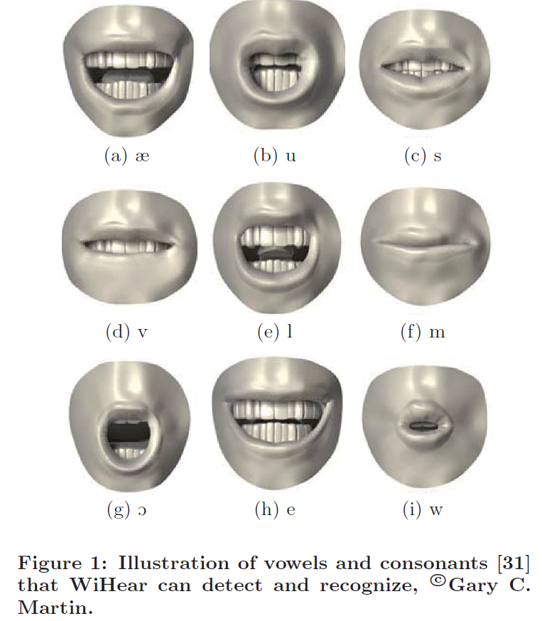
Feature Extraction
Apply a Multi-Cluster Feature Selection (MCFS) scheme
  To extract representative features from wavelet profiles to reduce the quantity of sub-waveforms

Slide 15
Classification
For a specific individual, his speed and rhythm of speaking each word share similar patterns.
Thus, WiHear can directly compare the similarity of the current signals and previously sampled ones by generalized least squares

Slide 16
Context-based Error Correction
Since the pronunciations spoken are correlated, it is possible to leverage context-aware approaches widely used in automatic speech recognition to improve recognition accuracy
Ex) when WiHear detects “you” and “ride”, if the next word is “horse”, WiHear can automatically distinguish and recognize “horse” instead of “house”
Therefore, use context-based error correction to further enhance our lip reading recognition
  After applying machine learning for classification of signal reflections and mapping to their corresponding mouth motions

Slide 17
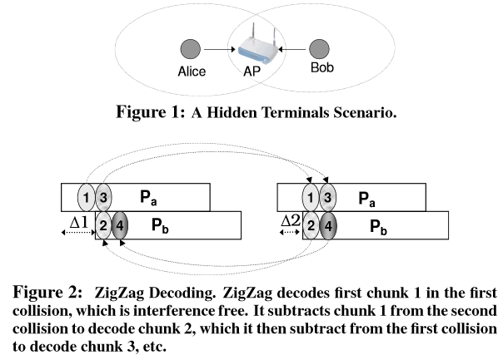
Extending to Multiple Targets
WiHear’s multi-antenna receiver can detect multiple target’s talks simultaneously by leveraging spatial diversity in MIMO system
  However, there are limited due to additional power consumption of multiple RF link and physical sizes of multiple antennas
ZigZag Cancelation
  To support multiple talk with only one receiving antenna

Slide 18
Implementation and Evaluation
Hardware Testbed
Experimental Scenarios
Lip Reading Vocabulary
Results

Slide 19
Hardware Testbed
Transmitter
  TP-LINK TL-WDR4300 wireless router
  Possesses directional antennas TL-ANT2406A and operates in IEEE 802.11n AP mode at 2.4GHz
Receiver
  a 3.20GHz Intel(R) Pentium 4 CPU 2GB RAM desktop equipped with Intel 5300 NIC (Network Interface Controller)
  Has 3 working antennas
  During the measurement, the receiver continuously pings packets from the AP at the rate of 100 packets per second and collects CSIs for 1 minute during each measurement
Use GNURadio software platform
  For USRP implementation
  implement WiHear into a 2×2 MU-MIMO system with 4 USRP N210 boards and XCVR2450 daughterboards, which operate in the 2.4GHz range

Slide 20
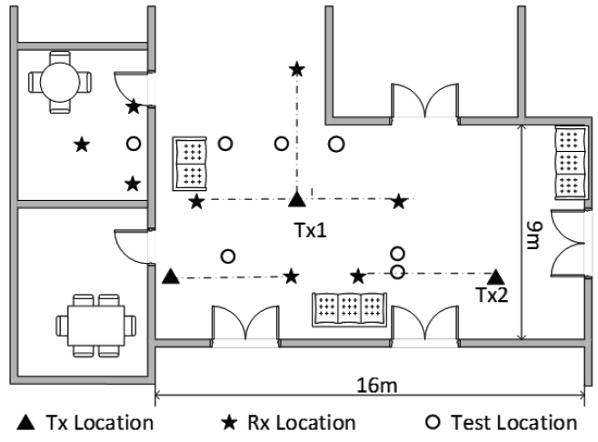
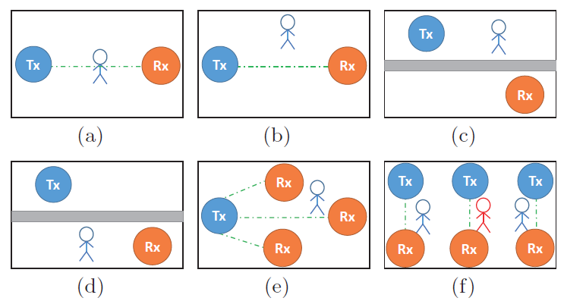
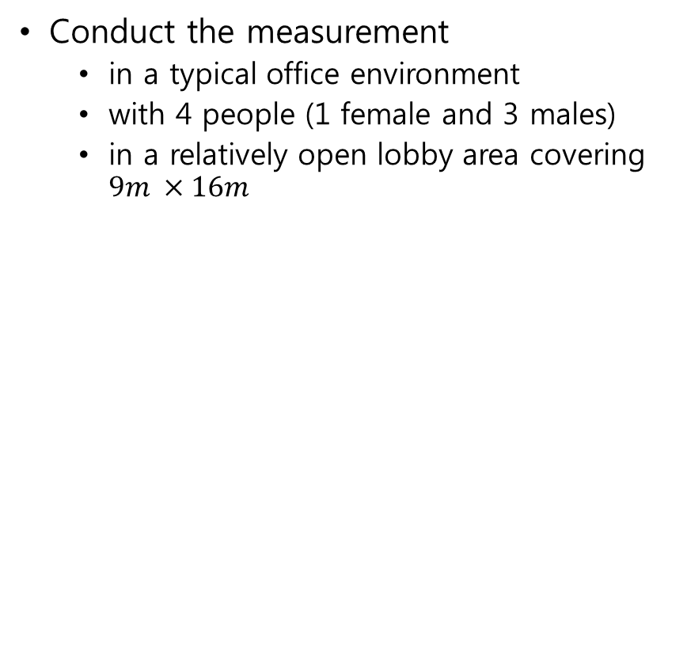
Experimental Scenarios
Conduct the measurement
  in a typical office environment
  with 4 people (1 female and 3 males)
  in a relatively open lobby area covering $9m ×16m$
Figure 8: Experimental scenarios layouts. (a) line of-sight
(b) non-line-of-sight
(c) through wall Tx side
(d) through wall Rx side
(e) multiple Rx
(f) multiple link pairs.

Slide 21
Lip Reading Vocabulary
The vocabulary list that WiHear can currently recognized
  It includes 14 syllables and 33 words.
Syllables:
  [æ], [e], [i], [u], [s], [l], [m], [h], [v], [O], [w], [b], [j], [S]
Words:
  see, good, how, are, you, fine, look, open, is, the, door, thank, boy, any, show, dog, bird, cat, zoo, yes, meet, some, watch, horse, sing, play, dance, lady, ride, today, like, he, she

Slide 22
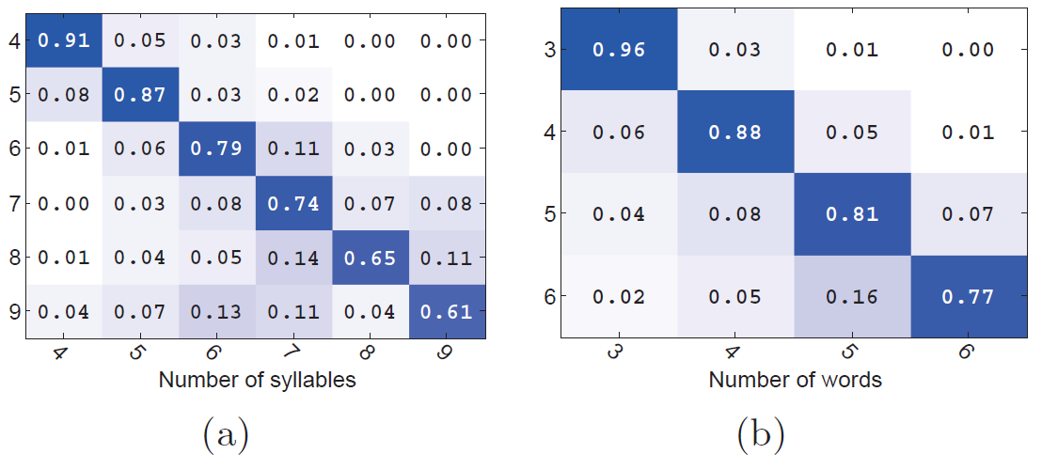
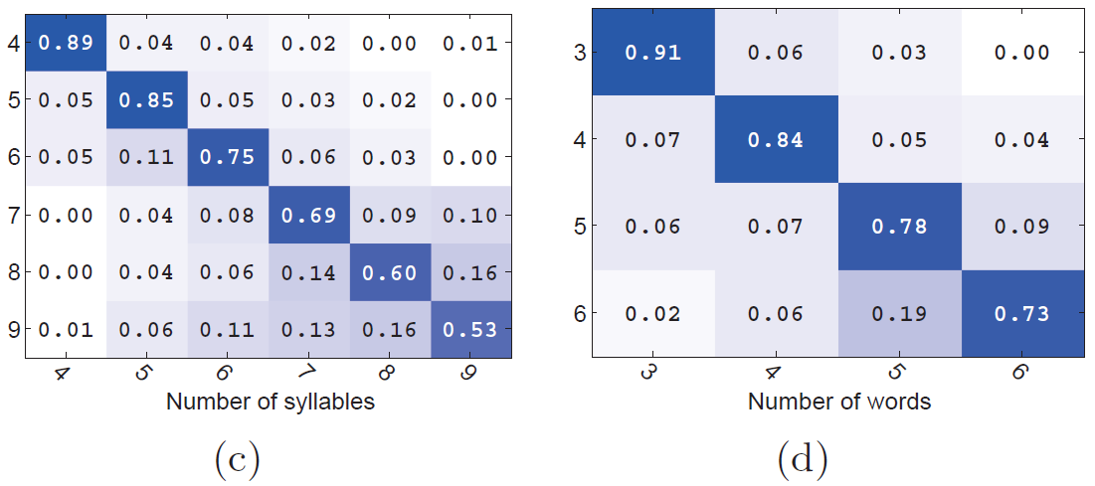
Automatic Segmentation Accuracy
Automatic segmentation accuracy for
Inner-word segmentation
on commercial devices
Inter-word segmentation
on commercial devices
Inner-word segmentation on USRP
Inter-word segmentation on USRP

Slide 23
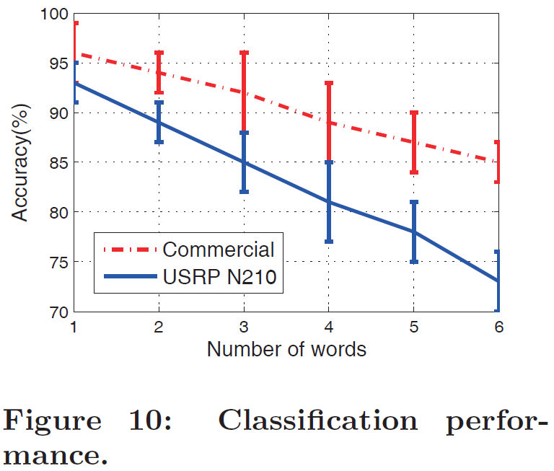
Classification Accuracy
The main reasons are two-folds:
  The USRP N210 uses omni-directional antennas which may introduce more irrelevant multipath
  the receiver of commercial Wi-Fi product has one more antenna, which gives one more dimension of spacial diversity

Slide 24
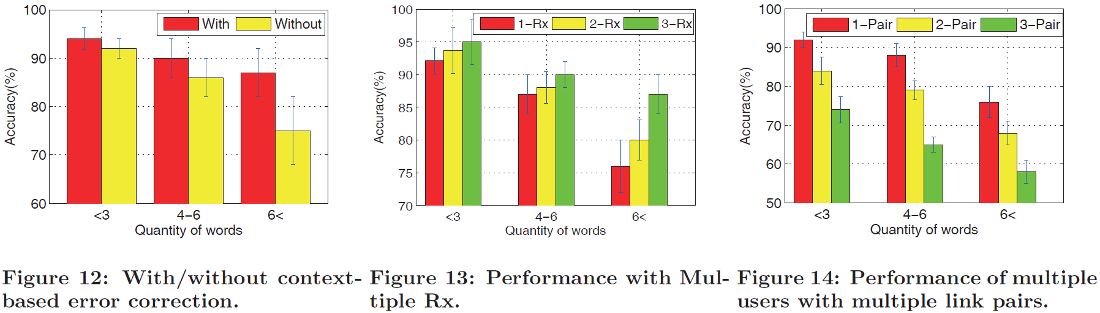
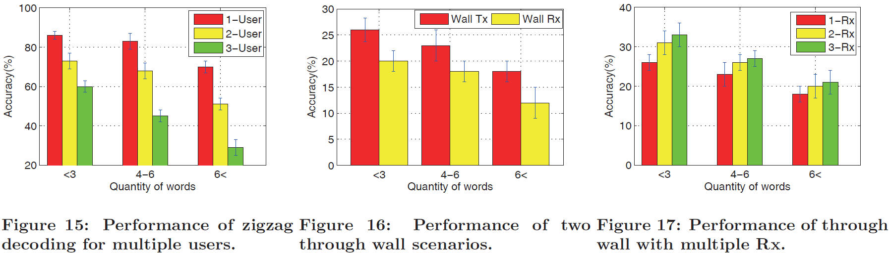
Results about Performance

Slide 25
Conclusion
This paper presents,
  WiHear is the 1st prototype in the world, trying to use Wi-Fi signal to sense and recognize human talks.
  WiHear is compatible with existing Wi-Fi standards and can be extended easily to commercial Wi-Fi products.
  WiHear may have many application scenarios.
    Has the potential to “hear” people talks through walls and doors within the radio range
    Can get more complicated information from talks than gesture-based interfaces like Xbox Kinect
    Can help disabled people to conduct simple commands to devices with mouth movements instead of inconvenient body gestures
    Can be extend for motion detection on hands

