Slide 1
CAMEO: A Middleware for Mobile Advertisement Delivery
Azeem J.Khan Kasturi jayarajah Dongsu han
Archan Misra Rajesh Balan Srinivasan Seshan
Singapore Management University
MobiSys 2013

Slide 2
Outline
Introduction
Motivation
Problem
Background
Cameo Architecture
Evaluation
Future Work
Conclusion

Slide 3
Introduction
Over 85% of the application to be downloaded from the mobile application marketplaces in 2012 will be free and principally supported by advertising revenue.
The End result is that Advertisement have become the de-facto that mobile application use to generate REVENUE.
The Current advertisement delivery frame work has certain limitation.
CAMEO

Slide 4
Motivation
Improving Performance of mobile advertisement delivery.
Decreasing Band with usage.
Reducing energy consumption on mobile.
Introduce monetization of advertisement by users and ISPs.

Slide 5
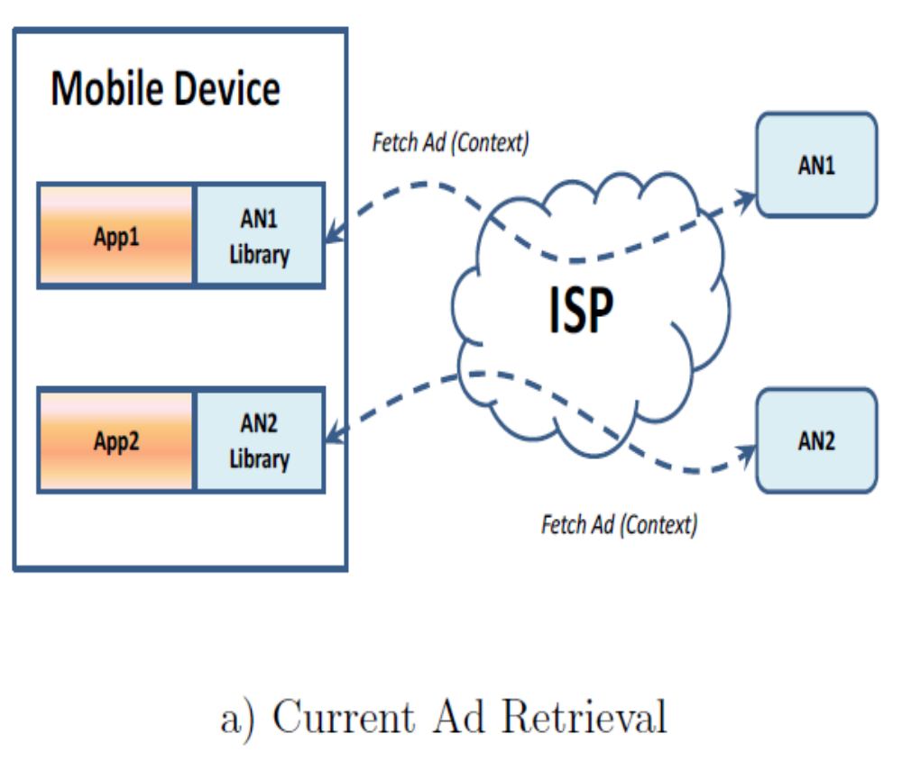
Problems-1
1. High Over heads Of Advertisement
Delivery.
i)Mobile Application presently engage in
Multiple transection to fetch and
Display single advertisement.
ii)An user effectively end up ‘paying for
advertisement related traffic generated
from their mobile device.
(5-8Kb Image advertisement of Angry Birds
generate almost 30kKB of network Traffic)
Notes:
Ad-supported applications, such as AccuWeather and Angry Birds, use advertisement libraries pro- vided by advertisement networks (AN) to fetch and display
advertisements. An individual application species the lay- out of an advertisement and supplies the relevant user con- texts, such as gender, age group, and keywords, using the
library. By interacting with the AN's servers, the advertisement library then retrieves and displays an ad that best matches the context and the AN's business interest.
App-Context –AN
AN-Libery – App

Slide 6
Problem -2
2.Limited Ability to use Ads as a Means to Monetize Connectivity.
i)Mobile ISP interested to offer free or subsidized connectivity in return for the prerogative to insert their own advertisement.
ii)Application might make themselves more appealing by continuing to operate even when the consumer does not have an explicit pre existing ISP subscription.

Slide 7
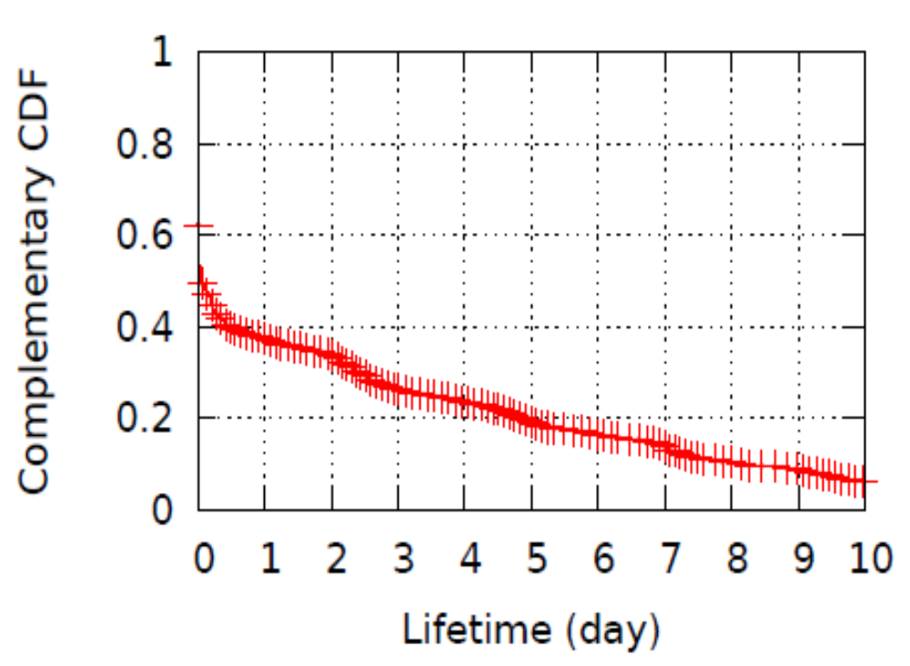
Background.
Data Collection process for Advertisement.
Contexts:-App, location, Device type 48% Ads 37% Ads
Period:-Every minutes, 2 weeks, 2 Months.
Procedure-Scripts of Components ….
Observation:-
Top 100 ads account for 50% of views.
37% of ads seen even after a Day.
Notes:
to get an in-depth un-derstanding of average user behaviors and connectivity, we
analyze the mobile usage patterns of twenty users with an instrumented Android phone that monitored user activity and network connectivity for more than a month.
A custom developed monitoring application was installed onto 20 Android-based smartphones at our Singapore campus. 12 of them belonged to students and the rest to ocesta on-campus. The monitoring application tracks and records almost every Android event related to user interaction as well as system information such as bat- tery level. For a subset of users, we also monitored their
bandwidth usage.
All ads are HTML based and they contain references to Javas cript code, icons, and/or images.

Slide 8
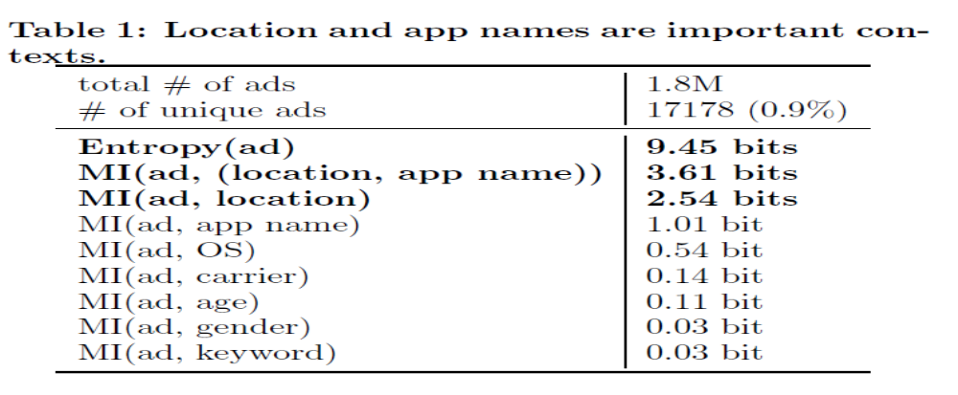
1.Which Context determine the ads to be displayed?
Notes:
We take an ad as a random variable whose value is its content and calculate its entropy and the mutual information of ads and different contexts with general statistics (Table 1).
First, the number of unique ads are relatively small. Across dierent fetches same ads reappear many times, which suggest that prefetching and caching can be effctive.
Second, location and app names give muchmore information than other contexts.

Slide 9
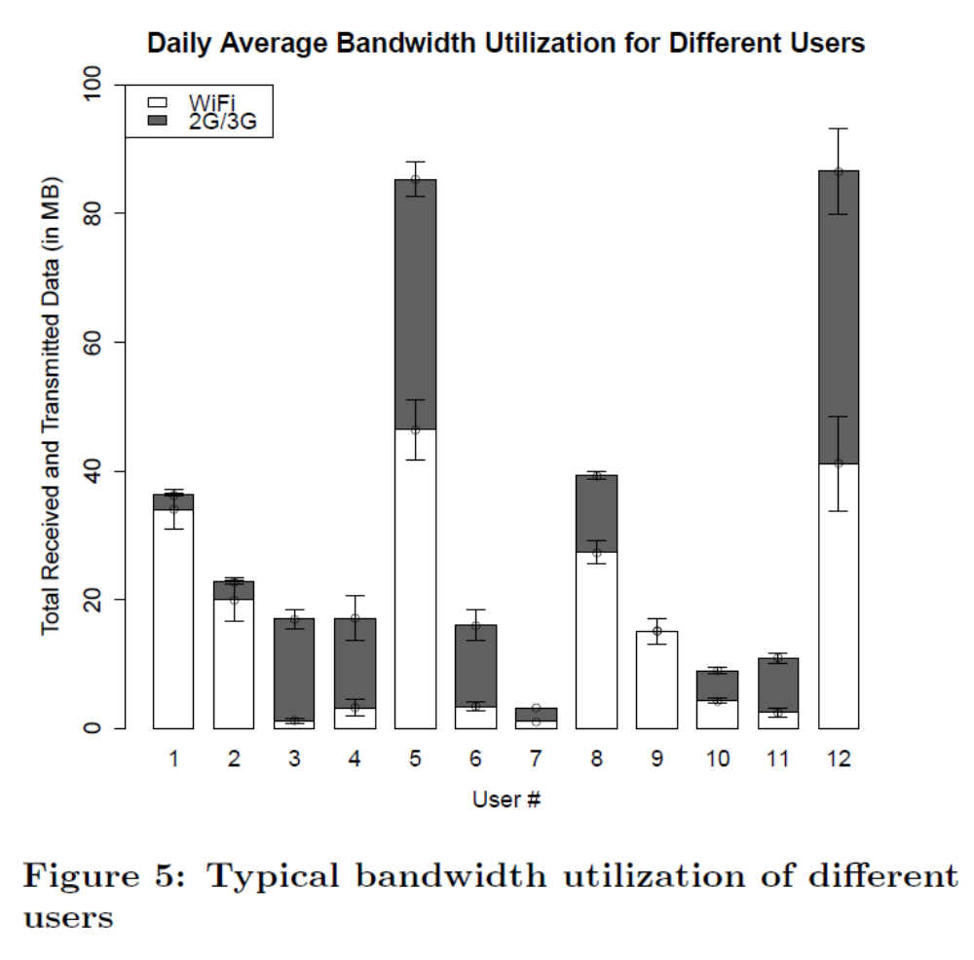
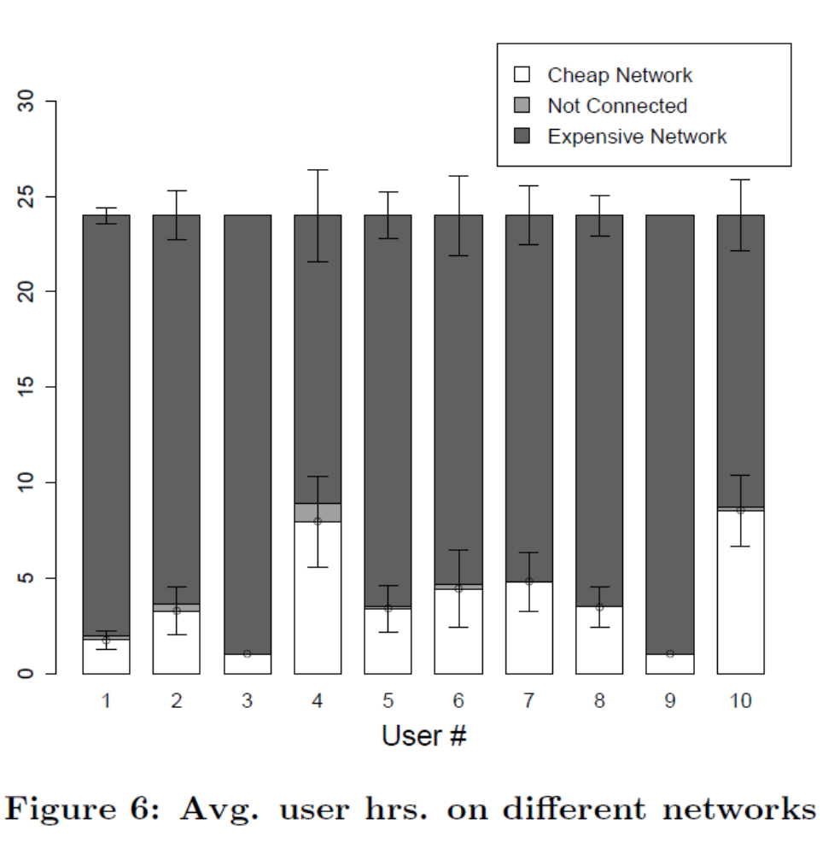
Background for addressing performance issues
Notes:
Figure 5 shows us the average daily bandwidth consumption for different users in our user study.
Average users consume 30 MB of upload and download data. 44% of the data was consumed while on a metered bandwidth network.
6. How often are users connected to cheap networks?
More then 50% user connected to wifi network .

Slide 10
CAMEO ARCHITECTURE
Reduce Overheads
The Advertisement Pre-fetch and local Serving functionality.
1.The Context Predictor Monitor the user context and applying matching learning techniques on the past context history to Predict the Future Context.
2.Advertisement manager supplies this predicted context to an AN and asks it to provide an appropriate corpus advertisement.
3. The Advertisement Manager performs a local lookup to select an advertisement matching the current context, and serves this advertisement to the requesting application.

Slide 11
Caching and Pre-Fetching
App-1
App-2
AN
AN
Context Predictor
AD manager
cache
Notes:
So 1st think behind on the cameo is two particular modeuls is AD manager and contecxt predictor.
When evear app request a add, asd manager goes to a cache fix out the request of add gives back to the app.
The Job of context predictor is to monitoring the user has been doing and then predict feature context.

Slide 12
Advertisement Selection
Online AD Selection
ANANS-(AN Advertisement Selection)
The AN then applies its custom selection logic, and delivers CAMEO a unique ID corresponding to the selected advertisement.
Note- That the advertisement itself not Download Again.
Offline AD Selection
Local Advertisement Selection(LAS)
Bulk pre-fetch of ads, An provides selection rules.
CAMEO downloads a simple XML-based rule set that dictates the advertisement selection logic..
Notes:
This rule-set is used in the FetchAd() method, taking the local corpus as input and returning the ID of the selected advertisement

Slide 13
BEAS-Best Effort Advertisement Selection.
CAMEO implementation allows ANs to specify two constraints:
(1) fi: how frequently an advertisement, adi, can bedisplayed, and
(2) Maxi: the maximum number of times an ad can be shown.
Given these speciation's ,CAMEO can apply a randomized selection procedure that adheres to these constraints.
Accounting And Verification
For all 3re Models the selection History, is also Logged in our currently primitive version of the Accounting and Verification Components.

Slide 14
Advertisement Selection
App-1
App-2
AD manager
Accounting
&
Verification
cache

Slide 15
Problem-2 Bartering ads for connectivity
1.BARTER
4.AD(s)
2.NEGOTIATE
3.AD FETCH 5.BITS USED
APP
ISP
CAMEO
OS
Notes:
CAMEO utilizes a slot-based model for negotiating and specifying the agreement by which applications can allow
ISPs to insert their advertisements in exchange for access connectivity.

Slide 16
ISP Negotiation
1.Pricing and negotiation model.
a. Per unit time And b. Per byte transfer.
a. Per unit time:- Time is partitioned in slots of t seconds, and the ISP obtains the right to show one advertisement in each slot.
b. Per byte transfer:- The ISP is allowed to show a total of x advertisements (of maximum size S) in exchange for y bytes of data traffic.

Slide 17
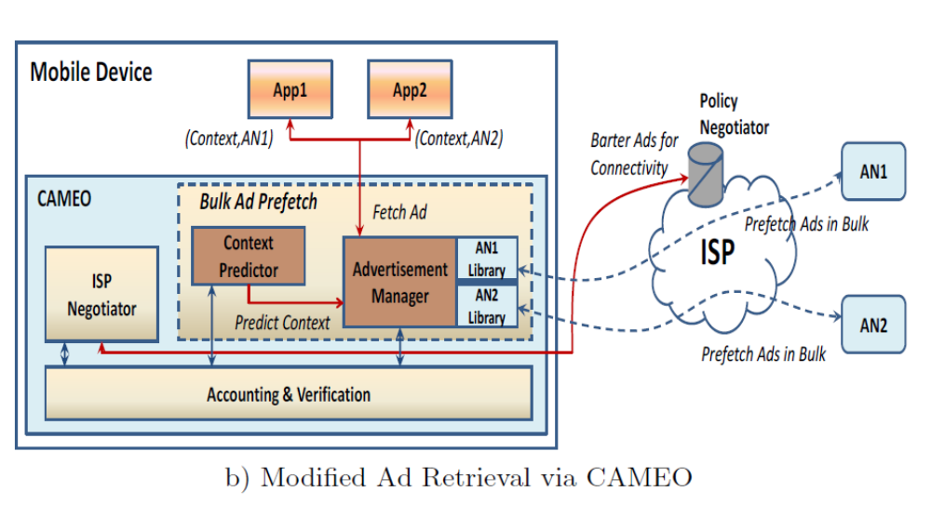
CAMEO Architecture
Notes:
To ensure that ANs and ISPs can trust this new model of CAMEO-mediated advertisement selection and display,
And
If the context prediction is inaccurate, CAMEO does not have the correct prefetched ads to display. As a result, CAMEO must make a decision to contact
the AN again to fetch a new ad or instead display a sub-optimal ad.
possibility of displaying ads when the device is online. If this was implemented it would created additional challenges related to tracking ads
shown. However it would also create a challenge similar to the problem of click and impression fraud in today's systems which is an ongoing research problem

Slide 18
EVALUATION
How Accurately can we predict users future context?
Context Prediction :- We measure the accuracy of prediction using two metrics time period of prediction and the fraction of time an application was used.
We divide each day into time bin.
1.Binary Prediction with Short Bin. Each Bin set to be 15 min(Test Set). Fraction of application.
2.Binery Prediction Into Long Bin. Total 96 Bin/day(Training Set). Application Use
3.The accuracy is then computed as 100-Σ δi · 100
To measure how often an application context appears in a day, the difference in the fraction of time (δ i) an application i was used in the test set versus the training set is computed.
Notes:
We measure the accuracy of prediction using two metrics| time period of prediction and the fraction of time an application was used. We divide each day into time bins. Using past history (training set), each bin has a list of applications that were observed as being used in that bin and we know the number of bins they appeared in. (i.e. fractional use).
We observe future usage (test set) to compute the prediction accuracy.
1. Predicting application context over shorter time peri-ods was dicult with the simple approaches but was much easier for longer time periods.
2. Users operate phones inconsistently over weekends.

Slide 19
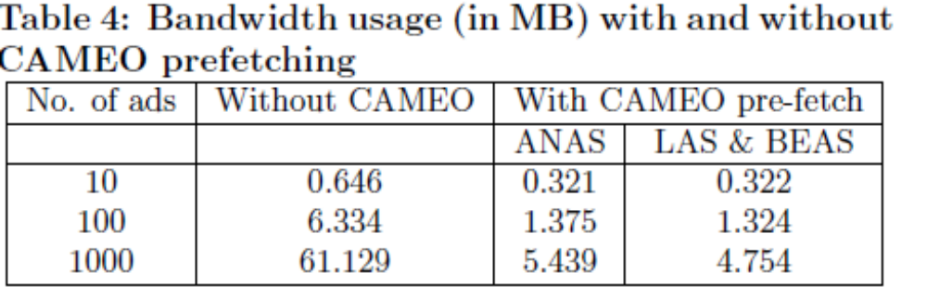
How much energy and bandwidth savings does it achieve?
CAMEO reduces the energy consumption by 38 times on 3G and 30 times on WiFi when 100 advertisements are displayed using the LAS or BEAS logic.
We estimate the bandwidth usage with and without CAMEO.
Notes:
(1) signicant repetitions of adver-
tisements (see Figure 2) by sending each unique advertise-
ment once and (2) overhead of DNS lookups and repeated
Javascript code [12, 28].

Slide 20
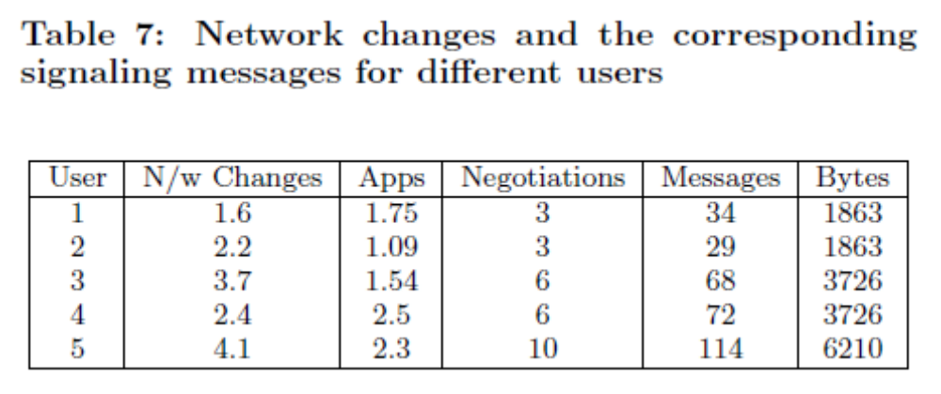
Is CAMEO's ISP negotiation feasible?
We show that the negotiation protocol introduces little overhead and ISPs may actually benefit from switching to an ad- supported model.
Notes:
Every time a user changes a network, all the CAMEO enabled applications that are in use will need to re-negotiate thereby creating a flurry of messages on the network.

Slide 21
FUTUREWORK
enable optimized advertisement delivery and advertisement bartering for connectivity, there are many repercussions of this design on the advertising and mobile application ecosystem that we leave for future work.
Network Traffic policing- This will require the creation of a contract between the ap-plication and the ISP regarding the terms of the exchange;
Privacy- However, the user should be able to specify which context data can be used by CAMEO.
Content Management - CAMEO's support for both ad developer and network provider advertising raises issues related to regulation and fairness.
Revenue maximization

Slide 22
Conclusion
Reduce Overheads
Pre-fetching and cashing enable significant.
reducing in band with and energy consumption.
- Offline access of ads.
Online and offline mode of ad selection to preserve and enhance current economic models .
Initial framework proposed and implemented -

Slide 23
THANK YOU
Q&A

Slide 25
Cameo
Challenge #1: Reduce Overheads
HOW?
1.Pre-Fetching and 2.Caching of advertisement.
WHY BOTH?
1.Pre-Fetching:-Cameo Can be configured to pre-fetch only when the mobile device is on a cheep network or wifi.
Advertisement context the matter such as location and app can be predicted.
Caching:-
Ads are repeated.
Small number of ads account for most ad views.
Overheads per ad are avoided.

Slide 26
Challenge-2 Offline Access to Ads
Online Selection Of Ads
-AN advertisement selection (ANAS)
Bulk pre-fetch of ads, online ad selection by AN.
Offline Selection Of ads
Local advertisement Selection (LAS)
Bulk pre-fetch of ads, An provides selection rules.
Best effort advertisement selection (BEAS)
Bulk pre- fetch of ads, Statistical selection By CAMEO.
Notes:
ANS -In the ANAS model, CAMEO issues a FetchAd() request, containing the corpus ID and receives back the ID (hash) of the advertisement selected for display.
BES-To sup- port LAS, CAMEO downloads a simple XML-based ruleset that dictates the advertisement selection logic. This rule- set is used in the FetchAd() method, taking the local corpus as input and returning the ID of the selected advertisement.

Slide 27
