Slide 1
Open Data Kit Sensors: A Sensor Integration Framework for Android at the Application-Level
Waylon Brunette et al.
University of Washington
Mobisys 2012
Presenter : Yongtae Park

Slide 2
Contents
Introduction
Open Data Kit (ODK) and ODK Sensors
Framework
  Framework Interface
  Sensor Drivers
Applications
Experiments
  Performance
  Power
  Ease of Use/Programming
Discussion and Future Work
Conclusion

Slide 3
Introduction
The platform shift
  From traditional PCs and standalone sensing appliances
  To mobile devices coupled with cloud services to create mobile information systems
Unprecedented opportunity to integrate consumer mobile devices with external sensors
  Enabling the collection of data directly on these devices
  But relying on conventional in-kernel device driver frameworks to integrate external sensors with consumer smartphones is impractical

Slide 4
Introduction
Technical challenges
  Managing the details of different physical communication channels
  Processing sensor-specific data
  Developing a user interface
  Designing application control logic
To reduce technical barriers in developing countries
  Open Data Kit (ODK) Sensors framework that uses external sensors simply

Slide 5
Open Data Kit (ODK)
The goal of this work
  Create a modular framework for adding new sensors
  Provide a high-degree of isolation between applications and sensor-specific code
  Understand the tradeoffs of several architectural approaches especially modularity and performance
  Facilitate the integration of new sensors into applications by making it possible to download new sensor capabilities from an application market

Slide 6
Open Data Kit (ODK)
ODK: A successful suite of mobile tools
  Exploit the rich interaction and high-performance computing capabilities of smartphones to improve information collection distribution and decision-support
ODK Sensors
  Expands ODK by creating a framework to ease the augmentation of a mobile consumer device with sensing capabilities
  Supports a variety of external sensors which are provided as a unified interface for sensing on Android devices

Slide 7
Framework
Creating a unified single-interface
Overall architecture for ODK Sensors consists of three apps
  User-Application App
    Communicates with sensors through the unifying framework API
  ODK Sensors Framework App
    Managing low-level, channel-specific communications and providing abstractions to isolate sensor driver code
  Sensor Driver Apps

Slide 8
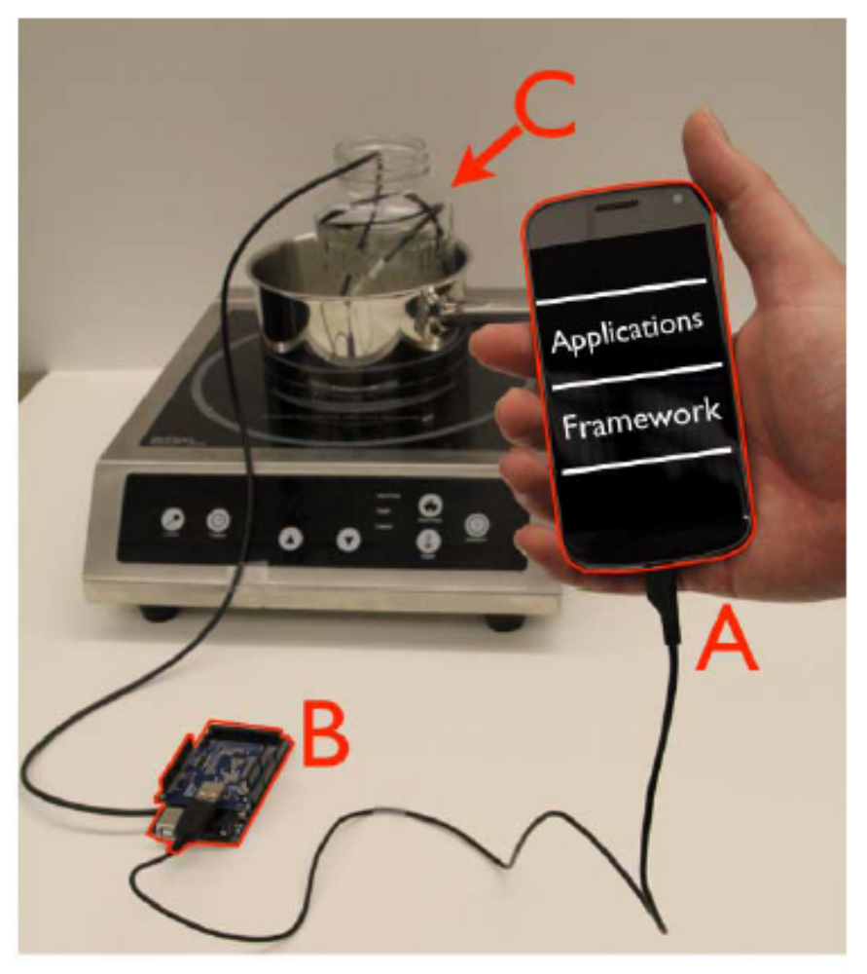
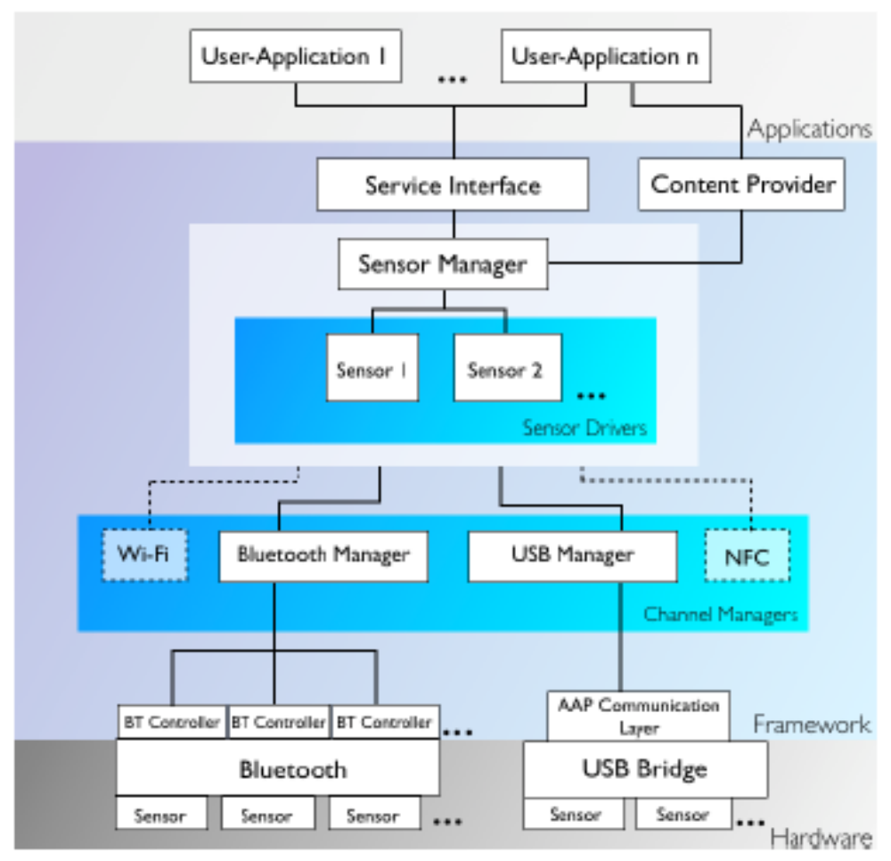
Framework

Slide 9
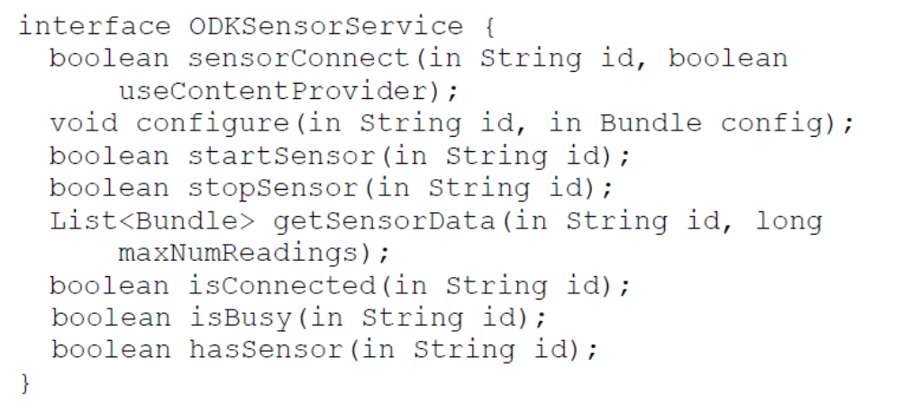
Framework Interface
Service Interface creates a common interface for user applications to leverage both built-in sensors and external sensors

Slide 10
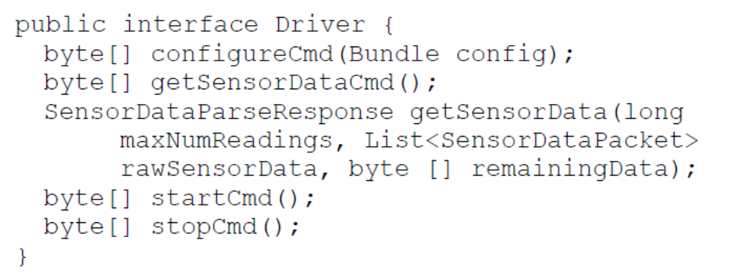
Sensor Drivers
Framework hides the complex sensor processing by Sensor Drivers
  Sensor configuration
  Connection
  Communication handshakes
  Buffering data
  Multiplexing
  Threading to use Bluetooth and USB

Slide 11
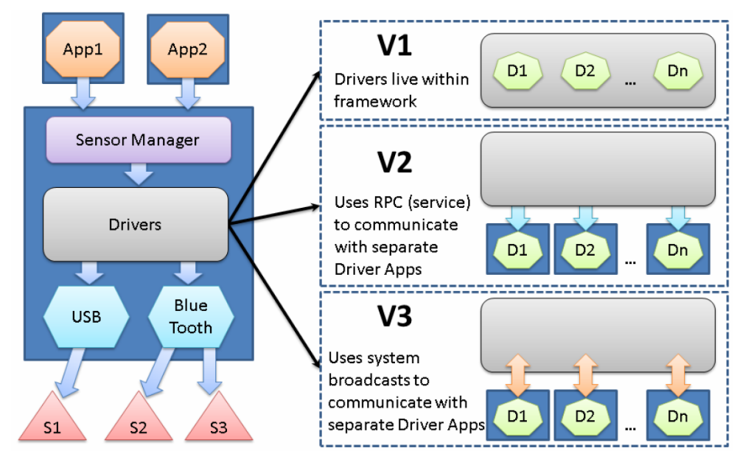
Sensor Drivers

Slide 12
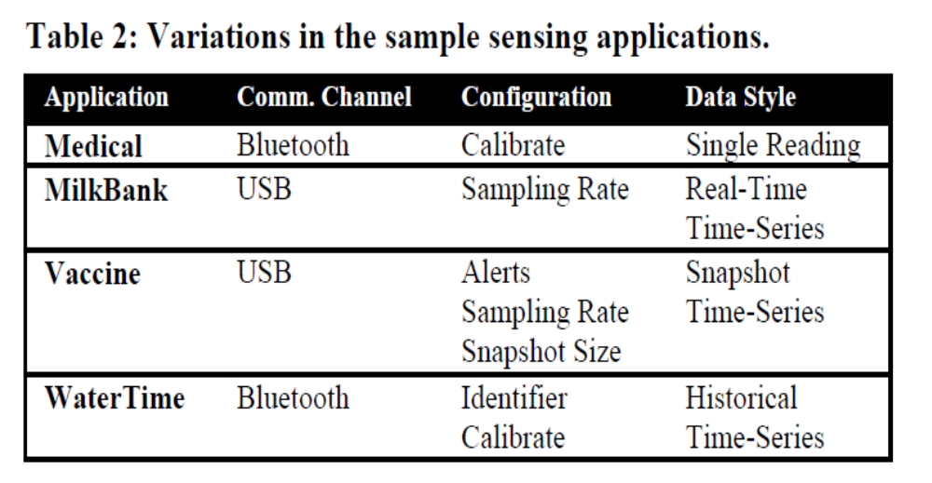
Applications
Single reading from a real time stream of data (blood pressure, pulse oxymetry)
An active session with the sensor and observes a stream of samples from the sensor in real-time (milk pasteurization)
Aggregate readings internally over a period of time and may report some to a remote location periodically (vaccine refrigerators)
Data retrieval is not automatic and requires someone to be within range of the sensor to offload the sensor’s stored data (WaterTime monitoring)

Slide 13
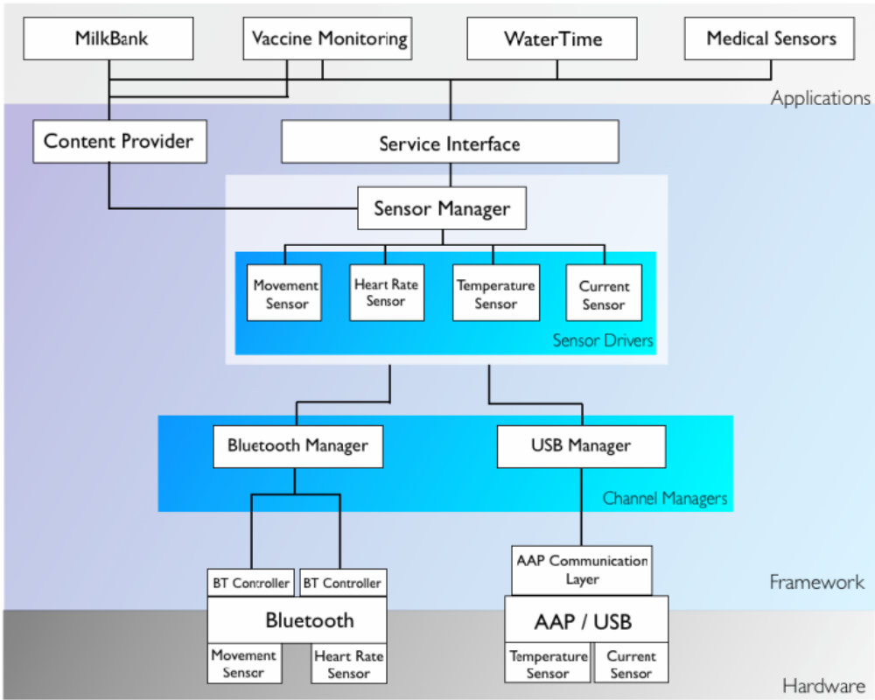
Applications

Slide 14
Experiments
Designed to explore the tradeoffs between the three frameworks in terms of
  Performance, power consumption and ease of programming
The code of the framework and drivers is identical for V1, V2, and V3
User applications were not affected across the three implementations

Slide 15
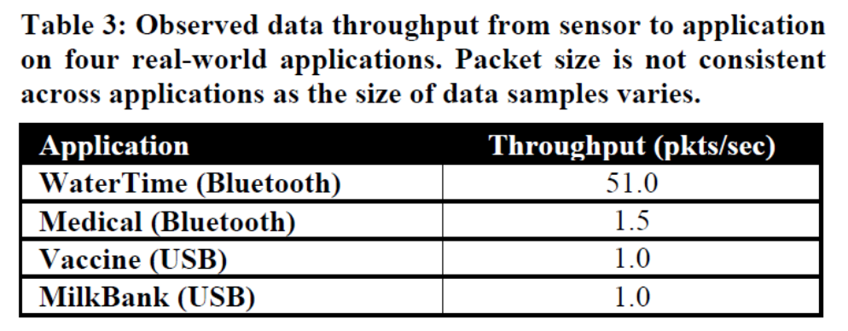
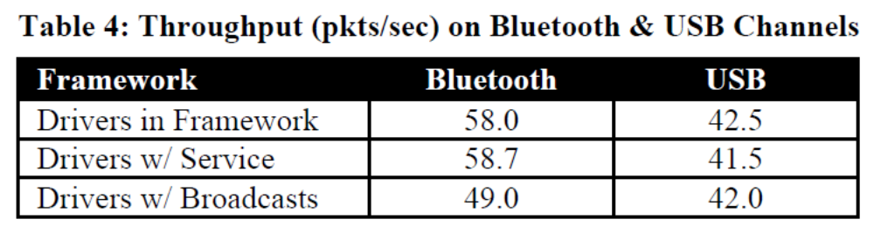
Sensor Application and Communication Channel Throughput
WaterTime requires a one-time bulk reading of historical data
Other apps collect one sample every 1 to 2 seconds
Throughput of USB channel had lower throughput than the Bluetooth channel
  USB Host driver on the Arduino adds some delays that impact channel performances

Slide 16
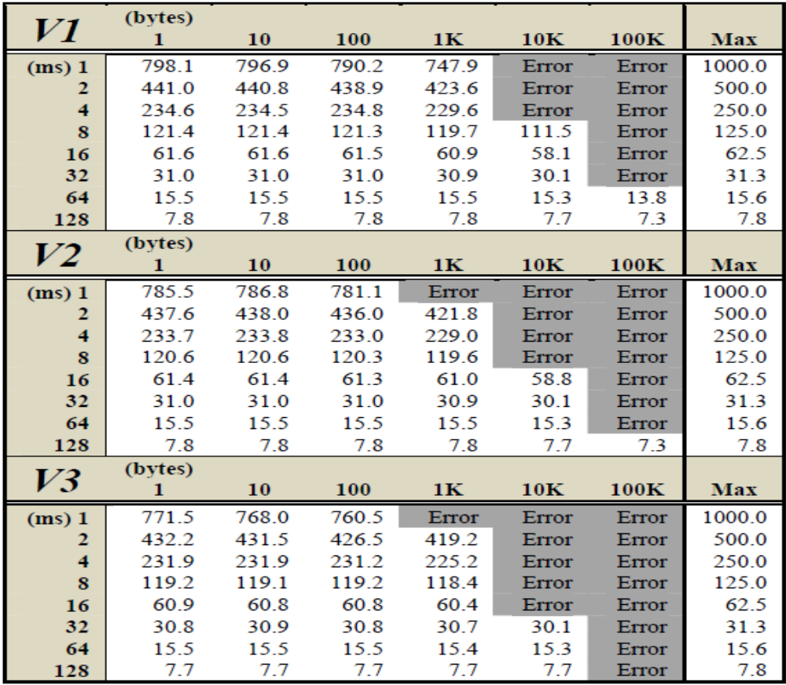
Framework throughput
V1 shows maximum throughput
V2 shows a drop-off in performance for large packets
  A default kernel—side buffer 4kB in size for each process
V3 had lower performance
  It communicates with drivers uses message-passing across process

Slide 17
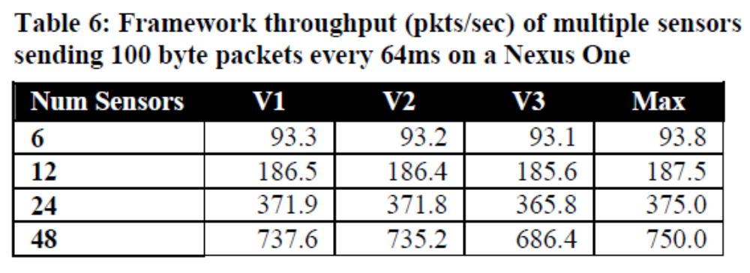
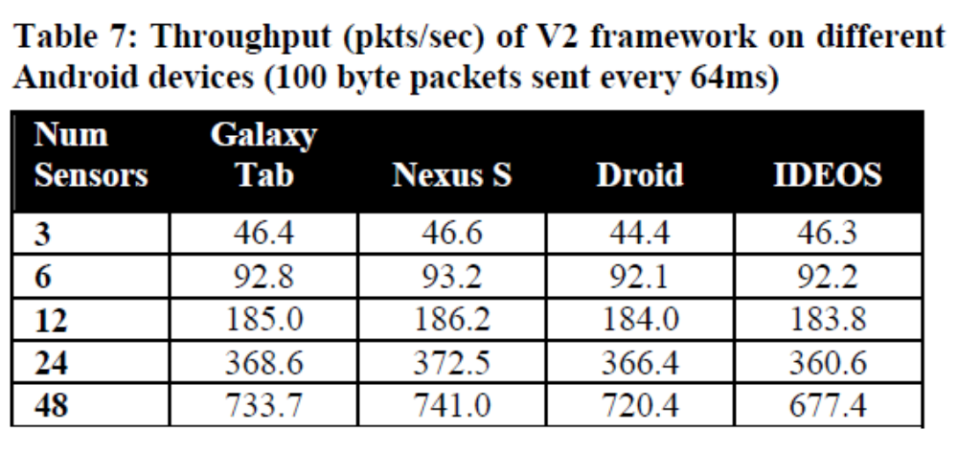
Framework throughput
100byte packets, every 64ms on a nexus one
12 sensors to be adequate for all the realistic applications
IDEOS is a Hawei smartphone that has lower RAM and smaller default heap sizes

Slide 18
Power and Ease of Use
Power - 12-hour tests where each framework processed 100pakcets/second on a Nexus One
  Each test resulted in an approximate 3% drain of the battery
    The screen, Bluetooth, Wi-Fi, and cellular radios were off
  Tests show there were only negligible differences between the frameworks
Ease of Use
  The application user is expected to be able to obtain and use basic Android applications
  Manufactures take advantage of Android’s application distribution system by using market place such as Google Play

Slide 19
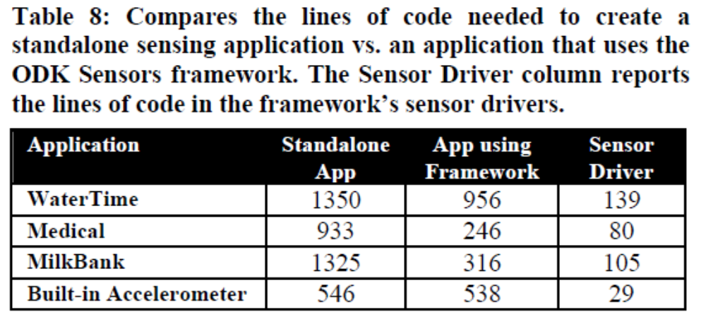
Ease of Programming
Significantly reduces the number of software packages an application developer needs to understand
Use the framework in order to communicate with multiple types of sensors over varied communication channels

Slide 20
Conclusion
The platform shift from traditional PCs to mobile devices
Create an application-level driver framework
  Enables convenient reuse of sensor-specific code between applications by logically separating the high-level application from the underlying sensor driver
  Enables the integration of data from a variety of sensors over both wired and wireless communication channels
  Simplifies application development by creating a single interface that can control virtually any kind of sensor
  Reduces the amount of code needed to access a sensor

