Slide 1
Section 10.7: IP Fragmentation
최성민
2015020501

Slide 2
10.7 IP Fragmentation
The link-layer has an upper limit on the maximum size of a frame that can be transmitted
  MTU (Maximum Transmission Unit)
  Fragmentation and Reassembly
When an IP datagram is fragmented, it is not reassembled until it reaches its final destination.
  First, not performing reassembly within the network alleviates the forwarding software (or hardware) in routers from implementing this feature.
  Second, it is possible for different fragments of the same datagram to follow different paths to their common destination.
Notes:
두번째 이유가 더 중요

Slide 3


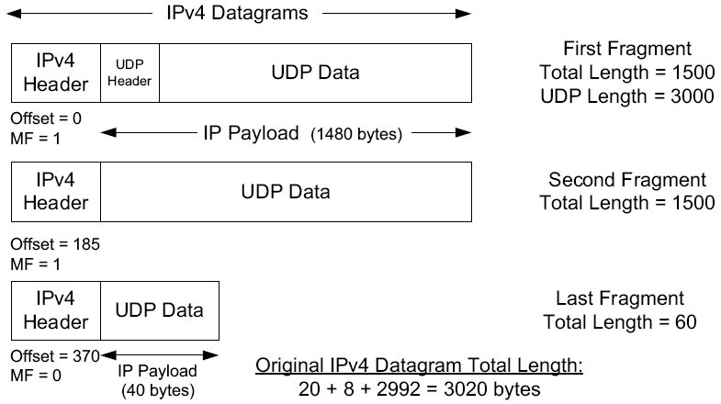
10.7.1 Example: UDP/IPv4 Fragmentation
①
②
③
1480
3000 Bytes
1480
40
①
②
③

Slide 4
10.7.1 Example: UDP/IPv4 Fragmentation
If one fragment is lost, the entire datagram is lost.
  IP itself has no error correction mechanism.
  Mechanisms are left as the responsibility of the higher layers.
    timeout and retransmission
There is no way to resend only one fragment of a datagram.
If the fragmentation was done by an intermediate router, there is no way for the originating system to know how the datagram was fragmented.
For this reason, fragmentation is often avoided.

Slide 5
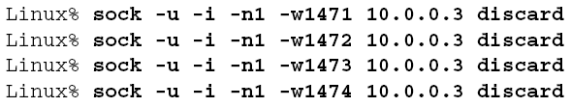
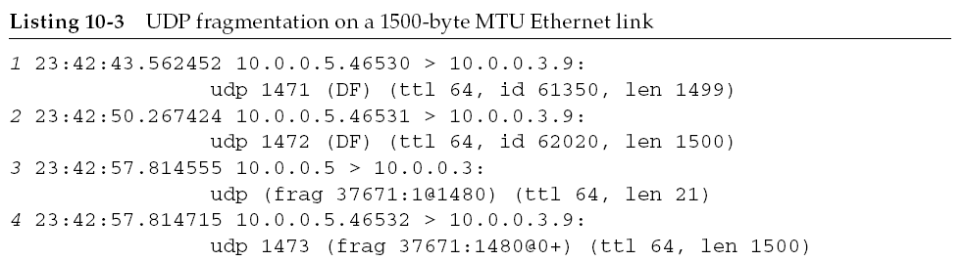
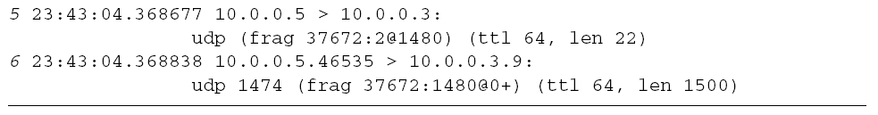
10.7.1 Example: UDP/IPv4 Fragmentation
- ②
- ①

Slide 6
10.7.1 Example: UDP/IPv4 Fragmentation
If the last fragment is delivered first, the receiving host is able to ascertain the maximum amount of buffer space.
If the first fragment is delivered first, there are techniques that would like to take advantage of higher-layer information available.
  first fragment include UDP port numbers.

Slide 7
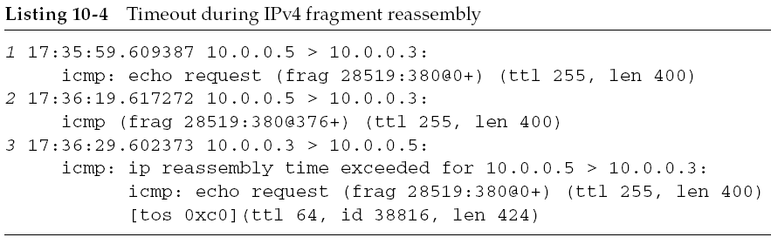
10.7.2 Reassembly Timeout
The IP layer must start a timer when any fragment first arrives. If this were not done, fragments that never arrive could eventually cause the receiver to run out of buffers.
A normal timeout value is 30 or 60s.
The timer starts when any of the fragments is received and is not reset when new fragments arrive.

Slide 8
Section 10.8: Path MTU Discovery with UDP
최성민
2015020501

Slide 9
10.8 Path MTU Discovery with UDP
The interaction between an application using UDP and the path MTU discovery mechanism (PMTUD) [RFC1191].
  It is useful if there is some way to determine an appropriate datagram size.
  Conventional PMTUD uses ICMP PTB messages in determining the largest packet size along a routing path.
    These messages are typically processed below the UDP layer.
    So either an API call is used for the application to learn the best current estimate of the path MTU size.

Slide 10
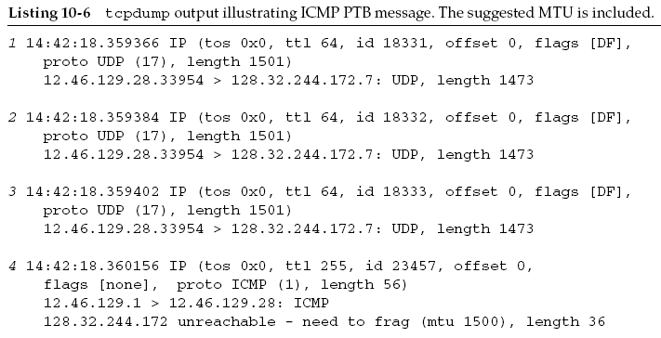

10.8.1 Example

Slide 11
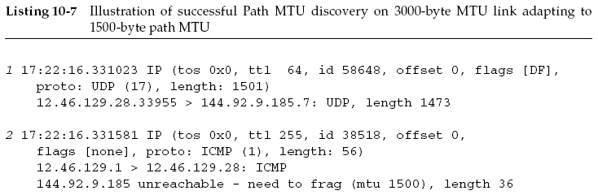
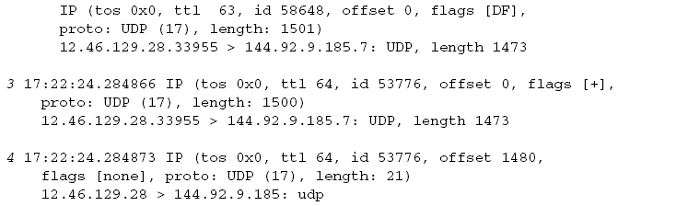
10.8.1 Example

Slide 12
Section 10.9: Interaction between IP Fragmentation and ARP/ND
최성민
2015020501

Slide 13
10.9 Interaction between IP Fragmentation and ARP/ND
When multiple fragments are to be sent,
  How many ARP messages should be generated?
  How many of the fragments are held until a pending ARP request/response is completed?

Slide 14

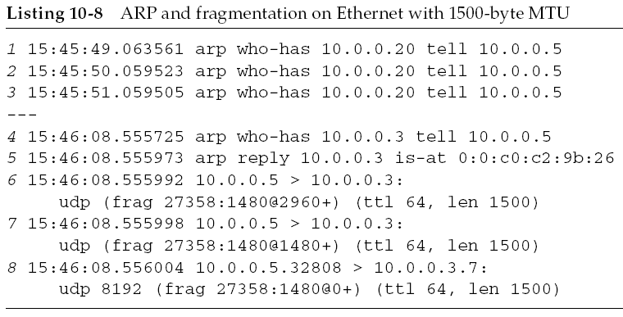
10.9 Interaction between IP Fragmentation and ARP/ND

Slide 15
10.9 Interaction between IP Fragmentation and ARP/ND
The interaction between fragmentation and ARP has been problematic.[RFC1122]
  an ARP request was sent for each fragment.
    ARP flooding
  only one of the fragments was queued pending the ARP response.
    The link layer should save at least one packet of each set of packets destined to the same unresolved IP address, and transmit the saved packet when the address has been resolved.
    This approach can lead to unnecessary packet loss.

Slide 16
Section 10.10: Maximum UDP Datagram Size
최성민
2015020501

Slide 17
10.10 Maximum UDP Datagram Size
IPv4
  The maximum size of an IPv4 datagram is 65,535 bytes
    The 16-bit Total Length field in the IPv4 header
  65535 – 20 – 8 = 65507 Bytes (User data in UDP datagram)
  (= Total Length - IP Header - UDP Header)
IPv6
  The 16-bit Payload Length field
    Not including the length of the header
  65535 – 8 = 65527 Bytes (User data in UDP datagram)
  (= Total length - UDP Header)
  IPv6 supports a Jumbogram option (see Section 5.3.1.2)
    4GB (4,294,967,295 bytes)

Slide 18
10.10 Maximum UDP Datagram Size
There are two main reasons why a full-size datagram of these sizes may not be delivered end-to-end.
  The system’s local protocol implementation may have some limitation.
  The receiving application may not be prepared to handle such large datagrams.

Slide 19
10.10.1 Implementation Limitations
Protocol implementations provide an API to applications that pick some default buffer size for sending and receiving.
  Some implementations provide defaults that are less than the maximum IP datagram size.
  The sockets API
    Typical default values are 8192 bytes or 65,535 bytes
Many UDP applications are designed to restrict their application data size to 512 bytes or less.

Slide 20
10.10.2 Datagram Truncation
The receiving application is not prepared to read that size.
What happens if the received datagram exceeds the size specified?
  the API truncates the datagram, discarding any excess data in the datagram beyond the number of bytes specified by the receiving application.
  (the exact behavior varies from implementation to implementation.)

