Slide 1

Chapter 15
Wireless
LANs
Copyright © The McGraw-Hill Companies, Inc. Permission required for reproduction or display.

Slide 2
Chapter6: Outline
15.1 INTRODUCTION
15.2 IEEE 802.11 PROJECT
15.3 BLUETOOTH

Slide 3

Chapter 15: Objective
The first section introduces the general issues behind wireless LANs and compares wired and wireless networks. The section describes the characteristics of the wireless networks and the way access is controlled in these types of networks.
The second section discusses a wireless LAN defined by the IEEE 802.11 Project. This section defines the architecture of this type of LAN and describes the MAC sublayer.
The third section discusses the Bluetooth technology as a personal area network (PAN). The section describes the architecture of the network, the addressing mechanism, and the packet format. Different layers used in this protocol are also briefly described and compared with the ones in the other wired and wireless LANs.

Slide 4
    15-1 INTRODUCTION
Wireless communication is one of the fastest-growing technologies. The demand for connecting devices without the use of cables is increasing everywhere. Wireless LANs can be found on college campuses, in office buildings, and in many public areas. Before we discuss a specific protocol related to wireless LANs, let us talk about them in general.

Slide 5
15.15.1 Architectural Comparison
Let us first compare the architecture of wired and wireless LANs to give some idea of what we need to look for when we study wireless LANs.

Slide 6
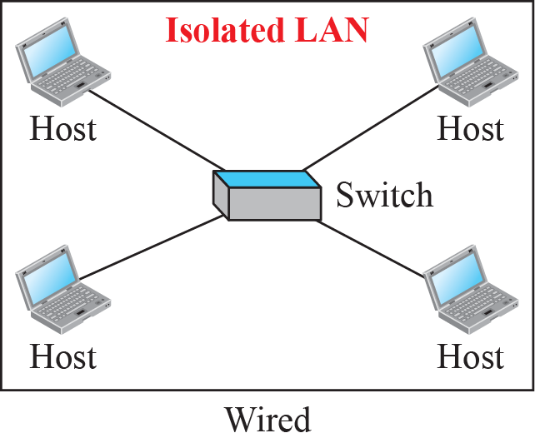
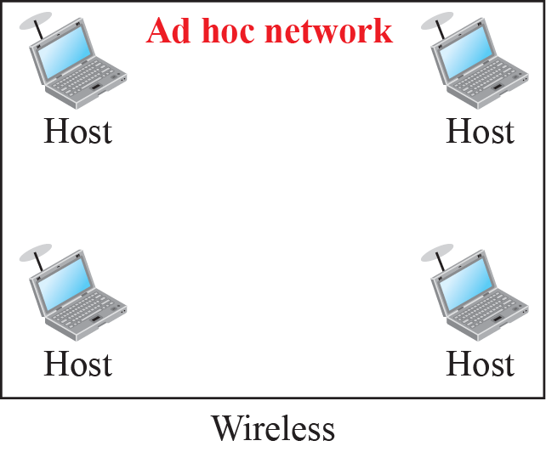
Figure 15.1: Isolated LANs: wired versus wireless

Slide 7
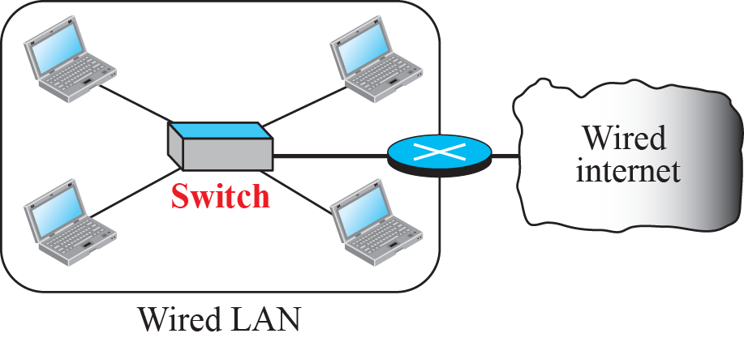
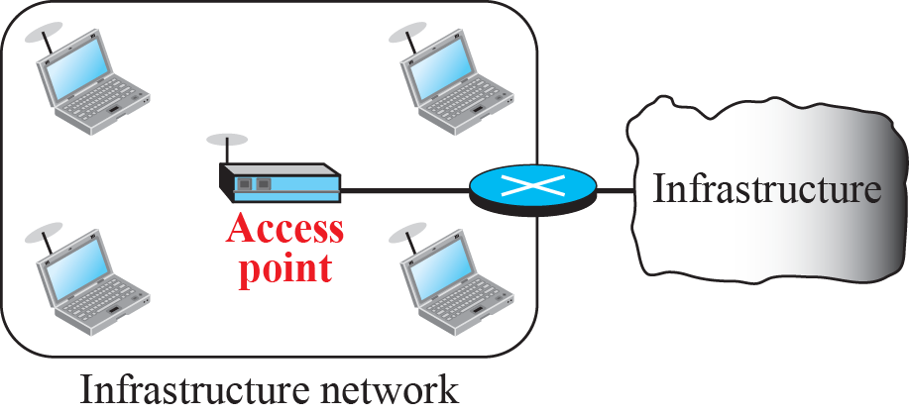
Figure 15.2: Connection of a wired LAN and a wireless LAN to other
networks

Slide 8
15.15.2 Characteristics
There are several characteristics of wireless LANs that either do not apply to wired LANs or the existence of which is negligible and can be ignored. We discuss some of these characteristics here to pave the way for discussing wireless LAN protocols.

Slide 9
15.15.3 Access Control
Maybe the most important issue we need to discuss in a wireless LAN is access control—how a wireless host can get access to the shared medium (air). The CSMA/CD algorithm does not work in wireless LANs for three reasons:
Wireless hosts do not have enough power to send and receive at the same time.
The hidden station problem prevents collision detection
The distance between stations can be great.

Slide 10
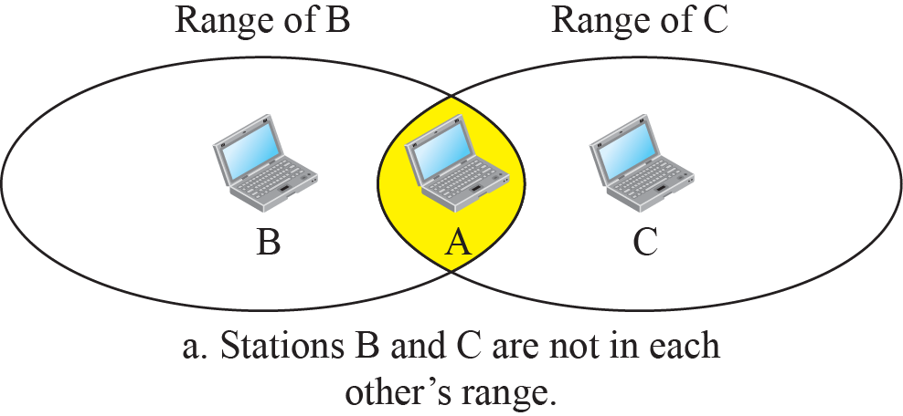
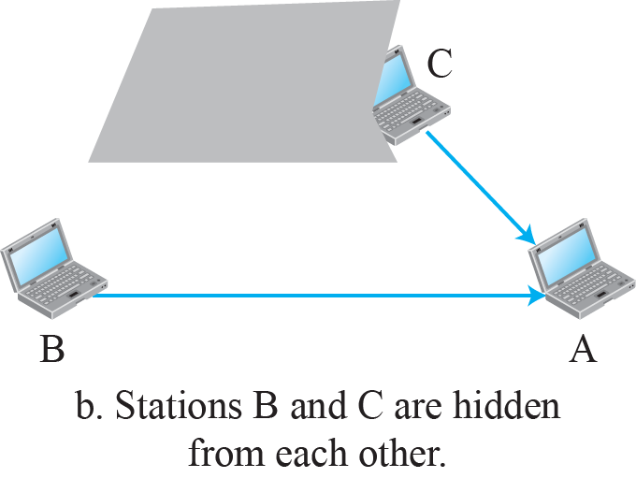
Figure 15.3: Hidden station problem

Slide 11
    15-2 IEEE 802.11 PROJECT
IEEE has defined the specifications for a wireless LAN, called IEEE 802.11, which
covers the physical and data-link layers. It is sometimes called wireless Ethernet. In some countries, including the United States, the public uses the term WiFi (short for wireless fidelity) as a synonym for wireless LAN. WiFi, however, is a wireless LAN that is certified by the WiFi Alliance.

Slide 12
15.2.1 Architecture
The standard defines two kinds of services: the basic service set (BSS) and the extended service set (ESS).

Slide 13
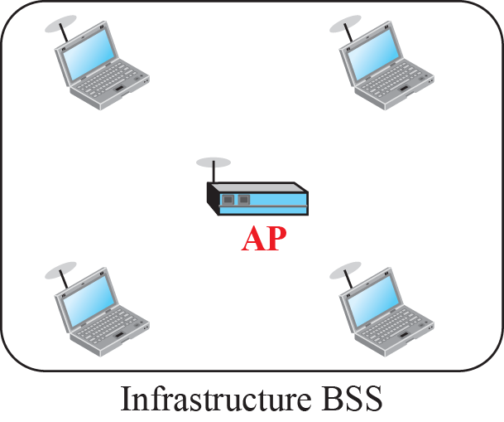
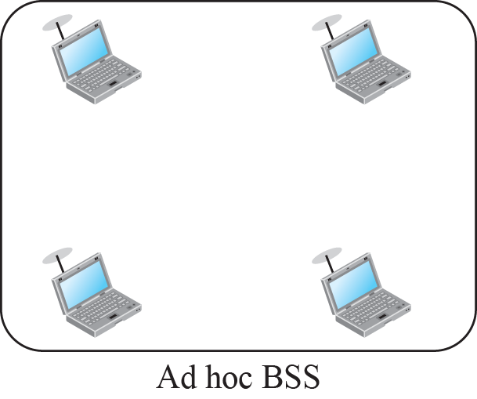
Figure 15.4: Basic service sets (BSSs)

Slide 14
Services
Station services:
  authentication,
  de-authentication,
  privacy,
  delivery of data
Distribution Services ( A thin layer between MAC and LLC sublayer)
  association
  disassociation
  reassociation
  distribution
  Integration

Slide 15
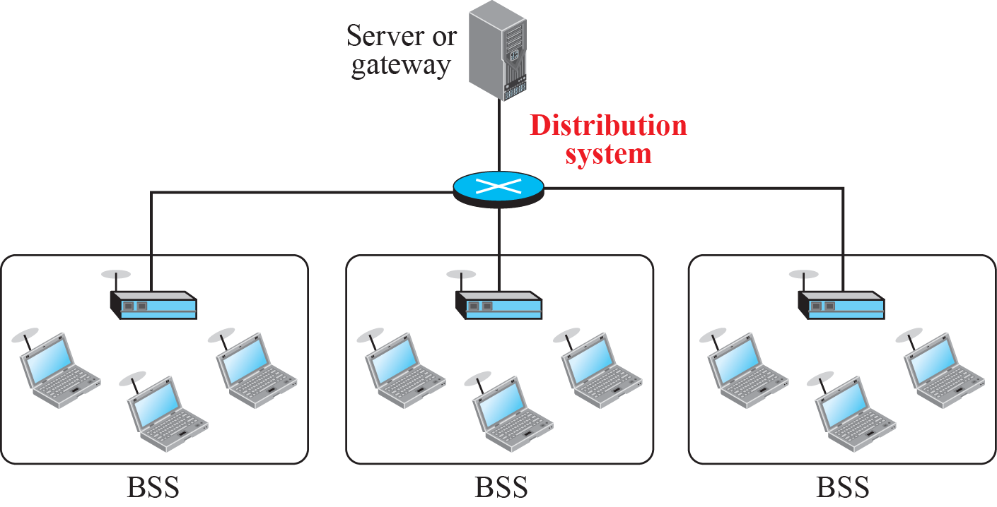
Figure 15.6: Extended service set (ESS)

Slide 16
15.2.2 MAC Sublayer
IEEE 802.11 defines two MAC sublayers: the distributed coordination function (DCF) and point coordination function (PCF). Figure 15.6 shows the relationship between the two MAC sublayers, the LLC sublayer, and the physical layer. We discuss the physical layer implementations later in the chapter and will now concentrate on the MAC sublayer.

Slide 17
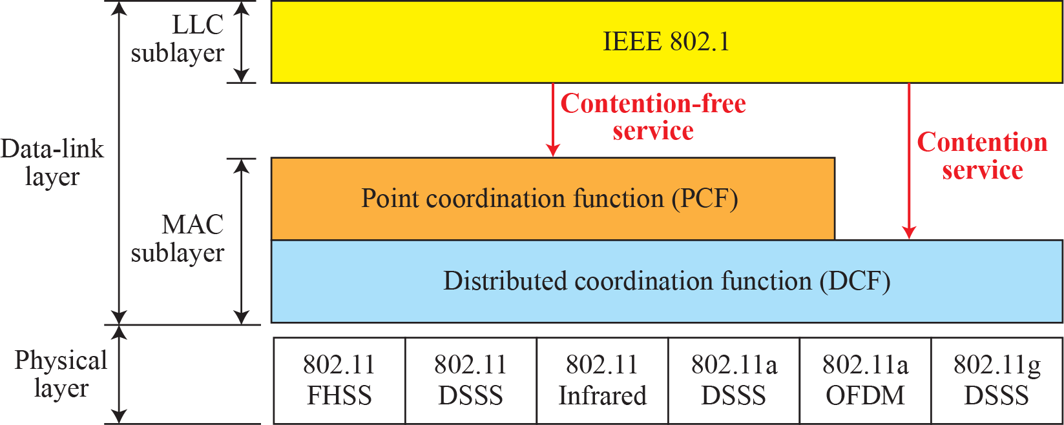
Figure 15.6: MAC layers in IEEE 802.11 standard

Slide 18

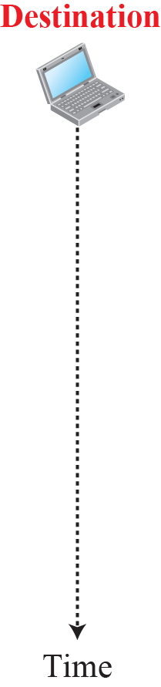











Figure 15.7: CSMA/CA and NAV

Slide 19
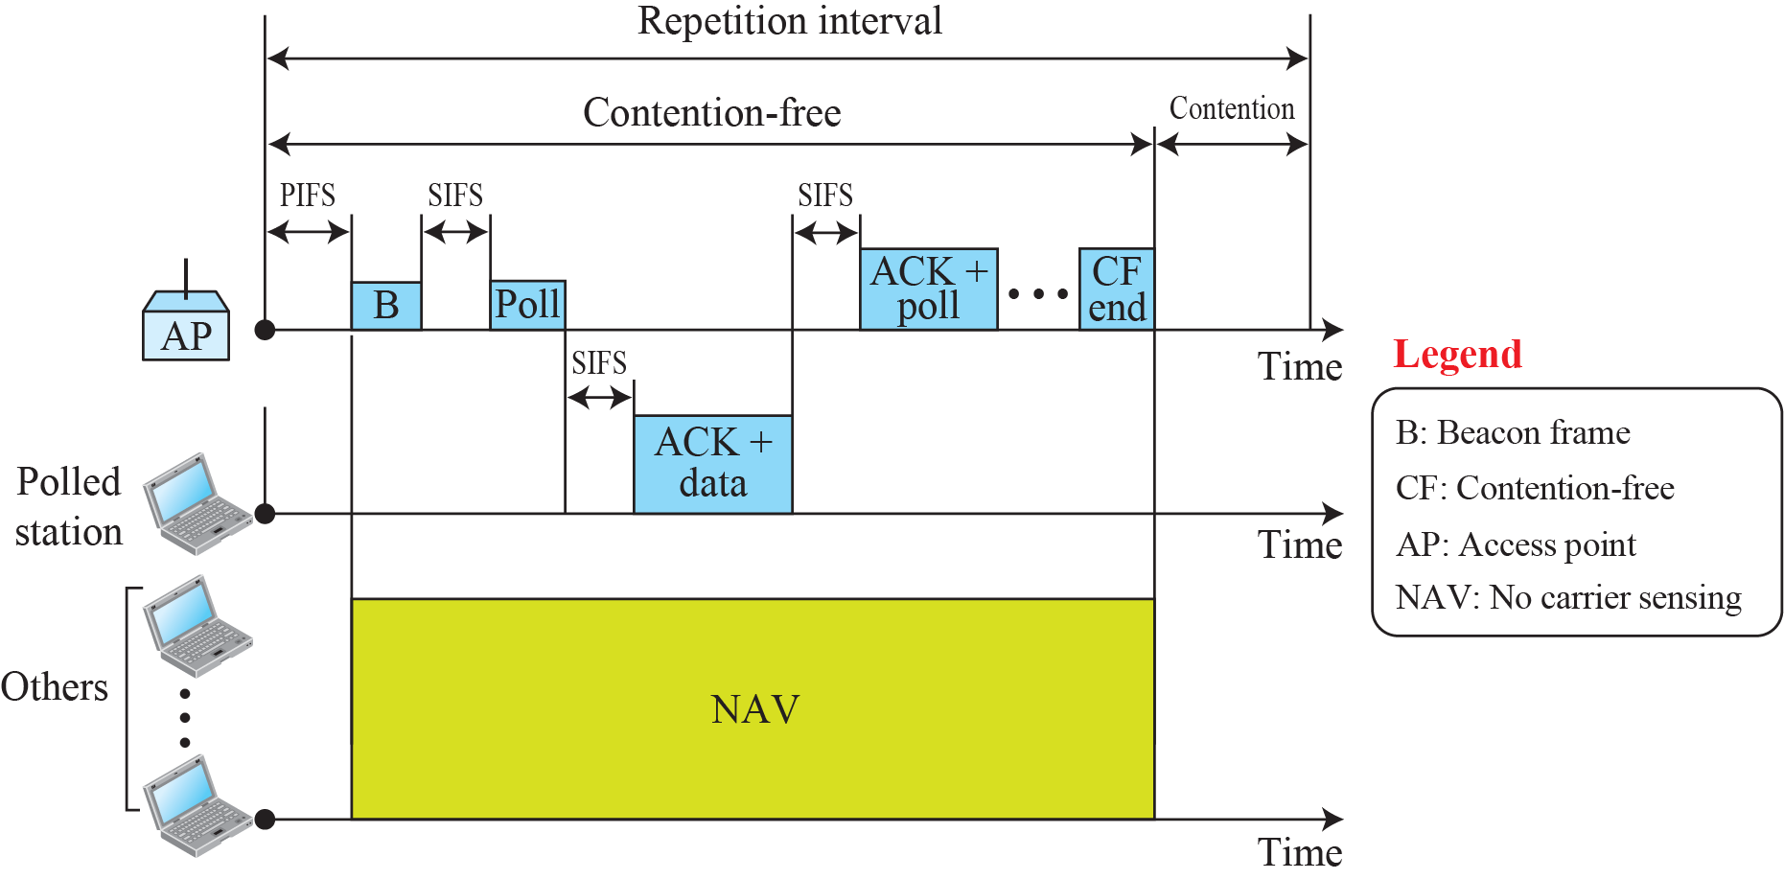
Figure 15.8: Example of repetition interval

Slide 20
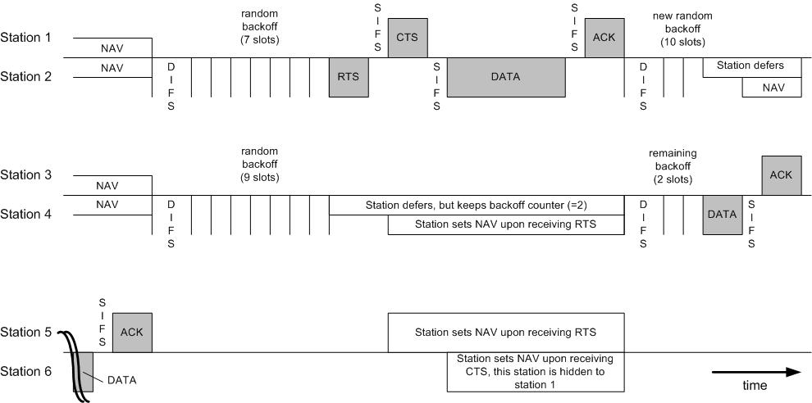
DCF Operation

Slide 21
802.11 Steps
All backlogged nodes choose a random number
  R = rand (0, CW_min)
Each node counts down R
  Continue carrier sensing while counting down
  Once carrier busy, freeze countdown
Whoever reaches ZERO transmits RTS
  Neighbors freeze countdown, decode RTS
  RTS contains (CTS + DATA + ACK) duration = T_comm
  Neighbors set NAV = T_comm
    Remains silent for NAV time

Slide 22
802.11 Steps
Receiver replies with CTS
  Also contains (DATA + ACK) duration.
  Neighbors update NAV again
Tx sends DATA, Rx acknowledges with ACK
  After ACK, everyone initiates remaining countdown
  Tx chooses new R = rand (0, CW_min)
If RTS or DATA collides (i.e., no CTS/ACK returns)
  Indicates collision
  RTS chooses new random no. R1 = rand (0, 2*CW_min)
  Note Exponential Backoff Ri = rand (0, 2^i * CW_min)
  Once successful transmission, reset to rand(0, CW_min)

Slide 23

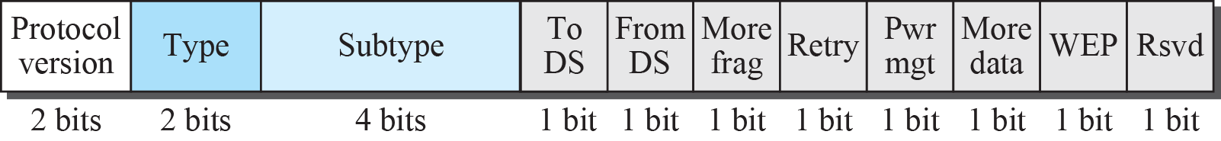
Figure 15.9: Frame format

Slide 24
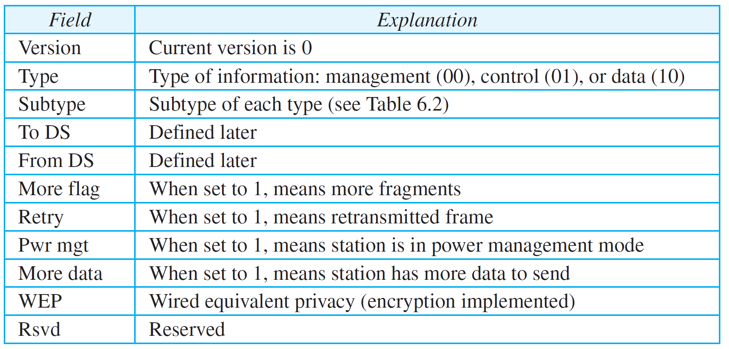
Table 15.1: Subfields in FC field
15.24

Slide 25
Frame Types
NAV information
Or
Short Id for PS-Poll
Upper layer data
2048 byte max
256 upper layer header
FC
Duration
/ID
Address
1
Address
2
Address
3
Sequence
Control
Address
4
DATA
FCS
2 2 6 6 6 2 6 0-2312 4 bytes
Protocol Version
Frame Type and Sub Type
To DS and From DS
More Fragments
Retry
Power Management
More Data
WEP
Order
IEEE 48 bit address
Individual/Group
Universal/Local
46 bit address
MSDU
Sequence Number
Fragment Number
CCIT CRC-32 Polynomial
BSSID –BSS Identifier
TA - Transmitter
RA - Receiver
SA - Source
DA - Destination

Slide 26
Frame Subtypes
CONTROL
DATA
MANAGEMENT
RTS
CTS
ACK
PS-Poll
CF-End & CF-End ACK
Data
Data+CF-ACK
Data+CF-Poll
Data+CF-ACK+CF-Poll
Null Function
CF-ACK (nodata)
CF-Poll (nodata)
CF-ACK+CF+Poll
Beacon
Probe Request & Response
Authentication
Deauthentication
Association Request & Response
Reassociation Request & Response
Disassociation
Announcement Traffic Indication Message (ATIM)

Slide 27
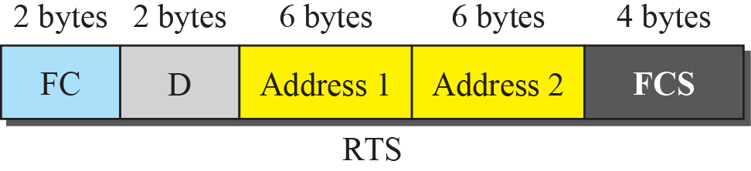
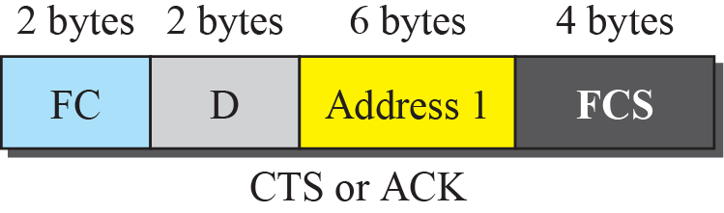
Figure 15.10: Control frames

Slide 28
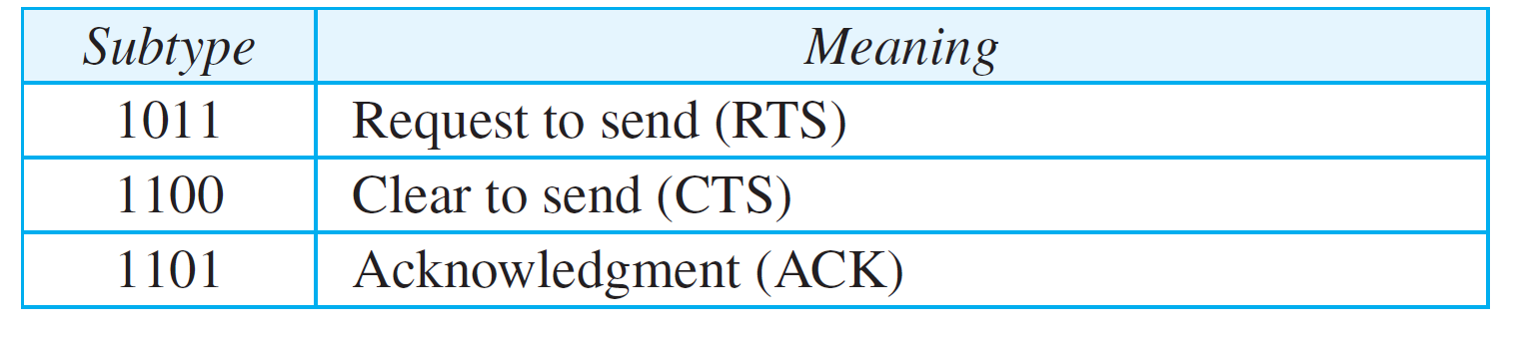
Table 15.2: Values of subfields in control frames
15.28

Slide 29
MAC Management
Interference by users that have no concept of data communication. Ex: Microwave
Interference by other WLANs
Security of data
Mobility
Power Management

Slide 30
Authentication
Authentication
  Prove identity to another station.
  Open system authentication
  Shared key authentication
    A sends
    B responds with a text
    A encrypt and send back
    B decrypts and returns an authentication management frame.
  May authenticate any number of station.
Security Problem
  A rogue AP
    SSID of ESS
    Announce its presence with beaconing
    A active rogue reach higher layer data if unencrypted.

Slide 31
Association
Association
  Transparent mobility
  After authentication
  Association request to an AP
  After established, forward data
  To BSS, if DA is in the BSS.
  To DS, if DA is outside the BSS.
  To AP, if DA is in another BSS.
  To “portal”, if DC is outside the ESS.
  Portal : transfer point : track mobility. (AP, bridge, or router) transfer 802.1h
  New AP after reassociation, communicates with the old AP.

Slide 32
Address Filtering
More than one WLAN
Three Addresses
Receiver examine the DA, BSSID
Privacy MAC Function
WEP Mechanism

Slide 33
Power Management
Independent BSS
  Distributed
  Data frame handshake
  Wake up every beacon.
  Awake a period of ATIM after each beacon.
  Send ACK if receive ATIM frame & awake until the end of next ATIM.
  Estimate the power saving station, and delay until the next ATIM.
  Multicast frame : No ACK : optional
Overhead
  Sender
    Announcement frame
    Buffer
    Power consumption in ATIM
  Receiver
    Awake for every Beacon and ATIM

Slide 34
Power Management
Infrastructure BSS
  Centralized in the AP.
  Greater power saving
  Mobile Station sleeps for a number of beacon periods.
  Awake for multicast indicated in DTIM in Beacon.
  AP buffer, indicate in TIM
  Mobile requests by PS-Poll

Slide 35
Synchronization
Timer Synchronization in an Infrastructure BSS
  Beacon contains TSF
  Station updates its with the TSF in beacon.
Timer Synchronization in an IBSS
  Distributed. Starter of the BSS send TSF zero and increments.
  Each Station sends a Beacon
  Station updates if the TSF is bigger.
  Small number of stations: the fastest timer value
  Large number of stations: slower timer value due to collision.
Synchronization with Frequency Hopping PHY Layers
  Changes in a frequency hopping PHY layer occurs periodically (the dwell meriod).
  Change to new channel when the TSF timer value, modulo the dwell period, is zero

Slide 36
Scanning & Joining
Scanning
  Passive Scanning : only listens for Beacon and get info of the BSS. Power is saved.
  Active Scanning: transmit and elicit response from APs. If IBSS, last station that transmitted beacon responds. Time is saved.
Joining a BSS
  Syncronization in TSF and frequency : Adopt PHY parameters : The BSSID : WEP : Beacon Period : DTIM

Slide 37
15.2.3 Addressing Mechanism
The IEEE 802.11 addressing mechanism specifies four cases, defined by the value of the two flags in the FC field, To DS and From DS. Each flag can be either 0 or 1, resulting in four different situations. The interpretation of the four addresses (address 1 to address 4) in the MAC frame depends on the value of these flags, as shown in Table 15.3.

Slide 38
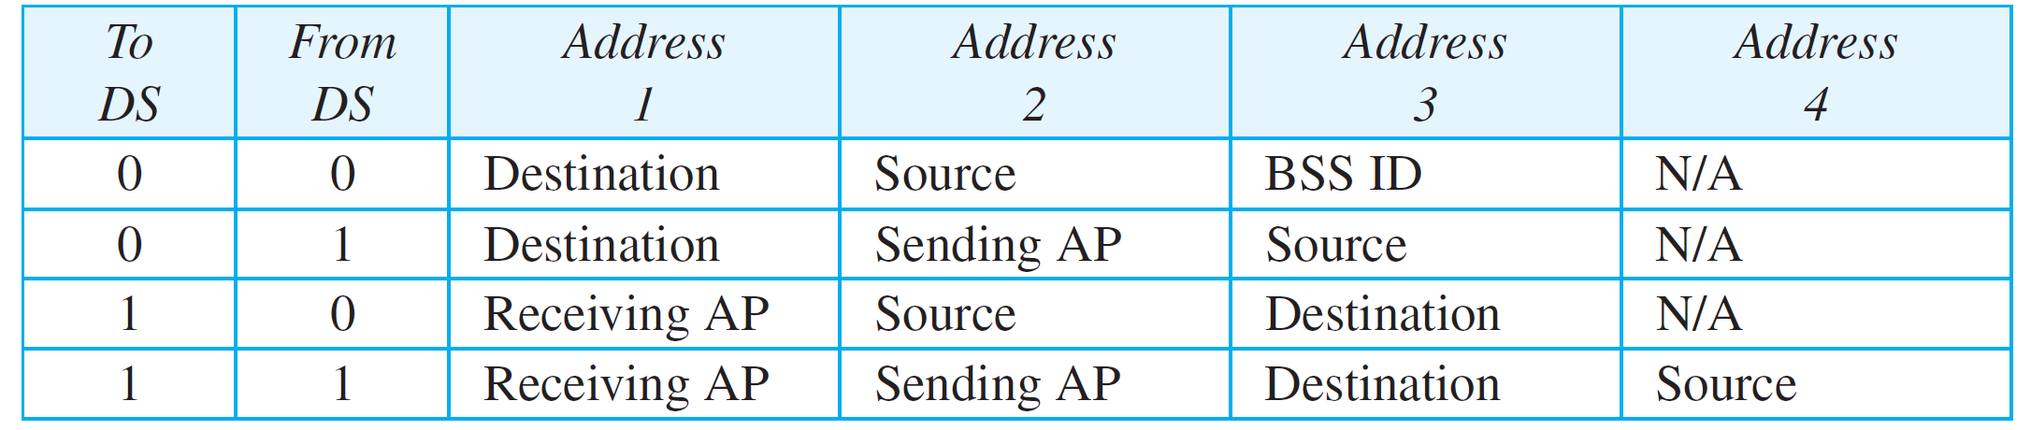
Table 15.3: Addresses
15.38

Slide 39
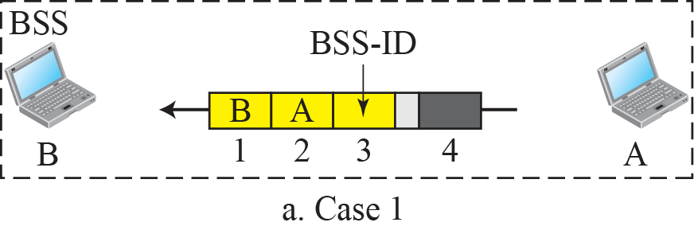
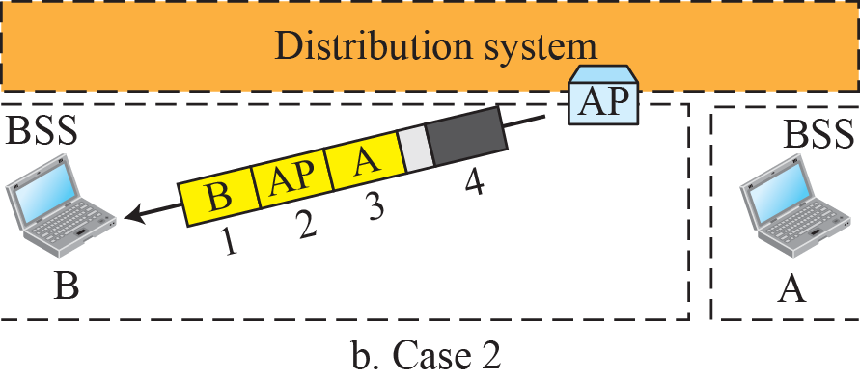
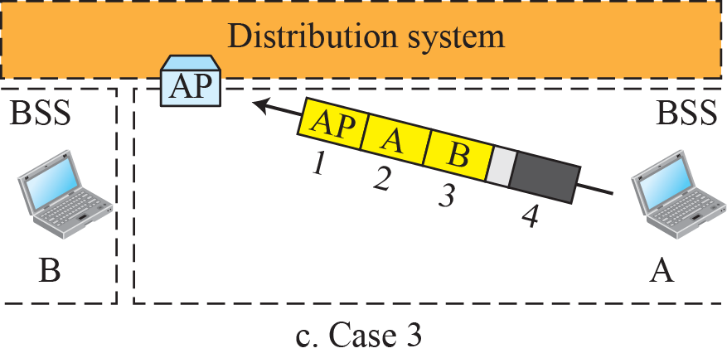
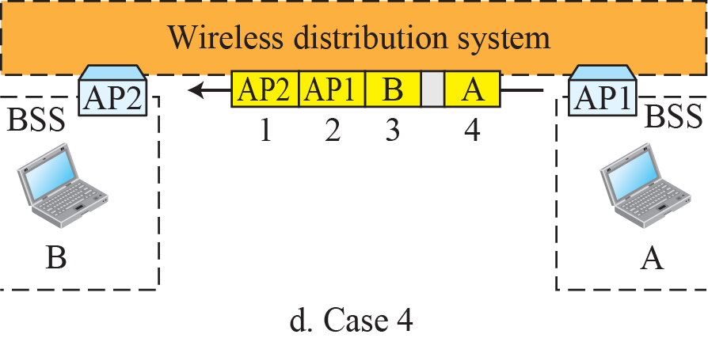
Figure 15.11: Addressing mechanisms

Slide 40
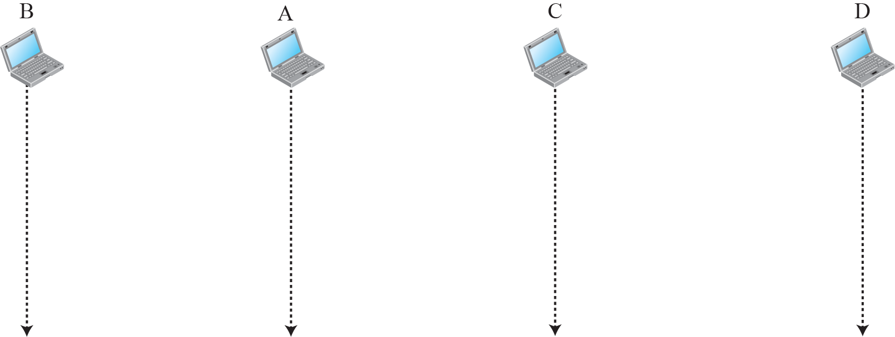
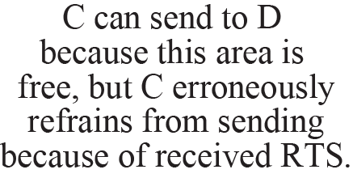


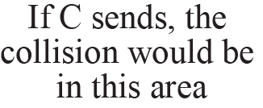
Figure 15.12: Exposed station problem

Slide 41
15.2.4 Physical Layer
We discuss six specifications, as shown in Table 15.4. All implementations, except the infrared, operate in the industrial, scientific, and medical (ISM) band, which defines three unlicensed bands in the three ranges 902–928 MHz, 2.400–4.835 GHz, and 5.725–5.850 GHz.

Slide 42
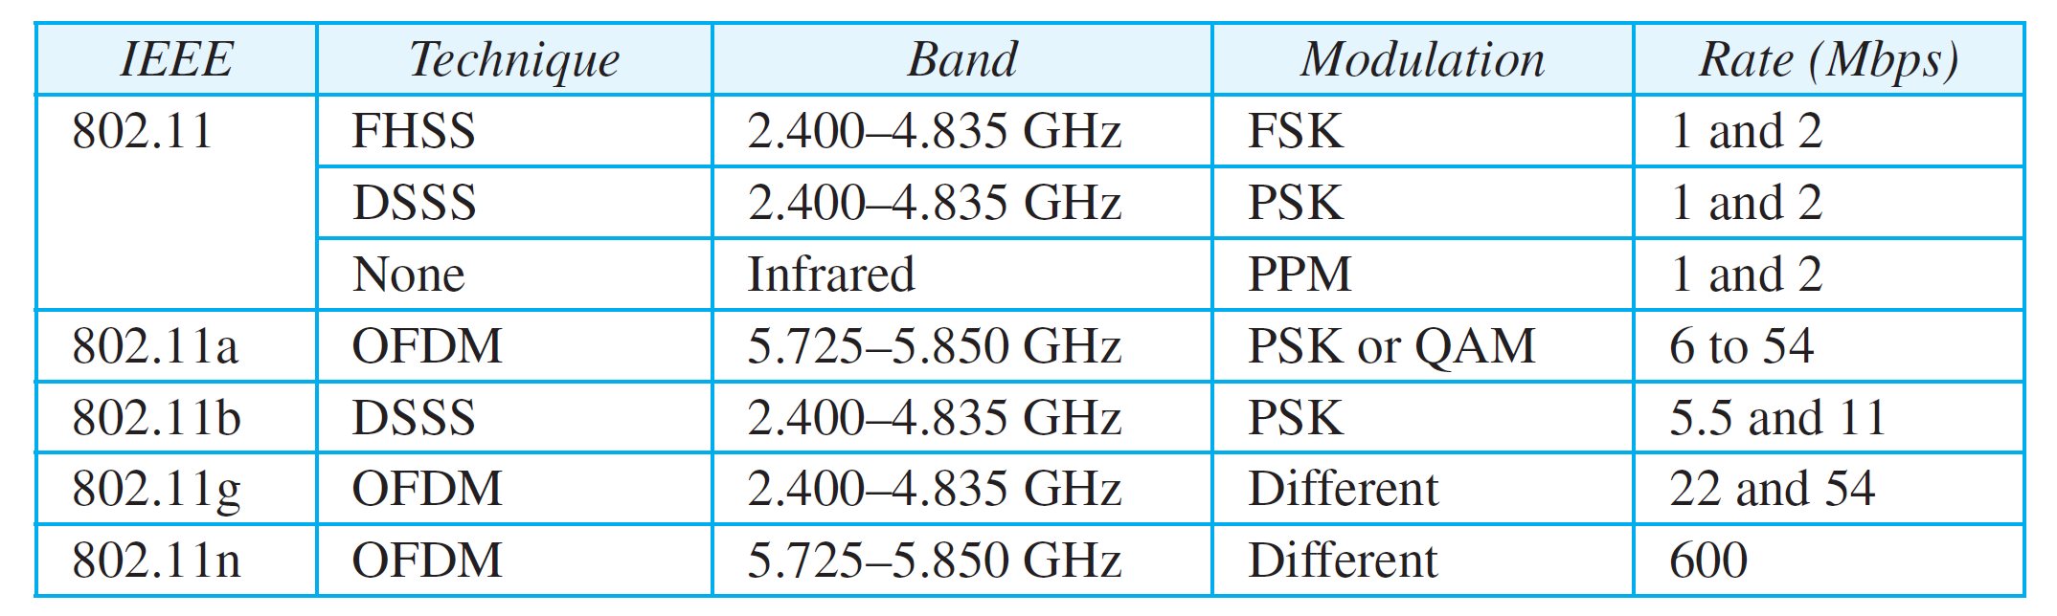
Table 15.4: Specifications
15.42

Slide 43
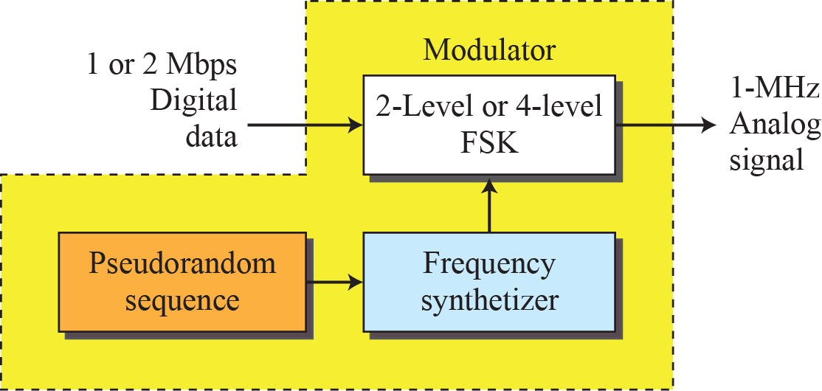
Figure 15.13: Physical layer of IEEE 802.11 FHSS

Slide 44
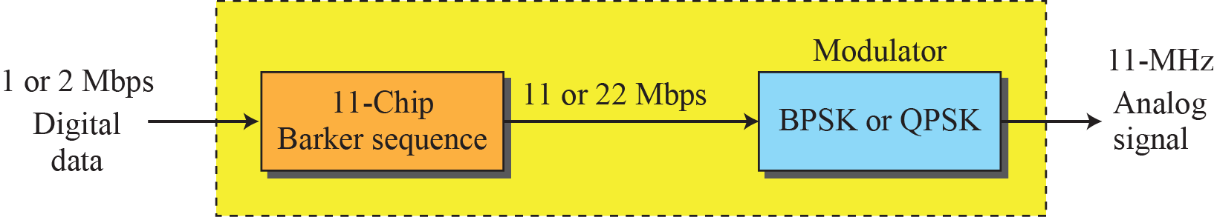
Figure 15.14: Physical layer of IEEE 802.11 DSSS

Slide 45
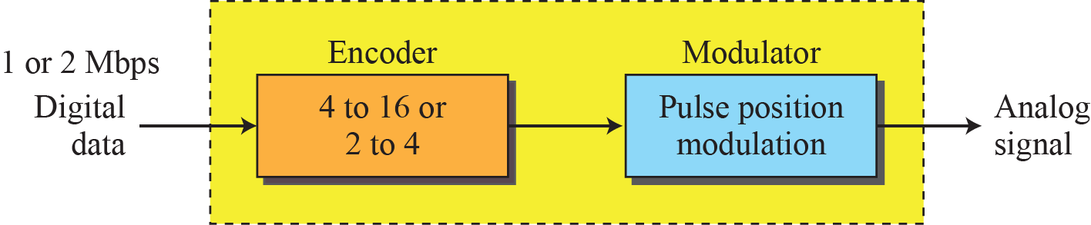
Figure 15.15: Physical layer of IEEE 802.11 infrared

Slide 46
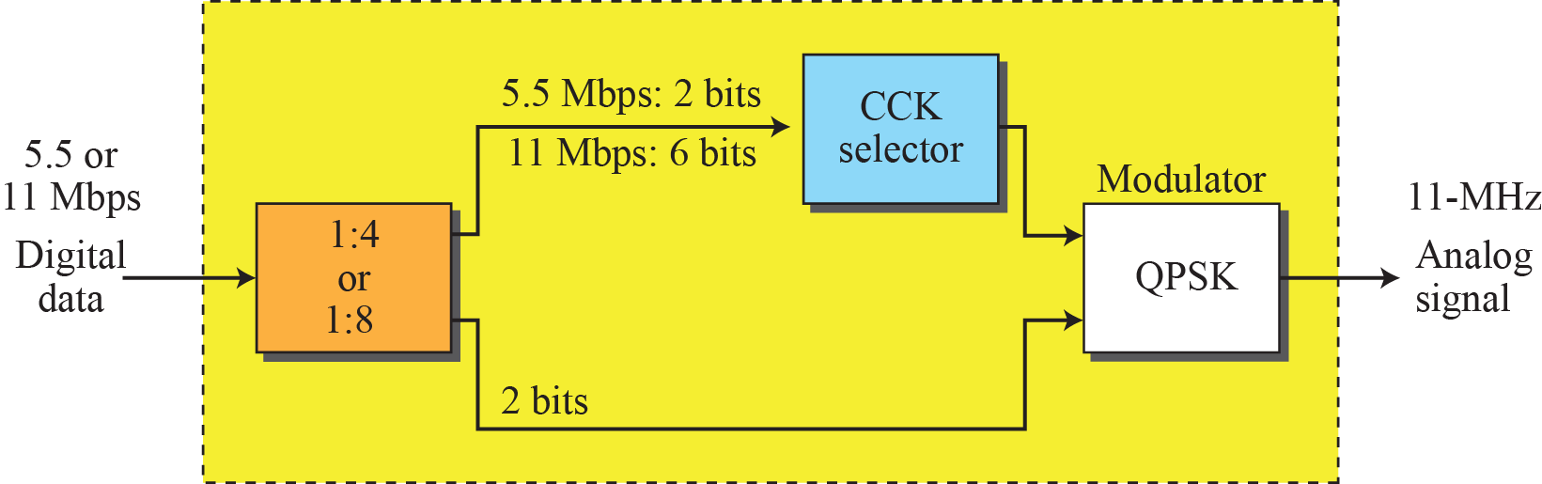
Figure 15.16: Physical layer of IEEE 802.11b

Slide 47
    15-3 BLUETOOTH
Bluetooth is a wireless LAN technology designed to connect devices of different functions when they are at a short distance from each other. A Bluetooth LAN is an ad hoc network. The devices, sometimes called gadgets, find each other and make a network called a piconet.

Slide 48
15.3.1 Architecture
Bluetooth defines two types of networks: piconet and scatternet.

Slide 49
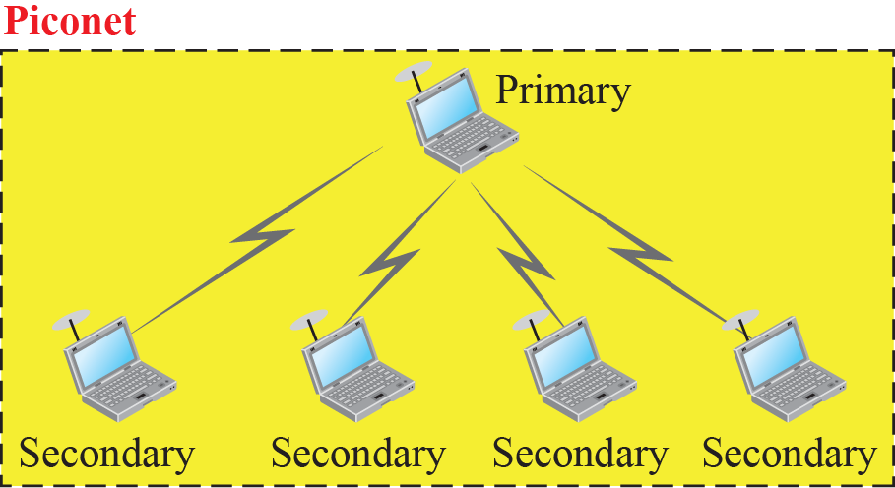
Figure 6.17: Piconet

Slide 50
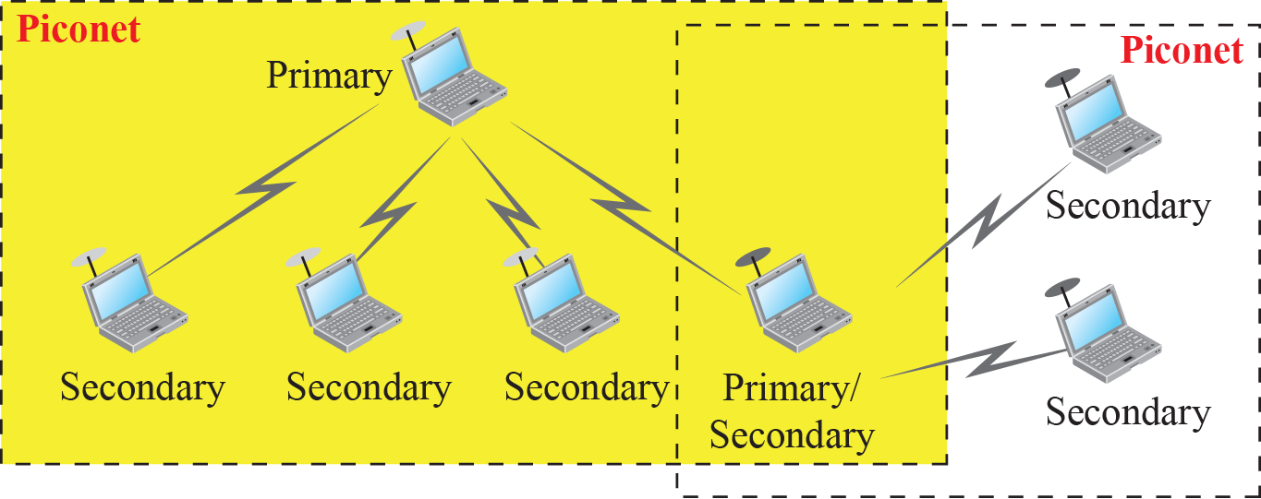
Figure 15.18: Scatternet

Slide 51
15.3.2 Bluetooth Layers
Bluetooth uses several layers that do not exactly match those of the Internet model we have defined in this book. Figure 15.19 shows these layers.

Slide 52
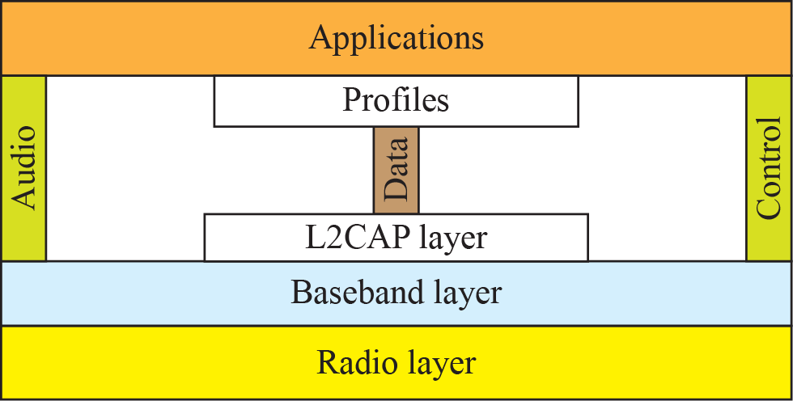
Figure 15.19: Bluetooth layers
~LLC
~MAC
~PHY

Slide 53
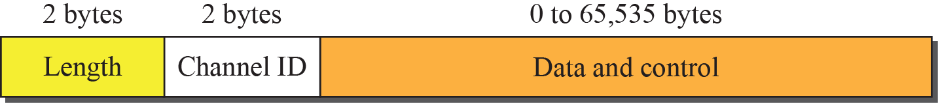
Figure 15.20: L2CAP data packet format
Length
  Size of the data from application
L2CAP performs Segmentation and reassembly (SAR)
  Into 339 + 4 bytes
  Reassembly at the destination

Slide 54
Figure 15.20: L2CAP data packet format
(Virtual) channel ID
  Signaling: 0x0001
    For Synchronous Connection Oriented (SCO) link
    No retransmission
      E.g. Audio application
  Connectionless data: 0x0002
    Asynchronous Connection-Less (ACL) link
    Retransmission

Slide 55
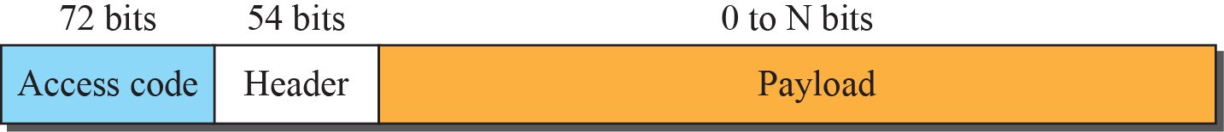
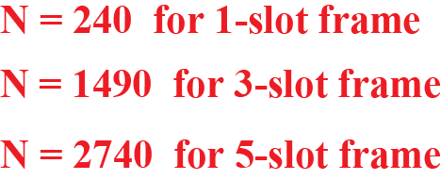
Figure 6.23: Frame format types
Baseband layer frame format
  625-366 = 259 uS necessary to frequency hopping
  1 b/Hz → 1 Mbps: 366 bits per slot (max)

Slide 56
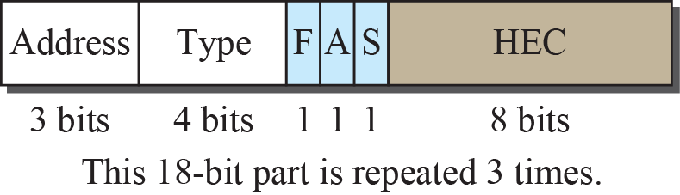
Figure 6.23: Frame format types
Access code
  Synchronization bits + primary’s identifier
    To distinguish piconets
Header = 3 x
  Bit-by-bit majority voting (a form of FEC)

Slide 57
Figure 6.23: Frame format types
Header
  Address: identifies a secondary (0=all)
  Type: data type from upper layers
  F = full buffer: for flow control
  A = ACK: Stop-and-Wait ARQ
  S = sequence number
  Header Error Correction

Slide 58
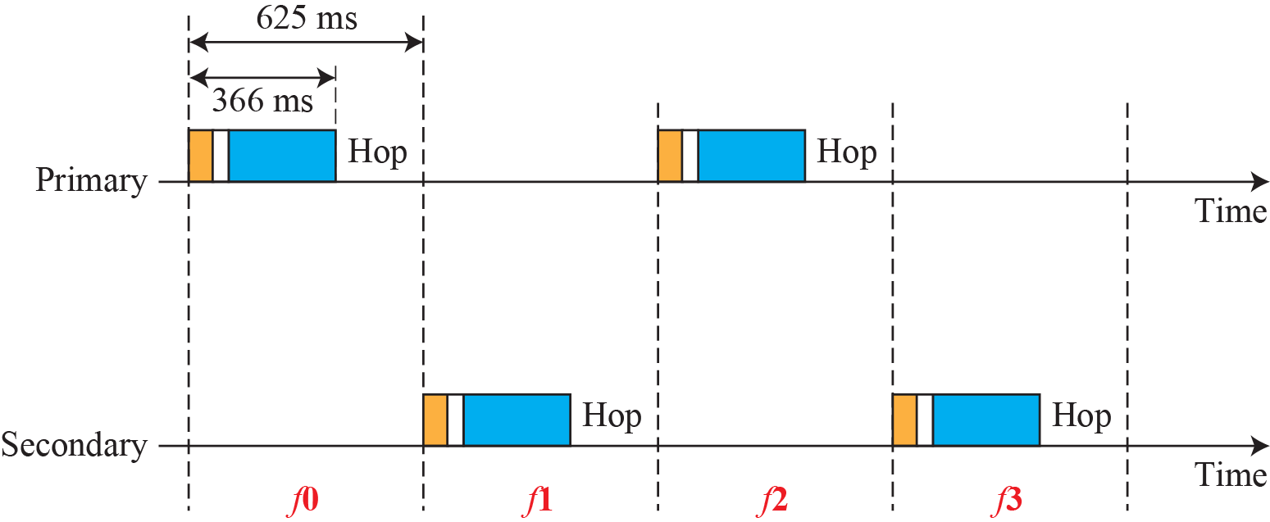
Figure 6.21: Single-secondary communication
79 channels of 1 MHz each
TDD
TDMA
uS
≡ Hopping 1600 times per second

Slide 59
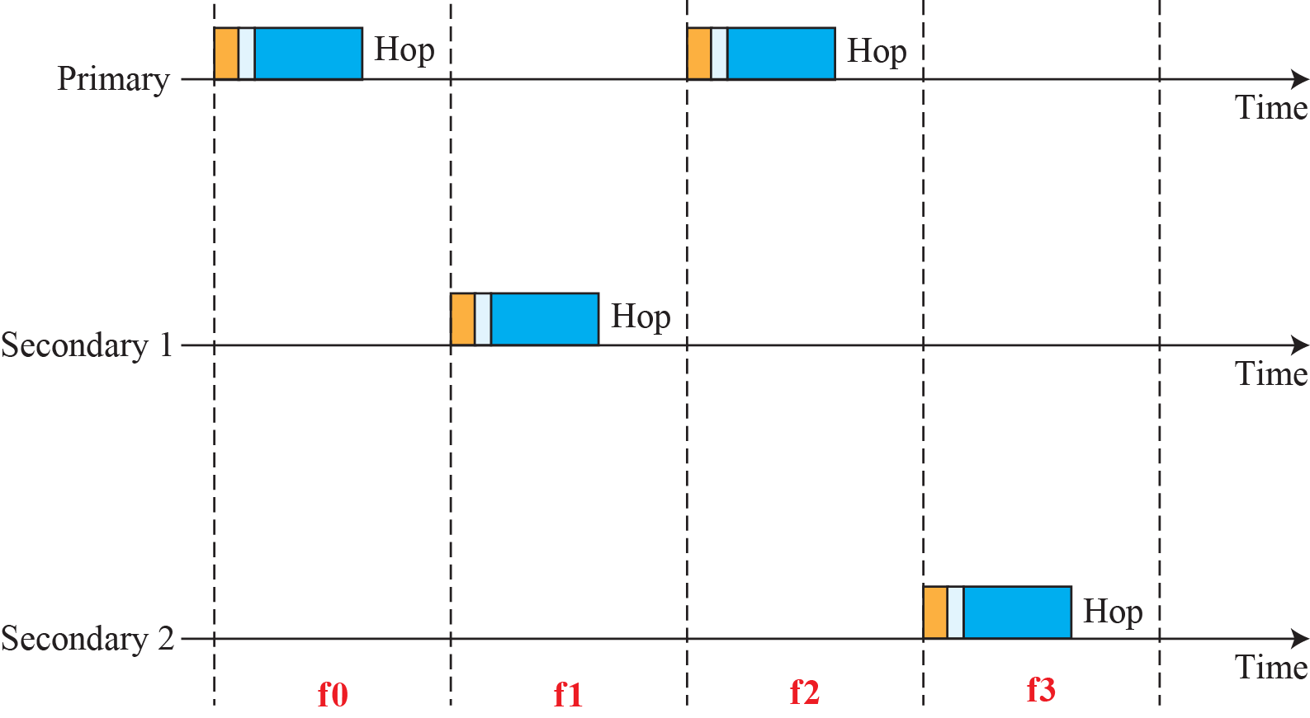
Figure 6.22: Multiple-secondary communication

Slide 60
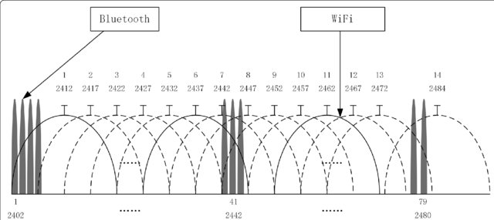
Radio layer
FHSS at 1600 Hz to avoid interference
  ISM band: 2.4 GHz
Frequency shift keying (FSM) for modulation

Slide 61
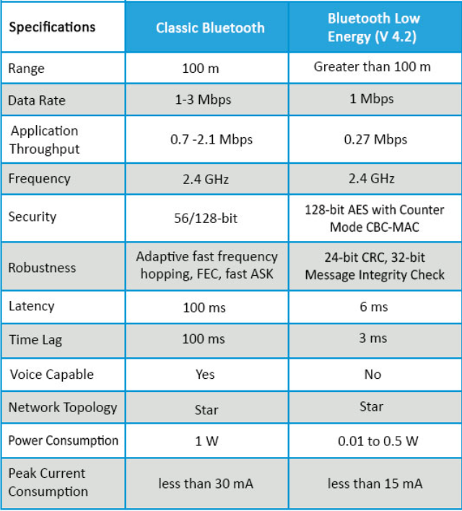
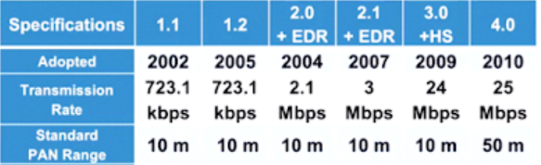
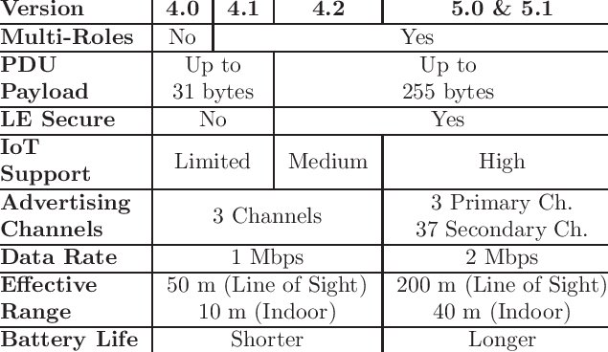
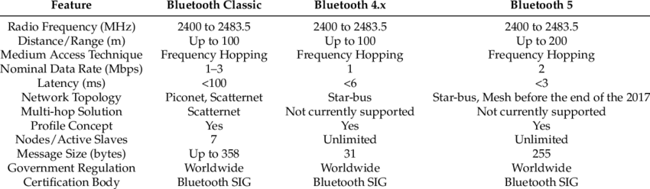
Bluetooth evolution

Slide 62
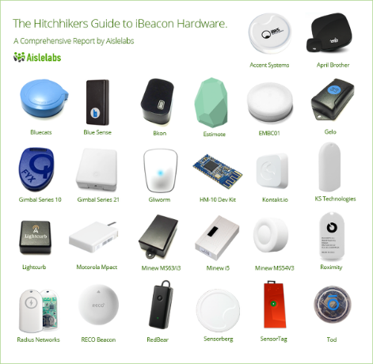

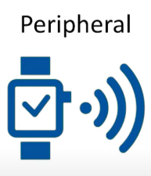
Bluetooth Low Energy (BLE)
Piconet revisited
  Smartphone: primary
  Beacon devices: secondary

Slide 63
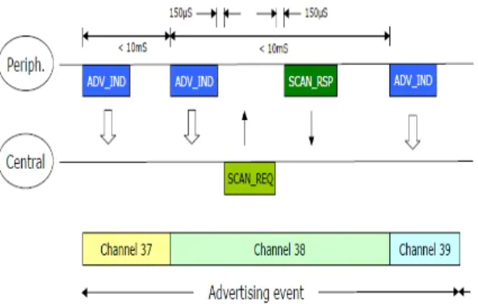
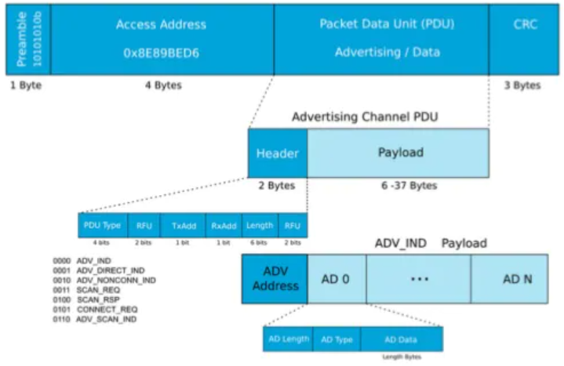
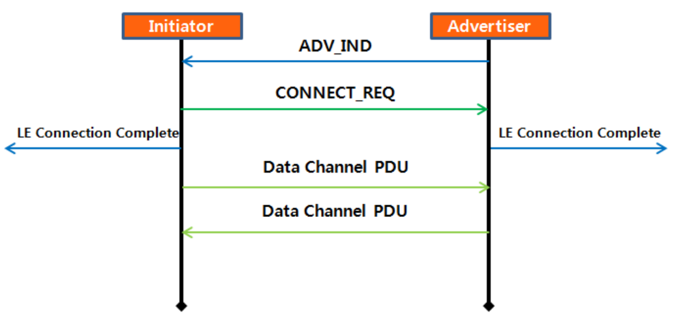
BLE connection
Advertisement and scanning

Slide 64



BLE connection
Connection request format
Channel map

Slide 65

BLE connection
Connection request format (from master)
Channel hop
Hop

Slide 66


