Slide 1
Internetworking Protocol (IP)
5Chapter

Slide 2
5.1 IP Characteristics
Connectionless (connectionless) Protocol
  “management” absent
    ordering, delivery guarantee, loss recovery, flow control, etc.
Best effort service provided
Packet: = datagram (datagram)

Slide 3
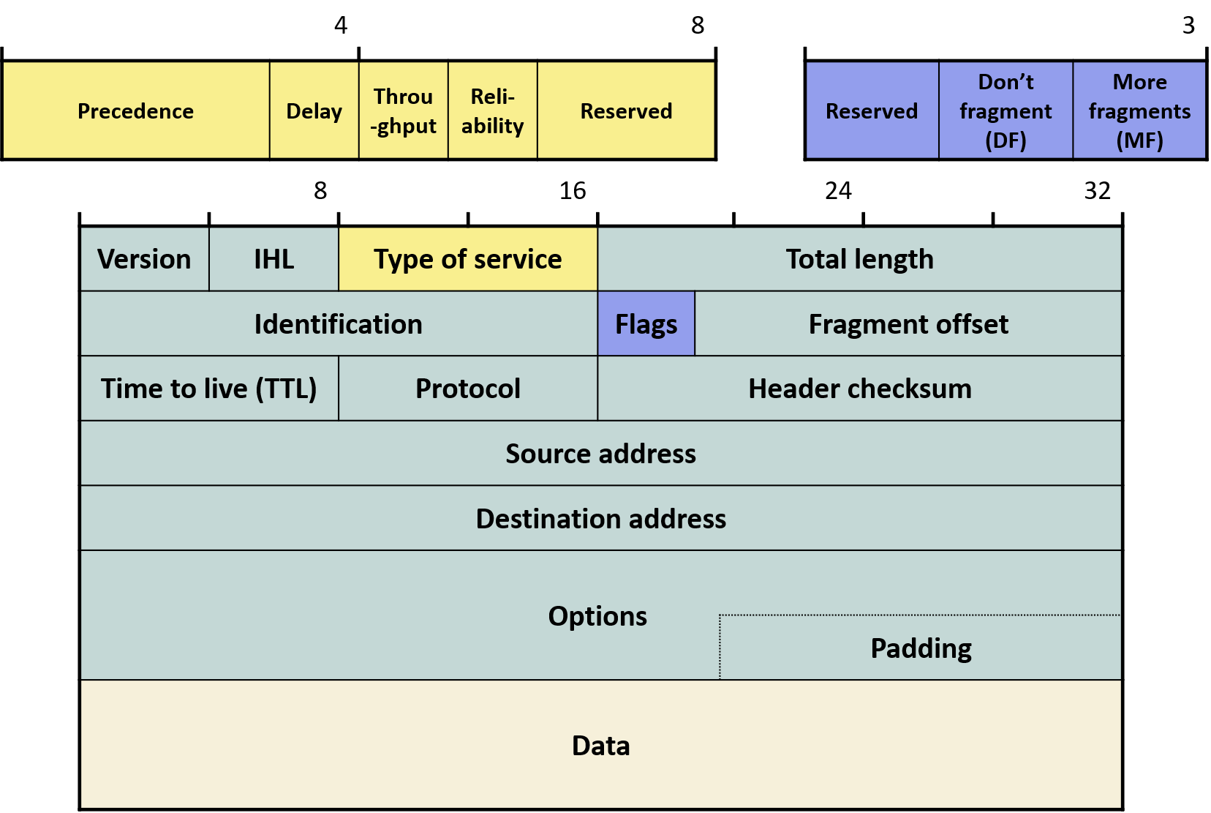
5.2 IP Header
20-60 bytes
  Version=4
  Header Length (x4)
  Type of Service
    Unused
  Total length = 65,535 bytes

Slide 4
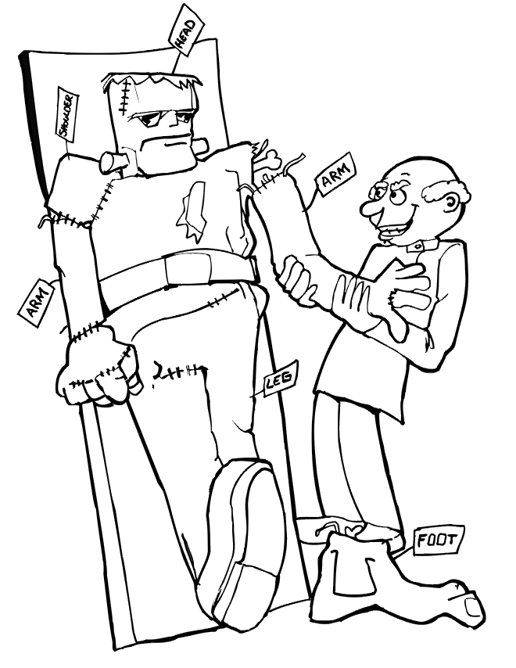
5.2 IP Header
MTUis limited by IP datagram size limit
  Transport layer IPdata passed down to IP, size+IPHeader size > MTUexceeds MTU, fragment(fragment)is required
  Routers in the network also fragment if the above condition holds
Identification: IP address pair (A, B) for each IP datagram per 1 incremented by 1
  (A,C) C≠B are completely different values
  reassembly(reassembly) to collect only fragments belonging to the same IP datagram that belonged to the same fragment from the same datagram

Slide 5
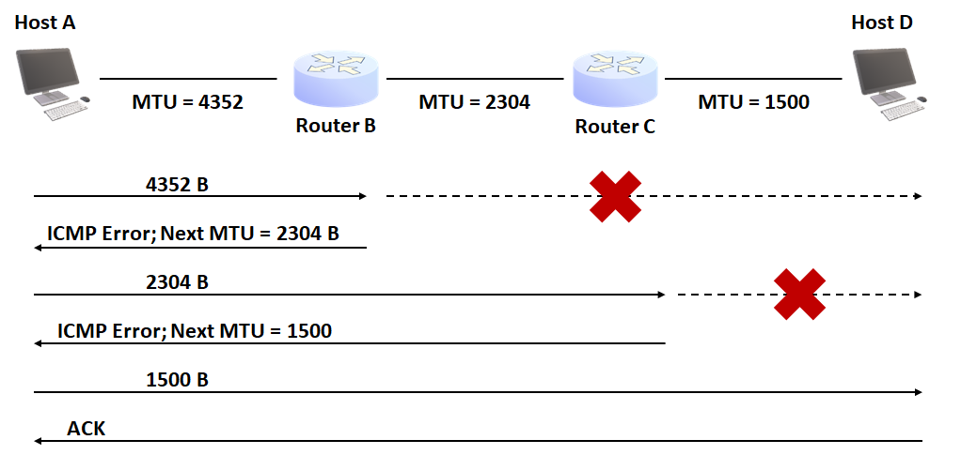
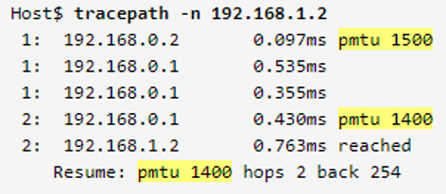
5.2 IP Header
More Fragment (MF): next fragment indicates whether more fragments follow
Don’t Fragment (DF): Transport layer fragmentation whether fragmentation is prohibited by the transport layer
  Mainly used for path MTU discovery (path MTU discovery; PMTU discovery): Why??

Slide 6
5.2 IP Header
Fragment offset
  Position in the IP payload before fragmentationIP
    First byte(=0) (=0) as reference, the starting byte of the current fragmentfragment/ 8
    Also cut in multiples of 8 8-byte units
  Example
    MTU = 1600
    IP payload size = 2800

Slide 7
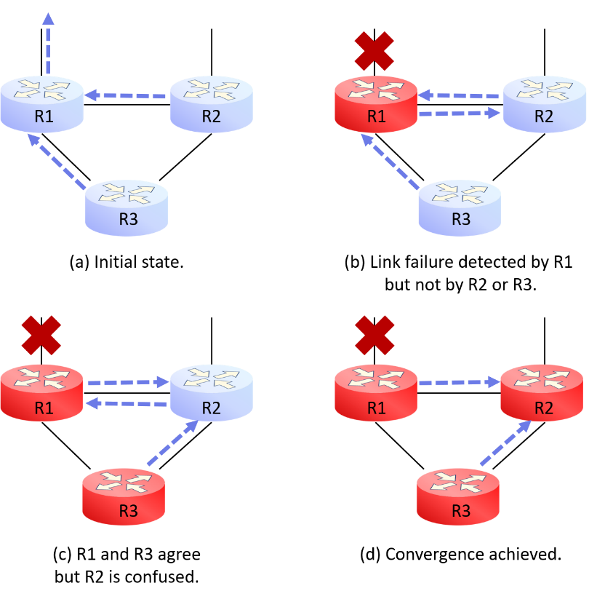
5.2 IP Header
TTL
  = Time to death: (routing loopwhen delivery fails due to routing loops) self-destruct mechanism
    Cf. tracert
  Originally measured in time, in practice decremented by the number of routers traversed: cf. IPv6 Hop Limit
    Initial value = = 128 (Windows), 64 or 255 (Linux), 64 (Android)
C:\Users\USER>ping www.unipi.it Ping wwwnew2.unipi.it [131.114.21.42] 32bytes of data: 131.114.21.42 reply: bytes=32 time=308ms TTL=39 131.114.21.42 reply: bytes=32 time=307ms TTL=39 131.114.21.42 reply: bytes=32 time=306ms TTL=39 131.114.21.42 reply: bytes=32 time=306ms TTL=39 131.114.21.42Ping statistics for Ping statistics: Packets: Sent = = 4, Received = = 4, Lost = = 0 (0% loss), Round trip times(ms): Minimum = = 306ms, Maximum = 308ms, Average = = 306ms

Slide 8
5.2 IP Header
Protocol
  The transport protocol at the source IP that carried the IP payload, andits number
  IP datagram after arriving at the destination, IP the transport protocol number that will receive the IP payload
    Example) TCP=6, UDP=17, ICMP=1, …
IP Header Checksum
  1’s complement of 1’s complement sum
  IP header only is checked
    IP payload is checked by the transport layer

Slide 9
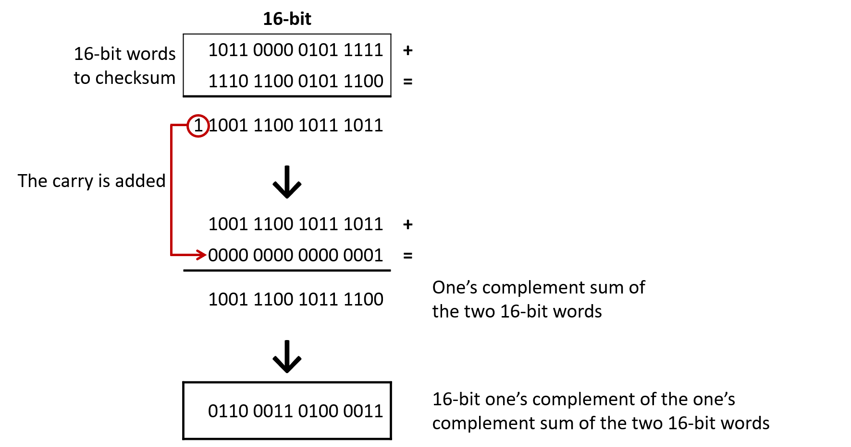
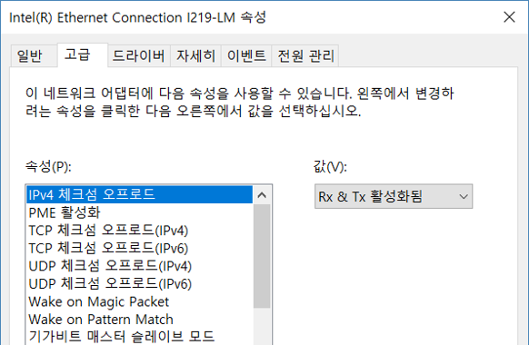
5.2 IP Header
1’s complement of 1’s complement sum
  Used by most Internet protocols
  Principle: T+(-T)=0
  Today, NICcan handle this (offload)

Slide 10
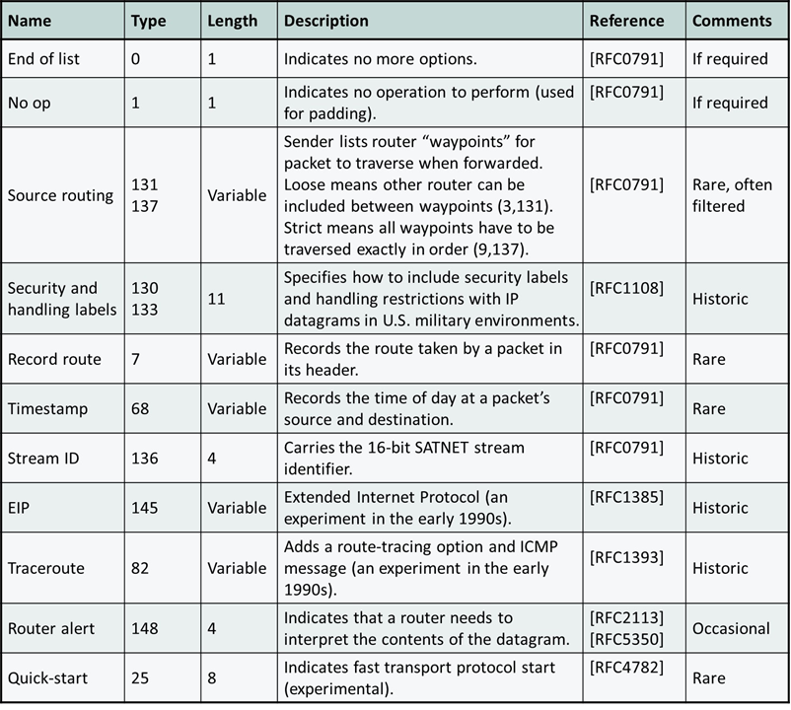
5.2 IP Header
IP address: see 4Chapter reference
Options
  Maximum 40 bytes
  Options are rarely used
    Most routers disallow options due to security concerns
      Drop!
    Router Alert option is still used today

Slide 11
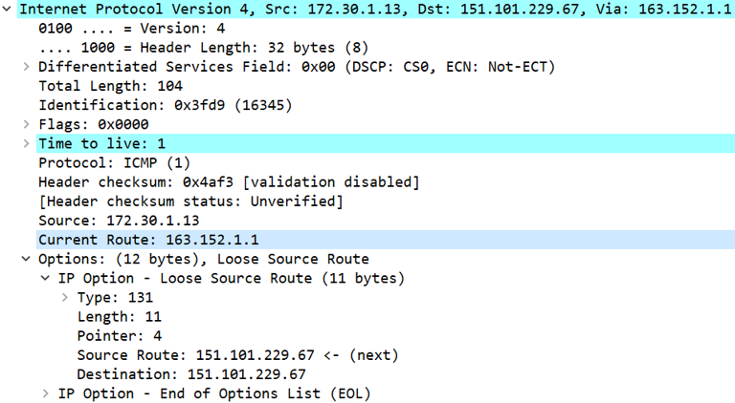
5.2 IP Header
IP Example of IP options being exploited for hacking
  Loose source routing
    tracert -j

Slide 12
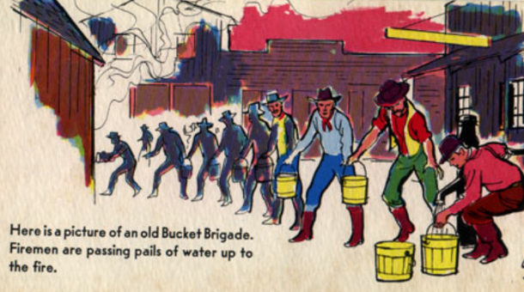
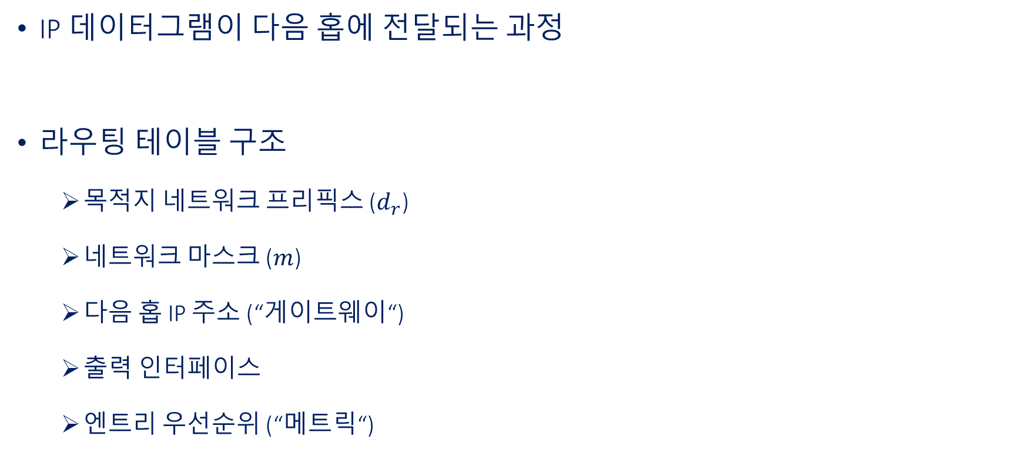
5.3 IP Forwarding
IP datagramProcess of forwarding to the next hop
Routing table structure
  Destination network prefix ($d_{r}$)
  Network mask ($m$)
  next hop IP address (“Gateway“)
  Output interface
  Entry priority (“Metric“)
IPv4 Route table ============================================================================= Active routes: Network destination Netmask Gateway Interface Metric 0.0.0.0 0.0.0.0 192.168.0.1 192.168.0.33 50 127.0.0.0 255.0.0.0 On-link 127.0.0.1 331 127.0.0.1 255.255.255.255 On-link 127.0.0.1 331 127.255.255.255 255.255.255.255 On-link 127.0.0.1 331 192.168.0.0 255.255.255.0 On-link 192.168.0.33 306 192.168.0.33 255.255.255.255 On-link 192.168.0.33 306 192.168.0.255 255.255.255.255 On-link 192.168.0.33 306 224.0.0.0 240.0.0.0 On-link 127.0.0.1 331 224.0.0.0 240.0.0.0 On-link 192.168.0.33 306 255.255.255.255 255.255.255.255 On-link 127.0.0.1 331 255.255.255.255 255.255.255.255 On-link 192.168.0.33 306 =============================================================================

Slide 13
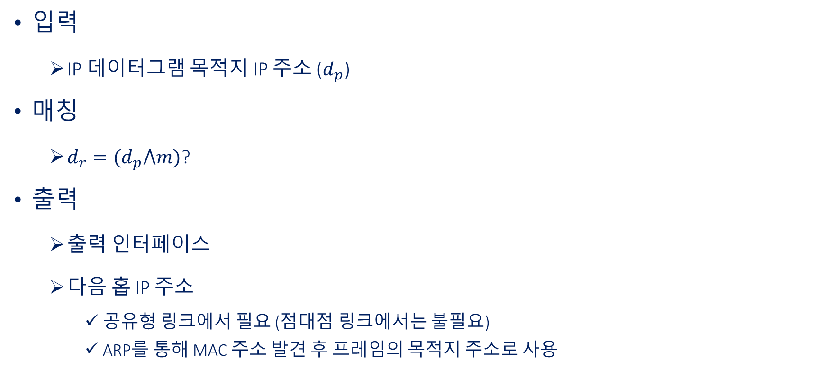
5.3 IP Forwarding
Input
  IP datagram destination IP address ($d_{p}$)
matching
  $d_{r}=(d_{p}⋀m)$?
Output
  Output interface
  next hop IP address
    Shared link: required (Point-to-point link: not required)
    ARPvia MAC found via ARP, used as the destination address of the frame
IPv4 Route table ============================================================================= Active routes: Network destination Netmask Gateway Interface Metric 0.0.0.0 0.0.0.0 192.168.0.1 192.168.0.33 50 127.0.0.0 255.0.0.0 On-link 127.0.0.1 331 127.0.0.1 255.255.255.255 On-link 127.0.0.1 331 127.255.255.255 255.255.255.255 On-link 127.0.0.1 331 192.168.0.0 255.255.255.0 On-link 192.168.0.33 306 192.168.0.33 255.255.255.255 On-link 192.168.0.33 306 192.168.0.255 255.255.255.255 On-link 192.168.0.33 306 224.0.0.0 240.0.0.0 On-link 127.0.0.1 331 224.0.0.0 240.0.0.0 On-link 192.168.0.33 306 255.255.255.255 255.255.255.255 On-link 127.0.0.1 331 255.255.255.255 255.255.255.255 On-link 192.168.0.33 306 =============================================================================

Slide 14
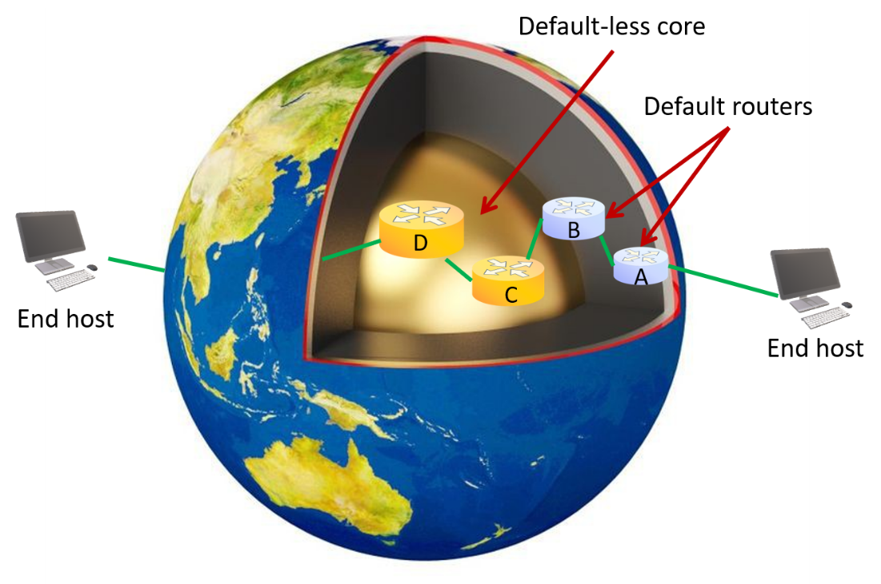
5.3 IP Forwarding
Matching entry always exists: 1 or more
  Default entry: “0.0.0.0”
Longest-prefix match rule
  City-level match (e.g., Seoul) vs. Borough-level match (e.g., Seongbuk-gu, Anam-dong, Seoul)
If still tied:?
  Metric (offload)

Slide 15
5.3 IP Forwarding
C:\Users\USER> route add 192.168.0.5 mask 255.255.255.255 192.168.0.11 metric 40 Verified!! C:\Users\USER> route -4 print IPv4 Route table ============================================================================ Active routes: Network destination Netmask Gateway Interface Metric 0.0.0.0 0.0.0.0 192.168.0.1 192.168.0.33 50 127.0.0.0 255.0.0.0 On-link 127.0.0.1 331 127.0.0.1 255.255.255.255 On-link 127.0.0.1 331 127.255.255.255 255.255.255.255 On-link 127.0.0.1 331 192.168.0.0 255.255.255.0 On-link 192.168.0.33 306 192.168.0.5 255.255.255.255 192.168.0.11 192.168.0.33 90 192.168.0.33 255.255.255.255 On-link 192.168.0.33 306 192.168.0.255 255.255.255.255 On-link 192.168.0.33 306 224.0.0.0 240.0.0.0 On-link 127.0.0.1 331 224.0.0.0 240.0.0.0 On-link 192.168.0.33 306 255.255.255.255 255.255.255.255 On-link 127.0.0.1 331 255.255.255.255 255.255.255.255 On-link 192.168.0.33 306 ============================================================================
Routing table management commands (Windows)
  route print
  route add
  route change
  route delete
Caution!!
  Without understanding matching rules, internet connectivity may be lostX

Slide 16
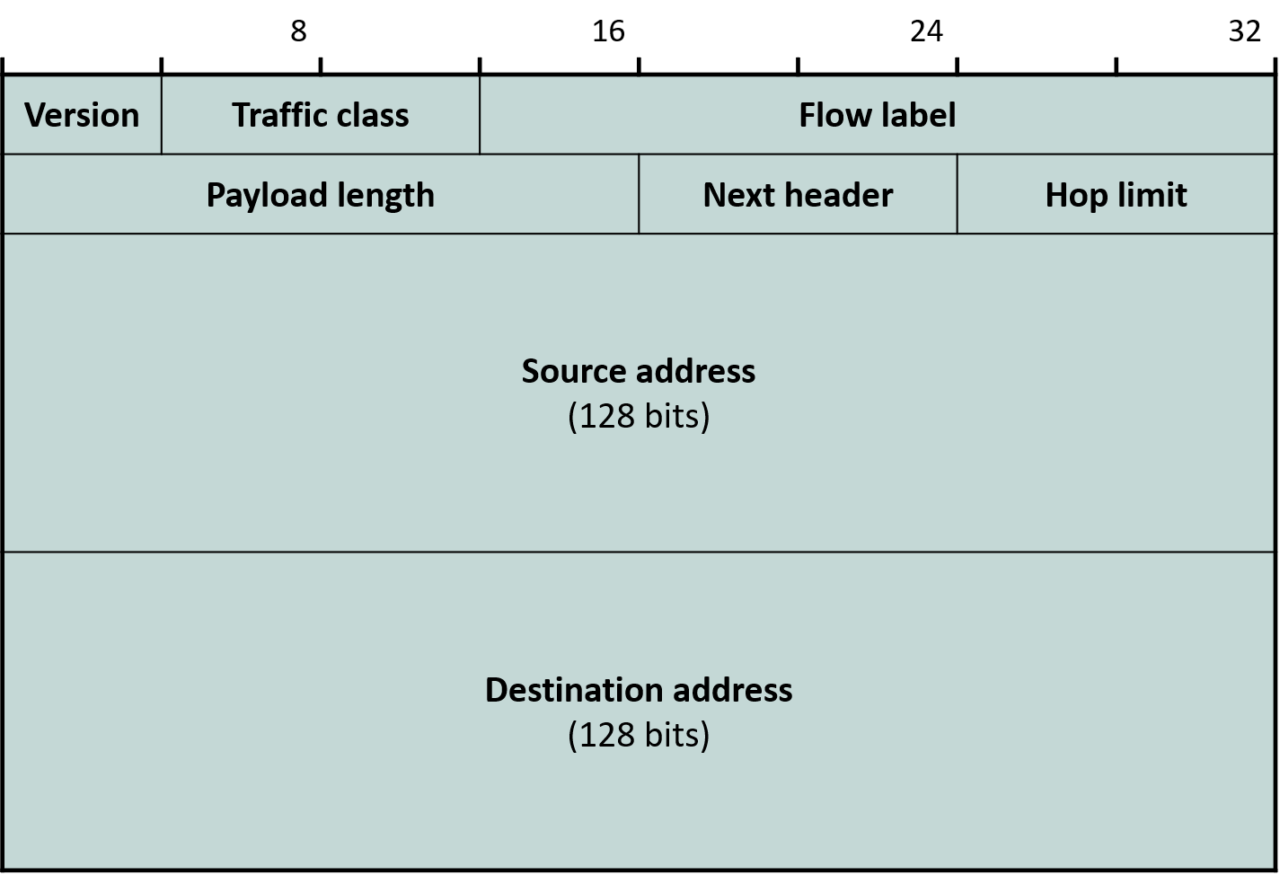
5.3 IPv6 Header
IPv4Drawing on the experience of IPv4, 40 bytes, simplified with unused fields removed
  Options, Checksum, fragmentation
Version=6
Traffic class, flow label: QoS -related fields
  Again, not used in practice
Payload lengthis similar to the previous total length
  Header length is fixed, so only payload payload length is needed
Hop Limit = IPv4 from TTL

Slide 17
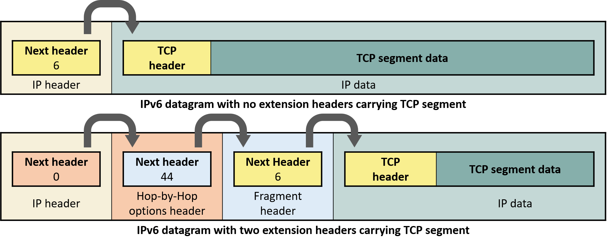
5.3 IPv6 Header
Options are placed in extension header to payload extension headers within the payload, fixing the header length at 40 bytes
  Extension headerand transport headers are treated at the same level: “next header”
    The last last extension header's next header is IPv4's Protocol field of IPv4
Extension headerExtension headers are not only for options
  Routing, fragmentation, authentication, encryption

Slide 18
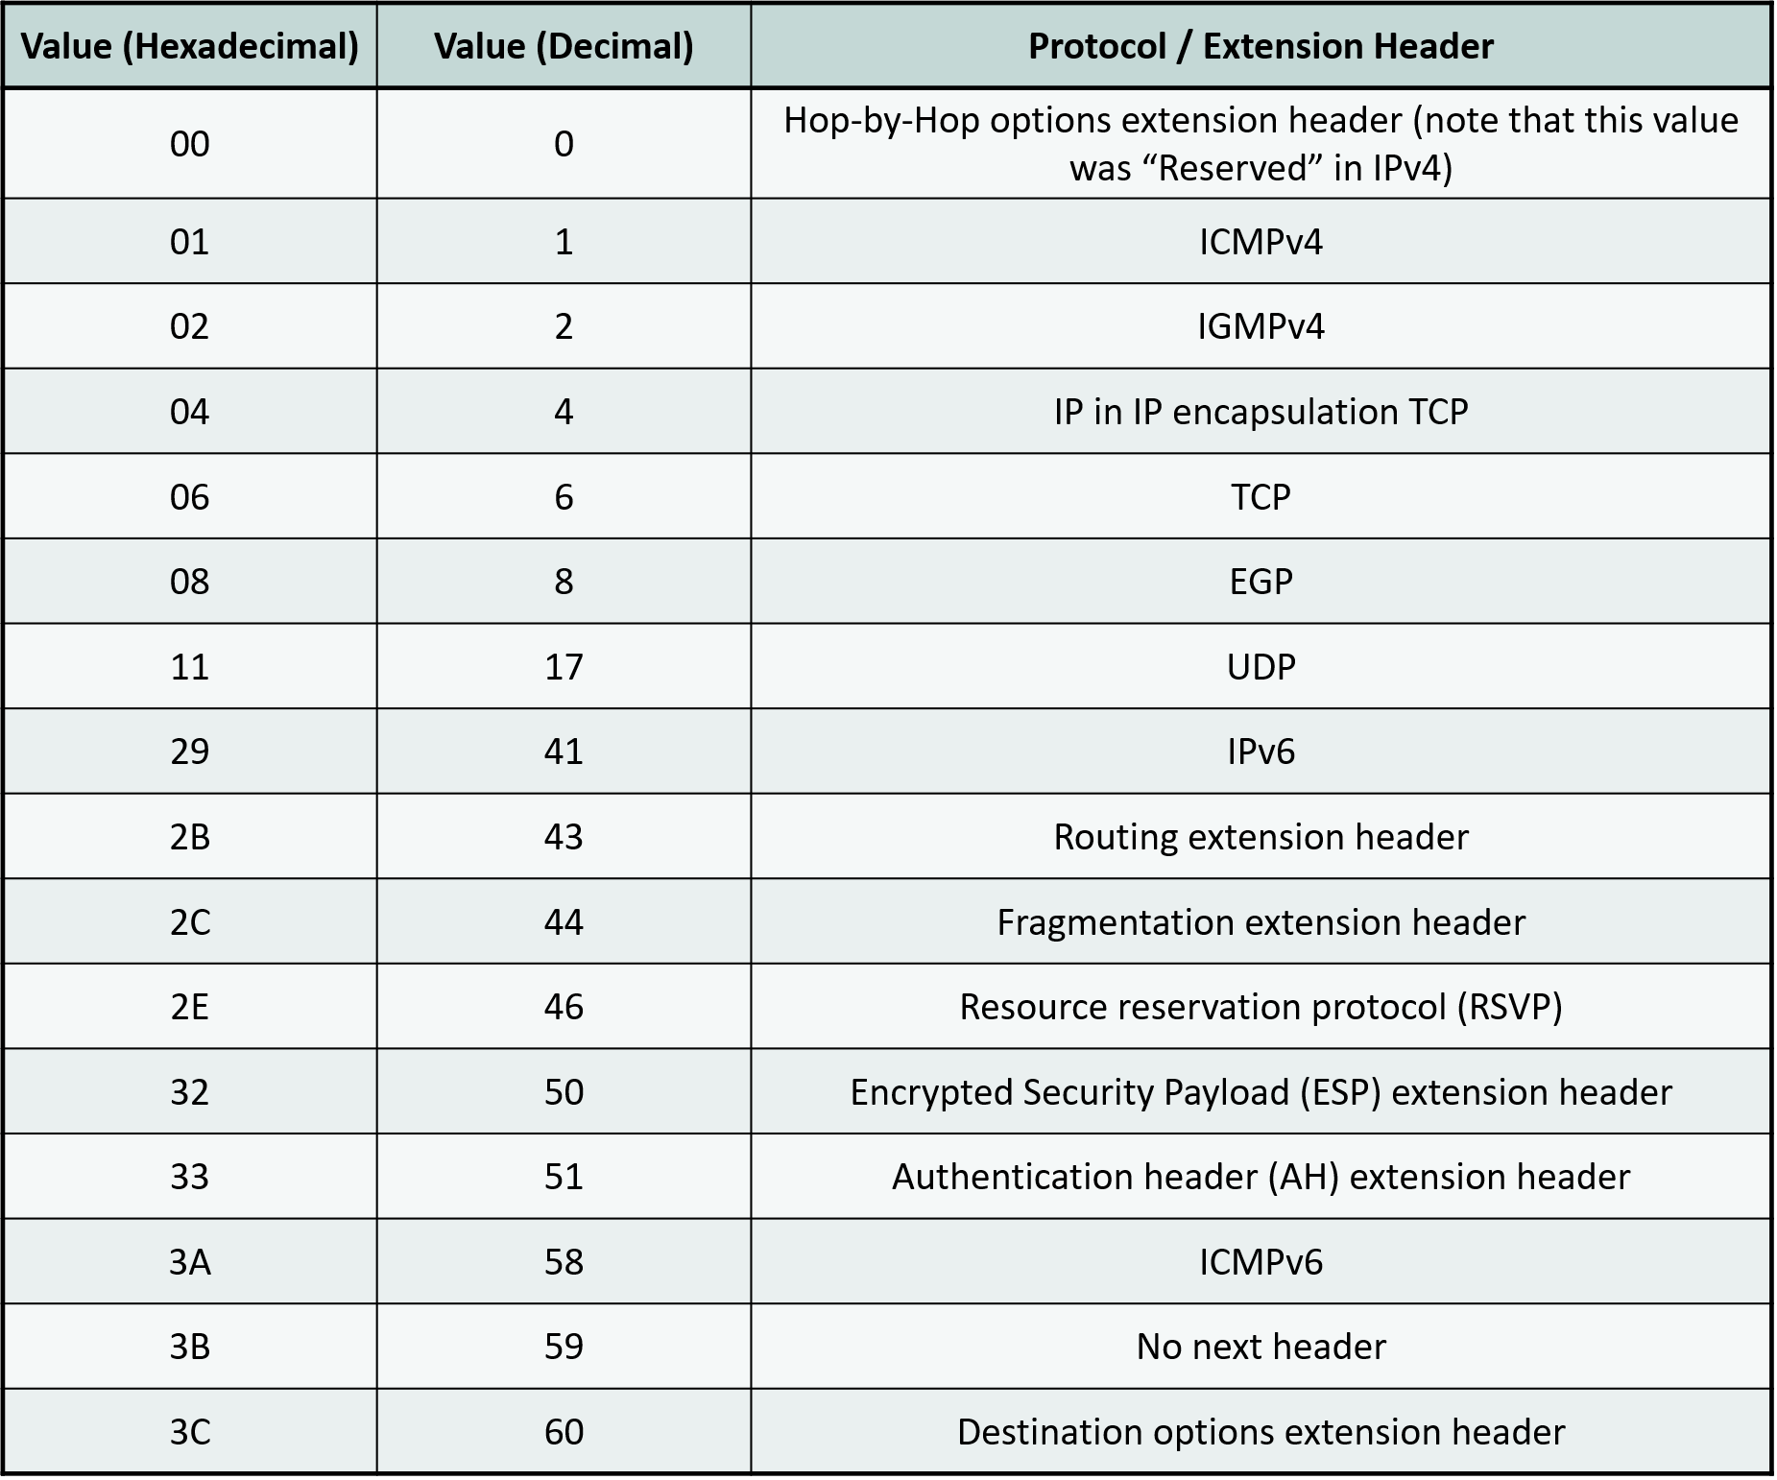
5.3 IPv6 Header
Next header value →
Option用 extension headertypes
  Hop-by-hop
  Destination
FragmentationTo prevent fragmentation from occurring:
  IPv6 datagram size ≥ 1280 bytes

